Slide 1
Phase Field Modeling of Interdiffusion Microstructures
K. Wu, J. E. Morral and Y. Wang
Department of Materials Science and Engineering
The Ohio State University
Work Supported by NSF
NIST Diffusion Workshop
September 16-17, 2003, Gaithersburg, MD

Slide 2
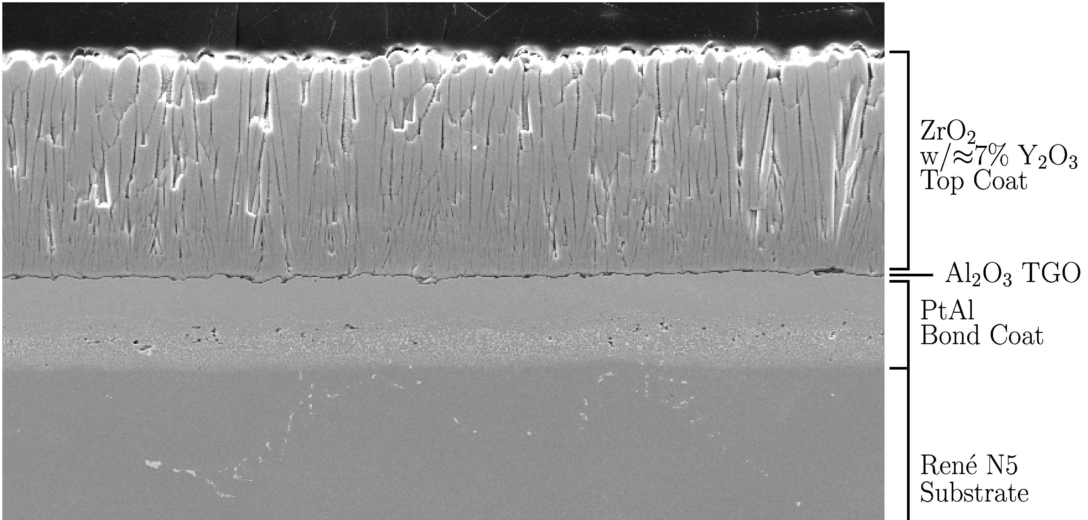
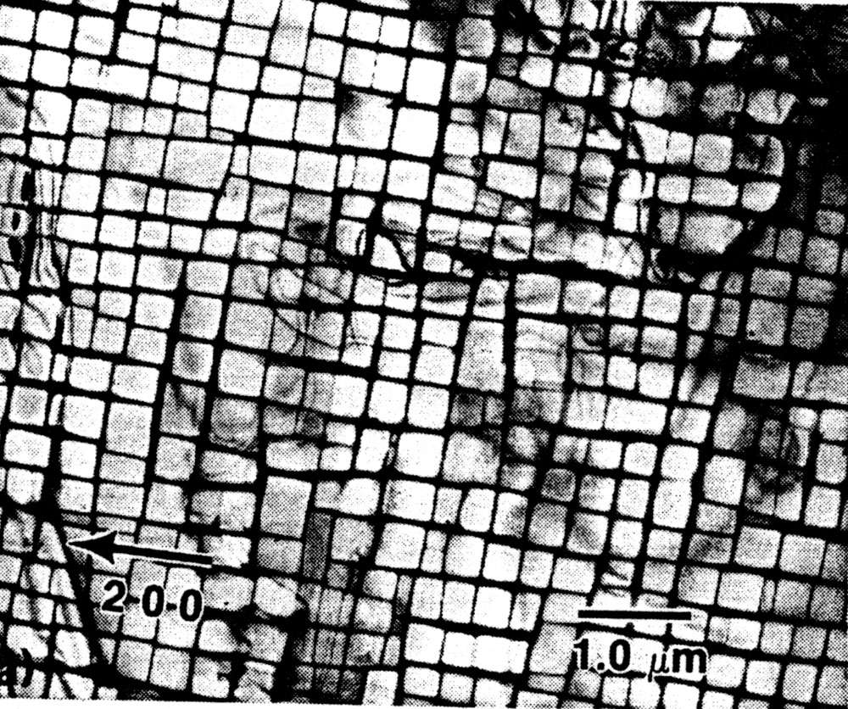
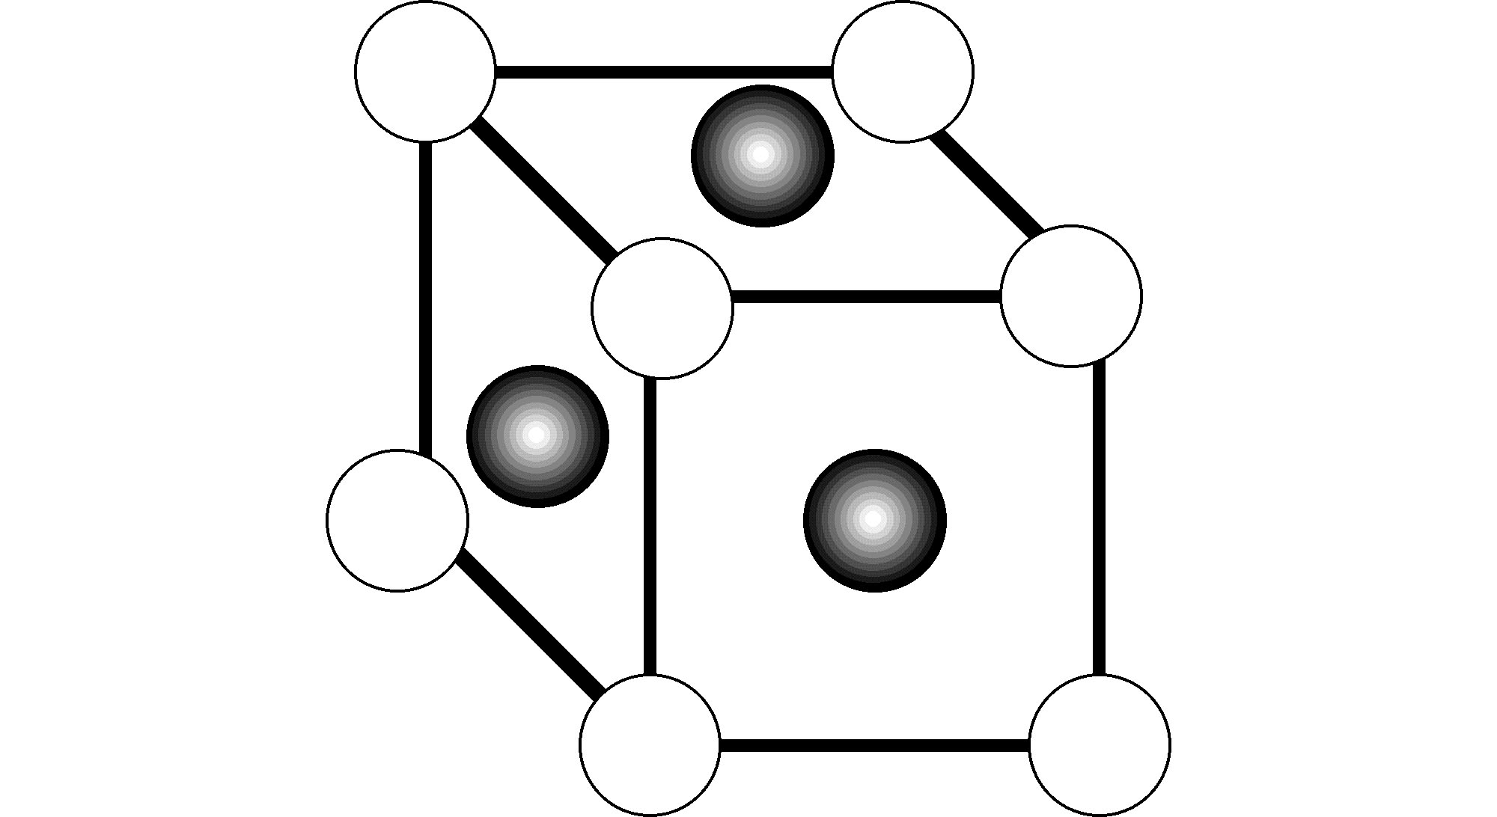
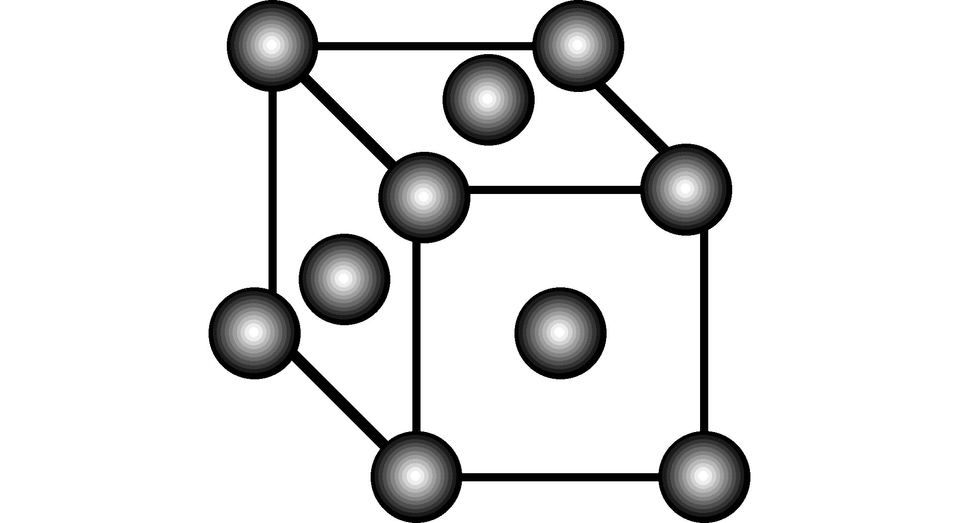
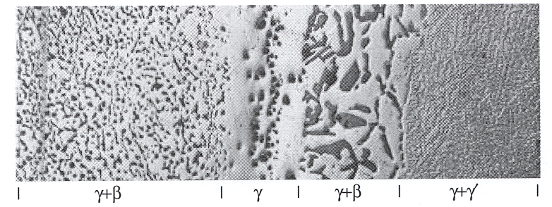
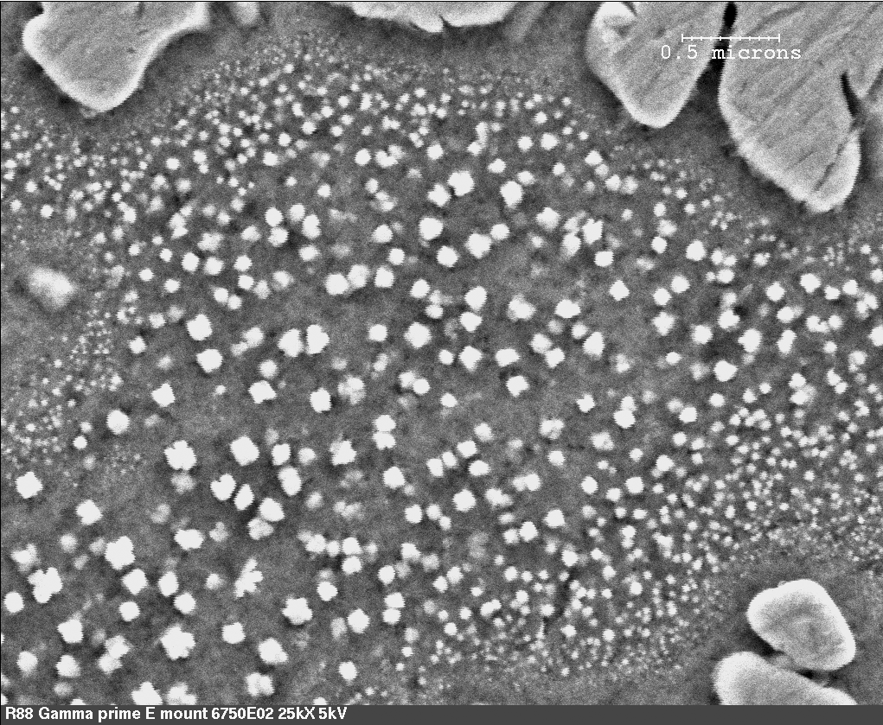
Examples of Interdiffusion Microstructures
Courtesy of M. Walter
γ/γ′
F-22
0.5 μm
Ni-Al-Cr
Turbine blade and disk
Disk alloy (courtesy of M.F. Henry)

Slide 3
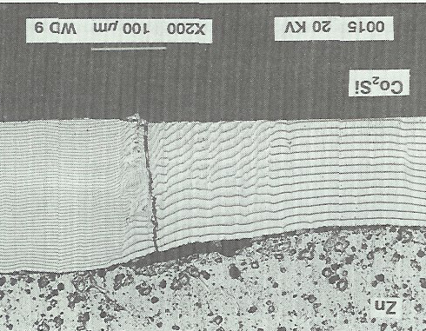
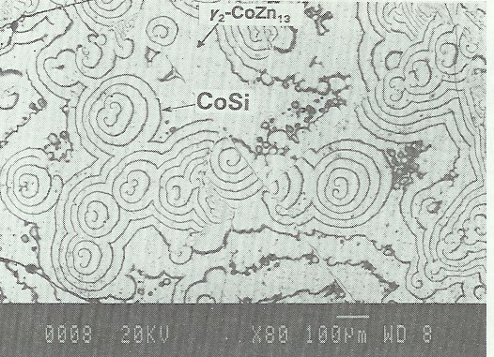
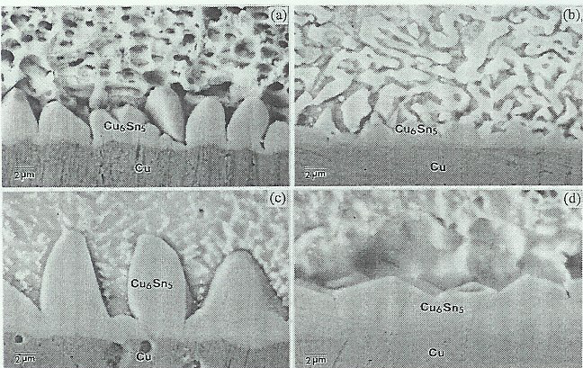
Examples of Interdiffusion Microstructures
Co₂Si/Zn diffusion couple
(MR Rijnders and FJJ Van Loo)
SnPb/Cu
SnBi/Cu
Pb and Pb-free solders
SnAg/Cu
Sn/Cu
(HK Kim and KN Tu)

Slide 4
Challenges in Modeling Interdiffusion Microstructures
Multi-component, multi-phase, multi-variant and polycrystalline
Very complex microstructural features:
  high volume fraction of precipitates
  non-spherical shape and strong spatial correlation
  elastic interactions among precipitates
Interdiffusion induces both microstructure and phase instabilities.
Effect of concentration gradient on nucleation, growth and coarsening.
Roles of defects and coherency/thermal stress on interdiffusion and phase transformation.
Robustness and computational efficiency of models.

Slide 5
Methods Available
Advantages
Simple and efficient: Error Function solutions are close forms and Dictra is computationally efficient.
Error
Function
DICTRA
Limitations
One-dimensional diffusion in a common matrix phase
Precipitates are treated as point sources or sinks of solute
Mutual interactions between microstructure and interdiffusion and corresponding effects on diffusion path and microstructural evolution are ignored
You don’t see the microstructure!

Slide 6
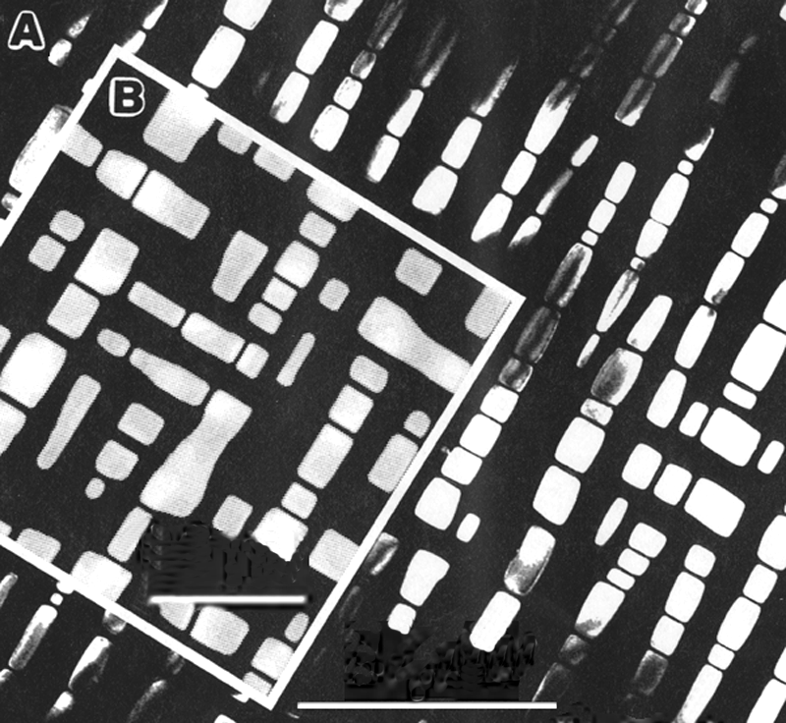
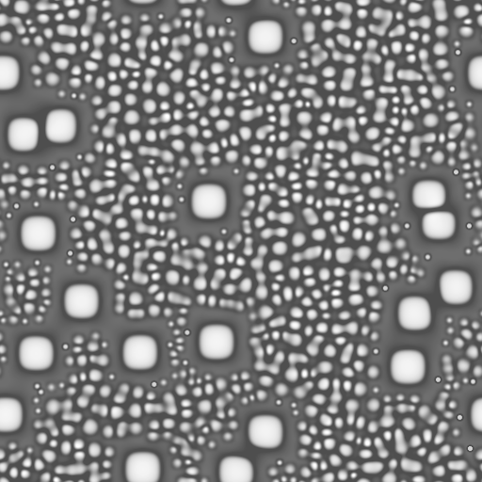
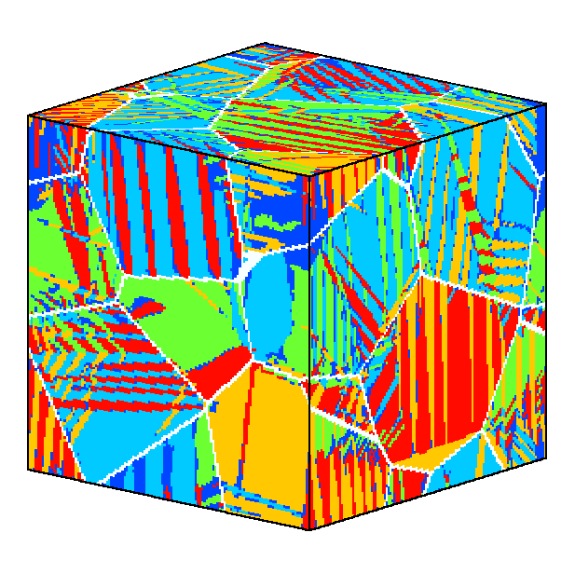
Advanced Microstructure Modeling
using Phase Field Method
0.5 μm
1 μm
2 μm
Y. Jin et. al.
The phase field method handles well arbitrary microstructures consisting of diffusionally and elastically interacting particles and defects of high volume fraction and accounts self-consistently for topological changes such as particle coalescence.

Slide 7
Study Interdiffusion Microstructures
Link to multi-component diffusion and alloy thermodynamic databases
Break the intrinsic length scale limit
Interaction between microstructure and interdiffusion processe:
- Motion of Kirkendall markers, second phase particles and Type 0 boundary, non-linear diffusion path
- Interdiffusion microstructure in Ni-Al-Cr diffusion couples

Slide 8
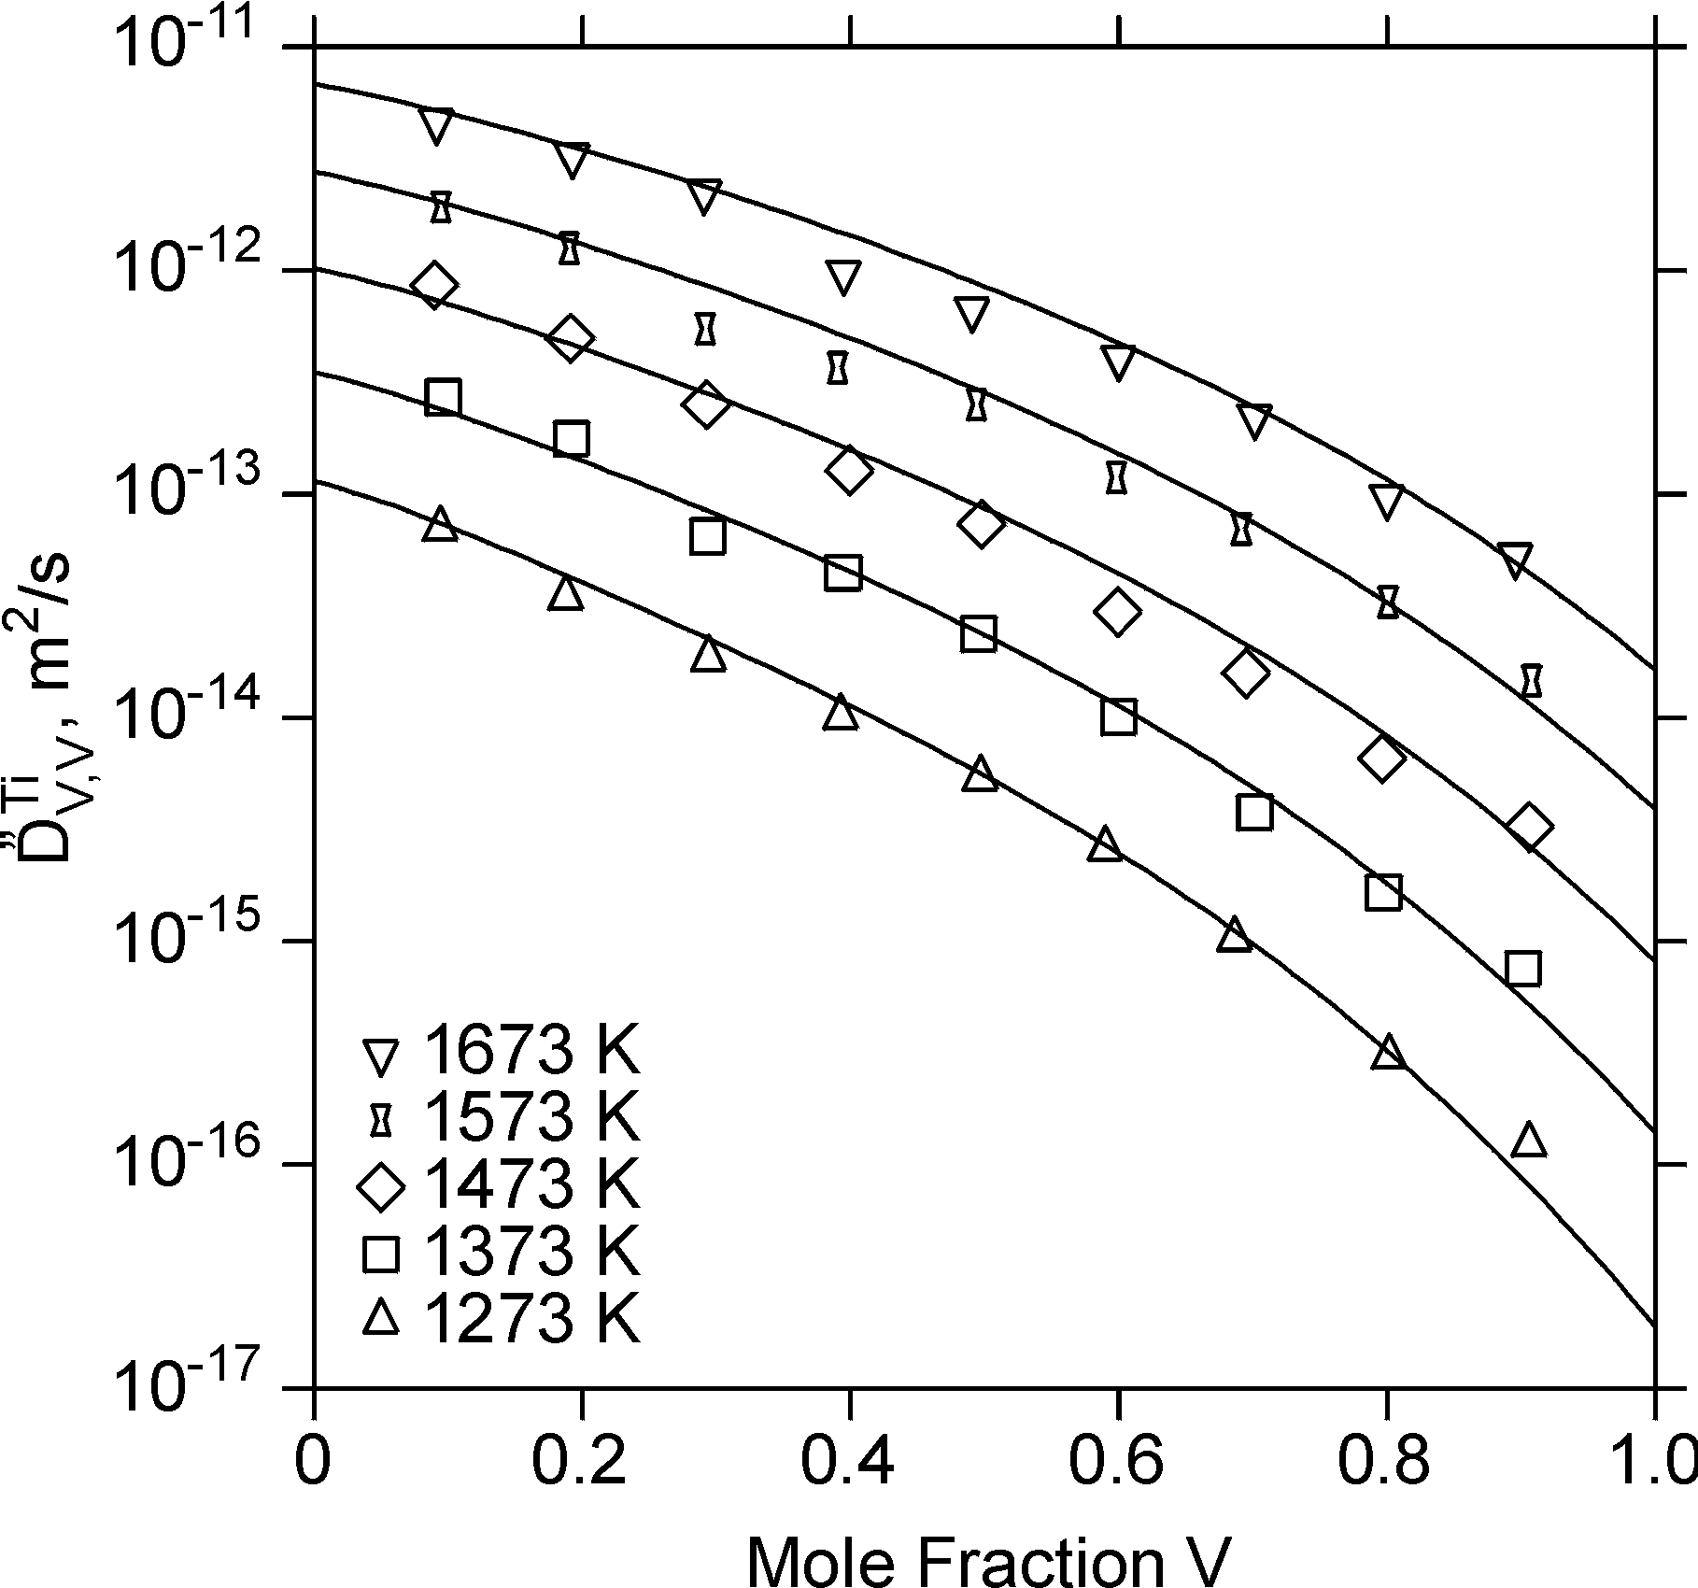


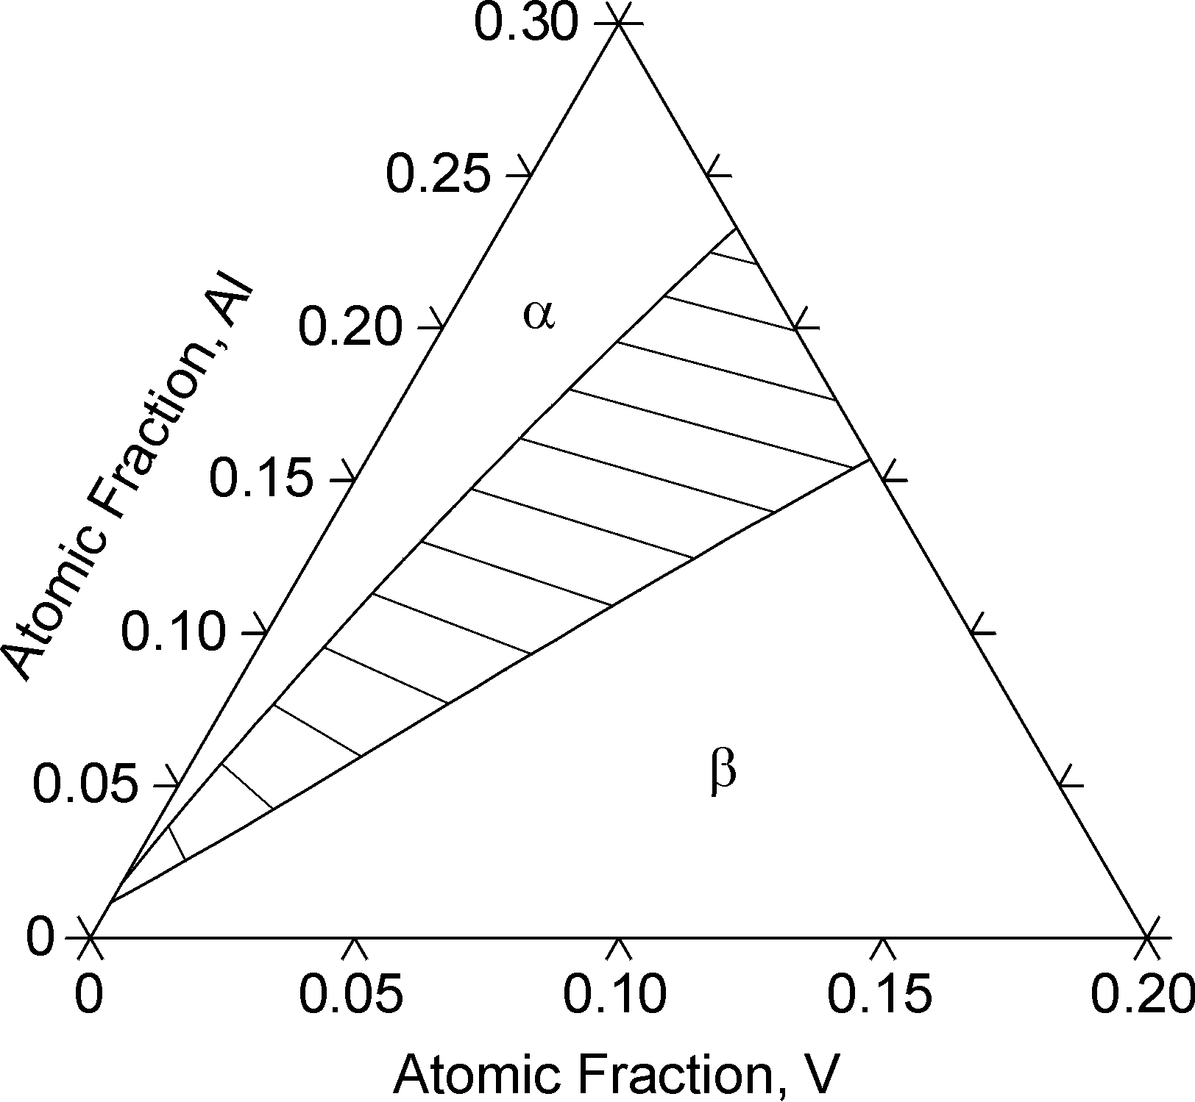

Linking to Thermo. and Kinetic Databases
DICTRA
Kinetic description
Interface
Properties
Experimental
Diffusivity Data
Atomistic
Calculations
Phase Field
Mobility
Database
DICTRA
Chemical Diffusivity of Ti
Optimizer
TD
Database
Thermo_Calc
or PANDAT
Experimental
TD Data
Atomistic
Calculations
Elastic
Properties
Thermodynamic description
1173K

Slide 9
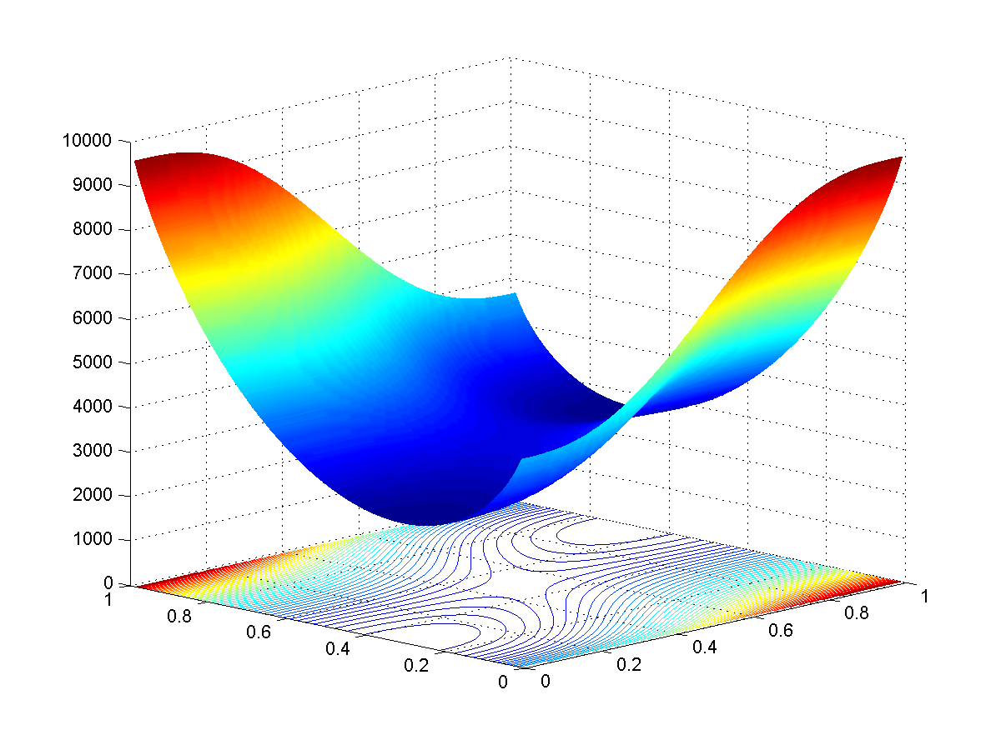
Linking to CALPHAD Method for Fee Energy
How to construct non-equilibrium free energy from equilibrium properties?
f
η =η_{ο}
f
η = 0
c
η
c

Slide 10
Construction of Non-Equilibrium Free Energy
Indirect Coupling: Landau polynomial expansion for the free energy:
Equilibrium free energy cannot be incorporated directly in the expression. A₁, A₂, and A₃ need to be fitted to thermodynamic data at different temperature in the whole composition range.
It is difficult to do for multicomponent systems.

Slide 11
Construction of Non-Equilibrium Free Energy
Direct Coupling: following the same approach as phase field modeling of solidification (e.g.,WBM or S-SK model)
o
Wang et. al, Physica D,1993; 69:189
Equilibrium free energy can be incorporated directly into the non-equilibrium free energy formulation for any multi-component system without any extra effort.

Slide 12
Application I: Model System
Free energy model
C
α’
Elements A and B form ideal solution while elements A and C or B and C form regular solutions
α
A
B
Wu et. al. Acta mater. 2001;49:3401
Wu et. al. Acta mater, preprint.
Acta Mater., 49(2001), 3401-3408

Slide 13
Phase Field Equations
Diffusion equations
Thermodynamic parameters
Kinetics parameters
M_{ij} - chemical mobilities
κ_{ij} - gradient coefficients
β_{I} - atomic mobilities
ρ - molar density

Slide 14



Interaction between Microstructure and Interdiffusion
Ppt and Type 0 boundary migrate as a results of Kirkendall effect
Type 0 boundary becomes diffuse
Kirkendall markers move along curved path and marker plane bends around precipitates
Diffusion path differs significantly from 1D calcul.
τ = 0
τ = 100
τ = 2000
β₁=1.0 β₂=5.0 β₃=10.0
4608x64 size simulation, 1024x256 size output

Slide 15
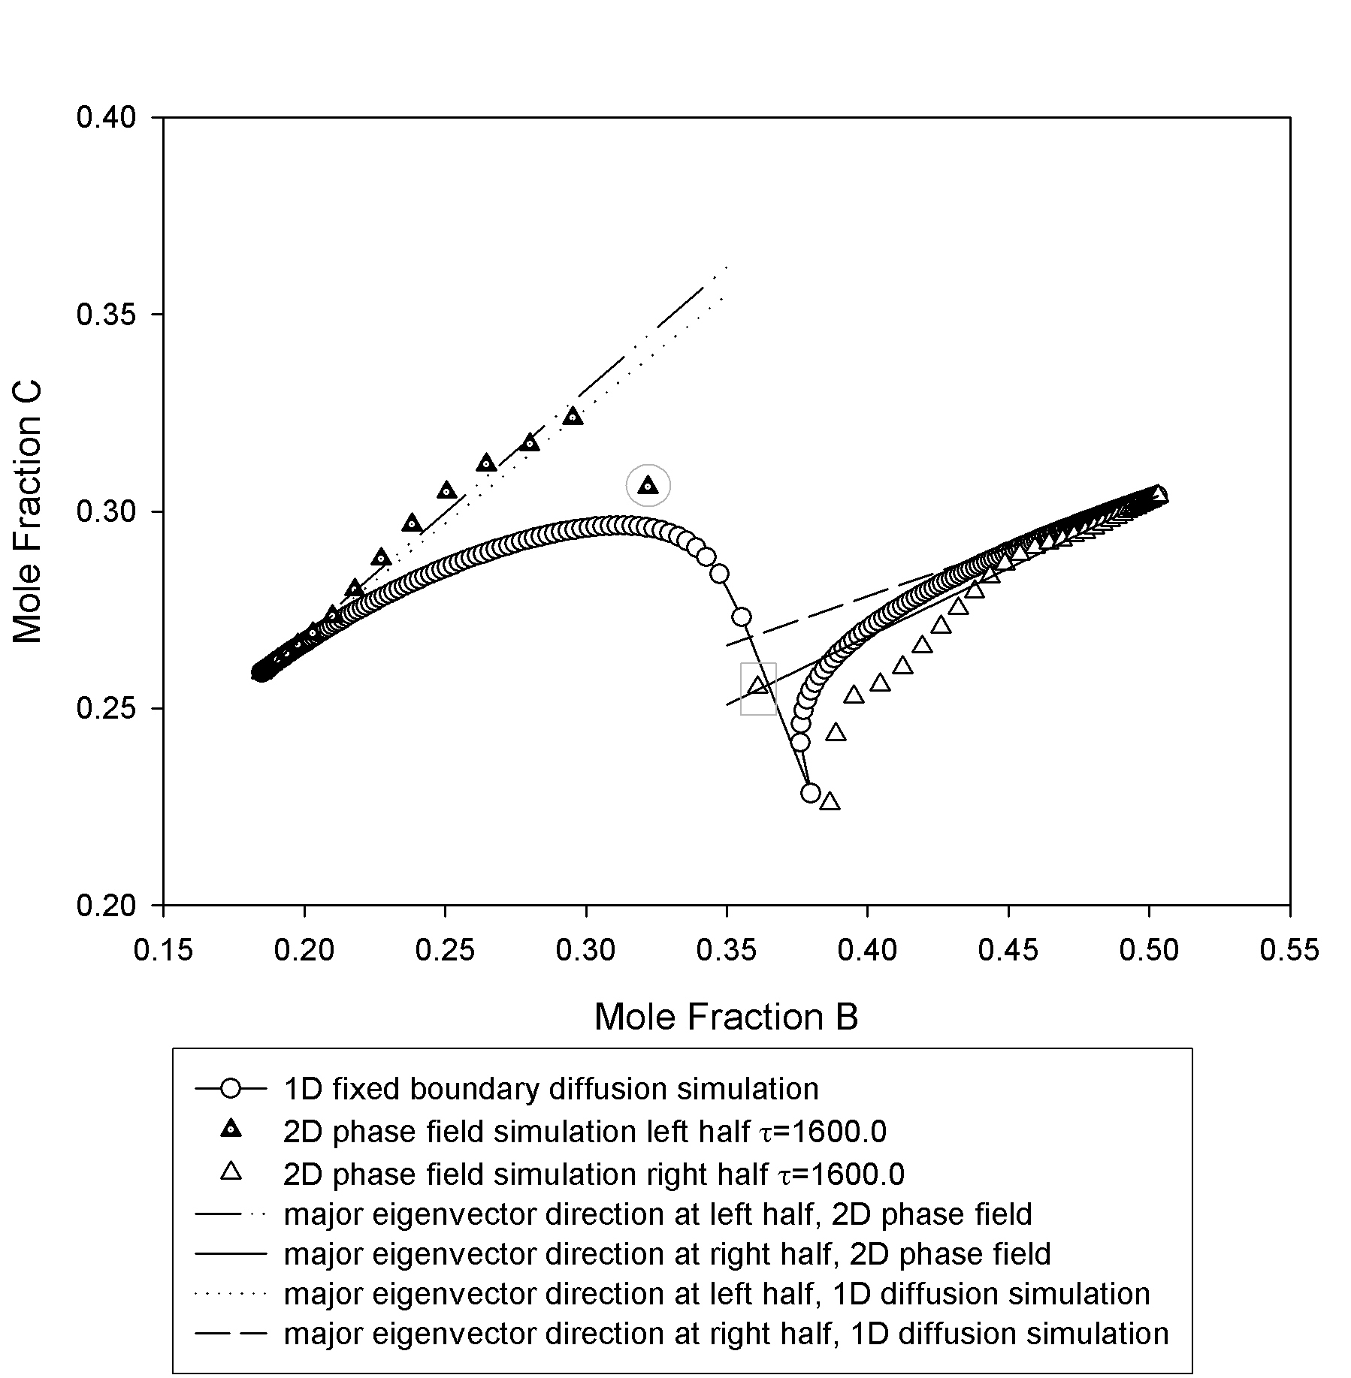
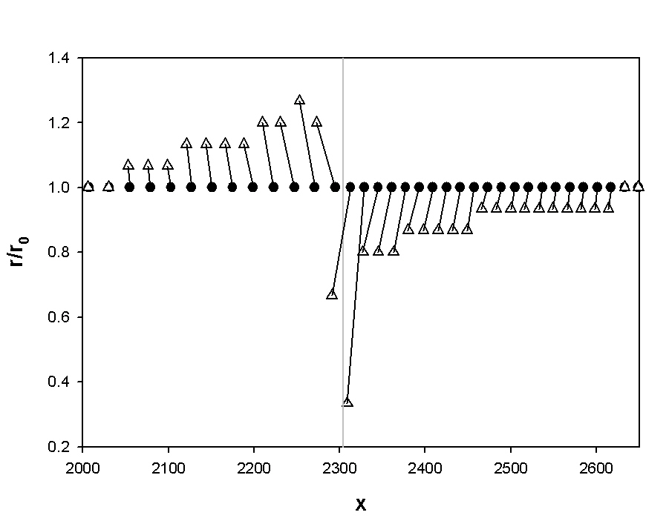
Diffusion path: comparison with 1D simulation
Wu et. al. Acta mater. 2001;49:3401
Wu et. al. Acta mater, preprint.
Size and position changes during interdiffusion

Slide 16
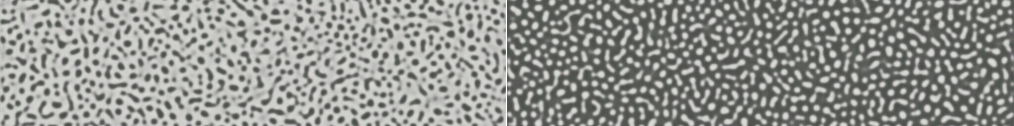

Diffusion Couple of Different Matrix Phases
β_{B}=10.0 β_{C}=5.0 β_{A}=1.0
J_{A}
τ=0.0
J_{B}
net flux of (A+B)
τ=2000.0
α′+α<α<α′<α+α′
α′
X_{B} = 25 at%, X_{C} = 40 at%
X_{B} = 32 at%, X_{C} = 60 at%
Kirkendall Effect: Boundary migrates and particles drift due to difference in atomic mobility
Moving direction opposite to the net flux of A+B
Non-linear diffusion path penetrating into single phase regions
α

Slide 17
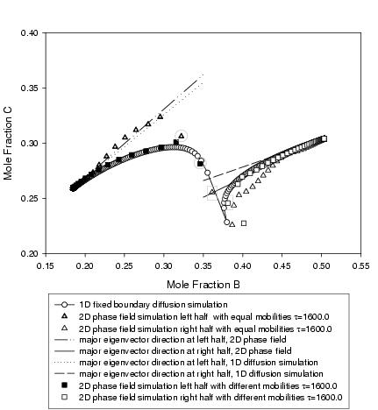

Effect of Mobility Variation in Different Phases
τ = 0
M: β₁=1.0 β₂=5.0 β₃=10.0
Ppt: β₁=1.0 β₂=5.0 β₃=5.0

Slide 18


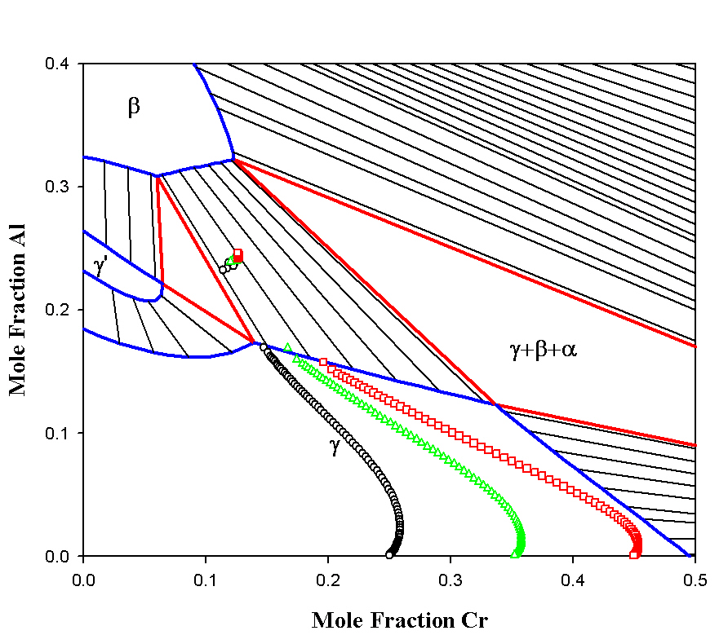

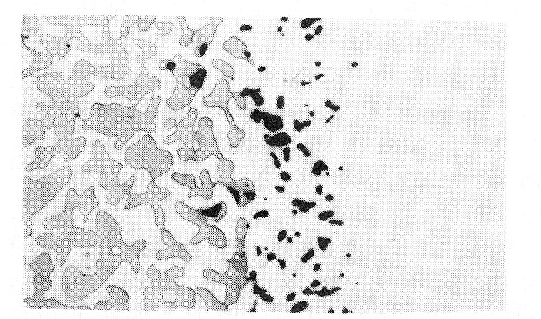
Interdiffusion Microstructure in NI-Al-Cr Diffusion Couple
0 hr
Free energy data from Huang and Chang
Mobilities in γ from A.EngstrÖm and J.Ågren
Diffusivities in β from Hopfe, Son, Morral and Roming
X_{Cr} =0.25, X_{Al}=0.001
320μm
4 hr
Ni-Al-Cr at 1200ºC
25 hr
100 hr
at 1200ºC
Exp. Observation by Nesbitt and Heckel
200μm

Slide 19


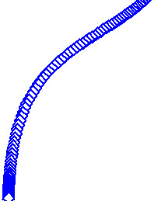

(a)
Effect of Cr content on interface migration
320μm
Annealing time: 25 hours
(b)
Ni-Al-Cr at 1200ºC
(c)
(d)
a
b
c
d

Slide 20
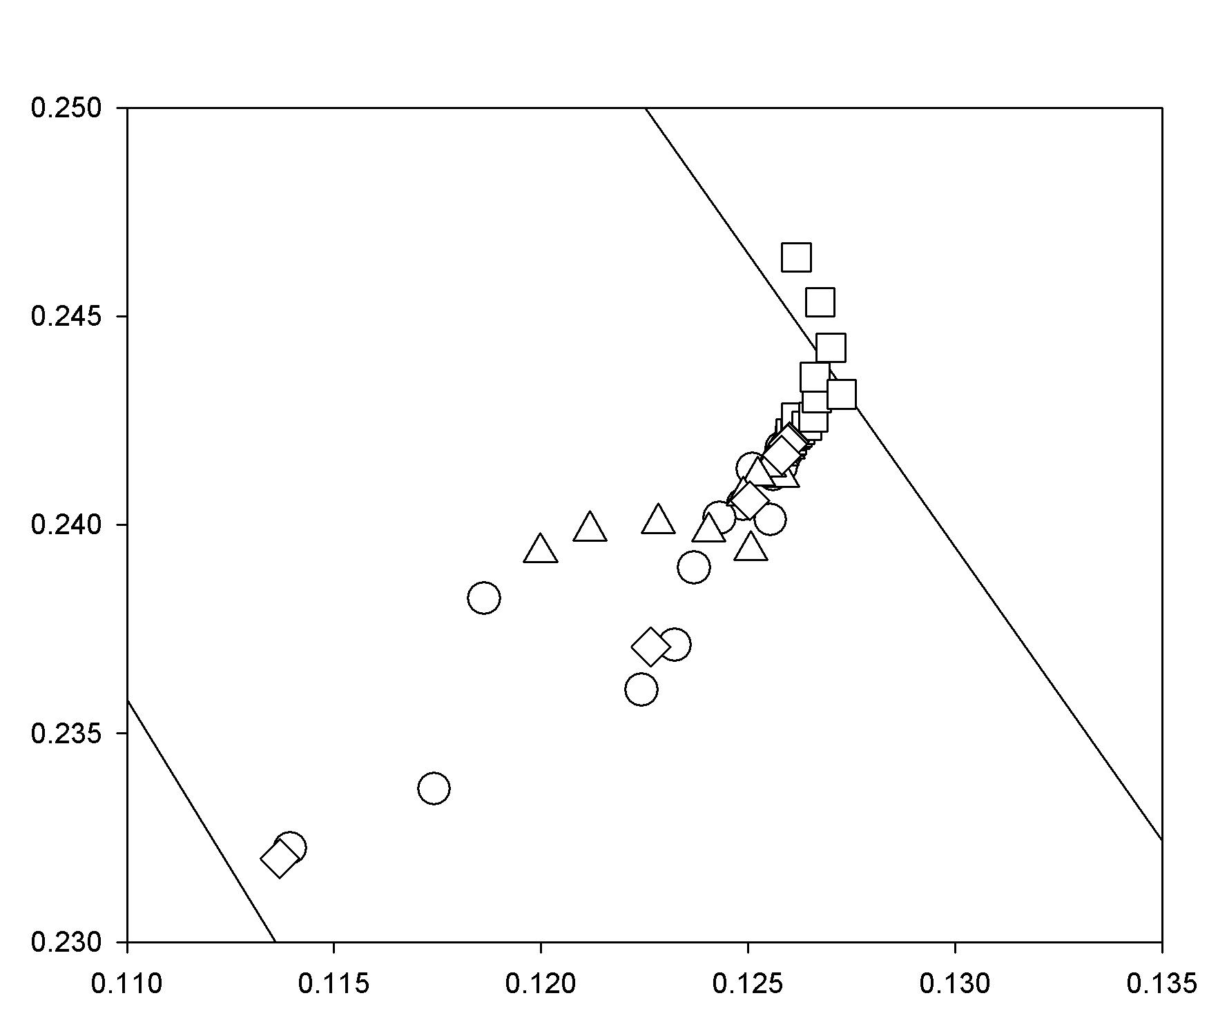
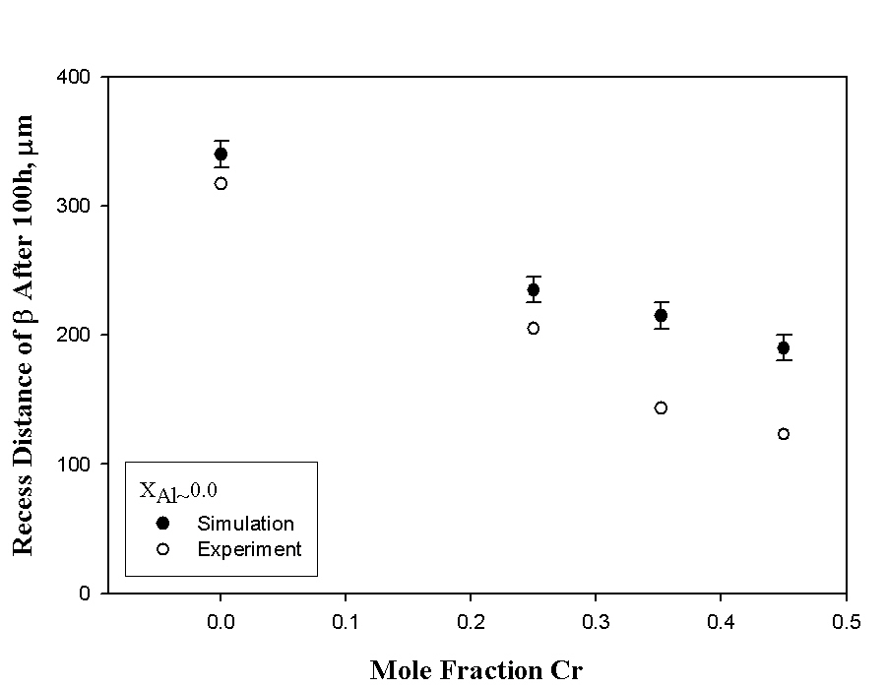
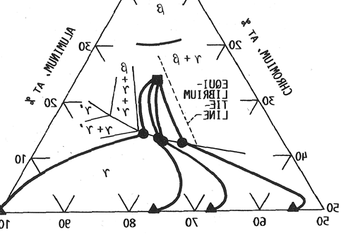
Diffusion path and recess rate - comparison with experiment
Exp. measurement by Nesbitt and Heckel

Slide 21
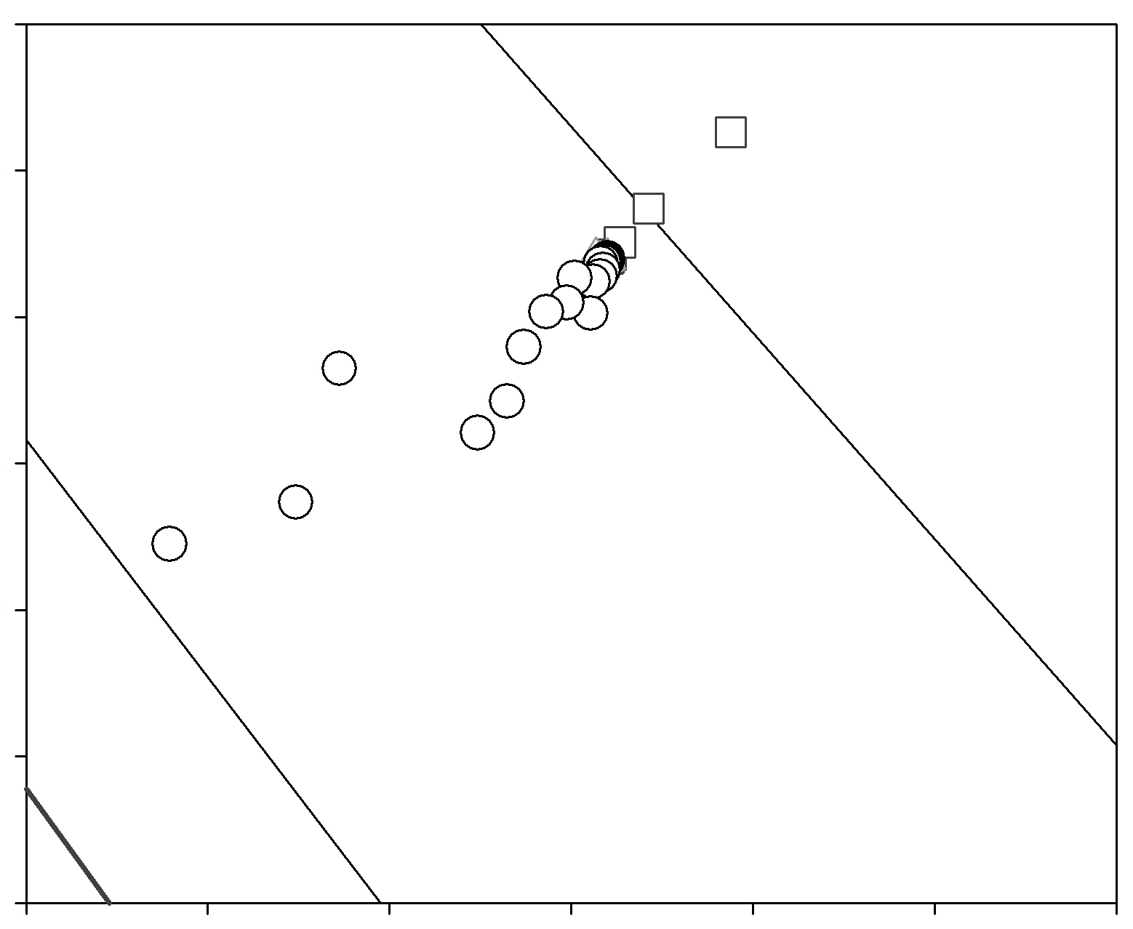

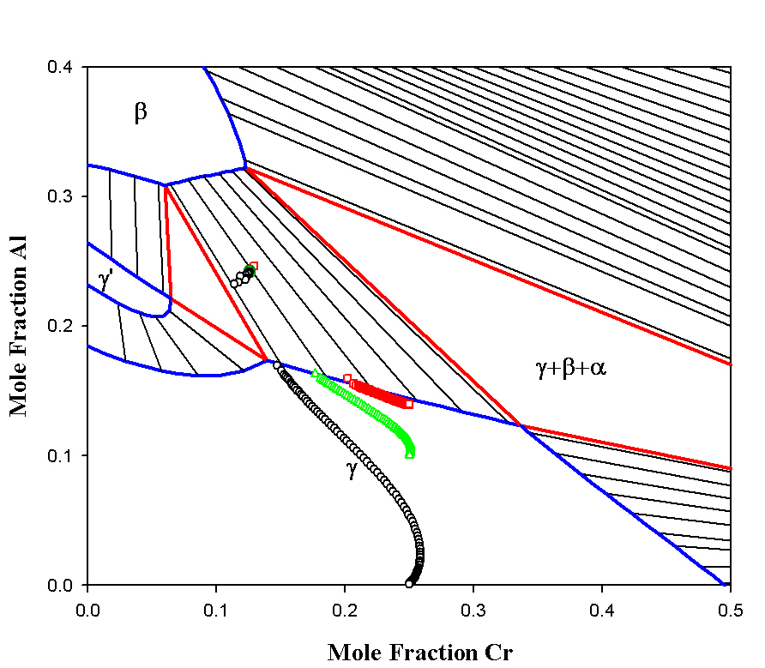

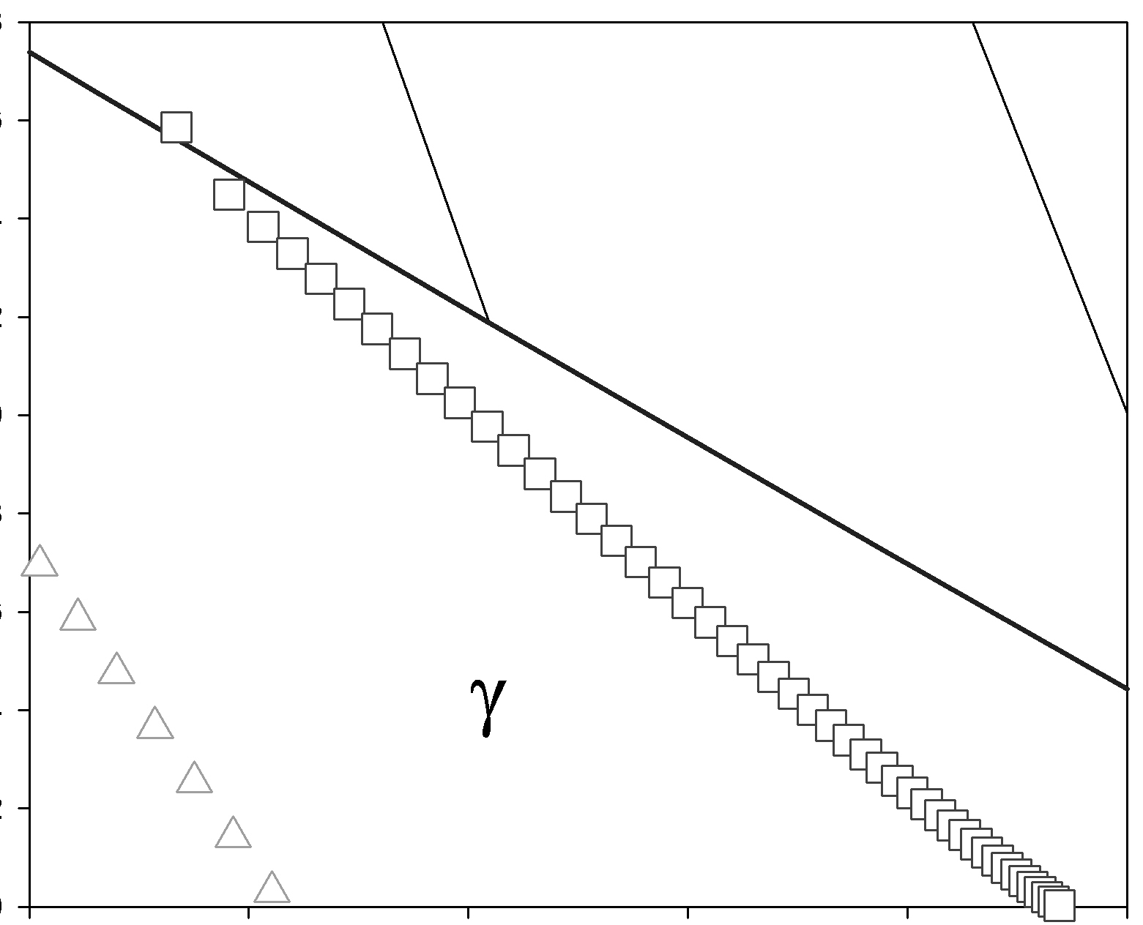
(a)
Effect of Al content on interface migration
320μm
(b)
(c)
c
b
Annealing time: 25 hours
a
c

Slide 22


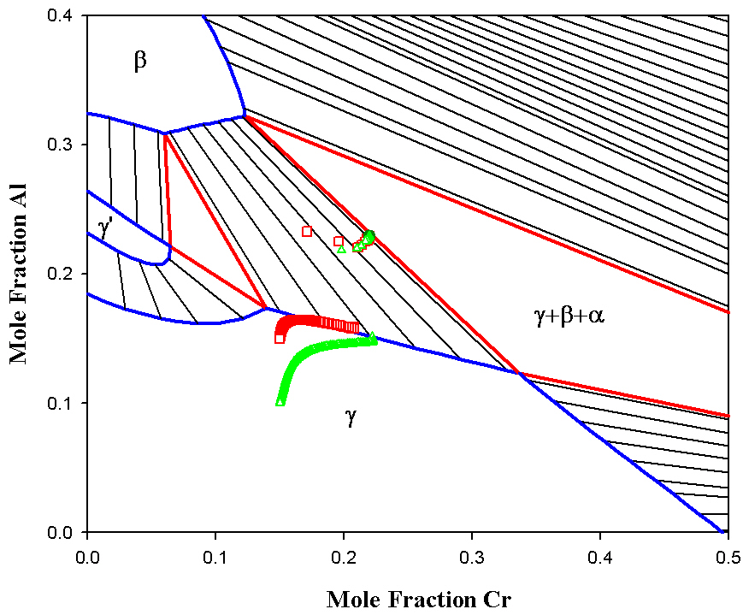
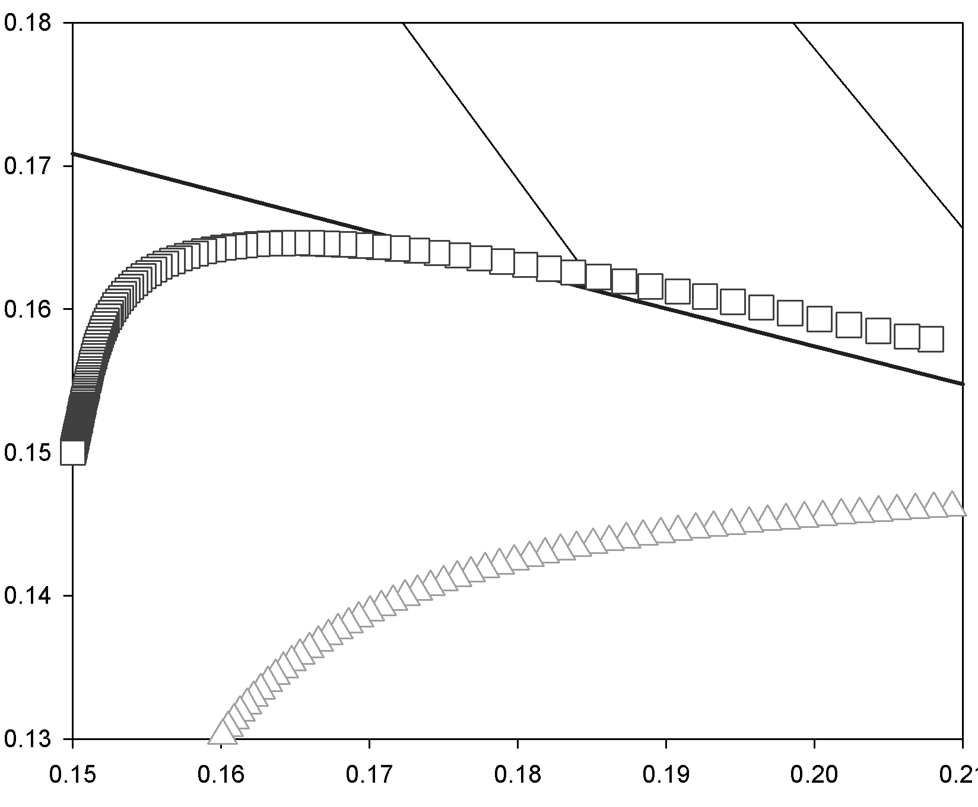
(a)
Effect of Al content on interface migration
320μm
Annealing time: 25 hours
(b)
b
a

Slide 23
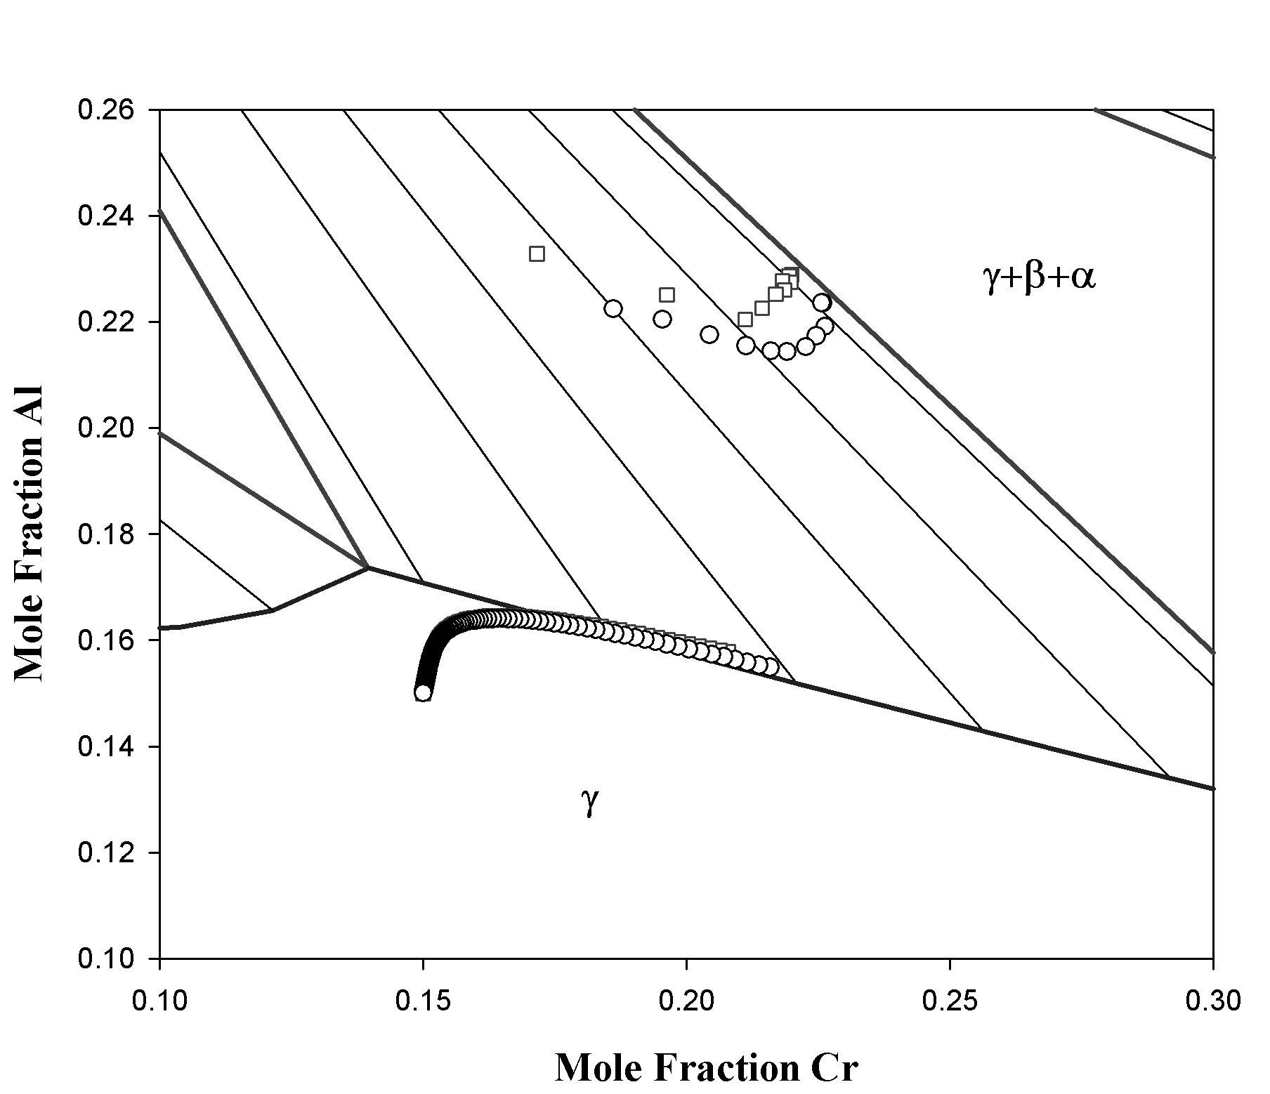

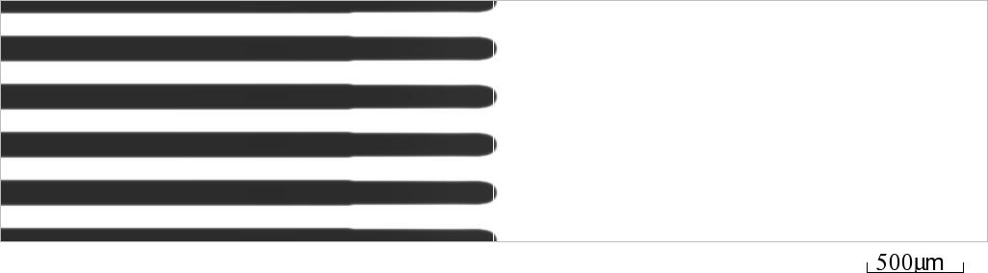
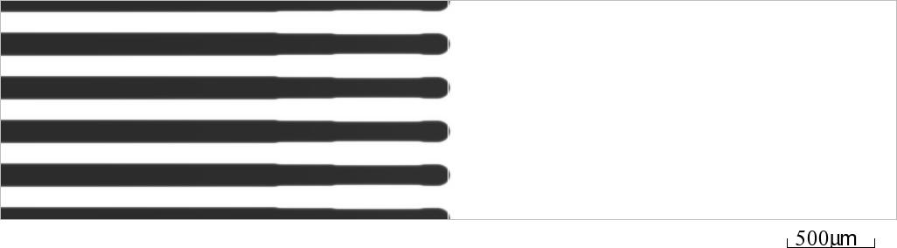
Diffusion Path in the Two-Phase Region
t = 0
t = 25h
t = 100h

Slide 24
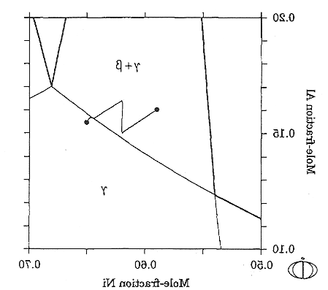

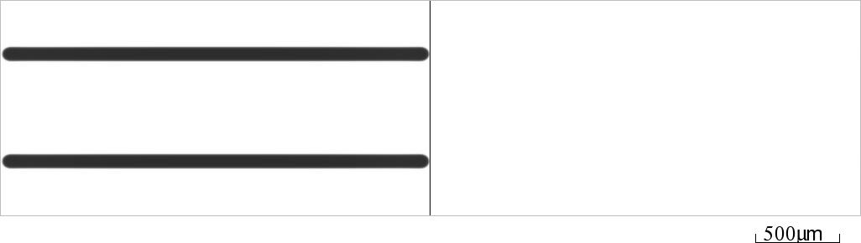
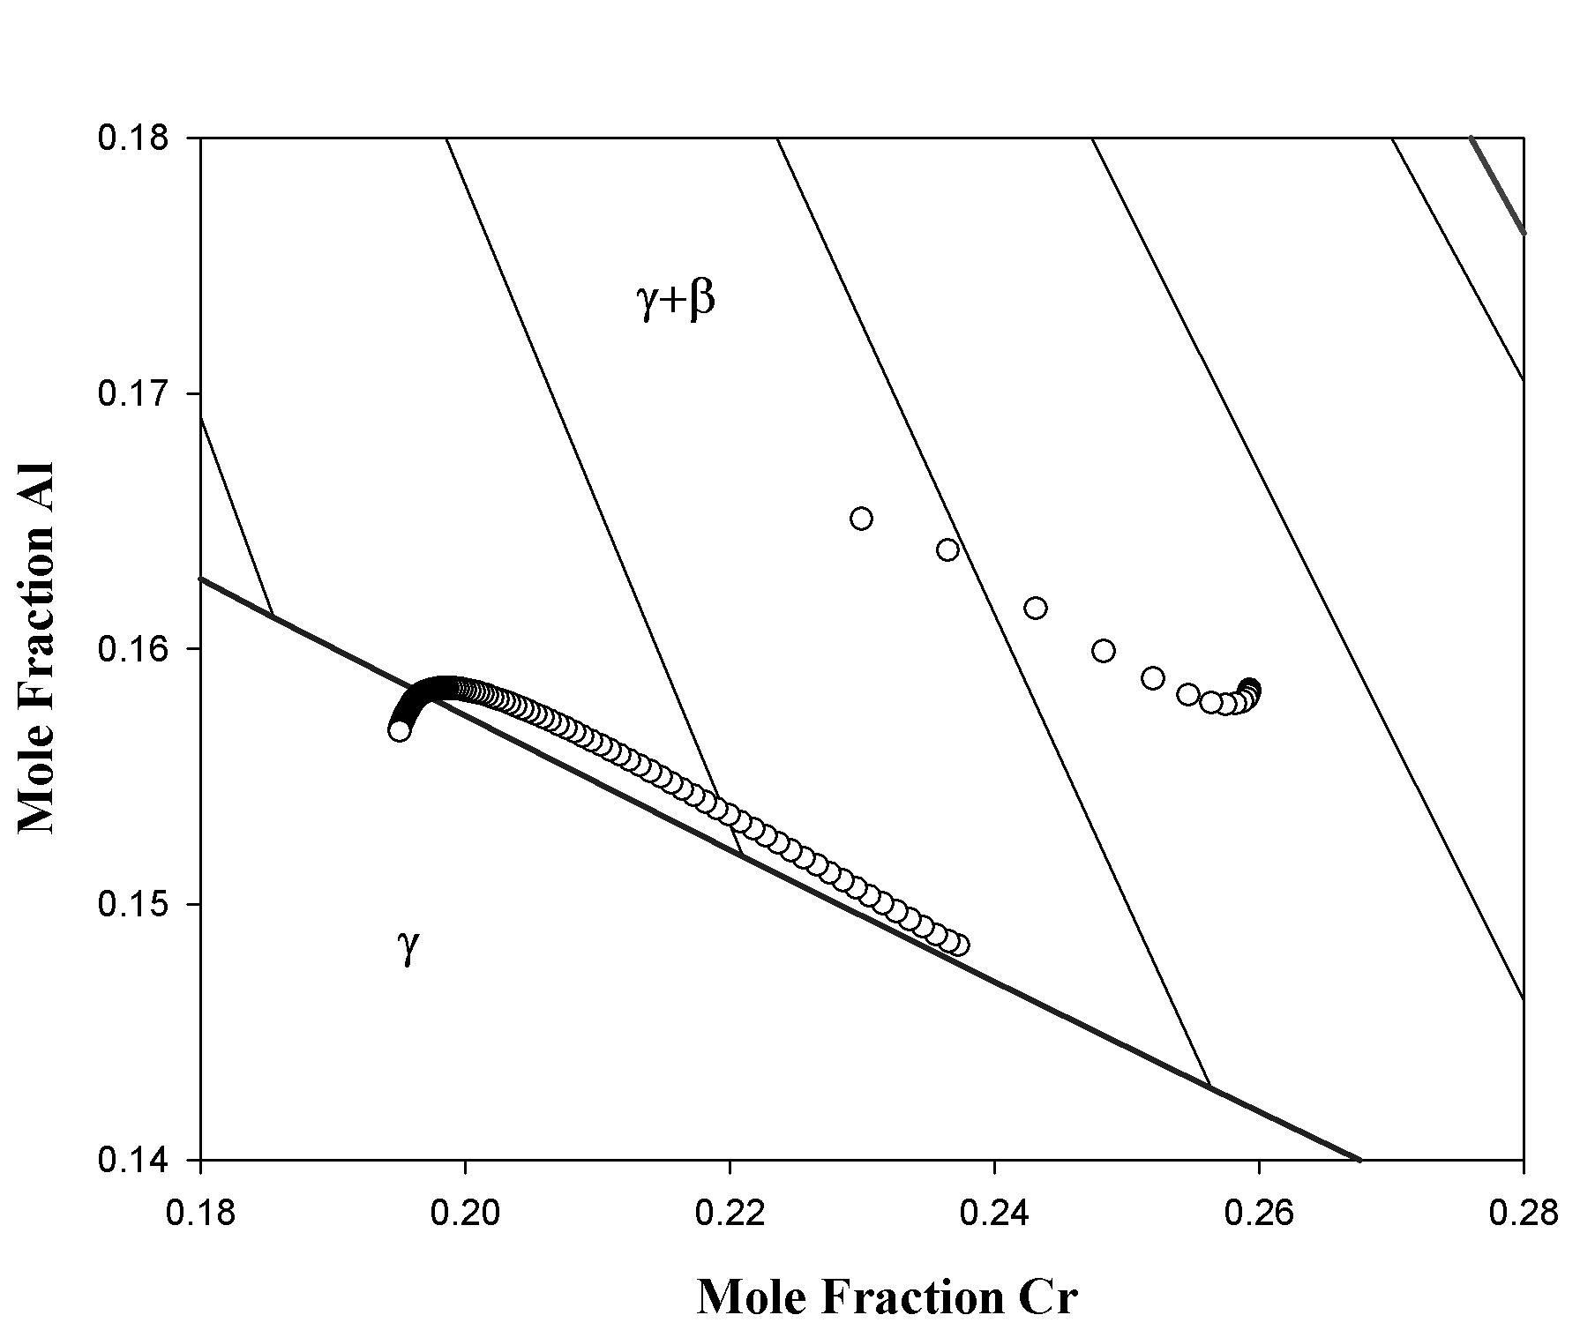
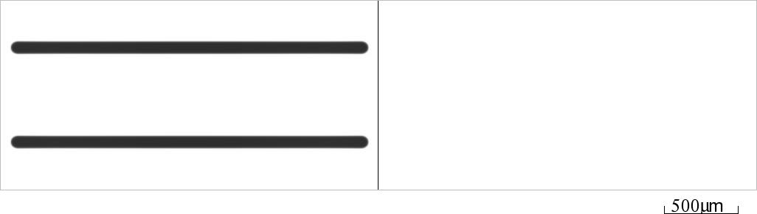
Diffusion Path - Comparison with DICTRA
500μm
t = 0
A.EngstrÖm, J. E. Morral and J.Ågren
Acta mater. 1997
t = 25h
t = 100h

Slide 25
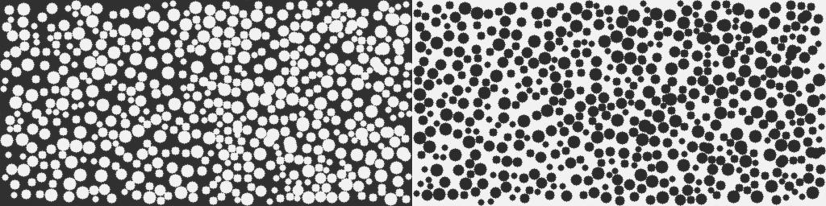
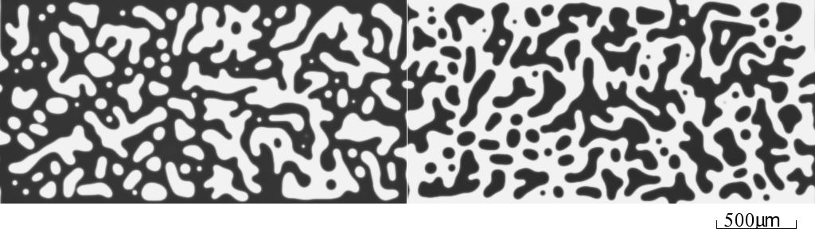
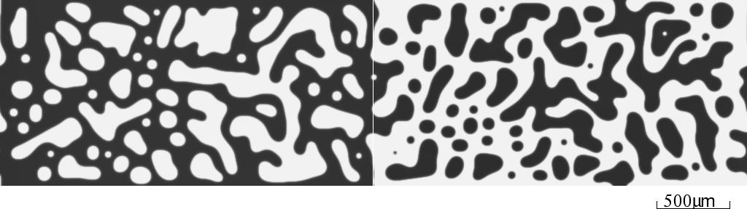
Two-Phase/Two-Phase Diffusion Couple
t = 0
10h
35h

Slide 26
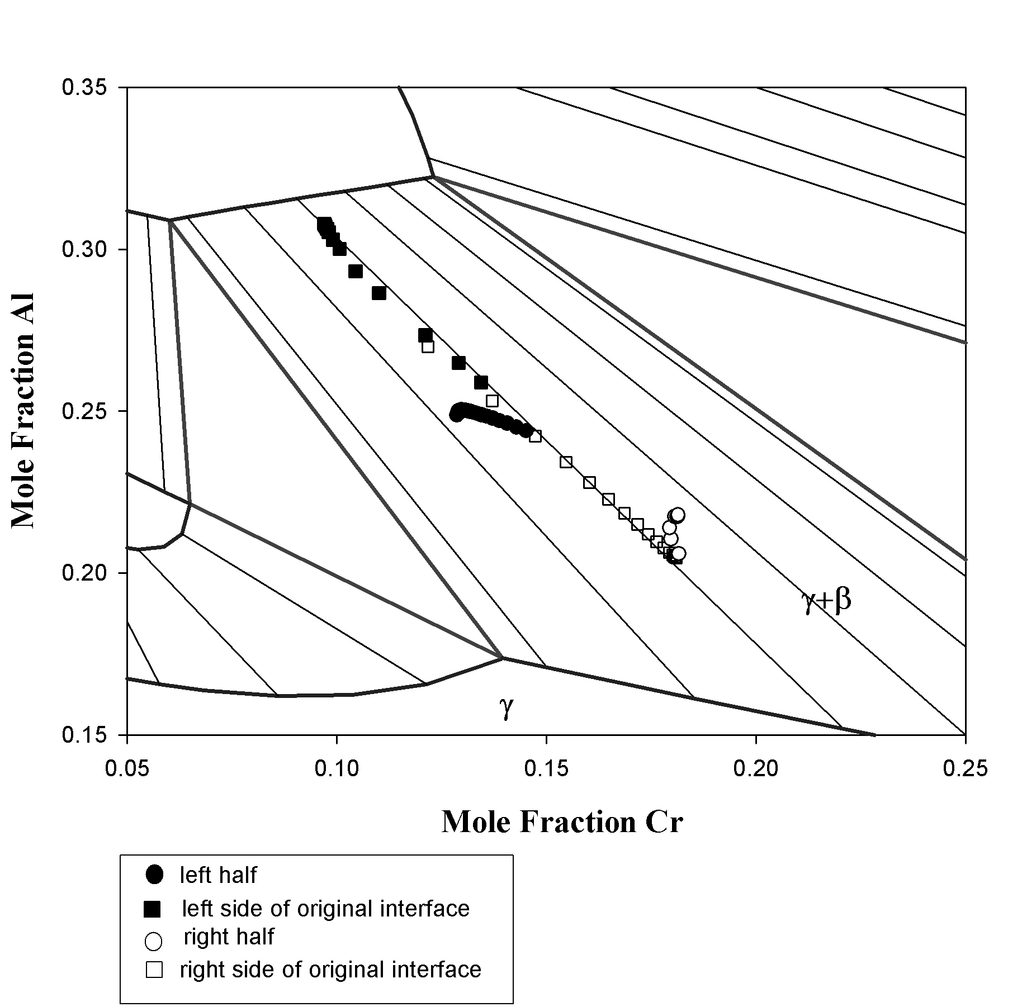

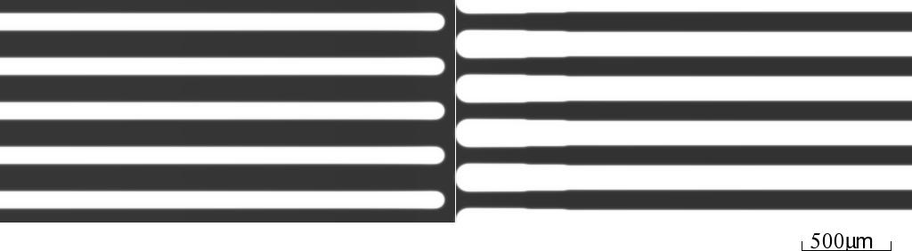
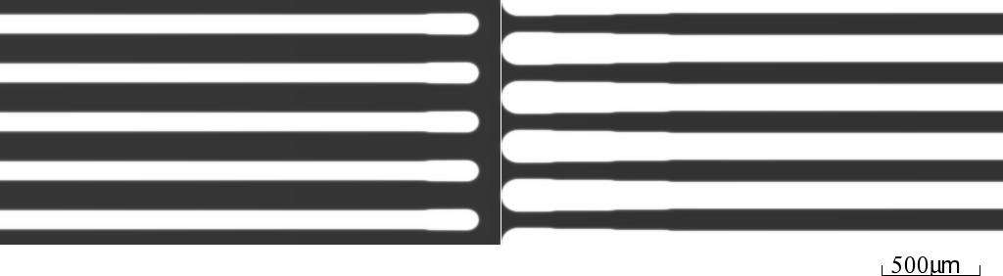
Two-Phase/Two-Phase Diffusion Couple
t = 0
t = 100h
t = 200h

Slide 27
Summary
Computational methods based on phase field approach and linking to CALPHAD and DICTRA databases have been developed to investigate for the first time effects of microstructure on interdiffusion and interdiffusion on microstructural evolution in the interdiffusion zone.
Realistic simulations of complicated interdiffusion microstructures in multi-component and multi-phase diffusion couples have been demonstrated.
Many non-trivial results have been predicted, which are significantly different from earlier work based on 1D models.

