Slide 1
Deposits & Withdrawals
A Survey of Depository Libraries That Have Recently Changed Status
Aric Ahrens
Illinois Institute of Technology
Luke Griffin
Jacksonville State University
Notes:
We want to thank Robin Haun-Mohamed and her staff, as well as the staff of the Senate Library, and Andrea Sevetson. Without their help in getting resources as well as their support, we could not have completed our study. And to Cathy Hartman and the DLC for the opportunity to present our research results.

Slide 2
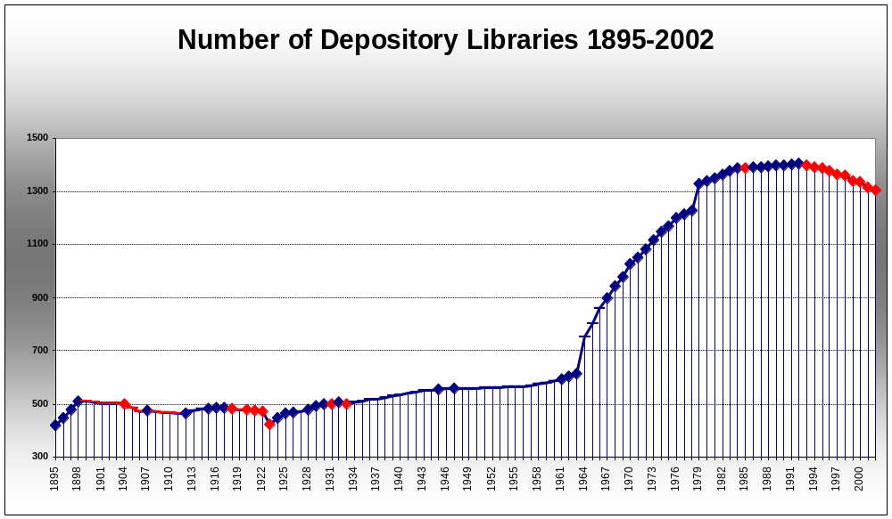
Notes:
This is a diagram of the number of depository libraries for the history of the independent GPO. It started in 1895 with 419 libraries. From this chart, we can show that there have been four main eras of government information. We will briefly look at the first three eras and then go into more depth about the current one.

Slide 3
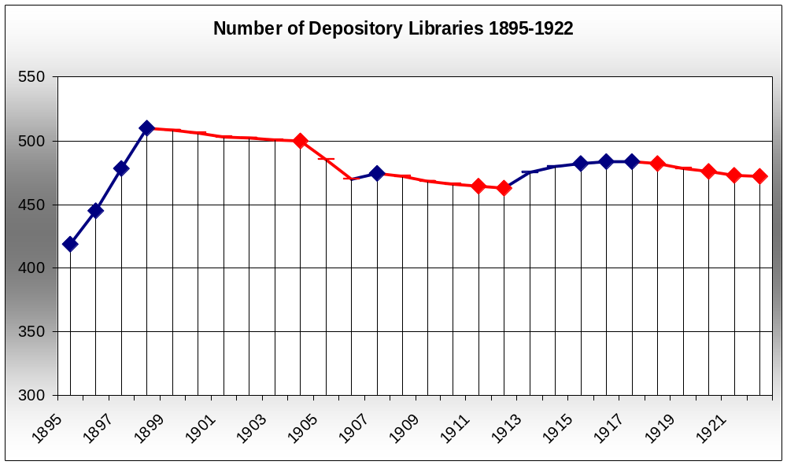
Formative Era – FDLP Takes Shape 1895-1922
Notes:
The system, with a capacity of 507, started with 419 libraries to support the information needs of 44 states and approximately 69 million Americans.
Almost immediately the inherent flaws within the system were realized by the people that had to carry out the intention of the law. Every library, regardless of size, received everything published through GPO. In the First Annual Report of the Supt. of Documents he makes a strong statement about this fault in design.
This formative period is marked by several characteristics:
Libraries have little choice as to whether to be a depository or not. Most libraries are appointed by members of Congress.
Libraries have no choice as to what they receive. All libraries act, basically as regionals.
Slow – Expensive distribution. GPO cannot afford to keep up with the distribution required in this system, and therefore cannot publish many works, or produce works fast enough so that they may be delivered while they are still useful and timely.
We see rapid growth as Congressmen quickly appoint the libraries, followed by a slow removal of libraries from the program. Little data exists to show why they left, but during this time, there is a period of stasis.
After 28 years of laboring in this system, and of several Public Printers and several Supt. of Docs as well as the library community begging Congress to reform the law, the law finally changes.

Slide 4
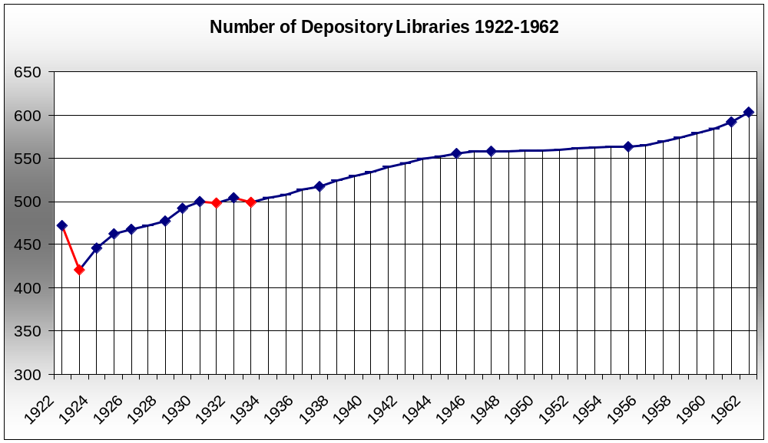
Selective Depository Era:
1922-1962
Notes:
The law was finally amended in 1922, and for the first time libraries were allowed to be “Selective Depository Libraries.” This was a major system change, and the affect was immediately noticeable. In 1923, when they were finally asked which documents they would like to select, 51 libraries immediately decided that they did not want to receive any documents, and they were removed from the program, 149 wished to receive less than half, and only 51 wanted to continue to receive all of the documents that were printed.
After the initial shock of the new system, we see steady growth in the number of libraries. This was a period of little change, and the number of libraries slowly grew, along with the country.
This period is marked by:
Slow but steady growth in the number of depositories after the initial drop-off.
A more time-efficient GPO.
A more cost-efficient GPO.
Less documents available to the entire public, but the more important and timely documents were now available before they were out of date.

Slide 5
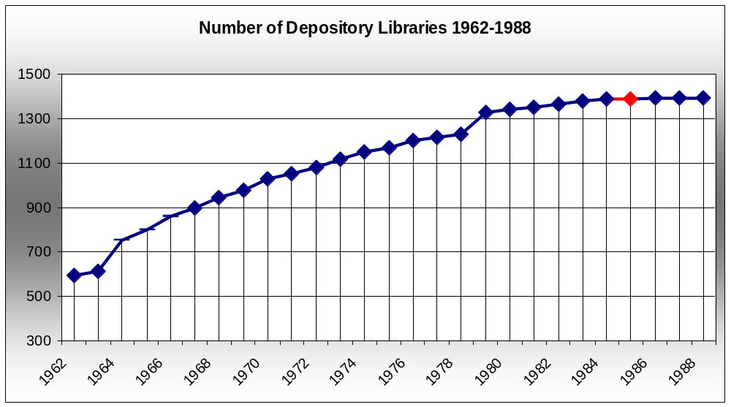
Expansion Era
1962-1988
Notes:
Eventually this system was not getting the job done. The nation had grown. Technology had grown as well. It was felt that the law needed to be amended to allow more libraries to enter the program. In 1962 the law was changed to allow more Congressionally appointed depositories. The act also established the current regional depository system. So begins a period of rapid growth. This is particularly important. It represents another fundamental change in the depository system, and is the reason for the population explosion in the number of depositories. As the number of depositories began to climb to again reach capacity, it was again decided to change the law to allow the law school libraries to be added to the program. This explains the jump in 1979.
Toward the end of this curve, you can see that the number of depositories, while still rising slightly, was entering another period of balance and stasis, and there would be no reason to think that the trends that we saw in the selective depository era would not continue, if it were not for a fundamental technology change.

Slide 6
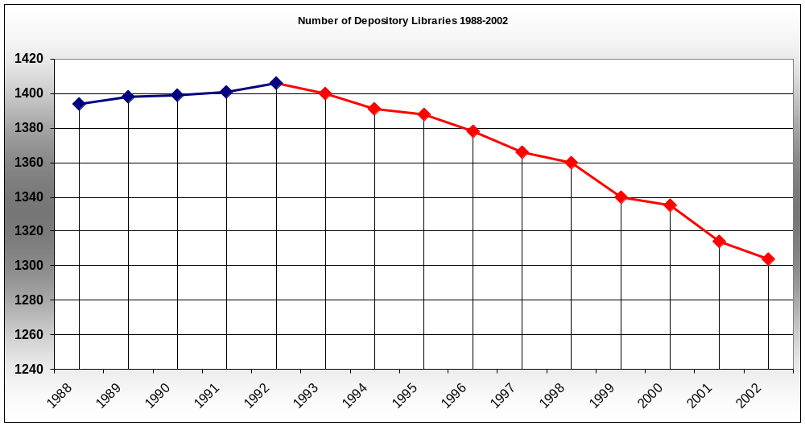
Electronic Era
1988-present
Notes:
In 1988 the first CD Rom, the Census Test Disc #2 was issued to all depository libraries. This was the first in a long line of signals that the depository role was going to expand to include newer technology.
By 1993, the shift to a more electronic government was clear. It was happening quickly. More quickly than our current system is built for. The “Government Printing Office Electronic Information Access Enhancement Act of 1993” was passed. The FDLP was changed. In “A Brief History of the FDLP,” Ridley R. Kessler Jr. states that this legislation “served notice to all 1,400 or so depository libraries that the electronic age was here to stay and that they had best begin to deal with it in a serious manner forthwith.”
Which they did, by dropping out of the porgram.
It is important to note that the first three era’s were brought about by law changes that fundamentally changed the structure of the depository program. This new change has come about through law changes that have fundamentally changed government, and laws have not been passed to change the FDLP in a way that meets the challenges brought about by these changes.
Problems associated with this change included:
Increased costs to libraries.
Lack of computer expertise.
Lack of computer maintenance.
Preservation problems.
Libraries immediately responded by dropping out of the program. Since 1993, there has not been a single year that more libraries joined the program than have left it.

Slide 7
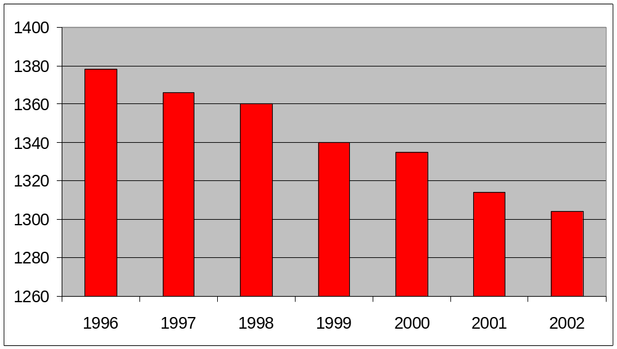
1996-2002
Notes:
By 1996 the trend has been well established, and the decline becomes more accelerated.

Slide 8
WHY?
Notes:
Why?

Slide 9
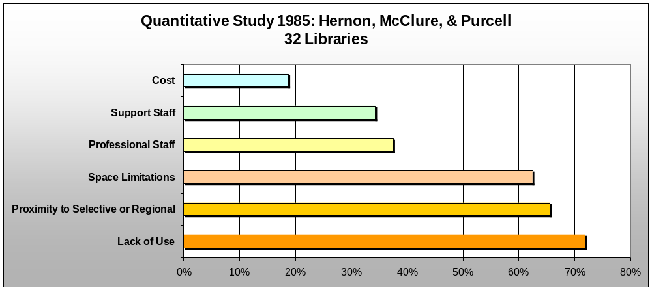
1985 Survey of Libraries that Dropped Out of the FDLP
Notes:
In 1985 Hernon, McClure, and Purcell conducted a survey of libraries that had decided to drop out of the program between Jan. 1970 – Sept. 1983.
What they found was that the biggest reason cited was the lack of use. Other reasons included proximity to another depository, space, staff, and budget considerations.

Slide 10
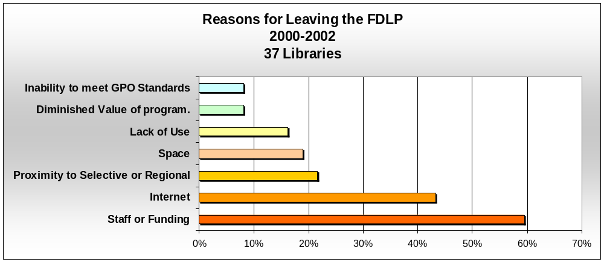
2002 Qualitative Summary of Libraries that Dropped Out of the FDLP
Notes:
Earlier this year we concluded a qualitative study, looking at the libraries that have dropped out of the program between 2000-2002. We were able to obtain a collection of qualitative material including letters, inspection reports, self-study reports, and emails from 32 of the libraries. Of those, 24 discuss reasons for leaving the program.
They now list far different reasons for leaving. Interestingly, the number one reason, diminished use, from the 1985 study, is now one of the least mentioned. Staff and funding has become the issue mentioned most, but the availability of the documents on the Internet is the main new reason, mentioned in this material by close to half of the libraries. The free availability on the Internet is the main “New” issue that is driving libraries out of the program. This in turn makes staffing and cost more of an issue, while diminished use is less of an issue. Quickly library directors begin to ask themselves, “If most of the things that our patrons are using are available freely on the Internet, why should we keep the expense of staff, space, preservation, maintenance?”
In addition we find two new reasons listed for leaving the FDLP. For years being a depository was something of a status symbol, particularly for academic libraries. However, many of those who dropped out talked about the eroding of this value. The libraries, or institutions were no longer “special” because they were depositories, but rather “burdened” because they were depositories. For this reason the Diminished Value of the Program and Inability to meet GPO Standards becomes more of an issue.
We are not saying that there are no good reasons for being a depository. What we are saying is that the rush to electronic is the driving dynamic that changes other factors and priorities in a library director’s mind. The role of the depository is changing because of the change in the way we run our government. We need to have a depository model in place that moves with these changes, and the laws need to shift in order for us to continue to provide a valuable service to the public.

Slide 11
Surveys and Profile
Survey of FDLP libraries that have dropped out since 1996.
Survey of FDLP libraries that have joined the program since 1992.
Profile of the libraries that have dropped out.
Notes:
We wanted to examine this affect more closely. We decided that we would survey the depository libraries that have dropped out of the program since 1996, asking them the reasons that drove that decision. We also surveyed the libraries that have joined the program since 1992 to discover their motivations.
We wanted to establish a profile and establish “risk factors” that would predict libraries that might drop out in the future.
Finally we wanted to examine the state of the FDLP in light of recent changes. Looking ahead to how the depository program needs to change in order to meet the demands of the new electronic government.
I would like to introduce Mr. Aric Ahrens, from the Illinois Institute of Technology who will discuss the results of our surveys.

Slide 12
Survey Response Rates
Drops Survey – FY 1996-2002
  78 of 103 surveyed libraries responded
  76% Response Rate
  Addressing Problems
Adds Survey – FY 1992-2002
  15 of 29 surveyed libraries responded
  52% Response Rate
Notes:
103 libraries who dropped their depository status during the period FY 1996-FY 2002 were surveyed. 78 responded, for a 76% response rate. We were extremely happy with the response rate, especially in light of the problems involved with not having current addresses for libraries with defunct depositories, and the lack of an appropriate contact person.
29 libraries that joined FDLP during the period FY 1992-FY 2002 were also surveyed, with a 52% response rate. We believe that the difference in rates may be due to an exuberance to participate on the part of former depositories coupled with a certain wariness on the part of new depositories.

Slide 13
Why are Depositories Dropping or Adding?
Survey Results – 1 to 5 Scale
  Rating of reasons for leaving FDLP
  Ranking of importance of different costs on decision to leave FDLP
  Rating of reasons for joining FDLP
  Rating of satisfaction level with FDLP

Slide 14
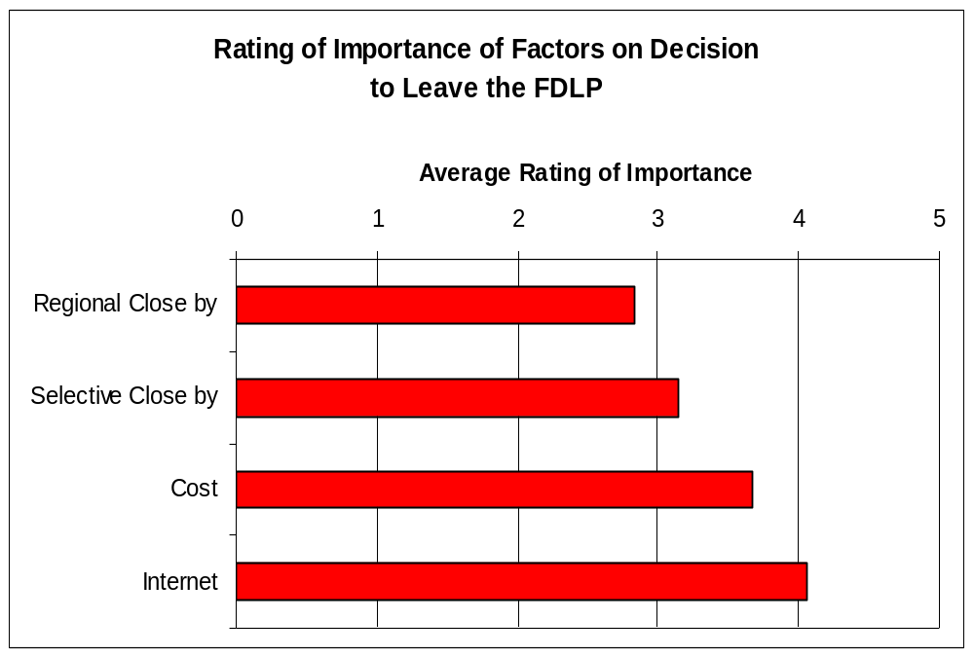
Notes:
You can see from this chart that the major factor indicated as a reason for terminating depository status was the availability of resources on the Internet. This reason trumped the reasons indicated in the previous study mentioned earlier. We believe that this does not diminish the importance of the other factors, but that the availability of resources on the Internet is an additional factor, that happens to be even more important than previously identified factors.

Slide 15
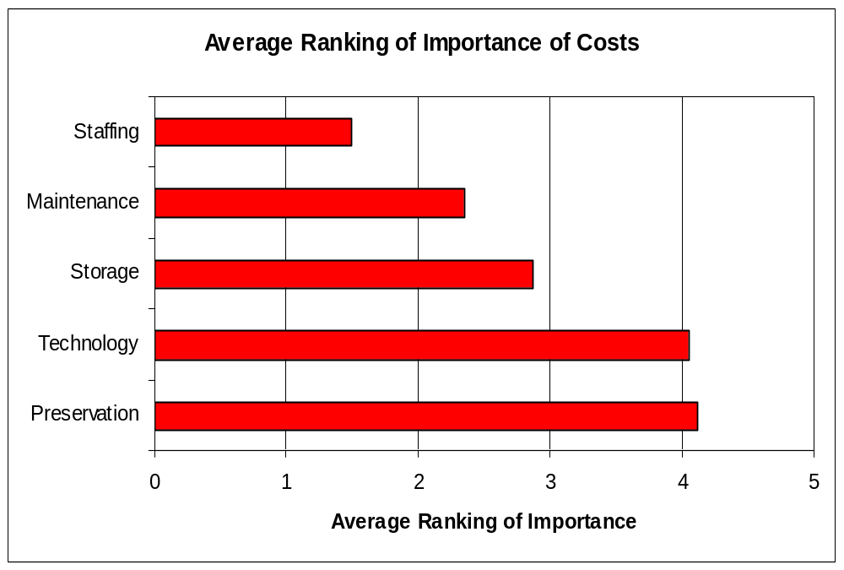
Notes:
Here we see a graph depicting the ranked importance of a breakdown of factors associated with cost. Staffing is the major factor cited by dropping libraries when they considered their decision to drop, with Preservation being the least important cost.

Slide 16
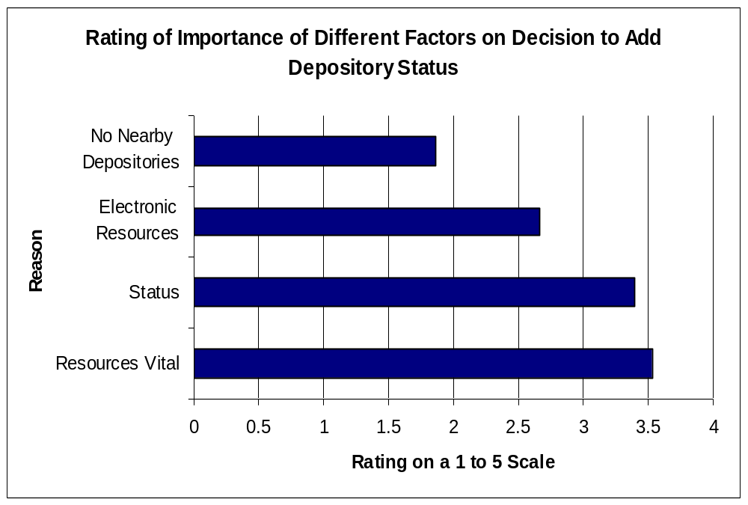
Notes:
Now we’ll look at the importance of certain factors in the decision to join the FDLP. Adding libraries cited the fact that they found FDLP’s resources to be vital as the most important factor in their decision to join, with status a close second.

Slide 17
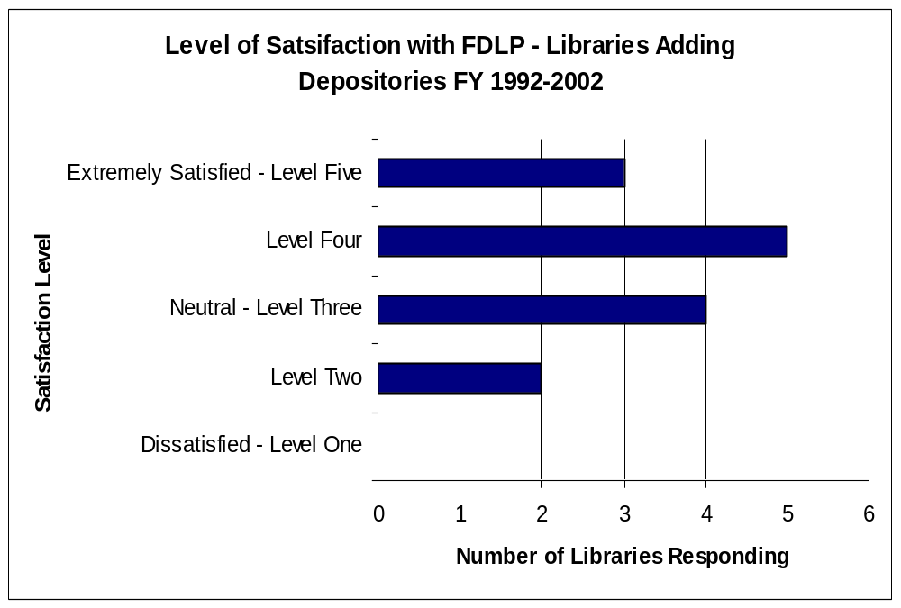
Notes:
Here we see a chart indicating the level of satisfaction indicated by the depositories who have joined FDLP in the last 11 years. Overall, this chart portrays a group of depositories that are satisfied with FDLP’s resources and service.

Slide 18
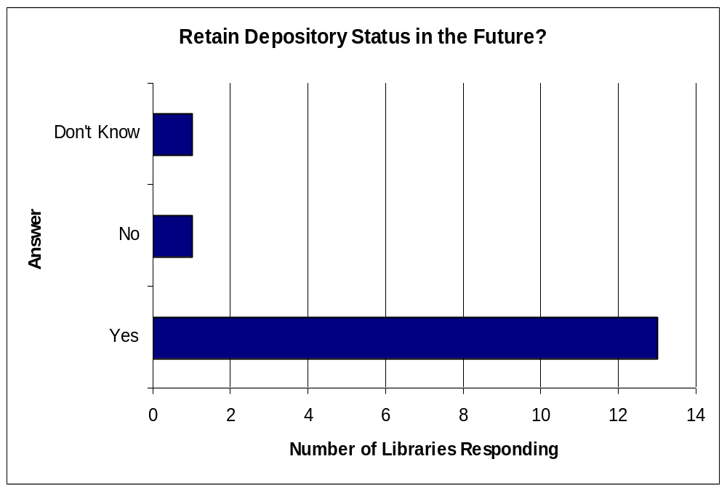
Notes:
This chart indicates the newly added depositories intentions regarding the continuation of their depository status. 13 responded that they would remain in the FDLP, one responded that they would not, and one expressed uncertainty.

Slide 19
What Factors do Dropping Libraries Have in Common?
Selection Rate
  Low Selection Rate – More Often
Collection Size
  Small Collection – More Often
Designation Date
  Post 1961 Designation – More Often
Library Type
  Public More Often, Law Less Often

Slide 20
Factor #1: Selection Rate
A Selection Rate of Under 20% corresponds to a Higher Drop Rate

Slide 21
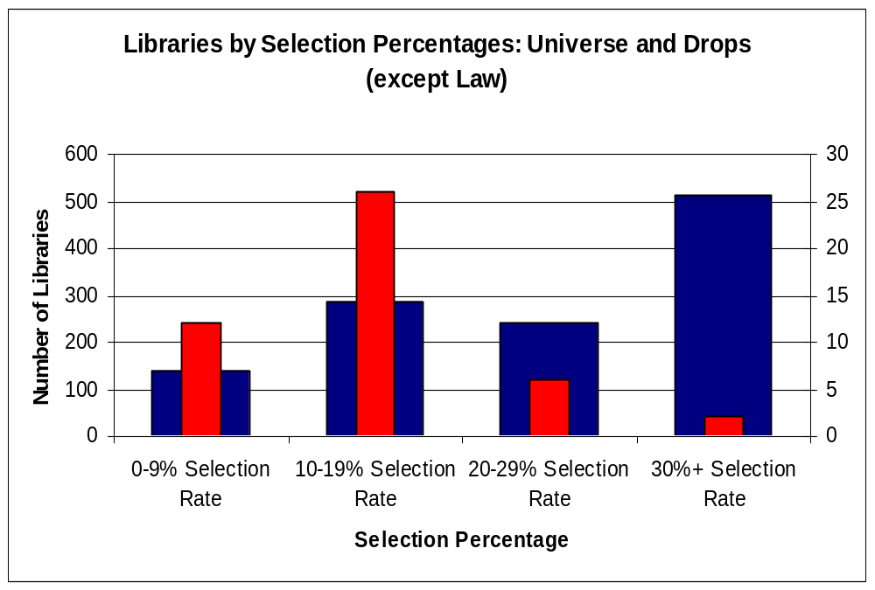
Notes:
On this chart, the Universe of depositories meeting a criteria is indicated in blue, with the number of depositories being read on the Left x-axis. The number of dropping depositories meeting the criteria is indicated in red, and the number of these dropping depositories is read from the Right x-axis. The axes have been formatted in order to allow the red columns indicating dropping depositories to surpass the blue columns indicating the overall total of libraries in height n cases where the drop rate is high, with the blue columns surpassing the height of the red columns when the drop rate is low. This was done in order to enhance the visualization of the data, and will be present in subsequent charts as well. You can see that depositories with selection rates in the 0-9% and 10-19% range have dropped depository status at a greater rater than those with 20% selection rates or greater.

Slide 22
Factor #2: Collection Size
A Collection Size of fewer than 1,000,000 volumes corresponds to a higher Drop Rate

Slide 23
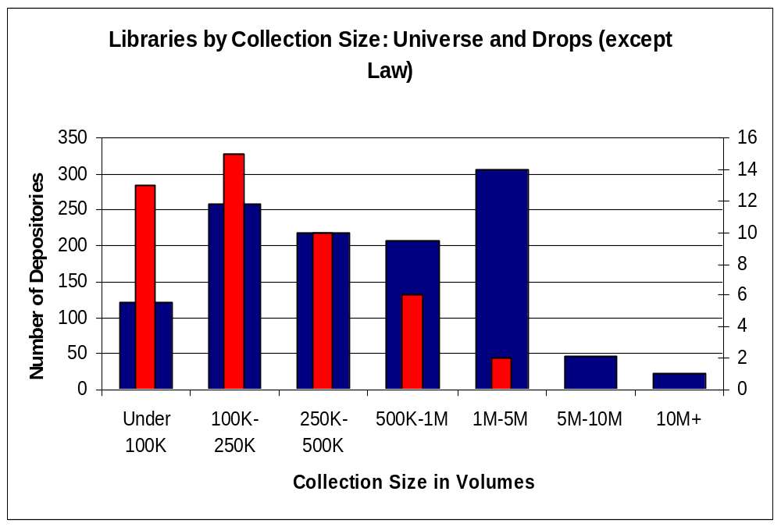
Notes:
Here we can see that the size of a libraries collection in volumes is a good indicator of their likelihood to drop depository status. Keep in mind that this collection size is a measurement not only of the depository materials, but of the library’s entire collection. There is a large drop off in drop rates after the 500-K-1M categories. Notice that the largest group of libraries is the 1-5M category, which lost only 2 depositories during FY 2000-2002. Meanwhile, not one library of over 5 Million volumes dropped their depository.

Slide 24
Factor #3: Designation Year
A Designation Year of 1962 or later corresponds to a Higher Drop Rate
  Law changes in 1962

Slide 25
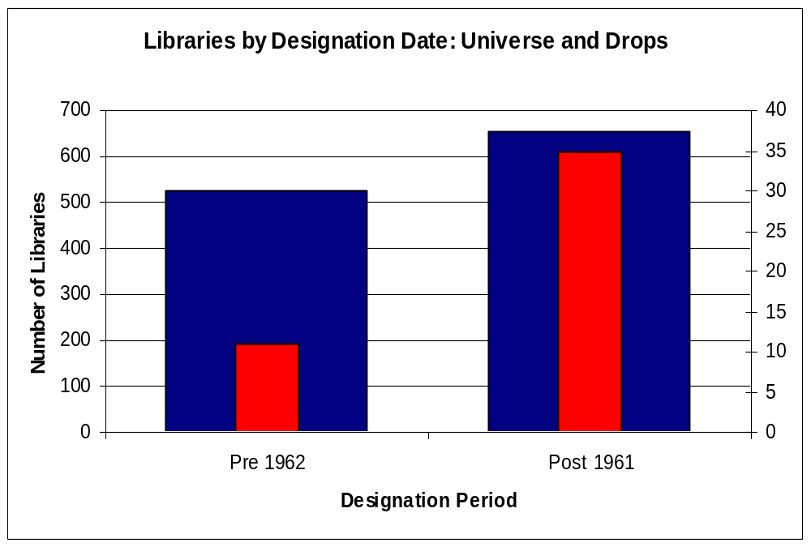
Notes:
Notice here that depositories with designation dates later than 1961 dropped at a higher rate. The difference is not quite as drastic as with the other factors of selection rate and collection size.

Slide 26
Factor #4: Library Type
Public Libraries have a higher Drop Rate
Law Libraries have a lower Drop Rate
  Consistently meet other 3 Factors, yet do not drop much

Slide 27
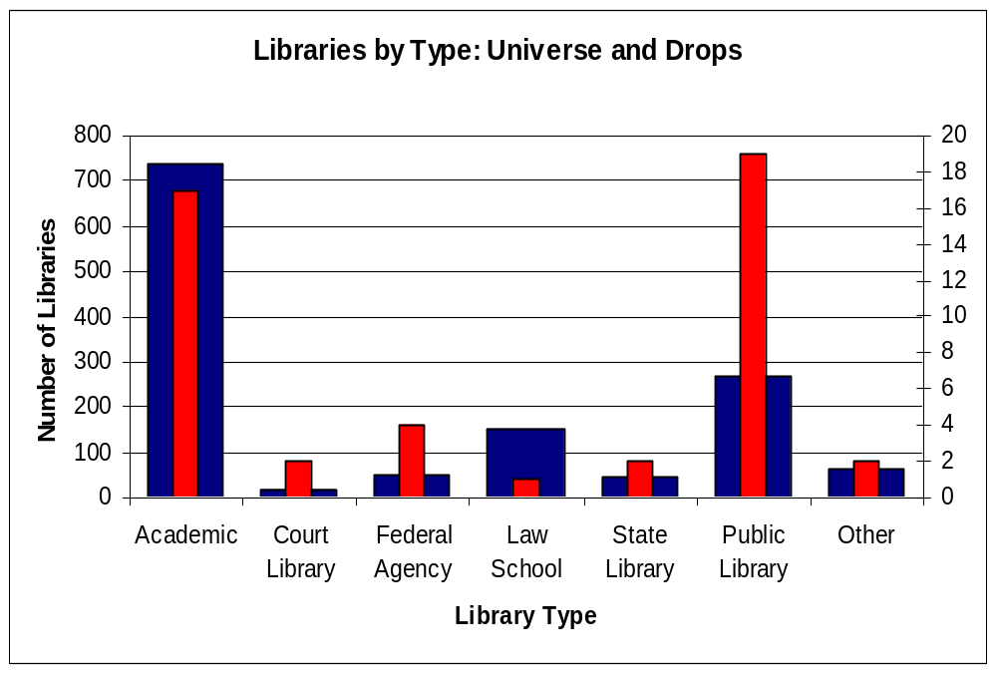
Notes:
Here it can be seen that Public Libraries outpace other types of libraries when considering dropping of depository status. Also, here in the middle, it can be seen that Law School Libraries drop their status much less frequently than other types of libraries.

Slide 28
Law Libraries - Theory
Have low selection percentages, small collections, and recent designation dates; yet they don’t drop often
Focused collections mean that small collections are normal, and low selection percentages can address their needs
Exceptions to the formula

Slide 29
Public Libraries - Theory
Up to eight areas of focus identified in texts when discussing Public Libraries’ Missions.
  Government Documents extremely relevant in only 2 of 8 areas
Lower selection rate among Public Libraries:
  May be a normal result of limited need
  May be necessary result of distribution of resources due to broader mission
Difficult to determine without focused survey

Slide 30
Public Libraries
355 Non-Law Libraries do not meet criteria of either less than 20% Selection Rate or less than 1 Million Volume Collection size
The 1 and only drop from this group happened to be a Public Library
Not statistically significant
Not a major factor when viewed alone

Slide 31
Post 1961 Designation Dates - Theory
Law changes in 1962
  Major increase in open slots
Less difficult to join FDLP
  Pre 1962 Depositories had to fight for admission
  Post 1961 Depositories, by comparison, had much easier time
Post 1961 Libraries
  Lower Selection Rates than Pre 1962 Libraries
  Smaller Collections than Pre 1962 Libraries
  Difficult to establish independence from these variables

Slide 32
Post 1961 Designation Dates
355 Non-Law Libraries do not meet criteria of either less than 20% Selection Rate or less than 1 Million Volume Collection size
No libraries from this group who dropped were designated after 1961
Not a major factor when viewed alone

Slide 33
Factor Summary
Exclusionary Factor: Library Type
  Law Libraries
Primary Factor #1: Selection Rate
  Less than 20%
Primary Factor #2: Collection Size
  Less than 1 Million volumes
Secondary Factor #1: Library Type
  Public Libraries
Secondary Factory #2: Designation Date
  Post 1961

Slide 34
Primary Factors
Selection Rate and Collection Size
  Nearly Universal Application
  Factors under control of Library to some degree
Exclude Law Libraries
  Formula doesn’t work; they don’t drop often

Slide 35
Secondary Factors
Designation Date: Post 1961
  Not significant by itself
  May increase likelihood of dropping, but only when combined with Primary Factors
Library Type: Public Library
  Not significant by itself
  May increase likelihood of dropping, but only when combined with Primary Factors

Slide 36
Combining the Primary Factors
Venn Diagrams
  Selection Rate Under 20%
  Collection Size under 1M Volumes
  Meet both criteria
  Meet neither criteria
  Law Libraries Excluded

Slide 37
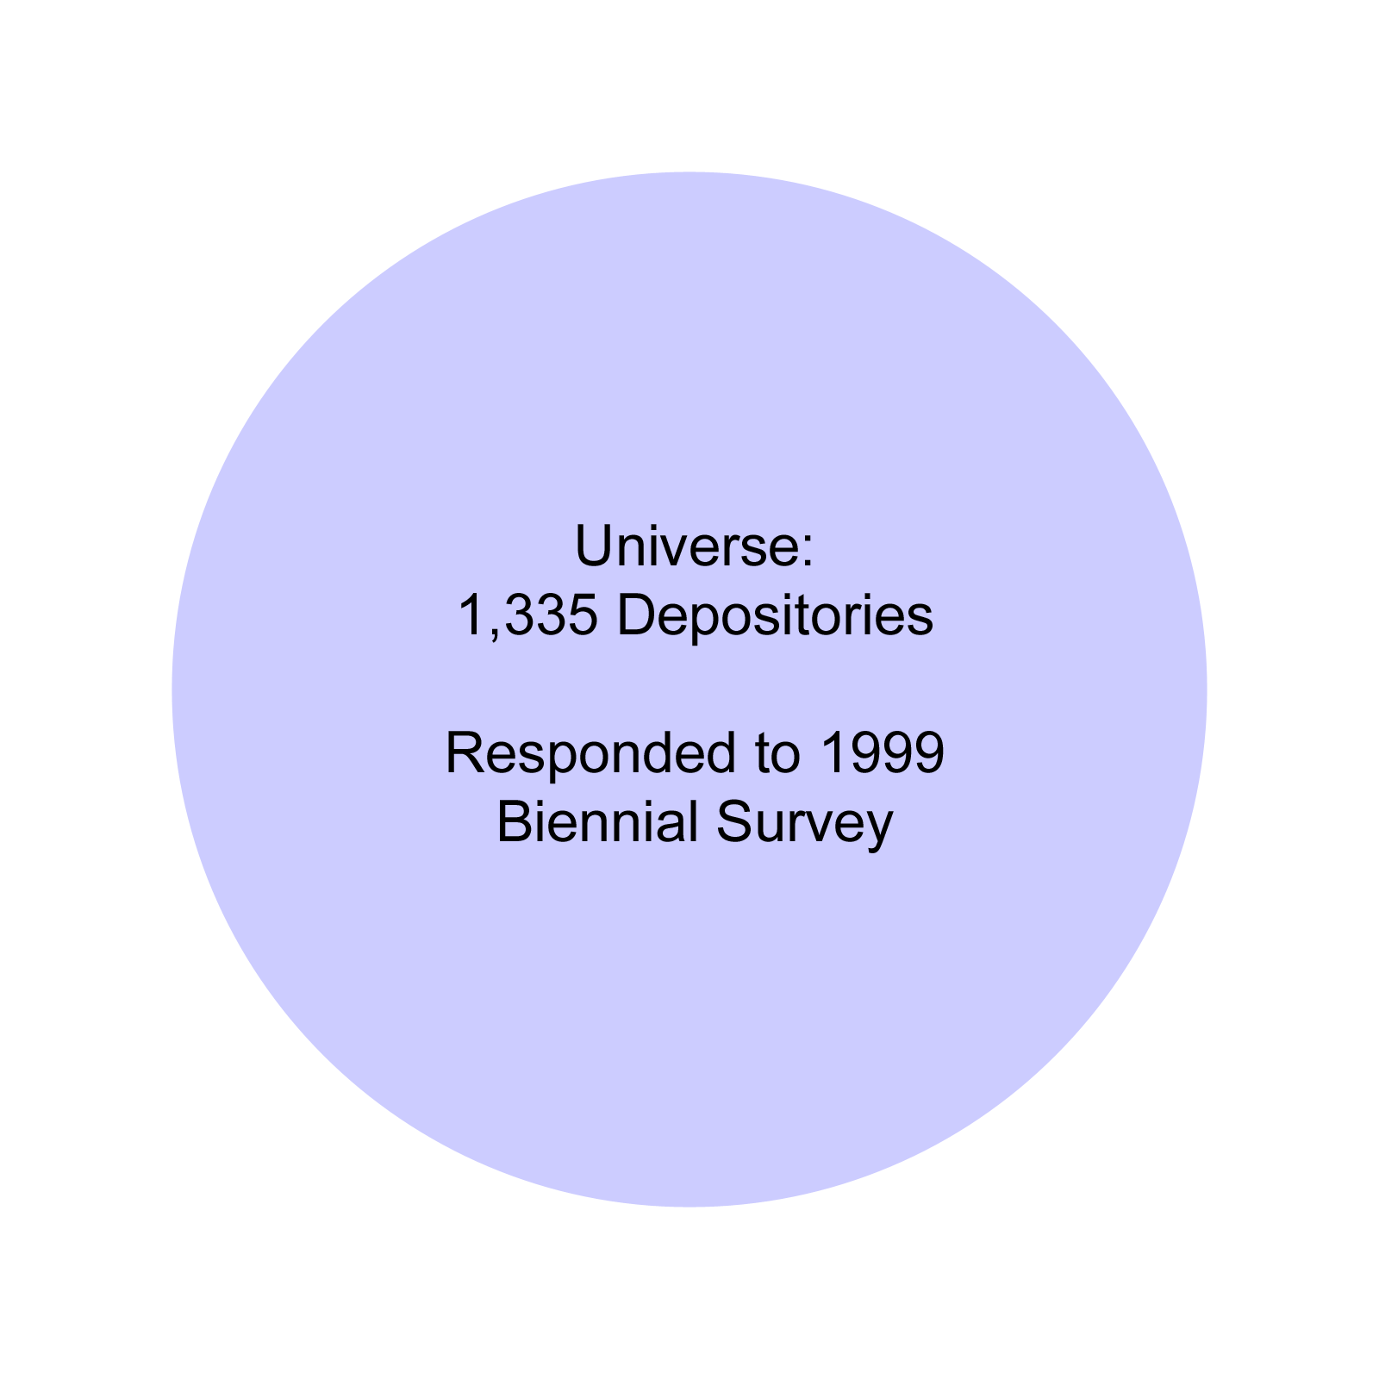
Notes:
So, here is the Universe of 1,335 depositories who responded to the 1999 Biennial Survey. From that, we’ll separate the law school libraries.

Slide 38
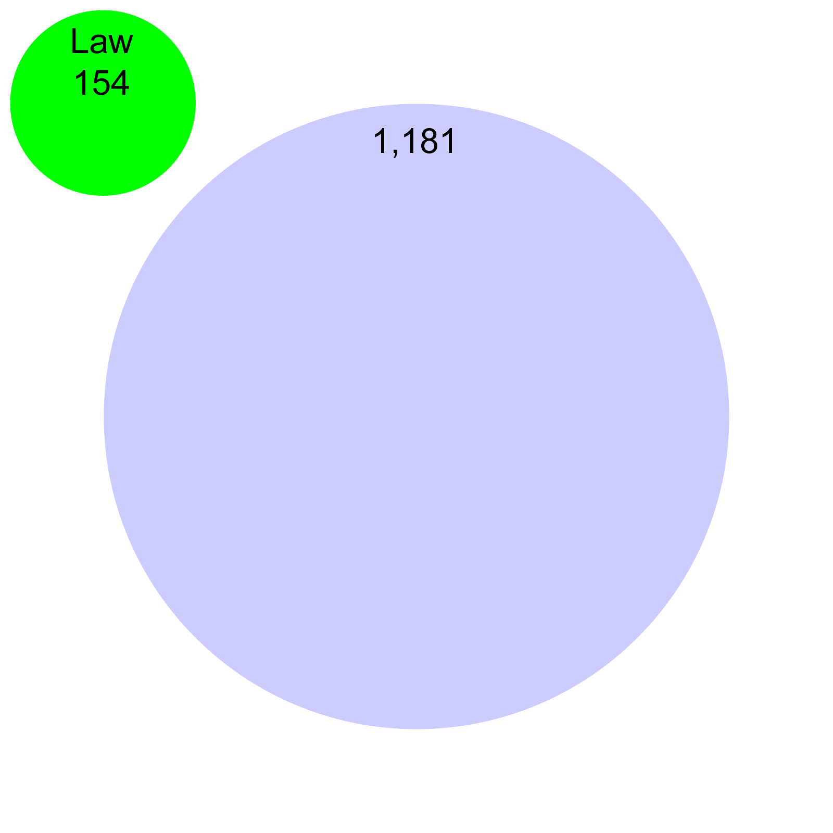
Notes:
Since the law libraries don’t fit the model, we’ll leave them here to the upper left, which leaves 1181 remaining libraries

Slide 39
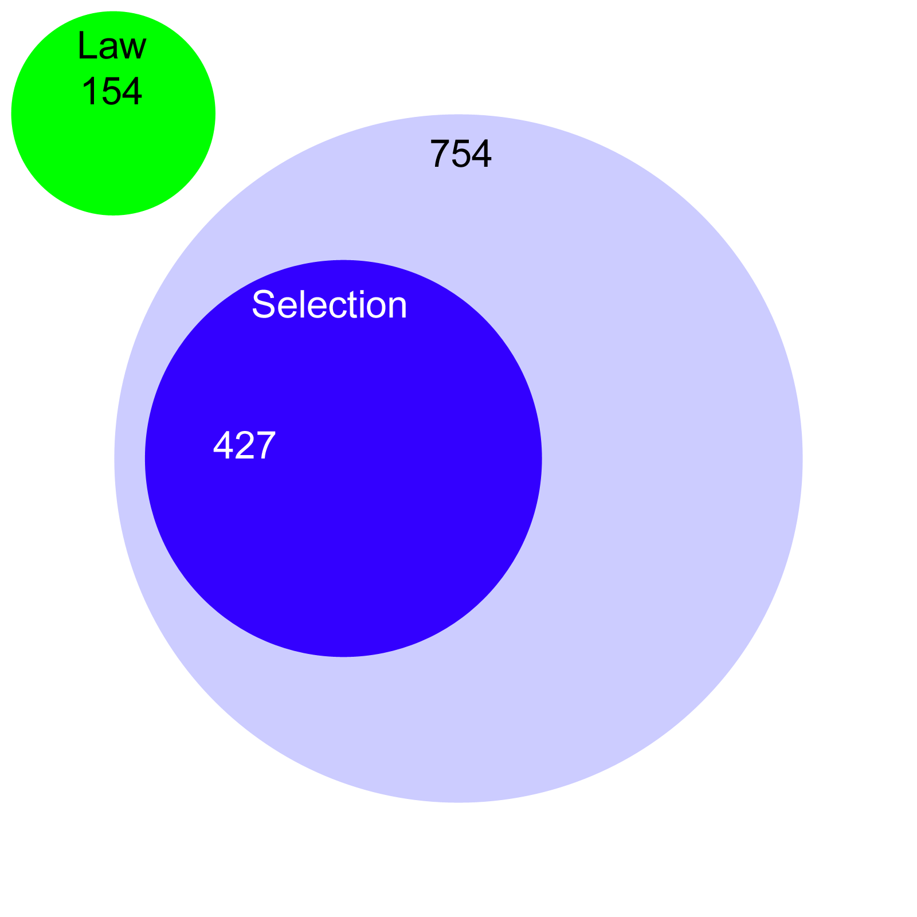
Notes:
Now, we’ll add the Selection Criteria. The 427 libraries in the blue circle all exhibit the Factor of having a selection rate below 20%. The remining 754 libraries at the top have selection rates of 20% or higher.

Slide 40
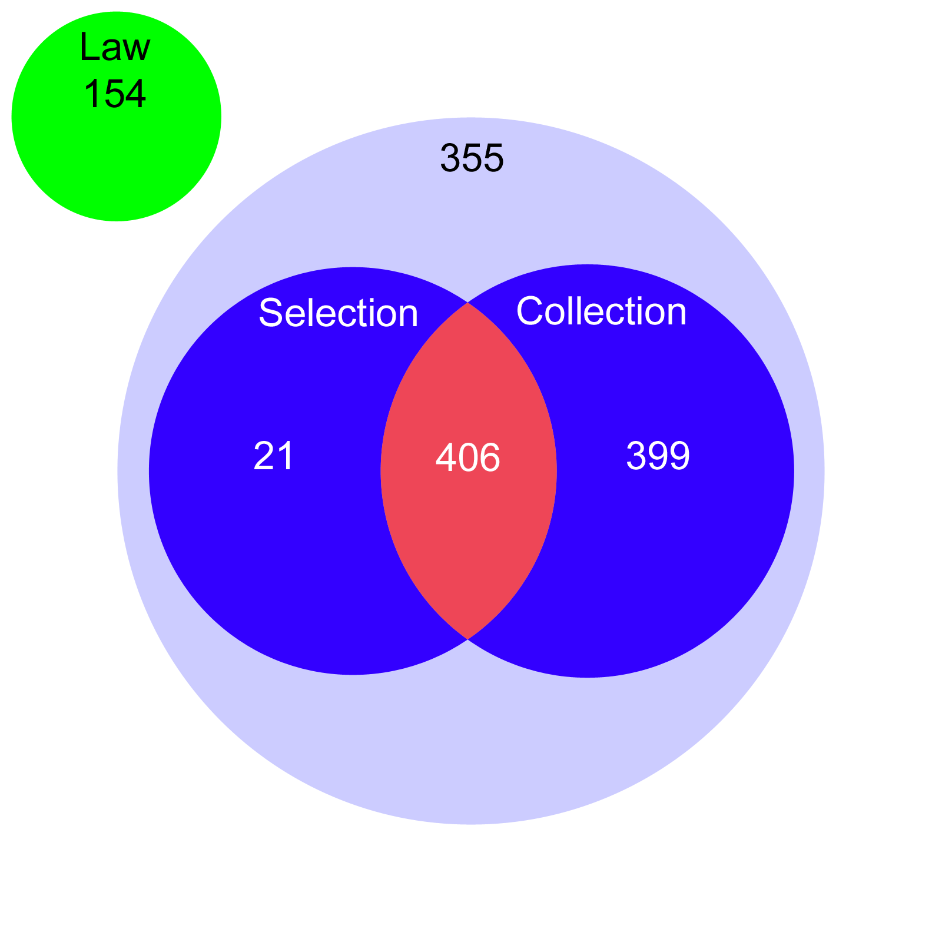
Notes:
Finally we’ll add the Collection criteria. You can see that of the 427 libraries that met the selection criteria, 406 also meet the Collection criteria of having collections of less than 1 million volumes. 399 libraries exhibit solely the criteria of having less than 1 Million volumes in their collections. And what is left at the top is a total of 355 libraries that do not meet either criteria. Please notice as well, that 3 of the five groups have roughly the same number of libraries, 355, 399 and 406. If these Factors were irrelevant, then we would expect roughly equal numbers of libraries dropping from each of these groups. Now, let’s look at the numbers of libraries from each group that dropped their depository status during the period FY 200 thru FY 2002.

Slide 41
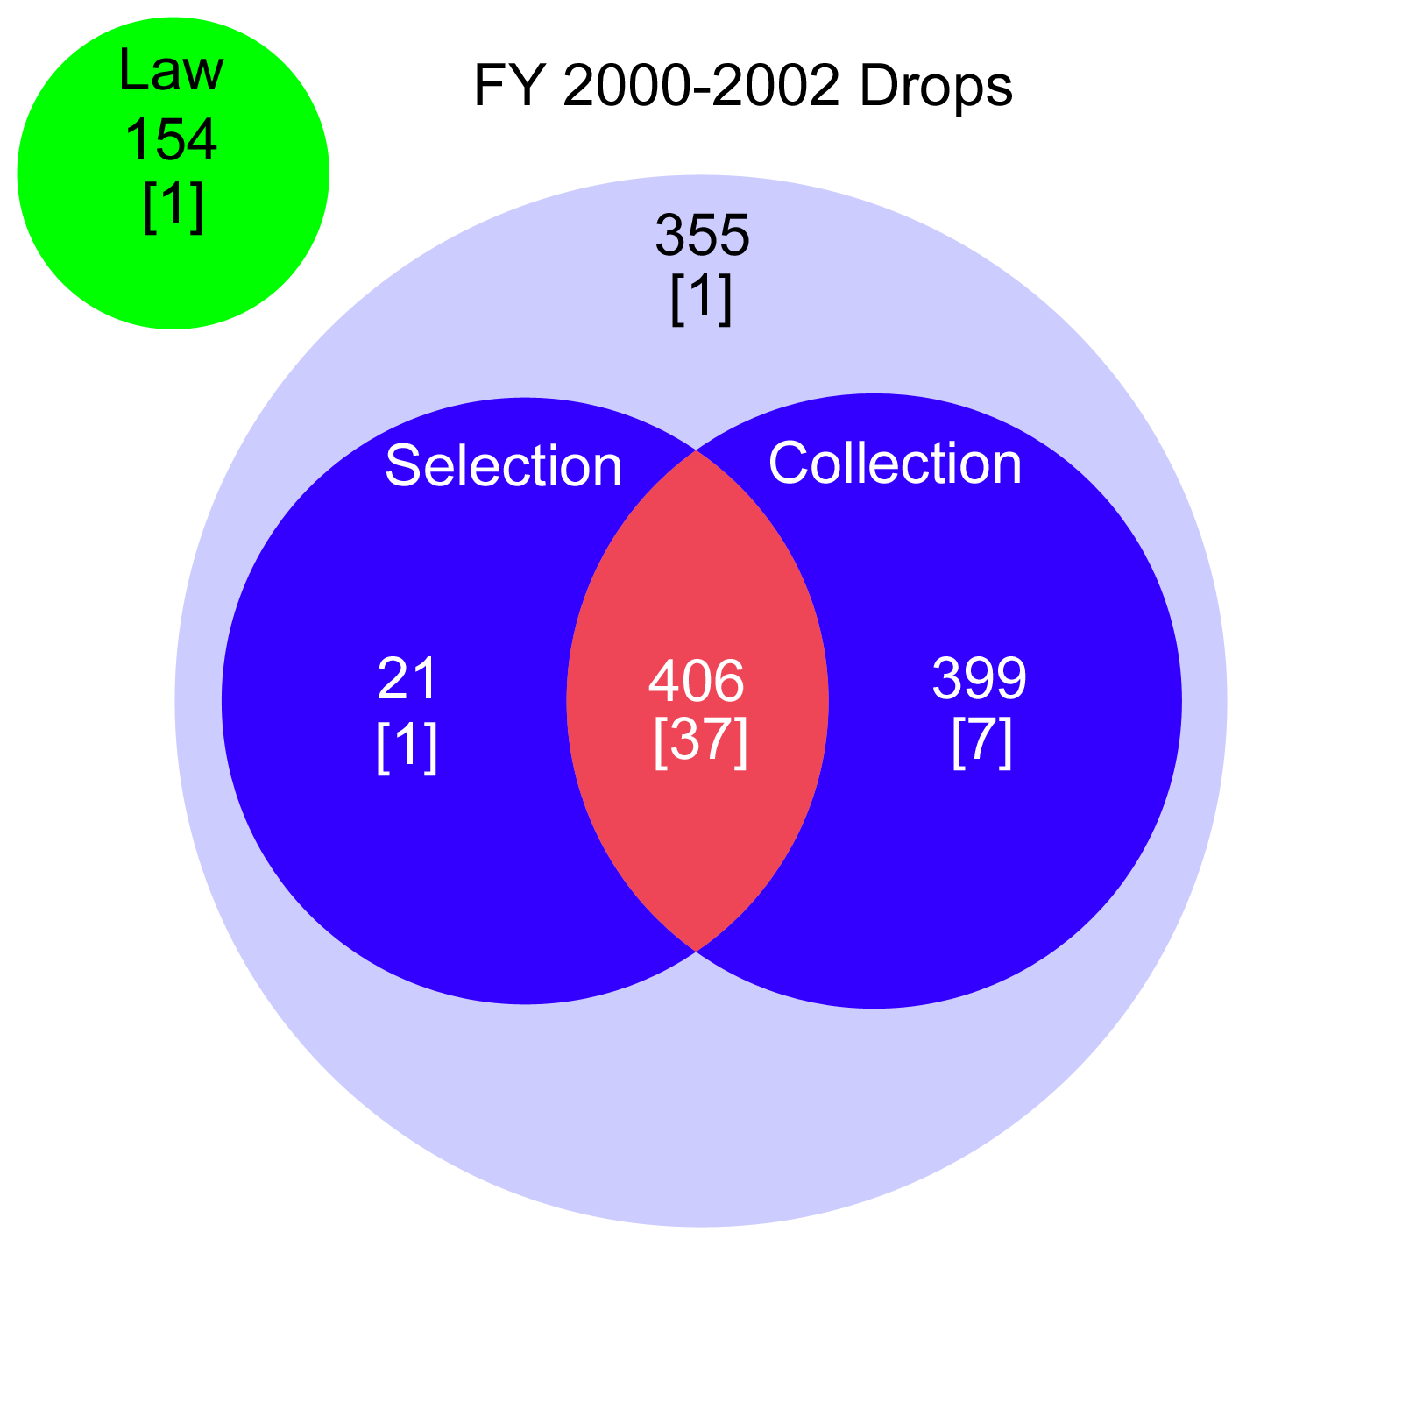
Notes:
You can see that the vast majority of the dropping libraries met both criteria. 37 of the 47 dropping libraries came from this group. Another 7 came from the group of 399 that only had small collections, and 1 of 21 came from the group that only had low selection rates. Only 1 library with a large collection and a high selection rate dropped, out of a pool of 355. Finally, 1 Law School library dropped. Now, lets take a quick look at the FY 2003 drops, to see whether this trend is continuing.

Slide 42
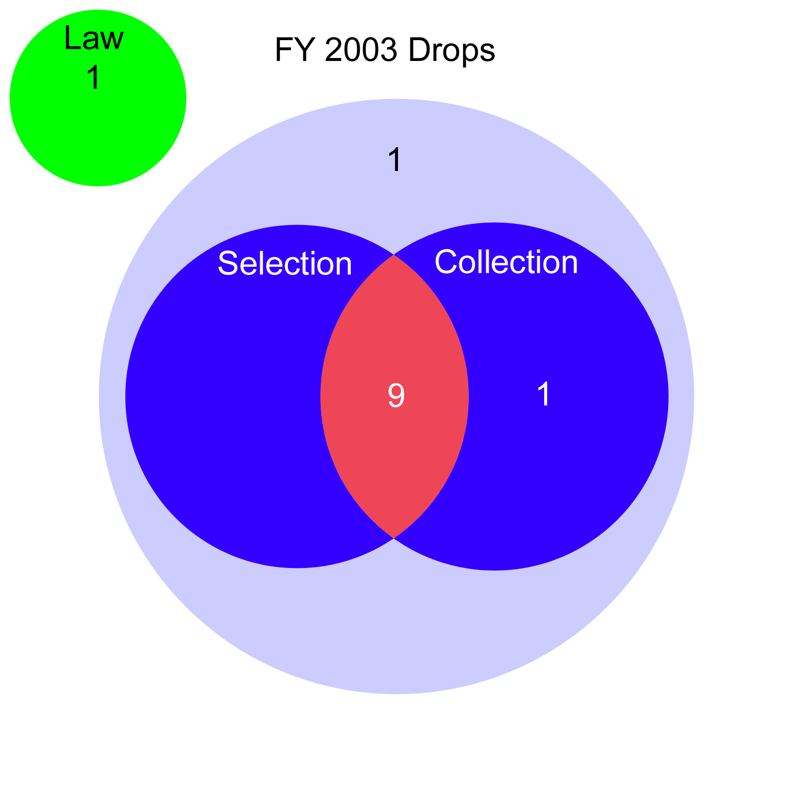
Notes:
Here we can see that 7 of 10 drops met both criteria. Finally, lets apply the Venn diagram to the Universe fo libraries that Added between FY 1992 and FY 2002.

Slide 43
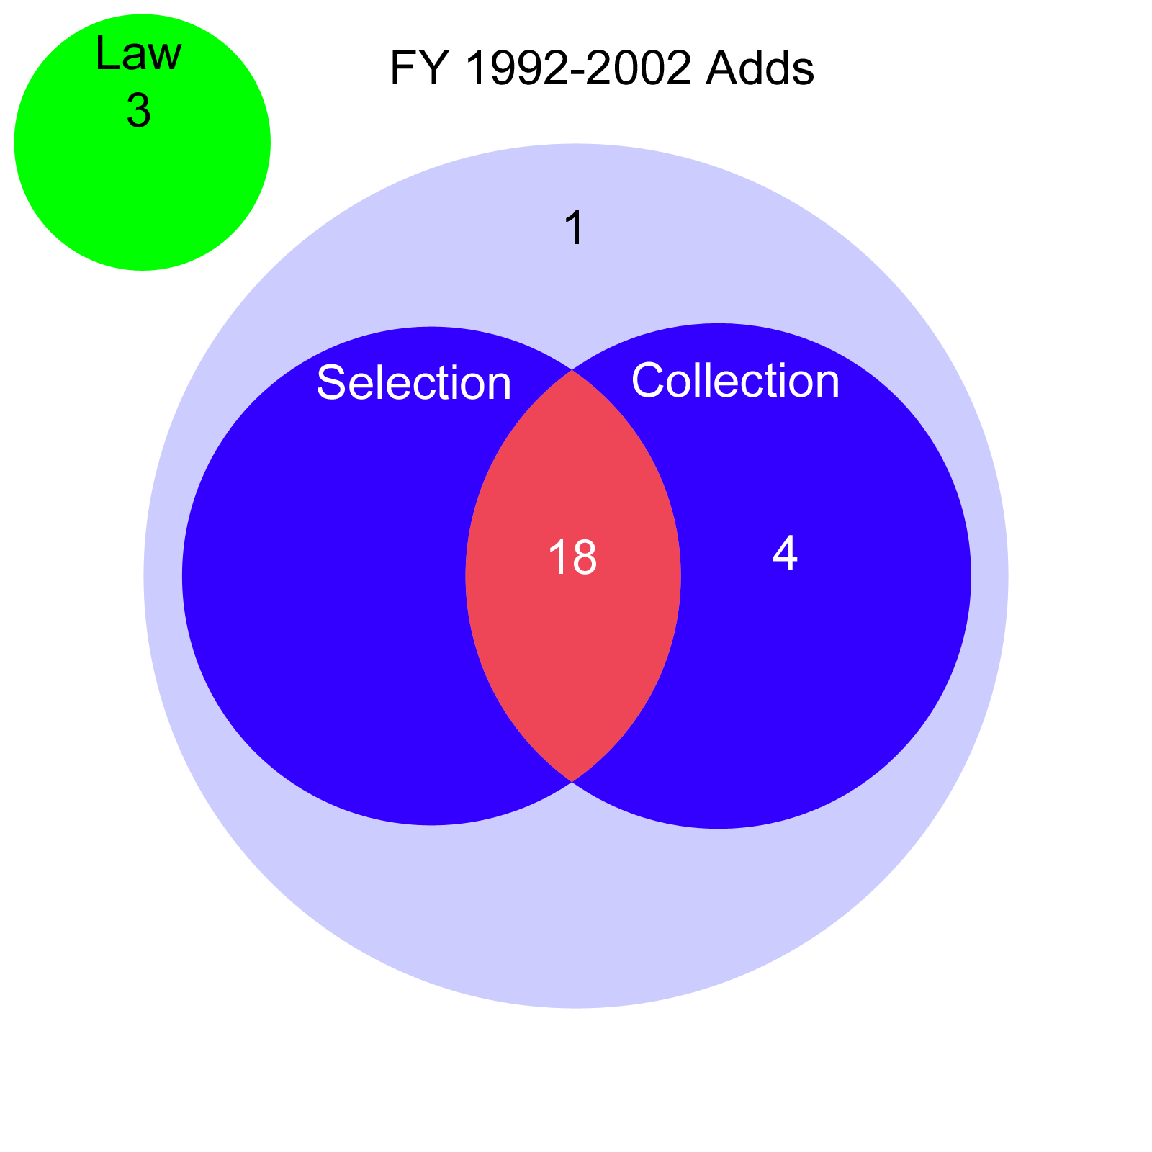
Notes:
18 of the 26 libraries that adding depository status in the last 11 years also meet the two criteris

Slide 44
37 High Risk Libraries
27 Responded to our Survey
Average importance of Internet availability was 4.19 on a 5 Scale
Compared to an average of 4.05 on a 5 scale for all libraries surveyed
Internet availability had a bigger impact on decision to drop of High Risk Libraries

Slide 45
Overall Picture
Small libraries dropping faster
  Low Selection Rates, Small Collection
Dropping libraries cite Internet
  Major factor in decision to drop
Internet satisfying small libraries’ needs
  Depository status becoming less appealing
Libraries Joining FDLP
  Cite high level of satisfaction with FDLP
  Statistically resemble those leaving FDLP
Notes:
So, let’s look at the Overall Picture. Small libraries are dropping faster, namely those with low selection rates and small collections. Dropping libraries cite the Internet as a major factor in their decisions to drop depository status. From these two facts, we can infer that the Internet is satisfying small libraries’ needs to the extent that Depository status is becoming less appealing. Finally, libraries who have joined the FDLP in the previous 11 years have cited a high level of satisfaction with FDLP, but yet they statistically resemble the libraries who are dropping.

