Slide 1
PERSONAL PROTECTIVE EQUIPMENT IN HEALTHCARE FACILITIES
AFTER TERRORIST EVENTS
Veterans Health Administration Office of Public Health and Environmental Hazards

Slide 2
OUTLINE
Background
Three considerations
  Expert opinions
  Regulatory analysis
  Modeling
Conclusions

Slide 3
HAZARDOUS MATERIALS ZONES
Traditional and newer terminology
Hot
Warm
Luke-warm
(“yellow”)
Cold
Site of active release, Size defined by existing SOPs
Removed from immediate release, decon activities
After primary decon (hospital receiving areas after initial decon)
Contaminant-free zones (emergency room)

Slide 4
ZONES and PPE
Who wears what where
Hot
Warm
Luke-warm
Cold
A, B, C
B, C
C
none

Slide 5
PPE and Chemical Terrorism Incidents
Incidents are like to occur in high-density area (subways, stadiums, etc)
“Hot zone” is likely to be defined by standard procedures in emergency management (HAZWOPER, DOT)
Local decontamination will occur as patients move into “warm zone” and beyond to uncontaminated areas
Local drift and operations may spread size of “warm zone”
Although hospitals will be involved, they are likely to represent a “luke-warm” or “yellow” zone

Slide 6
Contaminated patients and hospitals
Patients are likely to appear at hospitals under four conditions and scenarios
Planned
  Ambulatory - residual decon need ( “bus full of patients)
    after primary decon
    after suspected exposure but no documentation
  Stretcher-bound – symptomatic after primary decon
Unplanned
  Walk-ins
  “pick-up truck scenario” – unconscious patient in a pick-up truck, cab, or private motor vehicle with unknown degree of contamination

Slide 7
Who may need to don ppe?
Security staff, to maintain order and control access
Physicians or midlevel providers to triage and make preliminary diagnoses
Decontamination personnel
Waste management and equipment crews

Slide 8
Healthcare PPE issues
Clinical issues
PPE issues
Providers must be able to triage
  Identify respirations / airway patency
  Pulse and blood pressure
Providers may need to do CPR and insert iv lines
Life support precedes decon (radiation rule)
Decon must happen outside (exposure minimization)
Airlines may foul outside
SCBA are unwieldy and impair balance
Time limitations on wearer from level B vs C

Slide 9
ISSUE: WHAT LEVEL OF PPE IS APPROPRIATE?
Classified list of ~200 requested for CRT
National Institute for Standards and Technology, National Institute for Occupational Safety and Health, and Soldier Biological Chemical-Command are developing personal protective equipment standards for hot-zone and warm-zone work
PPE both enhances (protects) and interferes with performance

Slide 10
THREE APPROACHES
Consensus among experts
Regulatory Analysis
Modeling

Slide 11
I. EMERGING CONSENSUS ppe in healthcare facilities
JAMA article: levels C
  AG Macintyre et al. Weapons of mass destruction events with contaminated casualties: effective planning for health care facilities. JAMA. 2000;283:242-9.
Fairfax Inova Hospital: Level C
GWU: Level C
Washington VAMC: Level C
NMRT: Level C
Annals Emergency Medicine: level C
  Hick JL, et al. Protective equipment for health care facility decontamination personnel. Ann Emerg Med. 2003 Sep;42(3):370-380

Slide 12
I. EMERGING CONSENSUS ppe in healthcare facilities: impending regulatory actions
OSHA: healthcare response guidance document to be published fall 2003
AHRQ: healthcare response guidance document to be published fall 2003
Both will incorporate these considerations

Slide 13
II. REGULATORY ANALYSIS
1. HAZWOPER
HAZWOPER (1910.120):
  ICS
  Emergency response handling or controlling exposure
  Exposed to agents from release
  Unknown: at least level B protection
Not strictly applicable because
  No active major release
  Not in direct ICS
  Not engaged in handling or controlling release

Slide 14
II. REGULATORY ANALYSIS
1. HAZWOPER
1910.120 (q)(6)(2): compliance interpretations
Hospital personnel in decon should be trained to operations level
OSHA is unable to determine specific exposure levels and cannot recommend a specific level
Hospitals should conduct a risk assessment to determine likely risk

Slide 15
II. REGULATORY ANALYSIS
2. Respiratory protection
Respiratory protection standard 1910.134
  Program
  Hazard assessment required to determine needed level of protection
Personal protective equipment
  Hazard assessment

Slide 16
III. MODELING
GENERAL APPROACH
Define range of likely or possible scenarios of patients coming to hospital
Table-top exercise to identify likely important predictors of exposure
Range finding with limited number of representative agents to identify critical factors
Model selected agents under varying assumptions to define likely exposures (hazard assessment)
Identify needed protection factor and select ppe

Slide 17
PATIENTS AS A SOURCE OF CONTAMINATION
Assumptions aligned with NIST, NIOSH, and SBC-COM hot-zone and warm-zone modeling and extrapolated to down-stream scenarios (“luke-warm” zone)
10 gm of agent likely individual dose based on technology
½ to 2/3 of dose on clothing; clothing removal and effective disposal
Evaporation between hot-zone and hospital is a function of time, vapor pressure, and ambient conditions

Slide 18
INITIAL SCENARIO ASSUMPTIONS
50 patients Stable weather
Outside staging area Clear
Windspeed 3 m/sec Temperature 65º
3 zones: Typical terrorist devices
initial staging and triage
Decon tent
Holding area
Scenario 1: 2 at a time by ambulance, planned operations with sequential controlled disrobing and decon
Scenario 2: 50 at once by bus, chaos

Slide 19
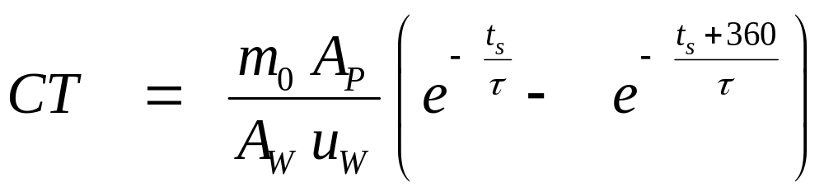
DETERMINANTS OF EXPOSURE
CT = integrated total exposure concentration
M₀= mass deposition (gm /m³)
A_{p}= contaminated surface area
A_{w} = area of column of air
U_{w} = wind velocity
T_{s} = start time for integration
Τ = evaporation time constant

Slide 20
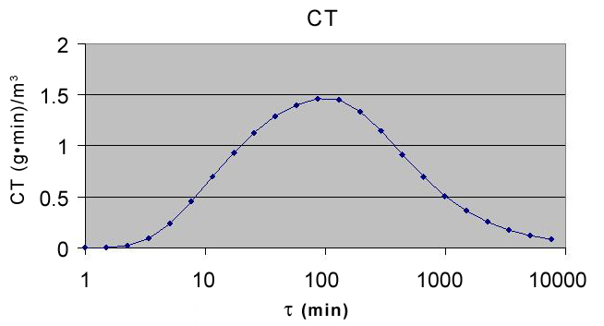
Total integrated exposure concentration (CT) of CWA for medical personnel as a function of the evaporation time constant

Slide 21
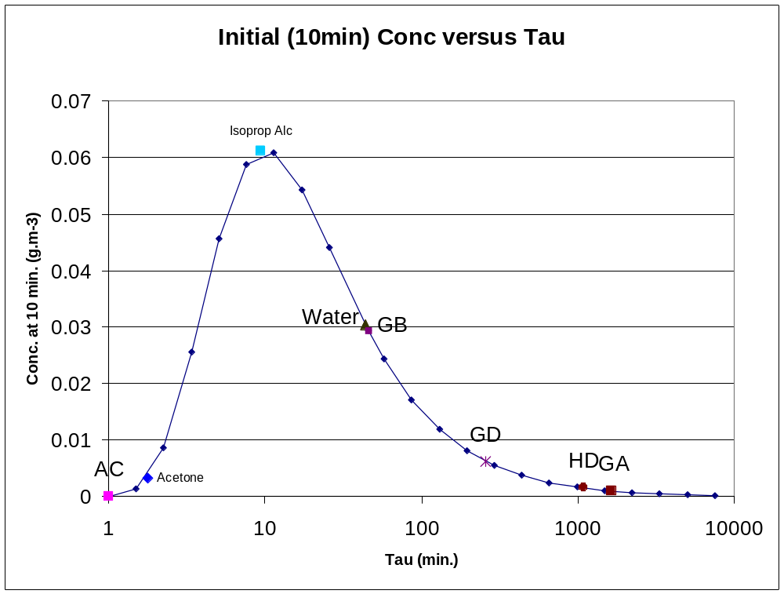

Slide 22
PHYSICAL CHARACTERISTICS OF WMD AGENTS
LD₅₀
_{(mg)}
LCt₅₀
(mg • min)/m
AGENT
VP mg/m³
Tau
Chlorine 2.5*10⁷ 6.67*10⁻⁴ 190,000
Phosgen 1.0*10⁶ 1.67*10⁻³ 3,200
Cyanide 1.1*10⁶ 1.50*10⁻² 2,000
Water 2.3*10⁴ 7.28*10⁻¹
Sarin 2.2*10⁴ 7.58*10⁻¹ 5.9*10¹ 35
Tabun 6.1*10² 1.6*10⁻³ 1.5*10³ 70
Mustard 9.2*10² 1.81*10¹ 7.1*10¹ 1,000
VX 1*10¹ 1.67*10³ 2.0*10⁴ 15

Slide 23
Number of lethal doses resulting from a 100 g deposition of a chemical warfare agent
Agent
Name
LD₅₀ (mg)
LD₅₀/100g of agent
GB
Sarin
1700
59
GD
Soman
350
286
HD
Sulfur Mustard
1400
71
GA
Tabun
1500
67
GF
GF
350
286
VX
VX
5
20000

Slide 24
Preliminary results that affect exposure control strategies
Major predictor of exposure is time since exposure in hot-zone
Lying vs standing patient affects concentrations
Clothing functions as a secondary source (requires exposure control strategy)
Decontamination effluent run-off may function as secondary source
Site operations planning and lay-out affects exposures
Equipment needs include clothing storage and fans for exposure control

Slide 25
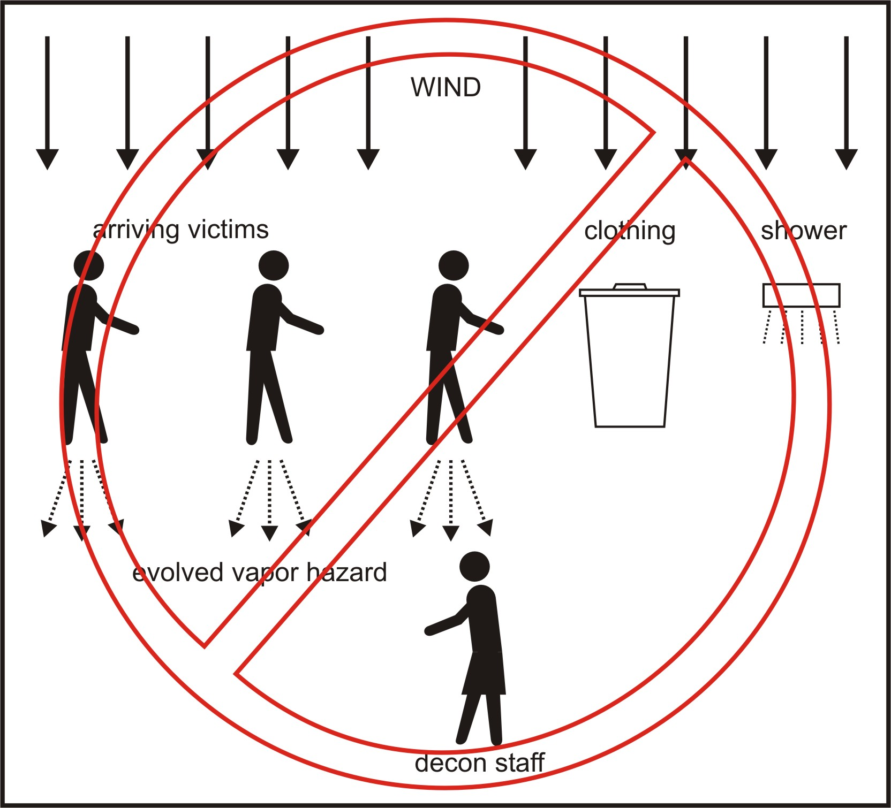

Slide 26
MODELING
Shape of dose distribution on victins
Temperature
Enclosures around staging
Ambient conditions
Serial vs synchronous arrival
Disrobing
Time since hot-zone / event
Clothing removal

Slide 27
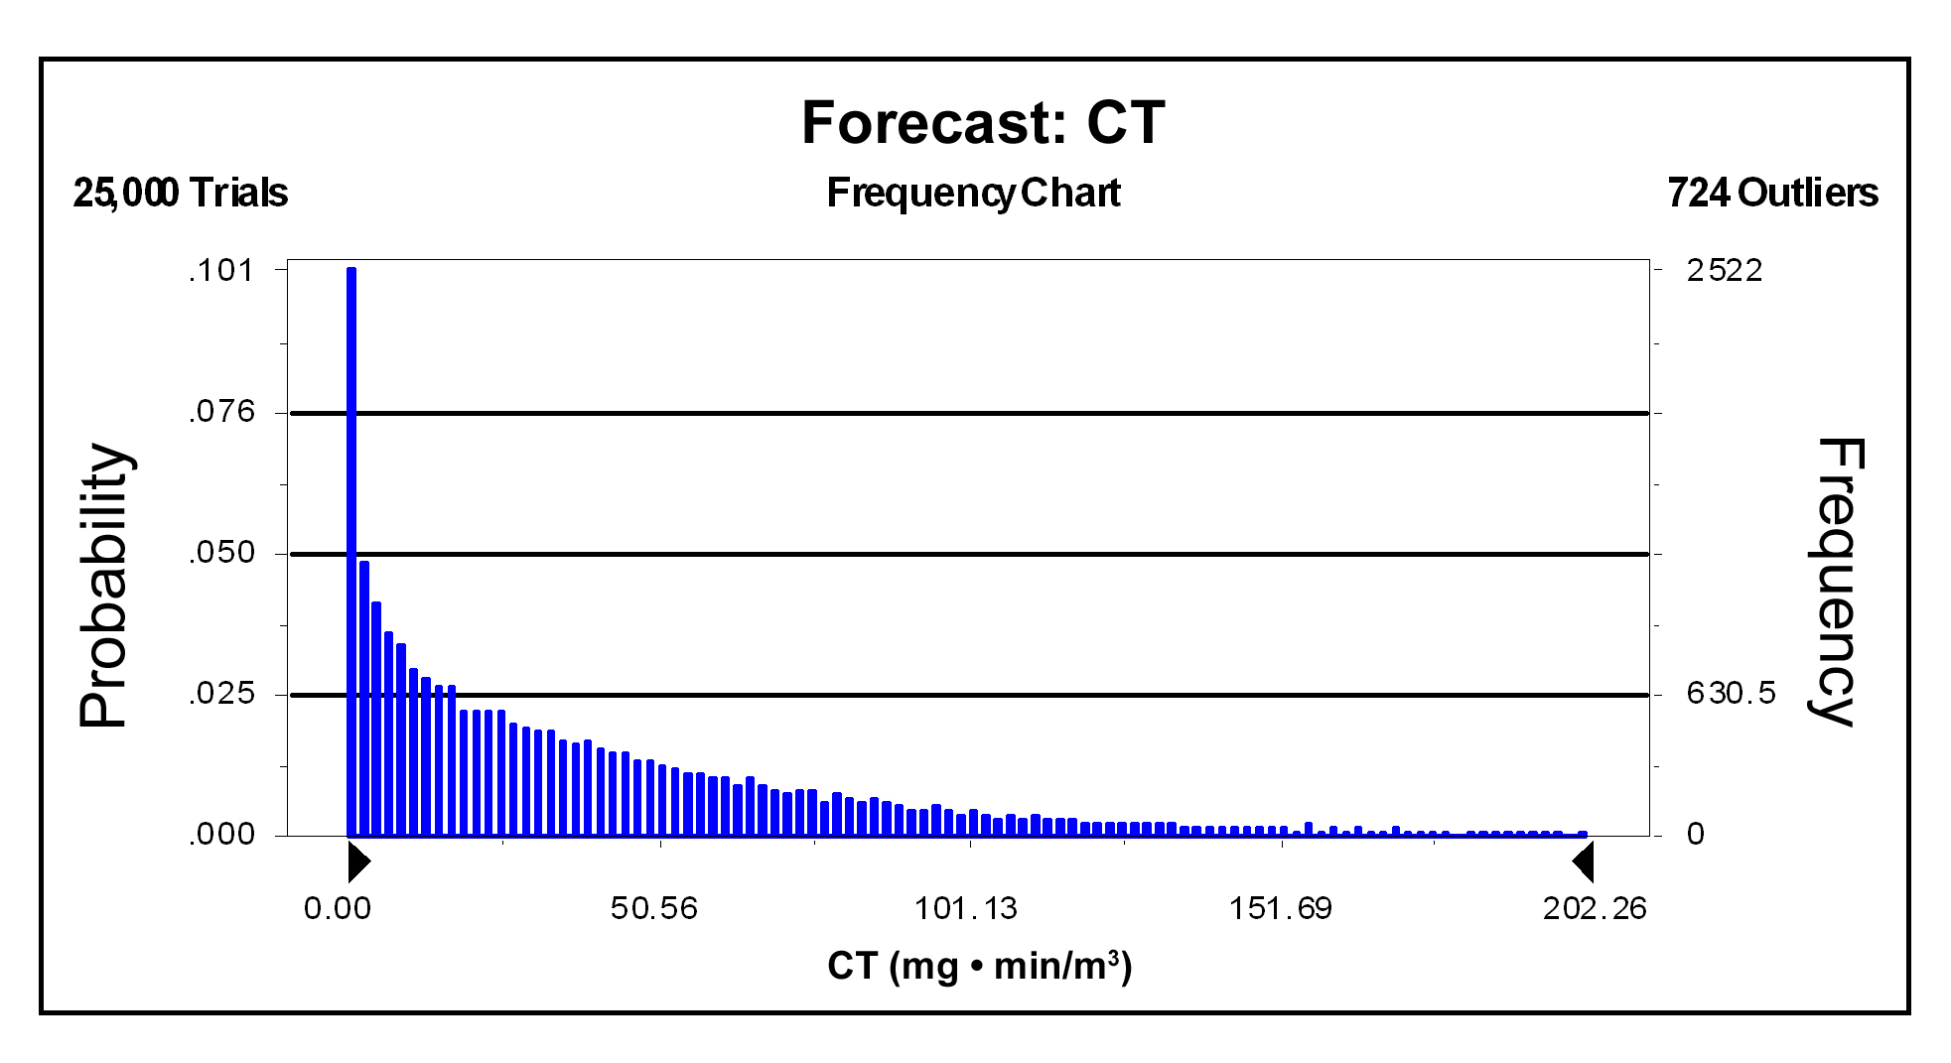
Monte Carlo forecast of total integrated exposure concentration (CT) of sarin when the mass deposition (m_{o}) is represented by a triangular distribution with a maximum value of 100 g and a likeliest value of 10 g

Slide 28
CONCLUSIONS:
Primary determinants of exposure
  Time since exposure
  Vapor pressure of agent
  Clothing removal
Secondary contributors
  Persistent sources (clothing storage, shower run-off, )
Unimportant
  shape of distribution
Protection
  PF of 500 brings internal concentrations below 2.1 mg*min/m³ (new NIOSH APR standard)
  Worst case (no clothing removal, unfavorable wind directions, …) leads to over-exposure of 2% of population

Slide 29
RECOMMENDATIONS
National
EMT triage / algorithms for treatment (Mark I, CN⁻)
AEPC
Clothing removal before transport
Local
  Medical surveillance (no susceptibility testing)
  Heat illness protocols
  Site planning / lay-out / secondary exposure control
  Level C ppe ensembles (PF ~ 1000: PAPR)

Slide 30
OUTSIDE (non-VHA) GROUP MEMBERS
Paul Fedele, PhD - Physicist, ECBC/SBC-COM
Paul Lioy, PhD - Exposure assessment EOSHI, UMDMJ/Rutgers
Panos Georgopoulos, PhD - Exposure modeling EOSHI, UMDMJ/Rutgers
Jack Longmire, MD, MPH - Occupational Medicine, OSHA
Meldoy Sands, MS – Health Care Enforcement, OSHA
Cynthia Duffield, MS, CIH - Exposure assessment, OSHA
Scott Deitchmann, MD, MPH - Occupational Medicine, NIOSH

Slide 31
VHA GROUP MEMBERS
Occupational and Environmental Health Strategic Healthcare Group
  Michael Hodgson, MD, MPH
  Mark Brown, Ph.D.

