Slide 1
Update on Business Methods
for the
Business Methods Partnership Meeting
June 19, 2007
by
Wynn W. Coggins
Group Director, Technology Center 3600
wynn.coggins@uspto.gov

Slide 2
Group 3620, 3690
Class 705
Wynn Coggins – Director 3620, 3690 (Business Methods)
3620 Workgroup
AU 3621 - Business Cryptography, Andrew Fischer, SPE
AU 3622 - Incentive Programs/Coupons, Eric Stamber, SPE
AU 3623 - Operations Research/Voting, Tariq Hafiz, SPE
AU 3625 - E-shopping, Jeffrey Smith, SPE
AU 3626 - Health Care/Insurance, Joseph Thomas, SPE (Luke Gilligan acting)
AU 3627 - Point-of-Sale/Inventory/Accounting, F. Ryan Zeender, SPE
AU 3628 - Cost/Price, Reservations, Transportation John Hayes, SPE
AU 3629 – Business Processing, John Weiss, SPE

Slide 3
Group 3620, 3690
Class 705
Wynn Coggins – Director 3620, 3690 (Business Methods)
3690 Workgroup (Finance and Banking)
AU 3691 - Finance & Banking, Alexander Kalinowski, SPE
AU 3692 - Finance & Banking, Vacant (James (Jay) Kramer, SPE, Acting)
AU 3693 - Finance & Banking, James (Jay) Kramer, SPE
AU 3694 - Finance & Banking, James Trammell, SPE

Slide 4
Search Experts in Class 705
3620 Workgroup
705/50-79 AU 3621 Kambiz Abdi 571-272-6702 KNX 5A59
705/14 AU 3622 Yehdega Retta 571-272-6723 KNX 5D79
705/7-12 AU 3623 C. Michelle Tarae 571-272-6727 KNX 5A05
705/ 26,27 AU 3625 Matthew Gart 571-272-3955 KNX 5D01
705/2-4 AU 3626 C. Luke Gilligan 571-272-6770 KNX 5A15
705/15-25,28-34 AU 3627 Michael Cuff 571-272-6778 KNX 5D29
705/5-6,13,400-418 AU 3628 Thomas Dixon 571-272-6803 KNX 5D21
705/1,80,500 AU 3629 Janice Mooneyham 571-272-6805 KNX 5D89

Slide 5
Search Experts in Class 705
3690 Workgroup (Finance and Banking)
705/35-45 AU 3691 Stefanos Karmis 571-272-6744 KNX 5D34
705/35-45 AU 3692 Narayanswamy Subramanian 571-272-6751 KNX 5A81
705/35-45 AU 3693 Jagdish Patel 571-272-6748 KNX 5D69
705/35-45 AU 3694 Susanna Meinecke-Diaz 571-272-6733 KNX 5A79

Slide 6
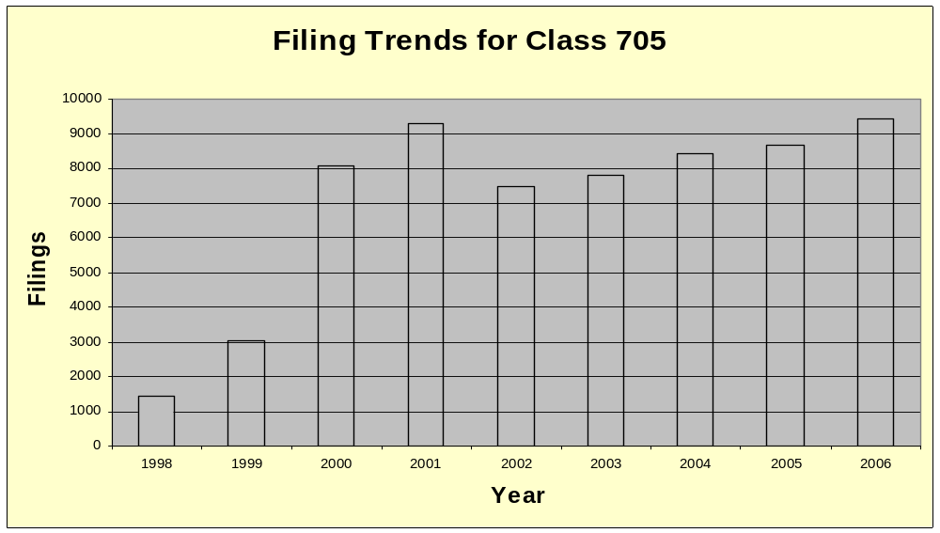

Filing Trends in
Class 705
Note: Filings in FY 2000-2001 indicate response to the internet “bubble”.
Notes:
The number of applications filed in the business method's area for each year from 1998 to 2006.

Slide 7
Pendency in Class 705 (At Mid-year 2007)
Pendency to First Action = 44 months
Pendency to Issue/Abandonment = 54 months

Slide 8
Allowance Rate Trends in Class 705
FY 2001 = 45%
FY 2002 = 44%
FY 2003 = 16%
FY 2004 = 11%
FY 2005 = 11%
FY 2006 = 19%
at mid year 2007 = 20%

Slide 9
Allowance Rate Trends in Class 705
Note: an increase in the allowance rate from FY 2004 to mid year 2007 is significant.
  We have gotten through the majority of the “bubble” cases that were filed in FY 2000 that contained very broad claims that were not allowable.
  The cases the examiners are now working on have noticeably narrower claims as a whole and we expect the allowance rate to continue to rise as a result.

Slide 10
Assignees for Patent Grants in Class 705 (2001-2005)
IBM = 137
PITNEY-BOWES = 90
NCR = 49
WALKER DIGITAL = 49
HITACHI = 37
FUJITSU = 32
MATSUSHITA ELECTRIC = 25
SONY = 24
CONTENTGUARD= 22
FRANCOTYP-POSTALIA = 22

Slide 11
Examiner Growth
Year FY ‘01 FY ’02 FY ’03 FY ‘04 FY ’05 FY ’06_ FY_’07*
Number of
Examiners 77 125 110 116 133 147 197
Patents 433 492 495 283 710 1,191 714
Issued
Allowance 45% 44% 16% 11% 11% 19% 20%
Rate
* FY’07 is at Mid Year
Notes:
For each year from 2001 to 2007:
The number of examiners working in the business method's area each year
The number of patents the business method's area granted each year and the corresponding allowance rate for that year.

Slide 12
Planned Growth in the Finance Arts
We added two new finance art units in the beginning of FY 2007. We currently have 4 finance art units.
We plan to double that and add 4 new finance art units in FY 2008 for a total of 8 art units.
  In the Finance Arts, we will increase from 48 examiners in beginning of FY ‘07 to 100 examiners by the end of FY ‘07.

Slide 13
Business Methods Web Site http://www.uspto.gov/web/menu/pbmethod/
Examples of what is posted:
Federal Register Notice requesting public input on NPL searching
Overview of Interim Guidelines for Subject Matter Eligibility
103 rejection examples
Class 705 white paper, core databases and classification definitions
Class 705 manager contacts list
March 2000 Director Initiatives
Revised MPEP 2106 – Examination guidelines for business methods
The paper “Successfully Preparing and Prosecuting a Business Method patent Application”
Thank you to our industry training volunteers

Slide 14
Quality
Enhanced Technical Training
  We have worked aggressively to identify examiner educational needs in the business method areas, and we have solicited Industry to provide technical training on business method-related topics. Examples of our recent participating organizations:
    ABA Section of Taxation
    ABA Section of Real Property, Probate, and Trust
    New York State Bar Tax Section
    IRS
    CheckFree
    Travelers Insurance
    The Federal Reserve
    Sensory Logic
    Microsoft

Slide 15
Quality
Enhanced Technical Training (cont.)
  We have communicated areas of training needs with partnership organizations.
  We encourage you to help us identify prior art.
  We have expanded the after-hours technical training program to include business related courses.
    Examiners can take classes in topics like finance, insurance, tax, and operations research.
    Examiners can ultimately achieve their MBA.

Slide 16
Quality
We have developed in-house training specific to Business methods. Examples:
  Improving skills in identifying patentable subject matter.
  Restriction training with specific examples.
  Board of Patent Appeals and Interferences (BPAI) common red flags.
  Claim interpretation.
  103 topics e.g. refresher on the Graham v. John Deere analysis.
  Search techniques and using the 705 search template.

Slide 17
Quality – Improving How We Get Prior Art to the Examiners
Examiner’s Electronic Digest
  Examiners can submit art for scanning into this database for others to search.
NPL Webpage
  Business methods has it’s own NPL webpage that is a collection of links specific to the technology of business methods.
    Links include databases (Dialog, ProQuest etc.) websites, daily newspapers, dictionaries, books and journals.
    Recommended internet sites to search.
    Web reference tools.
      i.e. the Wayback machine which provides a mechanism to date web sites

Slide 18
Quality – Improving How We Get Prior Art to the Examiners
Text search strategy tool which provides:
  Thesaurus and like terms tool
    i.e. input “financial instruments”; output = “stocks, bonds, futures”
    Helpful for examiners to identify known and used terms of art and broaden their search
  3000+ business/computer terms for text searching have been loaded.
  It can be dynamically updated through direct examiner input.

Slide 19
Quality – Improving How We Get Prior Art to the Examiners
A frequently used patents database has been developed.
  It has identified and documented for reference:
    Foundational patents
    Good overview patents
    Ground breaking patents
    State of the art patents

Slide 20
Prior Art
The USPTO is always looking for ways to ensure that examiners have the best prior art as early as possible in the examination process. Our data shows that when examiners have the right art in front of them, they make the right decisions.

Slide 21
We Need Your Help!
We need industry input on prior art resources. Let us know about:
  Databases
  Books, Technical Reports, and Conference Proceedings, Journals
  Web-based Resources

Slide 22
Quality
21st Century Strategic Plan Quality initiatives.
  In Process reviews of examiner actions.
    To help identify areas for improvement.
  Certification of examiners from the GS-12 to GS-13.
    Requires testing for promotion to the GS-13.
  Recertification of primary examiners.
    Through comprehensive work reviews.

Slide 23
Quality
Allowance Conferences and Appeal Conferences have become the focus.
  Results in better and immediate feedback to examiners.
    Case reviewed at time of allowance or appeal.

Slide 24
Pre-Appeal Brief Conferences
Pre-Appeal Brief Conferences
    Examiner, supervisor, and Appeal Practice Specialist participate.
    Formal review before the appeal brief is filed.
      Allows applicant the opportunity to have rejections believed to be clearly wrong reviewed prior to the filing of an appeal brief.
        Potentially eliminating the cost of preparing appeal briefs through early recognition that an application is not ready for appeal.

Slide 25
Appeal Conferences
Appeal Conferences
    Examiner, supervisor, and Appeal Practice Specialist participate.
    Mandatory in all cases where an acceptable appeal brief has been filed.
    Substantive review of issues prior to forwarding appeal to the Board of Patent Appeals and Interferences (BPAI).
      Potential time savings in cases where issues can be resolved prior to forwarding to the BPAI.

Slide 26
Legal Update
USPTO’s interim 101 Guidelines are still operative
Ex Parte Bilski
  “Informative Opinion” issued 09/26/06
    The opinion is available at: www.USPTO.gov.
      Currently on Appeal to Federal Circuit
      USPTO’s Brief filed at CAFC June 13, 2007

Slide 27
Legal Update
  Ex Parte Bilski (continued)
    Non-machine implemented process claims appear to fail the transformation test.
      With data processing arts like business methods, the majority opinion in Bilski suggests that transformation does not occur in non-machine implemented processes claims, and that these claims would not qualify as subject matter eligible for patent protection under 35 USC 101.
    In the five member Board panel, four members expressly incorporate by reference the legal analysis of the concurring-in-part/dissenting-in-part opinion of Lundgren.
    Note however, the majority contrasts the Lundgren (concurrence/dissent) tests for statutory subject matter with the interim Guidelines although in this case both produce the same result.

Slide 28
Legal Update
Ex Parte Comiskey
  Board Decision Mailed Jan 24, 2006
  Available at: www.USPTO.gov
  Currently on Appeal to Federal Circuit
  One of the issues in Comiskey is “An invention that Depends on Utility for Positive Law, Rather than Laws of Nature, May be Outside the Scope of 101”.
    Under section 101, a claimed invention can only be patented if it is “useful”.
    “The utility requirement of [35 USC] 101 mandates that the invention be operable to achieve useful results.” In re Swartz, 232 F.3d 862, 863 (Fed. Cir. 2000).

Slide 29
Defense to Infringement
In the American Inventors Protection Act of 1999, Congress created a defense to infringement suits for those who had begun, and not abandoned, the commercial use of business methods that were reduced to practice more than a year before the filing date of a patent on the business method by another.
  This defense alone does not invalidate the patent itself.
  We know of no decisions on the “first inventor defense”.

Slide 30
Hiring Pilot For the Finance Art Units
The USPTO currently has a proposal before the Office of Personnel Management that would allow the USPTO to pilot hiring patent examiners with specific backgrounds in finance, tax and insurance.
This is an important initiative that would allow us to hire outside the current OPM guidelines which require a science or engineering background to qualify as an examiner.

Slide 31
Specialized Education of Finance Area Examiners
We currently have 68 examiners working in the finance arts of business methods.
We will add 37 more examiners in the area by the end of FY '07.
Within the current staff, 1 examiner holds a PhD in finance and is a past associate professor of finance at the Univ. of Maryland.
  31 examiners have either an MBA or a masters in Finance, 11 examiners have a law degree, 1 examiner has a Masters in Economics, and 1 examiner has an undergraduate degree in finance.

Slide 32
Tax Strategy Patents
Recently, subclass 36T in Class 705 has been established and dedicated to tax strategies.
We have identified 60 issued patents related to tax strategy. Further, 86 published applications, not yet examined, relate to tax strategy.
This is a very small area of business methods.
  To put it in perspective, over 9,000 applications were filed last year in business methods, while only approximately 100 patents and patent publications exist in the tax strategy area to date.

Slide 33
Tax Strategy Patents:
Current Pendency
The average pendency to first office action in the tax strategy area is consistent with all other applications filed in business methods.
  Pendency to First Action = 44 month
  Pendency to Issue/Abandonment = 54 months

Slide 34
Tax Strategy Patents:
USPTO Outreach Efforts
To gain knowledge and improve our examination of applications relating to tax strategies, the USPTO is working on developing two significant relationships.
  The USPTO has partnered with the IRS and is currently developing a partnership with the American Bar Association's Section of Taxation (ABA) to pursue training and information exchange opportunities.
    The partnership with the IRS has resulted in training by the IRS for our finance examiners on financial products, wealth transfer, and pensions.

Slide 35
Thank You
Notes:
United States Patent and Trademark Seal

