Slide 1


ELECTRONICS STEWARDSHIP:
Multi-Site Success within the
U.S. Drug Enforcement Administration EMS Programs
Marv Howell
and
Jo Luke
www.asincorp.com
410-312-3535

Slide 2
ELECTRONICS STEWARDSHIP PRESENTATION OVERVIEW
Model
Formula
P-D-C-A Wheel
Process
Best Practices
Myths
Awards Achieved
Questions

Slide 3
ELECTRONICS STEWARDSHIP MODEL
Drug Enforcement Administration (DEA) sites with active and successful Environmental Management Systems (EMS) elected to incorporate the Federal Electronics Challenge (FEC) into their programs as a means to achieve Electronics Stewardship.

Slide 4
ELECTRONICS STEWARDSHIP MODEL (con’t.)
EMS teams use the FEC awards (Bronze, Silver, & Gold) as:
  Motivation to complete EMS goals
  A means to achieve E.O. 13423 goals
  A measurement of progress

Slide 5

FORMULA FOR SUCCESS
DEA’s formula includes four phases:
  Understanding what it takes to achieve an award
  Doing what is needed to meet the requirements
  Checking and taking corrective action
  Completing annual report & award applications and submitting on time.

Slide 6
FORMULA FOR SUCCESS (con’t.)
1. Understanding what it takes to achieve an award
  Develop appropriate targets
  Understand what it takes to achieve Mandatory Activities (MA) & Optional Activities (OA)
  Develop a plan

Slide 7
FORMULA FOR SUCCESS (con’t.)
2. Doing what is needed to meet the requirements
  Incorporating requirements into the DEA EMS at each site.
  Complete and Submit Baseline Survey
  Accomplish MA’s & OA’s
Notes:
Share these goals with the site through e-mail and post on the EMS share drive found at each site.
Post findings of the Baseline Survey to the share drive to show employees where improvement can be made.
Keep proper records and documentation necessary for awards submittal. Incorporating the FEC into EMS helps when documenting work accomplished.

Slide 8
FORMULA FOR SUCCESS (con’t.)
3. Checking and Taking Corrective Action
  Project leader reviews
  EMS team reviews
  Management reviews

Slide 9
FORMULA FOR SUCCESS (con’t.)
4. Annual Report & Award Application
  Ensure they are on-time and complete
  Clear timeline and requirements
  Cover all essentials
  Do not be late

Slide 10
P-D-C-A Wheel
EMS Teams use the P-D-C-A Wheel for Continuous Improvement
P-D-C-A Wheel integrates nicely into the FEC award requirements
ACT
PLAN
CHECK
DO

Slide 11
P-D-C-A WHEEL USED FOR FEC IMPLEMENTATION
Become an FEC Partner
Future Plans
Follow EO Goals
Complete & Submit
Annual Report & Award Application
Baseline Survey
Select Life Cycle
Identify Mandatory
Activities (MA’s)
Corrective
Action(s)
ACT
PLAN
Select Optional
Activities (OA’s)
Project Manager
Reviews
CHECK
DO
Develop Plan to
Achieve MA’s & OA’s
EMS Team Reviews
Implement Plan
Management Reviews
Turn It For Continuous Improvement

Slide 12
FEC
AWARD
PYRAMID
Submit Annual Report and Award Application
EO 13423
Goals
Employee Involvement
Management Commitment
FEC
Award
Optional Activities
(Lifecycles)
Mandatory Activities (Lifecycles)
Baseline Survey
Mentoring

Slide 13
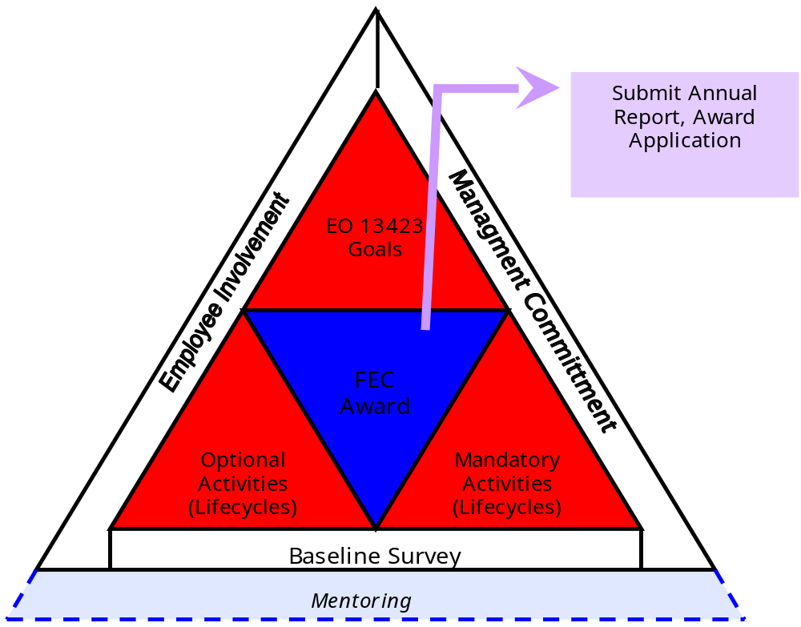
FEC
AWARD
PYRAMID

Slide 14
FEC
AWARD
PYRAMID
EO 13423
Goals
Employee Involvement
Award Application
Annual Report
Management Commitment
FEC AWARD
Optional Activities
(Lifecycles)
Mandatory Activities
(Lifecycles)
Baseline Survey
Mentoring
Go for the Gold!

Slide 15
OUR PROCESS
Deploy policy
Establish a baseline & set goals
Identify Mandatory Activities we can achieve
Select appropriate number of Optional Activities necessary for award level chosen

Slide 16
OUR PROCESS (con’t.)
Develop action plans
Implement
Monitor & take action

Slide 17

OUR PROCESS - POLICY
Develop a Policy Statement
Obtain Management Approval
Capture Policy in an Appropriate Format

Slide 18

OUR PROCESS - SET GOALS
Establish a baseline by completing the Baseline Survey
  Assess what your capabilities are
Use Mandatory Activities and Optional Activities to help meet EO 13423 and facility goals
Register your site and submit Baseline Survey (if necessary)

Slide 19

OUR PROCESS - SELECT MANDATORY ACTIVITIES
Review Life Cycles and their required Mandatory Activities before selecting targets
Give priority to activities which the site believes they can achieve
Next, select activities which will add the most value to the facility

Slide 20

OUR PROCESS - SELECT OPTIONAL ACTIVITIES
Review the Life Cycles selected to determine required amount of Optional Activities needed
  One Life Cycle selected = Three OA’s
  Two Life Cycles selected = Six OA’s
  All Three Life Cycles selected = Nine OA’s plus mentoring activity
Do not duplicate

Slide 21

OUR PROCESS - DEVELOP ACTION PLANS & IMPLEMENT
Develop Action Plans
  Who is going to do what, when & where?
  Gantt Chart Useful
  An Environmental Management Plan (EMP) is helpful too.
Execute plan and manage implementation

Slide 22

OUR PROCESS - MONITOR & TAKE ACTION
Track what is to be done
Determine whether activity and/or goal is on track or derailed
Take Corrective Action if activity and/or goal is not on track

Slide 23
BEST PRACTICES
Ensure Critical Factors Are Achieved
  Top Management is committed
  Inform all employees about FEC, what award the team is striving to achieve & how they can help
  Communicate progress
  Set policy for electronics stewardship and follow it

Slide 24
BEST PRACTICES (con’t.)
Ensure Critical Factors Are Achieved (con’t.)
  Develop & implement sound action plans that will achieve targeted mandatory and optional activities
  Review periodically and take action to keep on track
The Electronics Policy, Guidance or Memorandum should cover as many MA’s and OA’s as possible

Slide 25
BEST PRACTICES (con’t.)
Develop several FEC related presentations
  Share presentations with other agency sites seeking awards
  Present and/or distribute presentations to all employees (government and contract) at each site
  Presentation topics should include “Introduction To FEC”, “EPEAT”, “Energy Conservation & Power Management” and “Mentoring” (if going for the gold)

Slide 26
BEST PRACTICES (con’t.)
Never lose focus – the year flies by
Submit the Baseline Survey, Annual Report or Award Application documents on time
  Submitting these requirements late will result in an automatic award disqualification

Slide 27
7 FEC MYTHS
“FEC Award is not worth the effort”
“After a while you know all there is about FEC”
“FEC will become the single most important component of the EMS”
“You must always start at the bottom award level and work your way up to the next level” (Start with Bronze, up to Silver, and then Gold)

Slide 28
7 FEC MYTHS (con’t.)
“Mentoring is impossible”
“Mentoring takes too much time even if you could find someone to mentor”
“Energy Star and EPEAT computers do not have sufficient capabilities for our office environment”

Slide 29
AWARDS ACHIEVED
2007 Awards:
  Bronze
    Aviation Division, Aviation Operations Center, Fort Worth, TX

Slide 30

AWARDS ACHIEVED
2008 Awards:
  Silver
    Aviation Division, Aviation Operations Center, Fort Worth, TX
    North Central Laboratory, Chicago, IL
    Southeast Laboratory, Miami, FL

Slide 31
AWARDS ACHIEVED
2008 Awards:
  Bronze
    DEA Headquarters, Arlington, VA
    Dallas Field Division, Dallas, TX
    El Paso Intelligence Center (EPIC), El Paso, TX
    Mid-Atlantic Laboratory, Largo, MD
    Northeast Laboratory, New York, NY
    South Central Laboratory, Dallas, TX
    Southwest Laboratory, Vista, CA
    Western Laboratory, San Francisco, CA

Slide 32
EASTERN DEA SITES
CONTACT INFORMATION
Headquarters, Arlington, VA
  John Cunningham - 202-307-9629
  John.E.Cunningham@usdoj.gov
Mid-Atlantic Laboratory, Largo, MD
  James Malone – 301-583-3250 James.V.Malone@usdoj.gov
Northeast Laboratory, New York, NY
  Ann Marie O’Neill – 212-620-4926 Ann.Marie.M.ONeill@usdoj.gov
Southeast Laboratory, Miami, FL
  Jeannette Perr - 305-994-5174 Jeannette.M.Perr@usdoj.gov

Slide 33
WESTERN DEA SITES
CONTACT INFORMATION
Dallas Field Division, Dallas, TX
  Armando Salinas – 214-366-6900 Armando.Salinas@usdoj.gov
Southwest Laboratory, Vista, CA
  David Greenberg – 760-597-7900 David.E.Greenberg@usdoj.gov
South Central Laboratory, Dallas, TX
  Robert Marshall – 972-559-7957 Robert.M.Marshall@usdoj.gov
Western Laboratory, San Francisco, CA
  Phyllis Quinn – 415-744-7051
  Phyllis.E.Quinn@usdoj.gov

Slide 34

QUESTIONS?
Marv Howell, Analytical Services, Inc.
  940-725-3109
  MHowellQMT@aol.com
Jo Luke, Analytical Services, Inc.
  972-559-7967
  jluke@asincorp.com –or– jo.l.luke@usdoj.gov
www.asincorp.com
410-312-3535

