Slide 1
Seasonal Rainfall Forecasts
February – April 2008

Slide 2
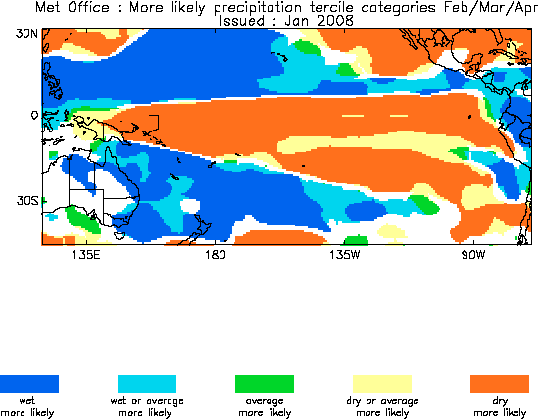
UKMO Seasonal Forecasts
http://www.metoffice.gov.uk/research/seasonal/monthly_forecasts/single_terce_cat2.html
Notes:
Username UKMO, password of7tor – choose region “Pacific”
http://www.metoffice.gov.uk/research/seasonal/monthly_nms/double_2004.html

Slide 3
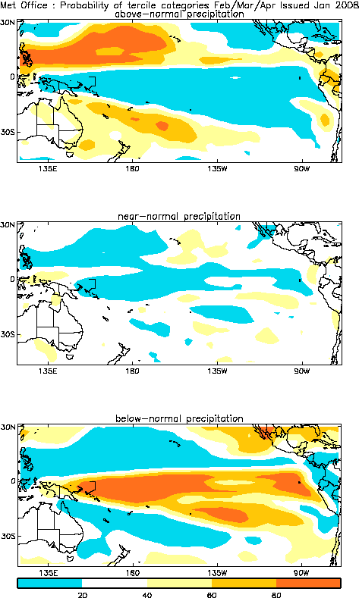
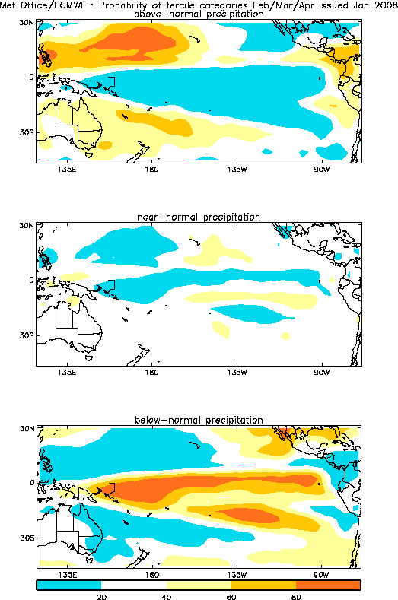
UKMO and UKMO/EC Seasonal Forecasts

Slide 4
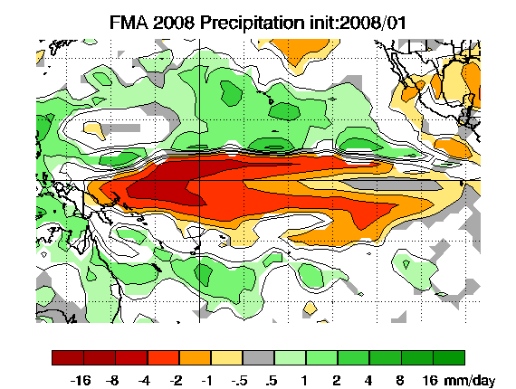
NASA NSIPP Seasonal Forecasts
The figure above is the precipitation anomaly from the 18 member ensemble mean. Anomalies are referenced to the 1980-1999 model climatology. Units are mm/day.
Shaded values represent significance at the 95% confidence level of a two sided t-test.
http://gmao.gsfc.nasa.gov/cgi-bin/products/climateforecasts/index.cgi
Notes:
http://nsipp.gsfc.nasa.gov/exptlpreds/latest/tier_2/IRI/latest_IRI_page1.cgi?month=December&year=2004&section=1

Slide 5
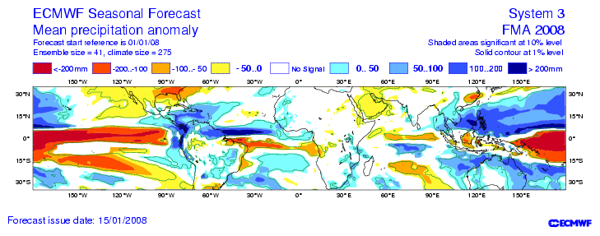
ECMWF: Mean precipitation anomaly
http://www.ecmwf.int/products/forecasts/d/charts/seasonal/forecast/seasonal_range_forecast/group_public/seasonal_charts_public_rain!2m%20temperature!1%20month!Tropics!200707!tercile%20summary/

Slide 6
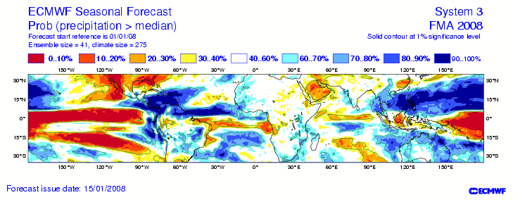
ECMWF: Probability of exceeding median

Slide 7
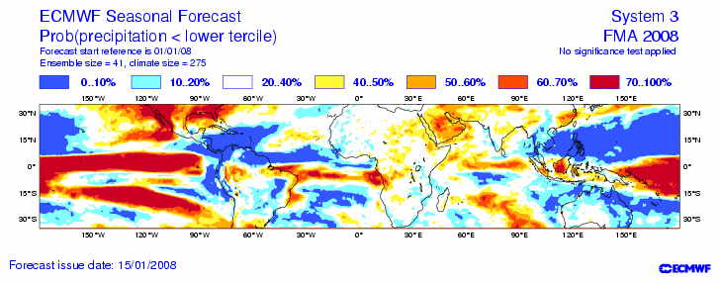
ECMWF: Probability lower tercile

Slide 8
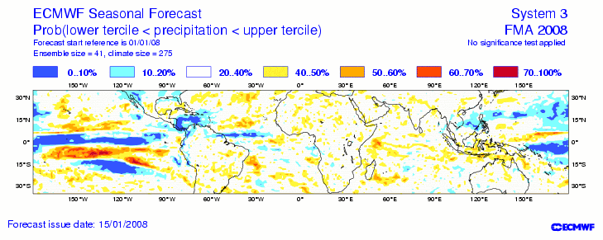
ECMWF: Probability middle tercile

Slide 9
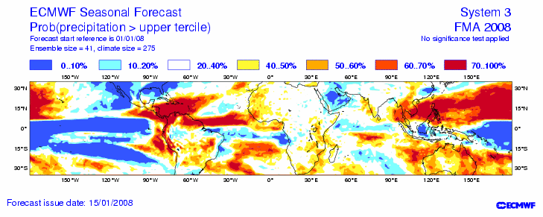
ECMWF: Probability upper tercile

Slide 10
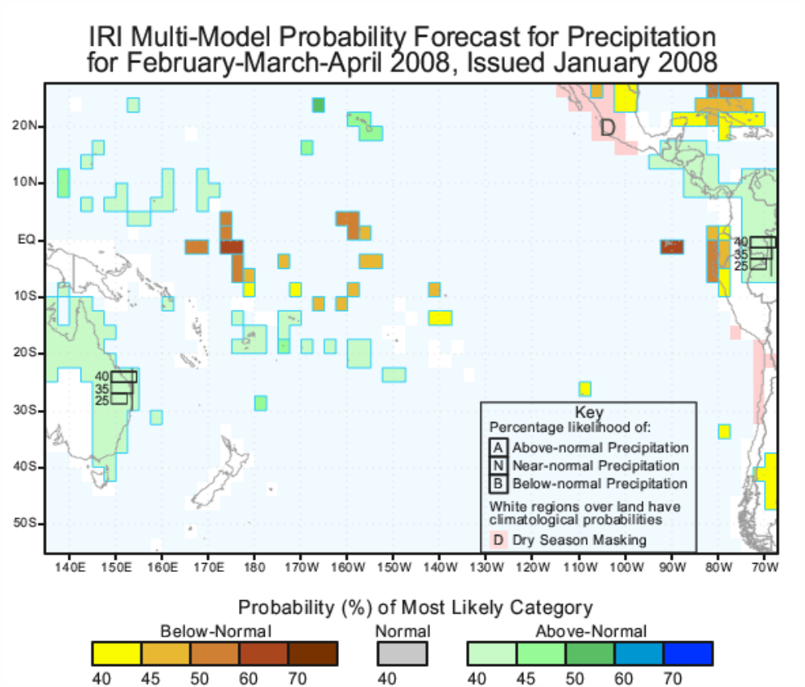
IRICP rainfall outlook
http://iri.ldeo.columbia.edu/climate/forecast//net_asmt/
Notes:
As in globalyyyymm.ppt, but for region “Pacific Islands”

Slide 11
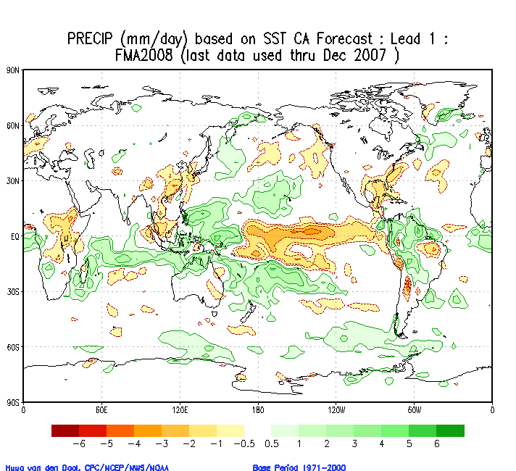
NCEP CA Forecast for Tropical Pacific
Acknowledgement: Dr Luke He, NOAA
http://www.cpc.ncep.noaa.gov/pacdir/CA1.html

Slide 12
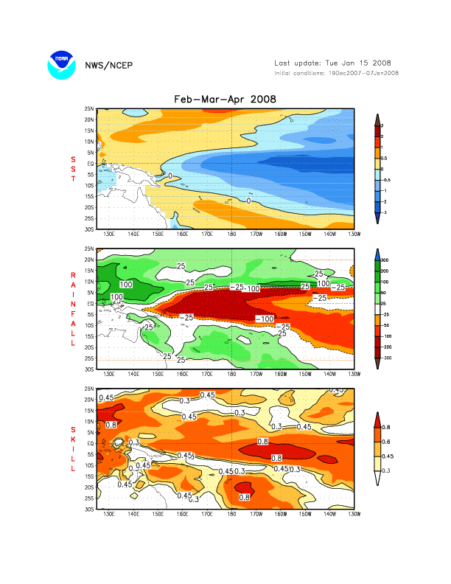
NCEP Coupled Model Forecast for Tropical Pacific
The upper panel shows tropical SST forcing for the AGCM integrations.
The second panel shows rainfall anomaly forecast.
The lower panel shows cross-validated skill (correlations corresponding to the rainfall forecast.
Acknowledgements: Dr Luke He and Dr Arun Kumar, NOAA
http://www.cpc.ncep.noaa.gov/pacdir/COU3.html

