Slide 1

ASSESSMENT OF THE IMPACT OF
DIRECT-TO-CONSUMER ADVERTISING OF PRESCRIPTION DRUGS ON CONSUMERS AND PRESCRIBERS
Petra Schultz, PharmD
Coordinator, Therapeutic Policy Management
Mayo Clinic/St. Luke’s Hospital
Jacksonville, Florida
Research Conducted:
SHANDS Jacksonville Medical Center
University of Florida
Health Science Center/Jacksonville

Slide 2
DIRECT-TO-CONSUMER (DTC)
ADVERTISING
Television
Radio
Print media

Slide 3
DTC ADVERTISING
Goals
  Patient education
  Promote product awareness
  Promote product sales
Potential Consequence
  Inappropriate medication use

Slide 4
DTC ADVERTISING
1996 spending estimated at $800 million
1998 spending estimated at $1.35 billion
$905 million spent in first six months of 1999

Slide 5
STUDY OBJECTIVES
Determine if DTC prescription drug advertisements were reaching SHANDS Jacksonville patients
Determine the impact of DTC advertising on patient demand
Determine the impact of DTC advertising on practitioner prescribing patterns

Slide 6

Research Site: SHANDS Jacksonville Medical Center

Slide 7
METHODS
Study Design
  Survey
Inclusion Criteria
  Adults > 18 years old
  Patient or prescriber in Internal Medicine or Family Medicine ambulatory clinics

Slide 8
METHODS
Procedures
  Patient surveys distributed at clinic visit
  Prescriber surveys distributed at noon conference and Grand Rounds

Slide 9
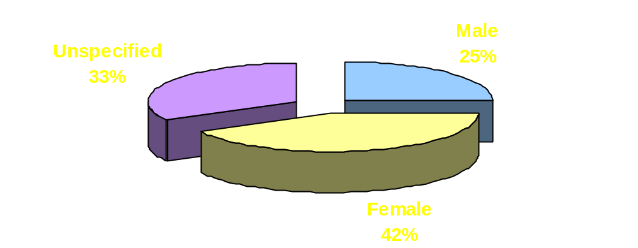
PATIENT DEMOGRAPHICS: GENDER
N = 65

Slide 10
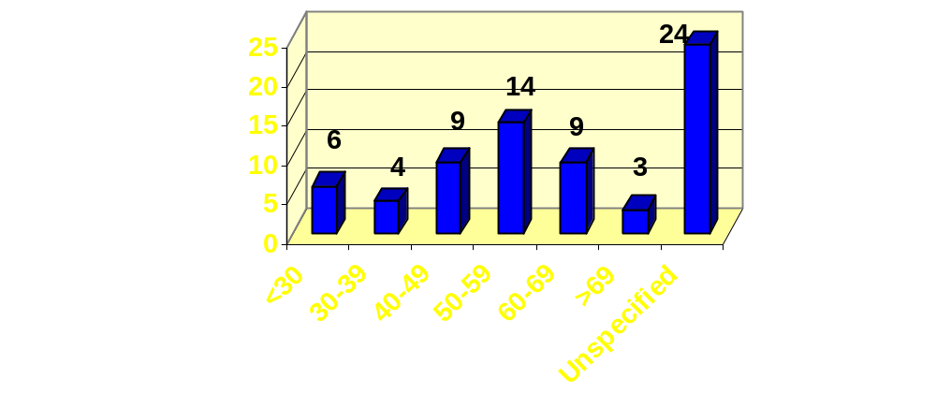
PATIENT DEMOGRAPHICS: AGE
N = 65

Slide 11
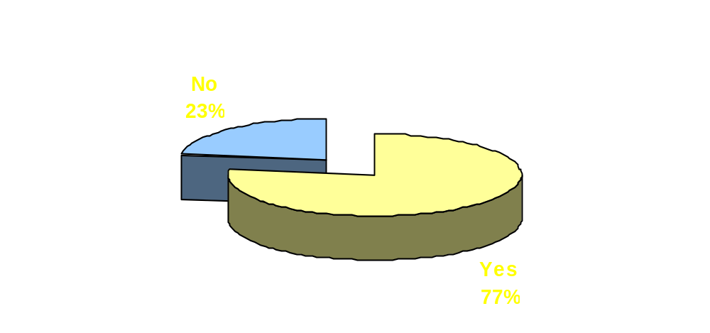
PATIENT RESULTS
Have you ever seen or heard any
advertisements for prescription medications?
N = 65

Slide 12
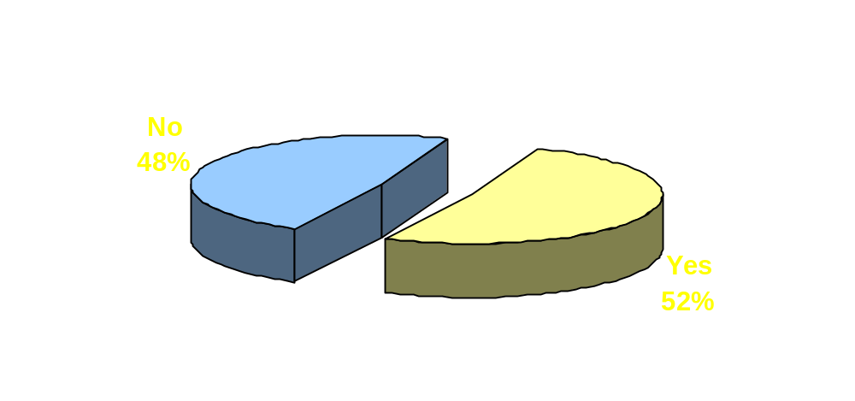
PATIENT RESULTS
Did the advertisement make you want to try
the medication?
N = 50

Slide 13
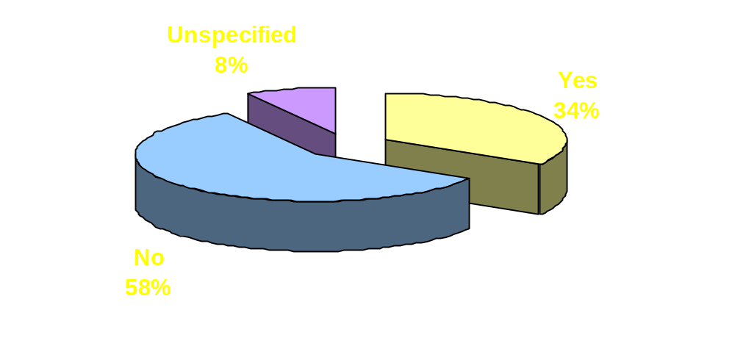
PATIENT RESULTS
Have you ever asked your doctor for a
prescription that you heard about through an
advertisement?
N = 50

Slide 14
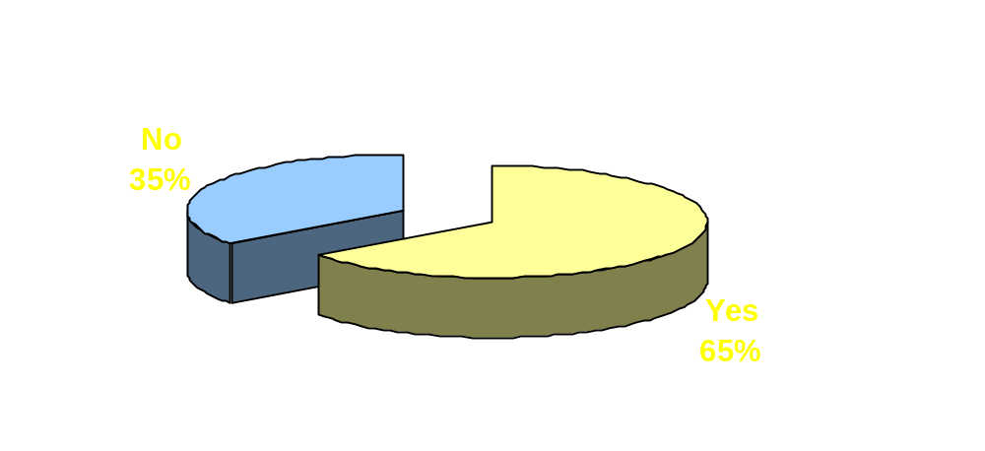
PATIENT RESULTS
Did your doctor give you a prescription?
N = 17

Slide 15
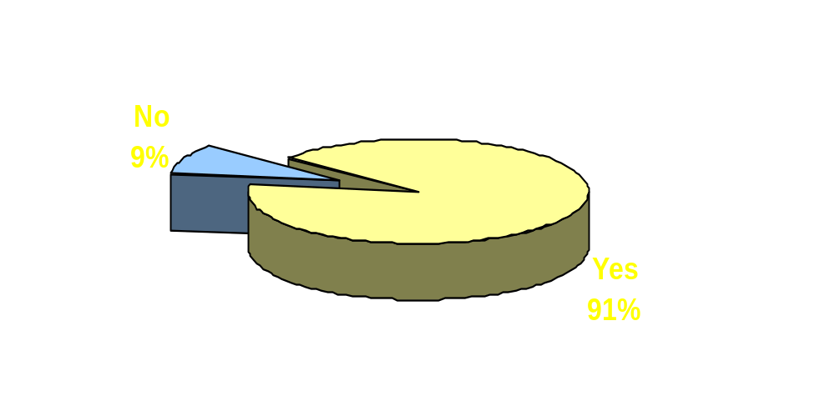
PATIENT RESULTS
Was the prescription for the medication that
you asked for?
N = 11

Slide 16
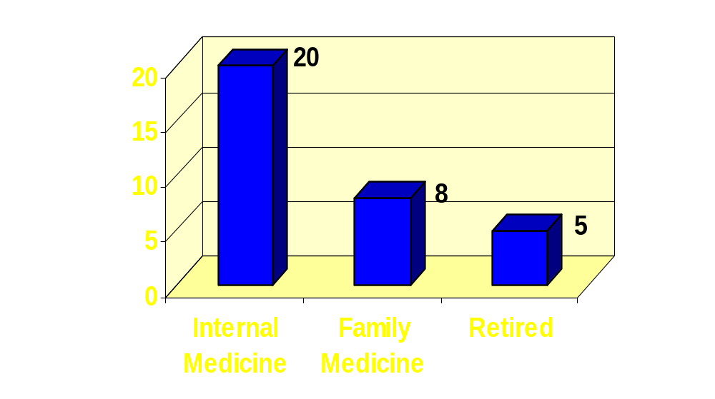
PRESCRIBER DEMOGRAPHICS: SERVICE
N = 33

Slide 17
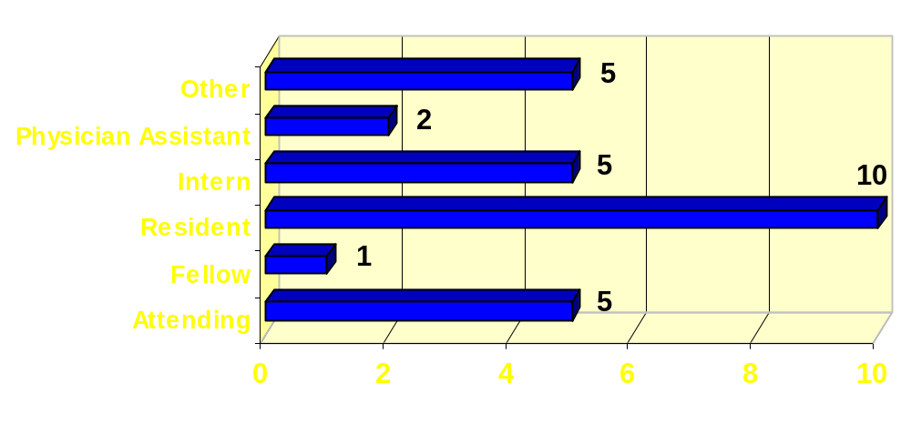
PRESCRIBER DEMOGRAPHICS: TITLE
N = 33

Slide 18
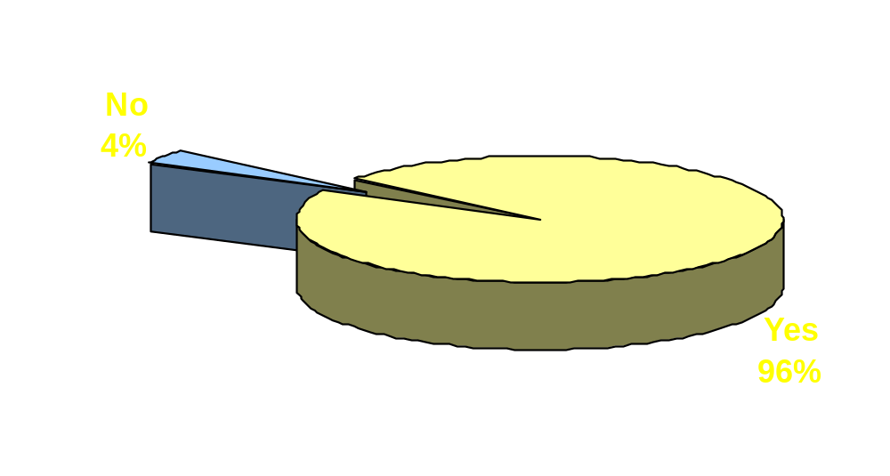
PRESCRIBER RESULTS
Have you ever seen or heard any direct-to consumer advertisements for prescription medications?
N = 28

Slide 19
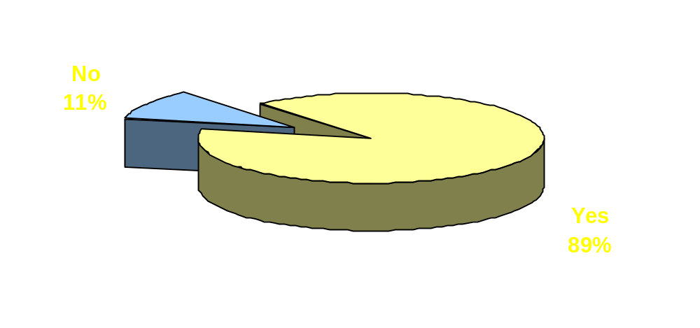
PRESCRIBER RESULTS
Have you ever had a patient ask you for a prescription medication based on an advertisement that they saw?
N = 28

Slide 20
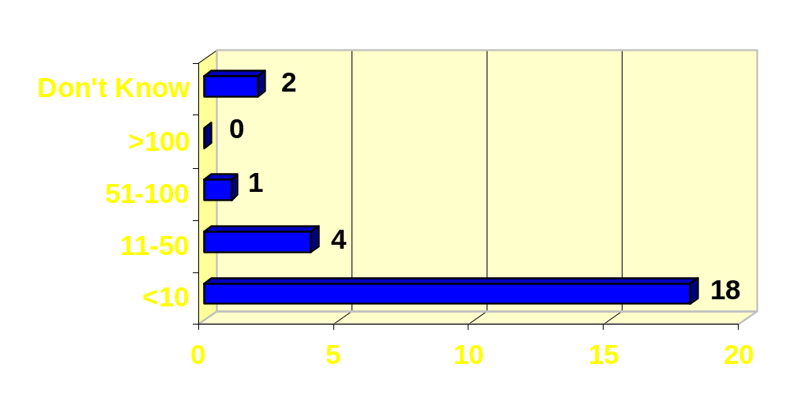
PRESCRIBER RESULTS
How many patients have asked you for a prescription based on an advertisement?

Slide 21
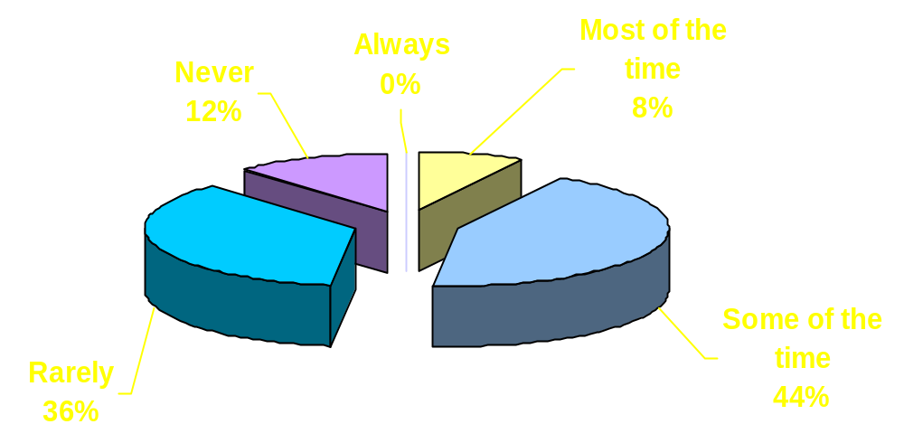
PRESCRIBER RESULTS
How often have you given a patient a prescription following a request?
N = 25

Slide 22
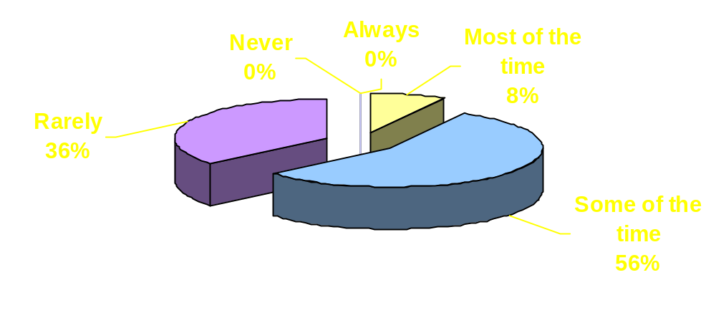
PRESCRIBER RESULTS
Would you have prescribed the medication anyway without the patient’s request?
N = 25

Slide 23
DISCUSSION
Majority of SHANDS Jacksonville patients exposed to DTC prescription drug advertising
Greater than half wanted to try a medication based on advertisement
Greater than one third asked for the medication

Slide 24
DISCUSSION
Most prescribers report being asked for a prescription based on an advertisement seen by a patient
Majority of prescribers report giving the prescription at least some of the time
Patient requests prompting prescribing

Slide 25
PHARMACIST’S ROLE
Provide objective drug information
Educate patients and other healthcare professionals
Promote appropriate and cost effective medication use

Slide 26
ASSESSMENT OF THE IMPACT OF
DIRECT-TO-CONSUMER ADVERTISING OF PRESCRIPTION DRUGS ON CONSUMERS AND PRESCRIBERS
Petra Schultz, PharmD
Coordinator, Therapeutic Policy Management
Mayo Clinic/St. Luke’s Hospital
Jacksonville, Florida
Research Conducted:
SHANDS Jacksonville Medical Center
University of Florida
Health Science Center/Jacksonville

