Slide 1



DoD Global Influenza Surveillance Program
Sentinel Site Surveillance at AFIOH
Sequence Analysis
And
Vaccine Effectiveness Overview
Luke T. Daum, PhD, Molecular Biologist
Angela Owens, MPH, Epidemiologist
Air Force Institute for Operational Health
Brooks City-Base, TX

Slide 2
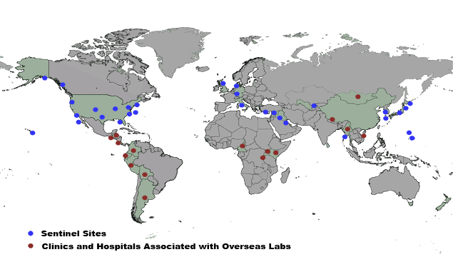
Sentinel Sites

Slide 3
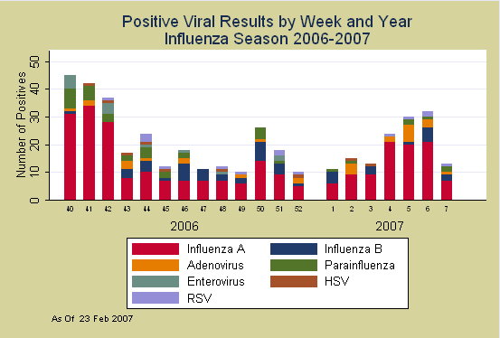
2006-2007 Season
(as of 23 Feb 07)
Influenza A: 266 (84.2%)
Influenza B: 50 (15.8%)
Notes:
We’ve processed about 1,200 specimens to date: 26% were lab-confirmed influenza (84% influenza A; 16% influenza B). Average of 26% of the total specimens received are positive for influenza by culture.

Slide 4
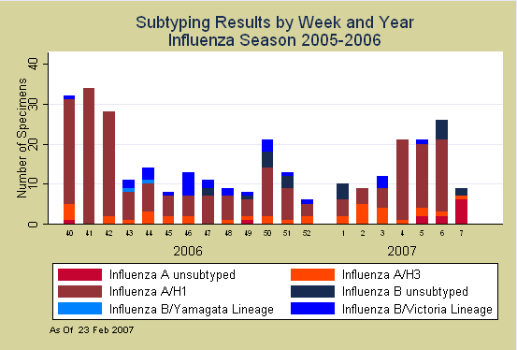
2006-2007 Season
(as of 23 Feb 07)
A(H1): 217 (85.4%) B/Victoria Lineage: 27 (93.1%)
A(H3): 37 (14.6%) B/Yamagata Lineage: 02 (06.9%)
Notes:
At this time, we’ve molecularly characterized 90% of the isolates. The majority of the influenza A were H1….(Luke)

Slide 5
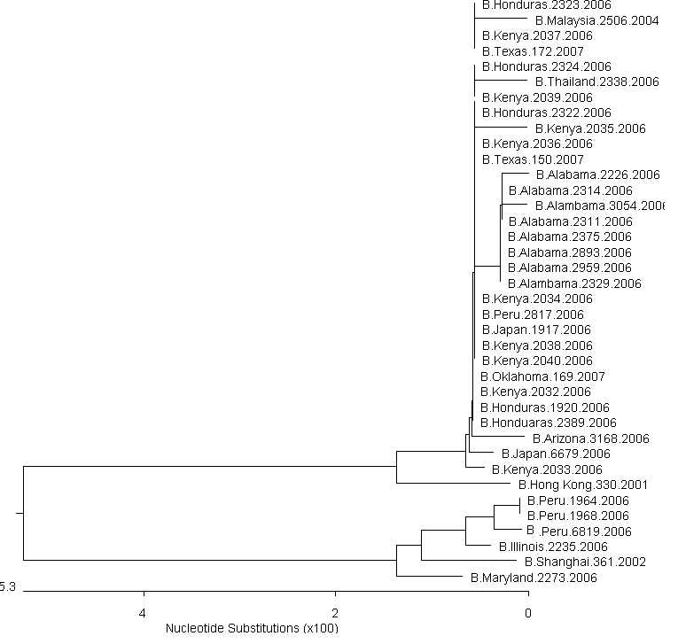
Influenza B Field Isolates
HA1 HA Phylogenetic Analysis
2006/07
HA1 Hemagglutinin of >40 globally obtained DoD strains
5 Strains (~9%) were Yamagata lineage: 2 U.S., 3 Peru
3 Peru’s collected in July/Aug 06, 2 U.S. in Sept/Oct 06
Majority were B/Victoria lineage
B/Malaysia sequence identity: 99.0-99.6%
B/Victoria lineage
B/Yamagata lineage

Slide 6
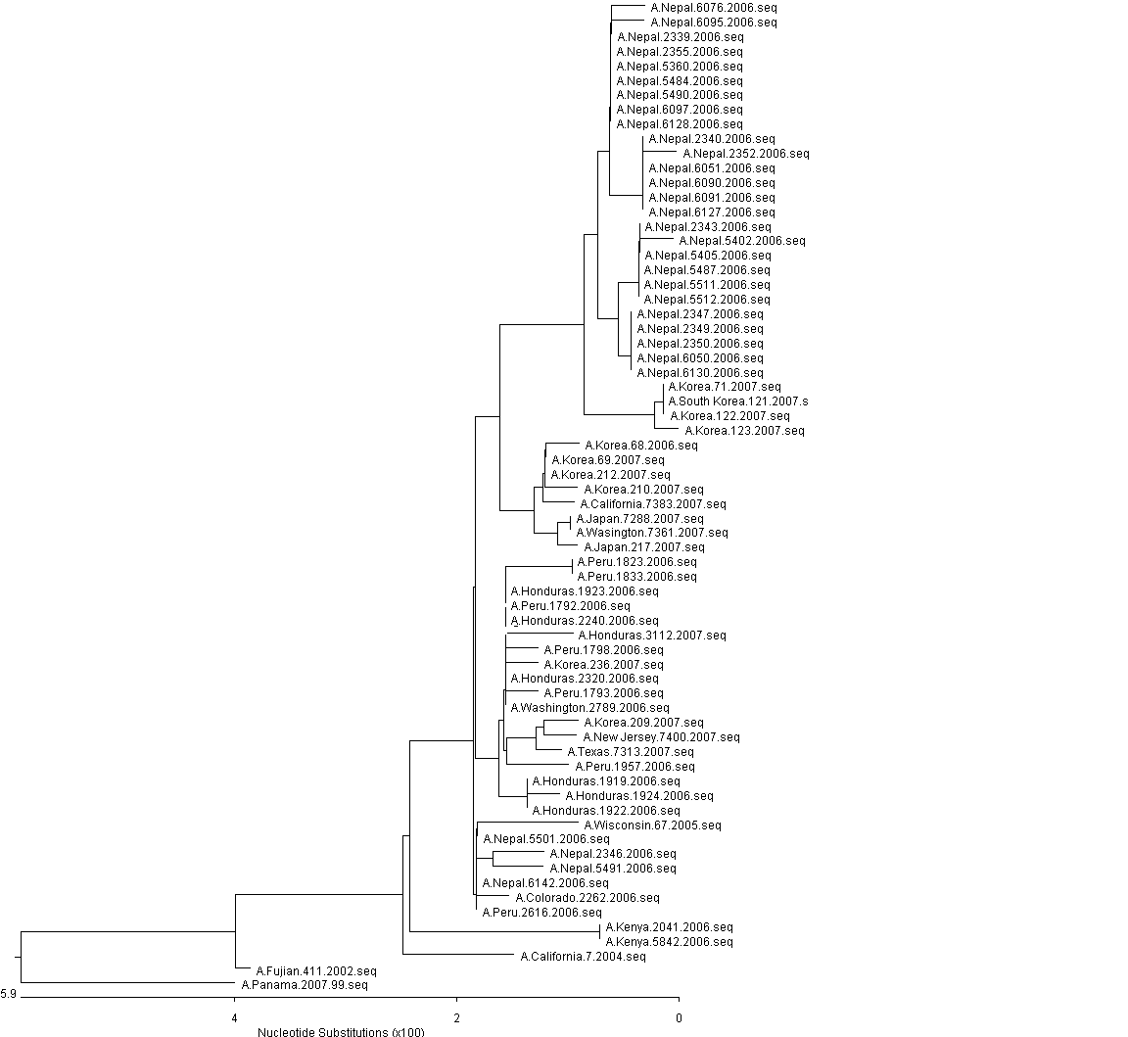
Influenza A (H3N2) Field Isolates
HA1 HA Phylogenetic Analysis
2006/07 Season
R142G
R142G
K173E
K173E
~50% of DoD isolates show mutation at
R142G
Isolates from this clade obtained from
Nepal, Korea, Japan, and the U.S.
Collected between July 2006 (Nepal) - Present (Washington,
Korea).

Slide 7
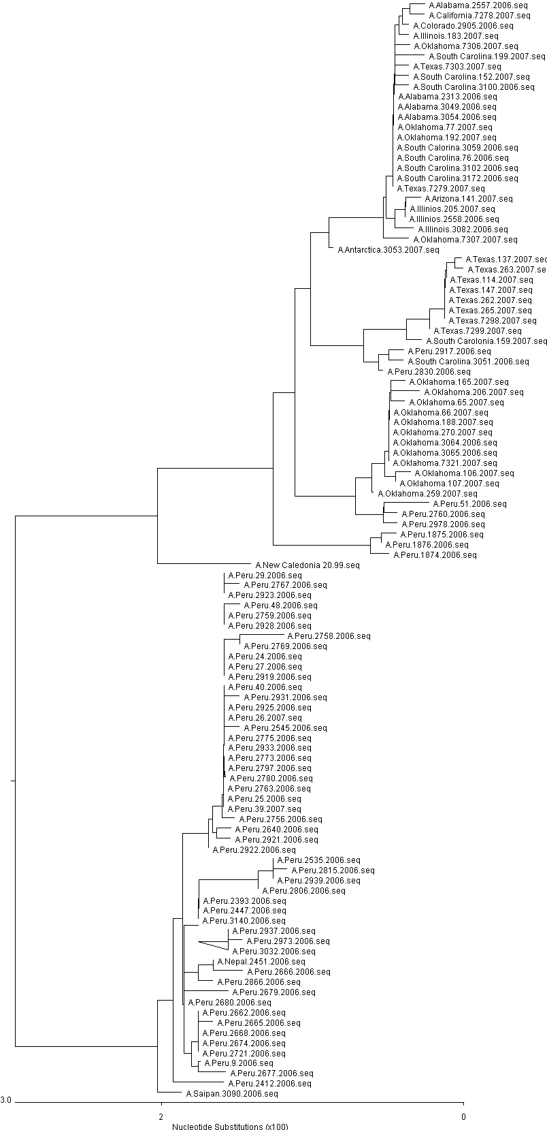
Influenza A (H1N1) Field Isolates
HA1 HA Phylogenetic Analysis
2006/07 Season
CLADE 1
Clade 1 isolates are from U.S., Peru, Antarctica.
HA is genetically similar to A/New Caledonia
vaccine strain (red box).
CLADE 2
Clade 2 isolates obtained from Peru, Nepal, and Saipan.
Genetically defined by several AA changes.
Many of these show reduced titers in CDC HI.

Slide 8
Vaccine Effectiveness
Descriptive Review - Preliminary
Period of Review
  01 October 2006 – 12 February 2007
Population
  US Military Treatment Facilities (MTFs)
Outcome
  Laboratory-confirmed influenza (viral culture)
Fully Vaccinated
  Vaccination date >14 days prior to clinic visit date
    Patients with vaccination date prior to August classified as unvaccinated
    Vaccination data gathered from Defense Enrollment Eligibility Reporting System (DEERS) and Influenza surveillance questionnaire

Slide 9
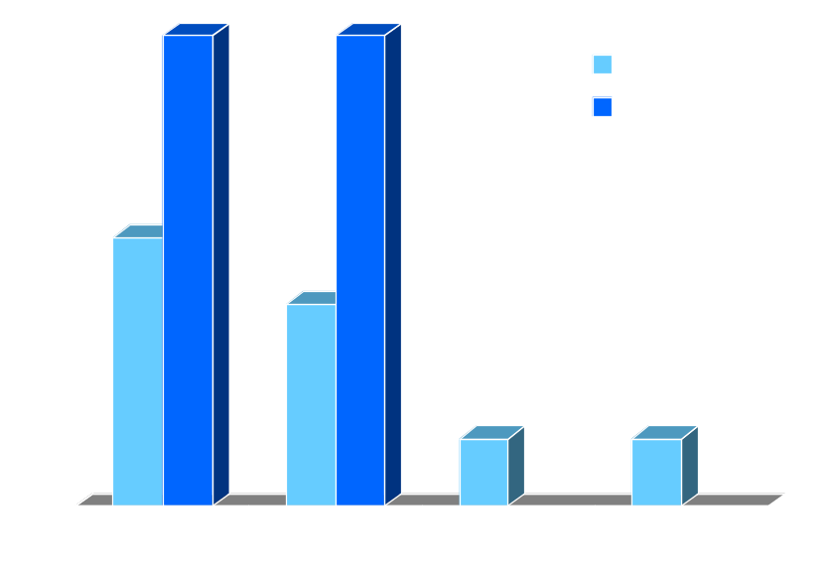
Vaccine Effectiveness
Descriptive Review - Preliminary
796 total specimens; 170 (21.4%) influenza samples
    65 of 170 (38.2%) identified vaccination status
      13 (20%) FluMist; 52 (80%) Injection
Possible Vaccine breakthrough
  23 of 65 (35.4%) patients
    3 Children; 3 Spouse; 17 AD
    All age groups represented
  AL, CA, OK, SC, TX, Antarctica, and South Korea

Slide 10
Vaccine Effectiveness
Descriptive Review - Preliminary
796 total specimens; 170 (21.4%) influenza samples
    65 of 170 (38.2%) identified vaccination status
      13 (20%) FluMist; 52 (80%) Injection
Possible Vaccine breakthrough
  23 of 65 (35.4%) patients
    3 Child; 3 Spouse; 17 AD
    All age groups represented
  AL, CA, OK, SC, TX, Antarctica, and South Korea

Slide 11
Vaccine Effectiveness
Descriptive Review - Preliminary
796 total specimens; 170 (21.4%) influenza samples
    65 of 170 (38.2%) identified vaccination status
      13 (20%) FluMist; 52 (80%) Injection
Possible Vaccine breakthrough
  23 of 65 (35.4%) patients
    3 Child; 3 Spouse; 17 AD
    All age groups represented
  AL, CA, OK, SC, TX, Antarctica, and South Korea

Slide 12
Vaccine Effectiveness
Descriptive Review - Preliminary
796 total specimens; 170 (21.4%) influenza samples
    65 of 170 (38.2%) identified vaccination status
      13 (20%) FluMist; 52 (80%) Injection
Possible Vaccine breakthrough
  23 of 65 (35.4%) patients
    3 Child; 3 Spouse; 17 AD
    All age groups represented
  AL, CA, OK, SC, TX, Antarctica, and South Korea

Slide 13
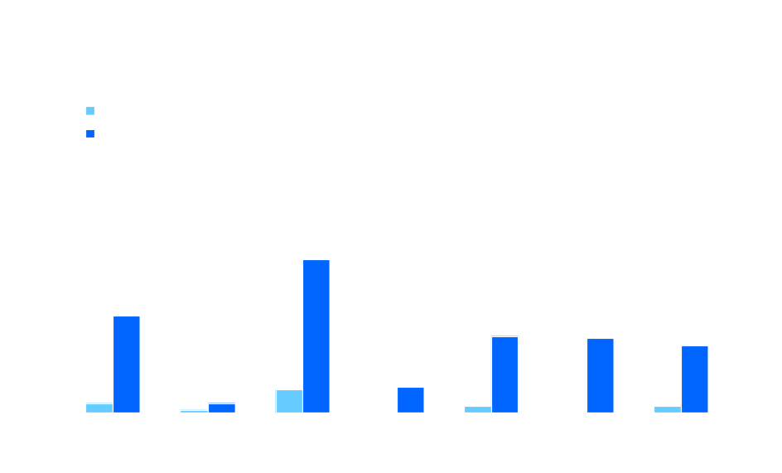
Vaccine Effectiveness
Descriptive Review - Preliminary
Naval Health Research Center, San Diego
Annual estimate of VE against laboratory-confirmed influenza (LCI) at 6 US military “boot camps”
  All trainees vaccinated upon arrival during fall/winter
  Cases occurring during first 14 days considered “unvaccinated”
Preliminary 2006-07 data shows 91% VE against LCI
  38/48 (79%) of cases to date were unvaccinated
  Estimate could be biased toward higher VE if flu infection was more likely in first 2 weeks of training
  However, low VE against any-cause ILI tends to support the finding of high VE against LCI
91% overall VE

Slide 14
Acknowledgements
Global Emerging Infections Surveillance and Response System (GEIS)
Centers for Health Promotion and Preventive Medicine (CHPPM) / Army Medical Surveillance Activity
Air Force Population Health Support Division
Centers for Disease Control and Prevention (CDC)
Sentinel sites in the DoD Global Influenza Surveillance Program

Slide 15
Contact Information
E-mail
  Influenza@brooks.af.mil
    Luke.daum@brooks.af.mil
    Angela.owens@brooks.af.mil
Telephone
  AFIOH Laboratory
    (210) 536-8383
  AFIOH Epidemiology Services
    (210) 536-3471
Notes:
Many sites have been unable to access the website since it became secure. Make sure that your computer’s IP address is listed as .gov or .mil and has a minimum of 128-bit security encryption capabilities. Contact your systems folks or Comm Sq if you are having any problems. This URL is also case-sensitive…The I on Influenza must be capitalized.
Questions regarding lab supplies, data, etc. can ALL be sent to the “Influenza” e-mail address.

