Slide 1
Bioinformatics:
Infrastructure for High-Throughput Automated Analysis of Genomes.
MCS
Argonne National Laboratory
Natalia Maltsev, Elizabeth Marland, Gong Xin Yu,
Alex Rodrigez, Dinanath Sulakhe, Praveen Chandromohan, Rich Lusk, Luke Ulrich, Ramya Krishnamurthy

Slide 2
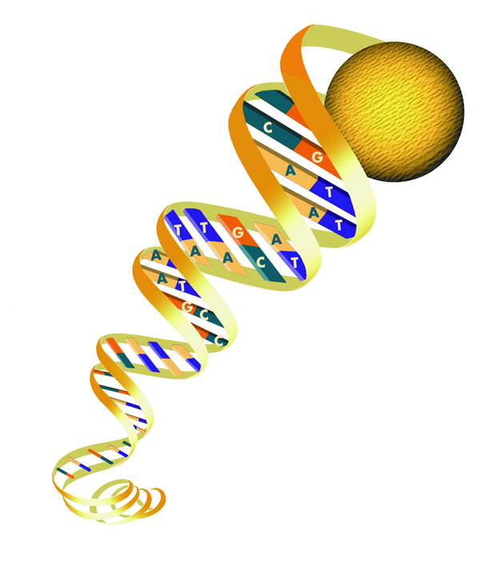
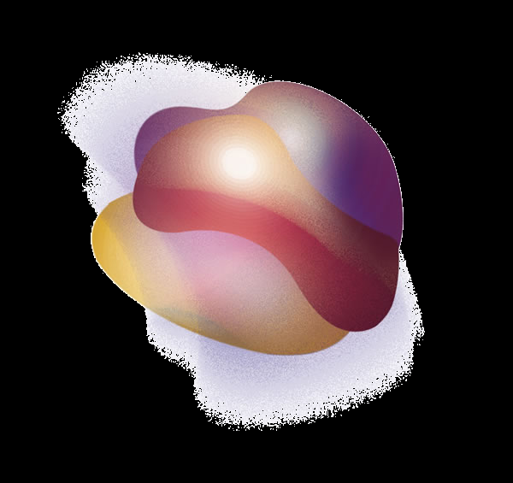
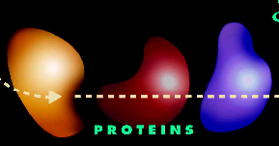
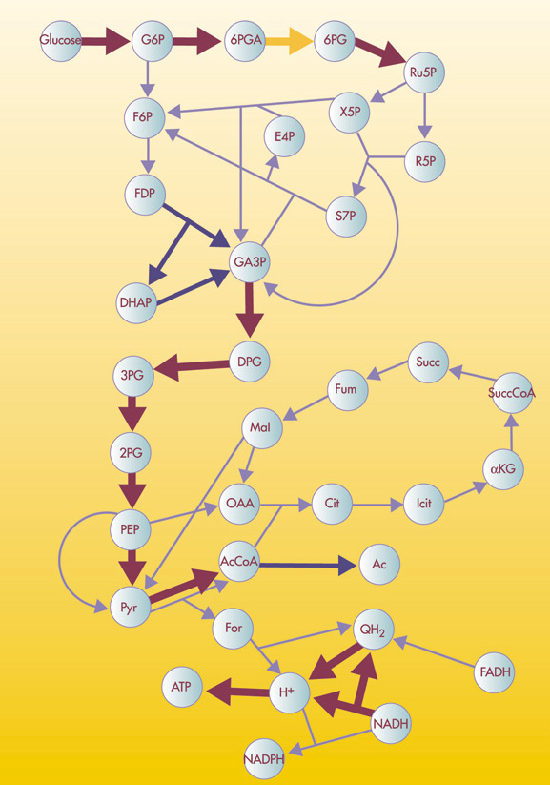
Biology in a Nutshell
(for people with little knowledge but infinite intelligence)
slide “borrowed” from Nagiza Samatova (ORNL)
Genome (ROM): assembly code on how to build proteins
Instructions: A, C, T, G
3 variables ⬄ amino acid
Genomes
Gene Products
Structure & Function
Genome consists of genes
Gene ⬄ Protein: Object description ⬄Object instantiation
Protein ⬄Functions
Enzymes: proteins that catalyze biochemical reactions
Pathway: sequence of reactions
Network (directed graph): set of pathways with metabolites as vertices and enzymes as edges
Pathways & Physiology
Notes:
As I said at the beginning, biology is a very fascinating area. It will constantly challenge you with its complexity and will encourage you with its simplicity once you discover it. One of the complexities that I found almost frustrating is a terminology. That’s why I decided to give this very brief background information, or “Biology on a Palm” from the computer scientist perspective. I assume that you have very little knowledge but infinite intelligence. As you know, now we have so-called “Post-Genome Era”. So you can see how much we are behind. Some people had been working in this area for the whole “Genome Era” but we decided to join them only now. But it is NOT late. Because all the advances made during Genome Period have actually made this area even more complex. Now it challenges us with lots of computational problems that even Terflop Machines are not capable of managing.

Slide 3
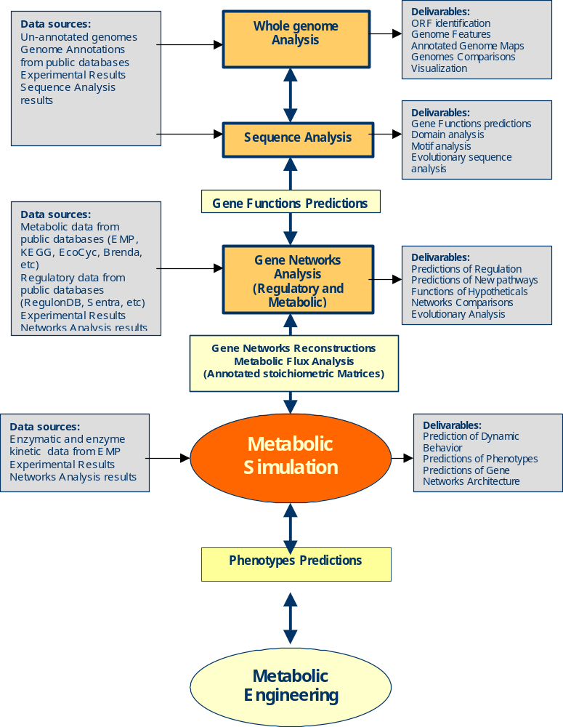
General Project Architecture
Sequence Analysis module
In G-Wiz
Stages of analysis:
Determine components of the system (assign functions to the genes)
Establish relationships between components (static model)
Develop dynamic model of the system

Slide 4
Goals of the Project
Development of:
  Integrated Computational infrastructure Gwiz/GADU
  Tools and algorithms for
    High-throughput genetic sequence analysis (assignments of functions to the genes in sequenced genomes)
    Metabolic Reconstructions from sequence data (static models)

Slide 5
Bioinformatics: Tasks for Q4 2002
To Ensure the robustness of dataflow in GADU System
Design a working plan for Chimerization of GADU
To use grid-based backend for high-throughput genome analysis
Develop Tools and Algorithms for High-throughput genome analysis (in collaboration with ORNL, Nagiza Samatova)

Slide 6
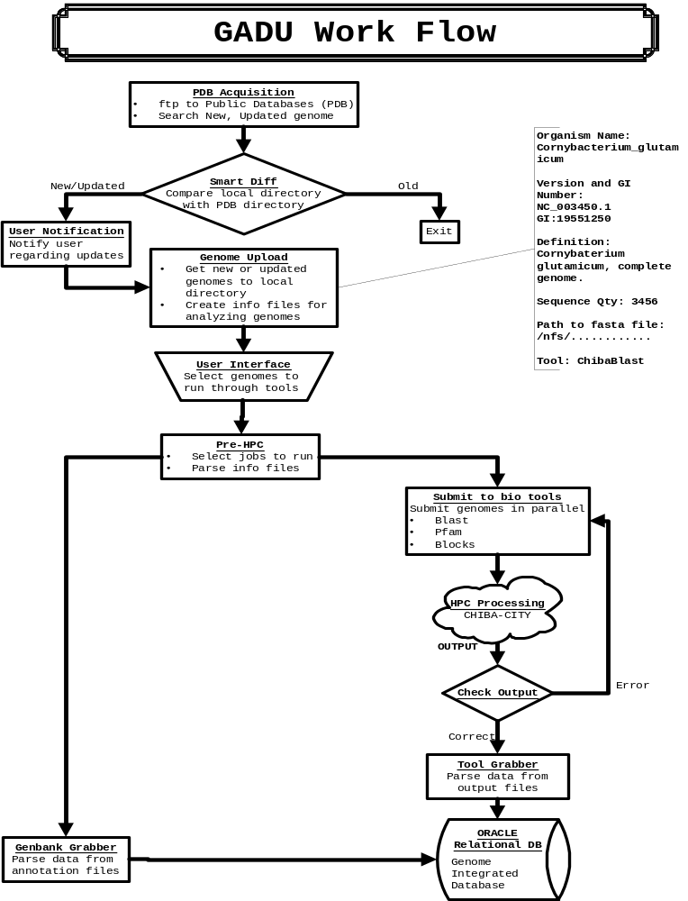
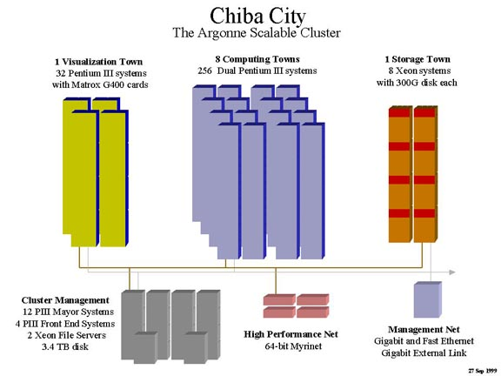
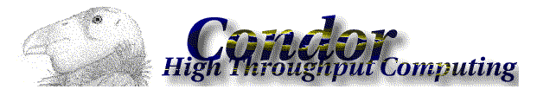
Data Acquisition Module
Gadu searches once a week through major public sequence databases (NCBI, TrEMBL, JGI, and more).
User is notified via email about new or updated genomes.
Gadu’s interactive web-based user interface allows the user to decide which genomes should be acquired and analyzed.
A user log containing the latest upload activity is available.
Acquisition Module
Data Analysis Module
Submit genomes to bioinformatics tools and algorithms :
Blast – comparative pair wise sequence analysis.
Blocks – based on HMM and multiple aligned ungapped segments corresponding to most highly
conserved regions of proteins.
Pfam – based on HMM and multiple sequence alignments covering common protein domains.
Clustering algorithms.
SVM-based algorithms.
Scale by parallel submission of jobs to HPC nodes (Chiba City).
256 nodes, 500 MHz, 512 MB RAM.
All steps of genome analysis are monitored to ensure correct outputs.
Analysis Module
Data Storage Module
Divided into two phases…
1. Before Data Analysis: Raw data downloaded from the public database sites (NCBI, TIGR, JGI etc..) is stored into Oracle relational database.
2. After Data Analysis: Data after the analysis (results of running the various tools like Blast, Pfam, and Blocks) are parsed and stored into the database.
Storage Module

Slide 7
Accomplishments
In collaboration with Zach Miller and Miron Livny (UWisc), GADU-Condor pipeline was established:
  Grid-FTP was Installed
  GADU submits Blast jobs to Condor via Grid-FTP.
100 genomes were submitted to Condor for Blast analysis.
Remaining Condor Tasks
Automate pipeline between GADU and Condor for periodic automated blast submissions.
Add analysis pipeline for InterPro and other bioinformatics tools
Add Condor pools at UofC to GADU

Slide 8
Computational Requirements – still need more…
A. Conventional tools. We will run each of them on approx 900,000 sequences
Blast
4000 sequences (one average bacterial genome) x 18 nodes (36 cpu) -> 4 hrs (550 MHz) on one cpu for 1000 sequences ~144 hrs
Pfam -- 100 sec/sequence
Blocks -- 55 sec/seq
B. This set of tools we will run on the order of 30,000 families. And also it will be put into an interactive workbench
1. ClustalW (40 seq)
CPU Speed: 2.2 Ghz
Time for MSA => 12.5 seconds
Total cycles needed: 12.5 s * (2.2e9) = ~27e9 cycles
Time for Bootstrapping => 9 s
Total cycles needed: 9 s * (2.2e9) = ~18.2e9 cycles
2. T_coffee (40 seq, aligning via clustalw and lalign)
CPU Speed: 2.2 Ghz
Time for MSA => 11 min 22 s = 682 s
Total cycles needed: 682 s * (2.2e9) = 1.5e12 cycles
3. MAST (searching against database with PSSM)
CPU Speed: 2.2 Ghz
Time for search: 26 min = 1560 s
Total cycles needed: 1560 s * (2.2e9) = 3.432e12 cycles

Slide 9
Problems: Data storage requirements
Stats for genome acquisition
Flat file size ~ 1 kb – 15 Mb
Current qty. Of genomes 100
Future qty. Of genomes 635
Process time for one genome: < 1 minute
Stats for genome analysis
Avg. Genome size ~ 4000 sequences (genes)
Blast - 4000 seq. X 18 nodes (36 cpu, 500 MHz) ➔ 4 hrs
One cpu for 4000 sequences ➔144 hrs!!!
Pfam -- 100 sec/seq x 4000 seq x 18 nodes ➔ 3 hours
Blocks -- 55 sec/seq x 4000 seq x 18 nodes ➔ 1.5 hours
Output file size (for 1 avg. genome of 4000 genes) There are 100 genomes!
Blast Blocks Pfam
Temporary Storage 0.8GB 28.1MB 10MB
Permanent Storage 0.8GB 8MB 10MB
Stats for genome storage
Time varies for each tool:
Blast ~ 1 hour (depends on size)
Pfam ~ 10 minutes
Blocks ~ 10 minutes
Total Time for Completion of One Genome
The following average is based on 18 nodes usage:
Average ➔ Data Acquisition ➔ 1 minute
Data Analysis ➔ 4 hours
Data Storage ➔ 1 hour .
Total time ➔ 5 hours

Slide 10
Plans for Q1 2003 for GADU
To run a prototype of GADU under Chimera
Add additional distrubuted resources to GADU :
  UofC Condor pool
  DataGrid cluster
  TeraGrid (Jazz?)
Develop approaches for recording of the data provenance
Find solutions for temporary and permanent data storage problem

Slide 11
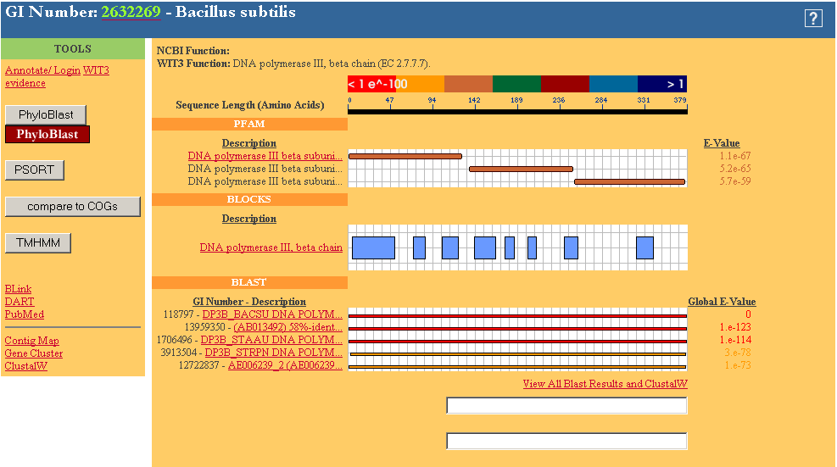

Slide 12
Tools Development: Algorithms for Automated Assignment of functions to Genes and Evolutionary Analysis of Protein Families
SVM -Based
Classification
Characterization
of the Protein Families
Knowledge
Base(WIT3)
HMM-Based
PhyloBLOCKS
Motivation:
To develop a library of Blocks
HMM profiles corresponding
to particular enzymatic
functions or evolutionary
versions of enzymes
Motivation: The current
resolution of tools such
as BLOCKs and Pfam are
unable discriminate closely
related homologous sequences
Hobacgen
BLAST
Output:
Refined BLOCKs
specific for particular
Enzymatic functions
Output:
1. A library of SVM Models for
identification of certain
enzymatic functions
andd computational tools for
predictions of protein
functions based on these
models
COGs
Applications:
1. Identification,
Classification and
characterization of
Proteins utilizing refined
BLOCKs.
2. Phylogenetic
analysis using BLOCKs
distribution to identify
cases of
convergent/divergent
Evolution of enzymes
Subunits
DB (ANL)
Applications:
1.Identification of conserved
amino acid residues
responsible for the
functionality of a protein
sequence.
2. Automated class-
ification and predicting
functions of proteins
Sources of Protein Families
GongXin Yu, Praveen Chandromohan,
Luke Ulrich, Liz Marland,
Natalia Maltsev – ANL
Nagiza Samatova - ORNL

Slide 13
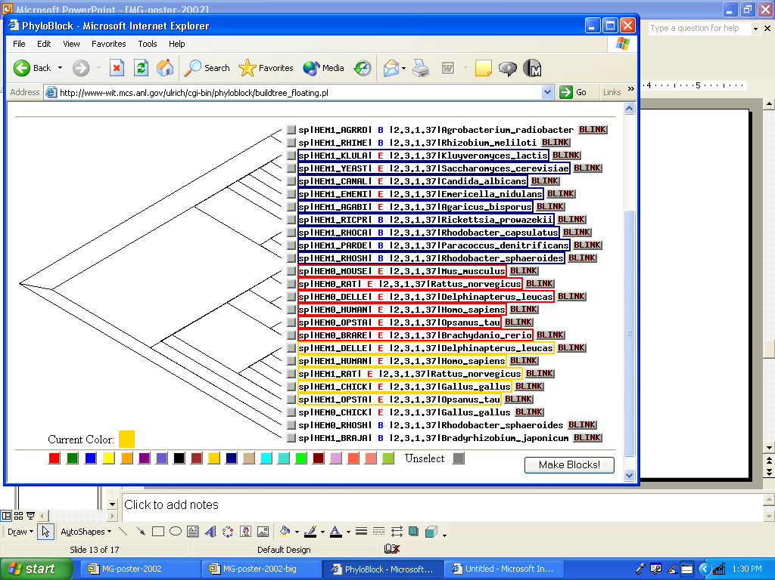
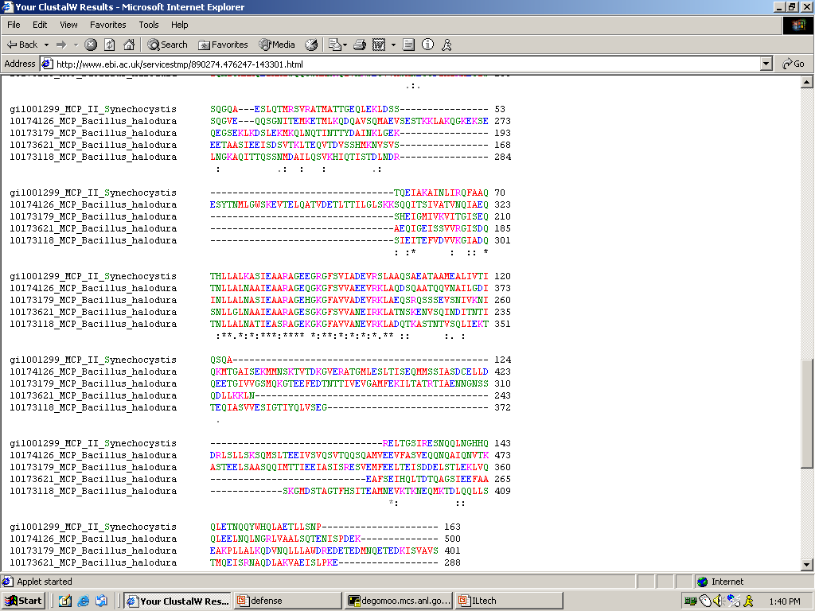
Protein Families
Knowledge
Base
Selected Set of
Sequences
for Particular
Protein Families
Habacgen
Families
CLUSTALW :
MSA and
create tree files
View tree files and user selection
of functional groups
BLAST
CLUSTALW – MSA
designated groups and then create BLOCKS using BLOCKMaker
COGS
PhyloBLOCKS
Schema
for creating BLOCKS from selected functional groups.
1. Run LAMA to verify uniqueness
of BLOCKS between the groups
BLAST using consensus
for additional verification.
2. Add BLOCKS to existing ANL DB

Slide 14

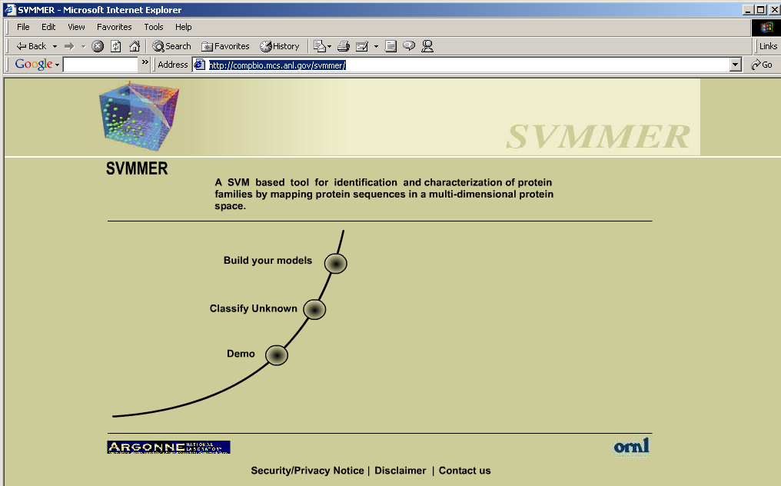
SVMMER
SVM- based Classification and Characterization Schema (in collaboration with Nagiza Samatova, ORNL)
Training
Testing / Classification
1. Build position specific
feature vectors (based on
profile made from training
set) for unknown or
test sequence.
2. Feed feature vectors
Into different models and
Predict if it belongs to the
Functional group it was
trained for.
Selected
Sequences
For Each
Functional
Group
MSA
Create profile
Build position specific
feature vectors based on
profile
3. Build models for
each functional group
Align unknown or
random sequence to
MSA for homologous
protein family
Predictions
http://compbio.mcs.anl.gov/svmmer/

Slide 15
Need More Compute Powerrrr….
SVM for Protein Identification
STATISTICS
Size of Training Set / Test Set : 1.5 GB each. (Huge Data Set as a Whole)
Each node in Chiba City : 500 MHz CPU 512 MB RAM
Approx Run Time for 1 Functional Group in a node:
  Learning Phase : 4 hours
  Classification Phase : 2 hours
  Total runtime for 2500 groups in 50 Nodes of Chiba (dual processors) approximates to 6 days!

Slide 16
Bioinformatics Report: Tasks for Q4 2002
To Ensure the robustness of dataflow in GADU System (more than a 100 genomes were processed in GADU) – DONE – no problem
Design a working plan for Chimerization of GADU – DONE (thanks to Nika and Mike Wilde)
To use grid-based backend for genome analysis – DONE – Condor at UofW (thanks to Miron Livny and Zach Miller)
Develop Tools and Algorithms for High-throughput genome analysis – on-going… (in collaboration with ORNL, Nagiza Samatova)
  PhyloBlock is available at http://compbio.mcs.anl.gov/ulrich/phyloblock/
  SVMMER (in collaboration with Nagiza Samatova, ORNL) is available at: http://compbio.mcs.anl.gov/svmmer/

Slide 17
Milestones for Q1 2003
GADU infrastructure development:
  Development of a Chimera-ized prototype of GADU
  Creating/enhancing a database framework for metadata and annotations
  Utilizing large distributed resources
    Condor (UofW – Blast, InterPro, UofC – Pfam, Blocks)
    DataGrid
    DOE ScienceGrid
    Other?
  Solving GADU space management problems
Tools development (in collaboration with ORNL)
  Development of algorithms for automated construction of specific HMM libraries for PhyloBlock
  Enhancement of SVMmer algorithm with feature selection

