Slide 1
Systems Biology at Argonne
Natalia Maltsev, Gong Xin Yu, Elizabeth Marland, Alex Rodrigez, Dinnanth Sulakhe, Ramya Krisnamurthi, Pavan Anumula, Tanuja Bompada, Praveen Chandramohan, Luke Ulrich, Richard Lusk…

Slide 2
What are we going to talk about?
Systems Biology – hmm… what is it?
Systems biology at Argonne
Bioinformatics at Argonne: Puma’s, WIT’s and Gwiz’es
Some questions and problems

Slide 3
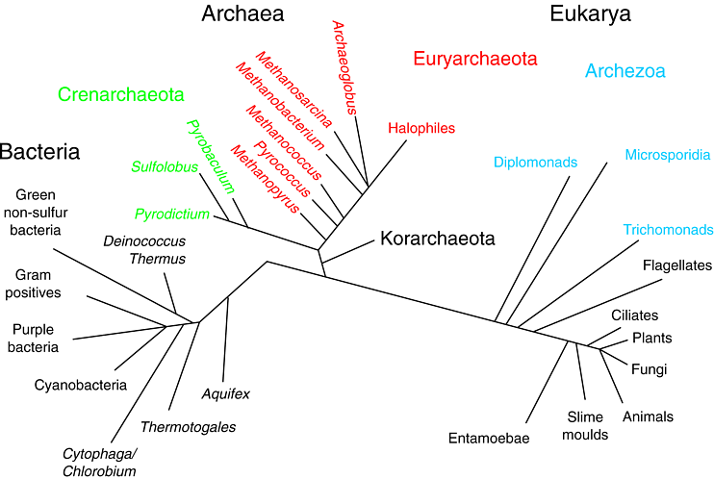
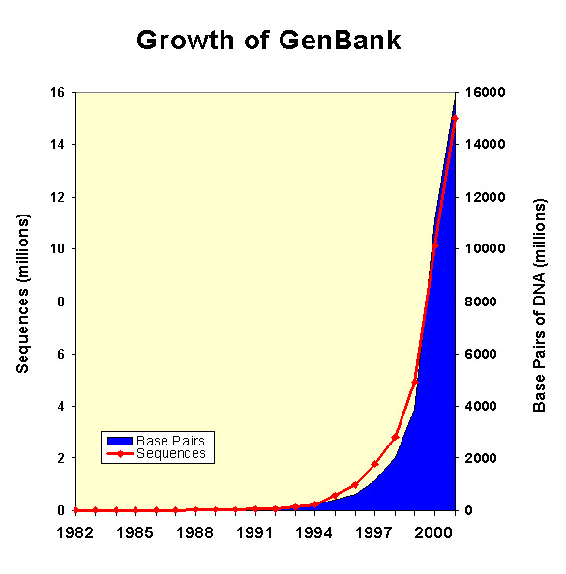

All this data… more the better
114 completely sequenced genomes
735 sequencing projects on various stages of completeness
High-throughput experimental technologies
High-throughput computational resources
So much data!!
Hmmm…

Slide 4
Approaches in Biology
Analysis of components (dissection)
Bioinformatics – insights from large datasets (pattern recognition, comparative analysis)
Systems biology – studies of emergent behavior (integration, modeling, perturbation)

Slide 5
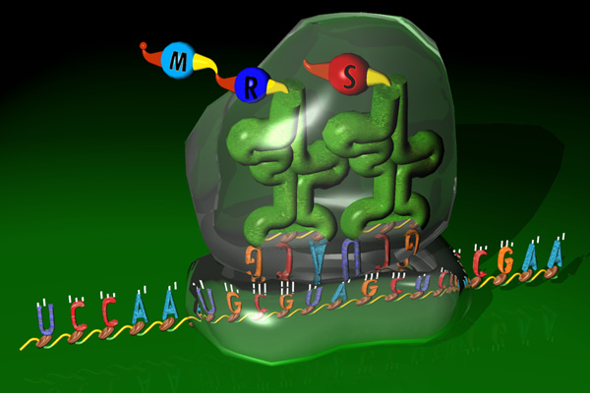
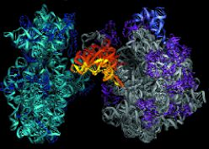
Biology as Systems Science:
Integrated Whole vs Parts
Cartesian view: any complex system can be analyzed in terms of properties of it’s parts
Systems approach: Living systems are integrated wholes whose properties cannot be reduced to those of the parts
Systemic properties of the whole arise from the “organizing relations” of the parts – that is from a configuration of ordered relationships that is characteristic of that of particular class of organisms or systems. Systemic properties are destroyed when a system is dissected into isolated elements

Slide 6
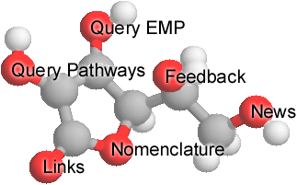
Enzymes and Metabolic Pathways Database http://emp.mcs.anl.gov
1. Access to EMP - a database of Enzymes and Metabolic Pathways
EMP contains 31,100 records, which encode full factual content of 19,500 publications describing biochemistry of more than 8,000 organisms. EMP is publicly available on the Argonne Web server at http://wit.mcs.anl.gov/EMP.
  This year we have reached an agreement and started extensive collaboration with EMPproject company on
    establishing of public EMPproject server at Argonne
    joint development of tools for analysis of metabolic data
2. Access to MCS Computational Resources
(scalable computational backend, integrated resources, platform-independent access)
3. Access to Experimental data via collaboration with Argonne Proteomics group (Dr. C. Giometti), and Pacific Northwest National Laboratory (Dr. R. Smith) et al.

Slide 7
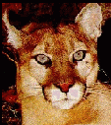
WIT/PUMA family of Integrated Systems for Genetic sequence Analysis and Metabolic Reconstructions
PUMA (1995) -- R. Overbeek, E.Selkov, N. Maltsev, T. Gaasterland
WIT (1996) -- R. Overbeek, E.Selkov, N. Maltsev, N. Larsen
WIT2 (1998->) -- R. Overbeek, E.Selkov, N. Maltsev, E.Selkov Jr., M. D'Souza, G. Pusch (http://wit.mcs.anl.gov/WIT2)
WIT3 prototype (2001-2002) G. X. Yu, N. Maltsev, E. Marland et al.
http://www-wit.mcs.anl.gov/wit3
Gwiz (2002->) -- under development

Slide 8
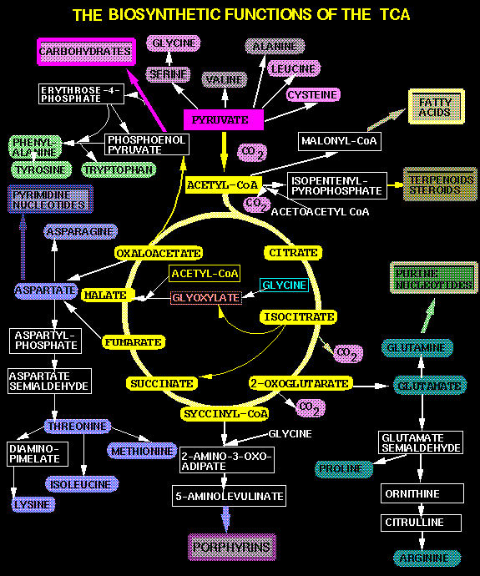
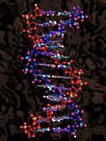
Characterization of Biological Systems
Sequenced Genome
Step 3.The Development of
Dynamic Models
Verification and refinement
of models using
Experimental data
Step 1. Identification of components of the system
Identify potential ORFs and assignf functions to the genes
Step 2. The development of a static model
. Reconstruct
Metabolic and Functional
networks using sequence data,
biochemical, expression and
other experimental data

Slide 9
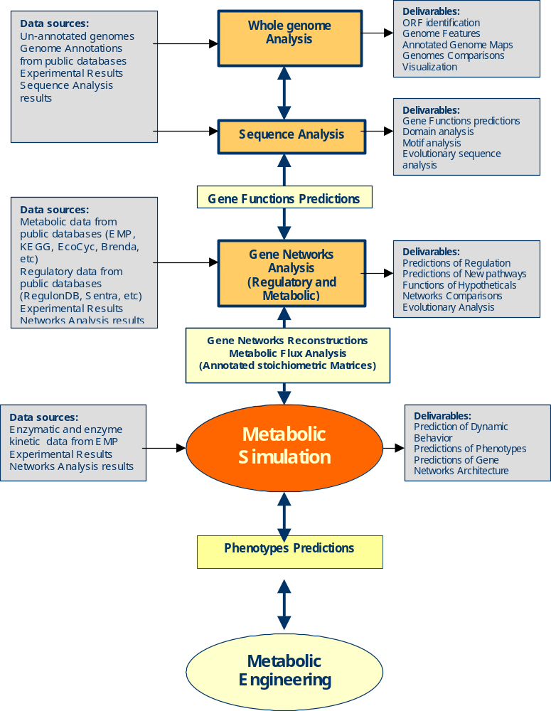
Systems Biology Project at MCS
Bioinformatics
Major goal:
the development of integrated scalable automated system for high-throughput analysis of the sequenced genomes and reconstruction of genetic networks from the sequence data in order to:
  support the core metabolic modeling program at MCS
  advance comprehensive understanding of microbial metabolism and physiology through comparative and evolutionary analysis of genes and gene networks

Slide 10

So far so good… We have Data we have tools, and we know what to do…
So what’s the Problem…!?!
Integrated environment for high-throughput analysis of the genomes and reconstruction of genetic networks from the sequence data
Integrated computational environment includes:
  The supporting database containing: data obtained from various electronic data sources; computational models, results of computational and experimental (in the future) analyses of the genomes and gene networks
  High-throughput genetic sequence analysis module consisting of:
    a computational infrastructure, tools and algorithms for high-throughput assignments of function to the genes in sequenced genomes (SVM- and HMM-based, voting algorithms, etc)
    The results of automated and interactive genetic sequence analysis of ~80 prokaryotic genomes
  Metabolic and regulatory networks reconstruction module contains:
    Tools and algorithms for reconstruction, representation, navigation and analysis of metabolic and regulatory networks
    Reconstructions of metabolic and regulatory networks for at least 50 organisms
  A library of hypotheses for experimental validation concerning functions of hypothetical proteins and architecture of metabolic and regulatory networks

Slide 11
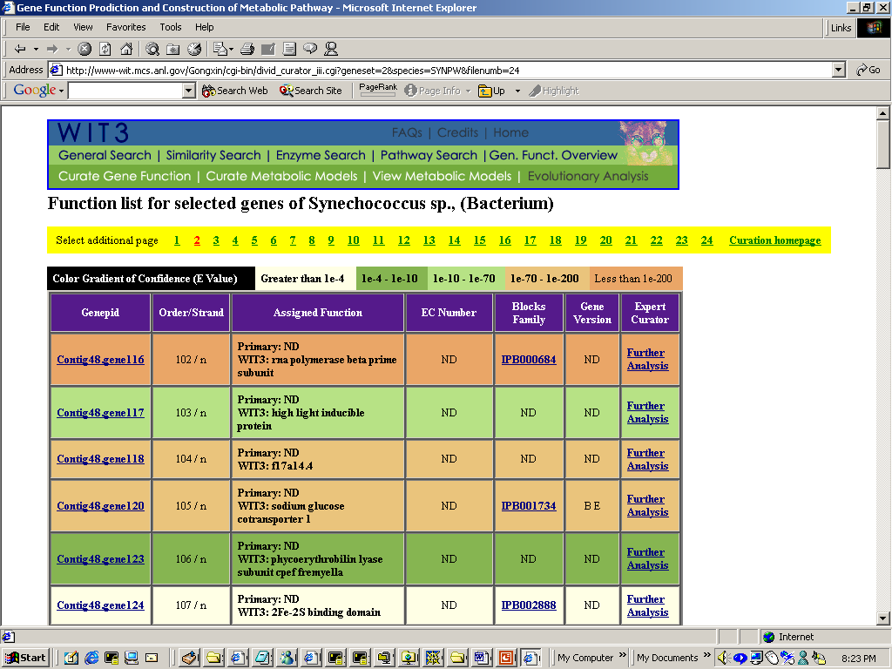
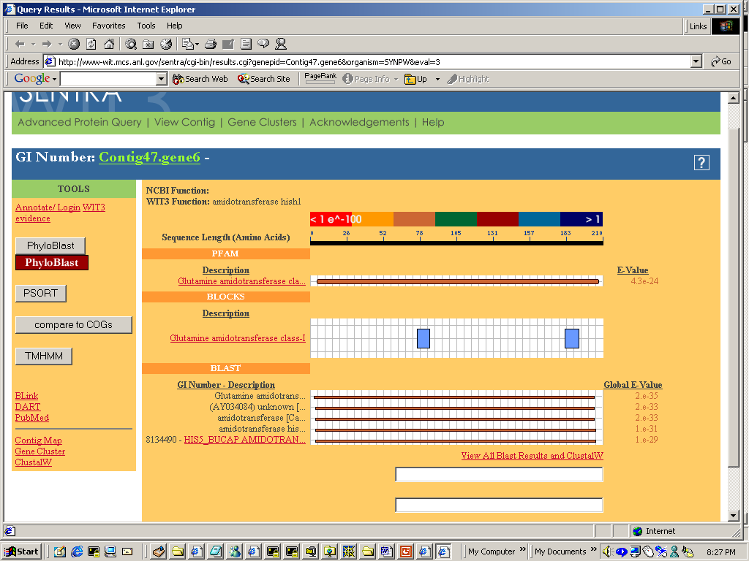
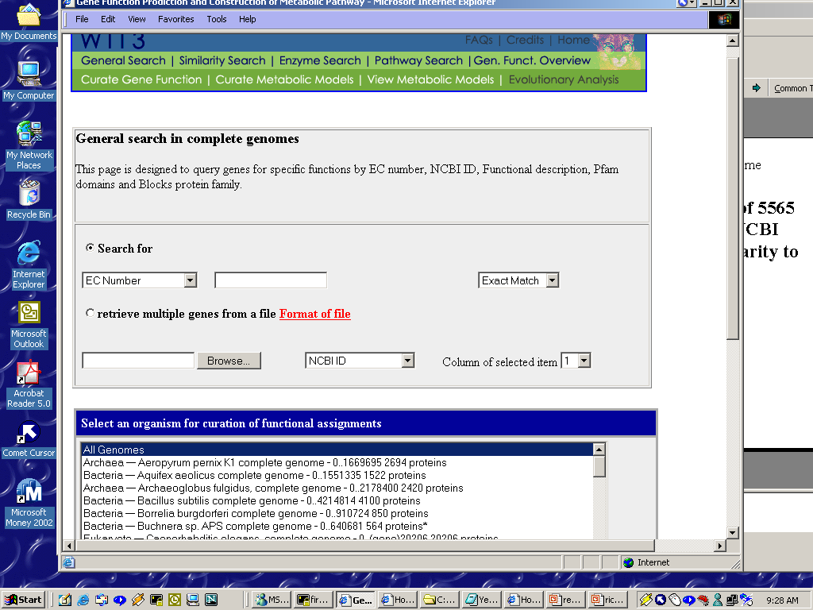
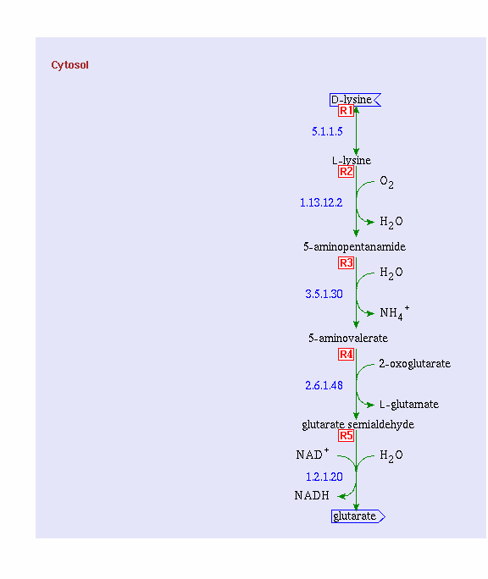
WIT3 http://www-wit.mcs.anl.gov/wit3
We have developed WIT3 – a working prototype of a new generation of integrated systems for high-throughput genetic sequence analysis and metabolic reconstructions (G.X. Yu et al.)
WIT3 now contains:
Automated analysis of 53 completely sequenced genomes
Metabolic reconstructions for over 40 prokaryotic genomes
Unique Knowledge Base for analysis of evolution of Protein families
Integrated Oracle-based database containing sequence and metabolic information
New algorithms for High-throughput genetic sequence analysis and metabolic reconstructions (e.g. voting algorithm, SVM and HMM-based algorithms)
Flexible user interface

Slide 12

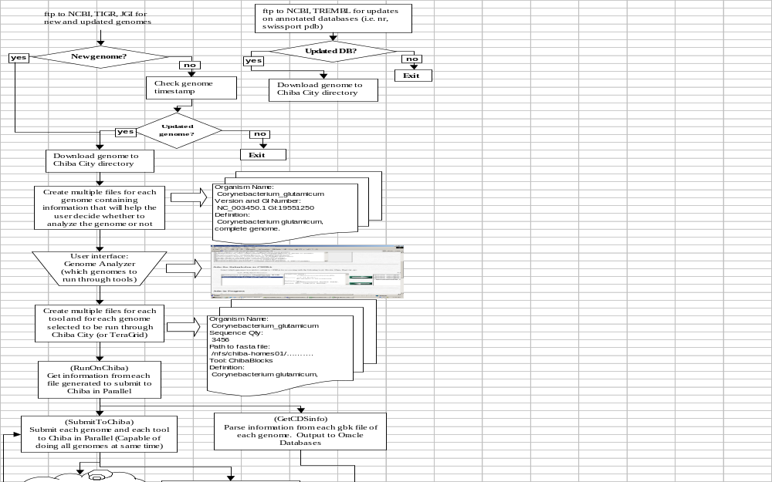
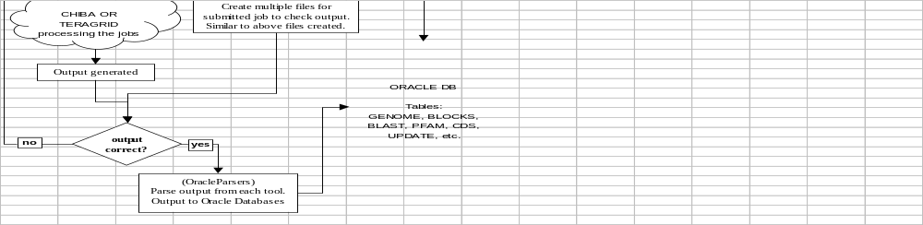
GADU System – demonization
and gridification of WIT
Data Acquisition Module
Data Analysis Module
Data Storage Module

Slide 13
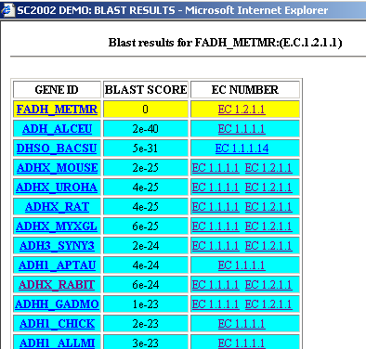
Genetic Sequence analysis: Bottlenecks
1. Incompleteness of the domains and motives libraries.
Currently available domains and motifs libraries (e.g. InterPro, Blocks) while containing a wealth of information for characterization and identification of proteins are still incomplete and do not yet contain information for a large number of enzymatic functions.
2. Low resolution of some sequence profiles
Some of the sequence profiles from the domain libraries can identify large protein families (e.g. aminotransferases), but unable to discern specific enzymatic functions.
3. Blast doesn’t help much either…

Slide 14

Evolution of Enzymes
The availability of phylogenetically diverse sequence data and the development of comprehensive bioinformatics methods now allow for the thorough investigations of evolutionary origins of metabolic pathways and enzymes.
A number of evolutionary mechanisms participate in establishing enzymatic functions. These include:
    divergent evolution or enzyme recruitment,
    convergent evolution or non-homologous replacement,
    horizontal transfer of genes from one organism to another
    and inheritance of a biological pathway from an ancestor.
Uncovering and understanding of evolutionary history of metabolic pathways and enzymes could provide information about past and present metabolic and evolutionary potential of the species. It can also help to guide engineering and discovery of new metabolic activities.

Slide 15
Tools: Algorithms for Automated Assignment of functions to the Genes
and Evolutionary Analysis of Protein Families
SVM -Based
Classification
Characterization
of the Protein Families
Knowledge
Base(WIT3)
HMM-Based
PhyloBLOCKS
Motivation:
To develop a library of Blocks
HMM profiles corresponding
to particular enzymatic
functions or evolutionary
versions of enzymes
Motivation: The current
resolution of tools such
as BLOCKs and Pfam are
unable discriminate closely
related homologous sequences
Hobacgen
BLAST
Output:
Refined BLOCKs
specific for particular
Enzymatic functions
Output:
1. A library of SVM Models for
identification of certain
enzymatic functions
andd computational tools for
predictions of protein
functions based on these
models
COGs
Applications:
1. Identification,
Classification and
characterization of
Proteins utilizing refined
BLOCKs.
2. Phylogenetic
analysis using BLOCKs
distribution to identify
cases of
convergent/divergent
Evolution of enzymes
Subunits
DB (ANL)
Applications:
1.Identification of conserved
amino acid residues
responsible for the
functionality of a protein
sequence.
2. Automated class-
ification and predicting
functions of proteins
Sources of Protein Families
GongXin Yu, Praveen Chandromohan,
Luke Ulrich, Liz Marland,
Natalia Maltsev – ANL
Nagiza Samatova - ORNL

Slide 16
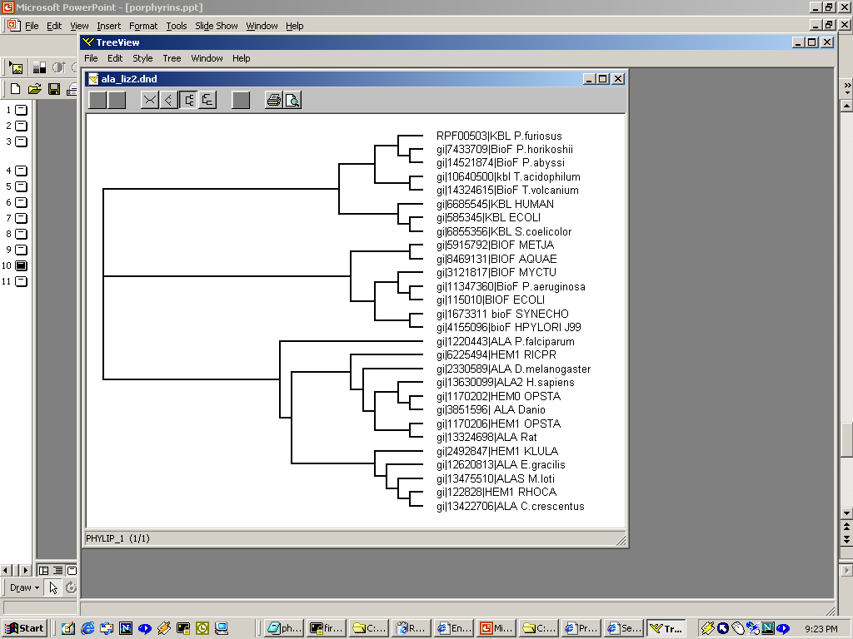
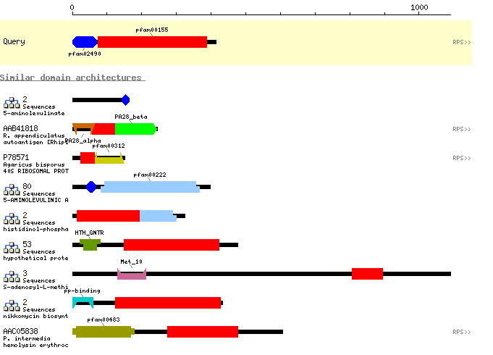
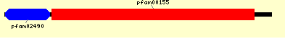
Example of the need for further refined BLOCKs
Case: Related aminotransferases
Divergent Evolution (Enzyme Recruitment)
ALA synthase (EC 2.3.1.37) ALA Pathway
Kbl (EC 2.3.1.29) Threonine Biosynthesis
BioF (EC 2.3.1.47) Biotin Biosynthesis
Porphyrin Biosynthesis - HEM
5-aminolevulinate synthase EC 2.3.1.37 (gi|7433712)
ALA domain Aminotransferase 1,2 domain
  Threonine biosynthesis - Kbl
  2-amino-3-ketobutyrate coenzyme A ligase EC 2.1.3.29 (gi|6685543)
ALA domain Aminotransferase 1,2 domain
  Biotin Biosynthesis - BioF
  8 AMINO-7-OXONENANOATE SYNTHASE EC 2.3.1.47 (gi|14521874)
No resolution from BLAST –
however phylogenetic trees reveal groupings and BLOCKs can be made to differentiate from
ALA domain Aminotransferase 1,2 domain

Slide 17
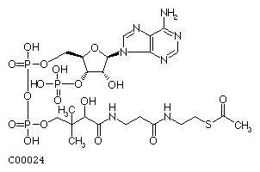
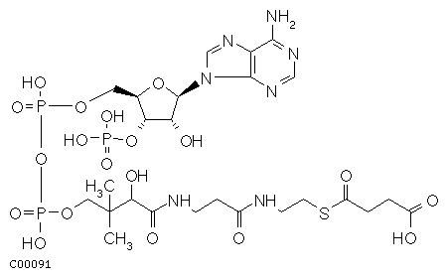
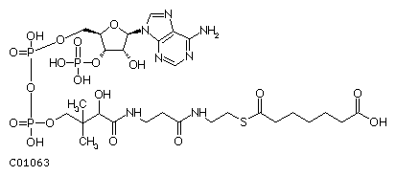
Evolution of Metabolic Pathways by Enzyme Recruitment (divergent Evolution)
  recruitment of promiscuous enzymes to metabolize novel substrates
E1
E1
E1
E2
S
S1
S2
S1
S2
Promiscuous
Enzyme
S1
Acetyl-CoA
KBL EC 2.3.1.29
Glycine C-acetyltransferase
Acetyl-CoA + Glycine = CoA + 2-Amino-3-oxobutanoate
Succinyl-CoA
ALA EC 2.3.1.37
5-Aminolevulinate synthase
Succinyl-CoA + Glycine = 5-Aminolevulinate + CoA + CO2
BioF EC 2.3.1.47
8-Amino-7-oxononanoate synthase
6-Carboxyhexanoyl-CoA + L-Alanine = 8-Amino-7-oxononanoate + CoA + CO2
6-Carboxyhexanoyl-CoA

Slide 18
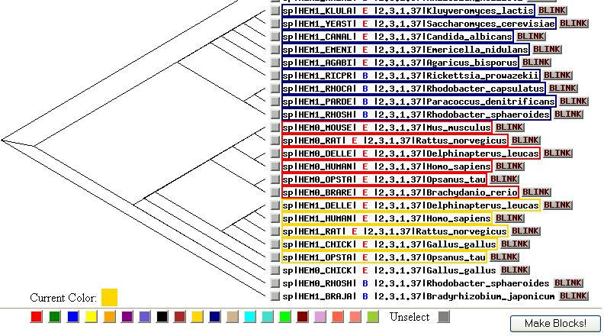
Results:
PhyloBLOCK

Slide 19
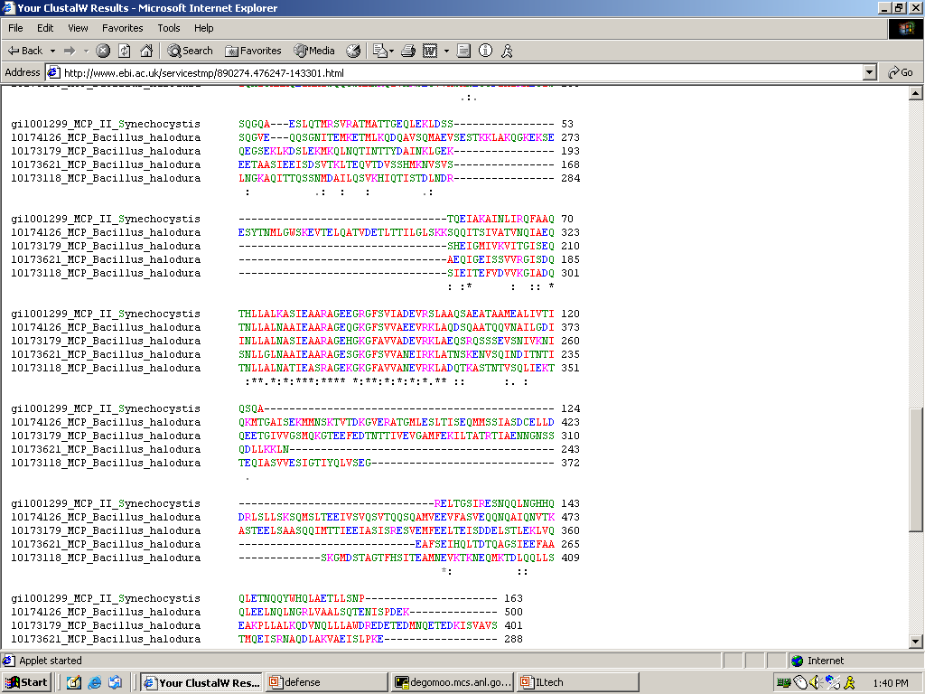
Protein Families
Knowledge
Base
Selected Set of
Sequences
for Particular
Protein Families
Habacgen
Families
CLUSTALW :
MSA and
create tree files
View tree files and user selection
of functional groups
BLAST
CLUSTALW – MSA
designated groups and then create BLOCKS using BLOCKMaker
COGS
PhyloBLOCKS
Schema
for creating BLOCKS from selected functional groups.
1. Run LAMA to verify uniqueness
of BLOCKS between the groups
BLAST using consensus
for additional verification.
2. Add BLOCKS to existing ANL DB
Refers to work in progress

Slide 20

SVM – based Classification and Characterization Schema
Training
Testing / Classification
1. Build position specific
feature vectors (based on
profile made from training
set) for unknown or
test sequence.
2. Feed feature vectors
Into different models and
Predict if it belongs to the
Functional group it was
trained for.
Selected
Sequences
For Each
Functional
Group
MSA
Create profile
Build position specific
feature vectors based on
profile
3. Build models for
each functional group
Align unknown or
random sequence to
MSA for homologous
protein family
Predictions

Slide 21
PhyloBlocks, SVMmer: Some applications
PhyloBlocks
  Identification of different evolutionary forms of the enzymes
  Identification of novel functional domains
  Identification of versions of enzymes related to a certain phenotypes (e.g. thermophilic, halophilic)
  Identification of cases of horizontal transfer (?)
  PCR primenrs
SVMmer
  Identification of functionally important residues
  Identification of highly diverged versions of enzymes

Slide 22
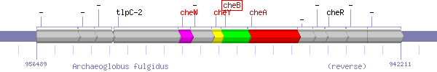
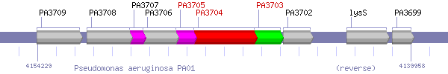
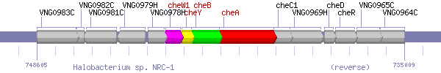
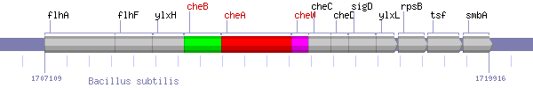
Some other algorithms: Conserved Chromosomal Gene Clusters – Clusters of functionally related genes in Prokaryotes.

Slide 23
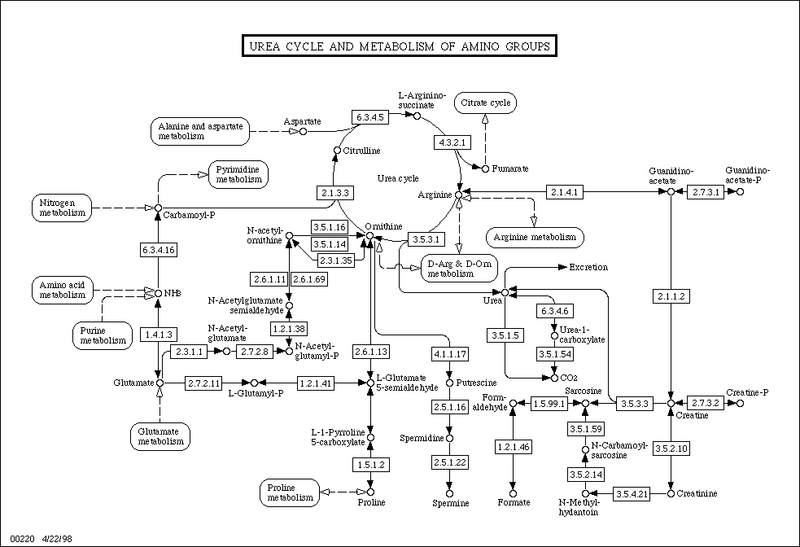
Networks Analysis
SBML, CellML, BSML, BML, GO….
Solution?
Identification of the Pathway Modules
Graphs, fluxes, phenotypes, evolution of the networks
Hierarchy of metabolic Networks

Slide 24
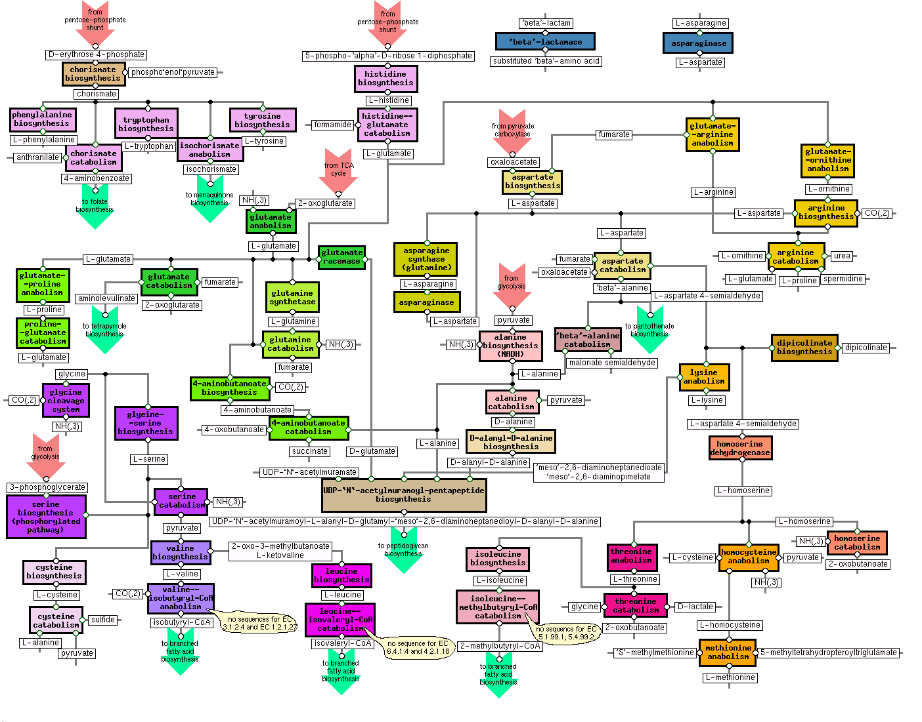

Slide 25
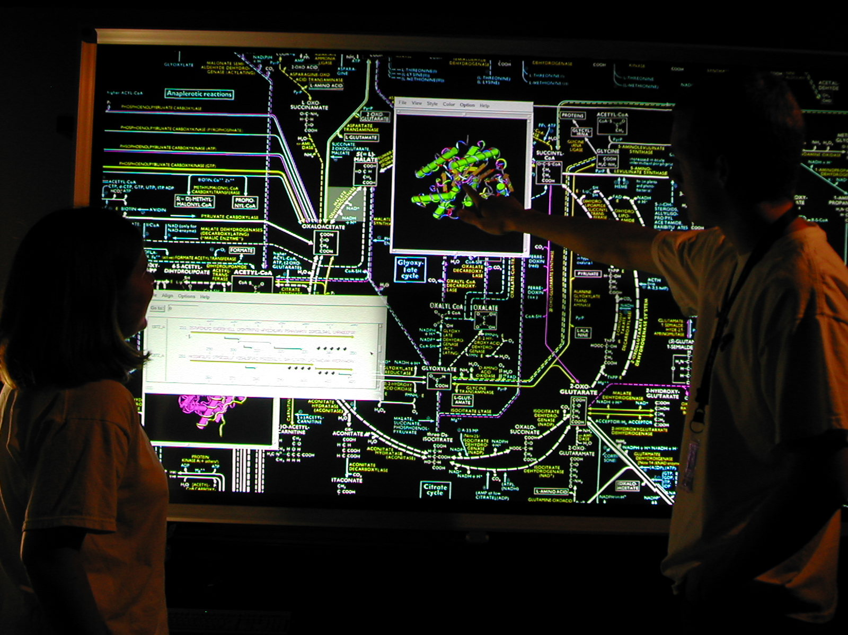

Slide 26
Bioinformatics: future plans
Systems Architecture development
  Incorporate of the grid technologies for the needs of computational biology
  Further develop GADU – the automated pipeline for data and process management to support high-throughput genetic sequence analysis in Gwiz
  Incorporate new classes of data in Gwiz integrated database (e.g. structural data, regulatory networks data)
High-throughput sequence Analysis of Genomes
  Incorporate in Gwiz at least 30 additional genomes (to reach the total number of more than 100 genomes in Gwiz)
  Perform automated predictions of functions to the genes in at least 80 genomes
  Establish partnerships with the experts on analysis of genomes of particular interest to DOE (e.g. for the needs of bioremediation, carbon sequestration, biomedical interest)
Gene networks analysis
  Develop computational environment, for representation, comparative analysis and visualization of gene networks
  Develop metabolic reconstructions for at least 20 additional organisms in Gwiz
  Develop CyanoDB – a database of metabolic reconstructions for Cyanobacteria
The development of tools and algorithms
  For genetic sequence analysis: continue to develop SVM-based tools, PhyloBlock clustering algorithms for analysis of protein families; enhance algorithms for analysis of conserved chromosomal gene clusters and chromosomal rearrangements; tools for whole genome comparisons
  For analysis of gene networks: develop tools for visualization and comparative analysis of networks; tools for representation fo gene networks in a form of stoichiometric matricies
  User interface and visualization tools for public GWIZ server

Slide 27
Collaborations
At ANL:
  NIH Midwest structural Biology Center (Dr. A. Joachimiak) – on selection of priority protein targets for 3D structure determination. During the last year 2682 potential protein targets were selected and thoroughly characterized in TarGet database.
  Globus group (Dr. Ian Foster, et al) – on adopting Grid technologies for the needs of bioinformatics
  Dr. Jorge More et al. – on the development of clustering algorithms for the needs of sequence analysis
Other Collaborations:
  Dr. Wen-Hsiung Li (University of Chicago) – on analysis of evolution of metabolic systems
  Dr. Olaf Schreewind (University of Chicago) – on analysis of secretory proteins in pathogenic Staphylococcus
  Dr. Nagiza Samatova et al. (ORNL) – on the development of the algorithms for high-throughput genetic sequence analysis
  Dr. I. Zhulin – (Georgia Tech) – on analysis of prokaryotic signal transduction networks
  Dr. Bruce Roe – (University of Oklahoma) on analysis of Bacillus stearothermophilus genome
  Drs. Michael Hucka and A. Finney (CalTech, Erato-Kitano project) – on development of systems biology markup language
  Alex Selkov (EMPproject Inc, Russia) – the development of tools for representation of metabolic pathways

