Slide 1

Trauma and PTSD: Issues in the Treatment of Drug-Dependent Women
Denise Hien, Ph.D.
  Research Scholar, Columbia University School of Social Work, Social Intervention Group
  Executive Director, Women’s Health Project Treatment and Research Center, St. Luke’s-Roosevelt Hospital
  NIDA-sponsored Symposium: Drug Abuse Treatment Issues in Women, American Psychiatric Association Meeting, May 5, 2004
Notes:
1

Slide 2
Overview of Presentation
To highlight the historical roots of treatment for traumatic stress and addictions in women
To address the relationship between traumatic stress and addiction in women
To present empirically supported treatment approaches for traumatic stress and addictions, highlighting manualized approaches and research findings
Notes:
2
7

Slide 3
Historical Context for the Study of Trauma and Addiction
Women’s Movement and Grassroots Advocacy for Battered Women in 1970s.
Crack/Cocaine epidemic; DSM-IIIR broadens criteria for PTSD; PTSD studies in Vets and Non Substance Abusers; Fullilove’s Snowball Sample, Miller’s work with criminal justice population in mid-late 1980s.
Surgeon General Koop declares Violence a Public Health Epidemic in 1991.
Judith Herman’s book Trauma and Recovery published in 1992.
Notes:
2
7

Slide 4
Historical Context for the Study of Trauma and Addiction (cont’d.)
Epidemiology from cross-disciplinary research over the late ‘80s and ‘90s establishes high rates—surpassing normal population estimates—for childhood abuse, domestic violence, crime victimization, and PTSD—especially for women.
Kendler and colleagues publish first co-twin study demonstrating causal link between childhood abuse and substance use disorders in 2000.
National consciousness of PTSD and addiction links following September 11, 2001.
Notes:
2
7

Slide 5
DSM-IV Criteria for
Posttraumatic Stress Disorder (PTSD)
A. The person has been exposed to a traumatic event
  event involved actual or threatened death or serious injury, or a threat to the physical integrity of self or others
  The person’s response involved intense fear, helplessness, or horror
B. The traumatic event is persistently reexperienced
C. Avoidance of stimuli associated with the trauma and numbing of general responsiveness
D. Persistent symptoms of increased arousal, including difficulty falling or staying asleep, irritability or outbursts of anger, difficulty concentrating, hypervigilance, exaggerated startle response (American Psychiatric Association, 1994)

Slide 6
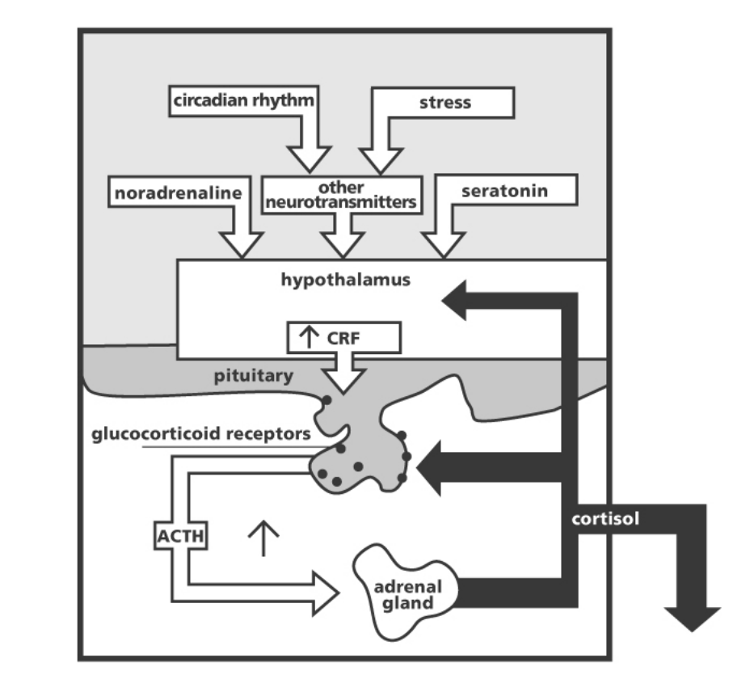
Neurobiological Changes in Response to Traumatic Stress
Limbic System -- Hippocampus and Amygdala
Neurotransmitters and Peptides
Changes in Hormonal System (HPA axis)
Notes:
5
4
Phase of Illnesses of chronic recurrent disorders is critical.

Slide 7
Relationship between Neurobiological Changes and PTSD Symptom Clusters
  Re-experiencing
  Avoidance/Numbing
  Hyperarousal
  Smaller Hippocampal Volumes
  Opioid Peptide System and Stress-related Analgesia
  Emotion Processing in the Amygdala and the Arousal System (HPA Axis)
Notes:
1

Slide 8
Simple vs. Complex PTSD
Simple PTSD typically develops from one incident, usually experienced as an adult.
Complex PTSD is associated with repeated incidents (domestic violence or ongoing childhood abuse).
  Broader range of symptoms: self-harm, suicide, dissociation (“losing time”); problems with relationships, memory, sexuality, health, anger, shame, guilt, numbness, loss of faith and trust, feeling damaged.

Slide 9
Features of “Complex PTSD” or “DESNOS”
A complex of symptoms associated with early interpersonal trauma
Alterations in
  the regulation of affective impulses (e.g., difficulty with modulation of anger and being self destructive)
  attention and consciousness leading to amnesias, dissociative episodes, and depersonalization
  self-perception (e.g., chronic sense of guilt and shame)
  interpersonal relationships (e.g., not being able to trust, not being able to feel intimate with people)
  somatization
  systems of meaning
Notes:
6

Slide 10
Pathways Between Trauma-related Disorders and Substance Use
PTSD
TRAUMA
SUD
Notes:
3

Slide 11
Clinical Challenges in the Treatment of Traumatic Stress and Addiction
Abstinence may not resolve comorbid trauma-related disorders
  for many patients the PTSD worsens
Women with PTSD abuse the most severe substances and are vulnerable to relapse for both conditions, as well as repeated trauma
Confrontational approaches typical in addictions settings frequently exacerbate mood and anxiety disorders
12-Step Models often do not acknowledge the need for pharmacologic interventions
Treatment programs often do not offer integrated treatments for Substance Use and PTSD
Treatments for only one disorder, such as Exposure-Based Approaches, are often marked by complications
  treatments developed for PTSD alone may not be advisable to treat women with addictions
Notes:
4
4
Phase of Illnesses of chronic recurrent disorders is critical.

Slide 12

Pandora
The first woman, created by Hephaestus (God of Fire) endowed by the gods with all the graces and treacherously presented with a box in which were confined all the evils that could trouble mankind.
As the gods had anticipated, Pandora opened the box, allowing the evils to escape.
Notes:
17

Slide 13
Empirically Supported Behavioral Treatments for PTSD and SUD
Sequential, Phase-Based Models:
Brady et al.
Triffleman et al.
Integrated Model:
Najavits et al.
Hien et al.
Notes:
7

Slide 14


Slide 15
Seeking Safety---Lisa Najavits, Ph.D.
Harvard Medical School, www.seekingsafety.org
Developed as a group treatment for PTSD/SUD women
Based on CBT models of SUDs, PTSD treatment, women’s treatment, and educational research
Educates patients about PTSD and SUDs and their interaction
Goals include abstinence and decreased PTSD symptoms
Focuses on enhancing coping skills, safety, and self-care
Active, structured treatment - therapist teaches, supports and encourages
Case management

Slide 16
Hien et al. Phase IB Study Design funded by Violence Against Women and Families Consortium,
(NIJ-NIDA lead institutes)
Randomized clinical trial
3 month cognitive behavioral individual psychotherapy treatments
  Seeking Safety--L. Najavits, Ph.D.
  Relapse Prevention Treatment--K. Carroll, Ph.D.
Non-randomized treatment-as-usual comparison condition
Notes:
18
6

Slide 17
Outcomes
Primary Outcomes
  PTSD Symptom Severity
  SUD Symptom Severity
Secondary Outcomes
  Psychiatric Symptom Severity
  Coping
  Emotion Regulation
  Retention
Notes:
27
16

Slide 18

Demographic Characteristics by Treatment Type (Total N=107)
Notes:
28

Slide 19

Seeking Safety (SS) vs. Relapse Prevention (RPT) vs. TAU Outcomes: Posttraumatic Stress Symptom Severity by Treatment Group (N=107)
**P<.01
**P<.01
**P<.01
All analyses adjusted for age and baseline PTSD severity. End-of-Tx F=4.71 (2,106),
r²=.42; 3-month Post F=4.94 (2,106), r²=.28; 6-month Post F=5.51 (2,106), r²=.22. Findings reported in Hien, DA, Cohen, LR, Litt, LC, Miele, GM & Capstick, C. (Under Revision), Promising Empirically Supported Treatments for Women with Comorbid PTSD and SUD, American Journal of Psychiatry. Do not cite without permission of the authors.
Notes:
33

Slide 20

Seeking Safety (SS) vs. Relapse Prevention (RPT) vs. TAU Outcomes: Substance Use Severity by Treatment Group (N=107)
***P<.001
**P<.01
P=.06
All analyses adjusted for age and baseline substance use severity. End-of-Tx F=6.01 (2,106),
r²=.42; 3-month Post F=4.82(2,106), r²=.36; 6-month Post F=2.87(2,106), r²=.35. Findings reported in
Hien, DA, Cohen, LR, Litt, LC, Miele, GM & Capstick, C. (Under Revision), Promising Empirically Supported Treatments for Women
with Comorbid PTSD and SUD, American Journal of Psychiatry. Do not cite without permission of the authors.
Notes:
34

Slide 21
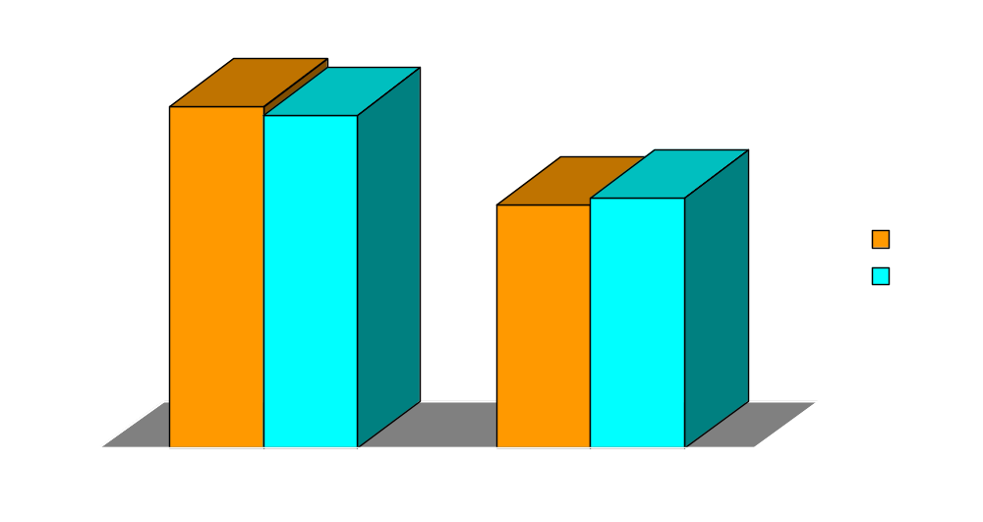
Retention: Percentage of “Completers” by Treatment Group (SS vs. RPT) (N=68)
N=28
N=24
N=18
N=20
Notes:
39

Slide 22
Findings
Both active treatments significantly impacted primary outcomes (PTSD and SUD) at post-treatment.
Retention rates also did not statistically differ between the two treatments.
Short term CBT treatments can have a significant impact on symptom outcomes for a population characterized by severe and complex trauma.
PTSD treatment DOES NOT result in increased symptoms of either PTSD or SUD in early recovery.
Standard RPT can also be an effective first step treatment for comorbid PTSD and SUD.
Notes:
42

Slide 23
Implications for Field
Treatment research which examines longer-term interventions and outcomes is indicated.
Improving retention remains a clinical challenge.
Studies are needed which test effects of elements such as:
  timing of sessions in the context of substance abuse treatment,
  optimal dose,
  combination psychopharmacology and behavioral interventions,
  addition of exposure therapy.
Notes:
42

Slide 24
Notes:
44

Slide 25
Women’s Health Project
Treatment and Research Center
Part of the Addictions Institute of New York (formerly Smithers) in the Department of Psychiatry, St. Luke’s Roosevelt Hospital Center
Member of the Clinical Trials Network Long Island Node
Located in Morningside Heights, 114th Street
Website: www.whpnyc.org
Pre- and Postdoctoral Psychology, Psychiatry and Social Work Training Internships
Notes:
46

