Slide 1
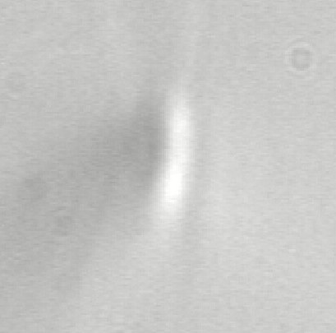
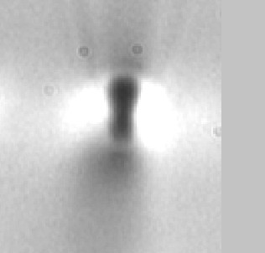
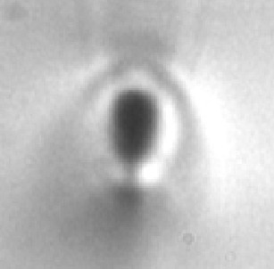
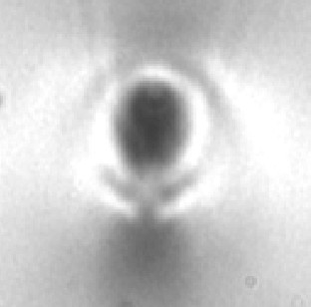
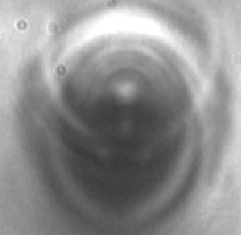
Ultrafast-laser patterning of glass for 3-D optical circuits
Denise Krol, University of California, Davis, DMR 0307002
Ultrashort-pulse lasers with pulse durations on the order of 100 fs can be used to directly write photonic structures inside a glass. This technique has great potential as a fabrication method for three-dimensional all-optical integrated components.
Active devices -such as waveguide lasers or amplifiers- can be fabricated in rare-earth doped phosphate glass. In these materials the quality of the devices depends critically on laser pulse energy and repetition rate. Both the morphology as well as the loss of the fabricated waveguides vary substantially for laser repetition rates between 250 kHz and 2.2 MHz and pulse energies between 80 and 320 nJ.. The lowest loss waveguides (< 1 dB/cm) are obtained for pulse energies > 320 nJ with rep rates < 885 KHz.
ultrashort-pulse laser
translation of sample
Waveguides can be fabricated by moving the glass sample relative to the focal region of the ultrafast laser beam.
The results also show that there are two laser modification regimes, characterized by different physical mechanisms. This information is of importance for further development of this technology for applications in optical data storage, information technology as well as bio-sensing and -imaging.
250 KHz
885 KHz
1327 KHz
1770 KHz
2213 KHz
Microscope images of the cross-sections of waveguides in Er-Yb doped phosphate glass. The waveguides were fabricated using a laser with pulse energy of 240 nJ, a pulse duration of 400 fs and a scan speed of 50 μm/s and varying repetition rates as indicated. The figure shows that the size and refractive index profile of the waveguides increases dramatically with increasing laser repetition rate.

Slide 2
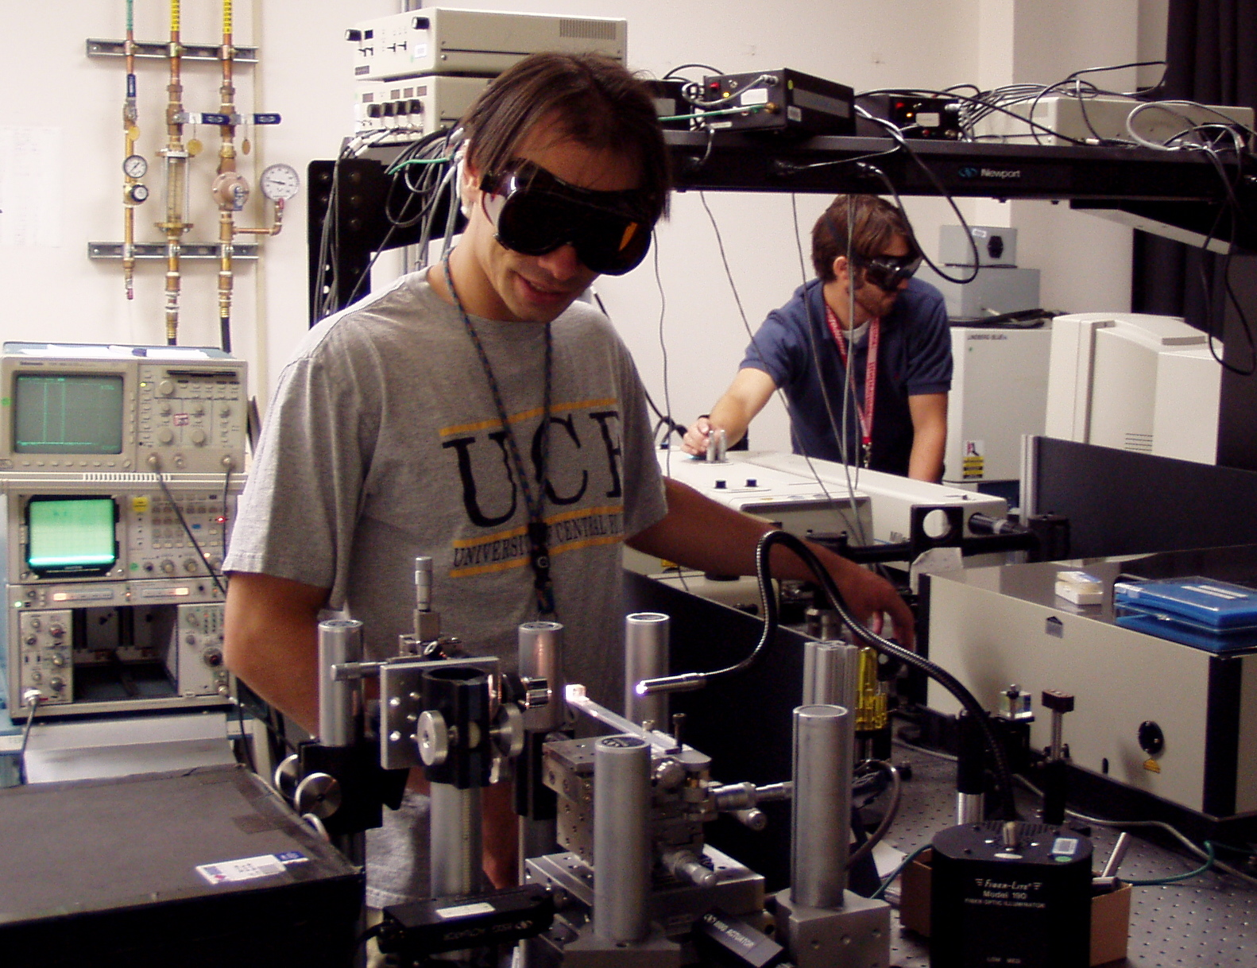
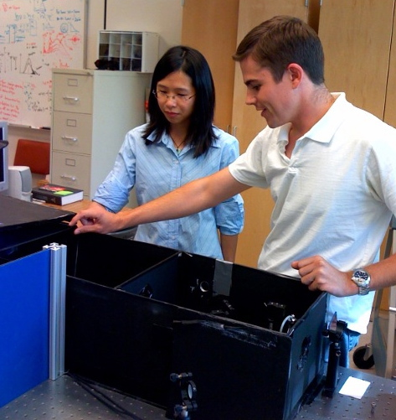
Ultrafast-laser patterning of glass for 3-D optical circuits
Denise Krol, University of California, Davis, DMR 0307002
This project has contributed to the education of 4 undergraduate (Ehsan Masoudi, Amber Zertuche, Ken Whitwer and Li Juan Lei) and 4 graduate students (Wilbur Reichman, Tobias Moritz, Jon Witcher and Luke Fletcher) as well as a post-doctoral scholar (Prissana Thamboon). Dr. Thamboon is currently on the faculty at Chiang Mai University, Thailand. Wilbur Reichman received his Ph. D. in 2006 and has accepted a position at ASML, Richmond, CA.
Graduate students Bill Reichman and Jon Witcher aligning the ultrafast laser system.
The undergraduate students, who have all graduated from the Optical Science and Engineering Program at UC Davis, have greatly benefited from this project by getting hands-on experience with state-of-the-art optical techniques. Ehsan Masoudi has gone on the graduate school and both Amber Zertuche and Li Juan Lei are currently employed at Tinsley Labs, an optics manufacturing company in Northern CA.
Graduate student Luke Fletcher explaining the confocal microscopy set-up to undergraduate student Li Juan Lei.

