Slide 1
Objective weighting of Multi-Method Seasonal Predictions
(Consolidation of Multi-Method Seasonal Forecasts)
Huug van den Dool
Acknowledgement: David Unger, Peitao Peng, Malaquias Pena, Luke He, Suranjana Saha, Ake Johansson and all data providers.

Slide 2
Popular (research) topic
(super) ensembles (>=1992; medium range)
Multi-model ‘approach’ (CTB priority; seasonal)
In general when a forecaster has more than one ‘opinion’.
→ Methods
→ Application to DEMETER-PLUS, (Nino34; Tropical Pacific)
Prelim conclusions, and further work

Slide 3
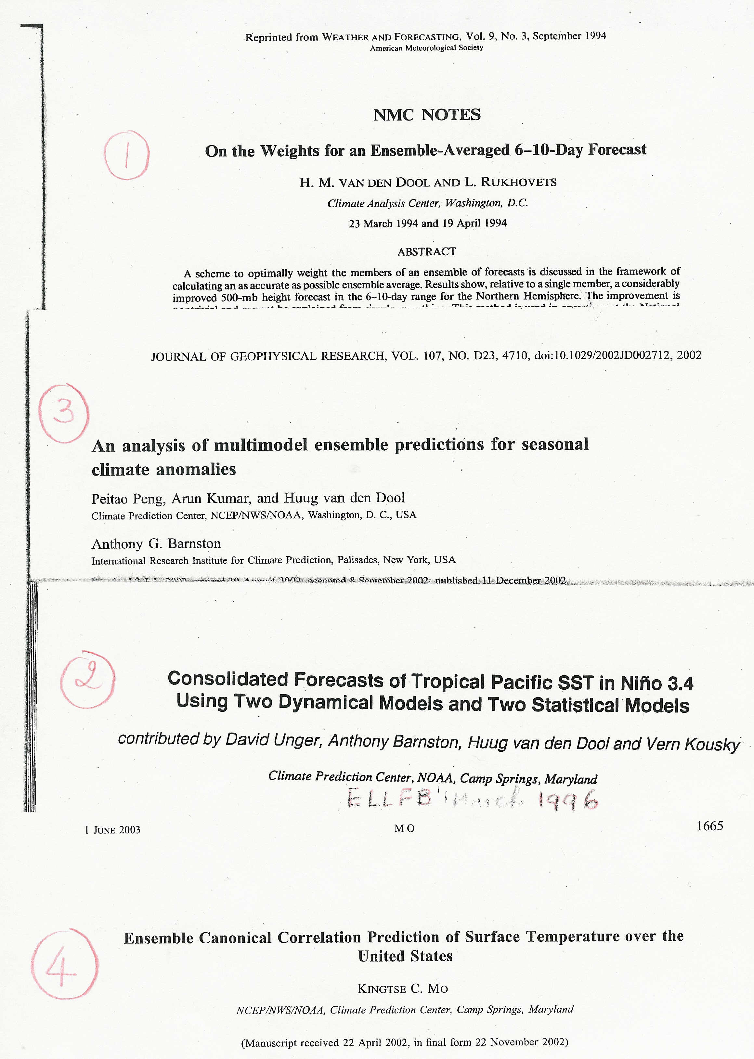
Oldest reference : Phil Thompson, 1977
Sanders ‘consensus’.

Slide 4
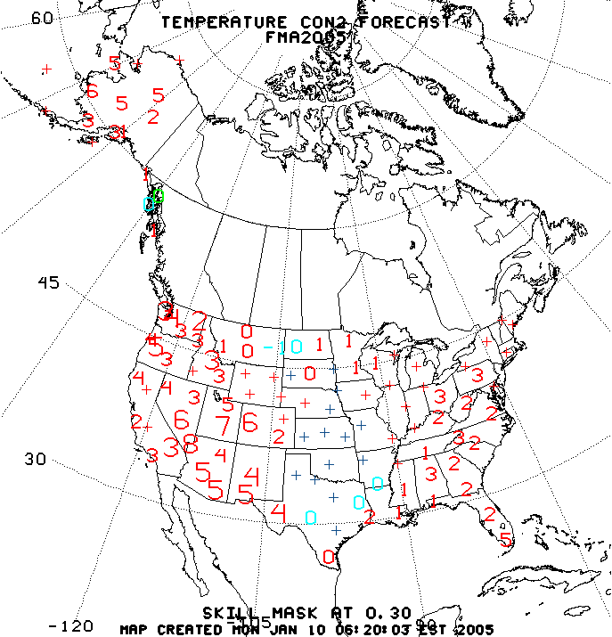
CCA and OCN consolidation, operational since 1996

Slide 5
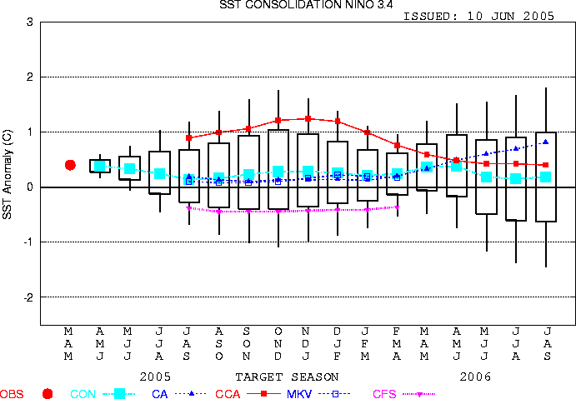

Slide 6
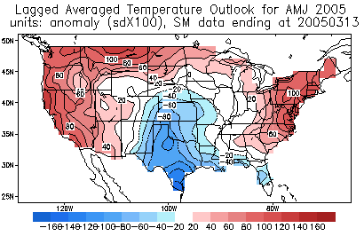
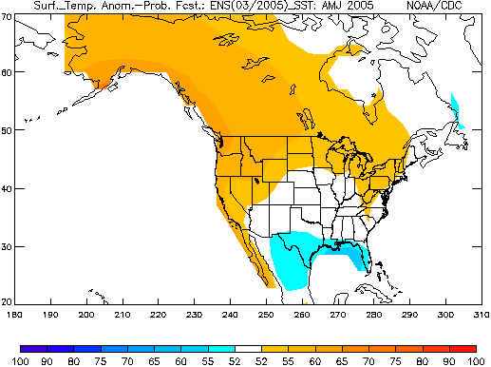
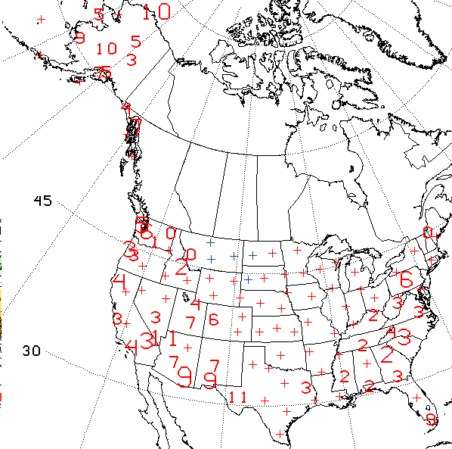
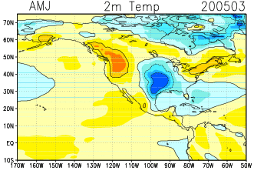
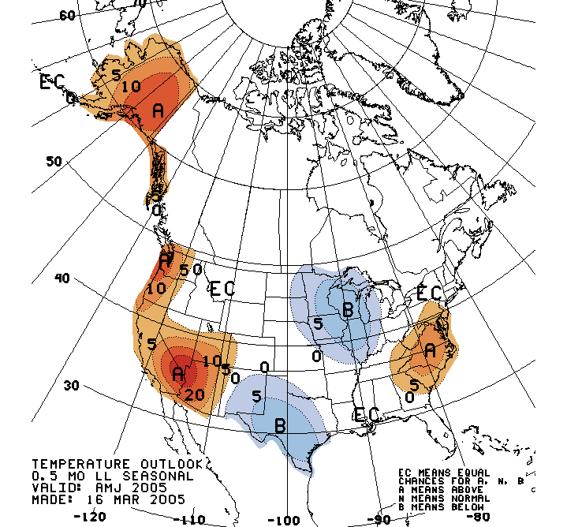
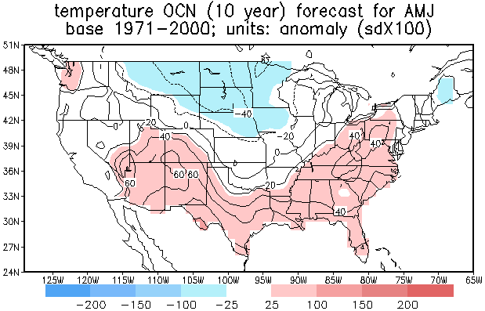
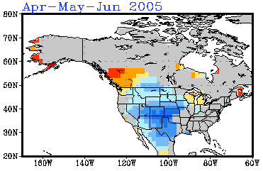
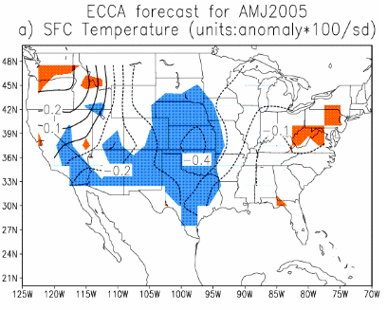
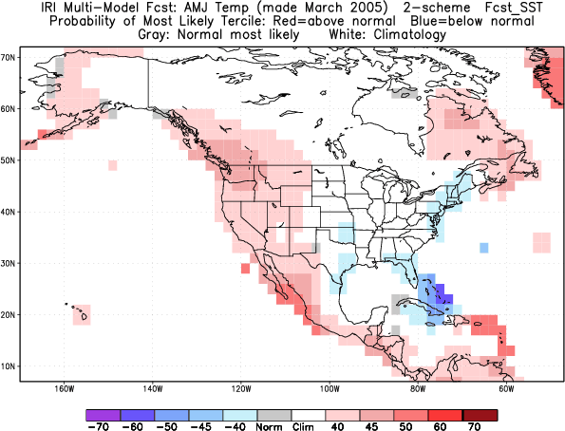
Forecast tools and actual forecast for AMJ2005
OCN

Slide 7
Forecast tools and actual forecast for AMJ2005
CAS
CDC
OCN
OCN+skill mask
Absent:
CCA, SMT, MRK, CA-SST,
NSIPP (via CDC and IRI)
local effects, judgement
Scripps
OFFICIAL
OCN
CFS
IRI
ECCA

Slide 8
There may be nothing wrong with subjective consolidation (as practiced right now), but we do not have the time to do that for 26 maps (each ~100 locations).
Moreover, new forecasts come in all the time. Something objective (not fully automated!) needs to be installed.

Slide 9
When it comes to multi-methods:
Good: Independent information
Challenge: Co-linearity

Slide 10
m1 m2 m3 m4 m5 ………………m9 equal weights
Realism
m1 m2 m3 m4 m5 ………………m9 weights proportional to skill
m1 m2 m3 m4 m5 ………………m9 weights based on skill and co-linearity
sophistication

Slide 11
m1 m2 m3 m4 m5 ………………m9 equal weights
Realism
m1 m2 m3 m4 m5 ………………m9 weights proportional to skill
m1 m2 m3 m4 m5 ………………m9 weights based on skill and co-linearity as per ridge regression, if possible
m1 m2 m3 m4 m5 ………………m9 weights based on skill and co-linearity
sophistication

Slide 12
Definitions
A, B and C are three forecast methods with a hindcast history 1981-2003. A is short hand for A(y, m, l, s), anomalies. Stratification by m is customary,
so A (y, l, s) suffices.
y is 1981 to 2003, lead=1, 6(13), space (s) could be gridpoints NH (for example) or Climate Divisions in US.
Matching obs O (y, l, s)
Inner products:
AB = Σ A ( y, l, s) * B (y, l, s), where summation is over time y, (some or all of) space s, and perhaps ensemble ‘space’.

Slide 13
In general we look for:
Con(solidation) = a*A + b*B + c*C
Simple-minded solution: a = AO/AA, b=BO/BB etc.
 a+b+c probably needs an additional constraint like a+b+c=1. a, b and c could be function of s, lead, initial (target) month. a, b and c should always be positive.
We like to do better, but….Simple-minded may be the best we can do

Slide 14
We still look for: Consolidation = a*A + b*B + cC ; minimize distance to O.
Full solution, taking into account both skill by methods and ‘co-linearity’ among methods:
Matrix * vector = vector
|AA AB AC| |a| |AO|
|BA BB BC| * |b| = |BO|
|CA CB CC| |c| |CO|
*) main diagonal, *) what is measure for co-linearity?
If co-linearity were zero, note a = AO/AA
No constraint on  a+b+c .

Slide 15
Full solution, taking into account both skill by methods and ‘co-linearity’ among methods:
AA AB AC a AO
BA BB BC b BO
CA CB CC c CO
If a, b, and c are too sensitive to details of co-linearity, try:
AA +ε² AB AC a AO
BA BB +ε² BC b BO
CA CB CC +ε² c CO
Even very small +ε² can stabilize the worst possible matrices.
Adding +ε² to main diagonal plays down the role of co-linearity ever so slightly.
2nd layer of amplitude adjustment may be needed

Slide 16
Why is CON difficult?
Science/technology: FAR too little data to determine a,b,c…z, given the number of participating methods (quickly increasing)
Political: Much at stake for external/internal participants (funding, pride, success). Nobody wants to hear:
your model has low skill, or
b) your model has some skill, BUT… no skill over and above what we know already via earlier methods (birthrights???).
Funding Agencies have stakes in something they have funded for years. They like to declare success (= CPC(IRI) uses it, and it helps them).

Slide 17
About ridging
Starts with Tikhanov(1950; 1977 in translation) on the math of underdetermined systems. Minimize rms difference (O-CON) as well as Σ a*a+b*b+c*c.
Gandin(1965), where ε² relates to the (assumed) error in the obs.
Ridging reduces the role of off-diagonal elements
‘Embrace’ the situation:
-) truncate forecast(obs) in EOF space (details?)
-) Now determine AA from filtered data….
-) Add ε² which is related to variance of unresolved EOFs
-) Controlled use of noise: off-diagonal elements unchanged.
-) solve the system.
Working on: Adjusted ridging where in the limit of infinite noise the simple-minded solution for a, b, c emerges.

Slide 18
Example: Demeter plus
9 models/methods (7 Demeter, 2 NCEP)
1981-2001 (1982-2002)
Monthly mean data
Nino34 (all of Eq Pacific)
Only Feb, May, Aug, Nov starts
Use ensemble mean as starting point
Anonymous justice, mdl#1, mdl#9

Slide 19
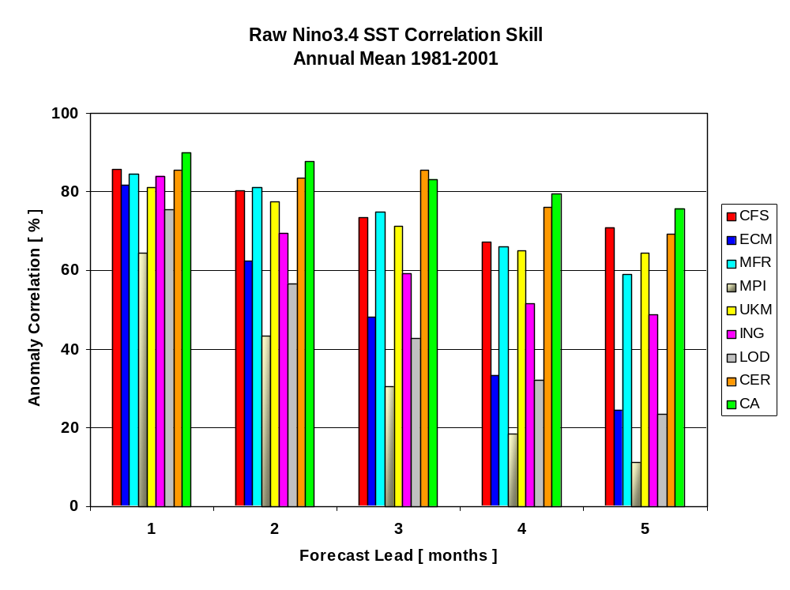
wrt OIv2 1971-2000 climatology

Slide 20
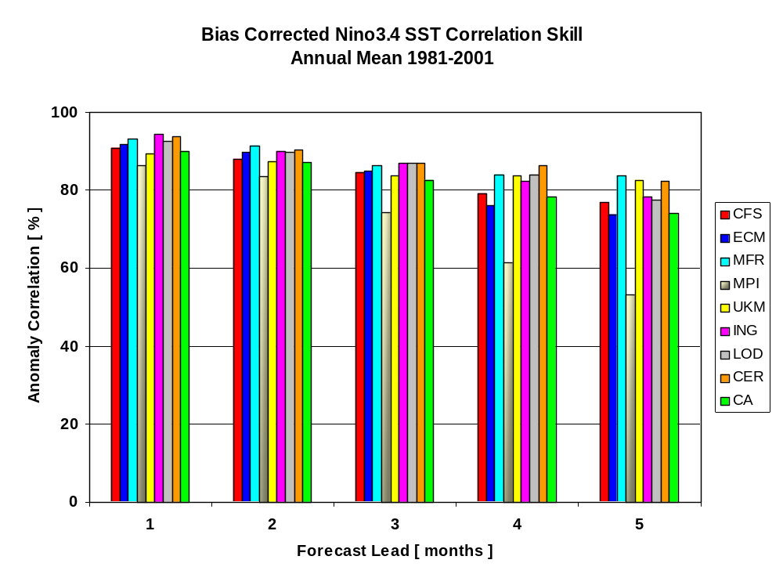
wrt OIv2 1971-2000 climatology

Slide 21
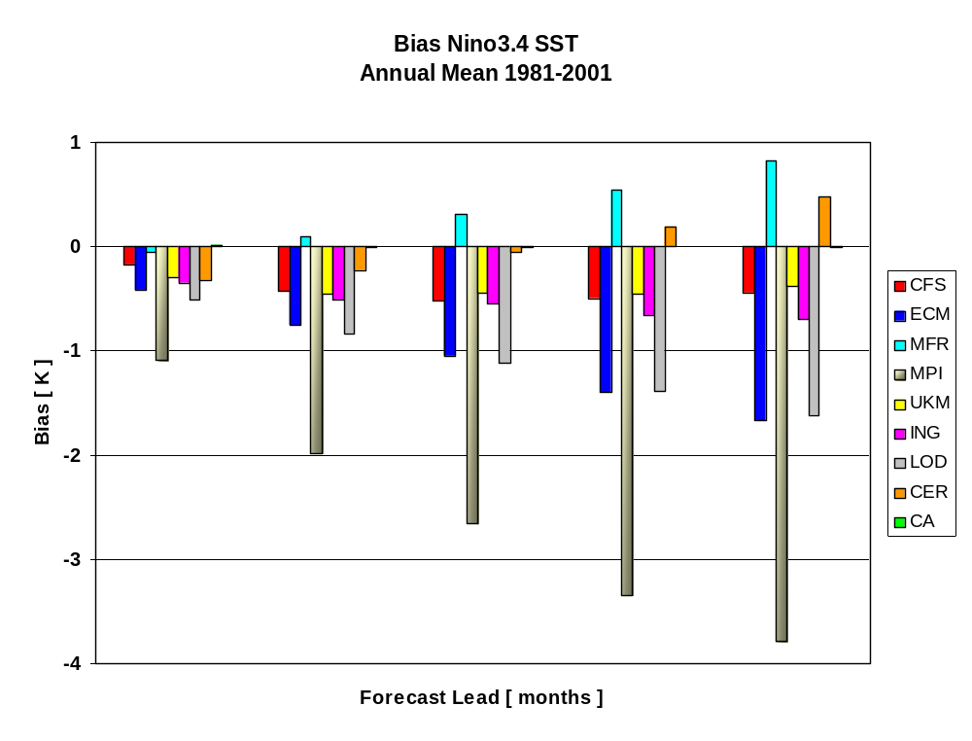
wrt OIv2 1971-2000 climatology
1 2 3 4 5
Forecast Lead [ months ]

Slide 22
Correlation matrix Demeter plus (m=1, lead=1 Feb→ March) correlations ………………………………………………………………………………< > sd ac
1.00 .94 .91 .95 .92 .93 .92 .93 .89 .91 .93 1
.94 1.00 .97 .91 .97 .95 .98 .97 .90 .65 .93 2
.91 .97 1.00 .92 .96 .94 .96 .99 .89 .67 .92 3
.95 .91 .92 1.00 .90 .92 .92 .93 .88 1.13 .92 4
.92 .97 .96 .90 1.00 .93 .96 .96 .90 .98 .93 5
.93 .95 .94 .92 .93 1.00 .94 .94 .94 .83 .97 6
.92 .98 .96 .92 .96 .94 1.00 .97 .90 .73 .93 7
.93 .97 .99 .93 .96 .94 .97 1.00 .88 .77 .92 8
.89 .90 .89 .88 .90 .94 .90 .88 1.00 .71 .95 9
1 2 3 4 5 6 7 8 9 sd ac standardize forecasts before proceeding

Slide 23
1 2 3 4 5 6 7 8 9
.14 -.15 .15 .11 .20 .40 .04 -.27 .25 0 (no* ridging)
.10 .03 .01 .12 .11 .25 .01 -.02 .27 1 (5% ridging)
.10 .04 .03 .11 .09 .21 .03 .01 .24 2 ←----
.10 .05 .04 .11 .09 .18 .04 .02 .22 3
.10 .06 .04 .10 .08 .17 .05 .03 .21 4
.
.
.10 .07 .06 .10 .08 .13 .06 .06 .16 9
.10 .07 .06 .10 .08 .13 .07 .06 .15 10 (50% ridging)
(.93 .93 .92 .92 .93 .97 .93 .92 .95 ) = ac
w  |w|  w*w %ridg ac m lead summary: .88 1.72 .42 .00 98.06 1 1 (unconstrained regression) summary: .87 .91 .17 5.00 97.90 1 1 summary: .86 .86 .14 10.00 97.75 1 1
…….. summary: .82 .82 .08 50.00 97.09 1 1
* NO ridging may not exist. 0 means 0.000…001%

Slide 24
ridge mon lead w(1)... w(9) CON ensave best mdl
.10 1 1 .10 .04 .03 .11 .09 .21 .03 .01 .24 97.7 96.4 96.5 ( 6)
.25 2 1 .18 .02 .12 -.01 .03 .10 .14 .09 .08 94.2 91.3 90.7 ( 3)
.15 3 1 .06 .12 .12 .00 .17 .12 .13 .10 .04 96.4 95.5 95.6 ( 7)
.05 4 1 .31 .02 .18 .14 .05 .25 .04 .13 .23 98.4 98.0 97.4 ( 6)
.05 1 2 .06 .02 .02 .00 .13 .16 .10 .05 .14 95.5 93.9 91.2 ( 7)
.15 2 2 .17 .00 .11 .08 .10 .05 .11 .06 .11 90.9 90.2 87.0 ( 3)
.10 3 2 .13 .22 .18 .01 .01 .12 .23 .14 .03 96.0 95.2 95.3 ( 7)
.15 4 2 .25 .08 .15 -.01 .13 .26 .11 .14 .18 98.3 97.4 97.6 ( 6)
.15 1 3 -.01 .17 .04 .03 .18 .18 .06 .00 .09 91.6 87.5 83.4 ( 3)
.25 2 3 .24 .07 .05 .04 .09 .00 .14 .08 .15 89.5 87.1 82.6 ( 9)
.30 3 3 .08 .20 .15 .00 .09 .17 .17 .17 .15 96.0 94.7 94.9 ( 2)
.30 4 3 .15 .05 .13 .00 .18 .21 .11 .13 .10 96.3 95.1 96.3 ( 6)
.25 1 4 -.01 .02 .08 .05 .25 .16 .08 .12 .02 89.3 81.9 81.3 ( 3)
.40 2 4 .18 -.01 .02 -.01 .12 .04 .17 .11 .19 90.5 85.6 86.2 ( 9)
.35 3 4 .09 .24 .16 -.01 .08 .16 .16 .15 .25 95.8 93.7 93.8 ( 2)
.25 4 4 .08 -.01 .14 .02 .16 .20 .05 .10 .09 95.9 93.9 95.1 ( 6)
.50 1 5 .12 .00 .14 .05 .23 .06 -.01 .08 .09 87.5 78.4 82.1 ( 5)
.50 2 5 .13 .08 .09 -.01 .14 .10 .18 .12 .18 89.5 87.1 84.5 ( 9)
.50 3 5 .16 .18 .17 -.01 .12 .19 .13 .13 .17 96.3 94.0 94.4 ( 3)
.25 4 5 -.01 .04 .15 .01 .11 .16 .02 .08 .08 92.0 87.4 90.7 ( 3) ridge imth lead w(1)... w(9) CON ensave best mdl

Slide 25
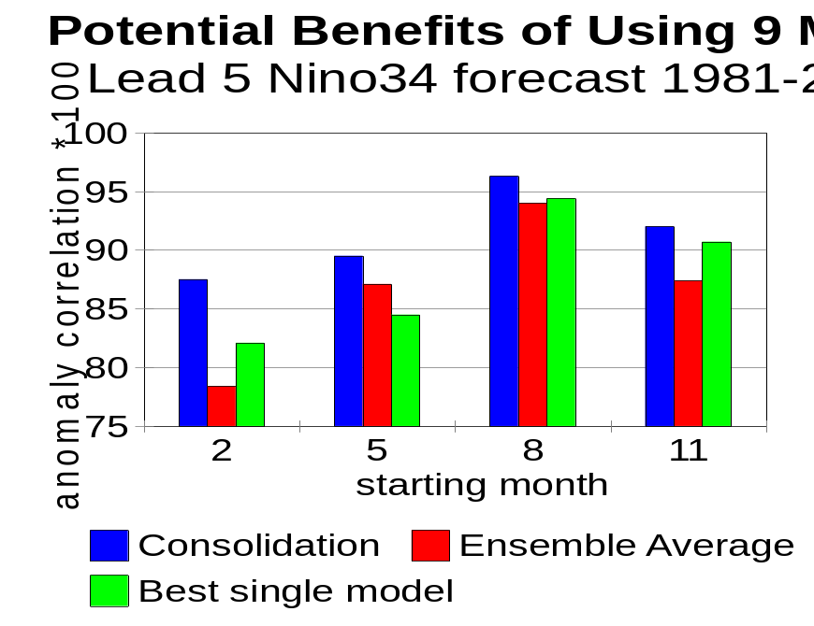
Fig. 1 The potential for improving the monthly mean Nino34 forecast at five month lead. We used a total of 9 models/methods, including all 7 DEMETER models, the NCEP-CFS and Constructed Analogue over the common period 1981-2001. The score of the best single model is in green. The ensemble average (which may suffer if bad models are included) is in red, and the consolidation (which hopefully assigns high/low weights to good/bad models through Ridge Regression) is in blue. There are 4 starts, in February, May, August and October. The word potential is used because the systematic error correction and the weights have not been cross-validated.

Slide 26
Weights from RR-CON are semi-reasonable, semi well-behaved
→ CON better than best mdl in (nearly) all cases (nonCV)
→Signs of trouble: at lead 5 the straight ens mean is worse than the best single mdl (m=1,3)
→ The ridge regression basically ‘removes’ members that do not contribute. ‘Remove’=assigning near-zero weight.
→ Redo analysis after deleting ‘bad’ member?? YES
→ For increasing lead more ridging is required. Why?
→ Sum of weights goes down with lead (damping so as to minimize rms).
→ Variation of weight as a function of lead (same initial m), .10, .06, -.01, -.01, .12, for mdl is at least a bit strange.
Impressions:

Slide 27
Variation of weight as a function of lead (same initial m),
.10, .06, -.01, -.01, .12, for one mdl is at least a bit strange.
What to do about it?. … Pool the leads….(1,2,3), (2,3,4) etc Result:
.07,.11,.06,.03,.09 better (not perfect), AND with considerably less ridging.
Demeter cannot pool nearby ‘rolling’ seasons, because only Feb, May, Aug, Nov IC are done. CFS, CCA etc can (to their advantage)

Slide 28
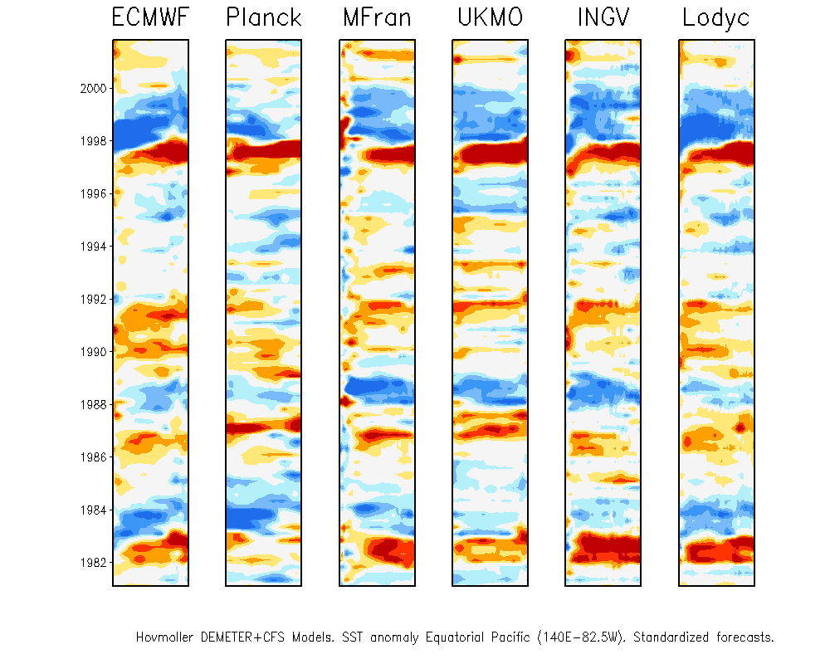
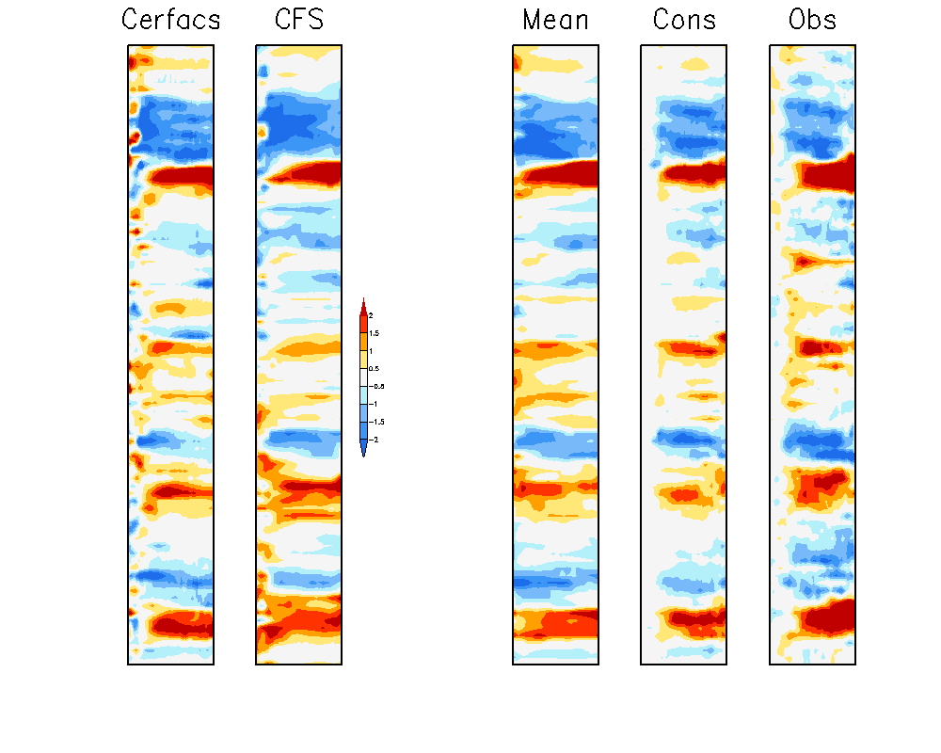
DEMETER + CFS. Equatorial Pacific. Lead 5
Beyond Nino34

Slide 29
Pacific Basin. All gridpoints along the equator. SE correction, and CV-1-out on SE correction and weight calculation
86.2 | 84.2 | 89.6
75.7 | 72.4 | 87.6
84.9 | 83.1 | 90.5
90.4 | 85.7 | 95.6
59.1 | 58.2 | 66.8
70.9 | 64.9 | 76.0
82.2 | 79.0 | 88.7
79.5 | 70.0 | 83.0
Ens Ave Best Mdl RR-CON
Starts
2
5
8
11
Lead 1
Lead 5

Slide 30
Closing comments
Consolidation should yield skill >= the best single participating method. Should! In the absence of independent information (orthogonal tools) the equal sign applies.
Consolidation will fail on independent data if hindcasts of at least one method are ‘no good’.
Consolidation will fail on independent data if the real time forecast is inconsistent with the hindcasts. (Computers change!!!; model not ‘frozen’)
To the extent that data assimilation is a good paradigm/analogue to consolidation, please remember ‘we’ worked on data assimilation for 50 years (and no end in sight)
Error bars on correlation are large, so the question whether method A is better than method B (e.g. 0.12 vs 0.09) is hard to settle (perhaps should be avoided). Same comment applies when asking: does method C add anything to what we knew already from A and B. Nevertheless, these questions will be asked.

Slide 31



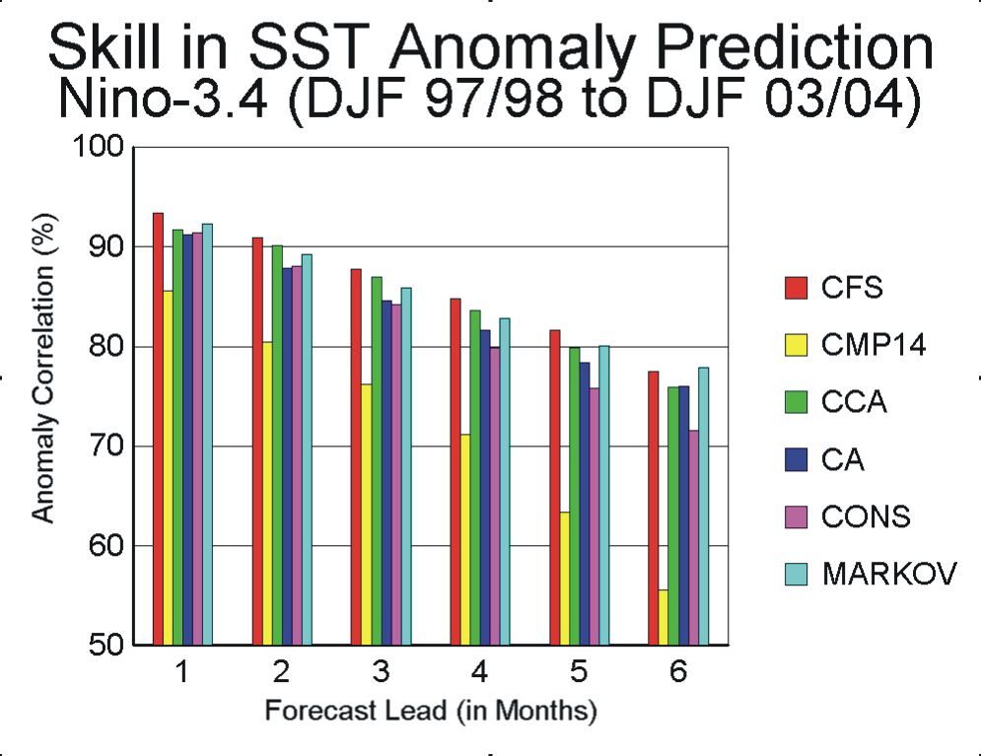
(73 cases)

Slide 32
Conclusions and work left to be done
Ridge Regression Consolidation (RRC) appears to work well in most (not all) cases studied. Some mysteries remain.
Left over methodological issues:
-) Systematic Error correction
-) Cross Validation
-) Re-doing RRC after poor performers are forcefully removed (when automated: based on what?)
-) Understand the cases where 50% ridging still is not enough
-) EOF filter (also good diagnostic)

Slide 33
Separate in hf and lf
Set lf aside
Do consolidation on hf part
Place lf back in

Slide 34
Extra Closing comment 1
Acknowledge that consolidation, in principle, can be combined with (simple or fancy) systematic error correction approaches.
The equation matrix times vector = vector becomes matrix times matrix = matrix. And the data demands are even higher.

Slide 35
.50 1 5 87.5 78.4 82.1 ( 5) ridge imth lead CON ensave best mdl without s.e. correction….. (otherwise the same fortran code)
.10 1 5 86.4 62.5 63.5 ( 1) ridge imth lead CON ensave best mdl
Without a-priori tool-by-tool se correction, the results of CON look phenomenal.
“Fold’ se correction into CON???

Slide 36
Extra Closing comment 2
There is tension between consolidation of tools (an objective forecast) on the one hand and the need for attribution on the other.
Examples: forecaster writes in the PMD about tools (CCA, OCN…) and wants to explain why the final forecast is what it is. This includes attribution to specific tools and physical causes, like ENSO, trend, soil moisture, local effects…
What is the role of phone conferences, impromptu tools and thoughts vis-à-vis an objective CON.

Slide 37
OPERATIONS TO APPLICATIONS GUIDELINES from Wayne Higgins’ slide
    The path for implementation of operational tools in CPCs consolidated seasonal forecasts consists of the following steps:
      Retroactive runs for each tool (hindcasts)
      Assigning weights to each tool;
      Specific output variables (T2m & precip for US; SST & Z500 for global)
      Systematic error correction
      Available in real-time
    The Path for operational models, tools and datasets to be delivered to a diverse user community also needs to be clear:
      NOMADS server
      System and Science Support Teams
    Roles of the operational center and the applications community must be clear for each step to ensure smooth transitions.
    Resources are needed for both the operations and applications communities to ensure smooth transitions.

Slide 38
OPERATIONS TO APPLICATIONS GUIDELINES from Wayne Higgins slide
    The path for implementation of operational tools in CPCs consolidated seasonal forecasts consists of the following steps:
      Some general ‘sanity’ check
      Retroactive runs for each tool (hindcasts). Period: 1981-2005. Longer please
      Assigning weights to each tool;
      Specific output variables (T2m & precip for US; SST & Z500 & Ψ200 for global)
      Systematic error correction
      Available in real-time (frozen model!, same as hindcasts)
      Feedback procedures

Slide 39
Multi-modeling is a Problem of our own making
The more the merrier???
By method/model: Is all info (even prob. Info) in the ens mean or is there info in case to case variation in ‘spread’
Signal to noise perspective vs regression perspective
Does RR inoculate against ‘skill’ loss upon CV?

Slide 40
END

Slide 41
.05 1 1 .16 .01 .03 .00 .10 .26 .02 .00 .28 97.8 96.4 96.5 ( 6)
.15 2 1 .21 .00 .14 .00 .01 .11 .16 .07 .07 94.4 91.3 90.7 ( 3)
.05 3 1 .02 .14 .14 .00 .20 .15 .14 .07 .01 96.5 95.5 95.6 ( 7)
.05 4 1 .35 .04 .19 .00 .07 .28 .08 .14 .20 98.3 98.0 97.4 ( 6)
.05 1 2 .06 .02 .02 .00 .13 .16 .10 .05 .14 95.5 93.9 91.2 ( 7)
.10 2 2 .18 .00 .12 .00 .13 .04 .13 .06 .13 90.9 90.2 87.0 ( 3)
.10 3 2 .13 .22 .18 .00 .01 .12 .23 .14 .03 96.0 95.2 95.3 ( 7)
.10 4 2 .28 .05 .15 .00 .13 .29 .09 .13 .18 98.4 97.4 97.6 ( 6)
.15 1 3 .01 .16 .03 .00 .18 .18 .07 .01 .09 91.6 87.5 83.4 ( 3)
.25 2 3 .23 .08 .05 .00 .10 .00 .14 .09 .16 89.6 87.1 82.6 ( 9)
.10 3 3 .02 .29 .15 .00 .04 .18 .19 .20 .14 96.2 94.7 94.9 ( 2)
.15 4 3 .17 -.01 .13 .00 .21 .27 .10 .13 .07 96.6 95.1 96.3 ( 6)
.15 1 4 -.01 .02 .05 .00 .29 .17 .10 .14 .00 89.5 81.9 81.3 ( 3)
.40 2 4 .18 -.01 .02 .00 .12 .04 .17 .11 .19 90.5 85.6 86.2 ( 9)
.15 3 4 .05 .32 .14 .00 .02 .15 .16 .15 .32 96.1 93.7 93.8 ( 2)
.25 4 4 .08 .00 .14 .00 .16 .20 .06 .10 .09 95.9 93.9 95.1 ( 6)
.40 1 5 .14 .00 .13 .00 .25 .06 .00 .09 .10 87.6 78.4 82.1 ( 5)
.10 2 5 .13 .01 .06 .00 .18 .08 .29 .09 .25 90.0 87.1 84.5 ( 9)
.05 3 5 .17 .29 .22 .00 .08 .23 .03 .07 .21 96.4 94.0 94.4 ( 3)
.25 4 5 -.01 .04 .15 .00 .11 .16 .03 .08 .08 92.0 87.4 90.7 ( 3)
Revised Table when forcefully removing mdl#4, and doing RRC on remaining eight..

Slide 42
One more trick for CON…..the eof filter m1 m2 m3 m4 m5 m6 m7 m8 m9 EV
1 .99 1.02 1.01 .98 1.01 1.00 1.01 1.01 .97 93.98
2 1.04 -.73 -1.02 1.12 -.84 .68 -.85 -.85 1.57 1.94
3 1.26 -.28 -.06 1.68 -.33 -.66 -.16 .45 -1.93 1.70
4 1.75 .87 -.93 -1.15 1.34 -.72 -.28 -.79 -.09 .79
5 .44 .79 -.63 -.83 -1.13 2.11 .38 -.07 -1.11 .60
6 .65 -.37 1.42 -.80 -.01 .50 -2.19 .86 -.05 .43
7 .89 .63 .49 -.71 -1.98 -1.33 .67 .62 .74 .33
8 .60 -2.01 -.85 -.83 .39 .20 .90 1.48 .11 .21
9 .72 -1.20 1.65 -.34 -.03 .26 .98 -1.77 -.28 .03 m=1, lead=1 m=4, lead=5 (less skill)
1.07 1.02 1.07 .56 1.04 1.08 1.06 1.07 .92 77.67
.07 .70 -.85 2.38 -.50 .15 .61 -.45 -1.13 11.36
.85 1.05 -.34 -1.44 -.64 -.50 1.01 .78 -1.64 4.89
1.06 -.97 -.02 -.17 1.78 .78 -.46 -.79 -1.51 2.48
.56 -1.35 -.26 .58 .73 -2.04 1.06 .73 .30 1.26
.35 1.41 -1.27 -.49 1.04 -.73 .23 -1.54 1.00 1.11
2.30 -.12 -.26 .29 -1.15 -.19 -1.35 .04 .60 .64
.33 -1.25 -1.19 -.48 -.79 1.40 1.56 -.45 .67 .39
.41 -.13 1.97 -.03 -.73 -.51 .92 -1.81 -.11 .18

Slide 43
What else?
Apply to low skill forecasts. NAO, PNA in Demeter-plus.
Apply to CPC tools: OCN, CCA, SMT, CFS, CAS, ‘composites’ ….anything that can be run as a frozen system for 1981-present (and kept up to date in real time). 1000 Q will arise.
Weights feed into Gaussian Kernel Distribution Method

Slide 44
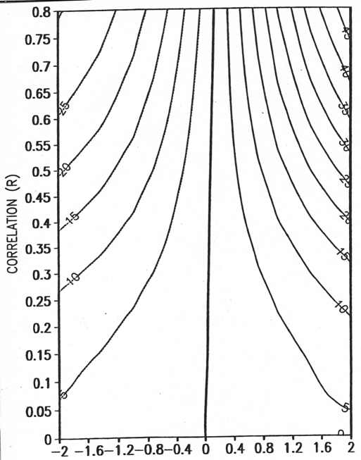
The current way of making prob forecasts
Source: Dave Unger. This figure shows the probability shift (contours), relative to 100*1/3rd, in the above normal class as a function of a-priori correlation (R , y-axis) and the standardized forecast of the predictand (F, x-axis). The prob.shifts increase with both F and R. The R is based on a sample of 30, using a Gaussian model to handle its uncertainty.

Slide 45
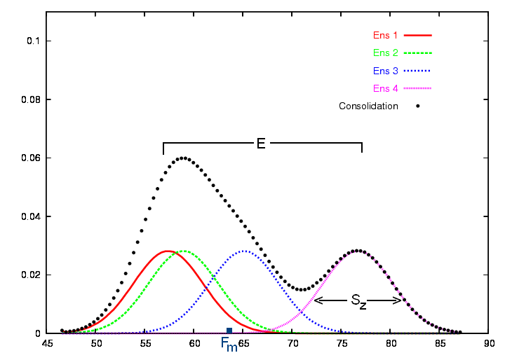
From Dave Unger
Diagram of Gaussian kernel density method to form a probability distribution function from individual ensemble forecasts. Four ensemble members are used in this example to produce a consolidation forecast distribution. E represents the spread, F_{m} is the ensemble mean, and S_{z} is the standard deviation of the Gaussian kernel distribution. The x-axis represents some forecast variable, such as air temperature in Degrees F, and the y-axis is probability density. S_{z} is the same for all 4 kernels but the area underneath each kernel varies according to the weight assigned to the member.

Slide 46
For increasing lead more ridging is required. Why?
1.00 .92 .88 .71 .84 .92 .91 .88 .74 1.32 .90 1
.92 1.00 .89 .77 .86 .93 .95 .91 .80 1.05 .93 2
.88 .89 1.00 .72 .91 .95 .92 .97 .92 .88 .94 3
.71 .77 .72 1.00 .85 .72 .81 .81 .65 1.74 .70 4
.84 .86 .91 .85 1.00 .85 .93 .95 .84 1.31 .88 5
.92 .93 .95 .72 .85 1.00 .91 .92 .85 .79 .94 6
.91 .95 .92 .81 .93 .91 1.00 .98 .83 .93 .92 7
.88 .91 .97 .81 .95 .92 .98 1.00 .87 .90 .93 8
.74 .80 .92 .65 .84 .85 .83 .87 1.00 1.01 .87 9
m=4, lead=5. 50% ridging required to achieve non-ve weights. Why? Don’t know yet.

Slide 47
Weights?
For linear regression?, optimal ‘point’ forecasts (functioning like ensemble means with a pro forma +/- rmse pdf)
Making an ‘optimal’ pdf?

Slide 48
CFS ‘unequal’ members
5 oldest members 9th, 10, 11, 12, 13 m-1
5 middle members 19,20,21,22,23 m-1
5 latest members 30,31,1,2,3rd m-1/m
One model, but 15 members. How to weigh them? (or 30 lagged members)
The NCEP Climate Forecast System. 2005 : S. Saha, S. Nadiga, C. Thiaw, J. Wang, W. Wang, Q. Zhang, H. M. van den Dool, H.-L. Pan, S. Moorthi, D. Behringer, D. Stokes, M. Pena, G. White, S. Lord, W. Ebisuzaki, P. Peng, P. Xie. Submitted to the Journal of Climate, 1st review finished.

Slide 49
weights ridge imth lead AC oldest middle latest CON ens.ave latest
-.09 .27 .38 .50 2 3 86.7 78.4 82.0
.21 .19 .20 .50 3 3 82.2 78.9 69.5

Slide 50
weights ridge imth lead AC oldest middle latest CON ens.ave latest
.16 .09 .29 .50 1 3 80.4 76.1 76.7
-.09 .27 .38 .50 2 3 86.7 78.4 82.0
.21 .19 .20 .50 3 3 82.2 78.9 69.5
.21 .19 .24 .50 4 3 88.9 84.4 71.2
.23 .19 .25 .50 5 3 85.6 79.1 81.4
-.08 .46 .43 .50 6 3 94.9 89.6 86.4
.16 .33 .49 .50 7 3 94.0 90.1 90.7
.35 .38 .39 .35 8 3 94.5 92.7 85.1
.33 .58 .31 .25 9 3 96.8 96.3 91.8
.42 .56 .14 .30 10 3 96.1 95.0 89.6
.17 .24 .48 .50 11 3 93.0 90.6 86.5
.30 .23 .16 .50 12 3 89.8 88.9 83.2
In contrast to Demeter, CFS has starts in all 12 months, and is up to date.

Slide 51
.14 .09 .28 .50 1 3 79.4 77.9 79.4
.00 .20 .43 .50 2 3 85.7 76.5 78.8
.25 .19 .26 .50 3 3 80.1 81.5 74.7
.24 .21 .28 .50 4 3 87.6 87.2 73.1
.23 .18 .18 .50 5 3 84.5 78.5 78.5
-.02 .32 .43 .50 6 3 94.3 88.8 84.7
.17 .26 .38 .45 7 3 93.0 90.7 88.1
.24 .31 .31 .35 8 3 94.1 92.6 85.6
.31 .37 .28 .20 9 3 96.6 96.3 91.6
.31 .40 .09 .25 10 3 95.7 93.5 89.8
.14 .17 .39 .45 11 3 92.9 90.3 86.9
.28 .20 .11 .45 12 3 89.8 88.6 82.4
oldest middle latest ridge m ld CON ens.ave latest
~
The same with lead pooling. Result is somewhat, but not much, better. Less ridging, more reasonable weights. Still October has unreasonable weights, .09 for the recent set.

Slide 52
.14 .09 .28 .50 1 3 79.4 77.9 79.4
.00 .20 .43 .50 2 3 85.7 76.5 78.8
.25 .19 .26 .50 3 3 80.1 81.5 74.7
.24 .21 .28 .50 4 3 87.6 87.2 73.1
.23 .18 .18 .50 5 3 84.5 78.5 78.5
-.02 .32 .43 .50 6 3 94.3 88.8 84.7
.17 .26 .38 .45 7 3 93.0 90.7 88.1
.24 .31 .31 .35 8 3 94.1 92.6 85.6
.31 .37 .28 .20 9 3 96.6 96.3 91.6
.31 .40 .09 .25 10 3 95.7 93.5 89.8
.14 .17 .39 .45 11 3 92.9 90.3 86.9
.28 .20 .11 .45 12 3 89.8 88.6 82.4
oldest middle latest ridge m ld CON ens.ave latest
~
The same with lead pooling. Result is somewhat, but not much, better. Less ridging, more reasonable weights. Still October has unreasonable weights, .09 for the recent set.

Slide 53
1.00 .94 .93 .93 .94 .92 .93 .90 .95 .90 .89 .90 .88 .90 .90 1.45 .90 1 10
.94 1.00 .94 .93 .95 .94 .93 .95 .94 .95 .91 .92 .93 .93 .94 1.34 .92 2 10
.93 .94 1.00 .97 .92 .95 .93 .95 .94 .97 .94 .95 .94 .95 .94 1.49 .90 3 10
.93 .93 .97 1.00 .91 .93 .89 .92 .91 .93 .92 .90 .92 .91 .91 1.47 .90 4 10
.94 .95 .92 .91 1.00 .93 .93 .93 .92 .93 .88 .90 .88 .91 .91 1.44 .91 5 10
.92 .94 .95 .93 .93 1.00 .96 .95 .93 .96 .92 .94 .93 .94 .96 1.52 .94 6 10
.93 .93 .93 .89 .93 .96 1.00 .94 .95 .93 .92 .92 .90 .93 .94 1.49 .91 7 10
.90 .95 .95 .92 .93 .95 .94 1.00 .95 .95 .95 .94 .94 .93 .95 1.51 .93 8 10
.95 .94 .94 .91 .92 .93 .95 .95 1.00 .92 .93 .94 .93 .92 .93 1.44 .90 9 10
.90 .95 .97 .93 .93 .96 .93 .95 .92 1.00 .94 .95 .93 .97 .96 1.42 .91 10 10
.89 .91 .94 .92 .88 .92 .92 .95 .93 .94 1.00 .95 .95 .95 .94 1.59 .89 11 10
.90 .92 .95 .90 .90 .94 .92 .94 .94 .95 .95 1.00 .95 .96 .94 1.51 .89 12 10
.88 .93 .94 .92 .88 .93 .90 .94 .93 .93 .95 .95 1.00 .95 .96 1.55 .88 13 10
.90 .93 .95 .91 .91 .94 .93 .93 .92 .97 .95 .96 .95 1.00 .95 1.54 .89 14 10
.90 .94 .94 .91 .91 .96 .94 .95 .93 .96 .94 .94 .96 .95 1.00 1.51 .90 15 10
Skill is consistently lower, and (sd higher) for the latest 5. October Mystery.
ac

Slide 54
