Slide 1

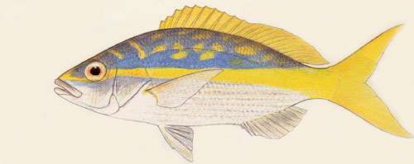
SEDAR8-DW10
DRAFT Observations on yellowtail snapper caught in US Virgin Islands’ commercial fisheries from 1983 to 2003
Joshua Sladek Nowlis
NOAA Fisheries
Southeast Fisheries Science Center
75 Virginia Beach Drive
Miami, FL 33149

Slide 2


“Luke Sladek Nowlis was born on Friday, November 26th, at 3:14am. He tipped the scales at 9lbs 1oz and was 21" tall. With the exception of a hopefully not serious blockage in his urethra, which is most likely to resolve itself, he and his mom Becky are healthy, and big sister Eliana and I are enjoying the new arrival. I hope this note finds you in good fortunes as well.”

Slide 3
Methods
Biostatistical sampling data through the Trip Intercept Program (TIP) were examined.
These data are collected by sampling fish from catches of fishers.
In the case of the US Virgin Islands (USVI), all of the sampling comes from commercial fisheries.
These data provide an opportunity to examine a few different aspects of the commercial fisheries in the USVI.
For the most part, USVI landings are reported by broad species groups, gear types, or some combination of both. These data also allow us to examine the size composition of the catch of many species. Such an analysis was performed for yellowtail snapper (Ocyurus chrysurus). Finally, these data allow us to examine catch per unit effort, and we have also done so for yellowtail snapper.

Slide 4
Weaknesses of this analysis include that many trips are only partially sampled, especially when they have caught a substantial number of a species. This limitation might possibly be addressed by linking the TIP data back to the landings report.
A second weakness, which applies only to the catch per unit effort analyses, is that trips were only included if yellowtail snapper were caught. Another complimentary measure would be proportion of trips that caught yellowtail snapper and could be achieved through additional analysis of the TIP data.
Finally, a number of TIP samples may have coding errors, particularly with respect to length and weight type, that would influence these results. If corrections were made to the dataset, these analyses would need to be rerun.

Slide 5
Size Composition of Catch
TIP samples were identified from the USVI, and categorized by island (St. Croix versus St. Thomas and St. John) and gear (pot, handline, and other). Samples were excluded if lengths or island were not recorded. If more than one yellowtail snapper was caught on an individual trip, those fish were averaged to avoid pseudo-replication. Sample sizes by month, island, and gear, are shown in Table 1.
The results of this analysis are presented in Figs. 1 and 2. Figure 1 shows the average length of yellowtail snapper sampled from various gear types on each of the three islands. This figure illustrates that there was minimal, if any decline, in the average length of yellowtail snapper sampled from 1983 to 2003. Linear regressions were fit to the four most prevalent sample strata: pot and handline catches from St. Croix and from St. Thomas/St. John.

Slide 6
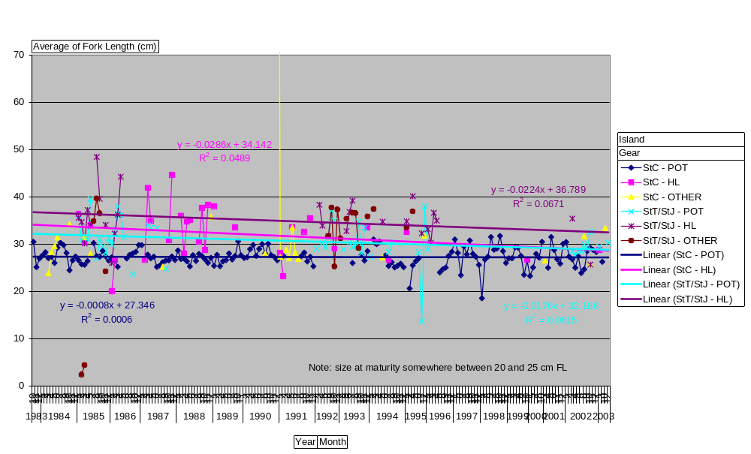
Fig. 1—Average Fork Length (cm). TIP data show a very slight, but not significant downward trend in the average size of yellowtail snapper caught in the USVI between 1983 and 2003.

Slide 7
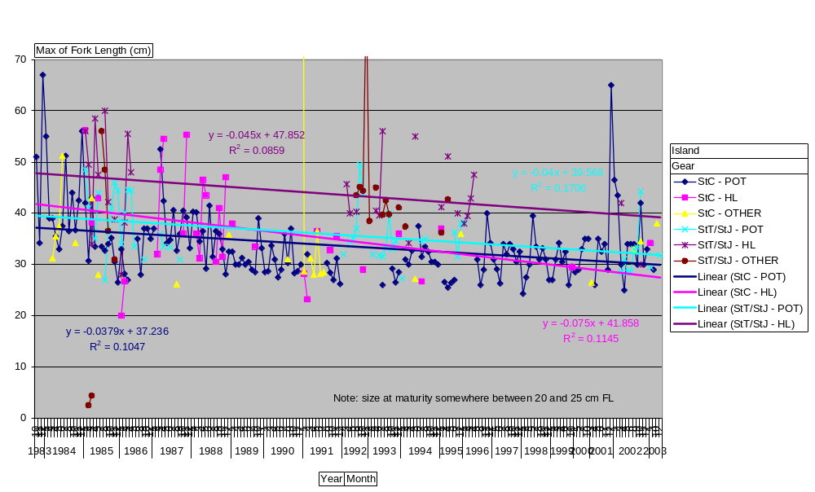
Fig. 2—Maximum Fork Length (cm). TIP data show a slight downward trend in the maximum size of yellowtail snapper caught in the USVI between 1983 and 2003.

Slide 8
Linear regressions were fit to the four most prevalent sample strata: pot and handline catches from St. Croix and from St. Thomas/St. John. All of these showed non-significant trends downward, which only explained between 6.7% (StT/StJ HL) and 0.06% (StC pot) of the observed variation. When maximum length was examined, it showed a slightly greater trend, again downward, accounting for between 8.6% (StT/StJ HL) and 17.1% (StT/StJ pot) of the observed variation.
None of these trends were substantial, but it is worth noting that all were downwards. These data will allow the assessment to examine any evidence of stock growth or decline, as observed from the size composition of fish caught. They will also allow for an estimation of population status by comparing the size distribution of fish being caught to the size composition possible under more or less fishing.

Slide 9
Catch Per Unit Effort
Catch per unit effort (CPUE) were also examined with these data. In this case, samples were excluded if island was not identified or if effort data were incomplete. As with the size composition data, trips were treated independently but multiple fish caught on the same trip were combined. Sample sizes by month, island, and gear, are enumerated in Table 2.
The results, shown after being logarithmically-transformed (Fig. 3), show conflicting information. The linear regression of transformed CPUE values indicates a decline in both the St. Croix and St. Thomas/St. John pot fisheries. The trend line for St. Croix explained nearly 30% of variation while that for St. Thomas/St. John explained over 20%. However, the handline fisheries showed non-significant trends upward, but these trends explained little of the variation (2.9% on St. Croix and 0.17% on St. Thomas/St. John).

Slide 10
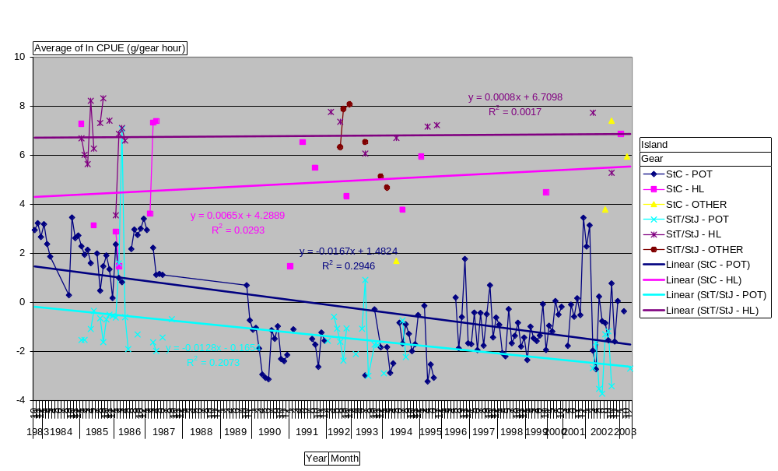
Fig. 3.—Average Logarithmically-Transformed Catch Per Unit Effort (g/gear hour). Data from pot-caught fish indicate a decline, while sparser data from handline-caught fish suggest stability or a slight increase.

Slide 11
Summary
Length frequency analysis would indicate that the yellowtail snapper populations off St. Croix and St. Thomas/St. John have been relatively stable since 1983, with perhaps a slight decline.
Catch per unit effort analyses of the pot fisheries off these islands provide stronger evidence for a decline. On St. Croix, the pot CPUE dropped from 4.4 to 0.17 g/gear hour. It appears the pot CPUE bottomed out in the early 1990s and has been recovering slowly since then. On St. Thomas and St. John, the pot CPUE dropped from 1.18 to 0.1 g/gear hour. Sparser data makes it difficult to see more detailed patterns.
However, CPUE from handline fisheries on both islands suggest stability or possibly even a very modest increase. Though the trends were very slight and explained minimal variation, they would represent substantial increases if they were verified, from 73 to 261 g/gear hour on St. Croix and from 820 to 960 g/gear hour on St. Thomas. While it would be tempting to dismiss these trends because of their relatively small sample sizes and poor statistical fit, it should also be noted that these CPUEs are substantially higher than pot CPUEs, suggesting it is the preferred method for catching yellowtail snapper.
This evidence needs to be reviewed to ensure that it is reasonable before moving forward. The discussion should focus especially on the validity of TIP data for quantifying effort and catch. Additional analyses, as identified in the methods section, may also provide insightful.

Slide 12
SEDAR8-DW-02
DRAFT A History of Yellowtail Snapper (Ocyurus chrysurus) Assessments from the US Caribbean and Florida
Joshua Sladek Nowlis
NOAA Fisheries
Southeast Fisheries Science Center
75 Virginia Beach Drive
Miami, FL 33149

Slide 13
US Caribbean
No one has yet conducted a formal assessment of the yellowtail snapper (Ocyurus chrysurus) stock in Puerto Rico and the US Virgin Islands.
The only previous attempt to ascertain the status of yellowtail snapper in this region came as part of a broader assessment of shallow water reef fish (Appeldoorn et al. 1992).
They found that data were improving in quality but still insufficient to examine some key issues such as spawning potential ratios. they found evidence of some general decline in all Puerto Rican reef fish fisheries combined.

Slide 14
US Caribbean
They (Appledoorn et.al.) found evidence of some general decline in all Puerto Rican reef fish fisheries combined.
This evidence included landings, which had peaked in 1979, hit bottom in 1988, and increased slightly in 1989 and 1990. Composition of the snapper portion of this catch had shifted from mostly shallow water to deeper water. Comparable data was not available to assess the Virgin Islands but landings apparently stayed relatively constant from 1975 to 1989. In both Puerto Rico and the Virgin Islands, catch-per-unit-effort, a possible index of abundance, had declined.
Analyses of the size-frequency of fish sampled from commercial catches provided additional details for each species. With respect to yellowtail snapper, there were some minor changes between 1985 and 1990 that varied from island to island.

Slide 15
Of greater concern for all islands was the number of small fish caught. Female yellowtail snapper mature somewhere between 20 and 25 cm FL (Cummings SEDAR8-DW-04). On Puerto Rico, Appeldoorn and others found the median size of landed yellowtail snapper was less than 25 cm in 1990, a decline from 1985. On St. Croix, the median yellowtail snapper in 1990 was larger than 1985, presumably because of larger trap mesh size. Yield-per-recruit analyses suggest that yellowtail snapper may have been fully- or slightly overexploited by the mid 1980s around Puerto Rico (Dennis 1991).
Appeldoorn, R, J Beets, J Bohnsack, S Bolden, D Matos, S Meyers, A Rosario, Y Sadovy, and W Tobias. 1992. Shallow water reef fish stock assessment for the U.S. Caribbean. NOAA Technical Memorandum NMFS-SEFSC-304. U.S. Department of Commerce, Miami, FL. 70 p.
Dennis, GD. 1991. The validity of length-frequency derived growth parameters from commercial catch data ad their application to stock assessment of the yellowtail snapper (Ocyurus chrysurus). Proc. Gulf Carib. Fish. Inst. 40: 126-138.

