Slide 1
HSLNKC 2004
(27 Libraries in the Greater KC Metro Area)
American Academy of Family Physicians
Baptist-Lutheran Medical Center*
Children’s Mercy Hospital
Cleveland Chiropractic College
Graceland University
Heartland Regional Medical Center
Liberty Hospital
Linda Hall
Menorah Medical Center
Midwest Research Institute
North Kansas City Hospital
Olathe Medical Center
Overland Park Regional Medical Center
Providence Health Center
Quintiles, Inc.
Research Medical Center
Shawnee Mission Medical Center
Shook, Hardy & Bacon
St. Joseph Health Center
St. Luke’s Hospital
Stowers Institute for Medical Research
Truman Medical Center – Lakewood
Kansas City University of Medicine and Biosciences
University of Kansas Medical Center
University of Missouri – Kansas City (HSL)
University of Missouri – Kansas City (SDL)
VA Medical Center

Slide 2
The Constant Problem
Extend Services
Promote Services
Cut Costs

Slide 3
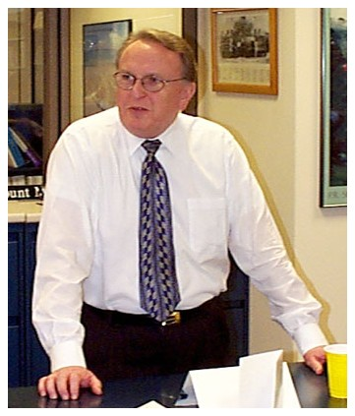
Professional Education
Educational Activities:
  Michelle Beattie University Missouri Kansas City
Increased CE opportunities via MLA, HOA/SLA and HSLNKC
Certificate Recognition
Jerry Baldwin, MLS; MnDOT

Slide 4
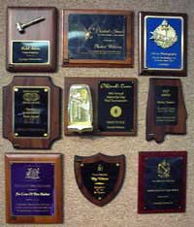
Public / Professional Recognition
Professional Activities:
  Sarah Kirby, MLS, AHIP
  Providence Medical Center
Five Professionally-oriented awards

Slide 5
Public / Professional Recognition
OUTSTANDING ONE-PERSON HEALTH SCIENCES LIBRARY
To honor a one-person health sciences library that has made an outstanding contribution to health sciences librarianship in the areas of impact on patient care; service to its institution; leadership in the profession; and innovation in information transfer.

Slide 6
Public / Professional Recognition
OUTSTANDING ACADEMIC HEALTH SCIENCES LIBRARY
To honor an academic health sciences library that has made special contributions in areas of service to its institution; professional leadership; innovative projects; and organizational efficiency.

Slide 7
Public / Professional Recognition
EXCELLENT RETURN ON INVESTMENT IN A HEALTH SCIENCES LIBRARY
To honor a library that has made an outstanding return on the budgetary investment made in its operation. This return is calculated on both the financial savings incurred on behalf of the patients and the less tangible impact on care as determined by reference to the professional literature.

Slide 8
Public / Professional Recognition
OUTSTANDING HEALTH SCIENCES LIBRARY
To honor a health sciences library that has made special contributions in areas of service to its institution; professional leadership; innovative projects; and organizational efficiency.

Slide 9
Public / Professional Recognition
OUTSTANDING OUTREACH EFFORTS
To honor a medical library that reaches beyond its physical walls to support other libraries, with particular reference to servicing interlibrary loans with promptness and timeliness; to service off-campus affiliated healthcare professionals; to seek out patrons who have otherwise not taken advantage of the information services available in the library.

Slide 10

Consortium Purchasing
Managerial Efficiencies:
  Cheryl Scott, MLS
  Olathe Medical Center
OVID Technologies Full Text Journal & Database collection.
Bylaws Adjustment

