Slide 1
Instrument design,
shielding/background simulations for Hyspec
Vinita J. Ghosh

Slide 2
Shielding simulations performed using MCNPX.
I would like to thank Erik Iverson and Franz Gallmeier for their help.
Instrument design simulations were performed using MCSTAS.
I would like to thank Garrett Granroth.
The polarizations simulations were performed using the NISP (neutron instrument simulation package) code developed at LANL.
I would like to acknowledge the help of P. A. Seeger and Luke Daemen.
At BNL Kim Mohanty who takes care of all our computers and work stations

Slide 3
Part I
Shielding simulations – results that influence the instrument design
Part II
Comparison of instrument performance (monochromatic flux on sample and energy resolution) inside and outside the target hall.

Slide 4
Hyspec design goals:
Largest possible monochromatic flux on small (2cm x 2cm) single crystal samples for moderate energy resolution.
2. Lowest possible background. In optimizing the details of the instrument design we are simulating both signal and background to ensure that we have the largest possible signal to background ratio.
3. Ability to do polarization analysis
Polarization analysis will be performed for Ei ~ 3.6 – 20meV
Since less than 50% of the neutrons will be used in a given polarization experiment it is important to have the highest possible flux on sample to ensure that we will have reasonable data collection rates.

Slide 5
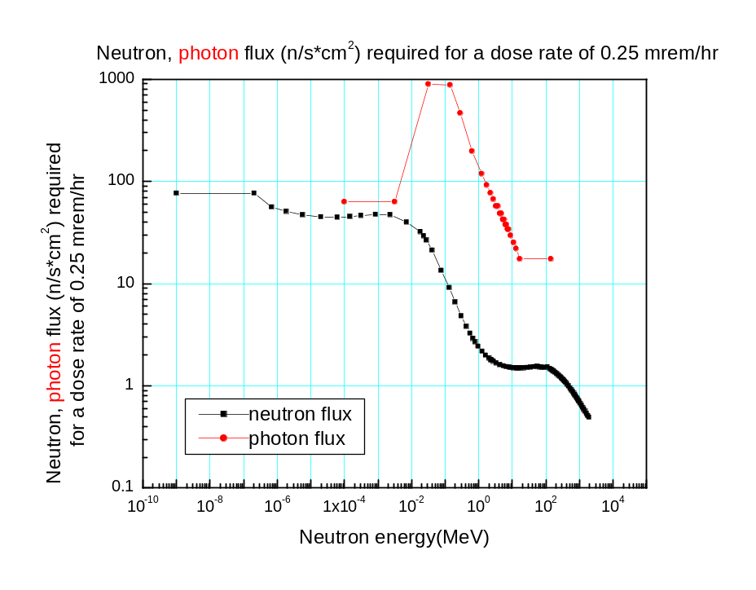
Goals for Hyspec shielding design.
1. Meet the biological dose rate criteria for the SNS facility:
Biological dose rate less than 0.25 mrem/hr.
2. Keep the background down to 1 neutron/detector/minute.
meV neutrons: flux of 100n/cm²/s will meet the dose rate requirement
MeV neutrons: only a flux of 1n/cm²/s can be allowed

Slide 6
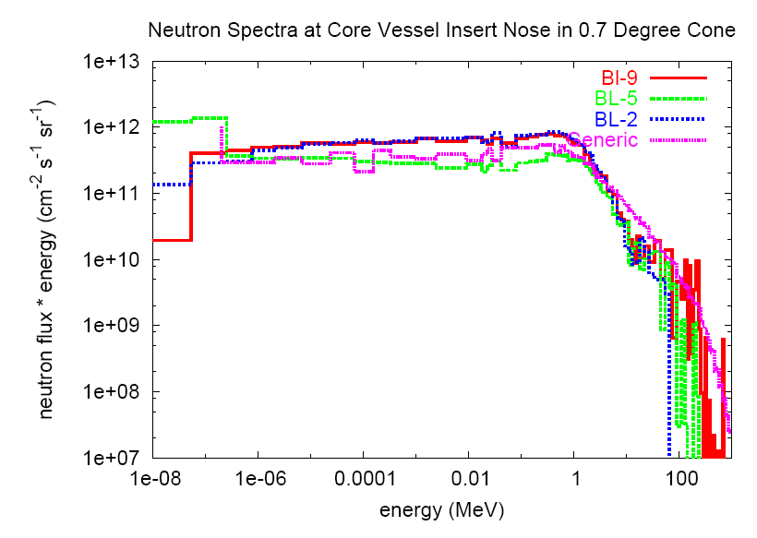
BL9 Water moderator
BL5 Cpl-H2
BL2 Decoupled H2
Generic average
E. Iverson’s simulation results for different SNS moderators

Slide 7
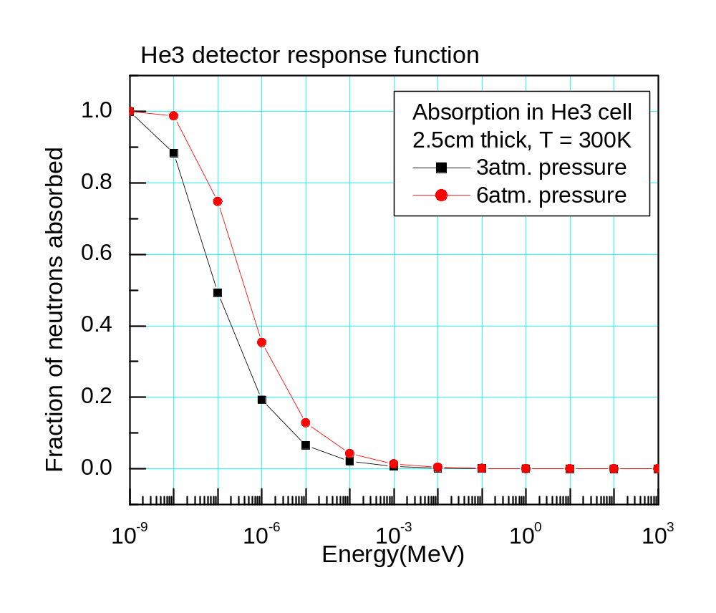
Shielding Goal #2.
Keep background down to 1 neutron per detector per minute.
Neutrons of low energies can be stopped easily in the drum shield
Neutrons with energy 1keV or more will not contribute to background.
High energy neutrons will moderate in the drum shield to produce neutrons that will add to background.
‘zhip’ zero hydrogen matrix for B₄C?

Slide 8
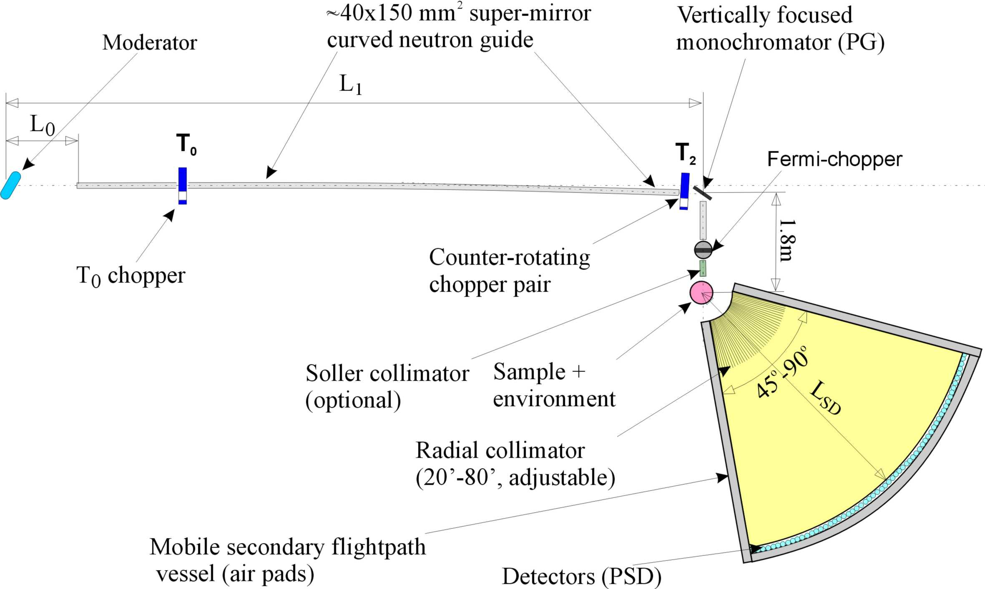
Drum shield
Beam stop
T1B chopper
T1A chopper

Slide 9
T0 chopper
Counter-rotating pair of rotors, rotating at 60Hz
20cm of inconel (or tungsten or steel)
Its main function is to stop MeV and keV neutrons and the initial gamma burst. Attenuation due to 2 rotors ~10⁻⁵ – 10⁻⁶
T1A (frame overlap)chopper
boron-loaded disc chopper at 60Hz
attenuation of 10⁻³-10⁻⁴
T1B (order suppressor) chopper
Same as T1A
stops eV and some keV neutrons as well as low energy neutrons
T2 (wavelength selector) chopper
Pair of counter-rotating discs, maimum rotation rate of 300Hz
Coated with gadolinium – an effective absorber of meV neutrons.

Slide 10
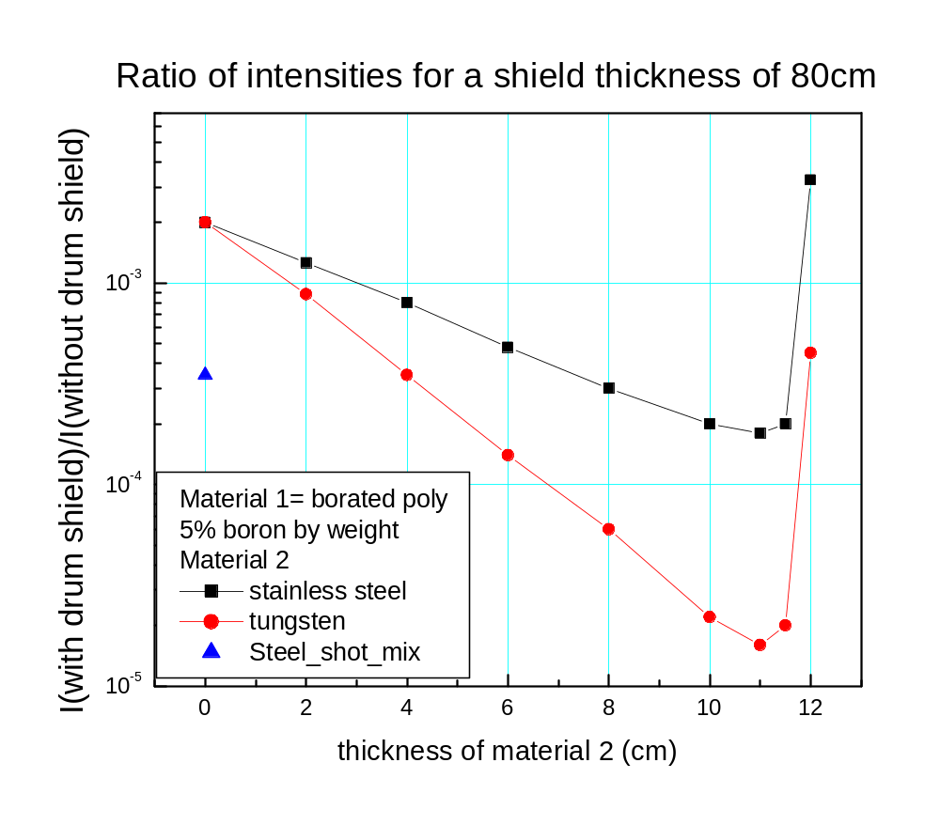
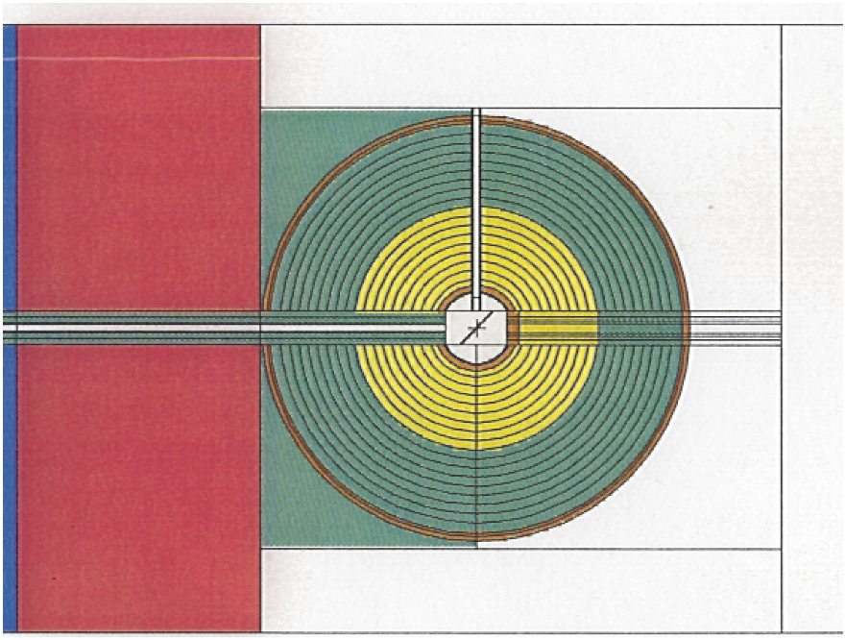
Drum shield simulations
IR=0.2m OR=1.0m, height 1.5m, surface area=9m² =10⁵cm²

Slide 11
Hyspec shielding inside the target hall
1/R² estimate for L_{MM}=25m, straight 4cm(w) 12cm(h) guide, no choppers
Total # of neutrons (all energies) at end of guide = 2.4x10¹⁰ n/s
MCNPX result
Total # of neutrons (all energies) at end of guide = 1.2x10¹⁰ n/s
= 7.2x10¹¹neutrons/minute.
If we want 1n/min/detector we need a total attenuation of 10⁻¹¹ to 10⁻¹²
Attenuation due to T0 chopper ~ 10⁻⁵ – 10⁻⁶
Attenuation due to drum shield ~ 10⁻³ – 10⁻⁴
For isotropic (nonBragg) scattering by the monochromator
neutron flux at drum shield face < 1n/cm²/s
Since scattering is not isotropic there may be a ‘hot spot’ in the line of sight of the moderator

Slide 12
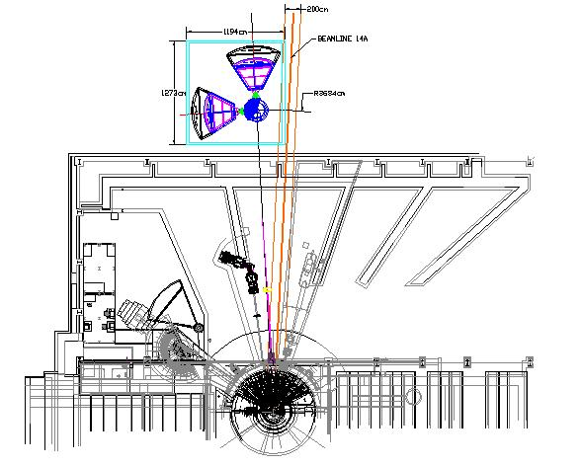
Shielding outside the target hall
L_{MM} ~ 35-40m
Guide options
4cm wide straight
4cm wide, curved
offset at mono. 16cm
Attenuation due to
curvature ~10⁻⁶
This will allow us to make the
Drum shield thinner

Slide 13
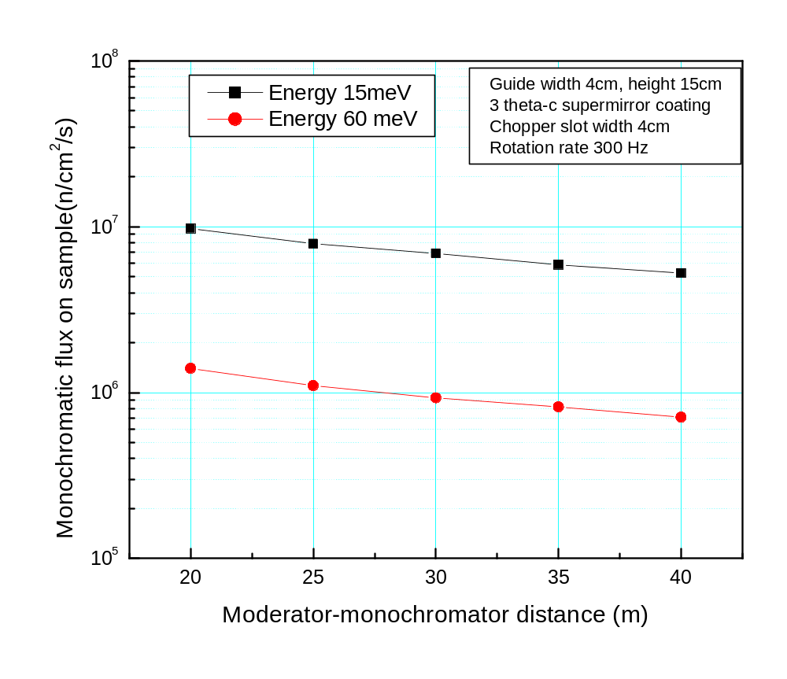
Comparison of instrument performance (monochromatic flux on sample and energy resolution) inside and outside the target hall.
Energy resolution for moderator-monochromator distance L_{MM}=25,35,40m
Ei(meV) | L_{MM}=25 | L_{MM}=35 | L_{MM}=40
3.6 | 2.2% | 2.2% | 2.1%
15 | 4.5% | 4.3% | 4.2%
30 | 6.4% | 6.0% | 5.9%
60 | 9.0% | 8.2% | 8.2%
90 | 10.4% | 10.1% | 9.8%

Slide 14
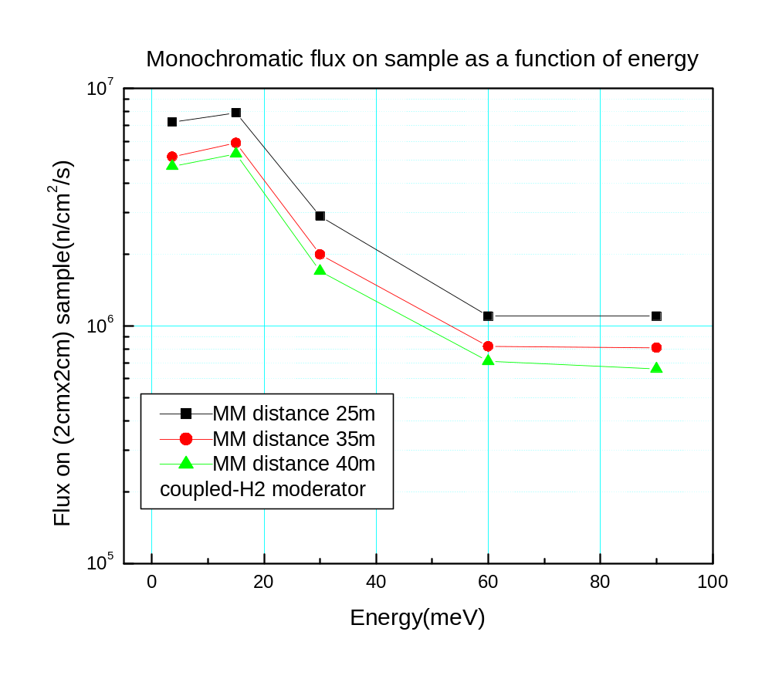
Monochromatic flux on sample for some representative energies
Monochromatic flux on sample for L_{MM} = 25,35, and 40m
Ei(meV) | L_{MM}=25 | L_{MM}=35 | L_{MM}=40
3.6 | 7.2e6 | 5.2e6 | 4.7e6
15 | 8.0e6 | 5.9e6 | 5.3e6
30 | 2.9e6 | 2.0e6 | 1.7e6
60 | 1.1e6 | 8.2e6 | 7.1e6
90 | 1.1e6 | 10.1e6 | 6.6e5

Slide 15
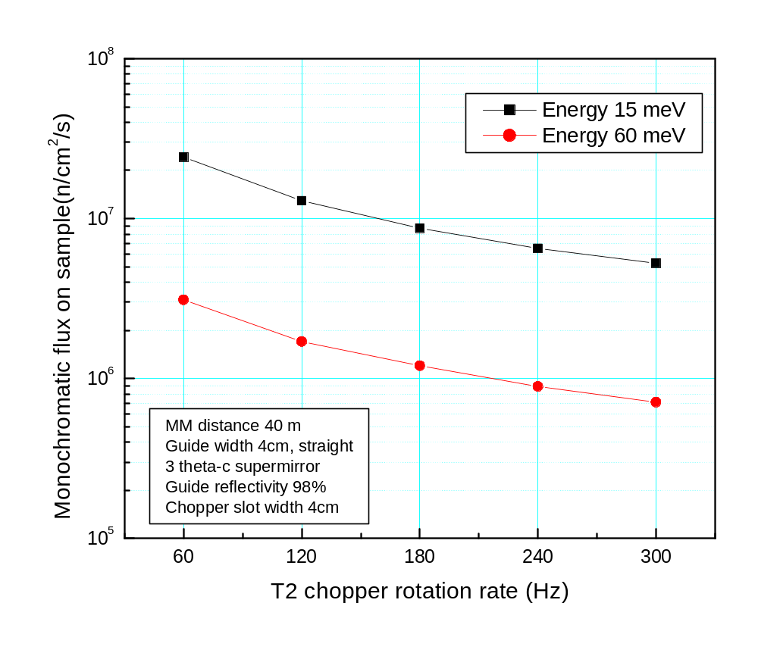
Can we increase signal outside the target hall?
1. Use a tapered guide that converges from 10 to 4 cm in the horizontal plane.
Does not look promising.
Increase the burst width at the sample
by slowing rotation rate of wavelength-defining (T2) chopper, or
by increasing the slot width of the T2 chopper.

Slide 16
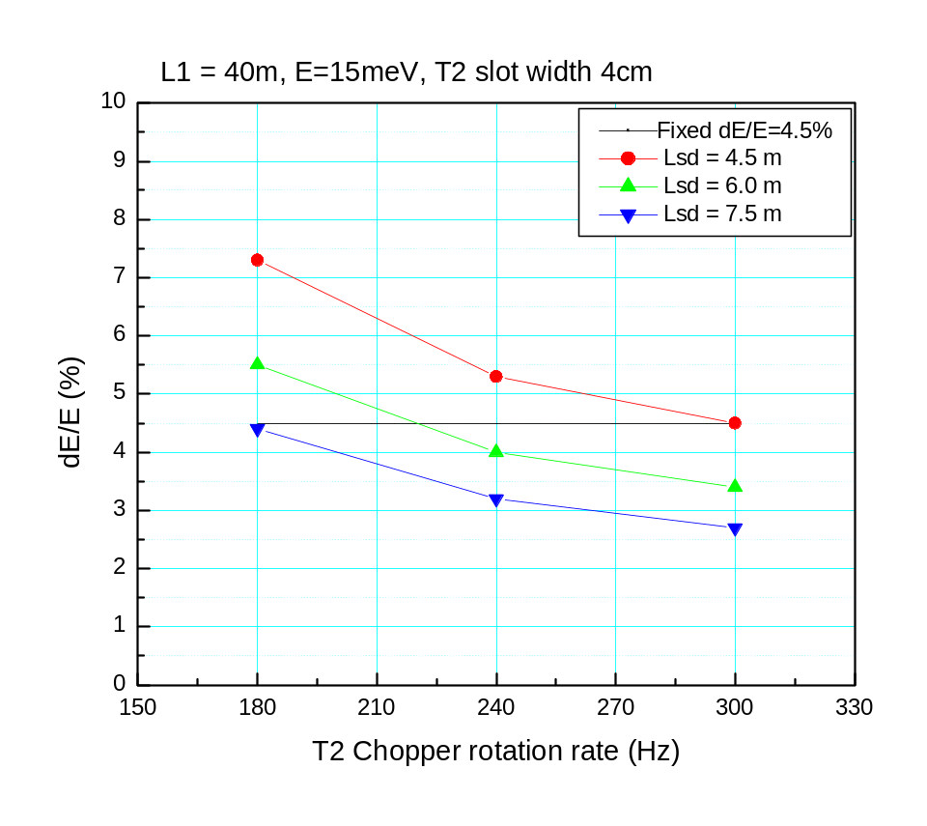
Energy resolution δE/E ~ 2 δt/t
As the burst width increases the energy resolution deteriorates
Energy resolution can be improved by increasing the sample-detector distance from 4.5 to 6 or 7.5m.
Ei = 15meV
L_{MM}(m) | T2 slot width | L_{sd}(m) | T2 rotation rate(Hz) | Flux on sample (n/cm²/s)
25 | 4cm | 4.5 | 300 | 8.0e6
40 | 4cm | 4.5 | 300 | 5.3e6
40 | 4cm | 6.0 | 240 | 6.5e6
40 | 4.5cm | 6.0 | 240 | 7.0e6
40 | 4cm | 7.5 | 180 | 8.7e6

Slide 17
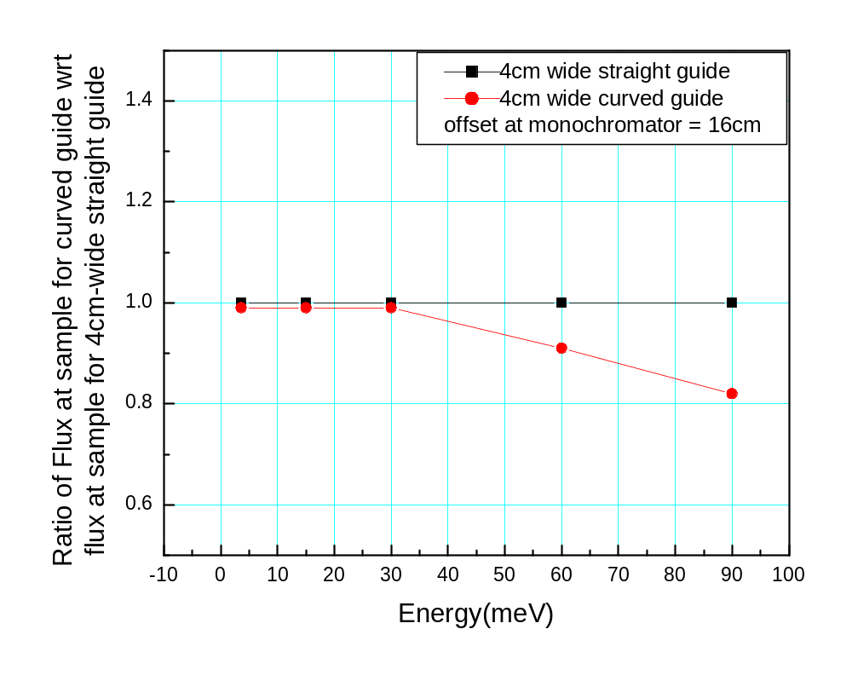
All results so far were for straight guides
Attenuation of background due to curvature ~10⁻⁶
How much loss of signal due to curvature?

Slide 18
Comparison of instrument performance inside and
outside the target hall
 | Inside L_{MM}=25m Lsd=4.5m | Outside L_{MM}=35-40 Lsd=4.5m | Outside L_{MM}=35-40 Lsd=6.0m
Signal (15meV) | 8.0e6 | 5.3e6 | 7.0e6
Energy resolution | 4.5% | 4.5% | 4.5%
Shielding/background | Difficult with straight guide | Much easier with curved guide | Much easier with curved guide
Advantages | Shorter primary guide | Drum shield is simpler | Drum shield is simpler
Extra Cost |  | Building | Bldg + larger detector bank

Slide 19
Future plans
1. Shielding sims with BL5 source instead of generic source
Using BNL multinode computer cluster
Drum shield design
2. Instrument optimization
Guide configuration, coating
Chopper placement
Variable monochromator-sample distance
3. Q resolution

Slide 20
Questions?

