Slide 1
Measurement of the First and Second Moment of the Hadronic Mass Distribution in Semileptonic B Decays
O.Buchmüller(SLAC)
and
H.Flächer(RHUL)
Preliminary Results foreseen for EPS03 in Aachen
Related Documentation:
BAD 663 (EPS conference contribution)
BAD 552 (Supporting Document)
BAD 465 (ICHEP02 hep-ex/0207084)
BAD 409 (Supporting Document)

Slide 2
OPE and the Moments
Parameterization of decay rate in terms of Operator Product Expansion in HQET in powers of α_{s}(m_{b})β₀ and Λ/m_{B:}
∗Λ, λ₁, λ_{2,} are non-perturbative parameters
  − λ₁ (-) kinetic energy of the motion of the b-quark
  − λ₂ chromo-magnetic coupling of b-quark spin to gluon
      from B*-B mass difference, λ₂=0. 12GeV²
  − Λ = m_{B} – m_{b} + (λ₁ - 3 λ₂)/2m_{B} …
  + Additional parameters enter at higher orders (ρ₁, ρ_{2,} τ₁, τ_{2,} τ₃, τ₄ )
  use theoretical estimates –1/m_{B}³
  Similar expressions for
  moments of hadron mass spectrum and
  the lepton energy spectrum from b→clν events
  as well as
  for moments of the photon energy spectrum from b→sγ events

Slide 3

Another “triangle” to be tested …
“shape function”
- OPE link not yet established -
b→sγ, X_{s}ll
BR ~10⁻⁴
⇒ m_{b}, Λ, λ₁, ...
b→ulν
BR ~10⁻³
⇒ V_{ub}
OPE link established
OPE link not yet established
b→sγ: Large potential for new
physics but still the issue of the
rather high photon energy cutoff.
b→X_{s}ll: “Flag ship analysis” for
future b exp. (LHCB, BTEV,10³⁵⁻³⁶)
Theoretical uncertainties on
X_{s}ll will dependent on the
knowledge of the b quark mass
and its fermi motion in B meson.
b→clν
BR ~10⁻¹
V_{cb},
m_{b}, Λ, λ₁, ...
Vub/Vcb: The largest uncertainty is due
to the imperfect knowledge of the b quark
mass and its fermi motion (Vub).
We need Theory and Experiment to not only establish the missing links
in the “OPE triangle” but also to check its consistency!
The measurement of the hadronic mass moments is one step in this direction …

Slide 4


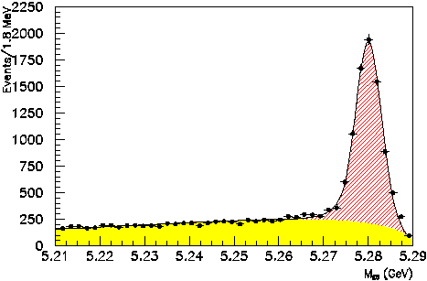
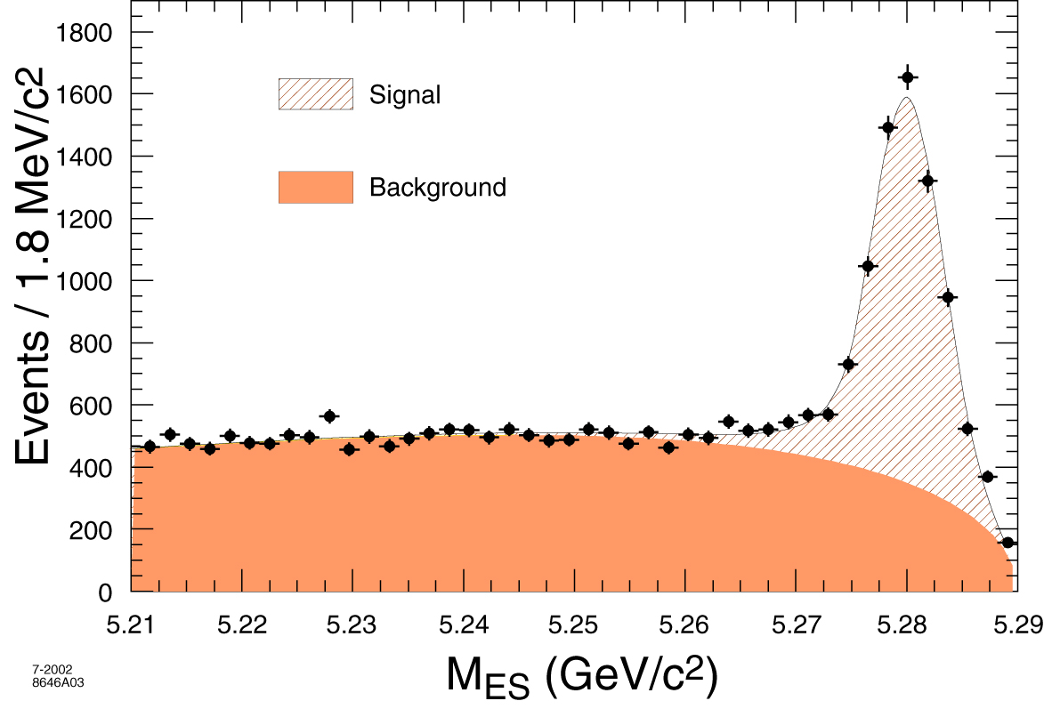
Basis of the Analysis: Fully Reconstructed B’s
Data set: 89 M BB events (ICHEP02: 55 M BB events)
Analysis based on events with one fully reconstructed B decay:
The events are further selected:
  = 1 e or μ with p* > 0.9 GeV/c
  |Q| ≤ 1
  Q’_{l} = Q’_{B} for B± and B⁰
  |E_{miss}-|P_{miss}|| <0.5 GeV
  E_{miss} >0.5 GeV
  |P_{miss}| >0.5 GeV
Final Sample:
  7114 Signal Events (5819 ICHEP02)
  2102 Background (3585 ICHEP02)
  ⇒ S/B > 3:1 (ICHEP02 1.5:1)
ICHEP02
cut

Slide 5
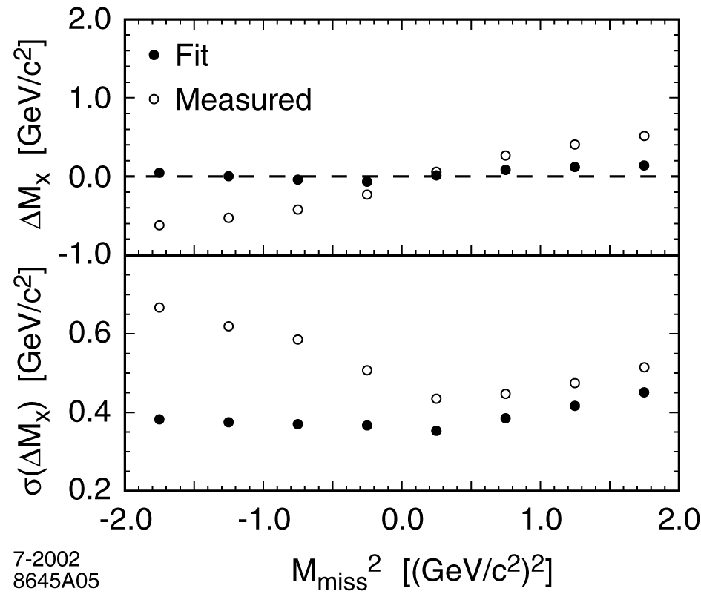
Basis of the Analysis: Kinematic Reconstruction
Better resolution and smaller bias!
BB -> Breco (X,l,Pmiss)
X-System
(3(4) measured parameters)
B reco candidate
(4 measured parameters)
Lepton
(3 measured parameters)
Apply Energy and Momentum conservation
E_{Breco}+ E_{X} + E_{l} + E_{ν} - E_{PEPII} = 0
P_{Breco}+ P_{X} + P_{l} + P_{ν} - P_{PEPII} = 0
4 Constraints
+ Mass Constraints
M(Breco)=M(X,l,ν)
⇒ + 1 Constraints
Missing Neutrino
(3 unmeasured parameters)
Observable:
Invariant mass of X-System
:= Mx
⇒ 2C Fit (NDF = 5 – 3 = 2)

Slide 6
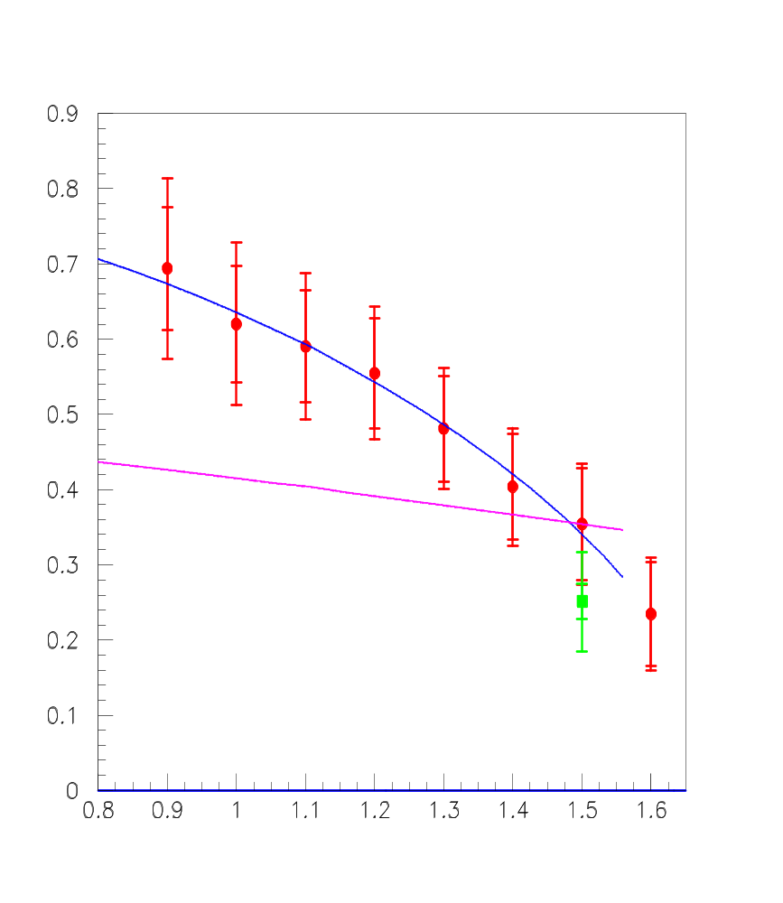
Reminder: Preliminary Results For ICHEP02
Strong dependence of moments on p*_{min}
For p*_{min}=1.5 GeV/c and
Λ=0.35 ± 0.13 GeV ^{[1]}
(reliance on b → sγ spectrum)
λ₁= - 0.17 ± 0.06 ±0.07GeV²
CLEO
λ₁= - 0.226 ± 0.07 ± 0.08 GeV²
BABAR Preliminary
CLEO
OPE (Falk, Luke)
Λ, λ₁ free param.
<M_{X}²-M_{Dspin}²>
No non-resonant
states (MC)
OPE (Falk,Luke)
Λ = 0.35 GeV
But
these parameters do not describe P* dependence of the moments!
λ₁(0.9 GeV/c) – λ₁(1.5 GeV/c)
= 0.22±0.04±0.05 GeV²
p*_{min} [GeV/c]
NB: Data points highly correlated

Slide 7
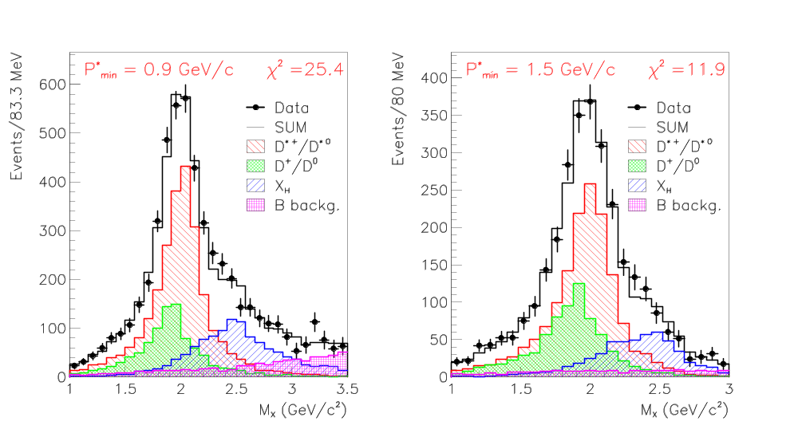
Reminder: Extraction Method For ICHEP02
Binned χ² fit to M_{X} Distribution: 4 Contributions
D = f_{D} P_{D}+ f_{D*} P_{D*} + f_{HX} P_{HX} + f_{BG}(fixed)P _{BG}
Ref.:
BAD409
⇒ Extraction method “ala CLEO” …..

Slide 8
Outstanding Issues with the Extraction Method
Model dependence for high mass final states - shape of non- resonant M_{X} distribution and so < M_{x}^{nreso}> (Goity-Roberts model)
⇒ makes the analysis very model dependent and eventually leads to a large
systematic uncertainty (especially at low P* cuts)
Branching fractions have to be measured - need to extract the relative fraction of D*,D and high mass final states
⇒ leads again to a strong model dependence because the shapes of all
individual components of the Mx distribution have to be taken from the MC
High correlation between data points - per construction lower P* cuts always includes all cuts at higher P*
⇒ due to the used extraction method it is almost impossible to calculate the
correlations between the different measurements
→ no quantitative interpretation possible!

Slide 9
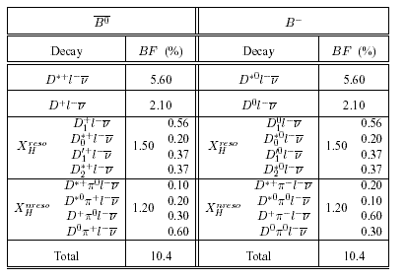
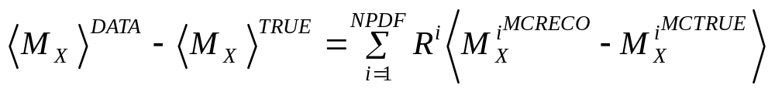
Direct Measurement of <M_{x}^{n}>
Requirement:
<M_{X}^{n}>^{TRUE} ≈ <M_{X}^{n}>^{DATA}
Different Modes used in the MC
For <M_{X}>^{TRUE} - <M_{X}>^{DATA} ≈ 0
we have only a small dependence on the R^{i} (BR) for the individual
Mx components (D*, D and X_{h}).
NPDF: individual modes
R_{i}: relative fractions
⇒small BR dependence!

Slide 10

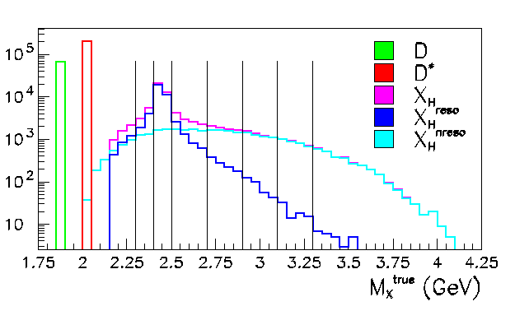
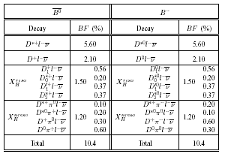
Calibration Curve
Define calibration curve independent of underlying model!
binning in bins of M_{x}^{true}
True modes:
D
D*
D** (two narrow +two broad)
X_{H} (4 spin dependent D^{(*)}PI)
Large variety of different models
and different final states
M_{x}^{true} binning (example)

Slide 11
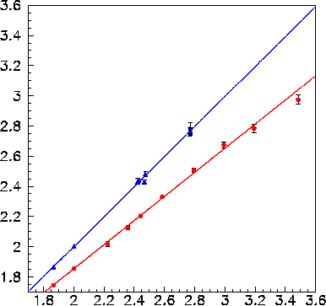
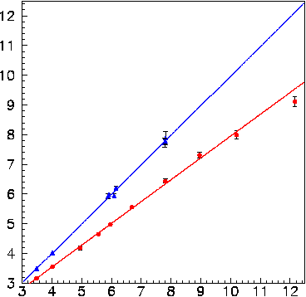
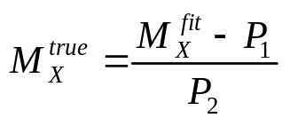
Calibration Curve
<M_{X}>
P₁=0.995±0.011
P₂=0.010±0.022
<M_{X}²>
P₁=0.995±0.011
P₂=0.021±0.046
4 x X_{H}
4 x D**
D*
D
P₁=0.799±0.007
P₂=0.256±0.016
P₁=0.735±0.007
P₂=0.606±0.030
<M_{X}>^{TRUE}
<M_{X}²>^{TRUE}
Two Important Conclusions:
1. We find a linear relation between <M_{X}^{n}>^{TRUE} and <M_{X}^{n}>^{RECO} (red curve).
2. Applying the calibration on an event-by-event level we can correct for mass biases
of all utilized modes (blue curve).
(more details in BAD552 and BAD663)
Linear calibration curve represents a model independent way
to fully correct for detector related mass biases!

Slide 12
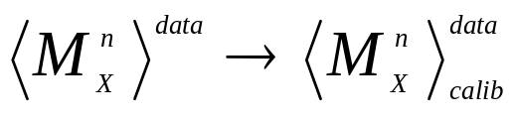
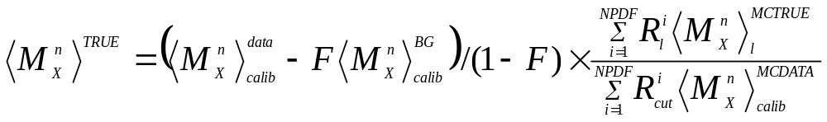
The New Extraction Method
Define calibration curve for observable <M_{x}^{n}> from MC
Calibrate the M_{x}^{n} data sample on event-by-event bases
3. Subtract the remaining peaking background (fraction F and mass <M_{x}^{n}>^{BG})
Intensive studies have been carried out to test the reliability of the MC
simulation by using the wrong sign data sample (see BAD552). It turns
out the largest uncertainty stems from the purely know “branching fractions”
of the “right sign” background (D^{(*)}, D_{s}).
4. Correct for acceptance effects (e.g. lepton acceptance)

Slide 13
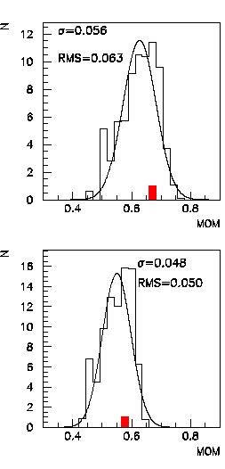
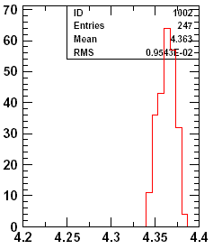
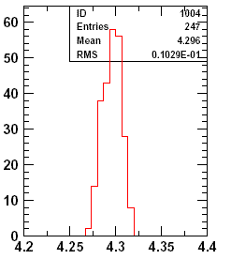
Model Uncertainty
“new extraction”
“old extraction”
Variation of all possible
model combinations defines
the model uncertainty
P*>0.9
P*>0.9
RMS(P*>0.9) =
0.01 GeV²
RMS(P*>0.9) =
0.06 GeV²
RMS(P*>1.1) =
0.01 GeV²
RMS(P*>1.1) =
0.05 GeV²
P*>1.1
P*>1.1
The new extraction method leads to a significant improvement
in the model uncertainty (~factor 5 better than old method) and makes
the measurement almost model independent.

Slide 14


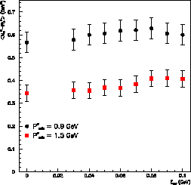
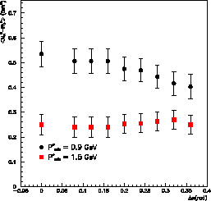
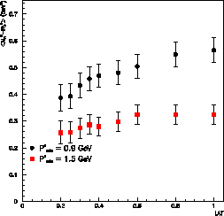
New Photon Selection
Remember:
ICHEP02 analysis
was based on SP3
In the past year several studies have been carried out
to test the reliability of the photon simulation (SP4)
for the X system in semileptonic B decays
(Jan Erik Sundermann, Robert Kowalewski, Recoil Vub task force, …)
⇒ Perform scan of <M_{X}²-M_{Dspin}²> in sensitive variables:
stable within the statistical errors!
NOT stable within the statistical errors!
NOT stable within the statistical errors!
P*=0.9 GeV
<M_{X}²-M_{Dspin}²>
P*=1.5 GeV
E_{γ}
Δα
LAT

Slide 15
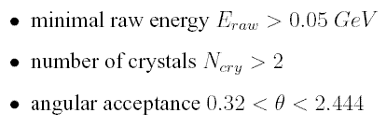

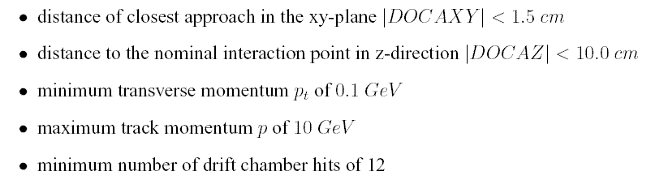
New Photon and Track Selection
New Photon Selection
“insensitive variables”
“sensitive variables”
Track Selection
(similar to the one used for ICHEP02)

Slide 16
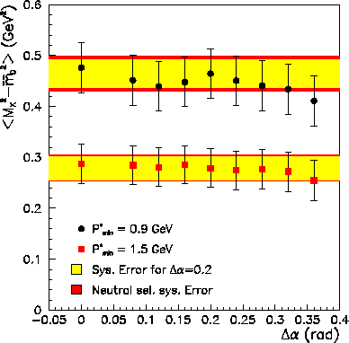
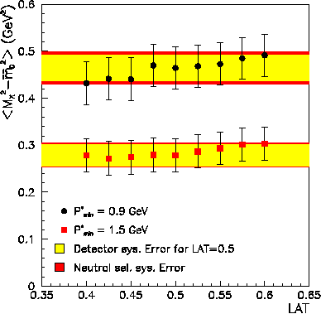
Stability of the new Photon Selection
Scan the stability of the moment measurement as function of Δα and LAT
Yellow Band = Detector error
Default measurement
Δα
LAT
A scan over a large range in Δα and LAT confirms that the results are now stable. All residual
variations a fully compatible with statistical fluctuations introduced by the scan procedure.
Use variation to determine a conservative systematic uncertainty
→ red band (add in quadrature to yellow band)

Slide 17
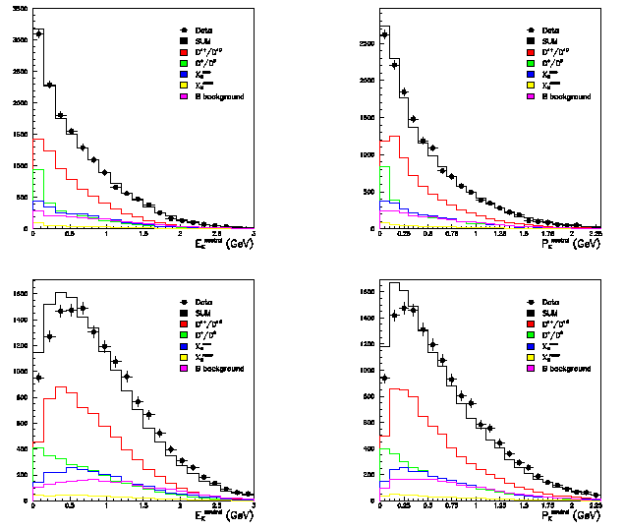
DATA –MC Comparison for P_{X}^{neutral}
P_{x}^{neutral} = 4-vector of all photons in the X-system
NEW
Photon Selection
Clear Improvement!
E_{x}^{neutral}
P_{x}^{neutral}
OLD
Photon Selection
E_{x}^{neutral}
P_{x}^{neutral}

Slide 18
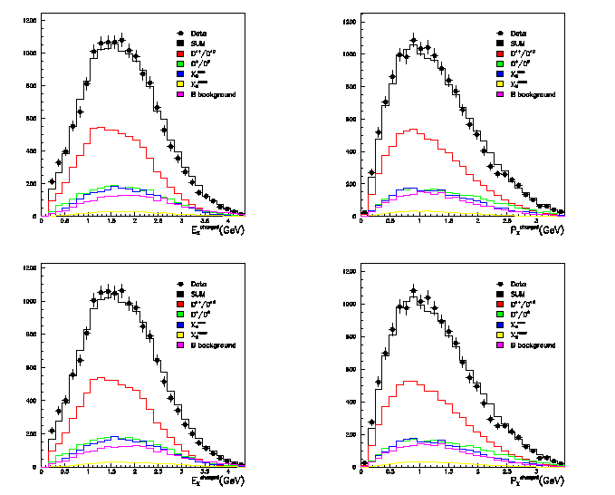
DATA –MC Comparison for P_{X}^{charged}
P_{x}^{charged} = 4-vector of all charged tracks in the X-system
NEW
Photon Selection
No change – as expected
E_{x}^{charged}
P_{x}^{charged}
OLD
Photon Selection

Slide 19
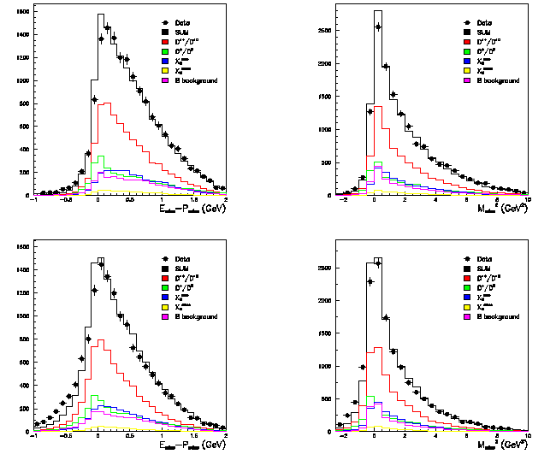
DATA-MC: E_{miss}-P_{miss} and M_{miss}²
NEW
Photon Selection
NEW
Photon Selection
Clear Improvement!
E_{miss}-P_{miss}
M_{miss}²
OLD
Photon Selection

Slide 20
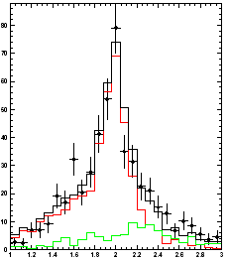
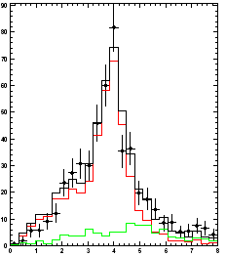
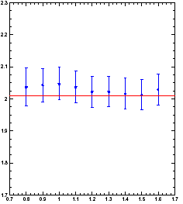
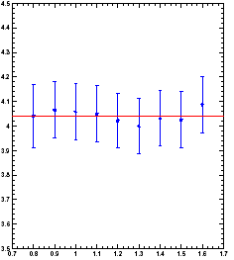
One Last Important Cross Check
Verification of the analysis
on partial reconstructed
B⁰→D^{*+}lν events
Apply the whole extraction
procedure to obtain
<M_{D*}> and <M_{D*}²>
M_{X}
M_{X}²
M_{D*}
M_{D*}²
<M_{X}>
<M_{X}²>
It Works!
P*
P*

Slide 21
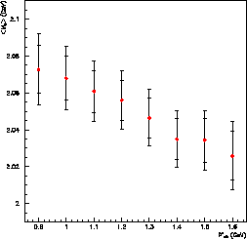
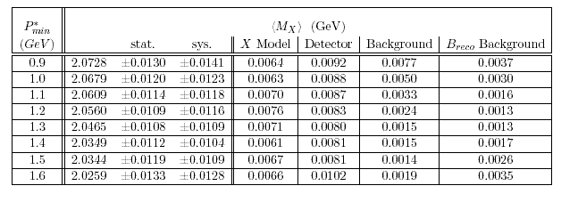
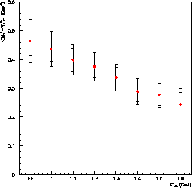
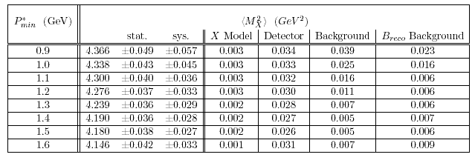
Results for <M_{X}> and <M_{X}²>

Slide 22
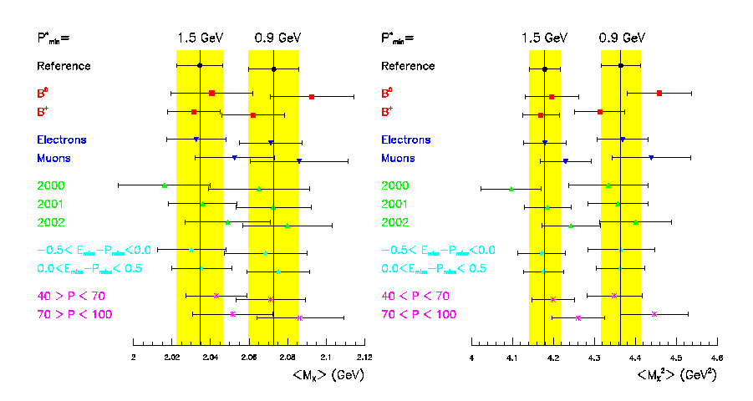
Independent Data Subsets
Good Consistency!

Slide 23
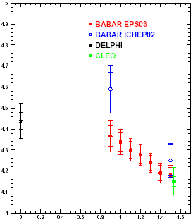
Comparison with ICHEP02
Major changes with respect to ICHEP02
Replace SP3 with SP4 MC and improve the photon
selection!
2. Change event selection and improve S/B for Breco
sample
→ 7114 Sig. over 2102 Backg. for 90 Mio BB
(5819 Sig. over 3585 Backg. for 55 Mio BB)
3. Replace old model dependent extraction method
with a complete new model independent approach!
→ Almost no correlation between the two methods
ICHEP02
Depending on the assumption of the correlation
for the ICHEP02 points as well as on common
systematic errors the new results have shifted
downwards by 1.5 to 1.9 sigma.
The largest fraction of the shift stems from the improved photon selection!

Slide 24
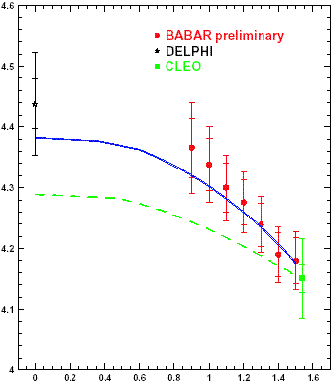
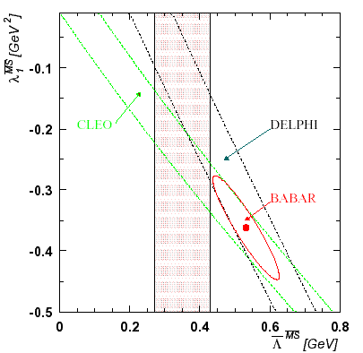
HQET Interpretation
⇒ Calculations from Falk and Luke (Phys.Rev.D57:424-430,1998)
Fit OPE for <Mx²> to BABAR data and extract the two leading HQE
parameters Λ and λ₁ (MS scheme) → all correlations are now taken into account!
CLEO b→sγ
<Mx²>
OPE fit to
the BABAR data
OPE prediction using CLEO data only
<Mx²> and <Eγ> from b→sγ
P*
hadron mass moments seem to be consistent (overlap from bands and BABAR ellipse)
but Δχ2=1 contour does not overlap with <Eγ> band from CLEO b→sγ
Notes:
⇒ Calculations from Falk and Luke (Phys.Rev.D57:424-430,1998)

Slide 25
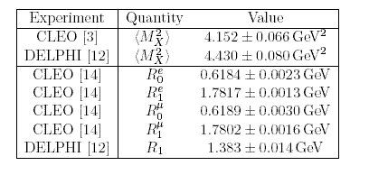
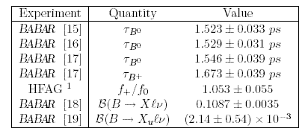
A more Comprehensive Approach
Based on improved OPE calculations in the
1s mass scheme (Phys. Rev. D67. 05012, 2003)
we can now not only include moment
measurements in the fit but also Γ_{SL}
Simultaneous extraction of HQE parameters
and Vcb!
“External Input”
(development of fit code in close collaboration with theorists)
Calculate Γ_{SL} from BABAR data only!
→ life time measurements and BR(B→Xlν) have
by now reached a precession that makes
Γ_{SL} (BABAR) very competitive!
“BABAR Input”
Two possibilities:
Check consistency of the HQE calculations by
comparing hadron moments from BABAR
with other moment measurements (“external input”)
Use the BABAR hadron moments together with
Γ_{SL} (BABAR) to obtained an improved
determination of Vcb

Slide 26
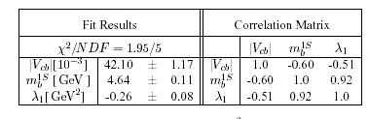
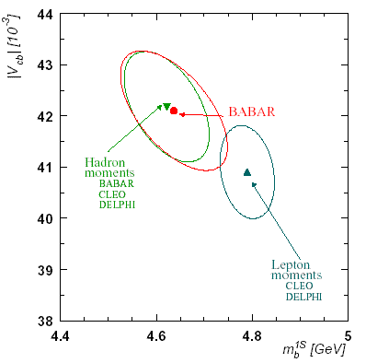
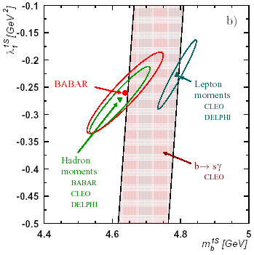
Consistency of the HQE: Hadron mom. vs. Lepton Mom.
Simultaneous extraction of Vcb, m_{b}^{1s}, and λ₁^{1s}
from a fit to the HQE in the 1s mass scheme
(O(1/m_{b}³) parameters are fixed in the fit)
BABAR only
Vcb - m_{b}^{1s} plane
λ₁^{1s} - m_{b}^{1s} plane
Note: Δχ²=1 contour include already part
of the theory errors. Only O(1/m_{b}³) uncertainties
are not included!
Good agreement between BABAR moments and other hadron moment measurements
Δχ²=1 contour of hadron moments and lepton moments do not overlap
→indication for large O(1/m_{b}³) corrections or maybe even more …?
(bear in mind that Γ_{SL} is common in both fits!)

Slide 27
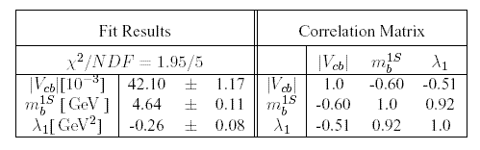

|Vcb| extracted using BABAR data only
BABAR only
[previous inclusive Vcb measurement from BABAR: |Vcb| = 42.3±0.7(exp)±2.0(theo) ~5% (Phys. Rev. D67, 2002) ]
The most precise measurement of Vcb from one single
experiment (life time, branching fractions, moments) and also
very competitive (3% total error)!
Caveat: We still have to establish the consistency of the the OPE
to at least the same level of accuracy we would like to achieve for Vcb (<1%)!

Slide 28
Summary and Conclusion
We have measured the first and second moment of the Mx distribution
for different P* cuts (0.9 to 1.6 GeV).
With a completely new and unique extraction approach we were able to
overcome outstanding issues (like model uncertainty and point-to-point
correlations) which lead to a significant improvement of the new results
The new results are ~1.5(1.9) Sigma below the results presented in ICHEP02
(mainly due to the improved photon selection).
Using a simultaneous extraction of Vcb, m_{b}^{1s}, and λ₁^{1s} from a fit to the HQE
calculations we obtain a improved measurement of Vcb which is based on BABAR
data only!
A comparison with other hadron moment measurements from CLEO and DELPHI
demonstrates a good agreement.
A consistency test of hadron and lepton moments in the framework of the OPE leads
to inconclusive results and demonstrates again the importance of the determination
of all the O(1/m_{b}³) parameters from data.
→ More moment measurements from different
physics processes will be needed to test HQET+OPE to the level of <1%.
⇒ BABAR is the perfect Experiment for this task and we are just at the beginning … ☺

Slide 29
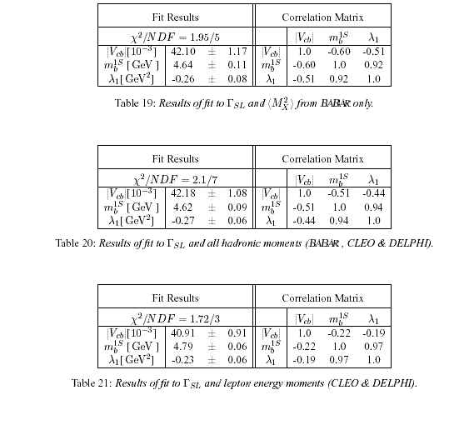
FIT RESULTS

Slide 30
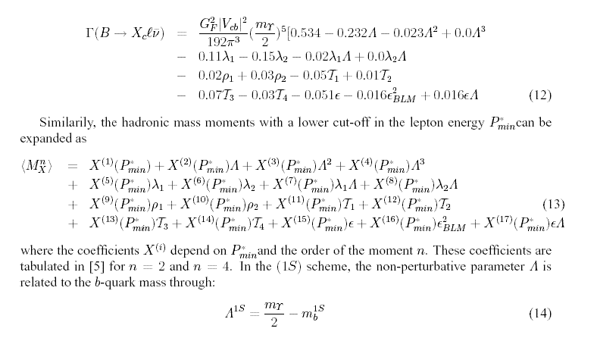
More on the Fit

Slide 31
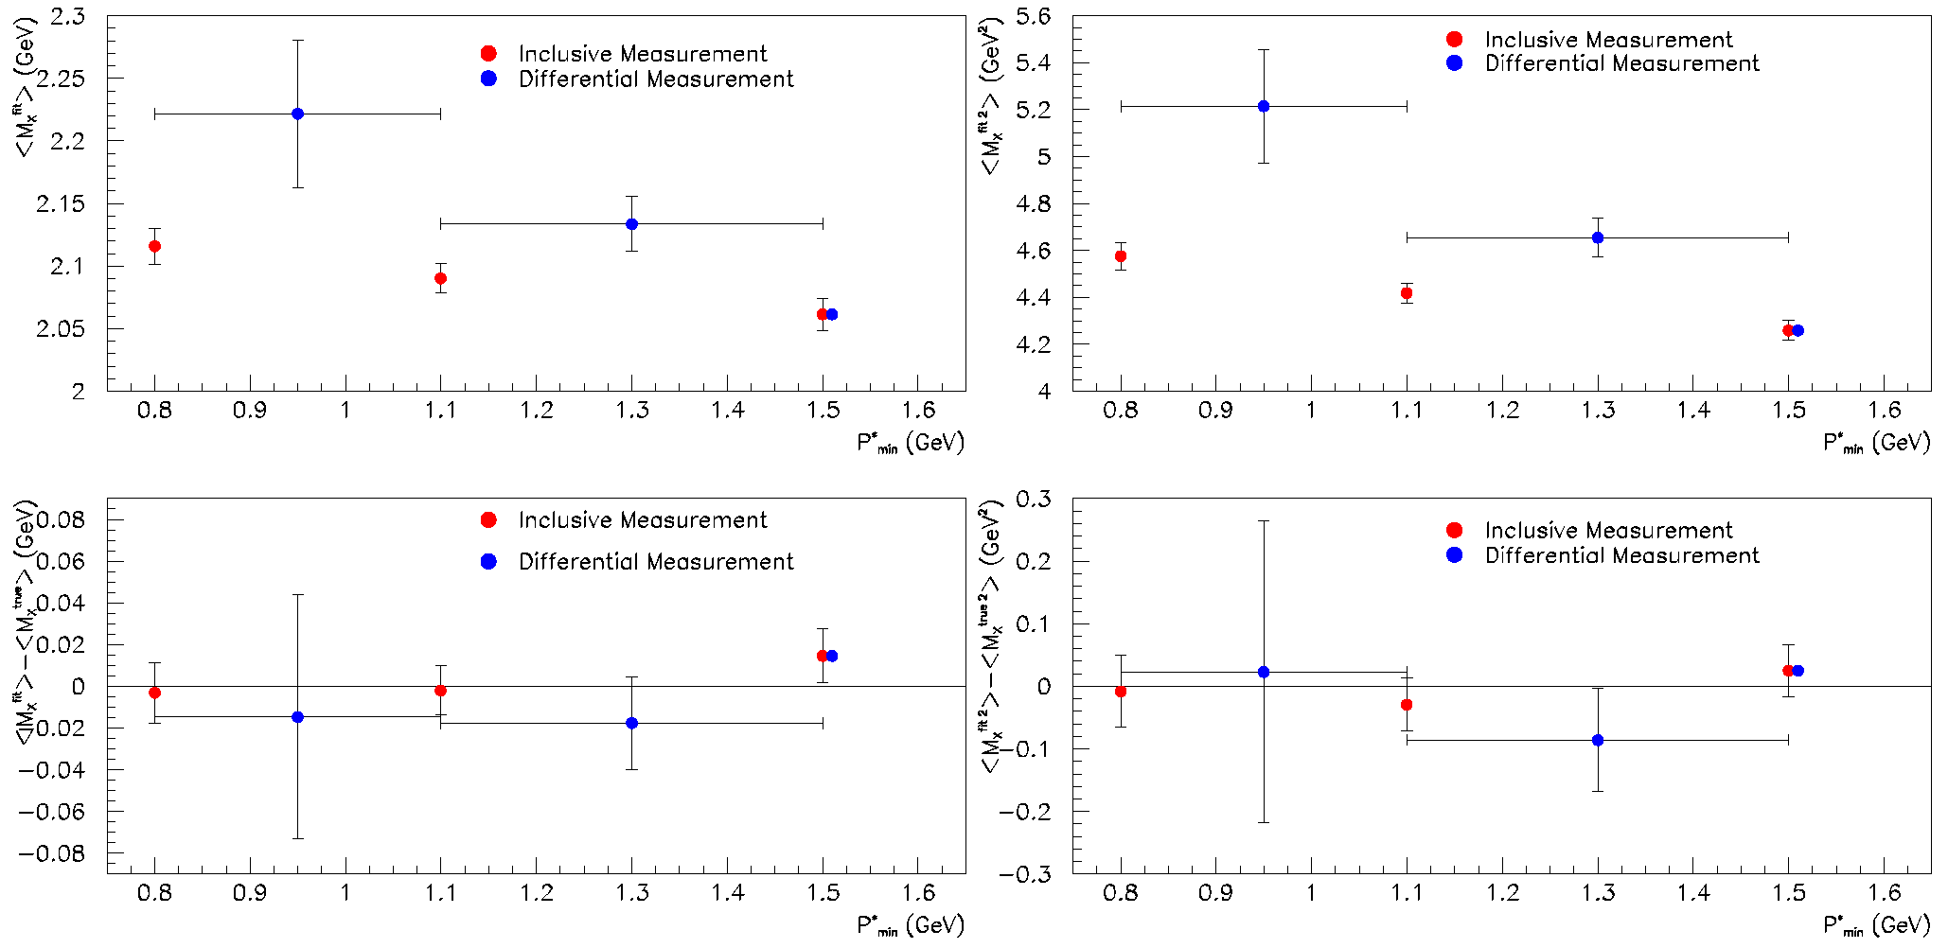
Does it work? – Crosscheck on MC

Slide 32
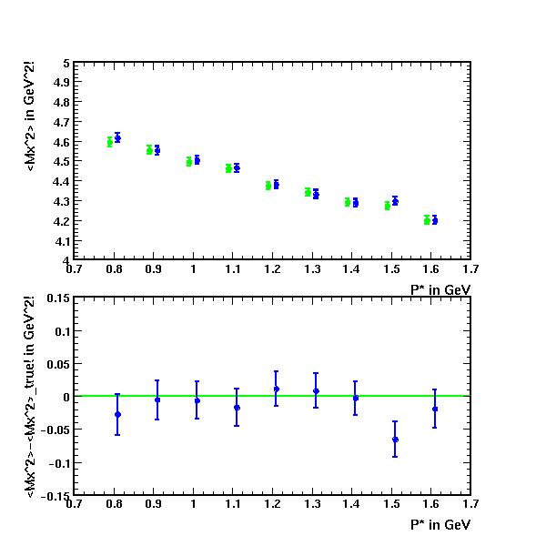
Cross Checks on the MC: <Mx²>
It Works!
raw <Mx²>
bias corrected <Mx²>
Applying the whole
analysis chain on the
generic MC yields the
<Mx²>_{true}
in the MC
<Mx²>
<Mx²> - <Mx²>_{true}
Low MC statistic
for high mass final States
(only 5 events)
> Large statistical uncertainty
in bias correction. Interpolation
or more MC stat. will fix this!

Slide 33
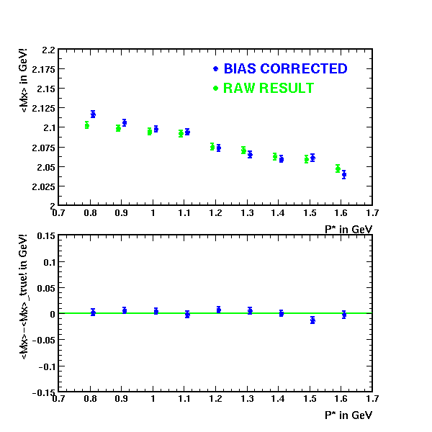
Cross Checks on the MC <Mx>
We can also measure
<Mx> (with even
higher precession)
Low MC statistic
for high mass final states
(only 5 events)
> Large statistical uncertainty
in bias correction. Interpolation
or more MC stat. will fix this!

Slide 34


Wrong Sign Background: DATA vs. MC
B⁰
B⁰ mixing
B⁺
P* bins: 0.8-1.0 GeV 1.0-1.4 GeV >1.4 GeV

Slide 35
Breco Sample: Comparison ICHEP02 and EPS03
EPS03
ICHEP02

Slide 36

Correlation Matrix for <Mx²>

Slide 37

Systematic Errors on <Mx²>

