Slide 1
Identification of new sources of partial resistance to oat crown rust
Marty Carson, USDA Cereal Disease Lab, St. Paul, MN

Slide 2
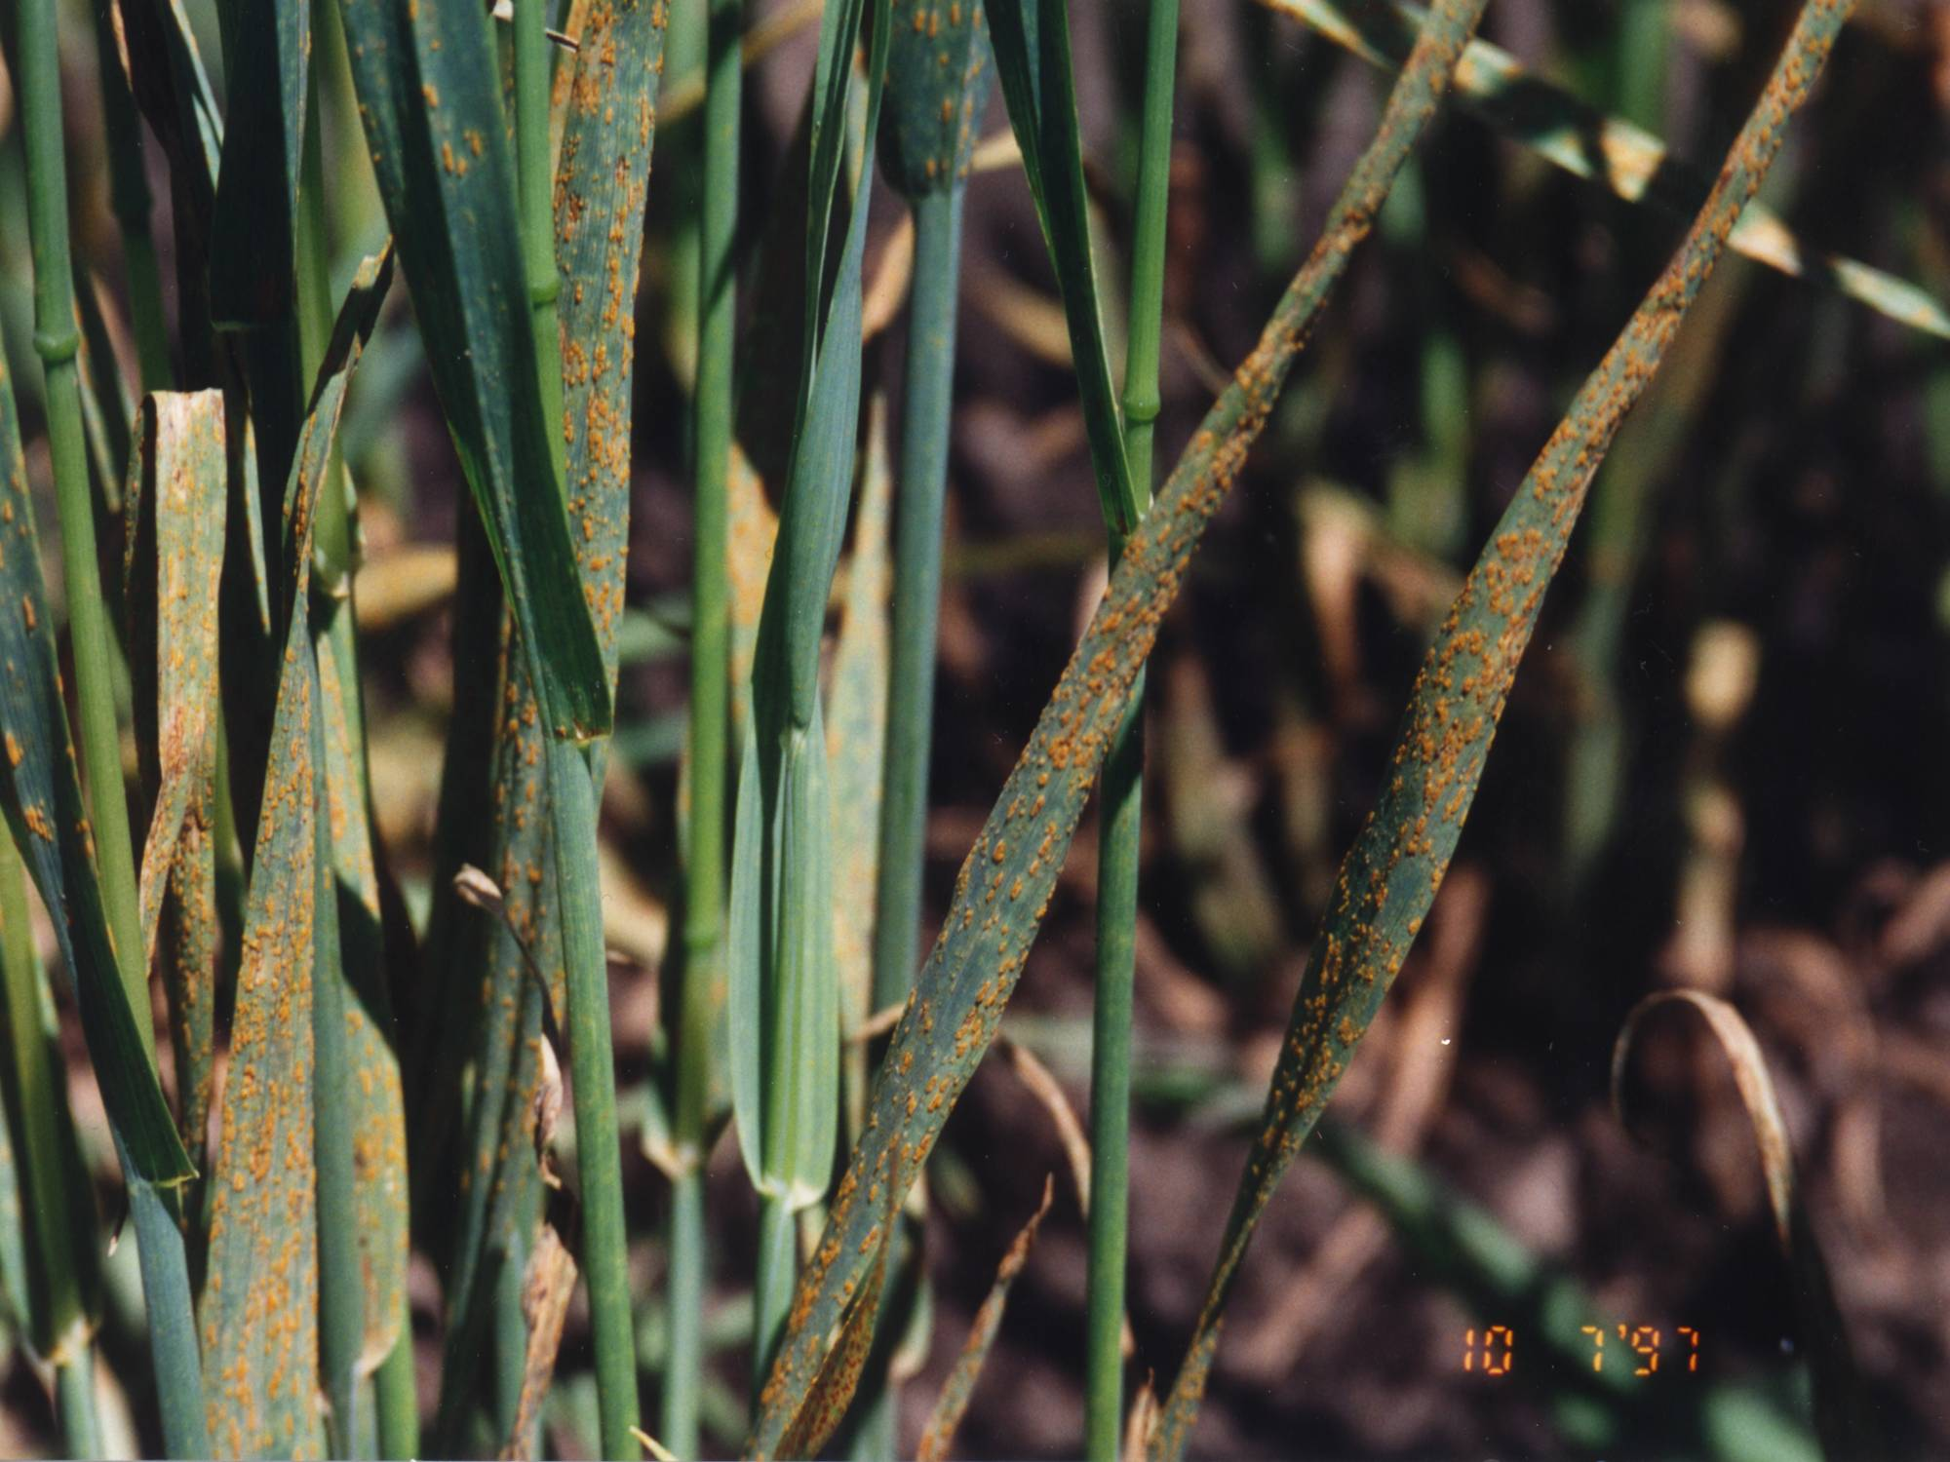

Slide 3
Oat Crown Rust: the Pathosystem from Hell
90+ Pc genes described; virulence to all of them
Sexually recombining pathogen
Positive virulence associations
No apparent cost to complex virulence
Resistant cultivars have a 3-5 yr lifespan

Slide 4
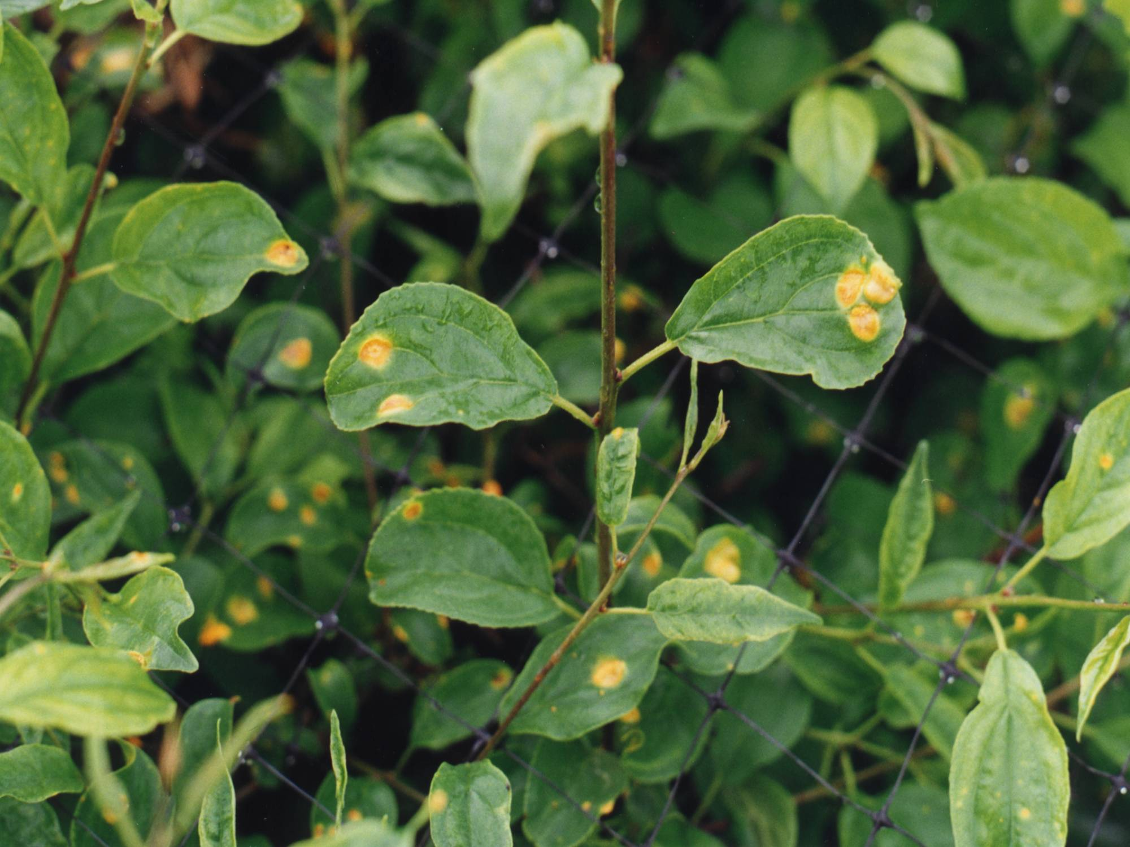

Slide 5
Insanity: continuing to do the same thing, but expecting different results

Slide 6
‘Slow Rusting’ or Partial Resistance to Oat Crown Rust
Portage, Minhafer, Lodi (Heagle & Moore, 1970)
Red Rustproof (Luke et al, 1972)
MN841801, MN841810, MN841804, etc. (Leonard, 2002)

Slide 7
Problem: Identification of partial, non-specific resistance in the presence of race-specific resistance genes when corresponding virulence in the pathogen population is at a low frequency (Parlevliet, 1983)

Slide 8
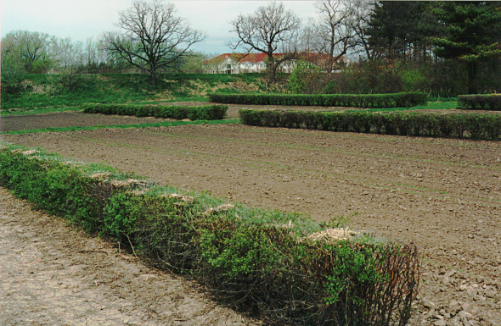

Slide 9
Entry | 2005 Buckthorn Nursery |  | 2005 Virulent Inoculum
 | 7/5 | 7/13 | 7/11 | 7/18
CDC Boyer | 4S | 45S | 10S | 25S
MN841801 | 2MR/MS | 22MR/MS | 7S | 15MR
Pc68 | Trace | 7S | 55S | dead
GS7 | 7S | 50S | 7S | 22S
IA 98822-2 | 5S | 50S | 20S | 32S
CI4706 | 0 | 10S | Trace | 1S
CI5562 | 4S | 50S | 10S | mature
CI5632 | 10S | 60S | 40S | 40S
CI7035 | 0 | 20S | 5S | 10S
CI8220 | 10S | 80S | 25S | 45S
CI8261 | 5S | 50S | 25S | mature
CI8262 | 4S | 55S | 15S | 30S
CI8429 | Trace | 30MR/MS | 5MS | 10S
CI9244 | 15S | 80S | 50S | dead
CI9248 | 1S | 10MR/MS | 5MS | 5MR
CI9416 | 4S | 40S | 15S | 30S
PI189733 | 7S | 30MS/MR | 25MS | 30MR/MS
PI260616 | 4S | 30S | 10MS | 10MS
PI263412 | Trace | 20S | 1MS | 5S
PI266884 | 0 | 7S | 1MR | 3MR
PI266887 | Trace | 15S | 2S | 7S

Slide 10
Entry | 2005 Buckthorn Nursery |  | 2005 Virulent Inoculum
 | 7/5 | 7/13 | 7/11 | 7/18
CDC Boyer | 4S | 45S | 10S | 25S
MN841801 | 2MR/MS | 22MR/MS | 7S | 15MR
Pc68 | Trace | 7S | 55S | dead
GS7 | 7S | 50S | 7S | 22S
IA 98822-2 | 5S | 50S | 20S | 32S
CI4706 | 0 | 10S | Trace | 1S
CI5562 | 4S | 50S | 10S | mature
CI5632 | 10S | 60S | 40S | 40S
CI7035 | 0 | 20S | 5S | 10S
CI8220 | 10S | 80S | 25S | 45S
CI8261 | 5S | 50S | 25S | mature
CI8262 | 4S | 55S | 15S | 30S
CI8429 | Trace | 30MR/MS | 5MS | 10S
CI9244 | 15S | 80S | 50S | dead
CI9248 | 1S | 10MR/MS | 5MS | 5MR
CI9416 | 4S | 40S | 15S | 30S
PI189733 | 7S | 30MS/MR | 25MS | 30MR/MS
PI260616 | 4S | 30S | 10MS | 10MS
PI263412 | Trace | 20S | 1MS | 5S
PI266884 | 0 | 7S | 1MR | 3MR
PI266887 | Trace | 15S | 2S | 7S

Slide 11
Entry | 2005 Buckthorn Nursery |  | 2005 Virulent Inoculum
 | 7/5 | 7/13 | 7/11 | 7/18
CDC Boyer | 4S | 45S | 10S | 25S
MN841801 | 2MR/MS | 22MR/MS | 7S | 15MR
Pc68 | Trace | 7S | 55S | dead
GS7 | 7S | 50S | 7S | 22S
IA 98822-2 | 5S | 50S | 20S | 32S
CI4706 | 0 | 10S | Trace | 1S
CI5562 | 4S | 50S | 10S | mature
CI5632 | 10S | 60S | 40S | 40S
CI7035 | 0 | 20S | 5S | 10S
CI8220 | 10S | 80S | 25S | 45S
CI8261 | 5S | 50S | 25S | mature
CI8262 | 4S | 55S | 15S | 30S
CI8429 | Trace | 30MR/MS | 5MS | 10S
CI9244 | 15S | 80S | 50S | dead
CI9248 | 1S | 10MR/MS | 5MS | 5MR
CI9416 | 4S | 40S | 15S | 30S
PI189733 | 7S | 30MS/MR | 25MS | 30MR/MS
PI260616 | 4S | 30S | 10MS | 10MS
PI263412 | Trace | 20S | 1MS | 5S
PI266884 | 0 | 7S | 1MR | 3MR
PI266887 | Trace | 15S | 2S | 7S

Slide 12
Entry | 2005 Buckthorn Nursery |  | 2005 Virulent Inoculum
 | 7/5 | 7/13 | 7/11 | 7/18
CDC Boyer | 4S | 45S | 10S | 25S
MN841801 | 2MR/MS | 22MR/MS | 7S | 15MR
Pc68 | Trace | 7S | 55S | dead
GS7 | 7S | 50S | 7S | 22S
IA 98822-2 | 5S | 50S | 20S | 32S
CI4706 | 0 | 10S | Trace | 1S
CI5562 | 4S | 50S | 10S | mature
CI5632 | 10S | 60S | 40S | 40S
CI7035 | 0 | 20S | 5S | 10S
CI8220 | 10S | 80S | 25S | 45S
CI8261 | 5S | 50S | 25S | mature
CI8262 | 4S | 55S | 15S | 30S
CI8429 | Trace | 30MR/MS | 5MS | 10S
CI9244 | 15S | 80S | 50S | dead
CI9248 | 1S | 10MR/MS | 5MS | 5MR
CI9416 | 4S | 40S | 15S | 30S
PI189733 | 7S | 30MS/MR | 25MS | 30MR/MS
PI260616 | 4S | 30S | 10MS | 10MS
PI263412 | Trace | 20S | 1MS | 5S
PI266884 | 0 | 7S | 1MR | 3MR
PI266887 | Trace | 15S | 2S | 7S

Slide 13
Entry | 2005 Buckthorn Nursery |  | 2005 Virulent Inoculum
 | 7/5 | 7/13 | 7/11 | 7/18
CDC Boyer | 4S | 45S | 10S | 25S
MN841801 | 2MR/MS | 22MR/MS | 7S | 15MR
Pc68 | Trace | 7S | 55S | dead
GS7 | 7S | 50S | 7S | 22S
IA 98822-2 | 5S | 50S | 20S | 32S
CI4706 | 0 | 10S | Trace | 1S
CI5562 | 4S | 50S | 10S | mature
CI5632 | 10S | 60S | 40S | 40S
CI7035 | 0 | 20S | 5S | 10S
CI8220 | 10S | 80S | 25S | 45S
CI8261 | 5S | 50S | 25S | mature
CI8262 | 4S | 55S | 15S | 30S
CI8429 | Trace | 30MR/MS | 5MS | 10S
CI9244 | 15S | 80S | 50S | dead
CI9248 | 1S | 10MR/MS | 5MS | 5MR
CI9416 | 4S | 40S | 15S | 30S
PI189733 | 7S | 30MS/MR | 25MS | 30MR/MS
PI260616 | 4S | 30S | 10MS | 10MS
PI263412 | Trace | 20S | 1MS | 5S
PI266884 | 0 | 7S | 1MR | 3MR
PI266887 | Trace | 15S | 2S | 7S

Slide 14
Entry | 2006 Buckthorn Nursery |  | 2006 Virulent Inoculum (1-9)
 | 6/28 | 7/5 | 7/14 | 7/23
CDC Boyer | 5S | 30S | 6.5 | 4.5
MN841801 | 5MS | 20MR/MS | 7.5 | 5.5
Pc68 | 5S | 30S | 6.0 | 1.5
Starter | 30S | 80S | 3.0 | 1.0
CI1712 | 3MS | 15MR/MS | 8.0 | 7.0
CI1965 | 4MS | 25MS | 6.0 | 3.5
CI4736 | 3S | 10MR/MS | 7.5 | 3.5
CI6991 | 5MS/S | 20S | 6.5 | 3.0
CI8000 | 3MS | 15MS | 7.5 | 6.5
CI8357 | 5S | 20MS | 8.0 | 4.5
CI8358 | 40S | 65S | 6.0 | 2.5
CI8432 | 5S | 15MS | 6.5 | 3.0
CI9247 | 0R | 4MR | 8.0 | 7.0

Slide 15
Entry | 2006 Buckthorn Nursery |  | 2006 Virulent Inoculum (1-9)
 | 6/28 | 7/5 | 7/14 | 7/23
CDC Boyer | 5S | 30S | 6.5 | 4.5
MN841801 | 5MS | 20MR/MS | 7.5 | 5.5
Pc68 | 5S | 30S | 6.0 | 1.5
Starter | 30S | 80S | 3.0 | 1.0
CI1712 | 3MS | 15MR/MS | 8.0 | 7.0
CI1965 | 4MS | 25MS | 6.0 | 3.5
CI4736 | 3S | 10MR/MS | 7.5 | 3.5
CI6991 | 5MS/S | 20S | 6.5 | 3.0
CI8000 | 3MS | 15MS | 7.5 | 6.5
CI8357 | 5S | 20MS | 8.0 | 4.5
CI8358 | 40S | 65S | 6.0 | 2.5
CI8432 | 5S | 15MS | 6.5 | 3.0
CI9247 | 0R | 4MR | 8.0 | 7.0

Slide 16
Entry | 2006 Buckthorn Nursery |  | 2006 Virulent Inoculum (1-9)
 | 6/28 | 7/5 | 7/14 | 7/23
CDC Boyer | 5S | 30S | 6.5 | 4.5
MN841801 | 5MS | 20MR/MS | 7.5 | 5.5
Pc68 | 5S | 30S | 6.0 | 1.5
Starter | 30S | 80S | 3.0 | 1.0
CI1712 | 3MS | 15MR/MS | 8.0 | 7.0
CI1965 | 4MS | 25MS | 6.0 | 3.5
CI4736 | 3S | 10MR/MS | 7.5 | 3.5
CI6991 | 5MS/S | 20S | 6.5 | 3.0
CI8000 | 3MS | 15MS | 7.5 | 6.5
CI8357 | 5S | 20MS | 8.0 | 4.5
CI8358 | 40S | 65S | 6.0 | 2.5
CI8432 | 5S | 15MS | 6.5 | 3.0
CI9247 | 0R | 4MR | 8.0 | 7.0

Slide 17
Entry | 2006 Buckthorn Nursery |  | 2006 Virulent Inoculum (1-9)
 | 6/28 | 7/5 | 7/14 | 7/23
CDC Boyer | 5S | 30S | 6.5 | 4.5
MN841801 | 5MS | 20MR/MS | 7.5 | 5.5
Pc68 | 5S | 30S | 6.0 | 1.5
Starter | 30S | 80S | 3.0 | 1.0
CI1712 | 3MS | 15MR/MS | 8.0 | 7.0
CI1965 | 4MS | 25MS | 6.0 | 3.5
CI4736 | 3S | 10MR/MS | 7.5 | 3.5
CI6991 | 5MS/S | 20S | 6.5 | 3.0
CI8000 | 3MS | 15MS | 7.5 | 6.5
CI8357 | 5S | 20MS | 8.0 | 4.5
CI8358 | 40S | 65S | 6.0 | 2.5
CI8432 | 5S | 15MS | 6.5 | 3.0
CI9247 | 0R | 4MR | 8.0 | 7.0

Slide 18
What are these sources of Partial Resistance?
CI1712 (Siberian sel.; Canada)
CI4706 (La Prevision, Argentina)
CI7035 (Buck sel., Argentina)
CI8000 (Ark. 2-51-20)
CI8357 (Fla. 65Q1896-97)
CI8429 (66Ab599, Fla.)
CI9247 (MN756515)
CI9248 (MN756555)
PI189733 (Nacional 190, Ecuador)
PI260616 (Amarela 5282 B 32, Brazil)
PI263412 (Red Algerian #31, Algeria)
PI266884 (Santa Maria, Portugal)
PI266887 (Santa Rosa, Portugal)

Slide 21
Barriers to Using Partial Resistance in Oat Breeding
Complex inheritance
Poor Agronomics of Sources
BYDV Susceptibility
Associated with Late Maturity (Diaz-Lago et al, 2002)

Slide 22
