Slide 1


Automatic Parallelization for Statistical Computing with pR
Nagiza F. Samatova (samatovan@ornl.gov)
Srikanth Yoginath
Guruprasad Kora
Xiaosong Ma
Jiangtian Li
DOE SciDAC SDM AHM, December 11-13, 2006

Slide 2
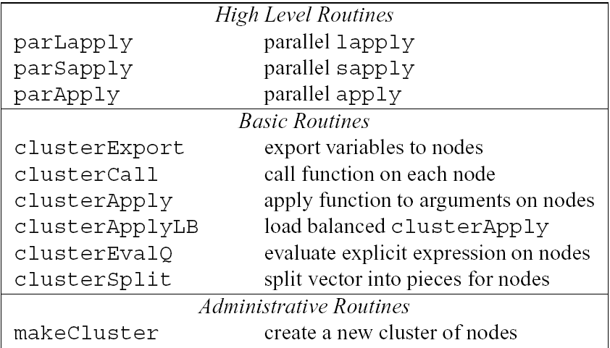
Statistical Computing with R
About R (http://www.r-project.org/):
Open source, most widely used for statistical analysis and graphics; similar to S.
Extensible via dynamically loadable add-on packages.
Originally developed by R. Gentleman and R. Ihaka.
> library(mva)
> pca <- prcomp(data)
> summary(pca)
> …
> dyn.load( “foo.so”)
> .C( “foobar” )
> dyn.unload( “foo.so” )
Towards Enabling Parallel Computing in R:
snow (Luke Tierney): general API on top of message passing routines to provide high-level (parallel apply) commands; mostly demonstrated for embarrassingly parallel applications.
snow API
Rmpi (Hao Yu): R interface to LAM-MPI.
rpvm (Na Li and Tony Rossini): R interface to PVM; requires knowledge of parallel programming.
> library (rpvm)
> .PVM.start.pvmd ()
> .PVM.addhosts (...)
> .PVM.config ()

Slide 3
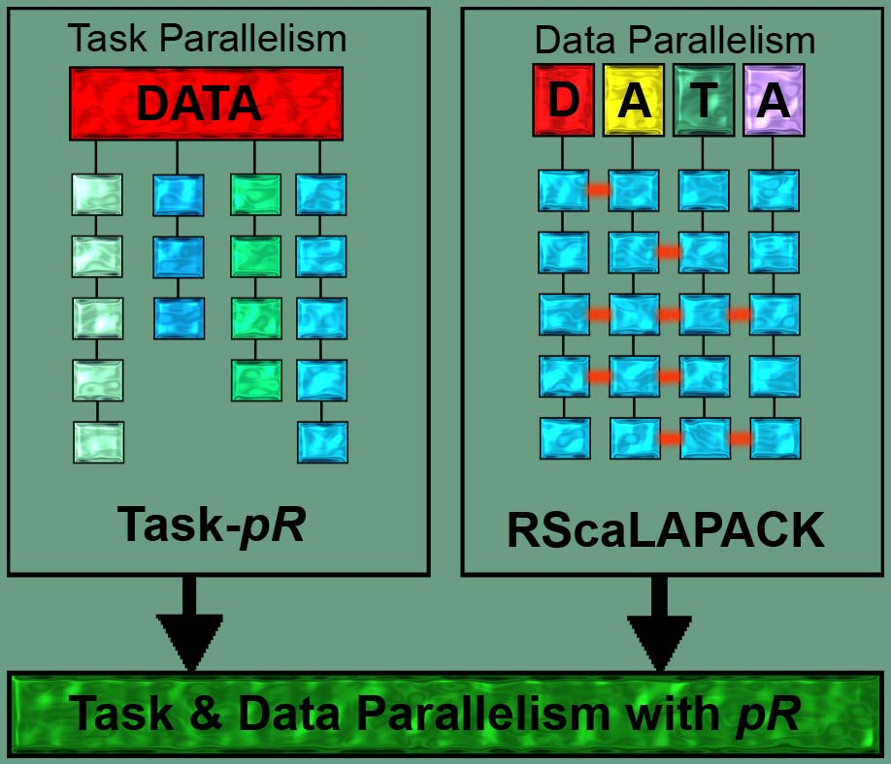

Task and Data Parallelism in pR
Goal: To provide efficient parallel statistical computing environment that: (a) automatically detects and executes task-parallel analyses in sequential R codes; (b) allows to easily plug-in data-parallel analyses codes in MPI-based C/C++/Fortran
Task-parallel analyses:
Data-parallel analyses:
Likelihood Maximization
Re-sampling schemes: Bootstrap, Jackknife
Markov Chain Monte Carlo (MCMC)
Animations
k-means clustering
Principal Component Analysis
Hierarchical clustering
Distance matrix, histogram, etc.

Slide 4
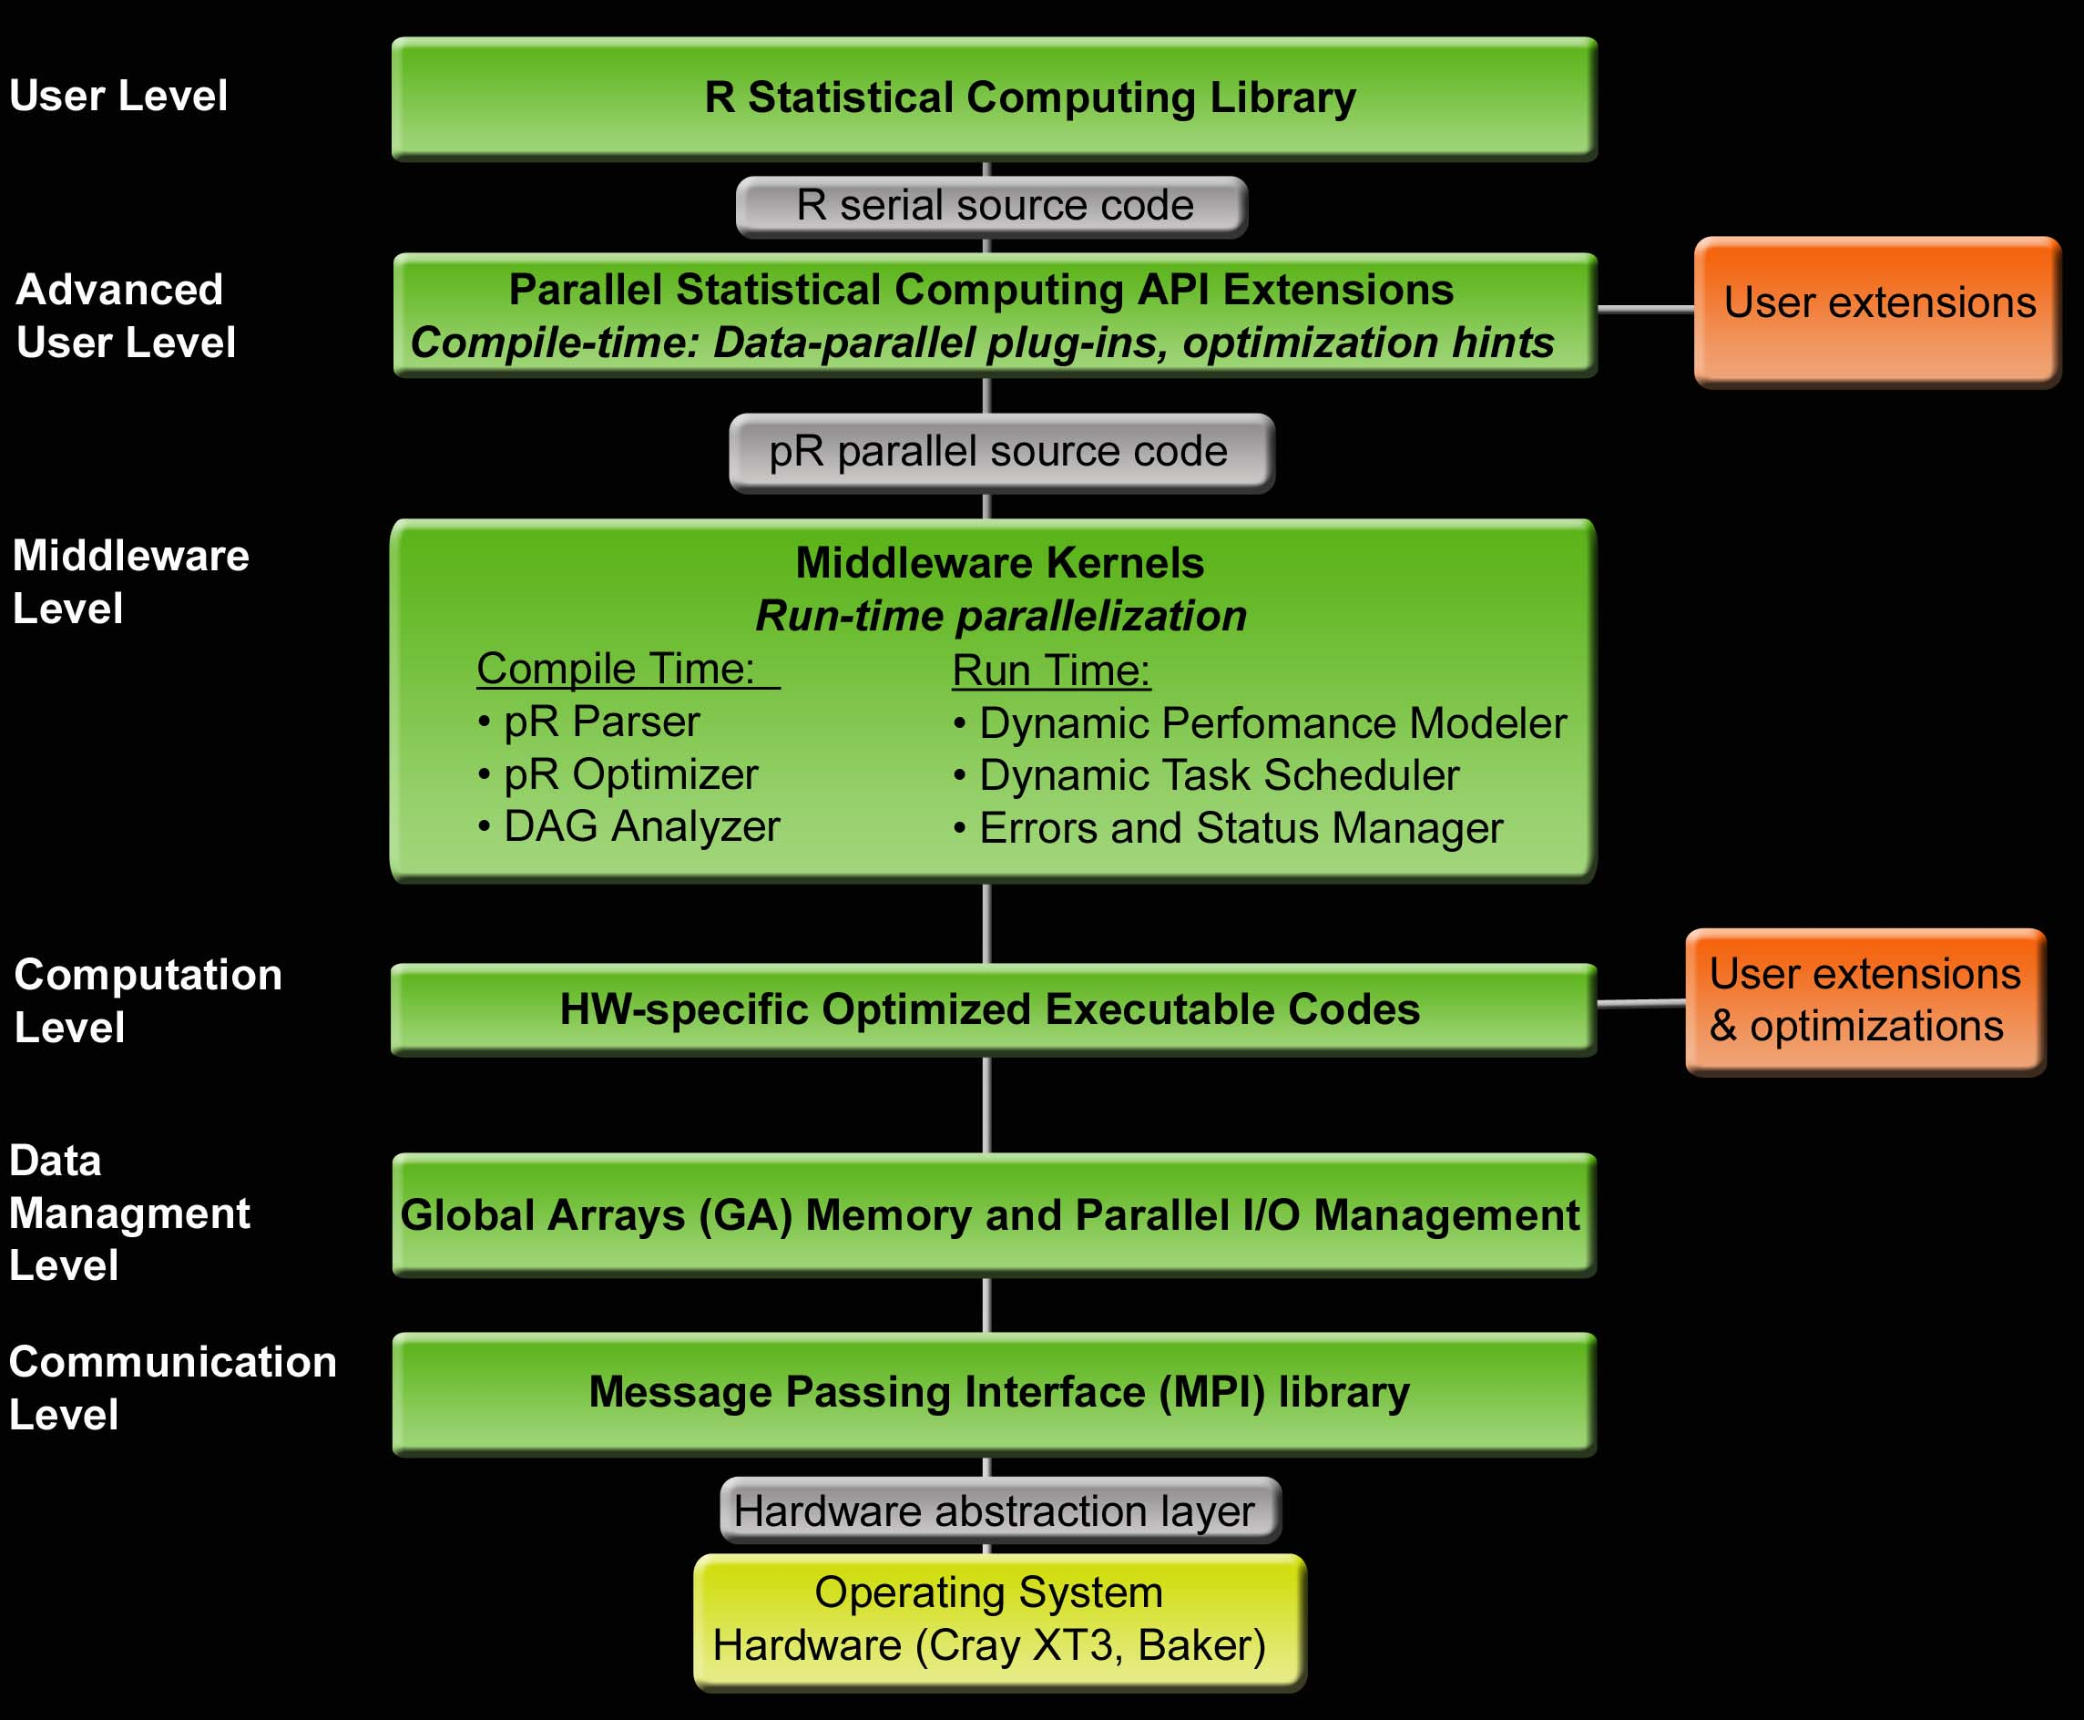
Software Stack for pR
R Serial Code
library (pR)
pR Parallel Code
pR Parser & Optimizer
Parse Tree
Dependency Analyzer
Task Precedence DAG
Performance Modeler
Weighted DAG
Dynamic Task Scheduler

Slide 5
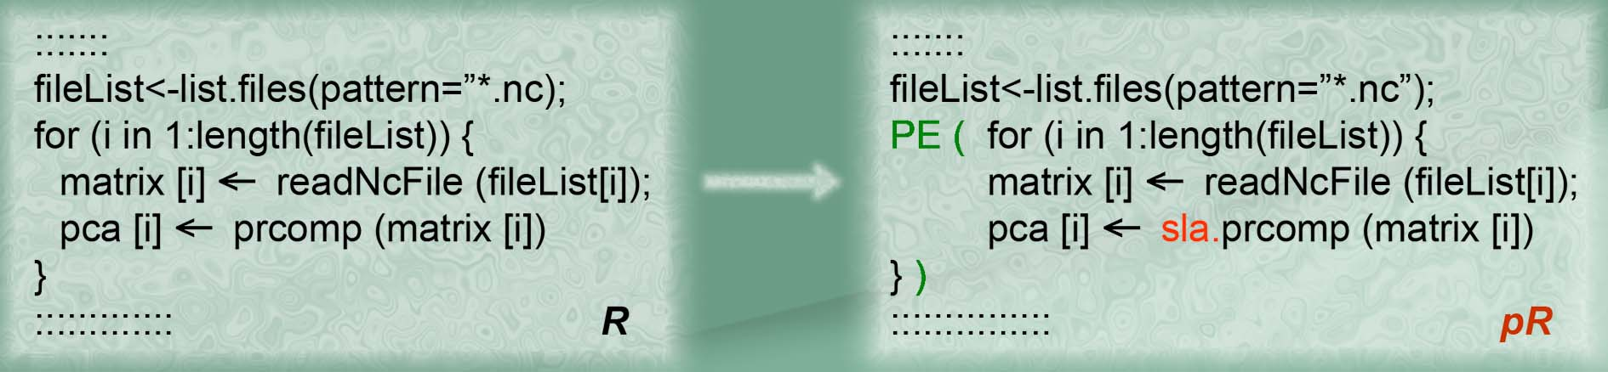
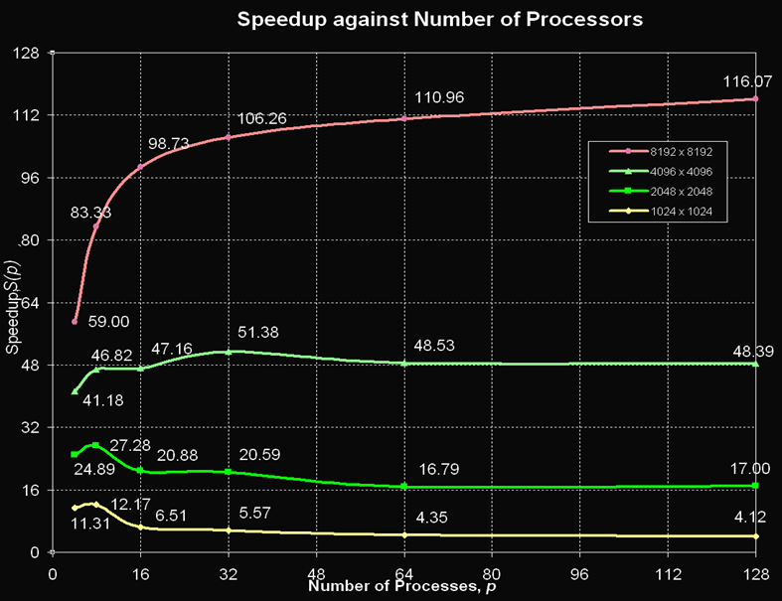
pR in Use
Across Science Applications:
Biology: Quantitative Proteomics (B. Hettich, G. Hurst, C. Harwood, C. Pan)
Climate: Analysis of Extreme Events (M. Branstetter, A. Ganguly, S. Khan)
GIS: GRASS+pR (G. Fann, B. Budhend)
Fusion: Distributed PCA (G. Ostrouchov)

Slide 6

Near-Term Future Plans
Release of automatic task-parallel component in pR
Exploit the use of Global Arrays (as opposed to Data Bank Cluster Manager) for distributed and shared memory management in pR
Provide basic parallel I/O (pNetCDF and ROMIO) hooks to pR
Identify requirements and demonstrate the use across other applications: fusion (S. Klasky), combustion (J. Chen), climate (J. Drake), nanoscience (P. Rack)

Slide 7
Recent Publications & Software
Samatova NF, Yoginath S, Kora G, Bauer D, http://www.aspect-sdm.org/Parallel-R or http://cran.r-project.org/mirrors.html.
Samatova NF, Branstetter M, Ganguly AR, Hettich R, Khan S, Kora G, Li J, Ma X, Pan C, Shoshani A, Yoginath S, Journal of Physics: Conference Series 46 (2006) 505–509.
Yoginath S, Samatova NF, Bauer D, Kora G, Fann G, Geist A, In Proceedings of the 18th International Conference on Parallel and Distributed Computing Systems (PDCS-2005), September 12 - 14, 2005, Las Vegas, Nevada.
Pan C, Kora G, McDonald WH, Tabb DL, VerBerkmoes NC, Hurst GB, Pelletier DA, Samatova NF, Hettich RL, Anal Chem. 2006 Oct 15;78(20):7121-31.
Pan C, Kora G, Tabb DL, Pelletier DA, McDonald WH, Hurst GB, Hettich RL, Samatova NF, Anal Chem. 2006 Oct 15;78(20):7110-20.
Ostrouchov G, Samatova NF, IEEE Transactions on Pattern Analysis and Machine Intelligence, 27:1340-1343, 2005.
Park B.-H, Ostrouchov G, Samatova NF, Computational Statistics and Data Analysis, 2007 (accepted).
Sisneros R, Jones C, Huang J, Gao H, Park BH, Samatova NF, IEEE Transactions on Visualization and Computer Graphics, 2007 (second revision).
Qu YM, Ostrouchov G, Yoginath S, Samatova NF, Journal of Computational and Graphical Statistics, 2007 (second revision).

