Slide 1
SNAP R&D
Chris Bebek
19 February 2004

Slide 2
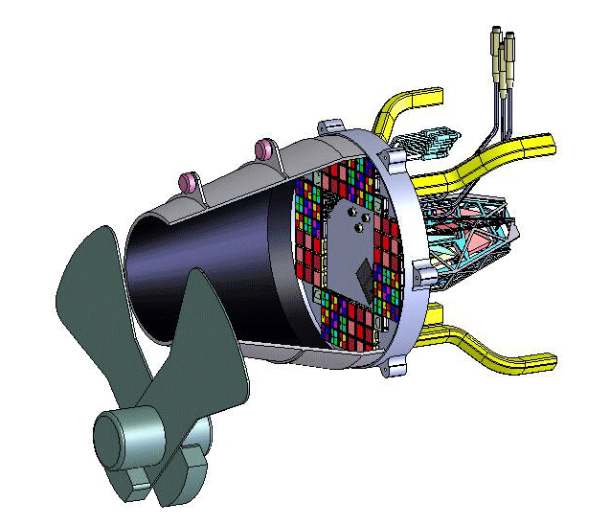
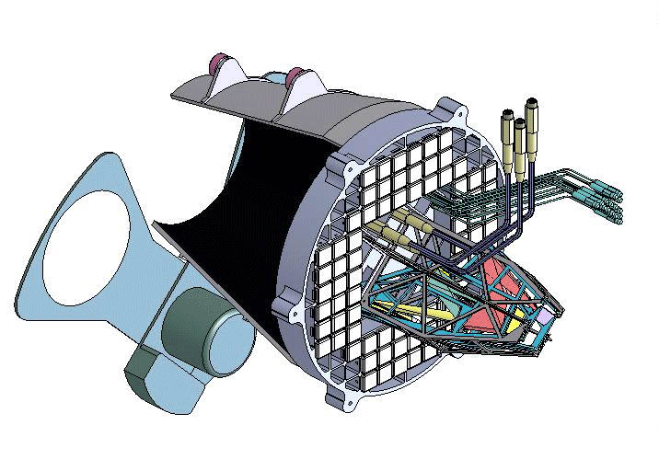
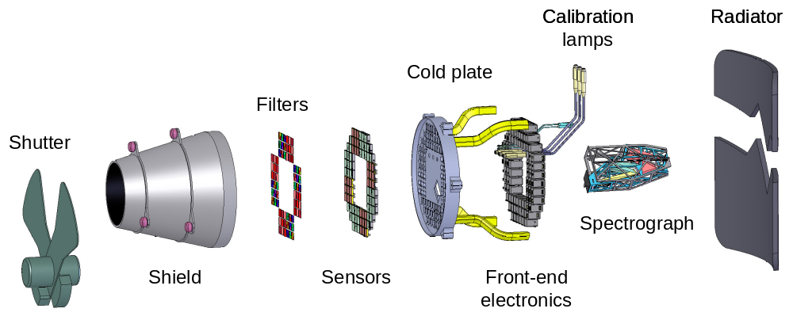
Instrument Working Concept

Slide 3
Focal Plane Concept
All instruments coalesced on one focal plane.
  Common 140K operating temperature.
  “Bolted” to telescope structure.
Photometer sensors in one focal plane, example.
  36 2k x 2k, 18 μm HgCdTe NIR sensors.
  36 3.5k x 3.5k, 10.5 μm CCD sensors
Spectrograph mounted to focal plane.
  Two channel spectrograph with light access port in the focal plane.
  Objects dropped into spectrograph light port by steering the satellite.
Fixed filter mosaic
  3 NIR bandpass filter types organized in 3 x 3 arrays.
  6 visible bandpass filter types organized in 6 x 6 arrays.
Guide off the focal plane during exposures.
  4 regions of star guider CCDs.
Telescope I&T and on-orbit calibration hardware

Slide 4
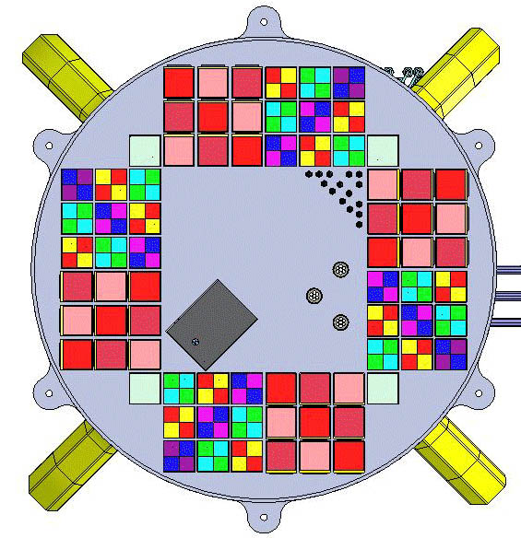
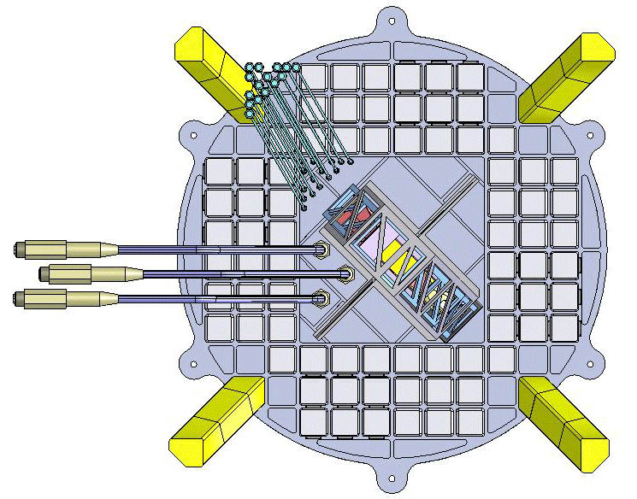
Focal Plane Concept
Focus star
projectors
Focus star
lamps
Thermal links
Guider
Visible
NIR
Spectrograph
port
Calibration projectors
Calibration lamps
Spectrograph
r_{in} = 6.0 mrad (129 mm)
r_{out} = 13.0 mrad (284 mm)

Slide 5
Instrument R&D Responsibilities

Slide 6
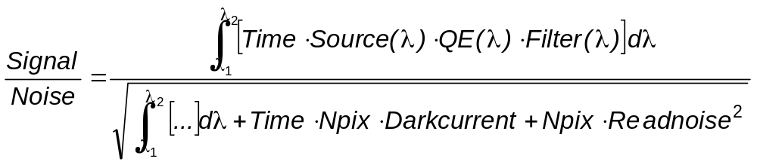
Impact of detector characteristics
Detector characteristics that determine signal to noise for a given exposure time or, conversely, determine the exposure time to achieve a specified signal to noise.
Dark current (e/pixel/s)
Read noise (e/pixel/read)
Quantum efficiency
Number of pixels to sum (charge diffusion effects + diffraction)
Visible – 1, 2, and 3 will not be a problem, modulo radiation damage effects
NIR – all four not simultaneously achieved

Slide 7
Near infrared detectors
All technologies are hybridized arrays of photodiodes on a CMOS multiplexer – format is 2kx2k, 18-20 μm pixels.
Photodetector material can be HgCdTe or InGaAs (for SNAP).
Ratios of elements determines high-side wavelength cutoff – we want ~1.7 μm to minimize counting thermal photons from a warm telescope.
Rockwell made 1.7 μm HgCdTe for the HST WFC3 upgrade – a long struggle that has probably solved the dark current issue but leaves QE and readnoise anti-correlated.
Raytheon is re-entering low cutoff HgCdTe business for astronomy.
InGaAs has large industrial base of optical communications and NIR industrial imaging.
Contracts in place
Rockwell – two lots of 2kx2k format to continue work on QE and readnoise made by MBE
Raytheon – two lots of 1kx1k format made by LPE
Rockwell/Sensors Unlimited – 1kx1k InGaAs device

Slide 8
NIR detector status
Rockwell HgCdTe
  Lot 1 complete – reproduces WFC3 results in 2kx2k format
  Lot 2 nearing completion – addresses decoupling readnoise and QE
Raytheon HgCdTe
  3 parts made, 2 delivered
  Very large dark current; supposedly improved 2.5 μm being tested by people we are in contact with.
  QE looks good
Rockwell/Sensors Unlimited InGaAs
  Photodiode array complete
  Assembly in progress

Slide 9
NIR testing
Things to measure
Dark current vs temperature
Readnoise and readnoise scaling with multiple samples
Quantum efficiency
Spatial response
Uniformity of all the above
Three collaborator test sites
U of Michigan – HgCdTe
  Two test stands for general measurements – dark current, readnoise, …
  Equipment to do absolute QE measurement
  Pin hole projector for intra- and inter-pixel response
Cal Tech – HgCdTe
  Test stand for general measurements – dark current, readnoise, …
  Calibration lamps for QE
JPL – InGaAs
  Test stand for general measurements – dark current, readnoise, …
  Calibration lamps for QE

Slide 10
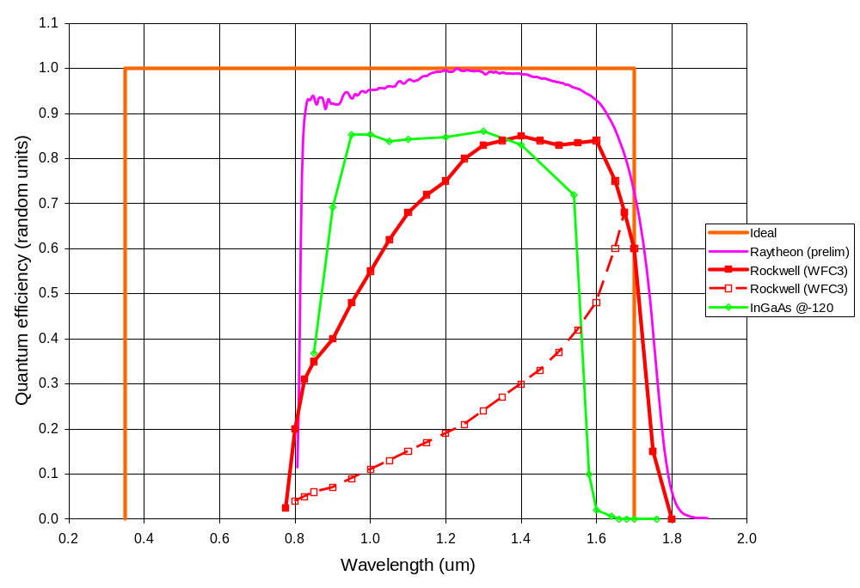
NIR tests - QE
Note, only the Rockwell results have been measured on true astronomical hybrids under typical astronomical observation conditions.

Slide 11
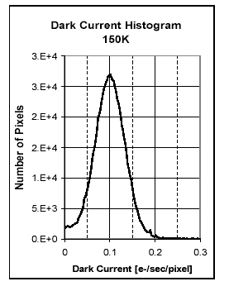
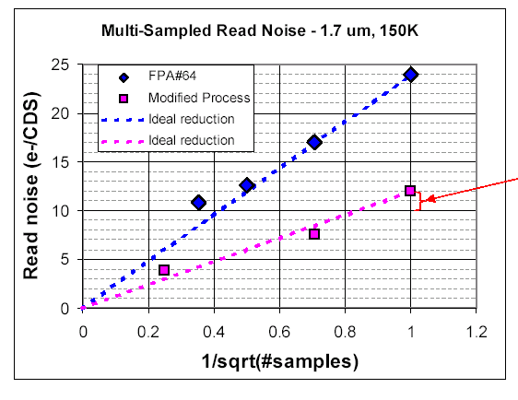
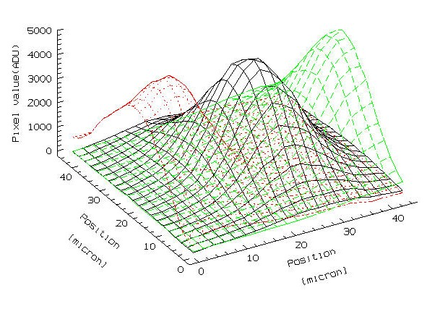
NIR tests
Dark current
  Determines operating temperature
  Determines temperature stability
Read noise
  Our target is ~5 e
  Devices are typically 10-20 e
  Prove that rt-n works
  Determines shutter closed time
Spatial response
  Determines number of dither samples required

Slide 12
Visible detectors
Focus is on LBNL CCD technology
  Extended red response – overlaps NIR detectors
  Control of charge diffusion – makes small pixels possible, hence a smaller focal plane.
  Enhanced radiation tolerance – high resistivity, n-type silicon
  Other CCD characteristics are typical
Challenges
  Robust fabrication process still be developed
  Packaging challenging due to silicon thickness
Testing at LBNL and Yale
Alternatives
  Venders interested in adapting LBNL technology
  Silicon PIN diode arrays
    Same multiplexer, package, and readout at NIR
    Only available in large pixels – expensive development to get to ~10 um
    Uncertain dark current and spatial response
    Have acquired one to understand state of the art

Slide 13
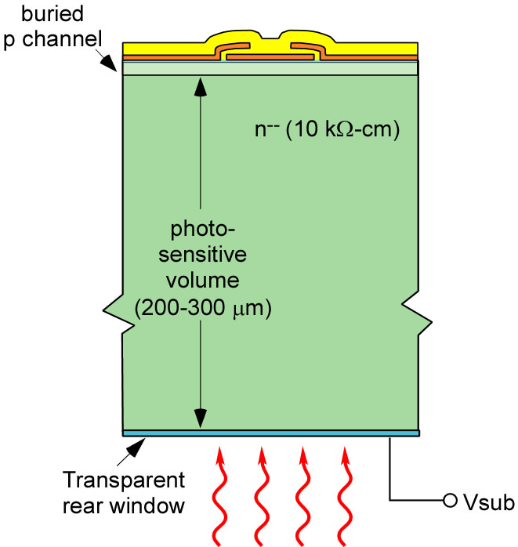
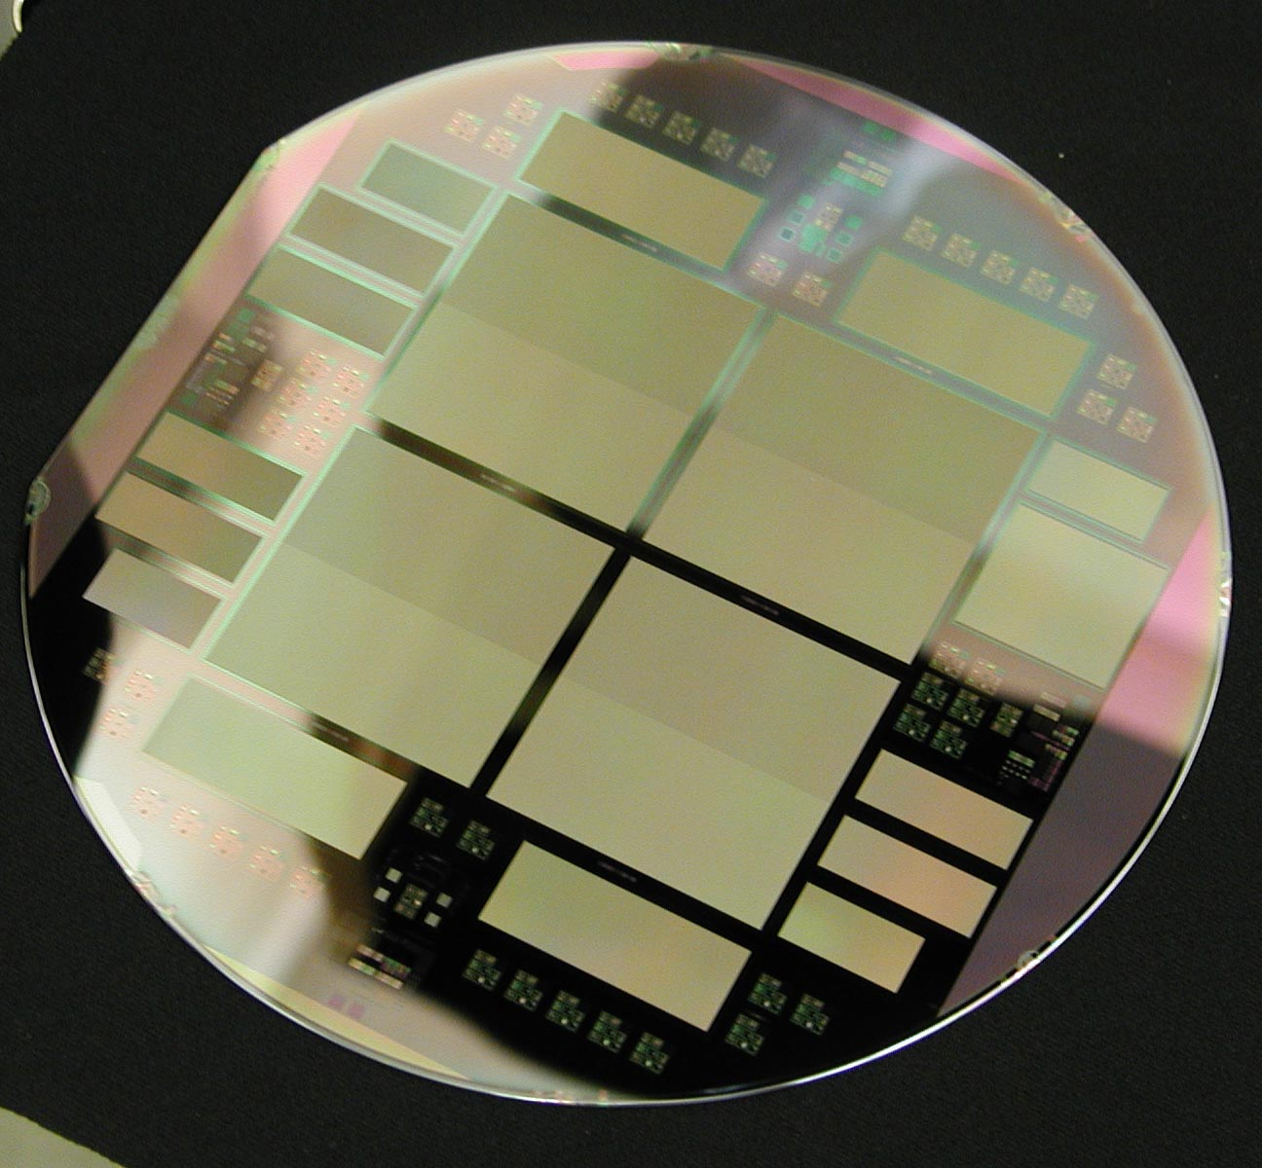
LBNL CCDs
High resistivity, p-channel silicon, over depleted.
DALSA processed wafer with four SNAP CCDs – 3.5kx3.5k, 10.5 μm pixels.
S.E. Holland et al., “Fully depleted back-illuminated p-channel CCD development,” SPIE conf. 5167 talk 07, 2003.

Slide 14
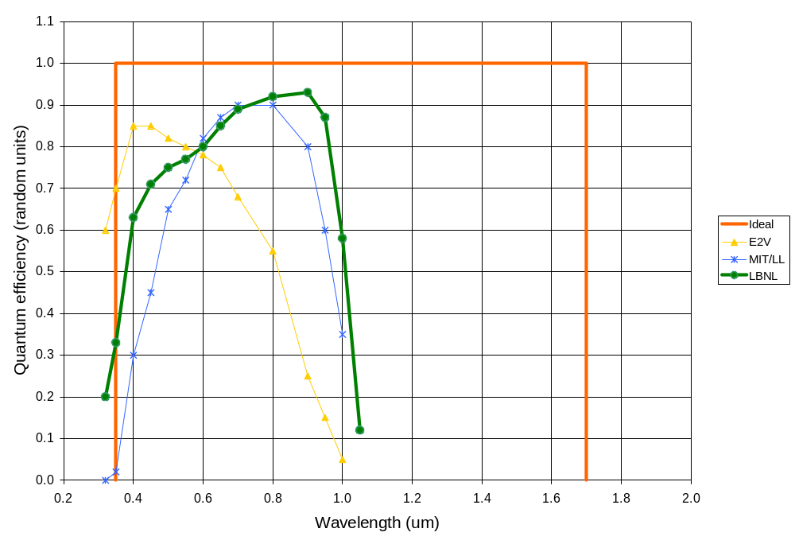
CCD testing - QE
LBNL CCDs have extended red response, >50% at 1 μm.
The thickness of the CCD reduces interference fringing at long wavelengths.

Slide 15
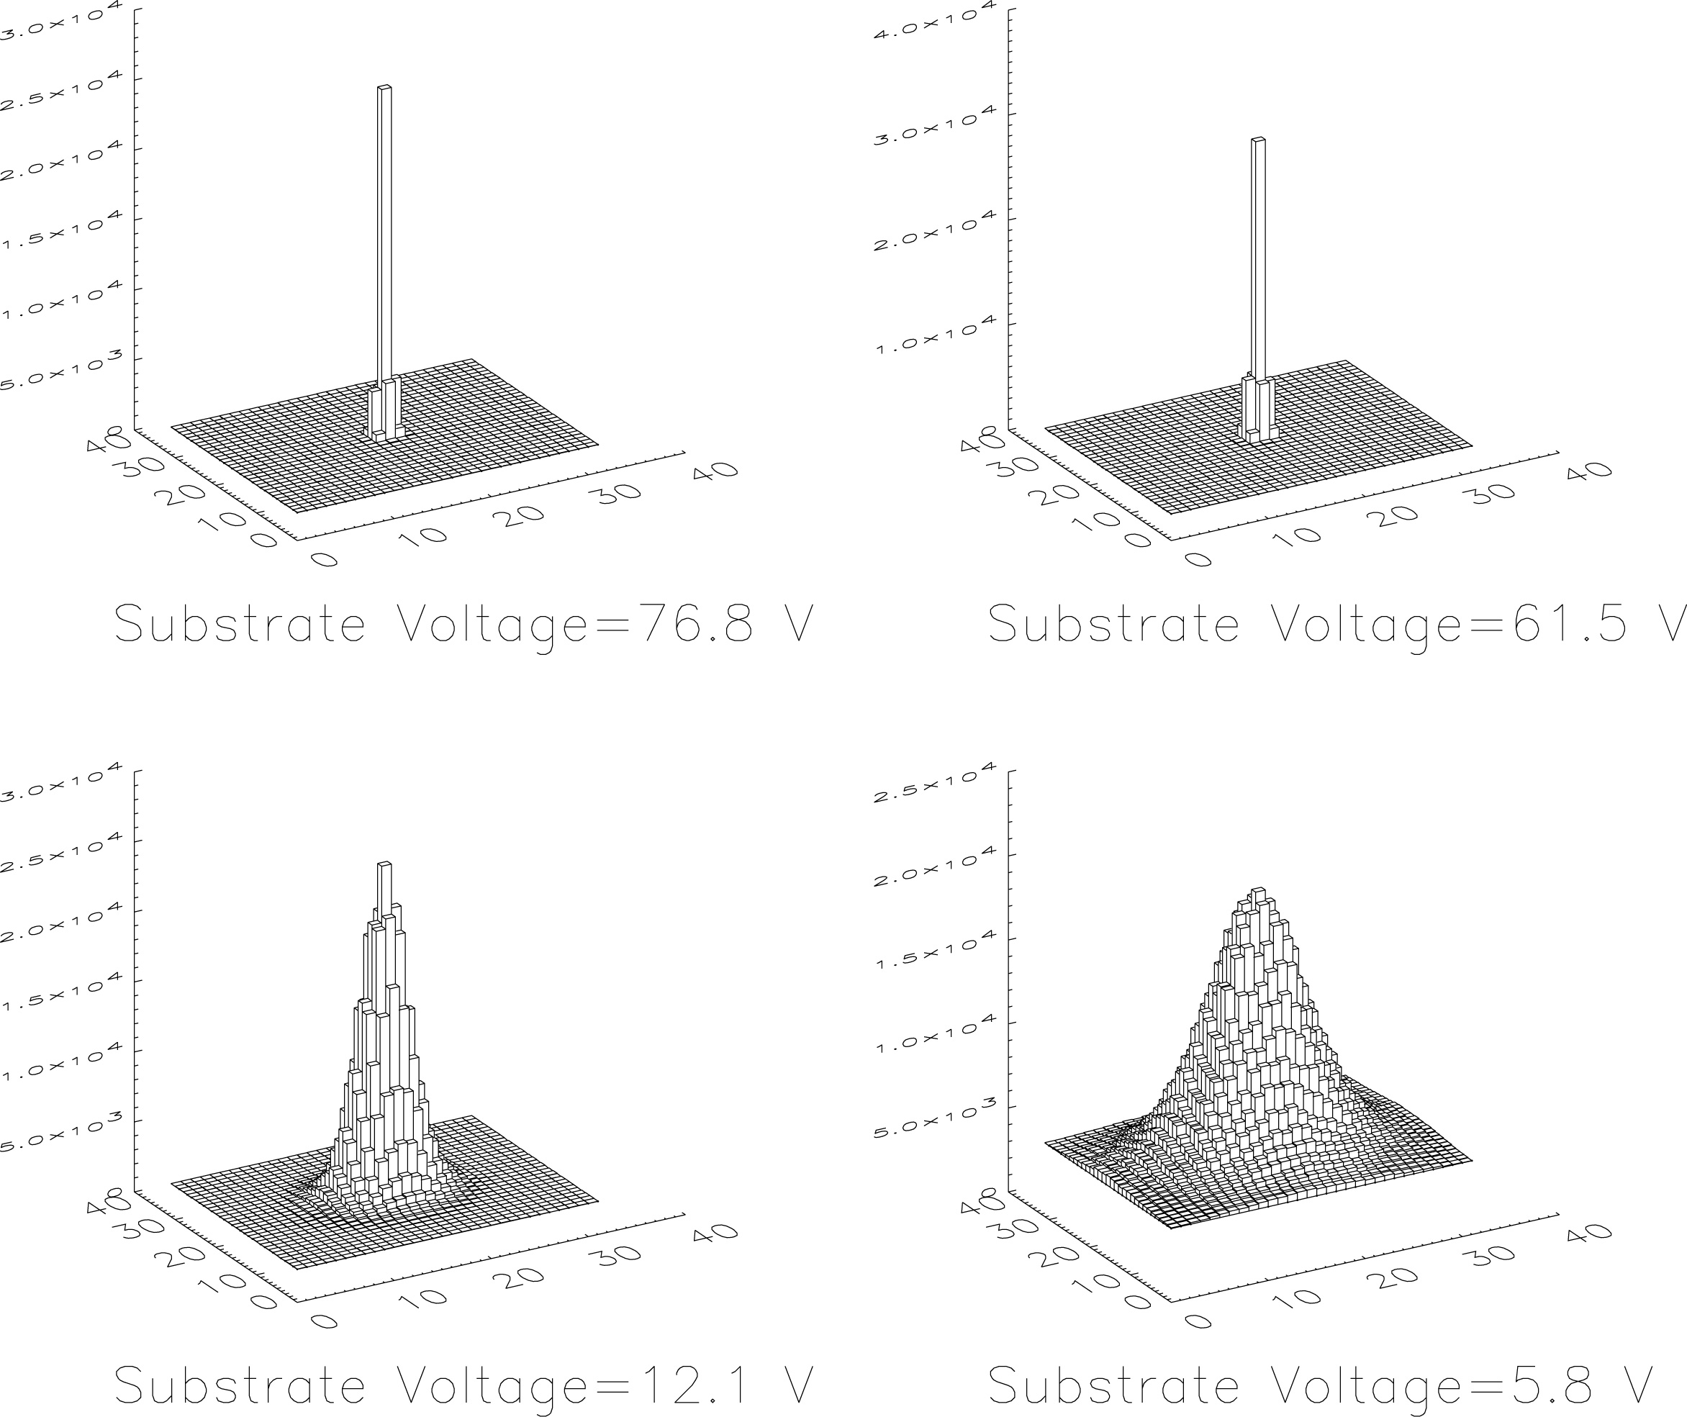
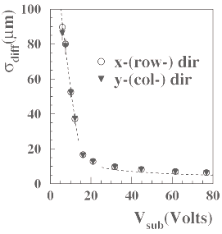
CCD testing - charge diffusion
Over-depletion voltage and silicon thickness can control diffusion.
Our measurements indicate that 80 V and 200 μm will give ~4 μm charge diffusion – 10 μm then make sense.
Typical CCDs have diffusion of 10-15 μm.
290 μm thick, 15 μm pixel
~6 μm scales to 4 μm at 200 μm thickness.

Slide 16
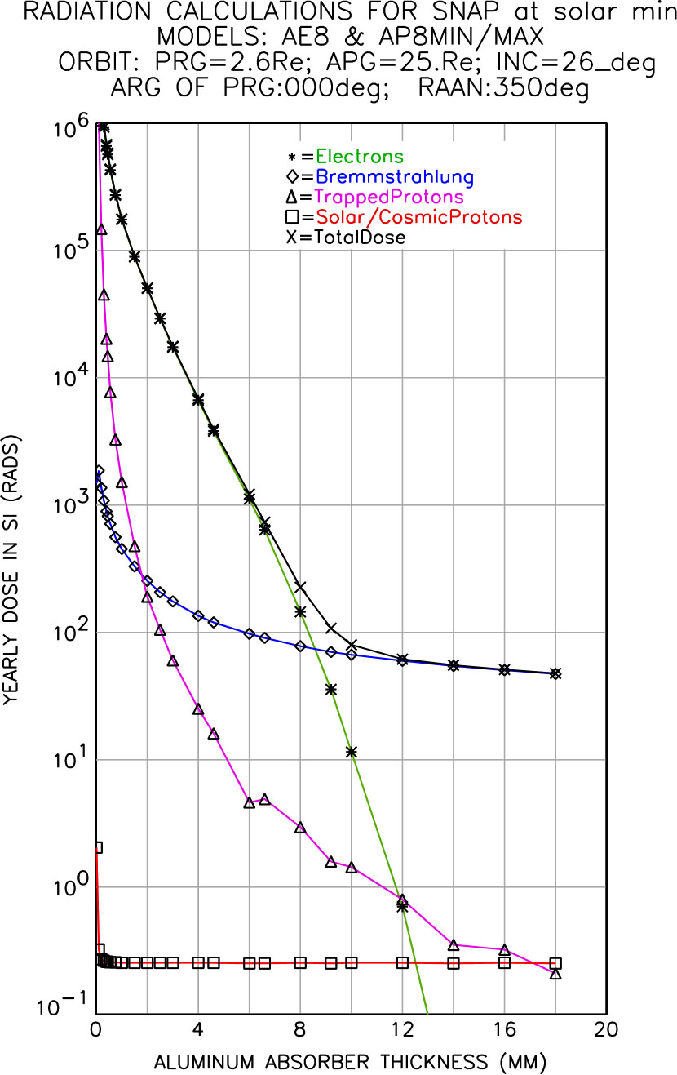
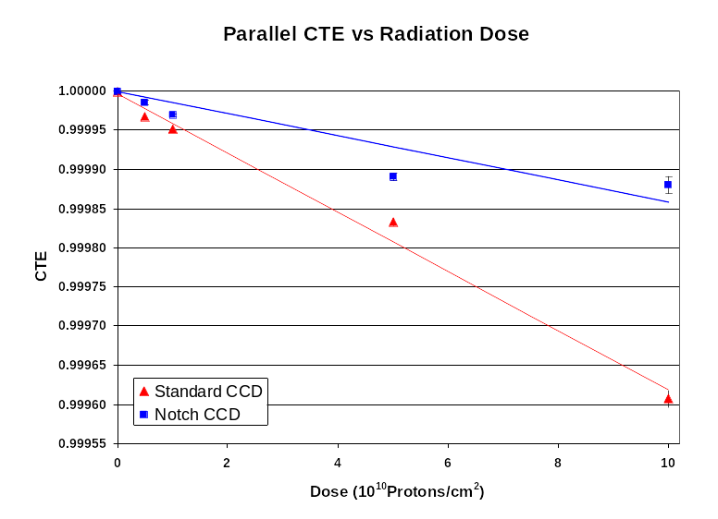
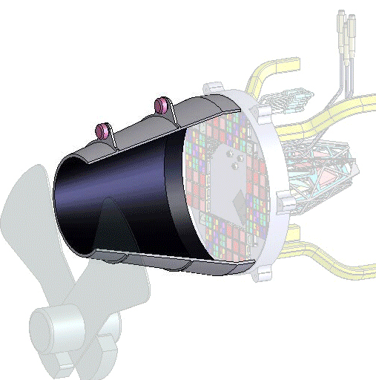
CCD testing - radiation tolerance
CCDs in space have proven to be very sensitive to CTE degradation and hot pixel formation due to radiation – mostly protons.
Proton radiation testing at room temperature shows >10 more radiation tolerance than previous space CCDs.
Program starting at Yale van de Graaff to do heavier ions.
FNAL using GEANT and MARS codes to design a radiation shield.
CTE radiation tolerance (12 MeV protons)

Slide 17
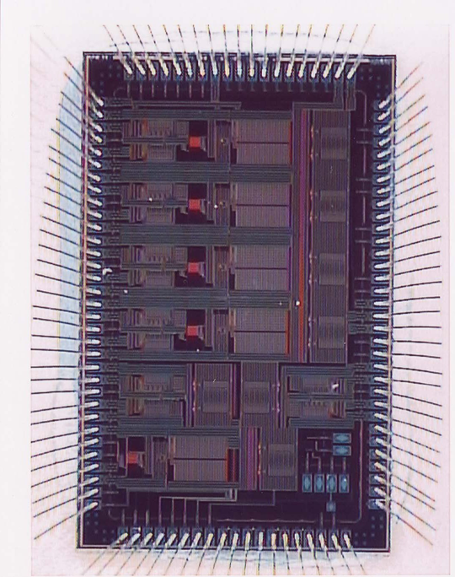
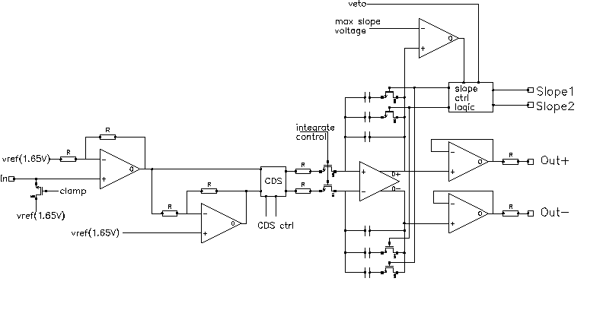
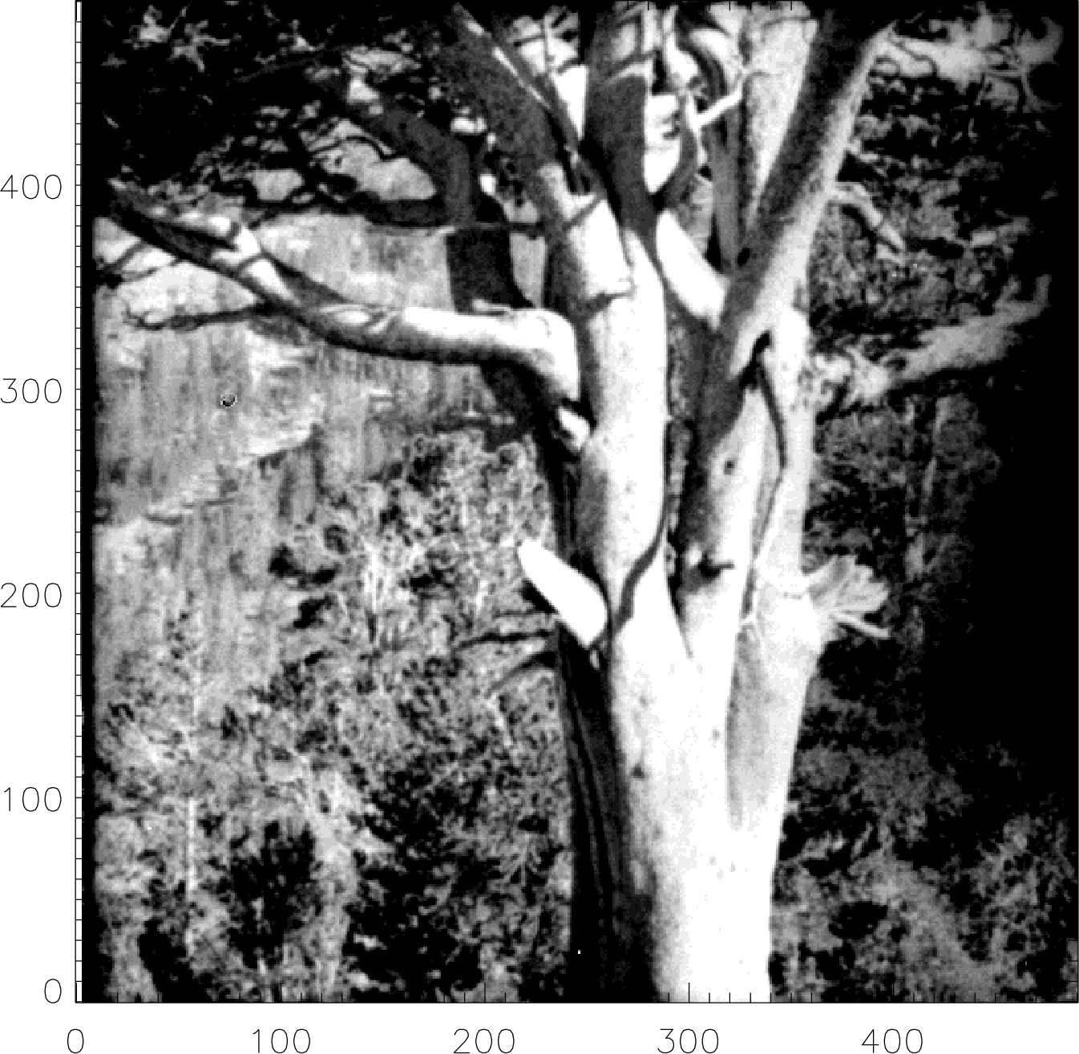
CCD electronics
Have built a four channel dual integration correlated double sampler CRIC.
Operates at 140 K so it can be co-located with CCD.
Meets specs, even after cold irradiation to >150 krad
Will submit version with ADC in March.
Image acquired with CRIC mounted next to an LBNL CCD operated at 140K.

Slide 18
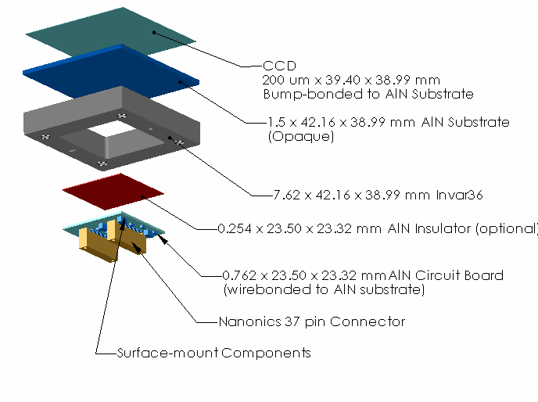
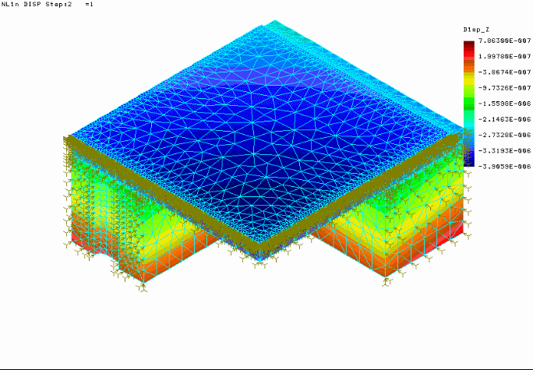
CCD Packaging
Four side abuttable package to allow nxm arrays
Provision for ASIC mount on back of package
Yale and LBNL working with Imaging Technologies Lab, University of Arizona

Slide 19
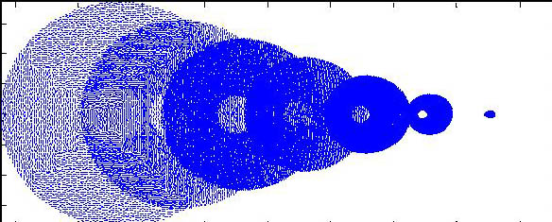
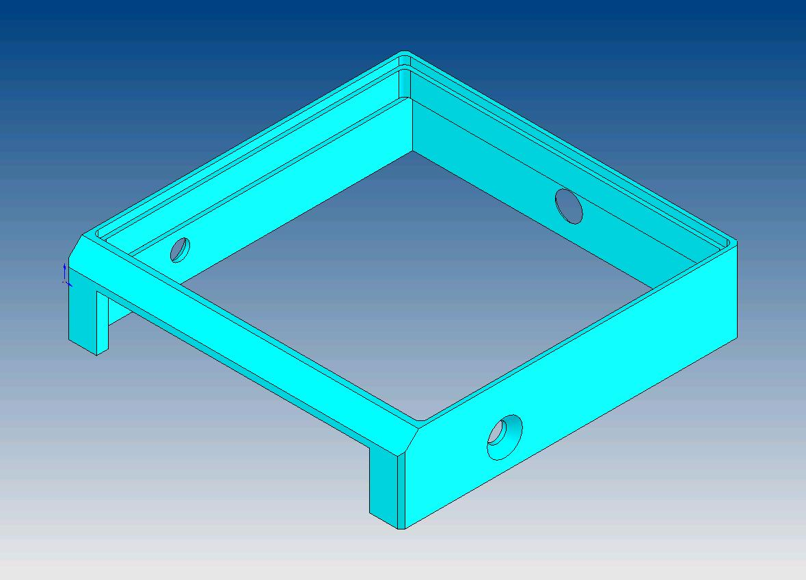
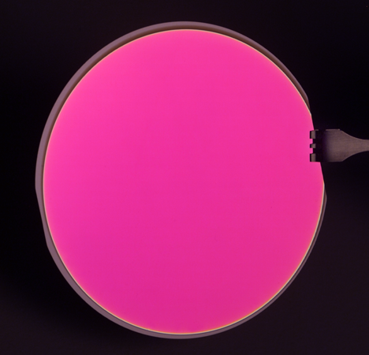
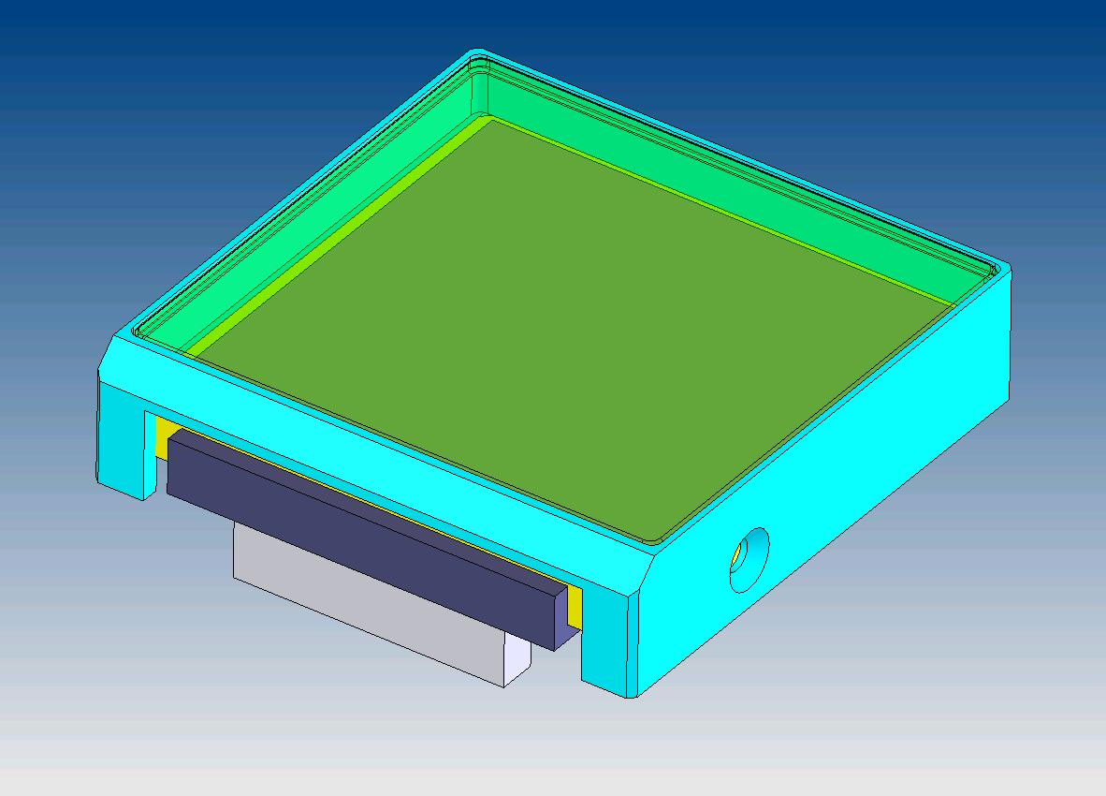
Filters
Star fluxes have >10⁶ range on the focal plane.
Discrete filter mounting can be a source of stray light and ghosting.
SSL and Michigan studying impact of suspended, discrete filters.
Indiana exploring direct deposited filters with Barr Assoc.
1 mm thick, 1 mm spaced filter
Discrete filter mounting
4” silicon wafer with V-band filter

Slide 20
SNAP Spectrophotometric Calibration
spectroscopic
spectroscopic
MKS
calibration
Fundamental
Standards
Primary
Standards
Secondary
Field
Standards
Calibrate
Instruments
₁
₂
₃
₄
photometric
photometric
₅
SNAP Science
Measurements
Calibration Transfer:
MKS calibration
  Fundamental Standards
  observed spectroscopically
Calibration Transfer
Primary Field Standards
observed spectroscopically
SNAP Spectrograph required to calibrate fundamentals and transfer calibration to primaries and to imager
=>Results in well calibrated spectrograph and imager
Primary Field Standards
observed photometrically
Secondary Field Standards
observed photometrically

Slide 21
Calibration Error Budget Framework
Color
calibration
Zero point
(sets scale)
Flatfields
Imager/
Spectrograph
Telescope
Aperture
corrections
Secondary star field calibration
Detector
Filter
Optics
Scattered light
Primary standards
calibration
intra-pixel
linearity
band pass shifts
non-uniformity
How do calibration transfer errors propagate down the network?
How well do filters+detectors, integral field spectrograph need to be calibrated?

Slide 22
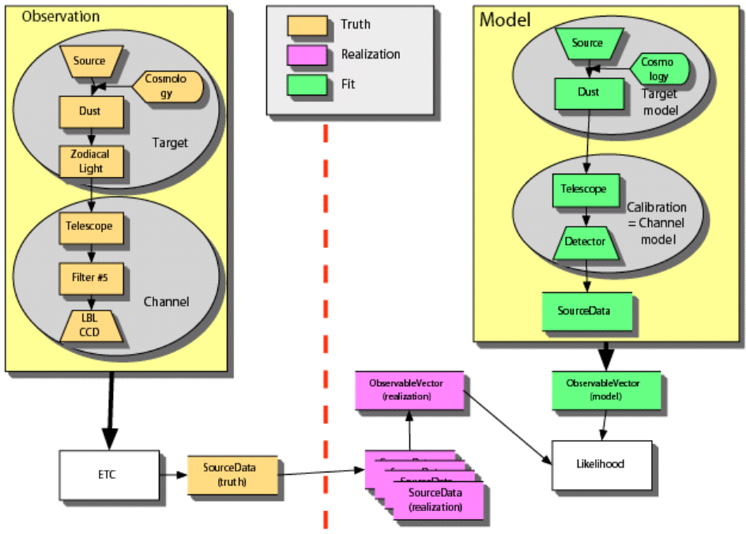
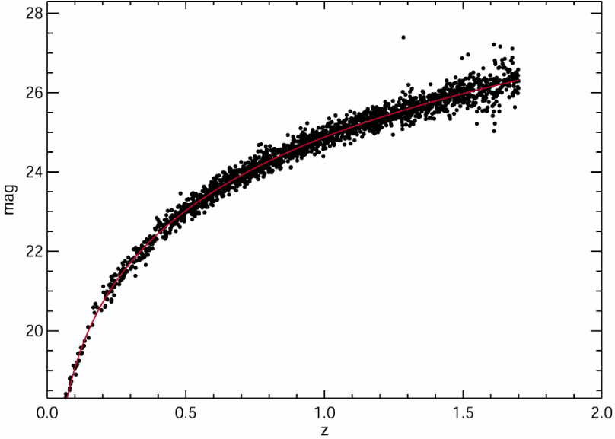
Simulation
Simulation impact on detector R&D is establishing minimum performance requirements.
This will make detector fabrication more achievable and provide margin to increase yield.
Left: The grand scheme of a typical simulation run has a mirrored structure. First there is the simulation phase, to the left of the red line, where truth is generated. A realization of the data and noise are created and thrown “over the wall” to the right side. Calibration and Analysis consist of a new set of models of the sources and instruments, which generate the fit, expected data to be compared with the realization.
Right: A Hubble curve generated by the simulation.

Slide 23
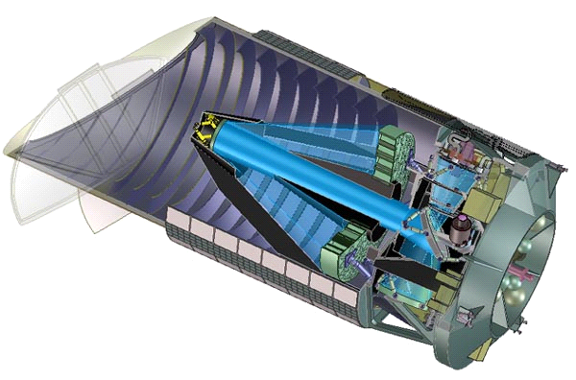
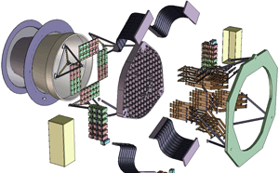
system engineering
Focal plane impacts
Optics that accommodates detector size and resolution
Partitioning of cold and warm elements
Packaging with final integration and test in mind
Partitioning of instrument electronics
Radiation and thermal shielding
…….

Slide 24
Conclusion
Large effort in demonstrating detector technology.
This will have to be followed by demonstration of large scale manufacturability.
Simulation and calibration studies will generate the least restrictive set of requirements for the detectors to achieve the above.
System engineering will produce an optimized concept for the telescope, focal plane, instrument electronics, spacecraft, and operations.
With the above, our response to a JDEM announcement of opportunity will be credible and defensible.

