Slide 1






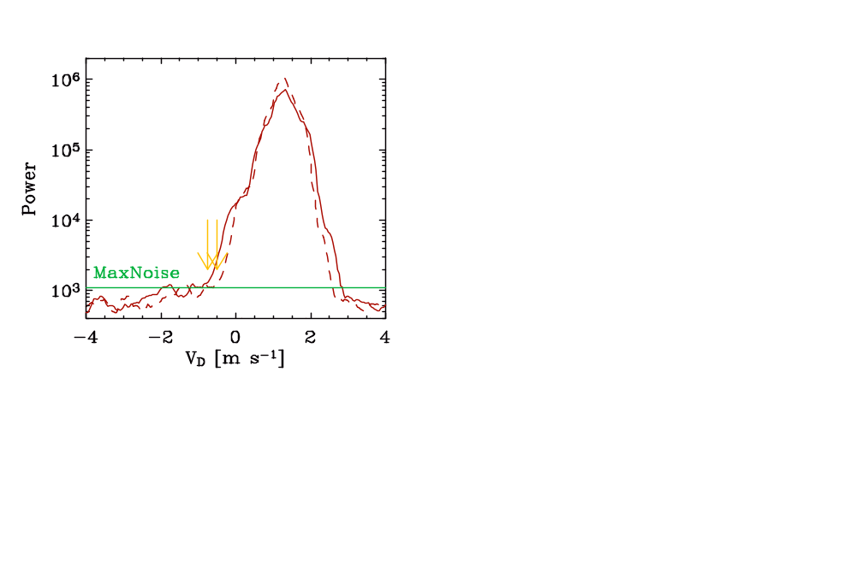
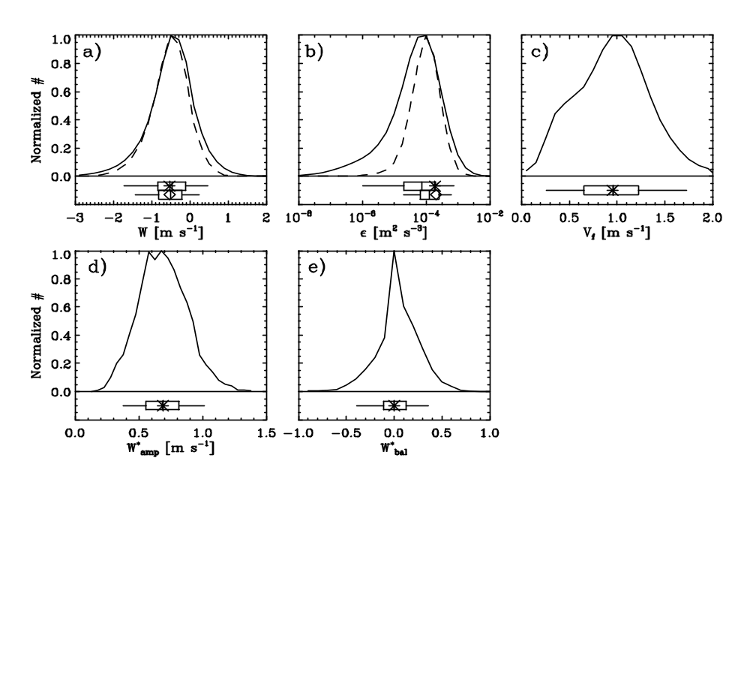
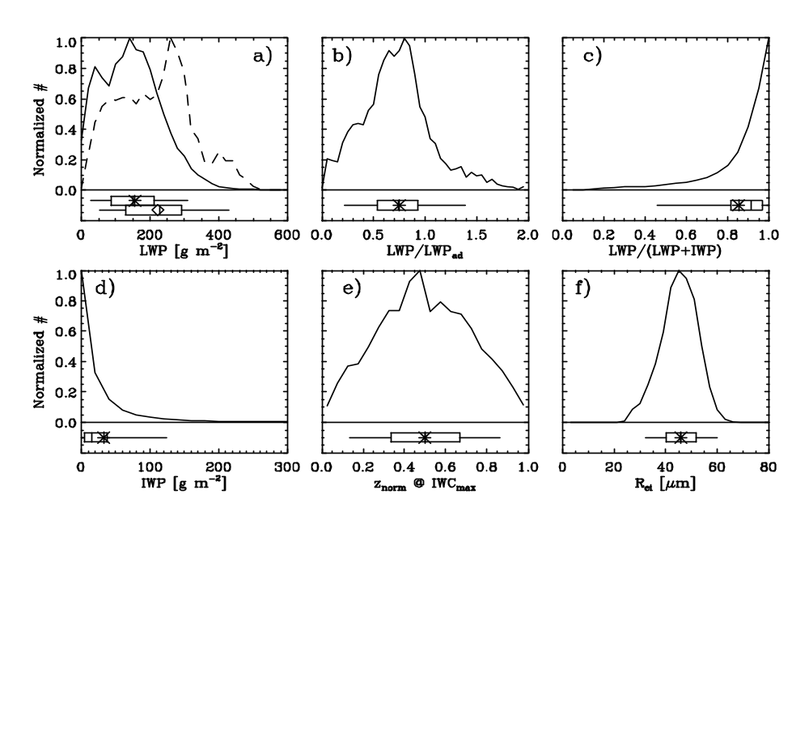
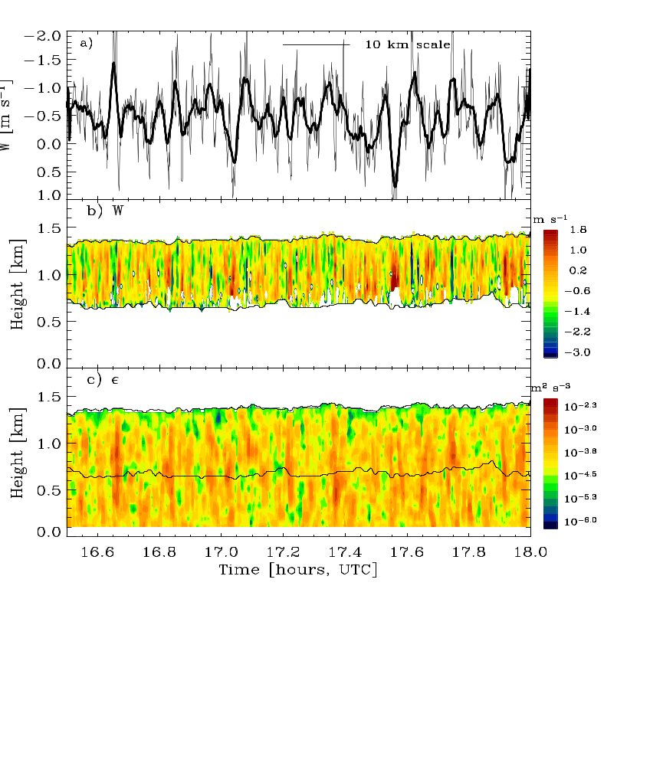
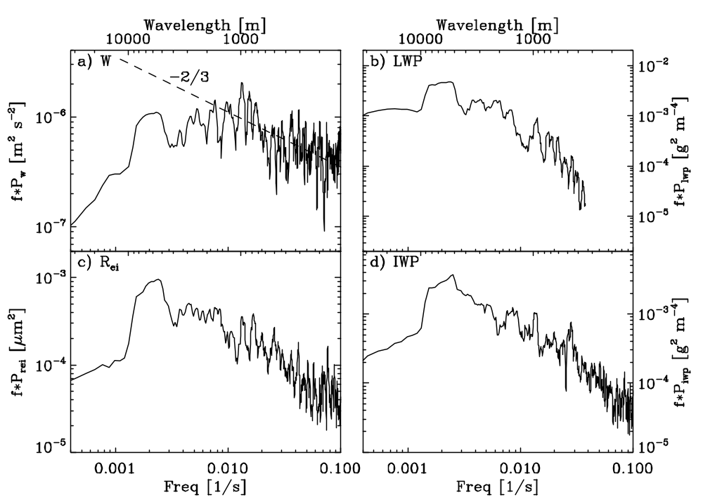
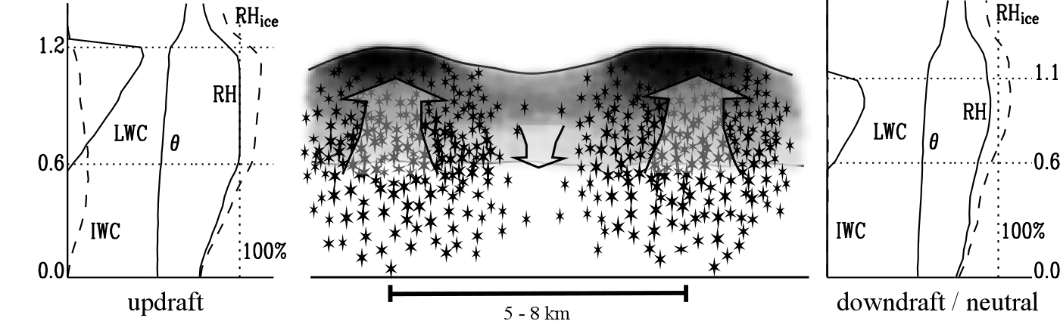
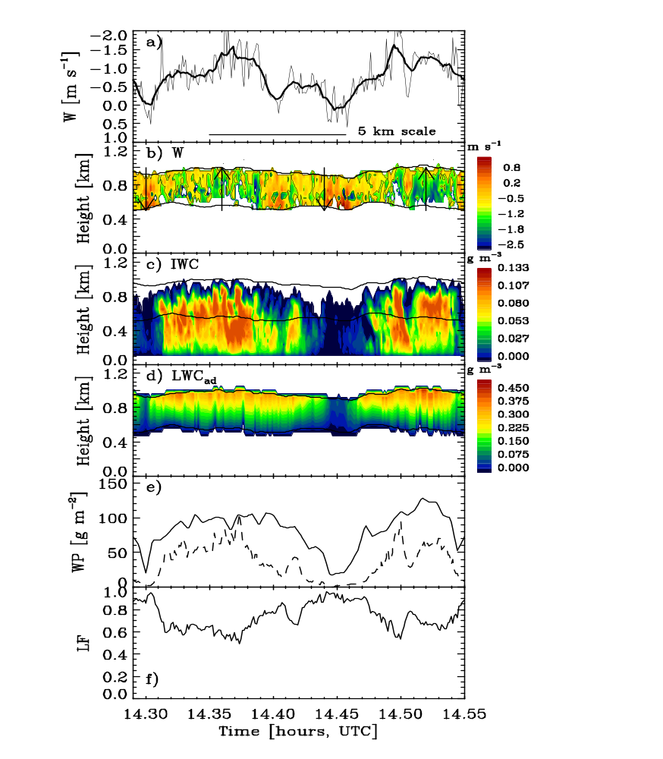
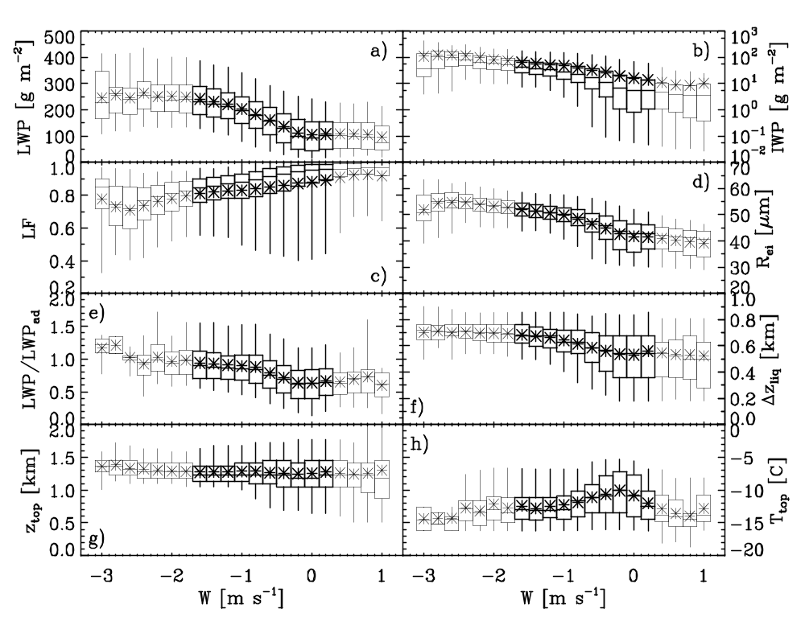
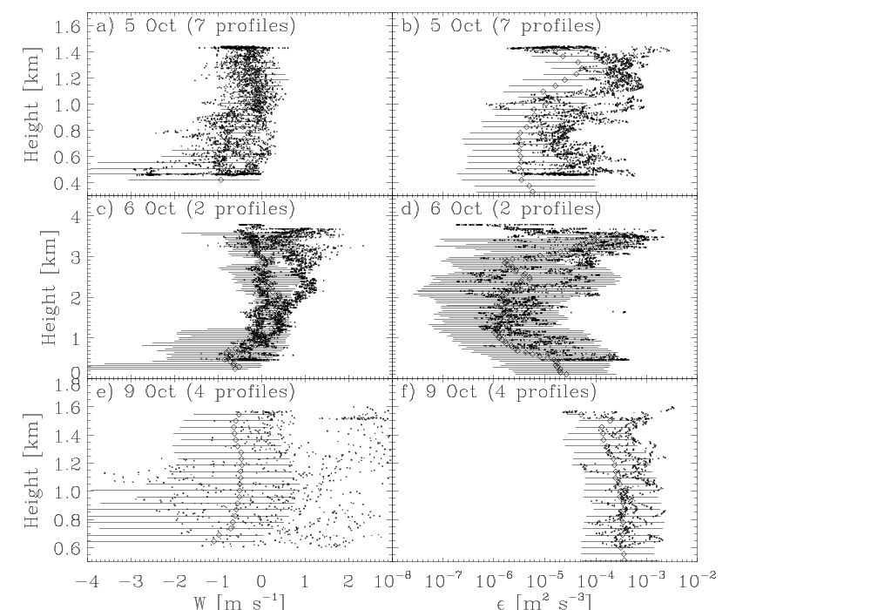
Vertical Motions in Arctic Mixed-Phase Stratus
Matthew D. Shupeª, Pavlos Kollias^{b}, Ola Perssonª, Ed Luke^{b}
Greg McFarquhar^{c}, Michael Poellot^{d}, Edwin Eloranta^{e}
ªCIRES – University of Colorado and NOAA/ESRL/PSD, ^{b}Brookhaven National Laboratory,
^{c}University of Illinois, ^{d}University of North Dakota, ^{e}University of Wisonsin
Air Motions from Doppler Spectra
Mixed-Phase Cloud Properties
Summary
Method
Identify regions containing cloud liquid (see E. Luke et al. poster)
Determine spectral broadening correction terms due to shear, turbulence, and beam width
Vertical velocity is the left edge of the spectrum (w/ correction)
Main assumption: Liquid droplets trace vertical air motions due to their limited size.
A Doppler Spectrum
Vertical velocity can be derived from cloud radar; results compare favorably with aircraft observations
Typical autumn, Arctic mixed-phase stratus: W = 0.6 m s⁻¹(up), LWP = 150 g m⁻², IWP = 20 g m⁻², 85% liquid fraction, R_{ei} = 45 μm, ice fall speed = 1 m s⁻¹.
Dominant scales-of-variability for vertical motions and microphysics are 0.6 – 10 km.
A conceptual model details the cloud life cycle by relating vertical velocity to other cloud parameters. Limited ice forming nuclei concentrations and ice particle fallout are important for liquid maintenance throughout the cloud life cycle.
Small liquid droplets trace vertical air motions
Ice
Particles
Liquid
Droplets
Retrieved Properties
During M-PACE
These distributions of cloud properties are characteristic of single-layer, low-level, autumn mixed-phase stratus observed in Barrow, Alaska. Cloud microphysical properties are derived using a combination of radar and microwave radiometer.
Correction for spectral broadening
Vert. Velocity [m s⁻¹]
Turb. diss. rate [m² s⁻³]
Ice fall speed [m s⁻¹]
W
An Example
Layer-averaged & height resolved vertical velocity, and turbulence derived from the horizontal variance of radar Doppler velocity
A Conceptual Model
relating air motions and microphysics
Vertical velocity
Timeseries Analysis
Cloud microphysical properties and vertical air motions vary on similar scales. Microphysics are dominated by 4 – 10 km motions while vertical motions are dominated by scales from 0.6 – 10 km.
Turbulent dissipation rate
Updraft
Liquid grows to form a near adiabatic profile
RH ~ 100% in liquid cloud layer
Cloud top lifts
Ice particle nucleation within liquid layer due to high RH_{ice}
Ice crystals grow to large sizes
IWC maximizes near liquid base
Neutral/Downdraft
Liquid evaporates (but not completely) becoming sub-adiabatic
RH < 100% in cloud layer
Cloud top descends
No new ice particle initiation
Ice crystals fall out of liquid layer (vertical stratification)
Aircraft comparisons during M-PACE
Vertical velocity (W) and turbulent dissipation rates (ε).
Retrieval data are mean (symbol) and middle 90% of data (line)
Dependencies
Vertical velocity influences cloud properties. For increasing updraft strength:
LWP, IWP, R_{ei} increase
Liquid fraction decreases
Liquid layer thickness increases
Adiabaticity increases
LWP
IWP
Funded by: ARM Grant DE-FG02-05ER63965

