Slide 1

CARES Planning Initiatives
VISN 18: VA Southwest Healthcare Network

Slide 2
Presentation Outline
February 2003 Changes in Planning Initiatives
  Changes in CARES Projections
VISN Summary
VISN-Level Issues
  Special Disability Programs
  Effective Use of Resources
    Proximity
    Vacant Space
  VISN/PI Team Identified Issues
  Collaborative Opportunities
VISN Markets (2)
Market Planning Initiatives
  Access
  Inpatient
  Outpatient
  Small Facility Planning Initiative

Slide 3
Changes in CARES Projections
The Revised CARES Projections Incorporates the following:
  The Census 2000 into the Veteran Population projections and therefore, the Enrollment projections
  The new Enrollment Policy Decisions
    Eligibility for new enrollment; and
    Increased co-pays

Slide 4
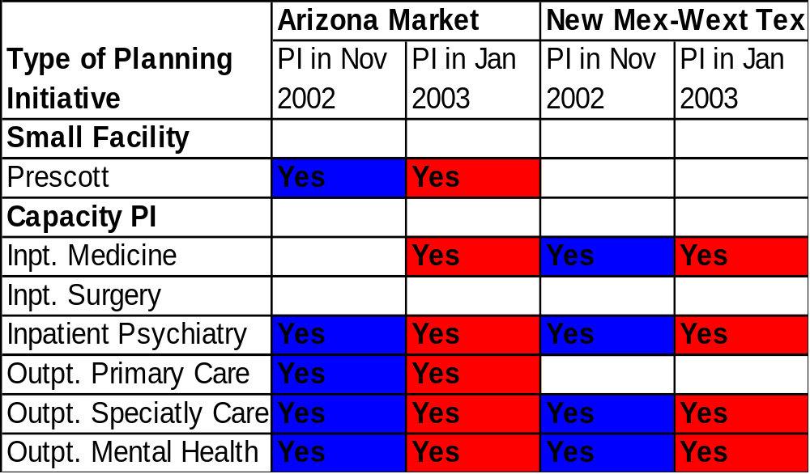
February 2003 Changes in Planning Initiatives

Slide 5
VISN 18 Overview
Enrollees
  Projected to increase by 0.5% from FY 2001 level to FY 2022
Planning Initiatives (PIs)
  Access
    1 Market has 2 PIs related to access in Hospital Care, and Tertiary Care impacting 128,481 enrollees
  Inpatient Demand
    2 Markets have 4 PIs related to increased inpatient demand
    No Markets have PIs related to decreased inpatient demand
  Outpatient Demand
    2 Markets have 5 PIs related to increased outpatient demand
    No Markets have PIs related to decreased outpatient demand
  Small Facility
    1 facility is projected to require fewer than 40 acute care beds

Slide 6
VISN 18 Overview
Other VISN-Level Issues
  Proximity
    No Acute Care facilities are within the 60-mile standard
    No Tertiary Care facilities are within the 120-mile standard
  VISN/PI Team Identified Issues
    Develop plan for research space at Phoenix and Tucson

Slide 7
VISN Overview
NHCU
Nursing Home Care:
  The need for NHCU care remains high over the planning period. The NHCU component of VA’s LTC Planning Model is in process of review to update the projections and should be available March 1st.
  Market Plans shall still consider any space and/or capital needs for NHCU care needs. (Realignment, renovations, conversion of space, etc.)

Slide 8
Domiciliary Policy
Domiciliary projections will not be part of this CAREs cycle.
However, DOMs may and should be included in Market Plans to reuse vacant space or as a result of realignments (especially when homelessness or residential rehab is the focus of Dom bed use).

Slide 9

VISN 18 – Issues
Special Disability Programs
Blind Rehab: VISN 18 has not been assigned a Blind Rehabilitation PI
The VISN has received a recommendation to establish a Visual Impairment Services Outpt Program (VISOR)
SCI: VISN 18 has not received any recommendations to increase SCI acute
& LTC beds.

Slide 10
Outpatient Mental Health
The forecasting model results in a systematic reduction in forecasted outpatient mental health visits.
We are working to understand the dynamics of the model that results in this outcome.
As a result, negative outpatient Mental Health Planning Initiatives will not be proposed or selected for Market Plan development.

Slide 11
VISN 18 OVERVIEW
  Collaborative Opportunities
  Enhanced Use—The team identified potential enhanced use opportunities in Phoenix for medical office building and clinic expansion
  VBA—None
  NCA—Potential columbarium at Prescott
  DOD—There are potential opportunities at:
    El Paso--William Beaumont Army Medical Center
    Phoenix--Luke AFB

Slide 12
VISN 18 – Issues
Special Disability Programs
Blind Rehab: Peak of legally blinded veterans in 2009 at 5,848 (from 5,267 in ’01) & ↓ to 5,774 veterans in ‘25. Consider space planning for blind rehab prgrms (i.e., VISORS, VICTORS, low vision clinics, BROS, & VIST) & restoration of inpt capacity for comprehensive blind rehab ctrs.
SCI: No issues.
Mental Health (SCMI, PTSD, SA): consider homeless initiatives. Concern RE comment on Doms in priority 4 – MH Inpt PI.
TBI: no specific recommendations.

Slide 13
VISN Level Issues
Effective Use of Resources – Proximity
Acute Care Hospitals with similar missions that are within 60 miles of each other: None in VISN 18
Tertiary Care Hospitals within 120 miles of each other:
PI? | Facility Name | Second Facility Name | Miles | Rationale
 | None
PI? | Facility Name | Second Facility Name | Miles | Rationale
 | None

Slide 14

VISN Level Issues
Effective Use of Resources – Space
Current Vacant Space: 67,699 square feet
Once the future workload demand data is translated into future space needs, any excess space that is identified will be added to the Vacant Space pool.
The final Planning Initiative for all VISNs will be to reduce this total Vacant Space pool by at least 10% beginning in FY2004 and 30% in FY2005.

Slide 15
VISN Level Issues
PI Team Identified Issues
Listed below are other issues that the VISN will consider when developing the Market Plans:
- Develop plan for research space at Phoenix and Tucson due to recent increases in research funding and start up of human genome project.

Slide 16
VISN Level Issues
Collaborative Opportunities
The following collaborative opportunities have been identified for VISN 18 to consider when completing Market Plans:
  VBA
    None
  NCA
    Potential columbarium at Prescott
  Enhanced-Use possible opportunities for vacant space:
    The team identified potential enhanced use opportunities in Phoenix for medical office building and clinic expansion
  DoD
    There are potential opportunities at El Paso/William Beaumont Army Medical Center, Phoenix/Luke AFB

Slide 17
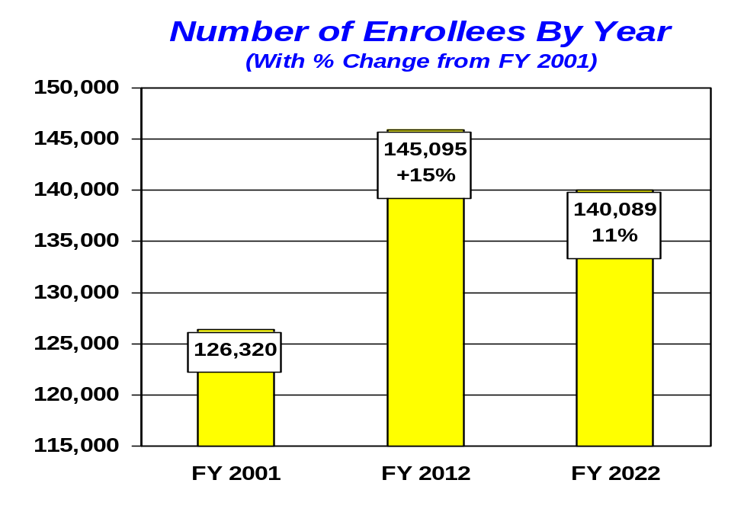
VISN 18 Arizona Market
Description of Market Area:
  The Arizona Market includes two urban tertiary care VA Health Care Systems located in Phoenix and Tucson, a hospital in Prescott, along with 12 CBOCS. Referrals and travel patterns play a key role in determining this market. The Phoenix and Tucson VAMCs have already reviewed their facilities and removed inefficiencies and duplicate tertiary services. Mountain ranges separating Arizona and New Mexico form a natural barrier that hinders East-West traffic
Medical Center(s):
  Phoenix (Tertiary)
  Tucson (Tertiary)
  Prescott

Slide 18
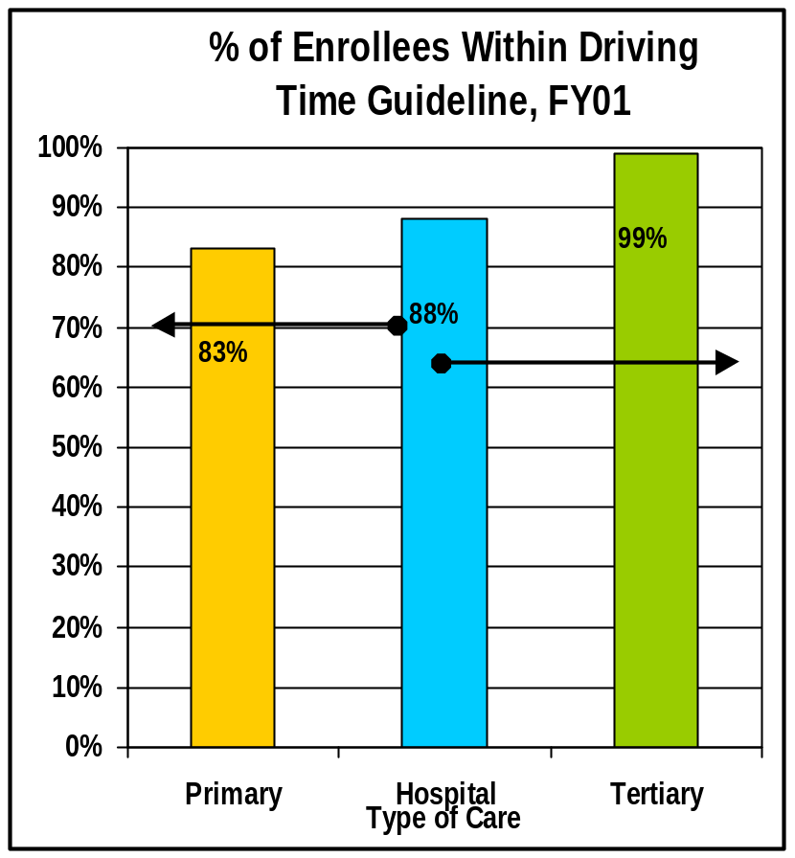
VISN 18 Arizona Market
CARES Planning Initiatives
Access
  Primary Care: 83% of the veterans residing within the Market are within the Access Guideline
  Hospital Care: 88% of the veterans residing within the Market are within the Access Guideline
  Tertiary Care: 99% of the veterans residing within the Market are within the Access Guideline
70%
65%
Identified as a CARES Planning Initiative.
This represents the Travel Time Guideline.
*NOTES: Significant Gaps are determined by first applying the percentage threshold and then a volume criteria.

Slide 19
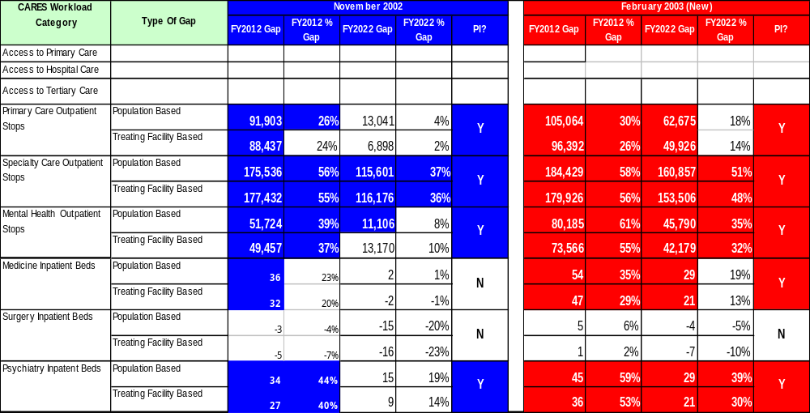
VISN 18 Arizona Market
CARES Planning Initiatives
*NOTES: Significant Gaps are determined by first applying a percentage change criteria for each CARES Category. If the gap meets this threshold, then it must meet the workload threshold criteria (beds for inpatient categories and stops for outpatient categories).

Slide 20
VISN 18 Arizona Market
CARES Planning Initiatives
Small Facility Planning Initiative:
  The following facilities were projected to have less than 40 beds in FY 2012 and/or 2022.
PI? | Facility Name | FY2012 (Beds) | FY2022 (Beds) | Rationale
Y | Prescott | 28 | 22 | # of projected beds is well below 40 bed standard. Need to evaluate impact on quality.

Slide 21
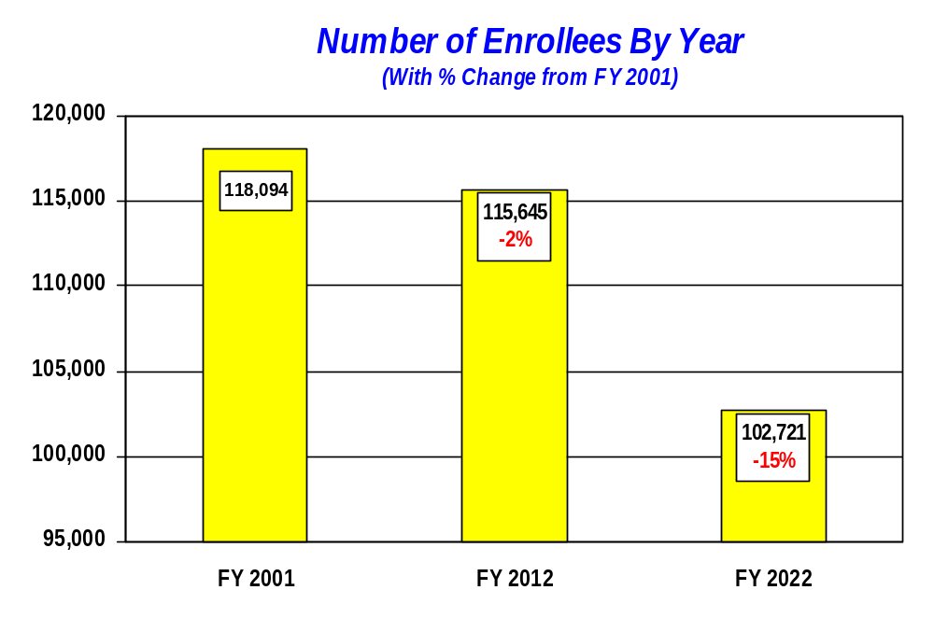
VISN 18 New Mexico-West Texas Market
Description of Market Area:
  This market includes all of New Mexico and West Texas and is divided into two sub-markets cutting the market into two slices: North and South. Albuquerque VAMC serves as the referral tertiary center for the whole market with two hospitals (Amarillo and Big Spring) in West Texas, both of which will need less than 40 beds by 2022. West Texas has a major access problem for hospital as well as tertiary care, but population in this region is so dispersed, there is no location which can both solve the access problem or reach a projected demand of 40 beds.
Medical Center(s):
  Albuquerque (Tertiary)
  Amarillo
  Big Spring

Slide 22
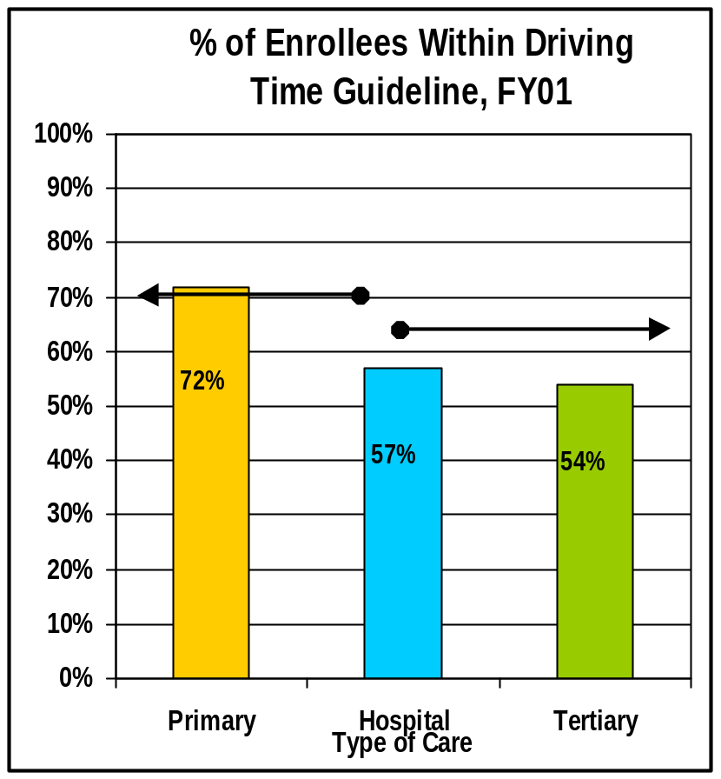
VISN 18 New Mexico-West Texas Market
CARES Planning Initiatives
Access
  Primary Care: 72% of the veterans residing within the Market are within the Access Guideline
  Hospital Care: 57% of the veterans residing within the Market are within the Access Guideline
  Tertiary Care: 54% of the veterans residing within the Market are within the Access Guideline
70%
65%
Identified as a CARES Planning Initiative.
This represents the Travel Time Guideline.
*NOTES: Significant Gaps are determined by first applying the percentage threshold and then a volume criteria.

Slide 23
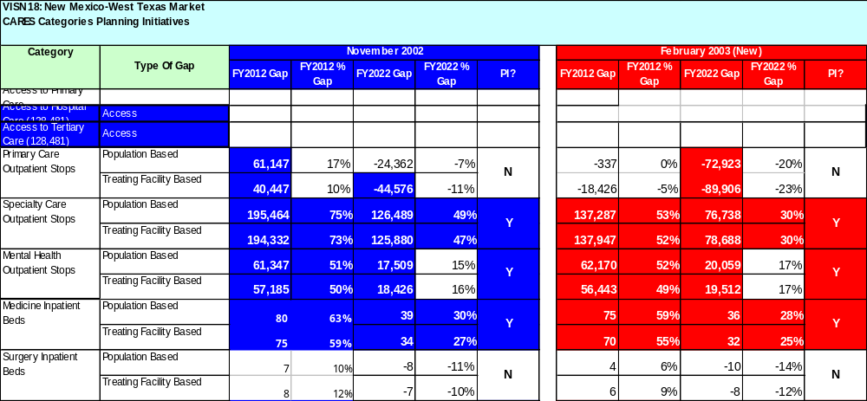
VISN 18 New Mexico-West Texas Market
CARES Planning Initiatives
*NOTES: Significant Gaps are determined by first applying a percentage change criteria for each CARES Category. If the gap meets this threshold, then it must meet the workload threshold criteria (beds for inpatient categories and stops for outpatient categories).

Slide 24
VISN 18 New Mexico-West Texas Market
CARES Planning Initiatives
Small Facility Planning Initiative:
  The following facilities were projected to have less than 40 beds in FY 2012 and/or 2022.
PI? | Facility Name | FY2012 (Beds) | FY2022 (Beds) | Rationale
 | None

