Slide 1
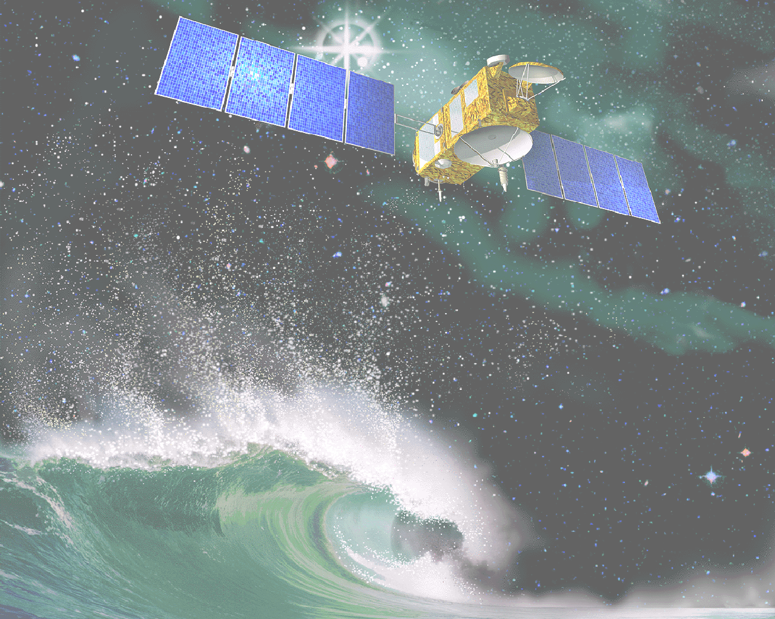

NOAA Ocean Satellite Data Course
Logistics and Objectives
Oregon State University
August 22-24 2006

Slide 2
Acknowledgments
Special thanks to
Stan Wilson and John Pereira (NESDIS)
NOAA’s Satellite Research & Operations (R&O) project
Ted Strub, Dudley Chelton and Peter Strutton (OSU)
Cooperative Institute for Oceanographic Satellite Studies (CIOSS)
OSU Department of Geosciences’ Digital Earth Classroom

Slide 3

Agenda
NOAA Ocean Satellite Data Course
Tuesday, Aug. 22, 2006 Morning
COAS Classroom, 193 Burt Hall
8:30 Introduction to the course - logistics and objectives
Cara Wilson
9:00 Overview of ocean remote sensing and IR specifics and applications
Ted Strub
10:00 Break
10:15 Visible, ocean color specifics and applications
Peter Strutton
10:45 Passive and active microwave:
SST, altimetry, scatterometry specifics and applications
Dudley Chelton
12:00 Satellite applications within Fisheries and Marine Sanctuaries
Cara Wilson
12:30 Lunch (on your own)

Slide 4
Agenda
NOAA Ocean Satellite Data Course
Tuesday, Aug. 22, 2006 Afternoon
Digital Earth Classroom, Department of Geosciences, 210 Wilkinson Hall
Dave Foley, Luke Spence, Carlos Rivero and Cara Wilson
2:00-5:30 Lab
Wednesday, Aug. 23, 2006
8:30-12:00 Lab
12:00-1:30 Lunch (on your own)
1:30-5:00 Lab
Thursday, Aug. 24, 2006
8:30-12:00 Lab
12:00-1:30 Lunch (on your own)
1:30-3:00 Lab
3:00-? Informal wrap-up (at Bombs Away over beer?)

Slide 5
Handouts
NOAA Ocean Satellite Data Course
Handouts
Textbook: “An Introduction to Ocean Remote Sensing”
by Seelye Martin
“Ocean Colour & Fisheries” chapter from upcoming IOCCG (International Ocean Colour Coordinating Group) report
“Fisheries and Satellite data” bibliography
Evaluation Forms

Slide 6
Applicants & participants
NOAA Ocean Satellite Data Course
Applicants & Participants
62 applications received for 30 spots
31 participants selected (1 ‘auditing’)
Division | # Applicants | # Selected
NOS | 10 | 6
NMFS/A | 9 | 4
NMFS/NE | 4 | 4
NMFS/NW | 12 | 4
NMFS/SE | 8 | 4
NMFS/SW | 11 | 4
NMFS/PI | 5 | 4
NMFS/S&T | 2 | 1
Non-NOAA | 1 | 0

Slide 7
NOAA Ocean Satellite Data Course
Background & Objectives:
The R&O (Research & Operations) project

Slide 8
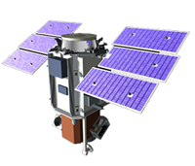
Senate language in the FY05 Budget
  NOAA’s mission is to fly operational satellites, but little of the sensor technology developed by NASA has been picked up by NOAA
  “Provide NOAA the capability to transition NASA remote sensed ocean measurements into operational products for the user community”
  Observations explicitly mentioned: “ocean winds from scatterometers…sea level…from altimeters, and…ocean color”
  Initially a one-year $4M level of effort in FY05, with no assurance for continuation, it was continued in FY06 at $4M
NOAA/NMFS/SWFSC PFEL
Notes:
Taken from R2O Tiger Team powerpoint presentation

Slide 9

Research & Operations (R&O) Tiger Team
Membership:
Stan Wilson and John Pereira, leads, NESDIS
Cara Wilson and Kenric Osgood, NMFS
Rick Stumpf, NOS
Al Powell, NESDIS/STAR
Fred Toepfer, Kevin Schrab, NWS
Bob Atlas, Mike Johnson, and Ants Leetmaa, OAR
FY06 Structure:
Team broken into three tasks, which have additional members:
SSH – Ants Leetmaa, lead (Lucas Moxley, NMFS/PIFSC)
SVW – Bob Atlas, lead (Dave Foley, NMFS/SWFSC)
Ocean Color – Rick Stumpf, lead (Cara Wilson, NMFS/SWFSC)
FY06 Funding:
Specific projects received funds in late May 2006
NOAA/NMFS/SWFSC PFEL

Slide 10
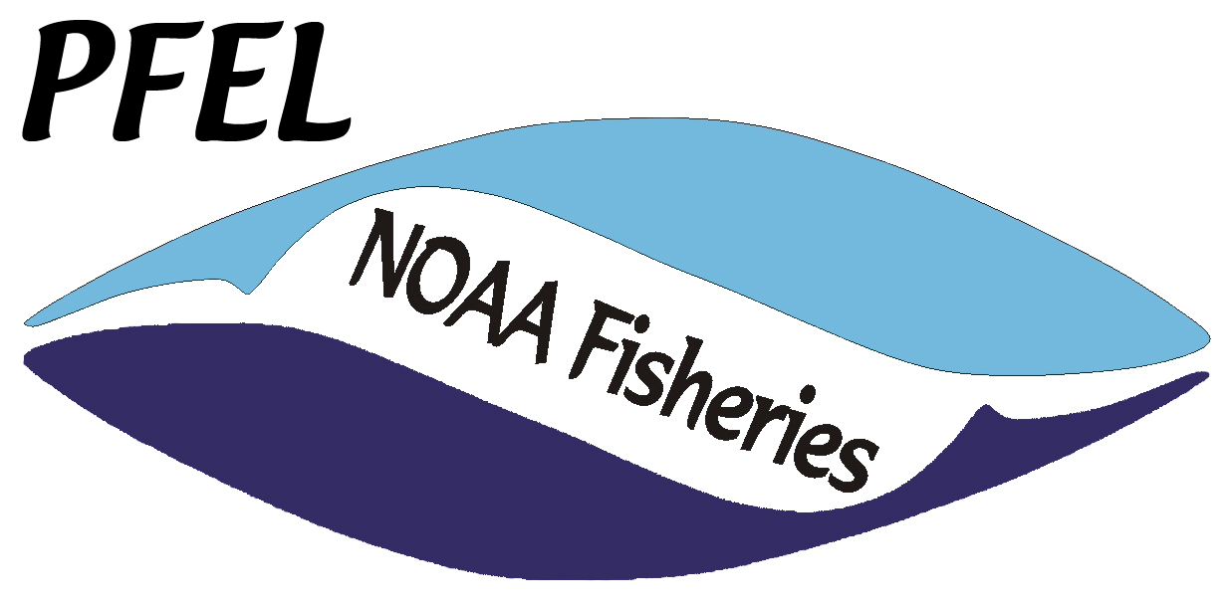
The Bottom Line…
NOAA will be taking over the operational acquisition of major satellite measurements such as SSH, ocean color and surface winds.
In support of this, NOAA needs to demonstrate the operational use of these data within the agency.
NMFS and NOS are the two NOAA LOs involved with the operational use of oceanic satellite data (ie non weather). For the open ocean, NMFS is the only LO.
NOAA/NMFS/SWFSC PFEL

Slide 11
Question…
The high temporal and spatial resolution of satellite data, and its continuity, make satellite data an important tool for monitoring and characterizing marine ecosystems. Satellite data will become increasingly more important as NOAA implements ecosystem approaches to management.
But currently the full potential of satellite data has not been realized within NMFS, or within fisheries science more generally.
Why is satellite data underutilized within NMFS, and what can be done to take advantage of the wealth of information this data can provide?

Slide 12
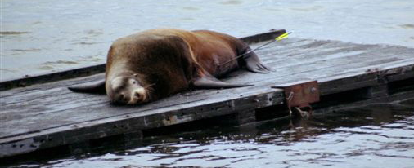
Some Issues
Satellite data can be difficult to access, manipulate and process, particularly for people who have never used it before.
Work required to get relevant parameters can be cumbersome, ie:
• primary productivity from chlorophyll
• fronts locations from SST fields
• climatologies required to generate anomalies
Timeseries of satellite data are relatively short compared to most fisheries datasets.
People too busy with their regular workloads to find time to familiarize themselves with new analyses.

Slide 13
NMFS R&O FY05 Project
Facilitate access to multiple satellite data sets to meet fisheries & IOOS needs
• NMFS Satellite group established
• Fisheries & Satellite data “road tour” to NMFS labs
• Primary productivity product on ERD LAS

Slide 14
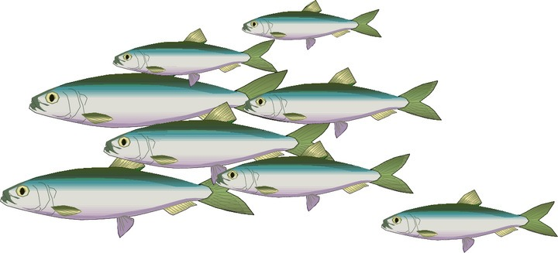
NMFS R&O FY05 Project
Facilitate access to multiple satellite data sets to meet fisheries & IOOS needs
Three primary results:
Establishment of internal NMFS-satellite working group
A series of informational seminars given at all 6 Fisheries Science Centers during the summer of 2005 (and continued into 2006…)
Access provided to global time-series of satellite-derived primary productivity, SSH and geostrophic currents via new Coastwatch West Coast Data Browser, the Oceanwatch Live Access Server (LAS) and by OPeNDAP technology at NOAA/NMFS/SWFSC/ERD

Slide 15
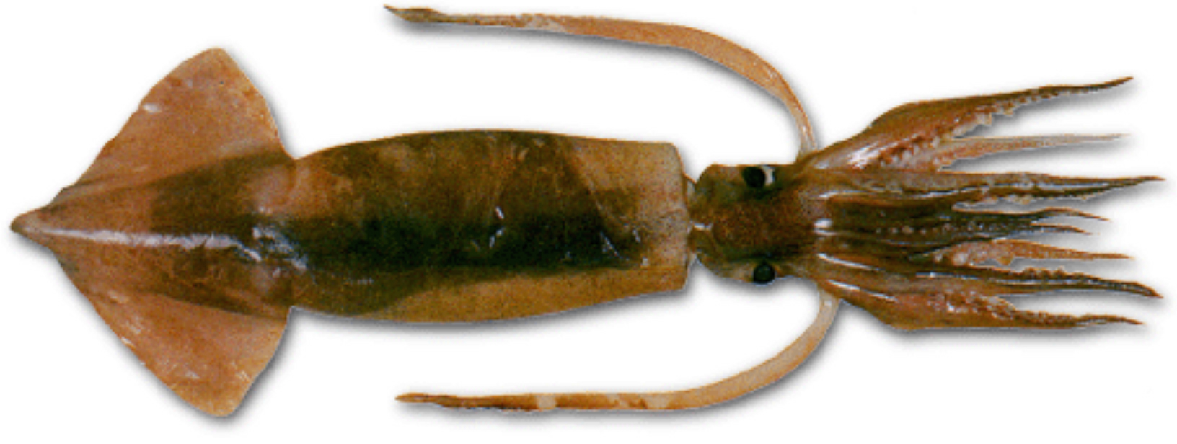
NMFS Satellite Group
Established Jan 2005
Satellite POCs for each science center
(appointed by lab director)
AFSC Jeff Napp (Seattle)
NEFSC Jay O’Reilly (Narragansett) NWFSC Bill Peterson (Newport)
PIFSC Jeff Polovina (Honolulu)
SEFSC Tom Leming (Mississippi) SWFSC Cara Wilson (Pacific Grove)
S&T Kenric Osgood (Silver Spring)
POC also a CoastWatch PI
Labs outside of the regional HQ laboratory

Slide 16
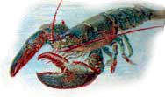
Outreach
NOAA Fisheries and Satellite Data –
Where are we and where are we going?
  AFSC Seattle, WA Jun 7, 2005
  SWFSC * La Jolla, CA Jun 15, 2005 PIFSC Honolulu, HI Jul 18, 2005
  SEFSC * Miami, FL Jul 26, 2005
  NEFSC Narragansett, RI Aug 2, 2005
  NWFSC Newport, OR Aug 16, 2005
  AFSC * Juneau, AK Jan 31, 2006 NEFSC * Woods Hole, MA Mar 10, 2006
  NMFS HQ Silver Spring, MD Mar 13, 2006
  NESDIS HQ Silver Spring, MD Mar 14, 2006
  SWFSC * Santa Cruz, CA Jun 20, 2006
  NMFS Stock Assessment Workshop Apr 19, 2006
* NMFS Satellite POC not at this lab
Most travel funded by the R&O project

Slide 17
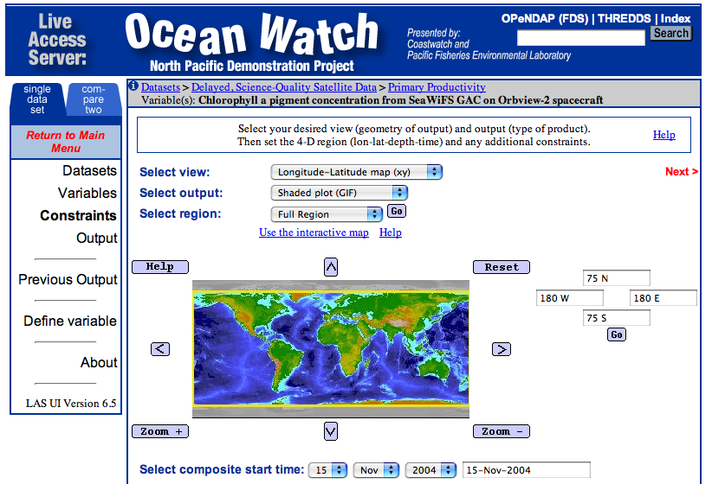
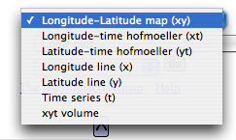
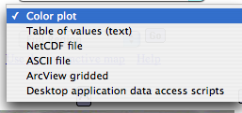
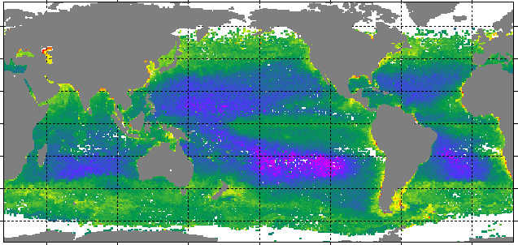
SWFSC OceanWatch LAS at ERD
http://oceanwatch.pfeg.noaa.gov
OPeNDAP has been identified by IOOS as DMAC standard
Primary Productivity
NOAA/NMFS/SWFSC PFEL
Notes:
Has both near real-time and delayed, science-quality satellite fields
Calculated primary productivity will be available by the end of Aug 2005

Slide 18

NMFS R&O FY06 Projects
Satellite data training
• 4 NMFS scholarships to 2-week Cornell class
• 3-day course for 30 NMFS/NOS participants
Develop satellite climatologies
Alaska satellite data browser
Ocean color frontal products
NASA/NOAA workshop in May 2006 on integrating satellite data into fisheries management

Slide 19
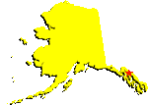
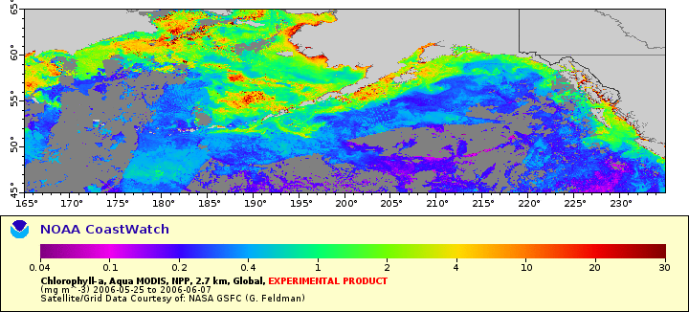
Alaska Satellite Browser
http://coastwatch.pfel.noaa.gov/coastwatch/CWBrowserAK.jsp
Per request from AFSC, a new satellite browser for the Alaska region was developed at NMFS/SWFSC ERD, based on the existing west coast CoastWatch browser
Sea ice data will be included
Different map projections, better suited to high latitudes, will be used
a NOAA R&O funded project

Slide 20
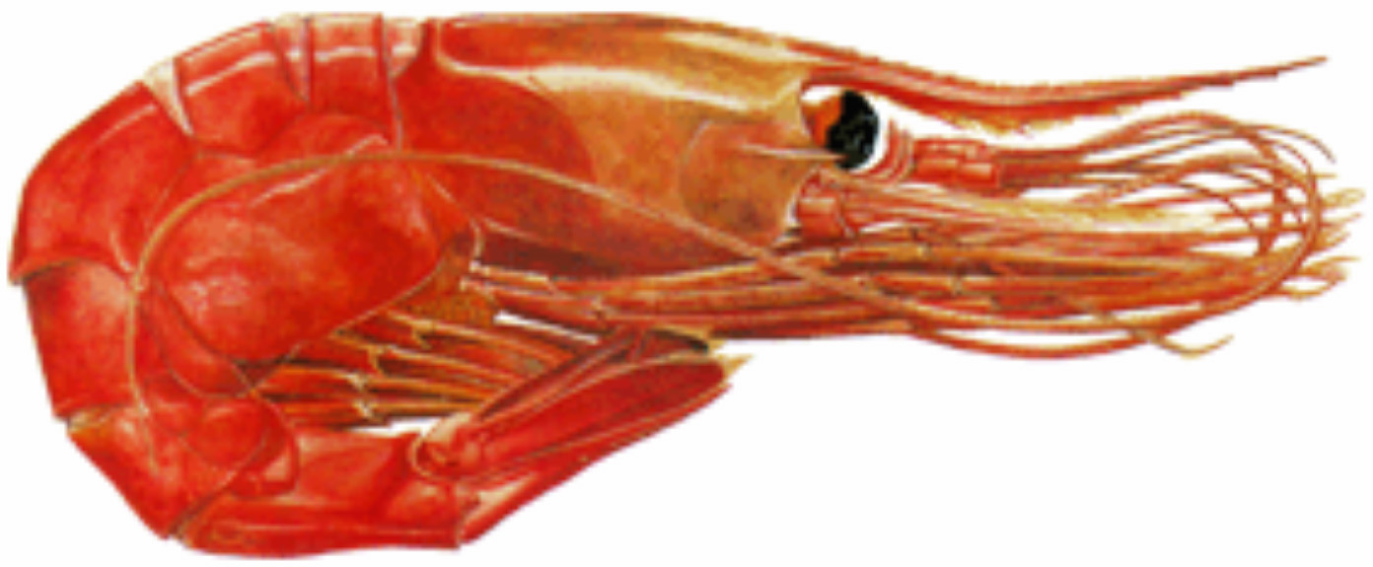
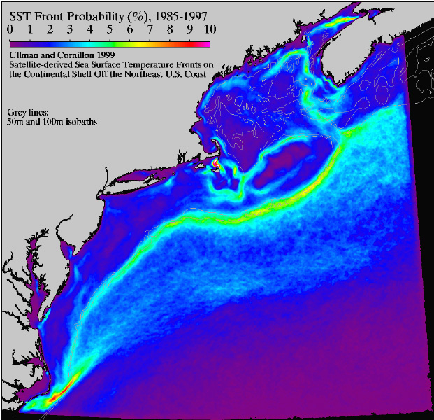
Frontal Products
Oceanic fronts are associated with zones of elevated primary and secondary productivity and fishery grounds
Coastal and offshore fronts can serve as “seed banks” for harmful algal blooms
Project underway (O’Reilly and Belkin) to develop monthly climatology of CHL and SST fronts, 1997-2006
SST Front Probability
a NOAA R&O funded project

Slide 21

NASA/NOAA Workshop
NASA/NOAA invitational workshop on applications of satellite data in ecosystem management and modeling, as used by NOAA Fisheries
May 3-5 2006 at MBARI
42 participants, from NASA, NMFS, NESDIS, NOS
5 projects developed that will be funded by NASA
R&O funded travel costs for all NOAA participants
Funding by NOAA’s R&O project

Slide 22

Cornell Summer Class on Satellite Data
2 week course taught by Bruce Monger, aimed at giving biological oceanographers and marine biologists the training needed to make easy and effective use of the available satellite data sets.
4 scholarships awarded to NMFS participants to attend the course (June 2-17, 2006).
In FY07 will try to secure 6 scholarships (one per NMFS science center).
Course is entirely IDL-based.
Funding by NOAA’s R&O project

Slide 23
NMFS R&O FY07 Projects?
Dependent upon NOAA’s R&O project receiving another congressional earmark
Satellite data training
• scholarships (6) to 2-week Cornell class
• another 3-day satellite course Mar 26-30, 2007
Other Ideas???….
feel free to contact me at cara.wilson@noaa.gov
  Fundamental objective:
  Provide NOAA the capability to transition NASA satellite ocean measurements into operational products for the user community

Slide 24
Future Special
Session
Special Session on
Satellite Applications in Fisheries and Ocean Management
AFS Annual Meeting
San Francisco, CA, Sept. 2–6 2007
or
ASLO/AGU/TOS Ocean Sciences Meeting
Orlando, FL, March 2–7 2008

Slide 25
Agenda
NOAA Ocean Satellite Data Course
Tuesday, Aug. 22, 2006 Morning
COAS Classroom, 193 Burt Hall
8:30 Introduction to the course - logistics and objectives
Cara Wilson
9:00 Overview of ocean remote sensing and IR specifics and applications
Ted Strub
10:00 Break
10:15 Visible, ocean color specifics and applications
Peter Strutton
10:45 Passive and active microwave:
SST, altimetry, scatterometry specifics and applications
Dudley Chelton
12:00 Satellite applications within Fisheries and Marine Sanctuaries
Cara Wilson
12:30 Lunch (on your own)
2:00 Lab, 210 Wilkinson Hall

