Slide 1
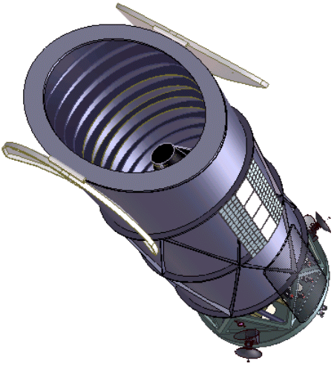
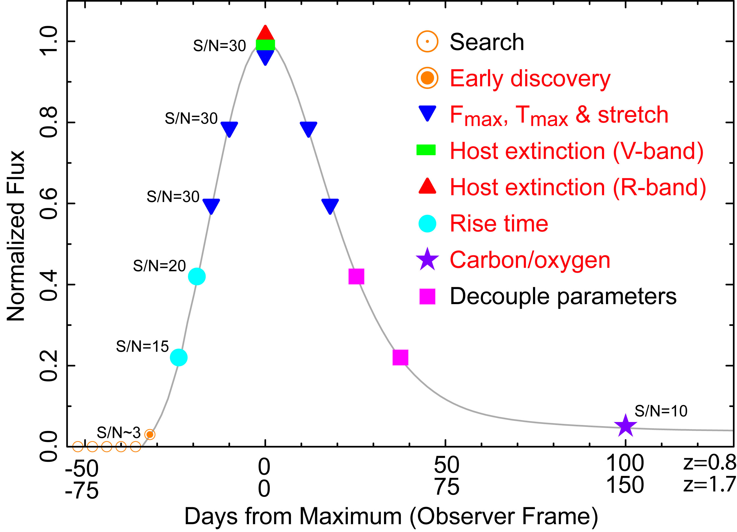
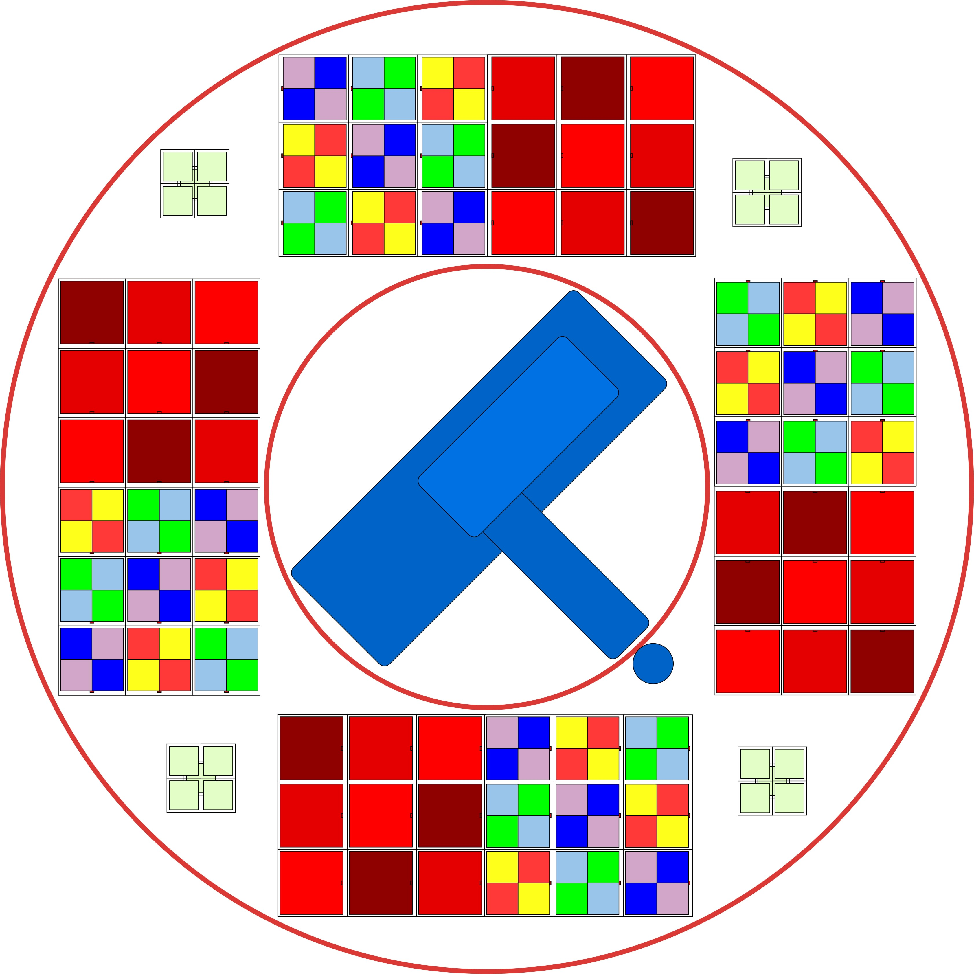
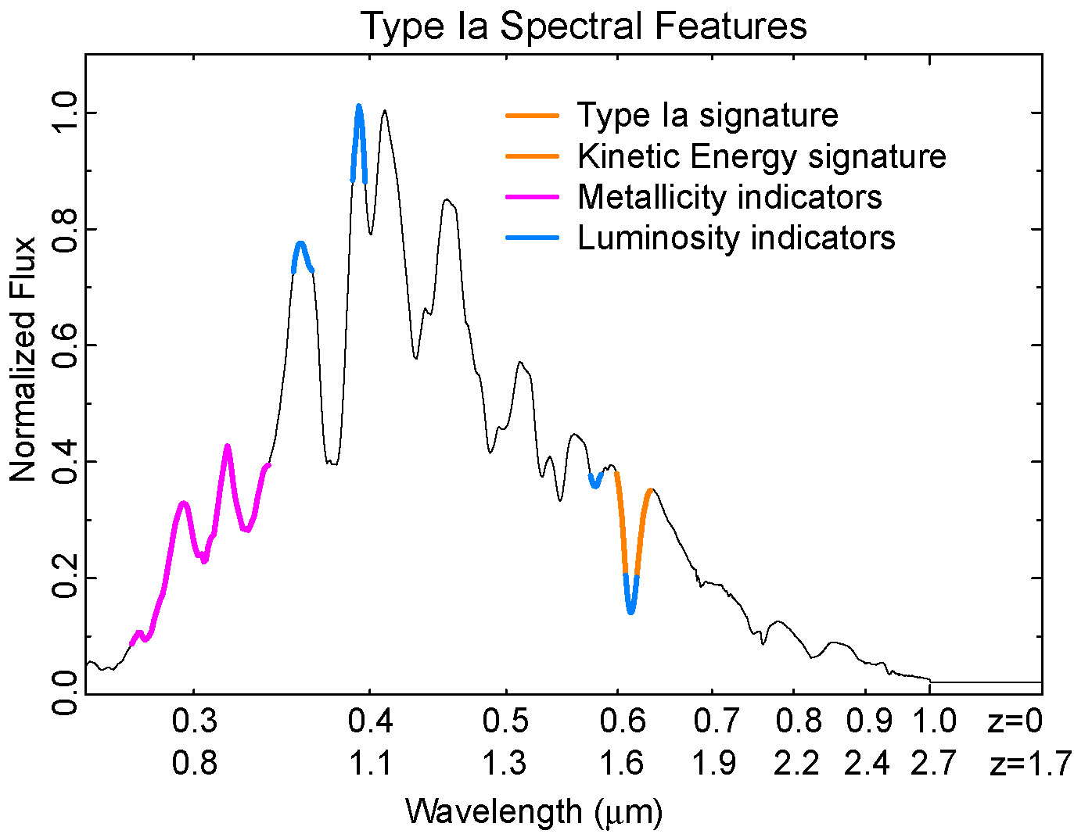
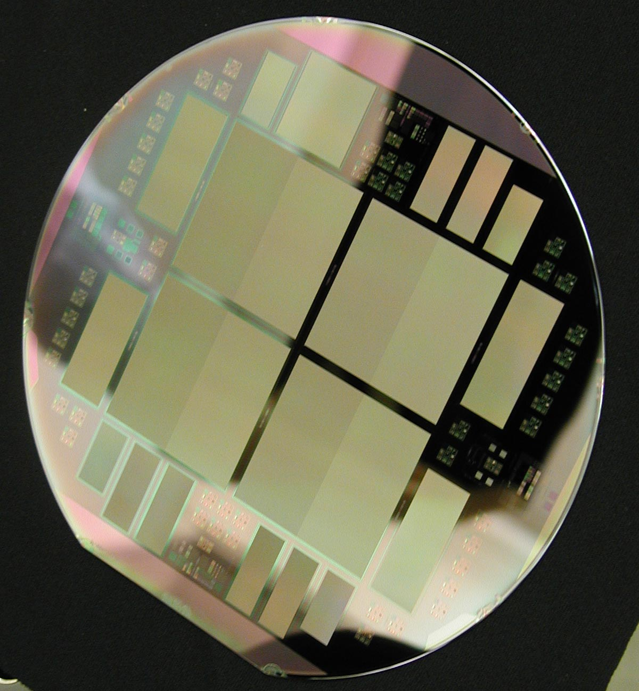
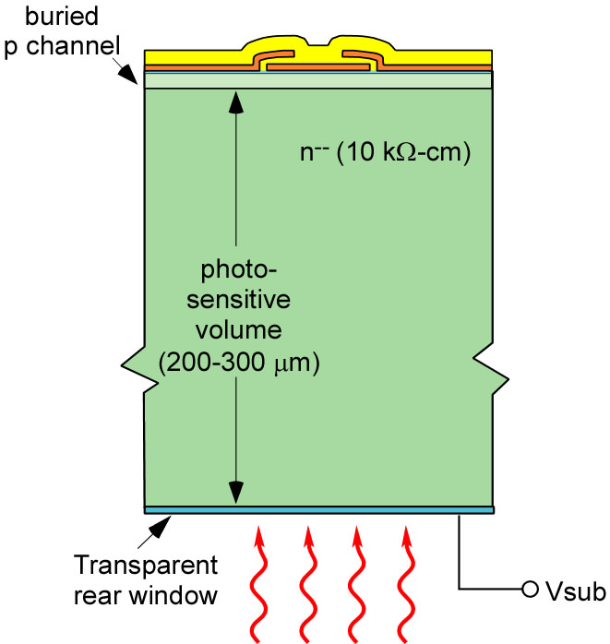
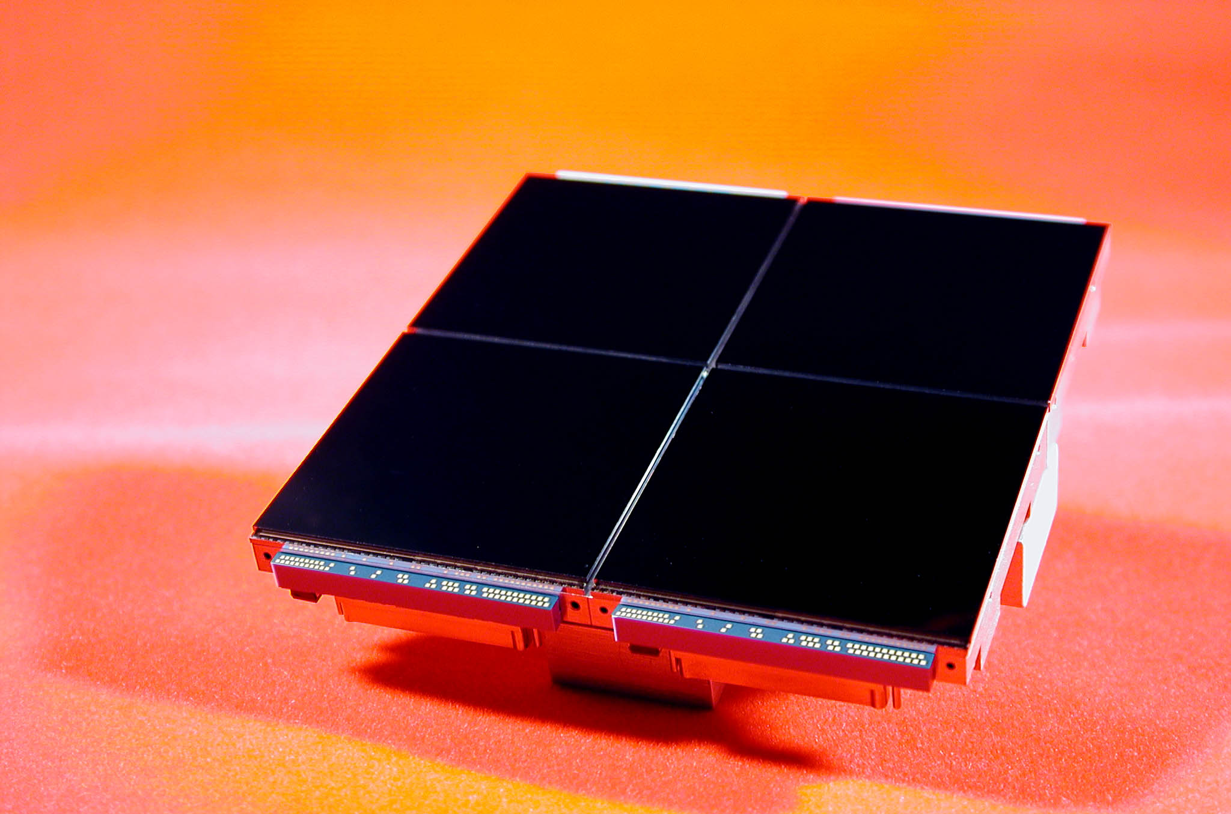
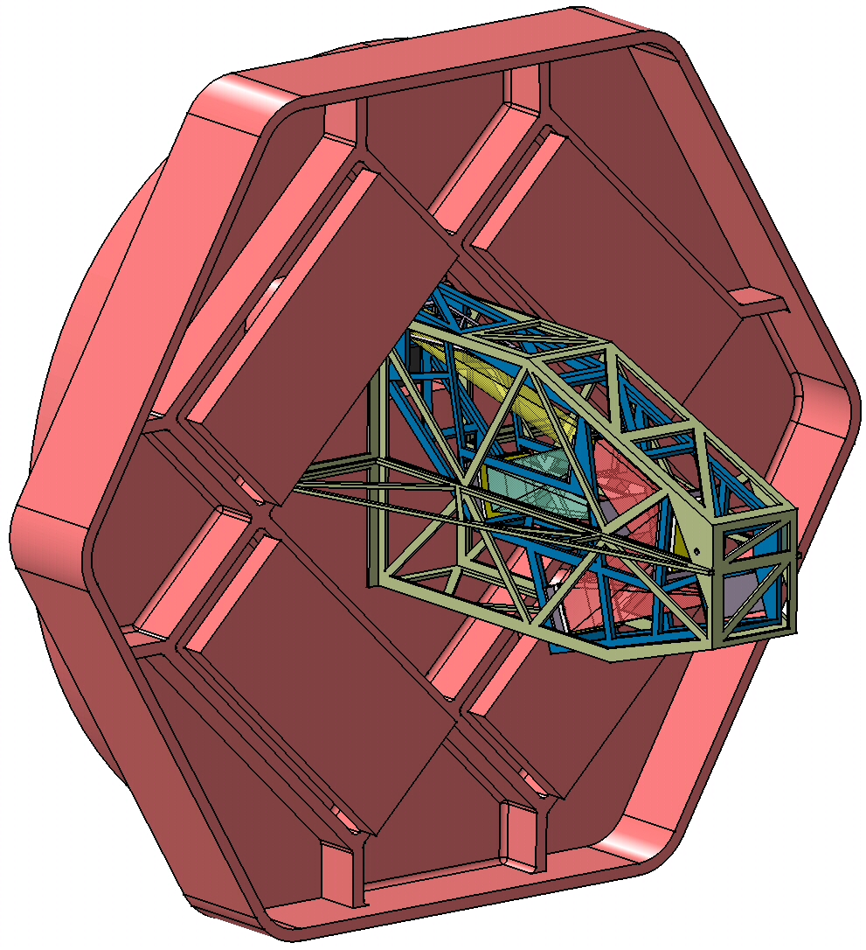
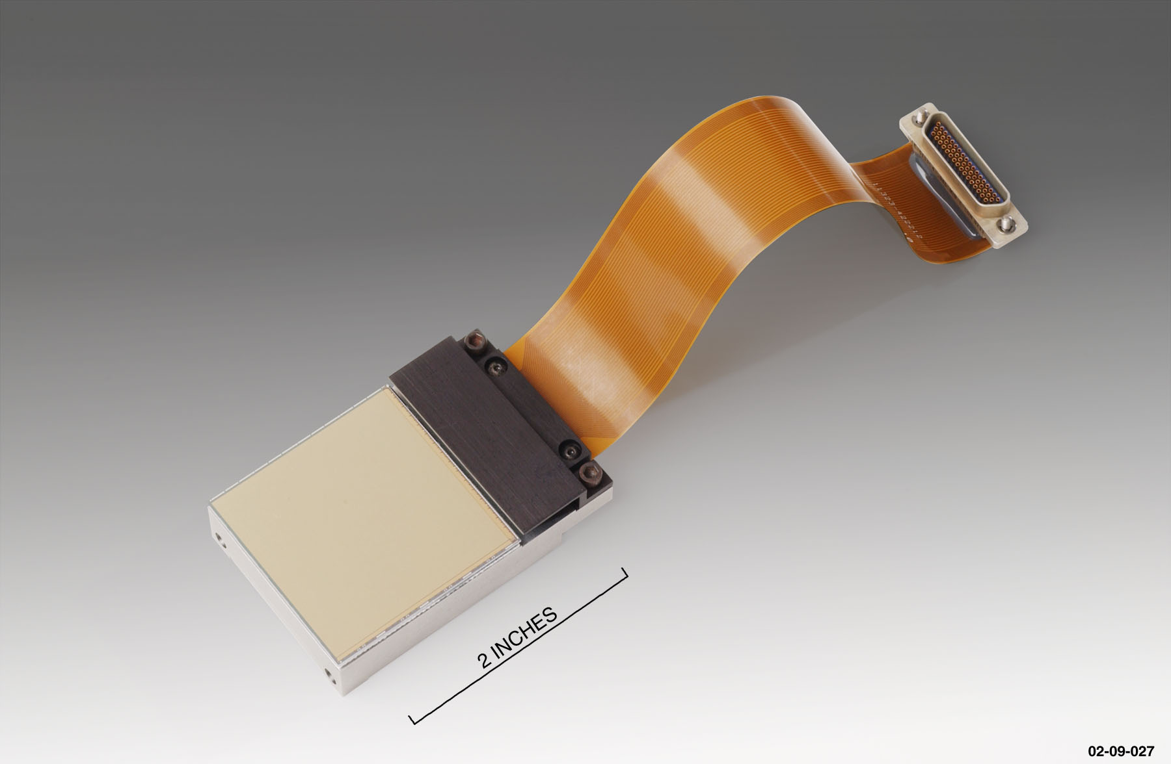
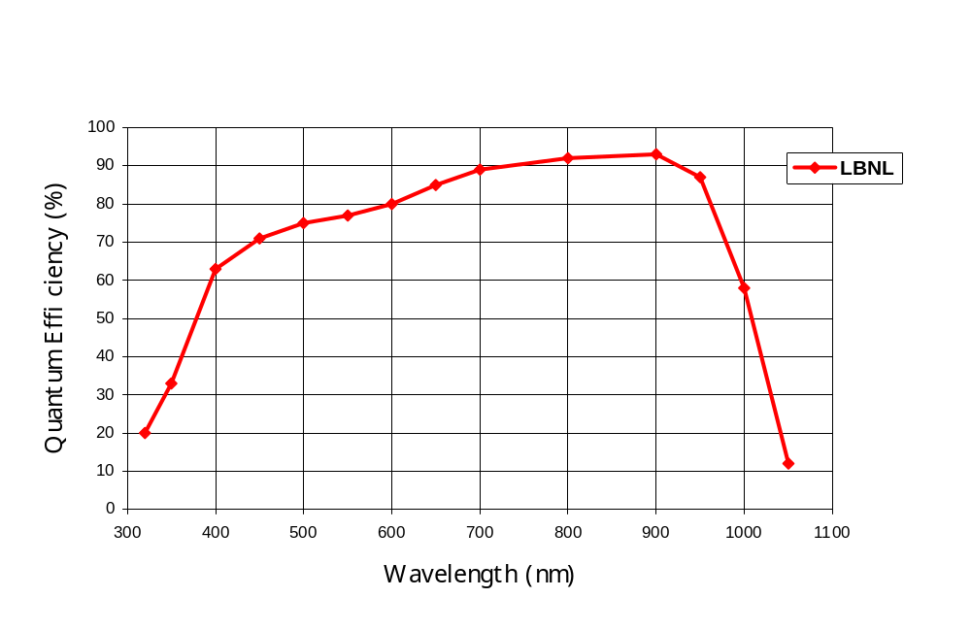
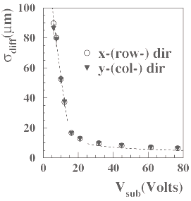
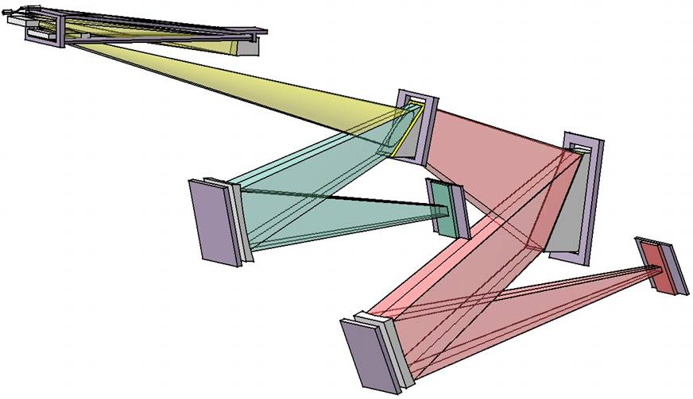
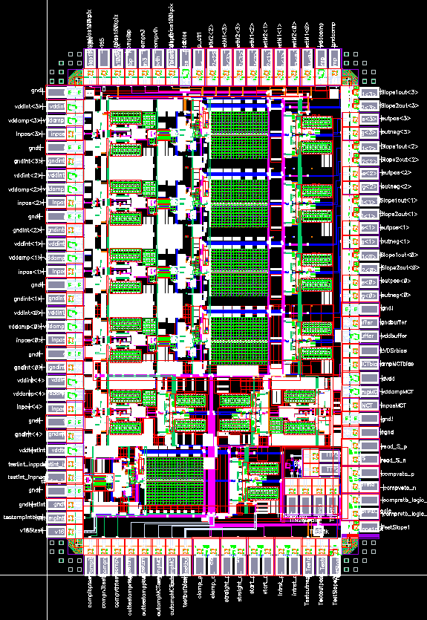
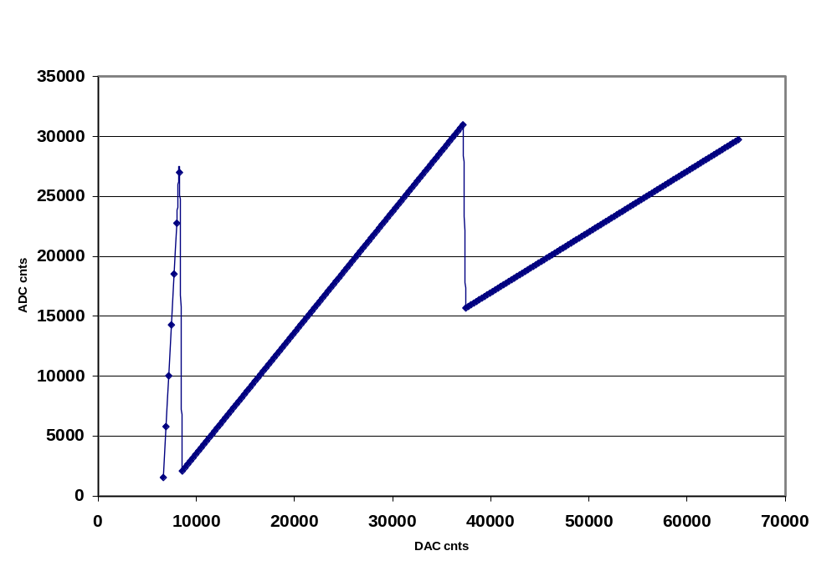
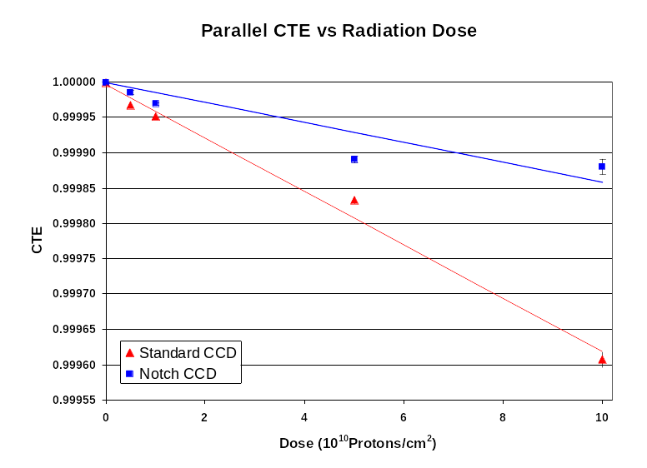
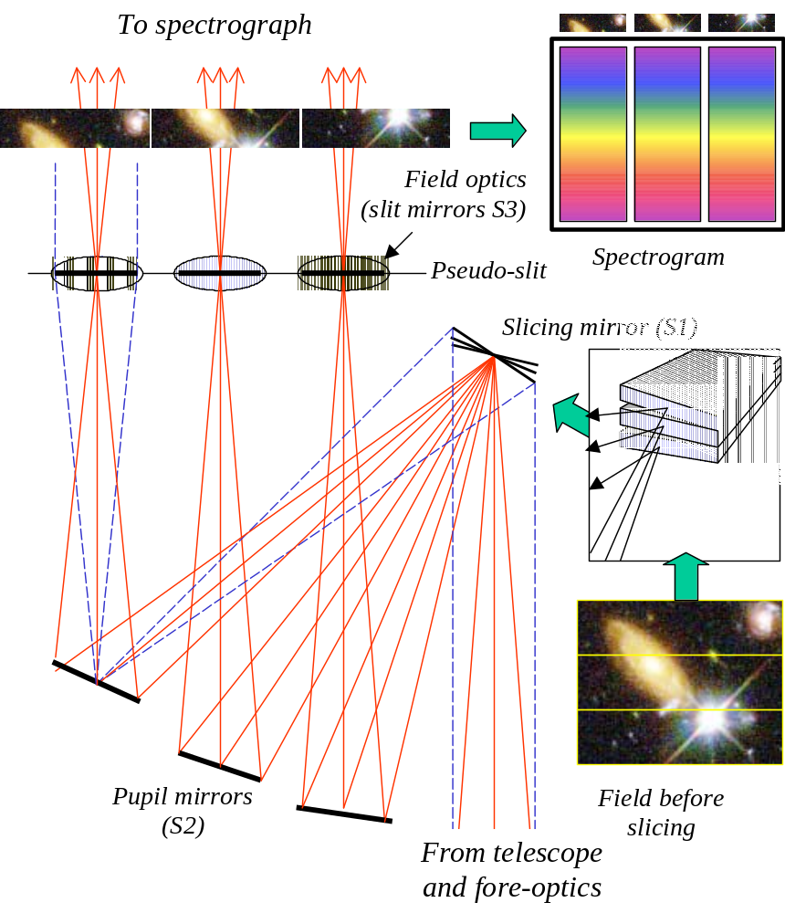
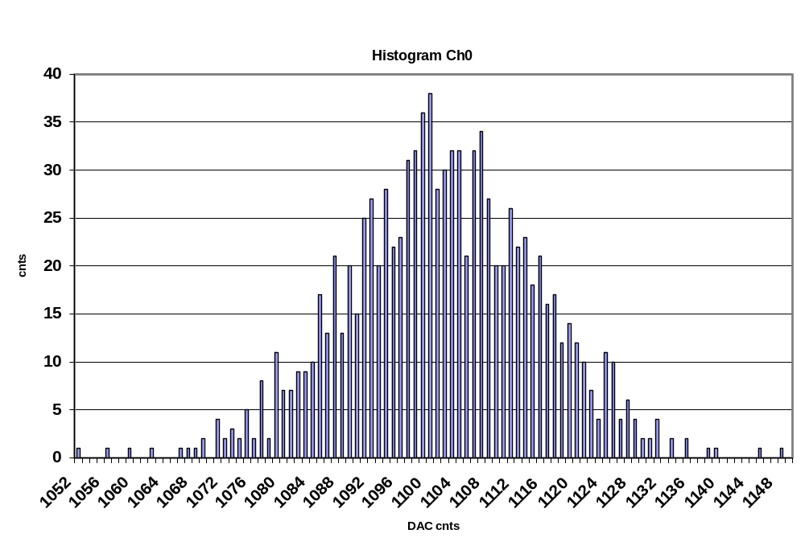
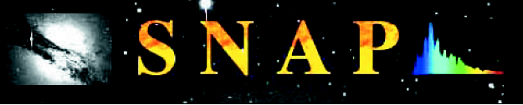
Supernova / Acceleration Probe:
SNAP Instrument Development
Photometry
SNAP Focal Plane
Spectroscopy
Metallicity
SiII
Discover and follow ~2000 Type Ia SNe from z=0.3 to 1.7
Repetitive 4-day scans of 15 square degrees
Light curves in 9 filter bands from 0.35 μm to 1.7 μm
Taken near peak brightness
Covers 0.35 μm to 1.7 μm
λ/δλ ~ 100
Used to identify Type Ia SNe by SiII feature and characterize other
features
Visible Light Sensors
Near-Infrared Sensors
Desired Features
  Dark current < 0.02 e-/pixel/sec
  Read noise < 4 e-
  QE > 80% from 0.4 - 1.0 μm
  Charge diffusion: σ < 4 μm
  Technologies
  LBNL p-channel CCDs
  Si PIN diodes
Spectrograph
Desired Features
  Dark current < 0.1 e-/pixel/sec
  Read noise ~ 5 e-
  QE > 65% from 0.9 - 1.7 μm
  Technologies
  HgCdTe 1.7 μm cutoff sensors from Rockwell or Raytheon
  InGaAs sensors
Desired Features
High throughput, optimized for minimum exposure time for z=1.7 SNe
Spectral resolution λ/δλ ~ 100 is sufficient to identify SiII feature of Ia SNe
  Technology
  Integral field unit based on image slicer technique
JWST NIRCam mockup
Spectrograph mounted
on back of focal plane
SNAP v. 1 CCDs (4) on
DALSA-fabbed 150mm wafer
LBNL CCD: Fully-depleted,
p-channel technology on
high-resistivity silicon
VIRGO 2048 x 2048 Arrays v
Spectrograph layout
showing visible and NIR arms
Input port
Slicer
Prism
BK7
Prism
CaF₂
Vis
Detector
NIR
detector
C. J. Bebek et al., “Proton radiation damage in p-channel CCDs fabricated on high-resistivity silicon,” IEEE Trans. Nucl. Sci. vol. 49, pp. 1221-1225, Jun. 2002.
Diffusion vs bias voltage for
250 μm thick LBNL CCD
Presented at IEEE 8/03
Sensor Electronics
Imager Splitter Technique
CRIC chip designed
at LBNL
1.5 LSB non-linearity on high gain range. Much lower on other ranges.
From “An assessment of the optical detector systems
of the W.M. Keck Observatory,” J. Beletic, R. Stover,
K Taylor, 19 January 2001.
Noise: 1.6e
2e @ 300 K
Four CDS channels
Multi-slope integration
16-bit dynamic range
Read noise < 2 e-
Power 6.5 mW/ch
http://snap.lbl.gov
Photo courtesy NOAO, taken with LBNL “hot red” CCD

