Slide 1
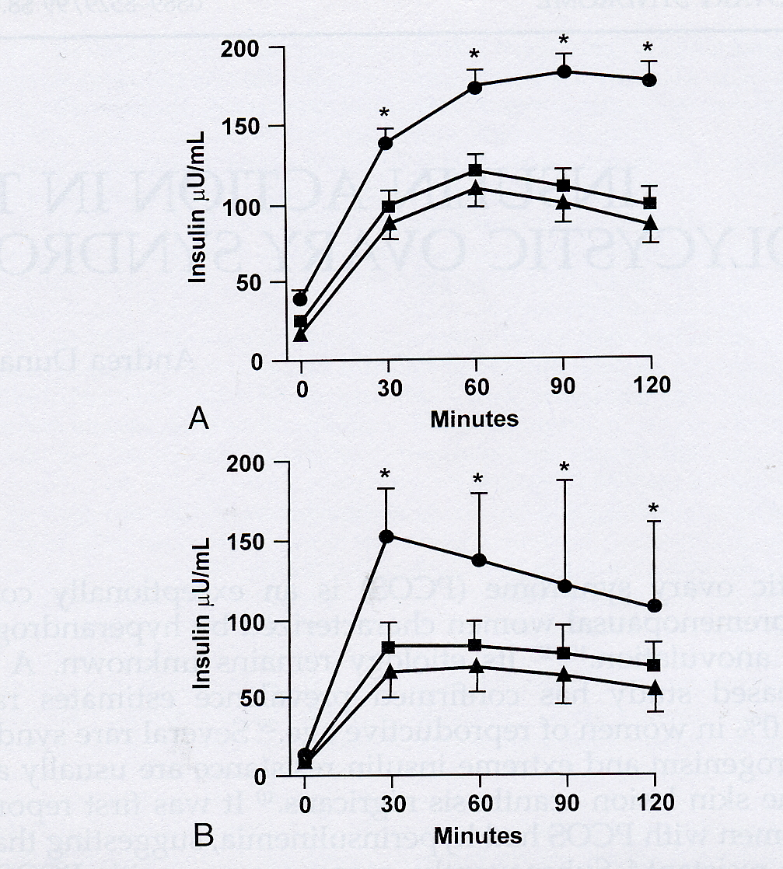

Slide 2
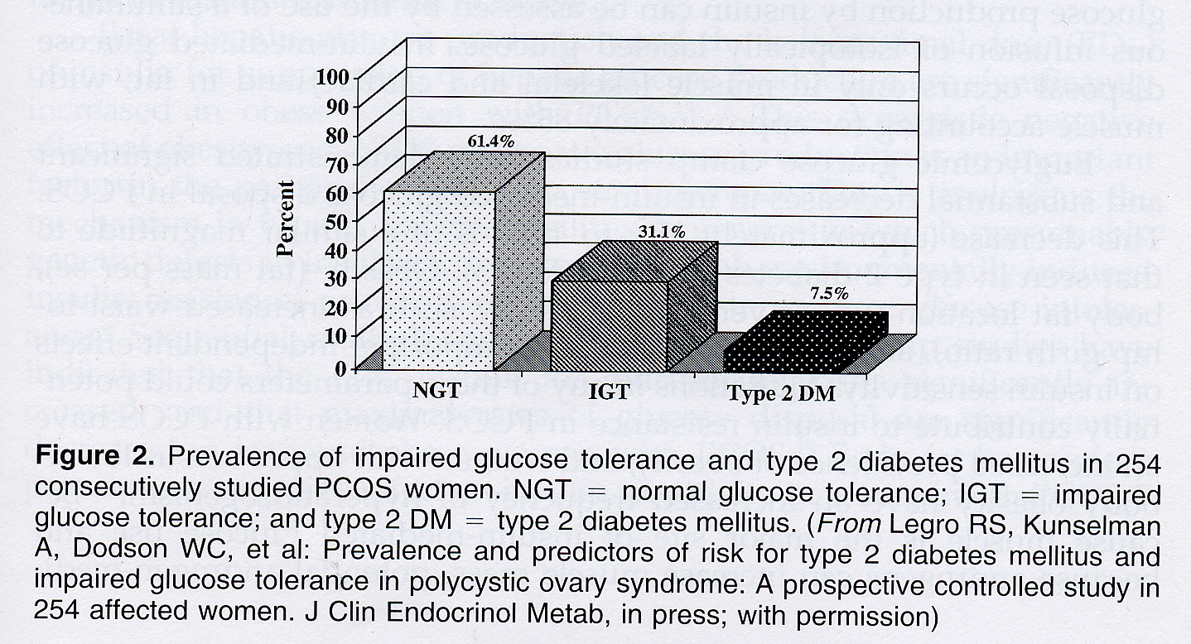

Slide 3
PCOS and Insulin Resistance
Clinical Research Centers
  Examination of parameters associated with insulin resistance
  Following correlated with insulin clamp model:
    Fasting insulin
    Subscapular skin-fold thickness
    Waist-to-hip ratio (associated with BMI)

Slide 4
Insulin Resistance
PCOS patients carefully defined
Screened fasting glucose, 75 gm OGTT
Incidence and prevalence NIDDM elevated
Similar to Pima Indians
  DA Ehrmann et al, Diabetes Care 1999

Slide 5
Androgens, PCOS, IR
Review two-cell model
Key regulatory enzymes
Impact of elevated insulin on ovarian steroidogenesis

Slide 6
PCOS and Androgens
Enzymatic steps in androgen biosynthesis
  Cholesterol side chain cleavage (CYP11a gene)
  17α-hydroxylase (CYP17 gene)
  3 β- and 17- β hydroxysteroid dehydrogenase (HSD)
  StAR (steroidogenic acute regulatory protein)

Slide 7
PCOS and Androgens
Cultured thecal cells from PCOS patients compared to cells from size-matched control follicles
exhibit ↑testosterone, 17-OH progesterone, progesterone after 20-40 doublings
    McAllister JM, Endocrine Society 2000

Slide 8
PCOS Steroidogenesis
cAMP activator
Pregnenolone, cholesterol, DHEA
Rapid metabolism to A4 and Testosterone
Absence of pituitary or paracrine factors
↑ 17α-hydroxylase, scc, 3β-, 17β HSD
Not StAR
Conclude: Selective alteration, not global cAMP
        McAllister JM, Endocrine Society 2000

