Slide 1
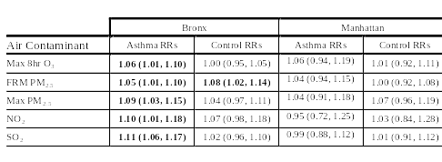
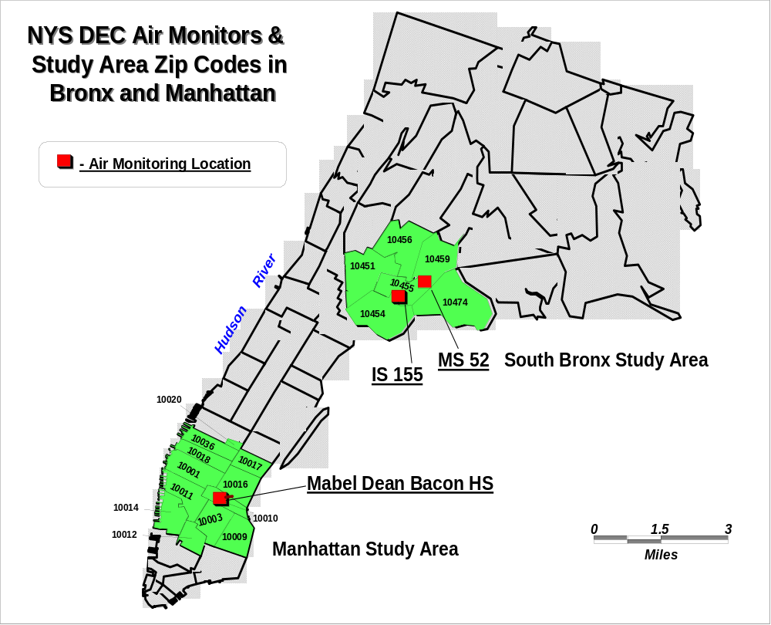
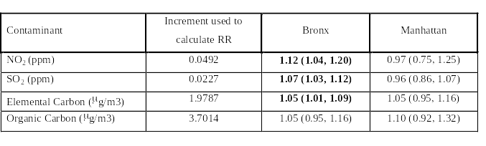
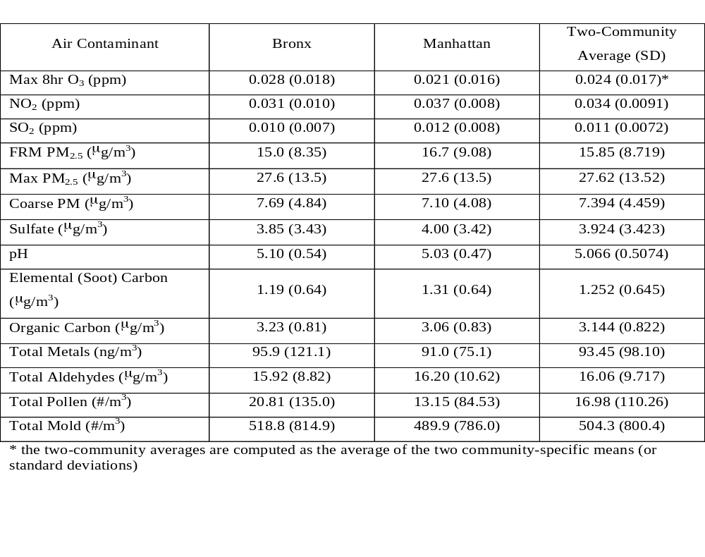
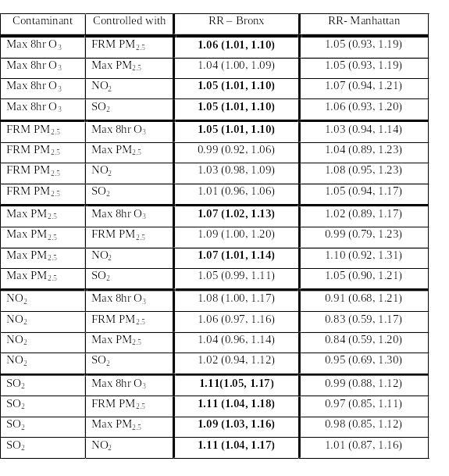
Associations between Air Pollutants and Asthma Exacerbations in New York City
GM Recer¹, PL Kinney², SA Hwang¹ and DA Luttinger¹
¹Division of Environmental Health Assessment, Center for Environmental Health, New York State Department of Health, Troy NY
²Columbia University School of Public Health, New York NY
Abstract
We sought to evaluate temporal associations between a panel of air contaminants and asthma emergency department (ED) visits in communities in the Bronx and Manhattan in New York City (NYC). Time-series analysis was used to determine whether and to what extent various air contaminants were associated with acute asthma exacerbations and whether the magnitude of the air pollution effect differed in the two communities. Air pollutant data were collected over approximately a two year period from January 1999 through November 2000 at centrally-located measurement stations in each community sampling a broad range of contaminants including ozone, sulfur and nitrogen oxides, particulate matter (PM_{2.5} and PM₁₀), acidic and basic gases, carbonyl compounds and bioaerosols. Samples for PM_{2.5} components including sulfate, elemental and organic carbon and metals were also collected. ED data on asthma visits for the corresponding dates were collected from the 22 hospitals throughout NYC that served the communities surrounding the air monitoring stations. From each hospital, data for patients who lived in zip code areas within approximately 1.5 miles of either measurement site were extracted. We used Poisson regression to test for effects of 14 key air contaminants on daily ED visits, with control for temporal cycles, temperature, and day of week effects. The core analysis utilized the average exposure for 0-4 day lags. Sensitivity analyses examined individual lag effects.
Concentrations of air contaminants were generally similar in the two communities, with mean levels tending to be slightly higher in Manhattan in most cases. Mean ozone and total pollen levels were significantly higher in the Bronx, compared to Manhattan. In single-pollutant models, five of 14 key pollutants had statistically significant effects on asthma ED visits in the Bronx: maximum 8 hour ozone, 24 hour nitrogen dioxide, 24 hour sulfur dioxide, 24 hour PM_{2.5} and maximum 1 hour PM_{2.5}. The results suggest that these pollutants had a statistically detectable impact on acute asthma ED visits in a community with a relatively high baseline rate of acute asthma exacerbations. Significant associations between asthma ED visits and individual PM_{2.5} components were not observed. No statistically significant pollution effects were observed in the Manhattan community. Our findings of more significant air pollution effects in the Bronx likely relate, in part, to greater statistical power for identifying effects in the Bronx where baseline ED visits were greater, but may also reflect greater sensitivity to air pollution effects in the Bronx. In two-pollutant and three-pollutant regression models, ozone and sulfur dioxide, and to a lesser extent, maximum one-hour PM_{2.5}, were the most robust pollutants. The more robust health impacts observed for daily maximum PM_{2.5} concentration compared to the 24 hour mean suggest that peak exposures may have larger health impacts. These associations with health effects in the Bronx occurred at ambient air levels that are below the current short-term National Ambient Air Quality Standards.
Methods -- Core Model Development
Results -- Single Pollutant Models
Results -- Control Health Outcomes
14 key analytes; single-, two- & three-pollutant models
Missing pollutant observations were filled in by regression
Estimation of missing values changed overall means by <10%
Outcome Measure -- Daily Emergency Department (ED) visits for primary diagnosis of asthma and control conditions (Table 2).
Cases defined by residence zip code areas within approximately 1.5 mile radius of ambient air monitoring stations (Figure 1).
GLM with spline smoothing for Season, Temperature
Day-of-week class variable added to model
0-4 day cumulative lag used to account for variability in lag structure (e.g. Figure 2) and observed delay in seeking ED asthma care
Relative Risks expressed as proportional change in ER visits associated with an increase in pollutant concentration equal to the pollutant’s overall daily mean during the study (Table 1)
Figure 3. Relative risks (± 95% CI) for asthma ED visits; 5-day cumulative lag; single-pollutant models. RR per mean increment for each pollutant from Table 1.
Table 6. Relative risks (95% confidence intervals) for control ED visits. Results are shown for the five pollutants that showed significant associations with asthma ED visits in the Bronx. RR per mean increment for each pollutant from Table 1. Bold text indicates statistical significance at the 0.05 level.
1.4
Bronx
1.3
1.2
1.1
Relative Risk
1
0.9
0.8
0.7
0.6
1.4
Manhattan
1.3
1.2
1.1
1
Relative Risk
0.9
0.8
Summary & Conclusions
Table 2. Crude Daily Acute Asthma and Control ED Rates
0.7
0.6
NO2
SO2
FRM 2.5
Max PM 2.5
Coarse PM
Sulfate
pH
Tot. Metals
Tot. Pollen
Tot. Mold
Bronx Manhattan
Mean Crude Mean Crude
Daily Daily Rate Daily Daily Rate
Cases Pop’n per 10⁵ Cases Pop’n per 10⁵
Asthma* 43 254,167 16.9 7.2 355,655 2.02
Control Outcomes** 27 254,167 10.6 10 355,655 2.81
* Asthma case defined as primary diagnosis ICD-9 codes 493 and, for children less than one year of age, 466.1 and 786.09.
** Control defined as primary diagnosis ICD-9 codes 365, 366.0-366.3, 531.0-531.3, 532.0‑532.3, 533.0-533.3, 534.0-534.3, 535, 537, 540-543, 558, 574-575, 590, 599. These include eye, gastrointestinal and renal/urinary diagnoses thought to be unrelated to air pollution.
Max 8 hr O3
Elemental Carbon
Organic Carbon
Tot. Aldehydes
  The results suggest that the criteria pollutants PM_{2.5}, SO₂, O₃ and NO₂ had a statistically detectable impact on acute asthma ED visits in a community with a relatively high baseline rate of acute asthma exacerbations.
  In two-pollutant and three-pollutant regression models, O₃ and SO₂, and to a lesser extent, maximum one-hour PM_{2.5}, were the most robust pollutants.
  It is of particular interest that we observed more robust health impacts of the daily maximum PM_{2.5} concentration compared to the 24 hour mean, suggesting that peak exposures may have larger health impacts with respect to acute asthma exacerbations.
  These associations with health effects in the Bronx occurred at ambient air levels that are below the current short-term National Ambient Air Quality Standards.
  Limitations
  Recent evidence (e.g., Koutrakis, Sarnat et al.) suggests the validity of ambient air monitors as a surrogate for personal exposure may vary among analytes.
  Five day exposure window could capture asthma ER visits with either slow or sudden progression, but could also weaken or mask associations (e.g., if pollutant has rapid onset, short lasting effect).
  Lack of statistically significant effects in Manhattan may reflect less statistical power in that study area, at least for cases where Manhattan RRs are similar to Bronx RRs.
  Positive but non-significant effects for control conditions may suggest some degree of overestimation of risk by the statistical model used.
  Recommendations
  US EPA should consider the findings in this study and others identifying respiratory health effects associated with SO₂ concentrations below current standards during their 5-year review of the SO₂ NAAQS.
  Future time-series studies examining associations between ambient air pollutants and health outcomes would benefit from direct evaluation of the relationship between personal exposure and regional monitoring data.
  More research should be conducted to try to determine if peak, short-term (e.g. hourly) elevated concentrations of PM_{2.5} are more strongly associated than daily average concentrations with asthma and other health endpoints. If the science is sufficiently strong, consideration should be given to the effects of short-term PM_{2.5} excursions in future reviews of the particulate matter NAAQS.
  The high correlations between pollutants (including components of PM_{2.5}; data not shown) make it difficult in these epidemiologic studies to confidently identify critical compounds. Alternative strategies to address this question should be considered in the future.
  Further evaluation of the statistical methods employed in time-series epidemiological studies is warranted, based on the suggestion of possible model bias indicated by our analysis of control outcomes.
  To the extent that targeted community based asthma interventions are planned with respect to air pollution messages, higher priority should be given to communities with larger asthma burdens.
Figure 1. Study Locations. Cases identified based on residence in shaded zip codes
Table 4. Relative risks from regressions based on daily maximum hourly (SO₂ and NO₂) or daily maximum three-hour (elemental and organic carbon) air levels. Bold text indicates statistical significance at 0.05 level.
Key to Hospital Codes
Bronx
B1: Our Lady of Mercy Medical Center
B2: North Central Bronx Hospital
B1
B3: Montefiore Medical Center
B2
B4: Jacobi Medical Center
B5: Montefiore Medical Center - Weiler Hospital
B3
B6: St. Barnabas Hospital
M1
B7: Bronx-Lebanon Hospital Center - Concourse Div
B4
B8: Lincoln Medical Center
B6
Manhattan
B5
M1: Presbyterian Hospital - Allen Pavilion
B7
M2: New York - Presbyterian Hospital
M2
M3: Harlem Hospital
M4: St. Luke's Roosevelt Hospital
M5: Mount Sinai Hospital
M6: Metropolitan Hospital Center
B8
M7: Lenox Hill Hospital
M3
M8: New York Hospital
M9: St. Luke's Roosevelt Hospital
M4
M10: New York University Medical Center
M5
M11: Bellevue Hospital Center
M12: Beth Israel Medical Center
M6
M13: Cabrini Medical Center
M7
M14: St. Vincent's Hospital
M9
M8
0
2.5
5
M13
M10
miles
M14
M12
M11
Map Legend
Study Hospitals
Bronx Study Area
Manhattan Study Area
Figure 2. Examples of Variable Single-day Lag Structure
  Lag patterns vary by pollutant
  Lag patterns vary by location
Table 1. Summary statistics [mean (standard deviation)] for pollutants included in Time Series Models. The values represent summary statistics of all daily observations from January, 1999 – November, 2000.
Results -- Multi-Pollutant Models
Bronx FRM PM_{2.5}
Manhattan FRM PM_{2.5}
Table 5. Relative risks (95% confidence intervals) for asthma ED visits as a function of 5-day mean air pollution from two-pollutant models. Pollutants included here were those that were significant predictors of ED visits in single-pollutant models. RR per mean increment for each pollutant from Table 1. Bold text indicates statistical significance at 0.05 level.
1.10
1.10
1.05
1.05
1.00
1.00
Relative Risk
Relative Risk
0.95
0.95
0.90
0
1
2
3
4
0.90
0
1
2
3
4
lag (d)
lag (d)
1.10
Bronx O₃
1.10
Manhattan O₃
1.05
1.05
1.00
1.00
Relative Risk
Relative Risk
0.95
0.95
0.90
0
1
2
3
4
0.90
0
1
2
3
4
lag (d)
lag (d)
Acknowledgements
Support for the study provided by New York State Department of Health,
New York State Department of Environmental Conservation, New York State Energy Research and Development Authority and the Agency for Toxic Substances and Disease Registry (US Dept of Health and Human Services)
Disclaimer
The findings presented here have been peer reviewed by the federal funding agency (ATSDR) but are preliminary pending receipt of final clearance and ATSDR publication.
1.10
Bronx SO₂
1.10
Manhattan SO₂
1.05
1.05
1.00
1.00
Relative Risk
Relative Risk
0.95
0.95
0.90
0
1
2
3
4
0.90
0
1
2
3
4
lag (d)
lag (d)

