Slide 1
Measurement of CP Violation in the K_{L} Charge Asymmetry by KTeV
The KTeV Collaboration
Arizona, UCLA, UCSD, Chicago, Colorado, Elmhurst, Fermilab, Osaka, Rice, Rutgers, Virginia, Wisconsin
University of Chicago
High Energy Physics Seminar
Hogan Nguyen
Fermilab
April 23, 2001

Slide 2
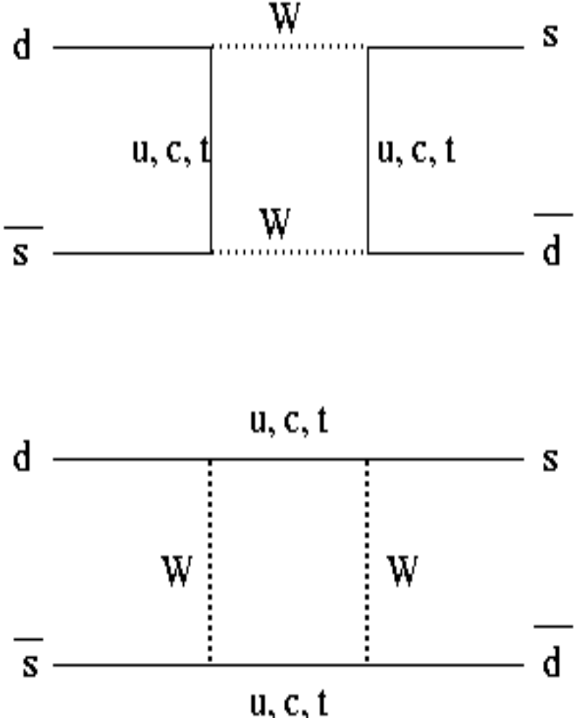

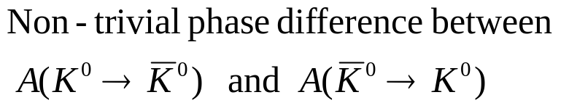
Asymmetric mixing:
“Explained” by a non-zero value for ImV_{td} (or η in the Wolfenstein parametrization)

Slide 3

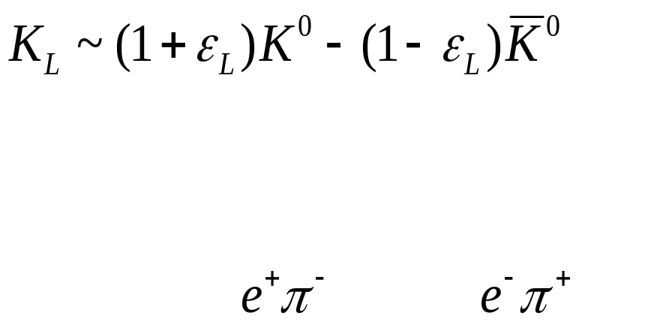
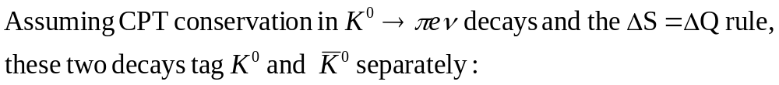
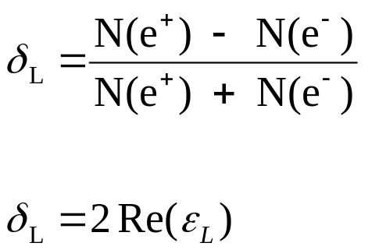
K_{L} → πeν Charge Asymmetry

Slide 4
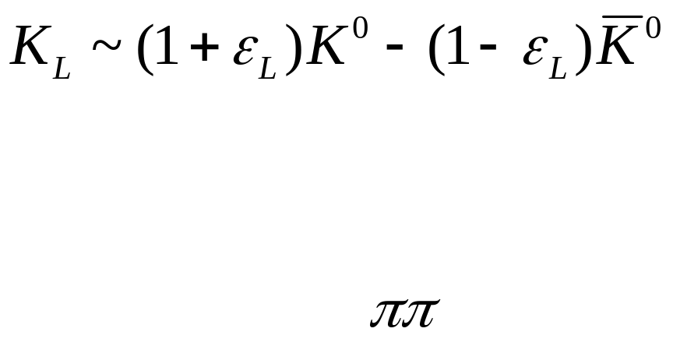
K_{L} Interferometry
In the 2π system, we are sensitive to a combination of CP and CPT violating effects from both the mixing part ε_{L} and the decay amplitudes to ππ.
Completely independent way to examine K_{L}-mixing
Can be used to untangle effects in ππ.

Slide 5
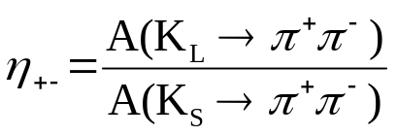
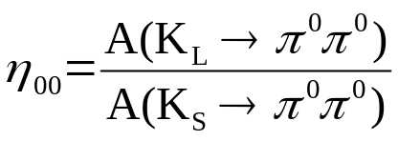
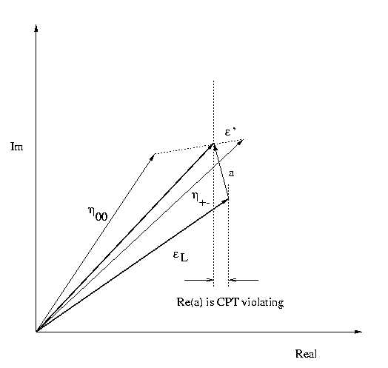
Relationship between η₊₋ , η₀₀ , and ε_{L}
2π amplitudes are sensitive to effects in both mixing and decay.
The charge asymmetry can be used to untangle these effects.
2/3η₊₋ + 1/3η₀₀

Slide 6
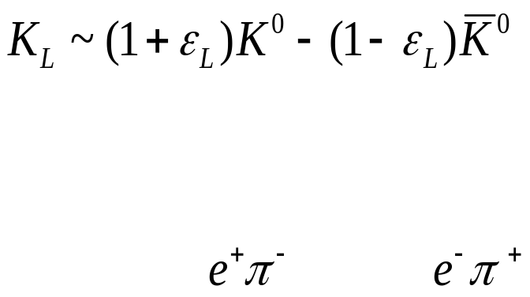
δ_{L} Contribution from New Physics
If there are CPT violating effects in Ke3 decays or the ΔS = ΔQ rule is violated, then:
δ_{L} = 2 Re ( ε _{L} – Y – X₋)
Y = CPT Violation in ΔS = ΔQ amplitude
X₋ = CPT Violation in ΔS = − ΔQ amplitude
Comparisons with the 2π system would be ambiguous. However, if we see any deviations, it would be quite exciting !

Slide 7
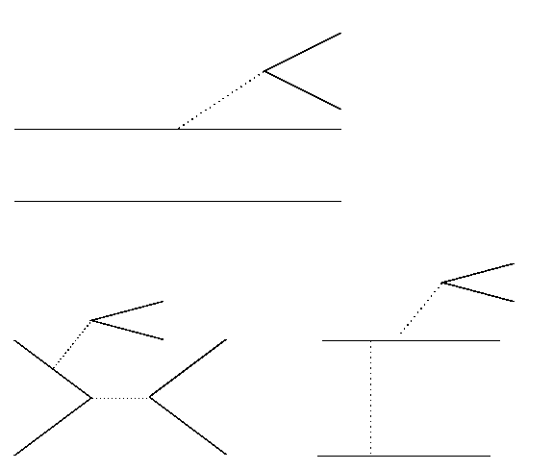





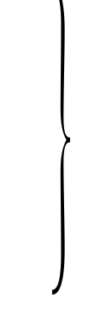









ΔS = ΔQ Rule
ΔS = ΔQ true in 1st order EW processes.
ΔS = ΔQ can be violated in 2nd order processes
Suppressed by O(10⁻⁷) [Dib, Guberina, Luke 91]

Slide 8
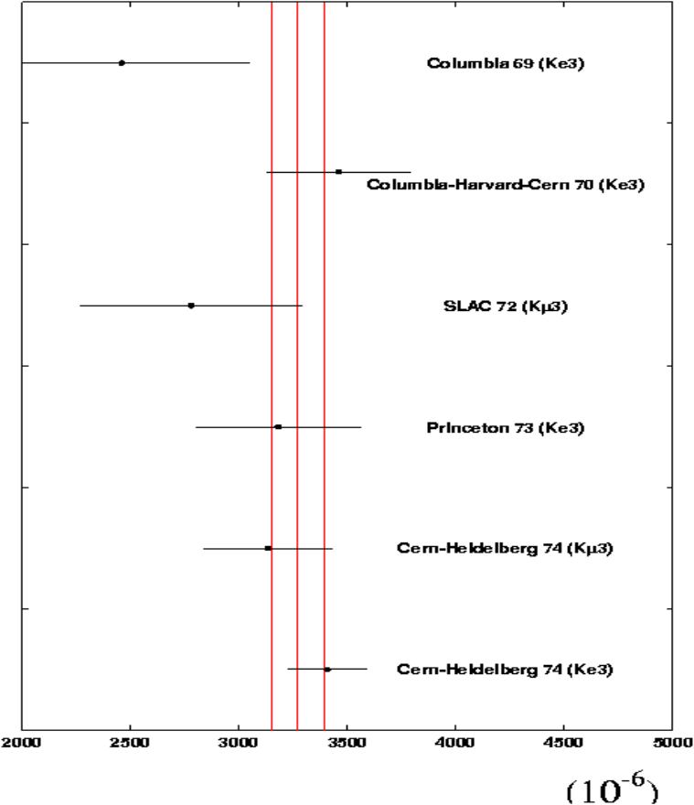
Measurements of K_{L} →πlν ChargeAsymmetry
PDG 2000 Average: 3270 ± 120 ppm
Current Best Measurement: 3408 ± 174 ppm
CERN-Heidelberg 74 based on 34 Million Ke3s
26 years since the last measurement of δ_{L}, and there has been tremendous advances in experimental techniques.
The measurement requires a careful control of systematics, beyond mere improvement in statistics.
KTeV is a state-of-the-art experiment designed to precision studies of CP violation and rare kaon decays.
We report here a preliminary result on δ_{L} based on 298 million K_{L} → πeν decays collected by E832 during the 1997 fixed-target run.

Slide 9
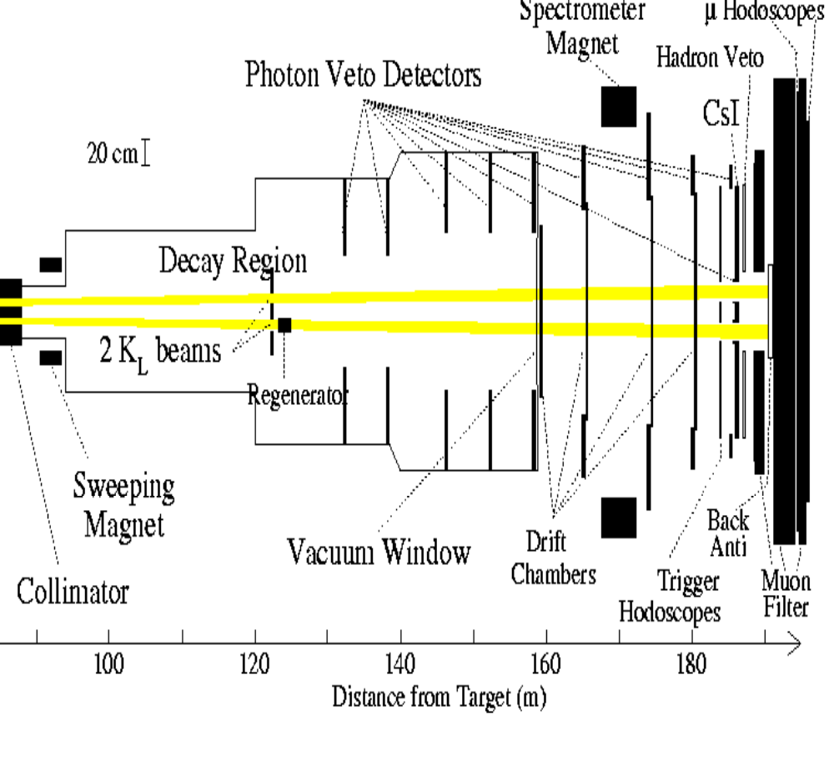
KTeV Detector (E832 Configuration)
Overview of Strategy
Since each of the two beams are not centered with respect to the detector, the detector has a significant geometrical asymmetry.
Rely on combining data collected with opposite magnet polarities in order to cancel this effect
Some biases are not related to acceptance, and so must be studied using other techniques.

Slide 10
Overview of Analysis Requirements
2 track events from the vacuum beam uniquely consistent with K_{L} → πeν kinematics
electrons/positrons ≡ E/P > 0.925. p_{e} > 5 GeV.
pions ≡ E/P < 0.925. p_{π} > 8 GeV.
Tracks are in the fiducial area of the CsI
K_{L} propertime† τ > 10.5 τ_{S} from the target
298 Million K_{L} → πeν (Ke3) events accepted
† Low momentum solution used.

Slide 11
8 Configurations of Ke3 Decays
e⁺π⁻ or e⁻π⁺
east or west K_{L} beam
+ 411 or – 411 MeV analysis magnet polarity
Each configuration has a partner that has an identical geometrical acceptance:
e⁺ π⁻ East +411 MeV ↔ e⁻ π⁺ East −411 MeV
e⁺ π⁻ West +411 MeV ↔ e⁻ π⁺ West −411 MeV
e⁺ π⁻ East −411 MeV ↔ e⁻ π⁺ East +411 MeV
e⁺ π⁻ West −411 MeV ↔ e⁻ π⁺ West +411 MeV
However, a given configuration and its partner do not necessarily have the same beam flux
e⁺
π⁻
CsI
e⁻
π⁺

Slide 12
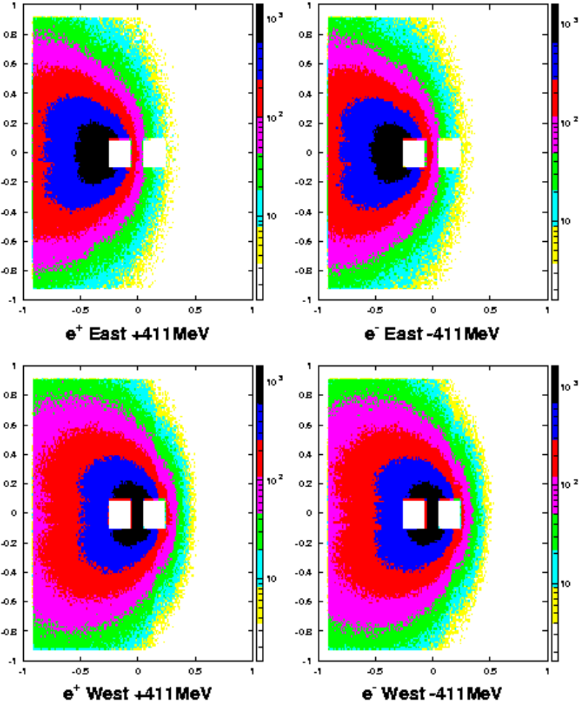
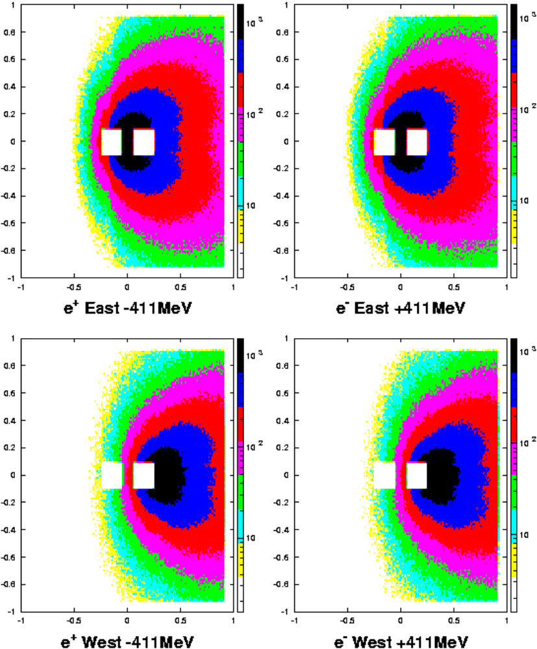
Illuminations of e± at the CsI

Slide 13
8 Configurations of Ke3 decays (cont)
A single ratio is formed to cancel the acceptances, the beam fluxes, and beam optics.
Br
(
e
+
π
−
)
N
(
K
east
+
411
)
A
(
e
+
π
−
east
+
411
)
L
Br
(
e
−
π
+
)
N
(
K
east
−
411
)
A
(
e
−
π
+
east
−
411
)
L
•
Br
(
e
+
π
−
)
N
(
K
east
−
411
)
A
(
e
+
π
−
east
−
411
)
L
Br
(
e
−
π
+
)
N
(
K
east
+
411
)
A
(
e
−
π
+
east
+
411
)
R
4
=
L
•
Br
(
e
+
π
−
)
N
(
K
west
+
411
)
A
(
e
+
π
−
west
+
411
)
L
Br
(
e
−
π
+
)
N
(
K
west
−
411
)
A
(
e
−
π
+
west
−
411
)
L
•
Br
(
e
+
π
−
)
N
(
K
west
−
411
)
A
(
e
+
π
−
west
−
411
)
L
Br
(
e
−
π
+
)
N
(
K
west
+
411
)
A
(
e
−
π
+
west
+
411
)
L
−
Fluxes Cancel
δ
=
R
1
L
R
+
1
Must Check if the Acceptances Really Cancel !

Slide 14
Systematic Effects and Corrections
Configuration acceptances do not cancel exactly
Particles and anti-particles behave differently in matter
Regenerative scattering by the beam
Backgrounds
For each cut in analysis, measure:
f ⁺ ≡ inefficiency (background) to e⁺ π⁻ configuration
f ⁻ ≡ inefficiency (background) to e⁻ π⁺ configuration
Correction to δ = ( f ⁺ − f ⁻ ) / 2

Slide 15
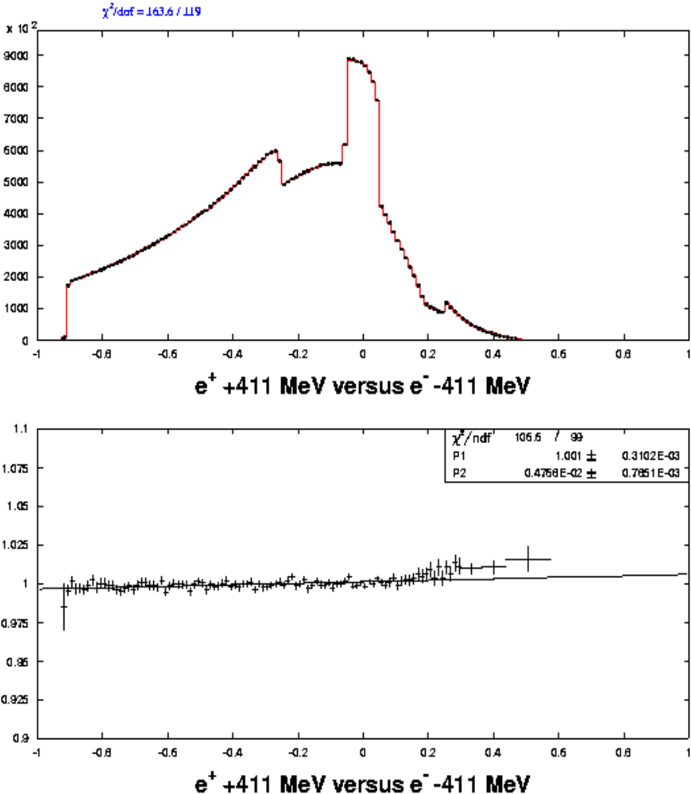
Acceptance Checks of Configuration Pairs
Illumination comparisons between configuration pairs.
Differences consistent with small imperfections in the magnetic field reversal:
B_{Y} component due to Earth’s magnetic field
small flaw in B_{X} component of magnet
-3.1 ± 1.6 ppm correction for these effects
Horizontal Illumination of Tracks at CsI
Slope due to Earth’s Magnetic Field

Slide 16
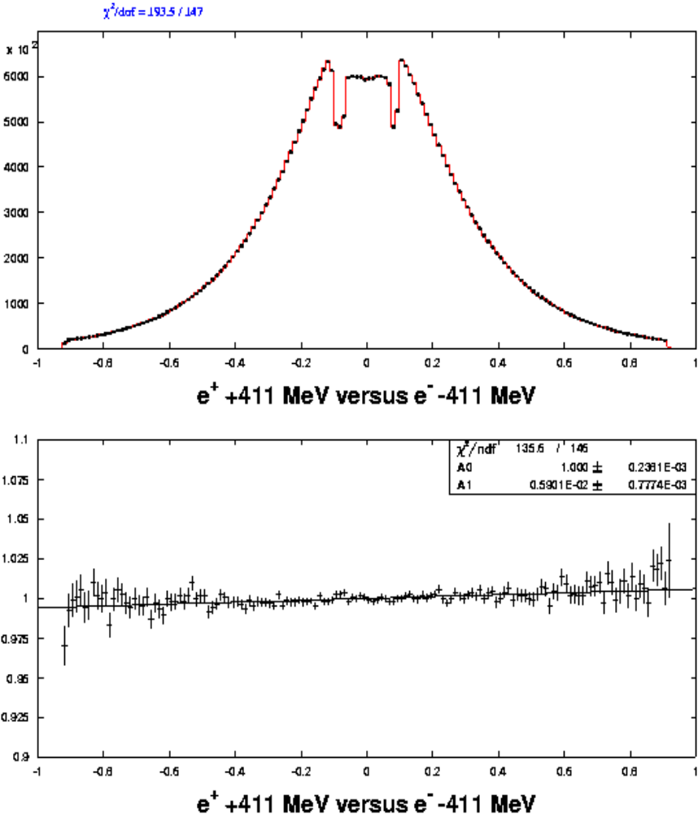
Vertical Illumination of Tracks at CsI
Acceptance Checks of Configuration Pairs
small flaw in reversal of B_{X} component of magnet

Slide 17
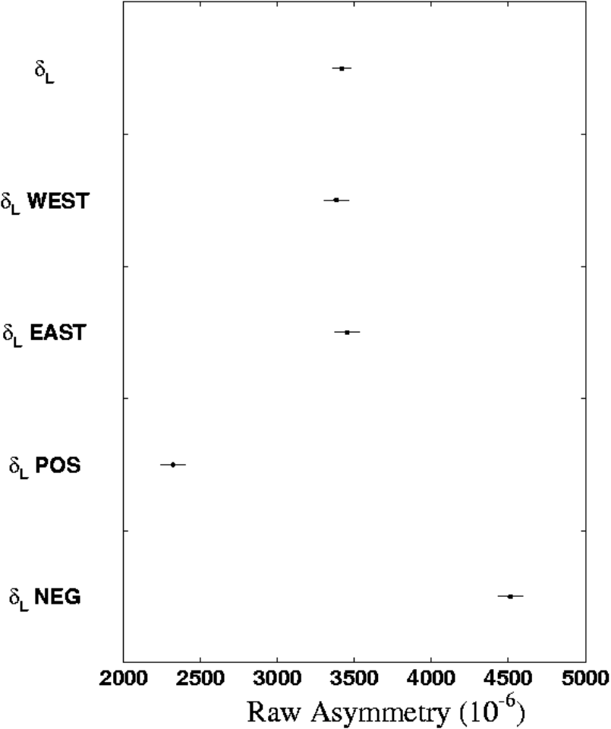
Detector Geometrical Bias
Combining data of opposite polarity is needed to cancel the detector’s geometrical bias.
Bias shows up as a large difference between polarity settings:
δ(−411 MeV) − δ(+411 MeV) = 2192 ± 116 ppm
Related to the complicated acceptance profile of the inner apertures ( beam holes in the trigger scintillator and CsI).

Slide 18
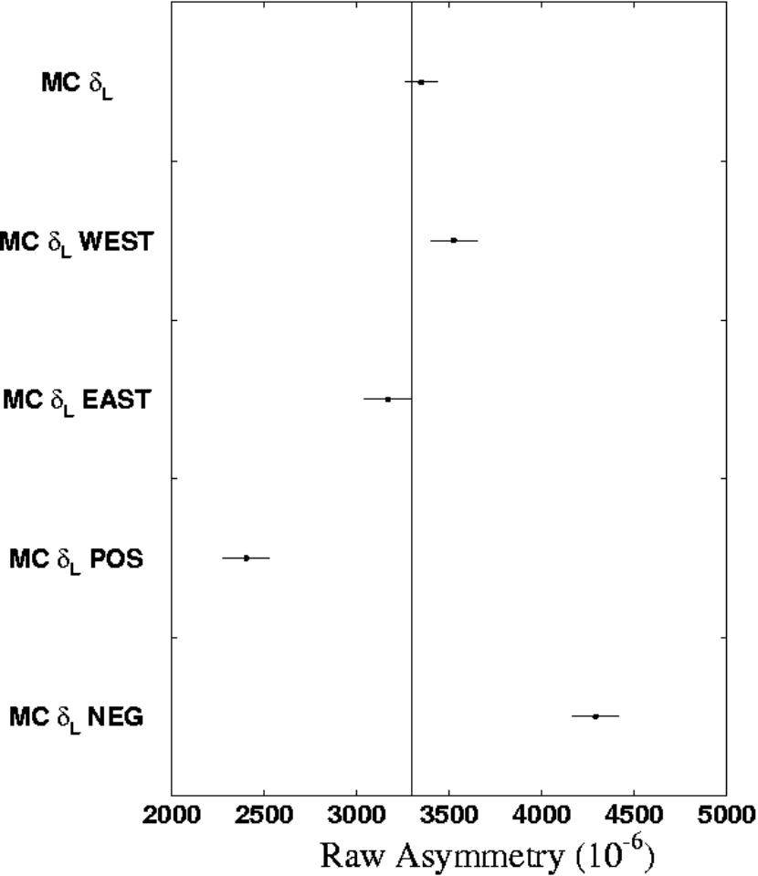
Detector Geometrical Bias (cont.)
Simulation reproduces the detector asymmetry:
δ(−411 MeV) − δ(+411 MeV) = 1889 ± 178 ppm
within 1.4 σ of the data
simulation recovers δ_{L} input value

Slide 19
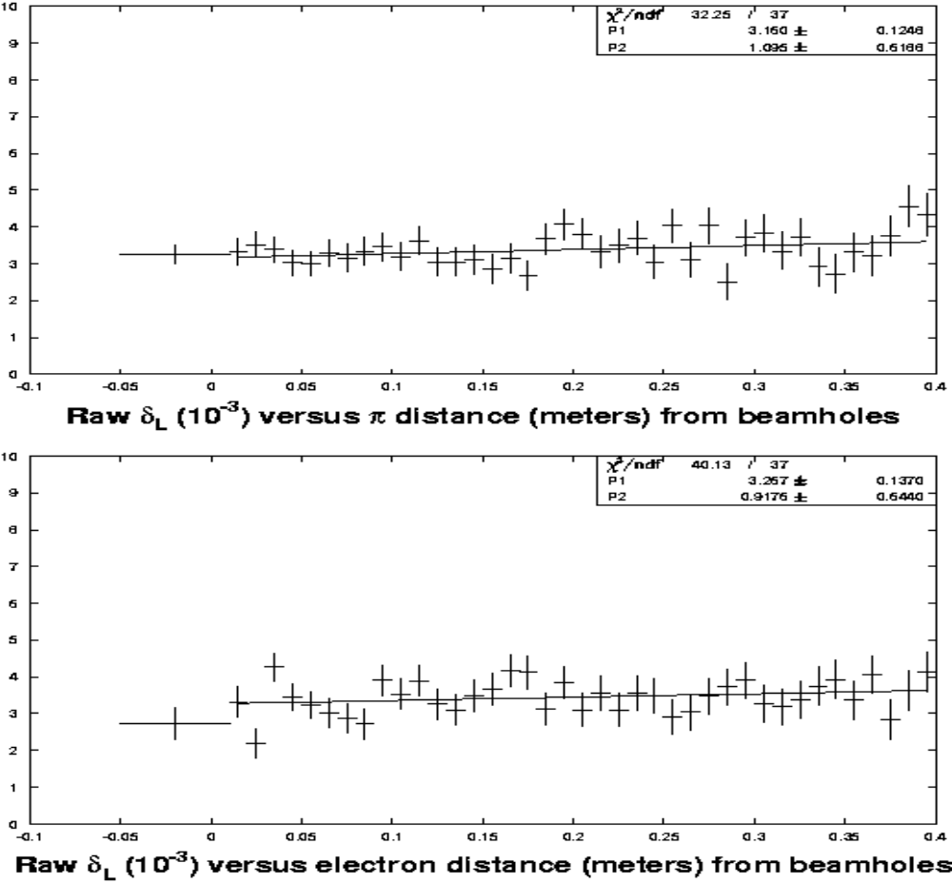
Detector Geometrical Bias (cont.)

Slide 20
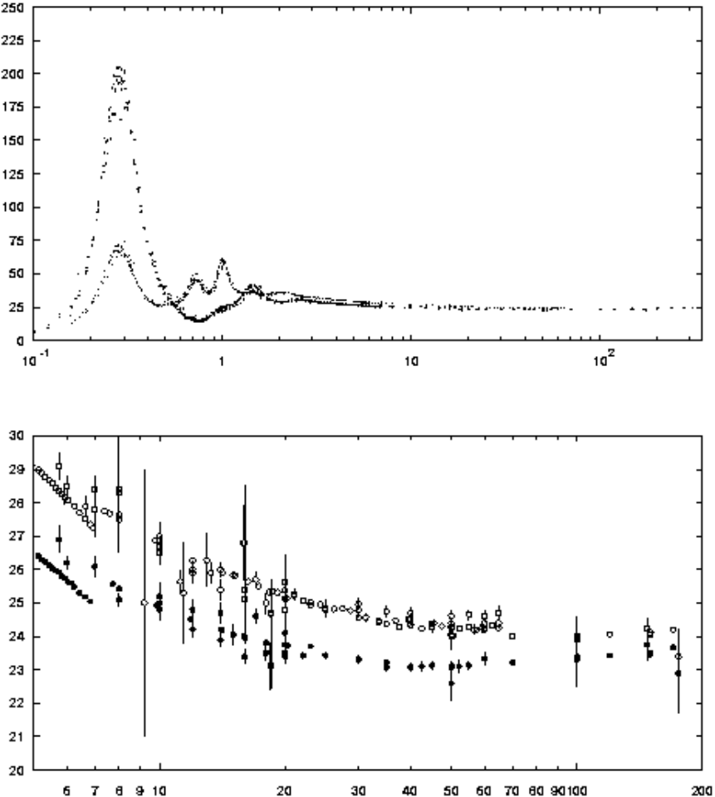
Particle/antiparticle differences in matter
e⁺ e⁻ differences:
e⁺ annihilation
δ-ray production differences between Bhabha (e⁺e⁻) and Moller (e⁻ e⁻) scattering
π⁺ π⁻ differences:
Isospin dependence in nuclear interactions
Detector has an unequal number of protons and neutrons
These effects bias the reconstruction of track kinematics and particle identification.
π⁺p versus π⁻ p total cross section (mb) vs p_{π}
† PDG 2000 Compilation

Slide 21
Particle/antiparticle differences in matter
e± biases: geant simulation/data
π± biases: measure directly with data
In comparison to previous measurements, our biases will be smaller due to:
a vacuum decay tank
an ultra-thin magnetic spectrometer
higher momentum spectra
TRD in E799 data, crucial for understanding the p.i.d. biases in rest of detector

Slide 22
KTeV Detector Material
Detector material proton excess element (mg/cm²) (mg/cm²)
Vacuum Window 47.0 2.7
Wire Drift Chambers 78.0 4.2
Helium Bags 483.8 0.0
Trigger Scintillators 1131.5 83.8
CsI 226.5 •10³ −36.9 •10³
Pb Absorbers 113.5 •10³ −23.7 •10³
Fe Absorbers 3148.0 •10³ −216.8 •10³
e⁺ e⁻ biases depend on the magnetic spectrometer material.
π⁺ π⁻ biases depend on the proton excess and deficit.

Slide 23
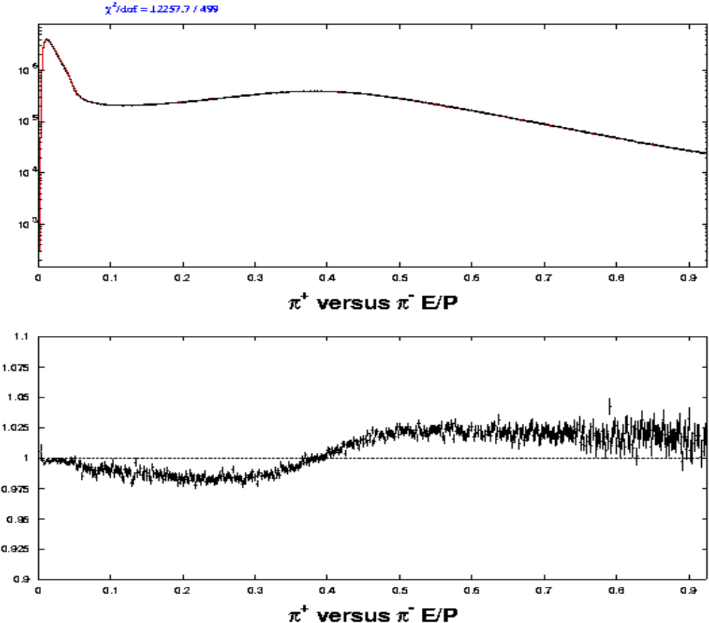
π⁺ and π⁻ Response in CsI
The requirement of E/P < 0.925 rejects more π⁺ than π⁻

Slide 24
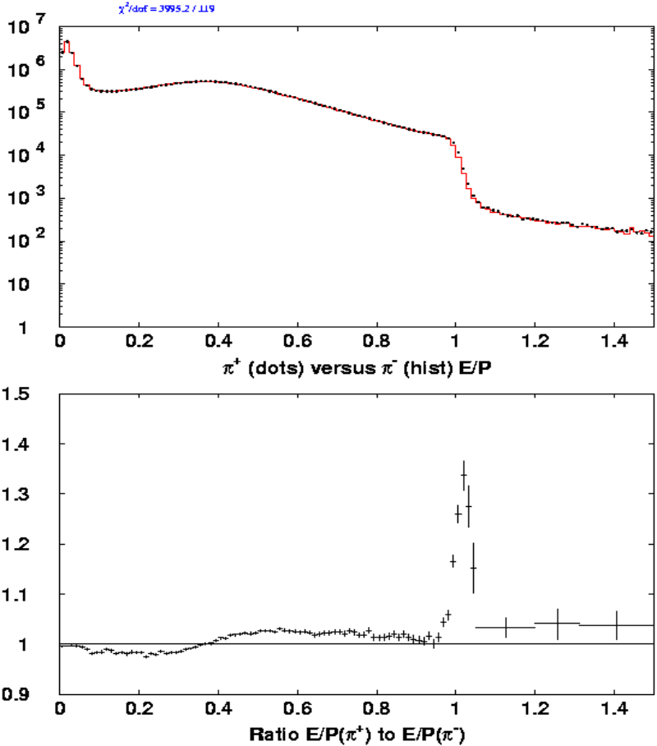
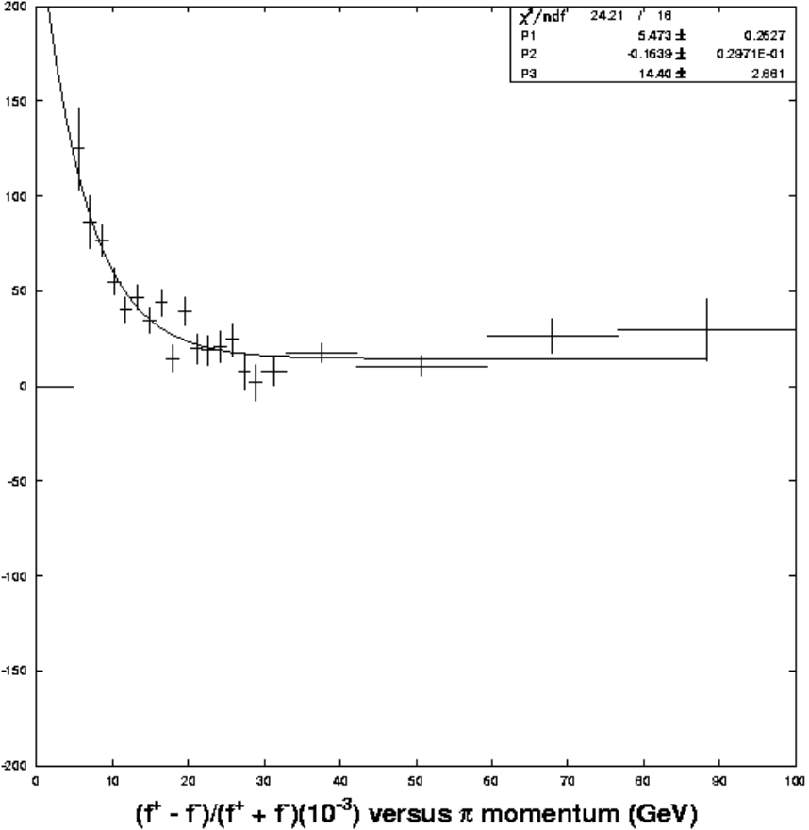
π⁺ and π⁻ Response in CsI (cont.)
Measured the E/P shape of pions using K_{L} → π⁺π⁻π⁰
<f ⁺ > = 5884±14 ppm <f ⁻> = 6196±14 ppm Correction = −156 ±10 ppm

Slide 25
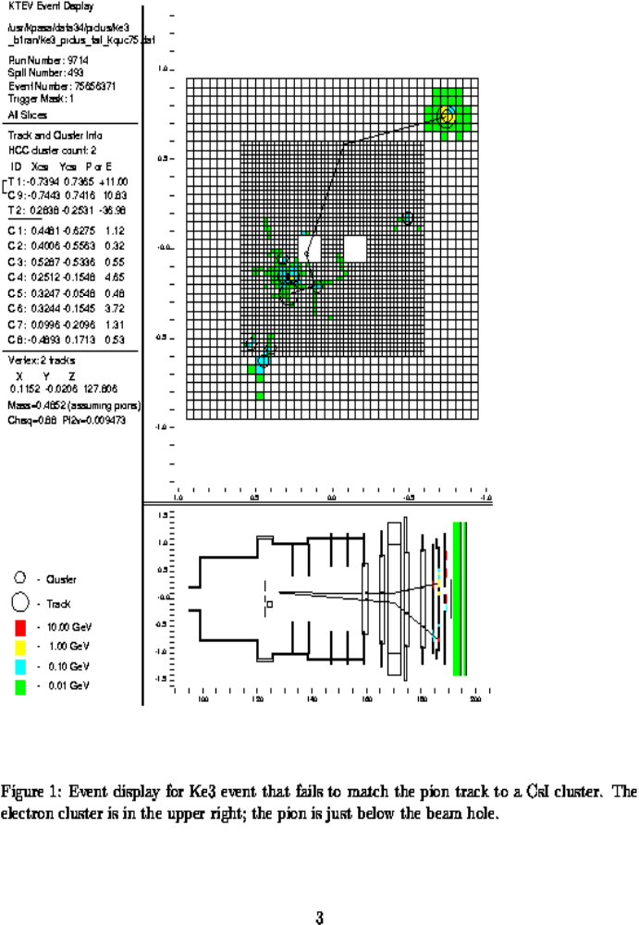
π± lost due to interactions in front of CsI
Hadronic interactions upstream of CsI, most likely in the trigger scintillators, causing failures in the matching of tracks to clusters.

Slide 26
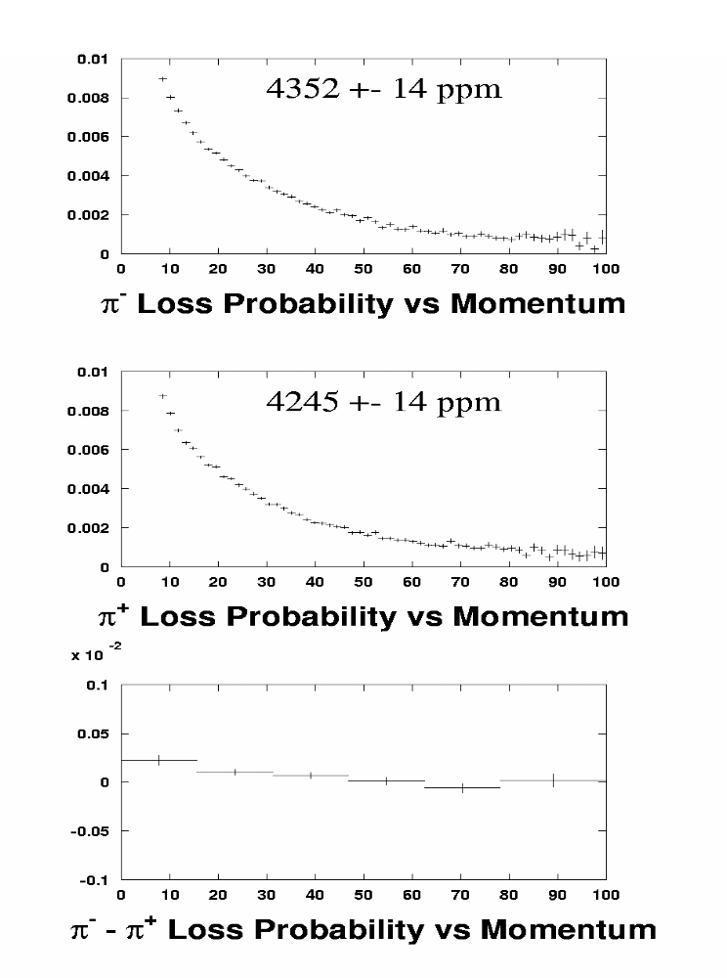
π± lost due to interactions in front of CsI (cont)
f ⁺ = 4245 ±14 ppm
f ⁻ = 4352 ±14 ppm
Correction = − 54 ± 10 ppm

Slide 27
π± Punch Through Correction
To reduce the trigger rate, the trigger required no activity in muon veto.
This vetoes pion decay-in-flight and punch through, which could cause a bias.
e±
π± decay and punch through sample
π±
CsI Filter μ-veto
e±
π±
μ
accidental μ sample

Slide 28
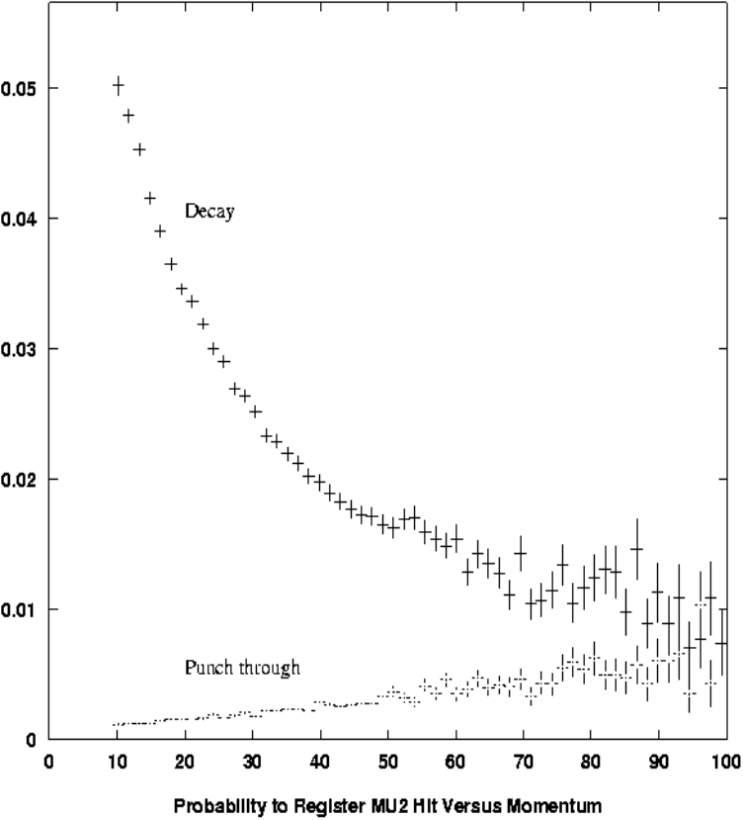
π± Punch Through Correction
Trigger vetoes mainly π decay-in-flight
(expect no bias to delta)
π punch through losses are smaller, but can in priciple can cause a bias
π veto probability
From an Unbiased Trigger Sample, measure:
δ_{L} (decay/punch) = (4.4 ± 1.3) • 10⁻³
δ_{L} (accidental μ) = (3.3 ± 1.0) • 10⁻³
Correction = 33.6 ± 39.8 ppm
Largest systematic uncertainty for this analysis

Slide 29
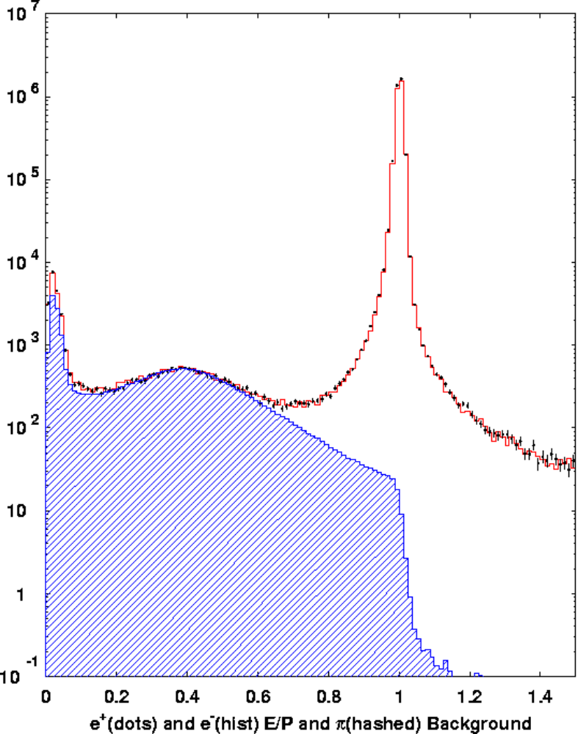
e⁺ and e⁻ Response in the CsI
Analysis requires e± E/P > 0.925
Though no bias is expected, we use the data to limit any possible effect.
Correction = −19 ± 18 ppm
Consistent with no bias

Slide 30
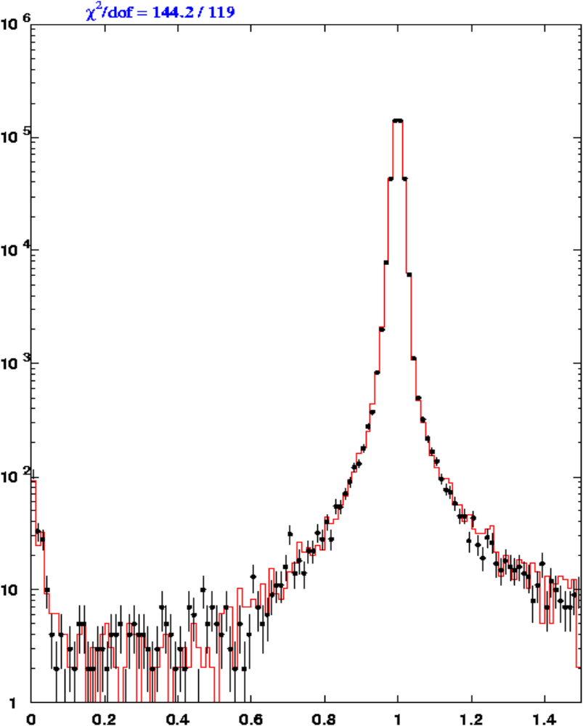
e⁺ and e⁻ Response in the CsI (cont)
Useful cross check from KTeV-E799 data
TRD used to remove pion background
correction (E799) = 3 ± 66 ppm

Slide 31
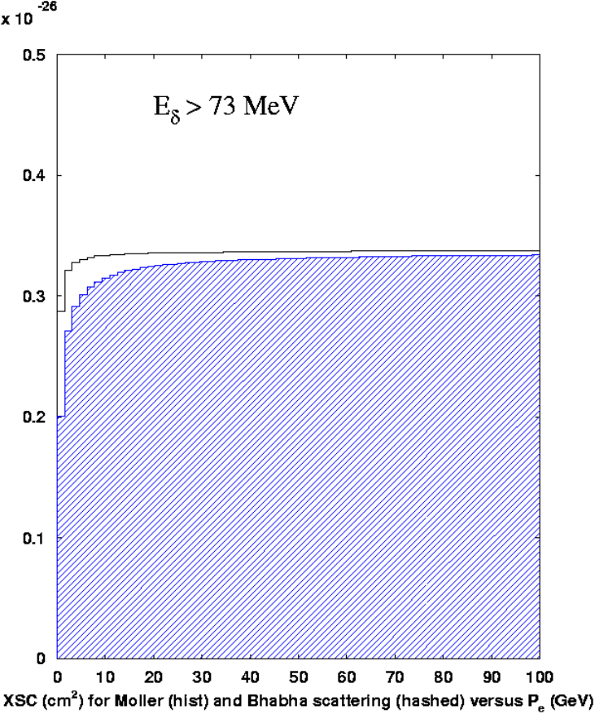
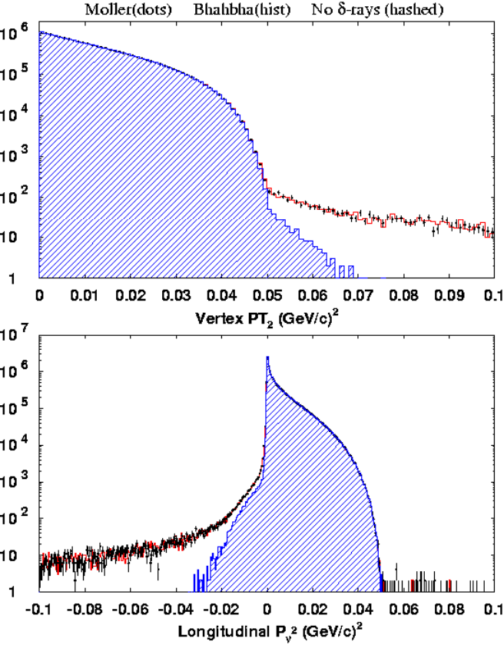
δ−rays correction
Correction of −8.3 ± 4.3 ppm to account for Moller/Bhabha scattering differences
δ-ray effect on kinematics
Moller (e⁻e⁻) vs Bhabha (e⁺e⁻) scattering

Slide 32
e⁺ and π⁻ absorption in trigger scintillator
Trigger loss due to reduced energy deposit in scintillator
γ
e⁺
γ
e⁺ annihilation loss estimated using Geant
11 ± 1 ppm
π⁻ p → n π⁰ loss estimated from Inagaki et. al. (NIM A359 - 1995)
2 ± 1 ppm
π⁻
n
π⁰
1 cm thick trigger scintillator

Slide 33
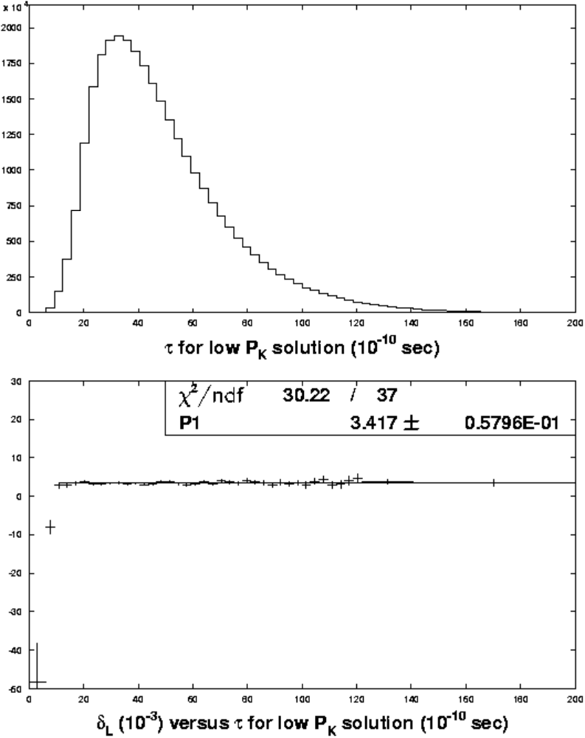
Residual Production Target K_{S}-K_{L} Interference Correction
Analysis removes events with propertime τ < 10.5 τ _{S} since they have large K_{S}-K_{L} interference effects.
Correction of −12 ± 1 ppm assigned to account for residual interference and propertime misreconstructions.
† Low τ solution used

Slide 34
Summary of Corrections
Effect Correction (ppm)
π⁺π⁻ difference in CsI −156 ± 10
π⁺π⁻ lost in trigger scintillator 54 ± 10
π⁺π⁻ lost in spectrometer 3 ± 3
π⁺π⁻ punch through 34 ± 40
e⁺e⁻ difference in CsI −19 ± 18
δ−ray production −8.5 ± 4.3
e⁺ annihilation in spectrometer 11 ± 1
π⁺π⁻π⁰, Κμ3, Λ background 0.5 ± 0.7
Target/absorber interference −12 ± 1
K_{L} scattering in final collimator −1.2 ± 2.3
K_{L} scattering in regenerator 0 ± 0
B-field reversal mismatch −3.1 ± 1.6
Sum −97 ± 46 (ppm)

Slide 35
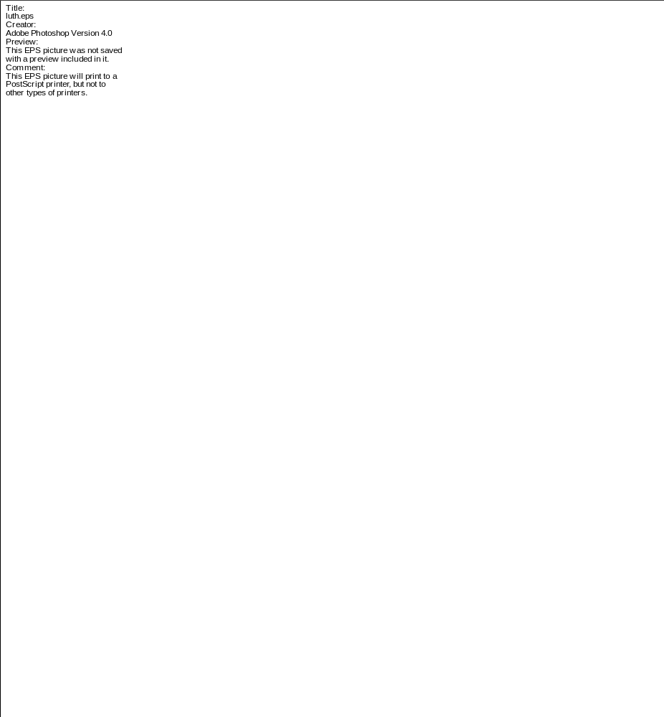
Corrections for Cern-Heidelberg 74
Effect Correction (ppm)
Interference in He decay volume −62 ± 12
π⁺π⁻ absorption in H₂ Cerenkov 61 ± 4
π⁺π⁻ punch through −169 ± 41
δ−ray production −100 ± 20
e⁺ annihilation in spectrometer 28 ± 1
Λ background 5 ± 2
Beam interaction in decay volume 2 ± 15
Accidentals 8 ± 5
K_{L} regeneration −17 ± 5
Cerenkov pmt pulse variation −1 ± 2
Sum −243 ± 50 (ppm)

Slide 37
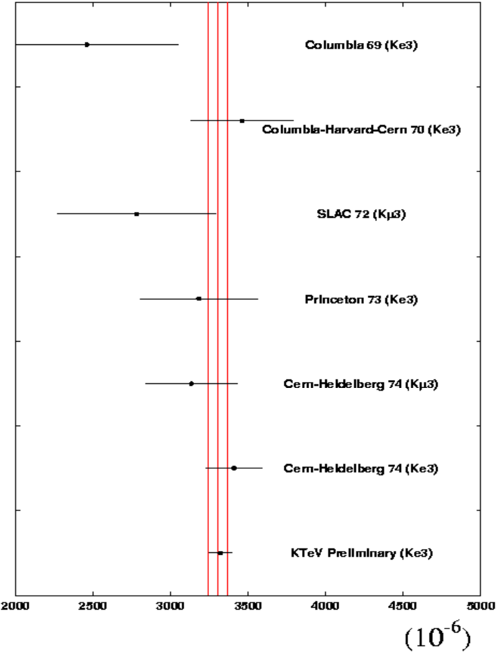
Preliminary Result for K_{L} → πeν Charge Asymmetry
298 Million K_{L} → πeν collected in 1997 run of KTeV-E832
Raw δ _{L} = 3417 ± 58 ppm
Correction = −97 ± 46 ppm
δ _{L} = 3320 ± 58(stat) ± 46(sys) ppm
= 3320 ± 74(comb) ppm
2.4 x more accurate than the previous best result (CERN-Heidelberg 1974)
Excellent agreement with all previous measurements
New Average: 3305 ± 63 ppm (χ² ⁼ 4.2/6 d.o.f.)

Slide 38
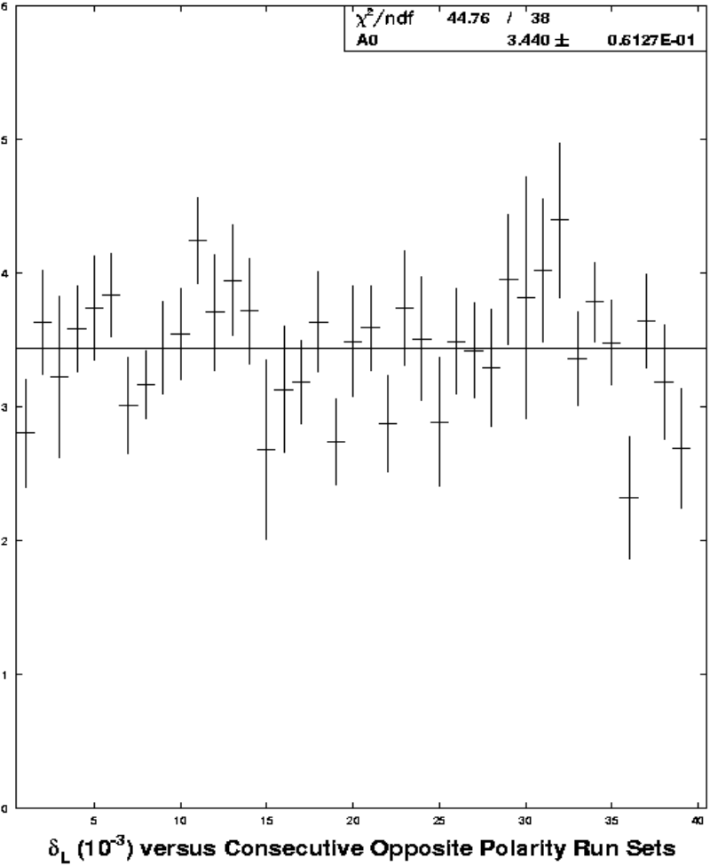
Other Systematic Checks
Consistency Within Data Set

Slide 39
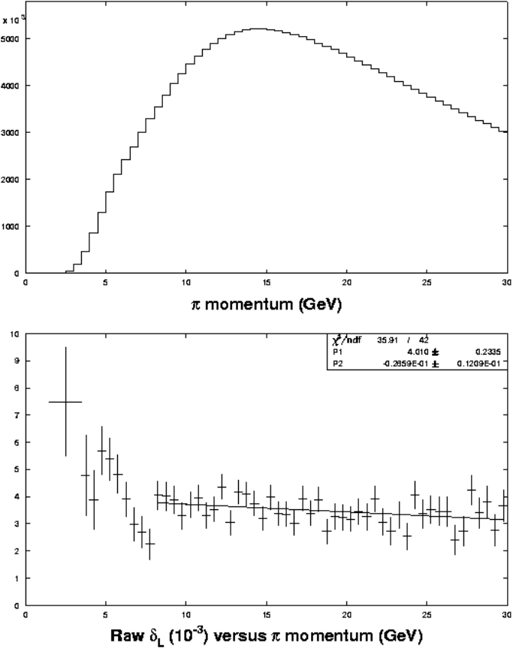
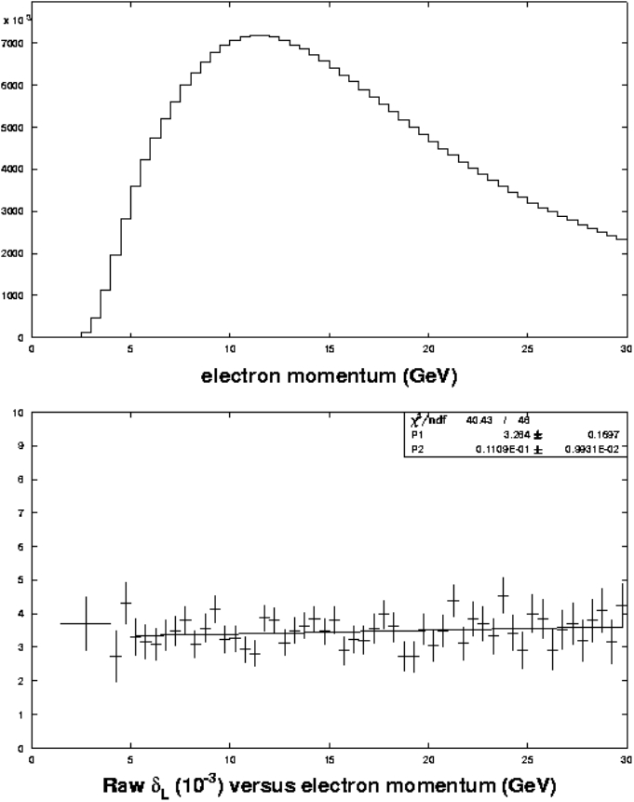
Other Systematic Checks (cont)
Dependence on e ± and π± momentum

Slide 40
Comparison to K_{L}→ ππ and limit on CPT Violation
Parameter PDG2000 averages
|η₊₋| 2276 ± 17 ppm
|η₀₀| 2262 ± 17 ppm
φ₊₋ 43.5 ± 0.5 °
φ₀₀ 43.2 ± 1.0 °
2Re(η₊₋) 3302 ± 37 ppm
2Re(η₀₀) 3298 ± 60 ppm
δ_{L} 3305 ± 63 ppm
(PDG avg and this result)
2/3η₊₋ + 1/3η₀₀
Re(a) = 2/3 Re η₊₋ + 1/3 Re η₀₀ – Re ε_{L}
= −2 ± 35 ppm (assuming ΔS=ΔQ)

