Slide 1



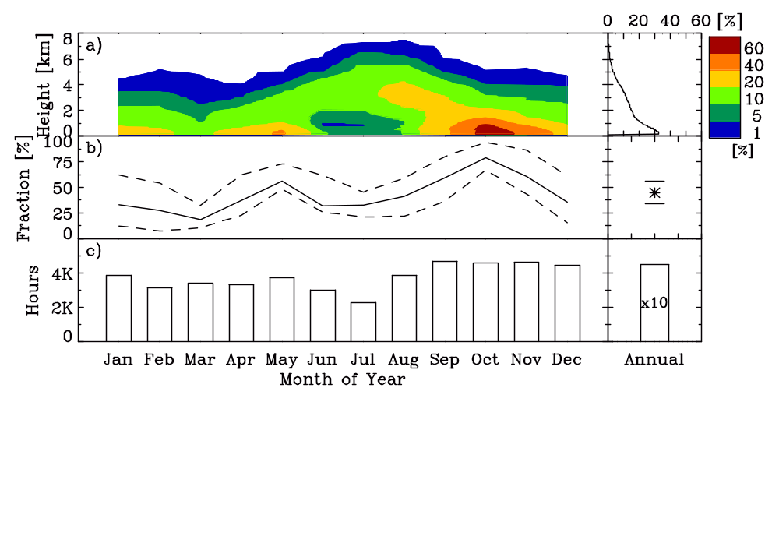
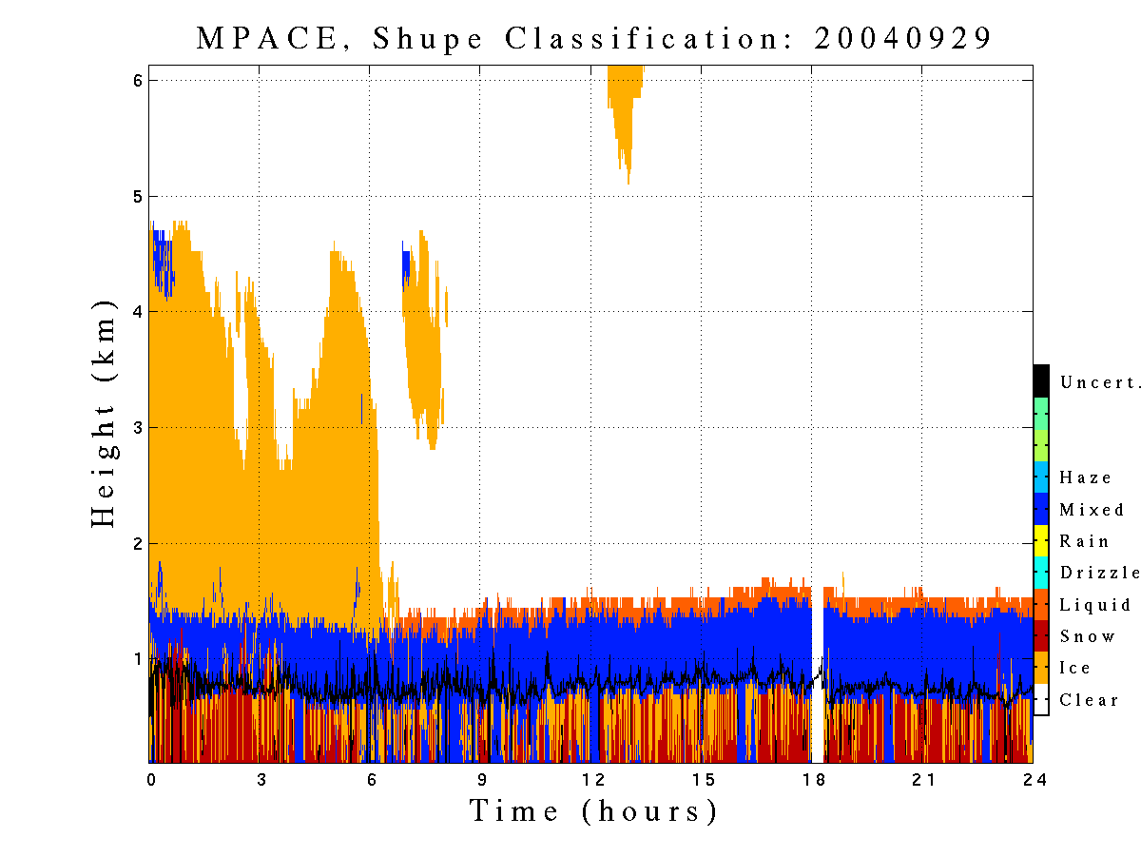
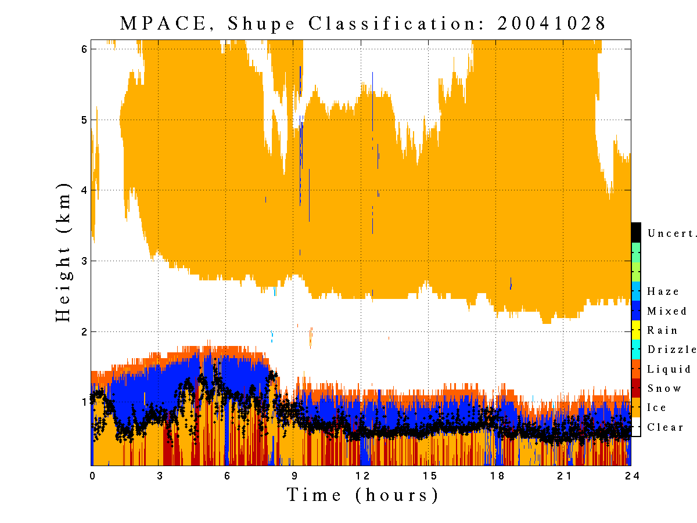
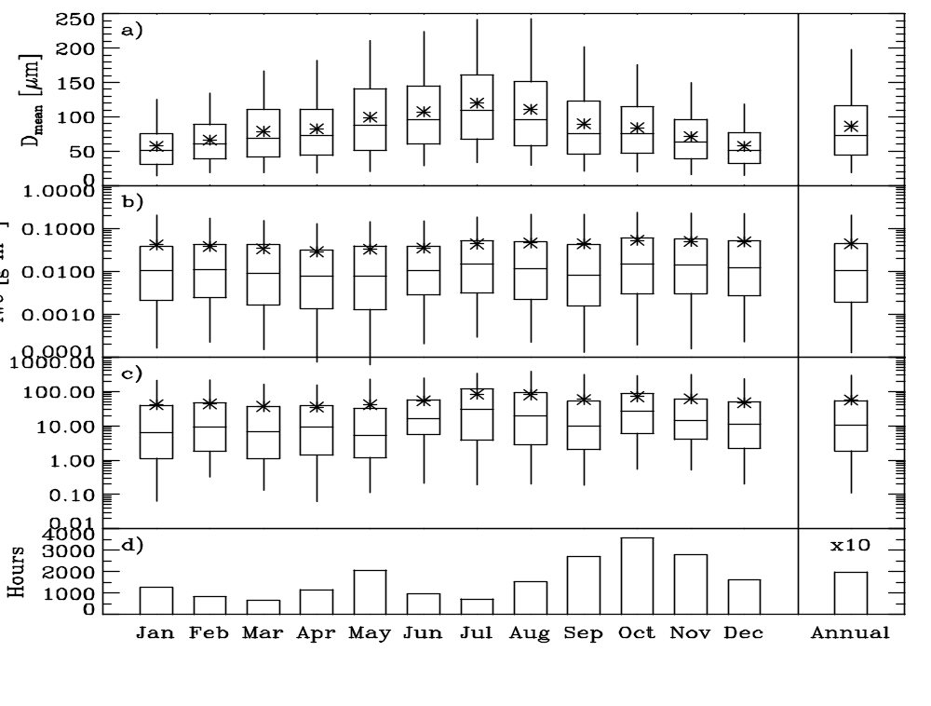
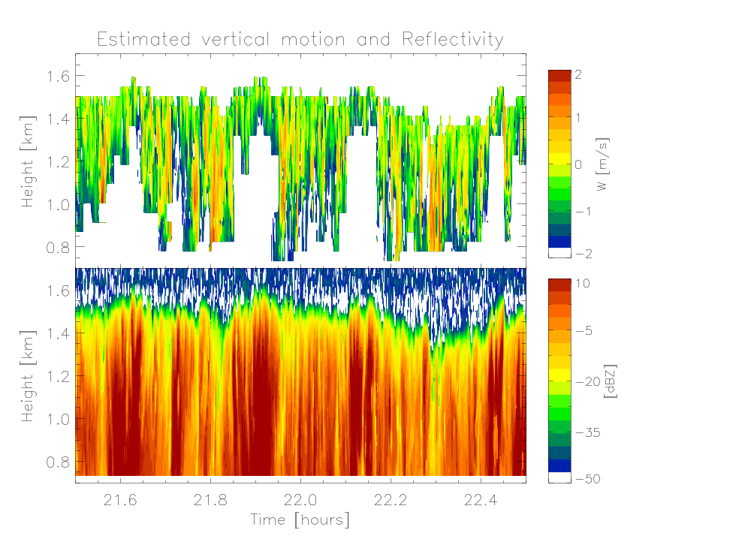
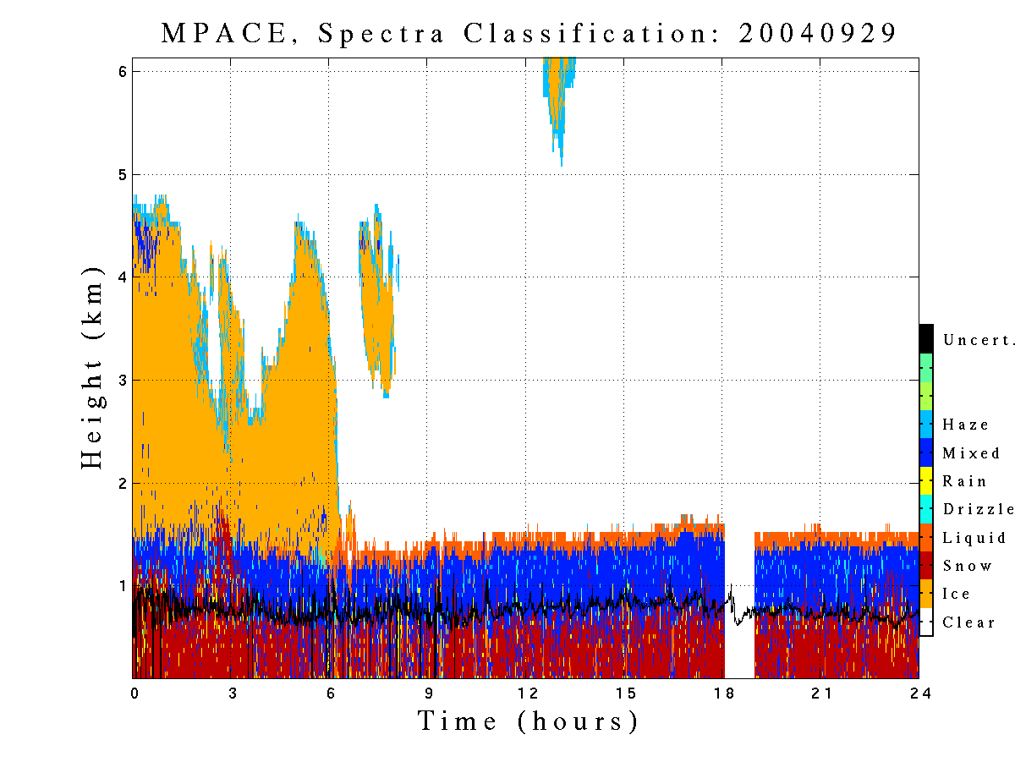
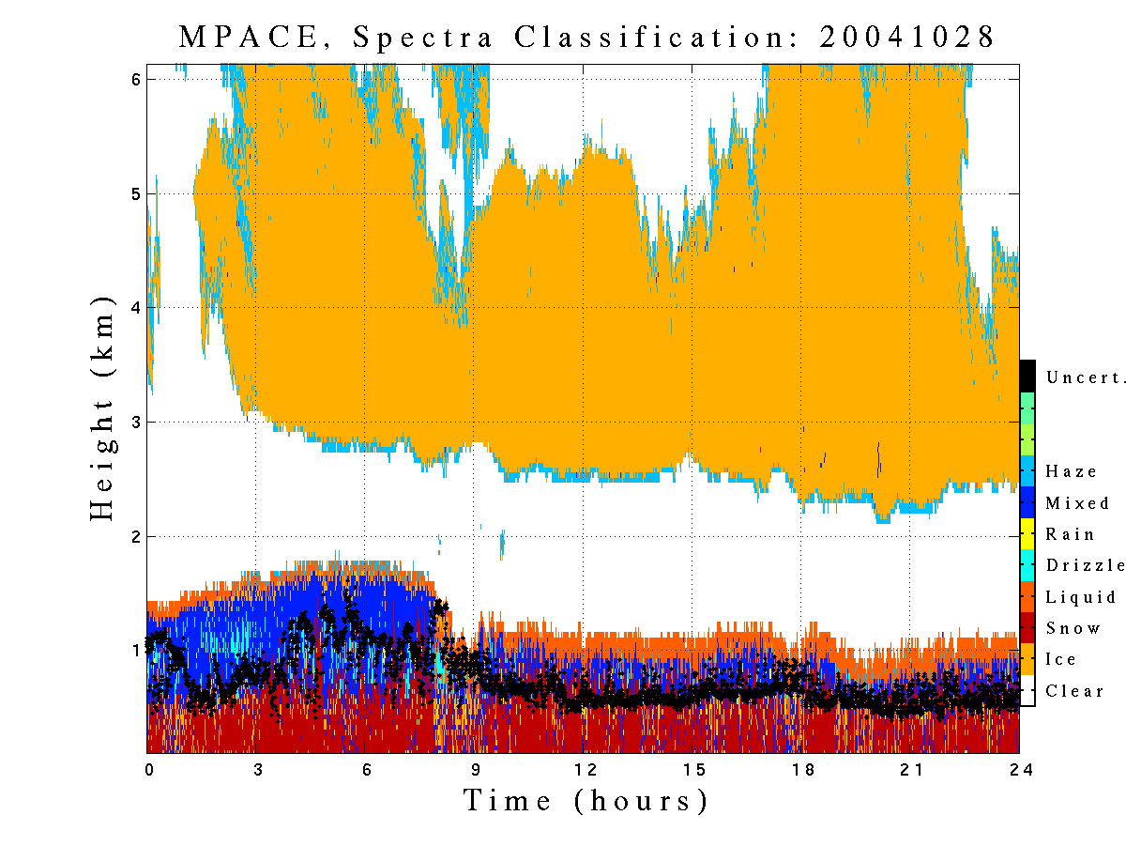
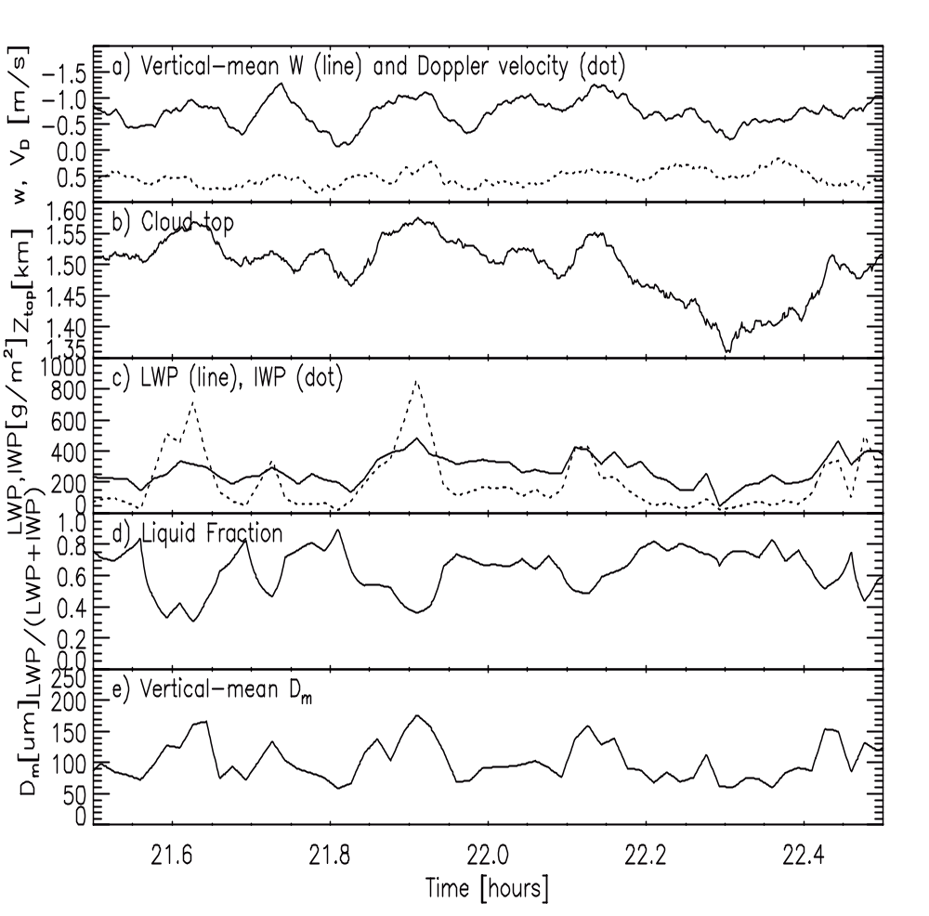
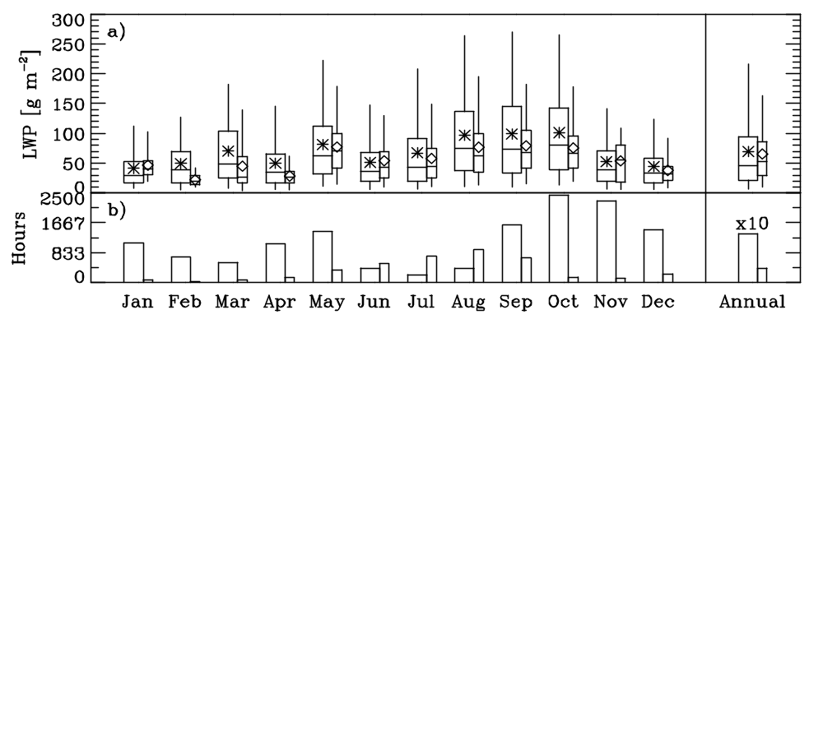
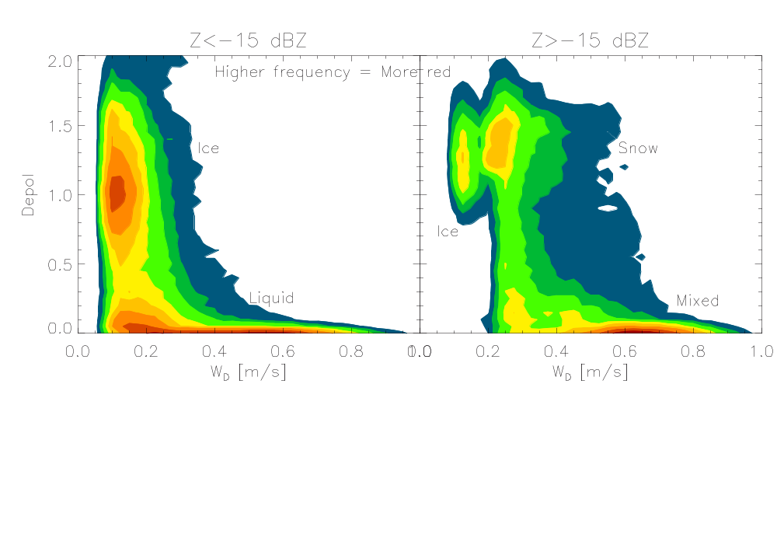
Towards a Characterization of Arctic
Mixed-Phase Clouds
Matthew D. Shupeª, Pavlos Kollias^{b}, Ed Luke^{b}
ªCooperative Institute for Research in Environmental Sciences – University of Colorado and NOAA/ESRL/PSD
and ^{b}Brookhaven National Laboratory, Atmospheric Science Division, Upton, NY
Identifying Mixed-Phase Clouds
Mixed-Phase Cloud Properties
Summary of Typical Arctic
Mixed-Phase Cloud Characteristics
Two new cloud classification methods have been developed and show a promising and exciting level of agreement in a comparison during MPACE:
Multi-instrument Method: Uses lidar backscatter and depol ratio, MMCR reflectivity, Doppler velocity, and spectrum width, and temperature soundings to classify all cloud pixels observed by lidar or radar
MMCR Doppler Spectra Method: Uses a trained neural network to identify indicators of cloud type from MMCR Doppler spectra alone. The method utilizes wavelet decompositions and statistics of reflectivity, mean spectrum width, mean velocity, skewness, and kurtosis from the primary spectral peak (see Luke et al. poster).
All mixed-phase cloud properties presented in this panel were derived from MMCR and MWR measurements at the NSA site for the time period of March 1998 through December 2004. The statistics in all plots cover this full time period. Microphysical property retrieval methods are summarized by Shupe et al. (2005, ARM Science Team Meeting and JAM, 44, 1544-1562).
Fraction with height
45% occurrence fraction with maxima in transition seasons.
Ice particle mean size: 30-150 μm
Ice Water Content: 0.001-0.04 g/m³
Ice Water Path: 10-60 g/m²
Liquid Water Path: 20-90 g/m²
Ice sizes and LWP are smallest in winter and largest in summer.
IWC and IWP are smallest in spring and largest in fall.
LWP, IWP, and ice particle sizes increase in updrafts
The fraction of ice relative to liquid increases in updrafts
Mixed-Phase Cloud
Occurrence Fraction
Total (line) and year-to-year range (dash)
Data volume
M-I
M-I
Black dots are lidar cloud base
Both methods identify mixed-phase
region at top of ice cloud
Cloud Occurrence. Mixed-phase clouds occur 45% +/- 10% of the time per year at the NSA site. There is a marked increase in mixed-phase cloudiness in the spring and fall transition seasons, mostly at heights below about 1 km.
A Case for Vertical Motions
Can Doppler spectra provide information on air motions?
Particle physical size
95th percentile
Simple Retrieval Method
Identify time-height pixels that contain liquid water using methods in panel #1 (small liquid droplets are considered as tracers of clear air motions).
Determine the most negative (upward) end of the Doppler spectrum above the noise for each pixel.
[Vertical Motion Example]
75th percentile
Mean
50th percentile
Excellent agreement on liquid-topped,
mixed-phase layers with ice/snow below
25th percentile
Some discrepancies near
the liquid base
5th percentile
Can the Doppler spectrum width help with classification?
For radar reflectivities > -15 dBZ (which are typical for mixed-phase clouds due to large ice particles), the mixed-phase clouds occupy a distinct, characteristic region with low lidar depolarization ratio (due to the typical high concentration of liquid droplets) and wide MMCR Doppler spectrum width (due to multiple phases present). This information aids the multi-instrument classification discussed above.
Monthly and Annual Microphysics Statistics
Liquid properties Ice properties
Case Results
W results suggest a net large-scale updraft of 0.7 m/s with small scale circulations of magnitude +/- 0.6 m/s.
All cloud properties and cloud top height are clearly correlated with W; during local updrafts, liquid and ice increase and the cloud top lifts.
During local updrafts, the fraction of cloud ice relative to liquid increases.
Layer quantities
Data volume
Mixed-phase (star), Single-phase (diamond)
Data volume
Interesting Microphysics Results
LWP for mixed-phase clouds is on average similar to the LWP for all-liquid clouds at NSA; this is different from SHEBA where mixed-phase clouds had higher LWPs.
Ice particles in mixed-phase clouds are 33% larger than in all-ice clouds, while the IWCs are a factor of two larger (not shown).
Ice particle sizes at NSA are similar to SHEBA, however IWC, IWP, and LWP are significantly larger at NSA than at SHEBA (not shown).
Acknowledgments
Ed Eloranta – lidar measurements during MPACE
ARM Grant DE-FG02-05ER63965

