Slide 1
How Far Energy Efficiency?
Or, why Hoffert et al. may be only half right. . .
John A. “Skip” Laitner
Senior Economist for Technology Policy
EPA Office of Atmospheric Programs
Rethinking Our Energy Future
NREL Analytic Seminar
Washington, DC
Thursday 12 July 2005

Slide 2
Acknowledgments
This presentation draws on many of the ideas from the 2005 AAAS Seminar on Extreme Energy Efficiency. With special thanks to my co-panelists, including Tina Kaarsberg, David Bassett, Marilyn Brown, Katherine Clay, John Holdren, Eli Hopson, Joe Roop, and Art Rosenberg.
But I would also like to acknowledge the many invaluable insights and contributions of a wide variety of friends and colleagues, including Diana Bauer, Fatih Birol, Michael Brody, Penelope Canan, Tom Casten, Ken Colburn, Ruth Schwartz Cowan, Laura Cozzi, Stephen DeCanio, Jerry Dion, Therese Dorigan, Neal Elliott, Andrew Fanara, Lorna Greening, Don Hanson, Alan Heeger, Benoit Lebot, Amber Leonard, Irving Mintzer, Bob Olson, Bill Prindle, Sam Rashkin, Wendy Reed, Dave Rejeski, Amanda Sauer, Steve Sexton, Anita Street, Suzanne Watson, and Elizabeth Wilson.
Finally, I would like to extend my appreciation to the NREL Energy Analysis Seminar Team, including Eldon Boes, Doug Arent, Michelle Kubik, Wanda Addison, and the others who make this forum a very real and important contribution to the dialogue.
Now more than ever, the views expressed do not necessarily reflect those of the U.S. Environmental Protection Agency or the U.S. Government.

Slide 3
The Short Road Ahead
Begins with a question and opening perspectives
Updates the emerging technology perspective
Rethinks historical and future forecasts
Offers some additional (hopefully useful) insights based on a few “paper and pencil” exercises
Closes with some final thoughts and perspectives
Provides supplemental slides (with a bibliography)

Slide 4
Perhaps a Surprising Answer?
If I had asked this group at an IEA workshop this past May what is the current record for fuel economy with a standard gasoline engine research vehicle, some might have ventured a guess of 100 miles per gallon (mpg); or perhaps even a respectable 200 mpg.
Last May, many of you may have been surprised to learn that a French team (designers of the car, “the Microjoule”), participating in the Shell Eco-Marathon, had achieved the rather astounding result of: 10,705 mpg.
In late June students from the Federal Polytechnical school of Zurich set an even more impressive new world record for fuel efficiency: 12,665 mpg — this time in a hydrogen fuel cell vehicle, also as part of the Shell Eco-marathon.
I highlight these results, not to suggest that a standard consumer vehicle would ever achieve this level of efficiency — not in a way that is both cost-effective and comfortable;
rather, it is to suggest we know so little about real efficiency opportunities that we unnecessarily limit our options by excluding such possibilities in our future scenario analyses
(e.g., Hoffert et al., among others).

Slide 5
A Thesis and Some Opening Caveats
For purposes of the discussion here this afternoon, “energy efficiency” means an average 2% annual rate of decline (or greater) in worldwide energy intensity per unit of output or GDP over the next century.
In the spirit of Karl Popper’s (2002)† notion of a testable hypothesis, the evidence suggests: there are no physical or economic limitations on policies which might promote this rate of energy efficiency improvement.
This is not to say, however, that there are no environmental or economic barriers which might otherwise impede some accelerated rate of improvement in energy efficiency.
Nor is this to say that such a rate of accelerated energy efficiency is an autonomous trend; in other words, it will require a clear and persistent set of policy signals to approach any such practical opportunities.
Finally, this is not to say that what is possible to do, should be necessarily what is done. That will be the focus of future assessments to determine an equitable and cost-effective path toward the future.
† See the bibliographic appendix for a complete citation of references used in this presentation.

Slide 6
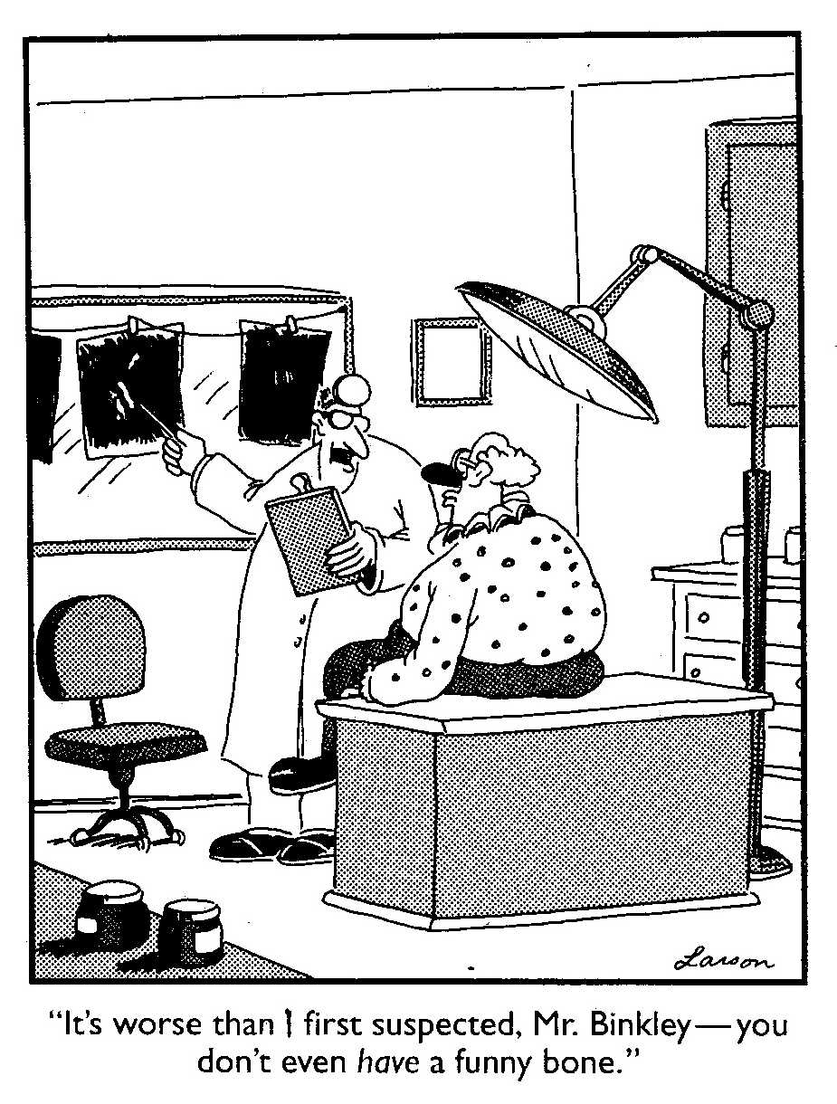
What exactly would you guess Mr. Binkley to be?
an economist?
an engineer?
an NGO?
a federal employee?
a member of congress?
Or should we choose instead, “f”, all of the above — to the extent that all of us take ourselves much too seriously so that we don’t really ask better questions?

Slide 7
Standard Forecasts and the Technology Gains from Efficiency and Structural Improvements
Where the economy might head with shifting preferences, and with the right mix of R&D and policies
Level of Energy Efficiency Innovation
New areas of insights from in-depth technology assessments and energy future policy scenarios?
Where the economy
seems to be right now
Time
Where most models and policy
reviews seem to focus

Slide 8
TechCast: Technology Market Shares at 30% By. . .
Technology | Mean | Average Confidence Level | Standard Deviation of Confidence Level
Broadband | 2005 | 77.19% | 20.44%
Online Finance | 2008 | 64.33% | 20.02%
Wireless | 2009 | 61.85% | 24.49%
Business to Business | 2010 | 60.60% | 20.46%
Entertainment on Demand | 2010 | 60.24% | 18.57%
Green Business | 2011 | 64.35% | 17.49%
Teleworking | 2014 | 52.50% | 20.76%
Global Grid | 2014 | 60.33% | 24.97%
Alternative Energy | 2017 | 59.22% | 19.98%
Nanotech | 2018 | 51.29% | 22.62%
Hybrid & Fuel Cell Autos | 2019 | 56.09% | 18.11%
Organic Farming | 2020 | 50.17% | 17.70%
Distributed Power | 2021 | 57.50% | 17.22%
Enabling
Technologies
Energy
Technologies
Source: Results based on Technology Experts Panel convened as part of a Delphi Survey completed by TechCast LLC for the EPA Office of Atmospheric Programs, March 2004.

Slide 9
Standard Energy Projections versus the Recent EPA-TechCast Delphi Survey
AEO 2004 Outlook
Hybrid and Fuel Cell Vehicles — 6% by 2025
Non-Fossil Energy Resources — 23% by 2025
Distributed Generation — 16% by 2025
EPA-TechCast Survey
Hybrid and Fuel Cell Vehicles — 30% by 2019 (+/- 4 years)
Non-Fossil Energy Resources — 30% by 2017 (+/- 6 years)
Distributed Generation — 30% by 2021 (+/- 5 years)
The market shares of these and other “energy using” technologies, as well as the adoption of broadband and the many other “enabling” technologies, might suggest significantly different opportunities and impacts from the usual mix of reference case energy projections and future policy scenarios.

Slide 10
An Opening Thought on the Tough Choices
“Individuals have a natural tendency to choose from an impoverished option bag. Cognitive research in problem solving shows that individuals usually generate only about 30 percent of the total number of potential options on simple problems, and that, on average, individuals miss about 70 percent to 80 percent of the potential high-quality alternatives (emphasis in the original).”
Dr. Jeffrey S. Luke
Catalytic Leadership: Strategies
for an Interconnected World, 1998

Slide 11
The Prospect of Emerging Technologies

Slide 12
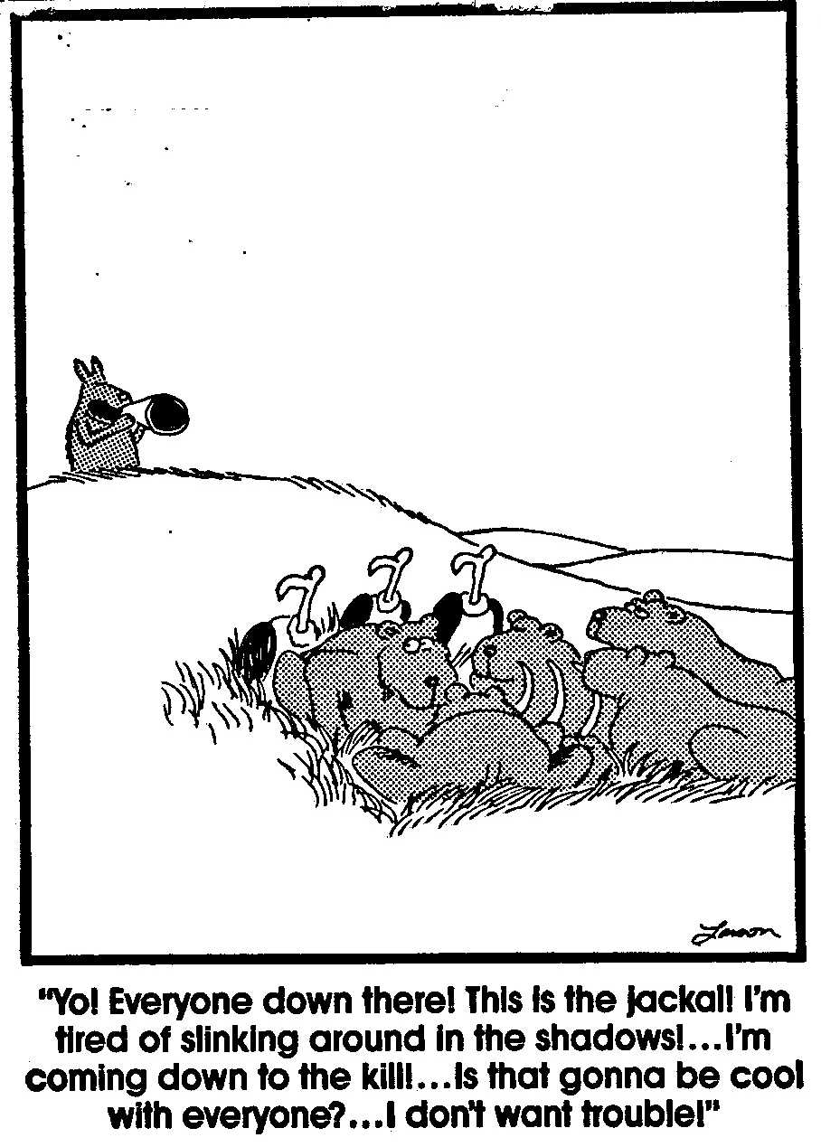
Perhaps the Jackal as a possible Role Model for energy efficiency opportunities?

Slide 13
The Emergence of Instant Manufacturing
While clearly not the typical Star Trek “replicator,” ink jet printers may provide the backbone for an entirely new generation of instant manufacturing technologies (Amato 2003†), producing everything from hearing aids, shoes, and cell phone covers to replacement bones and body tissue. And even large scale buildings (Khoshnevisk 2004†).
The technique? Selective laser sintering of materials deposited by dozens or hundreds of micro-nozzles according to a pattern embodied within a 3-D print file.
Such processes may be more energy-efficient and use a greater array of basic materials; they also benefit from negligible economies of scale — which means they can rely more on local resources, and be located closer to local production needs.
The implications for both direct and transportation energy use may be significant — and positively beneficial.

Slide 14
The Possibility of CO₂ Fuel Cells??
Under the existing paradigm, carbon dioxide is viewed only as a problem; but from perhaps a different perspective it becomes a useful energy resource. How?
The continuous oxidation of scrap iron in the presence of a constant CO₂-rich gas stream and water can be a means to sequester CO₂ as well as generate hydrogen gas and electricity.
Imagine the possibilities of using Fe/CO₂ fuel cells for both CO₂ mitigation and energy production — at a net profit of $30/tCO₂ (Rau 2004†).

Slide 15
A Thought Experiment in Convergent Technologies
If technology is explicitly represented in economic forecast and policy models at all, it tends to reflect only discrete structures and isolated energy systems; for example, separate photovoltaic (PV) systems which might be mounted on building rooftops.
But, what if we instead think in terms of Building Integrated PV systems (BIPV) — using light emitting polymers and other materials that are integrated into a single structural composite? (These are among the possibilities being explored by NREL and many others.)
In such a case we can then imagine individual structural components that converge to do the work of five separate systems, providing:
  Structural support,
  Thermal comfort,
  Lighting needs,
  Power generation; and
  Information flow and processing.
In this example, efficiency improvements can be two or three times as large as energy models might otherwise suggest.

Slide 16
Other Emerging Technology Trends
Movement away from commodity-based ownership to service-based leasing.
Increased linkages between waste minimization and product maximization (Bailey and Worrell 2004†).
Multiple outputs from convergent technologies.
Decentralized generation continuing to show net economic and environmental benefits (Casten and Downes 2005†).
Reduced transaction costs fostering smaller and more decentralized business decision-making enterprises through improved information and communication technologies.
Increased environmental awareness and concerns, enabled by new technologies which facilitate changes in consumer and business preferences.

Slide 17
Forecast Review and “Penciling” through Some Future Assessments

Slide 18
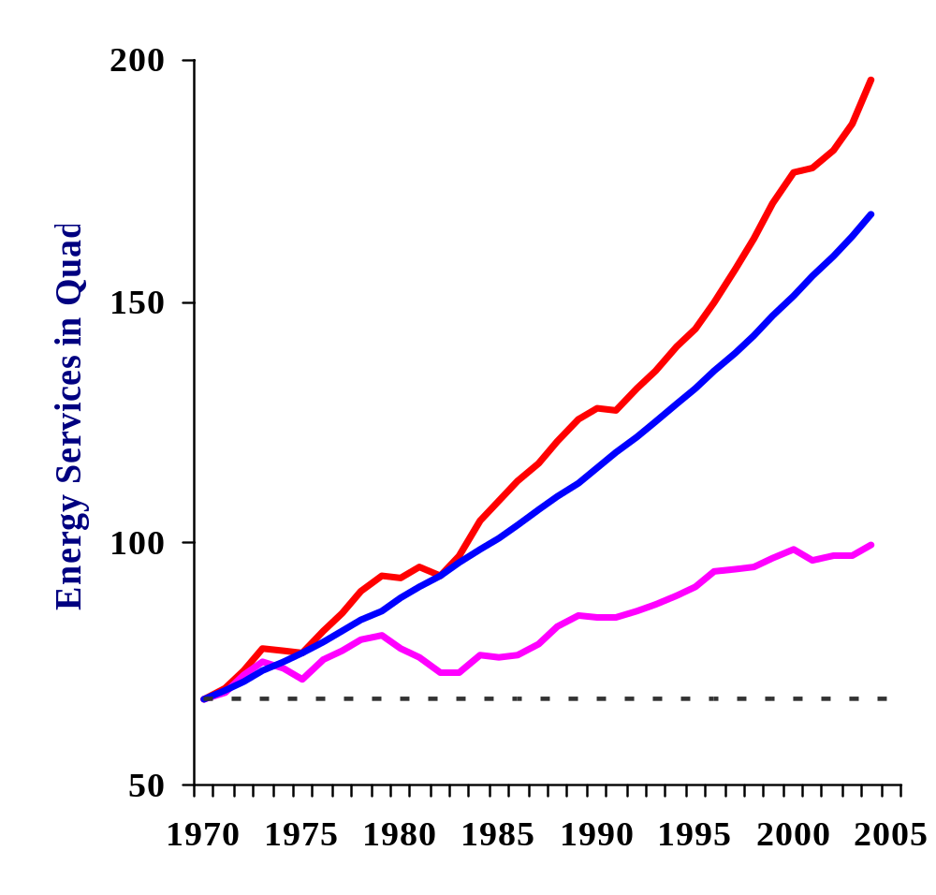
Without New Efficiency Technology,** Energy Use Would Be Almost 3 Times 1970 Levels
Contrast 3 Energy Patterns
  Using 1970 Technology
  Standard 1970s Forecast
  Actual energy use since 1970
An increase to ~195 quads based on 1970 technology
Since 1970, energy efficiency has met 75% of new energy service demands in the U.S,
Typical forecasts
to ~160 quads
while new energy supplies have perhaps contributed only 25% of new energy service demands.
Actual use of ~100 quads in 2004
** Where “energy efficiency” is broadly defined as the difference between the 1970 and 2004 energy intensities.

Slide 19
Other Useful Perspectives on Those Historical Efficiency Gains
By 2004, improved energy efficiency (compared to 1970 technologies and market structure) was already providing 75 percent of all U.S. energy services, which is:
  1.3 times our total energy production
  8.9 times our total domestic oil production
  3.7 times our total petroleum imports
So this question, why do we always think there is more energy, but we almost always assume that the efficiency resources are already used up?

Slide 20
Now on to Some Future Assessments about our “Efficiency Reserves”

Slide 21
We reasonably know what the U.S. energy reserves might now be, but do we know what our reserves of “efficiency” look like?
Let us begin with an average annual GDP growth rate of 2.6% in the U.S. (generally tracking a little more than 3% today, slowly declining to 2.3% by 2100 — to reflect a population growth of 0.8% and productivity gains of 1.5%); then
The frozen efficiency scenario, based on 2005 market structure and technology, implies that 47,400 quads in cumulative energy services will be needed by the year 2100. The problem is that, according to BP’s latest data, our known reserves of conventional energy resources are less than 6,000 quads.
The good news is that if we further assume an average decline in energy intensity of about 1.3% per year (starting at 1.6% today and slowly declining to 1.0% by 2100); then

Slide 22
Our reserves of energy efficiency (Part II)
By the year 2100 the US will be using ~350 quads of energy (about 3.4 times current levels). Cumulatively over the period 2005 through 2100, we will need ~19,400 quads of delivered energy supply. But again, this is more than three times the known reserves.
On the other hand, energy efficiency gains will provide perhaps 28,000 quads of cumulative energy services through the year 2100.
Assuming we can average a decline in energy intensity of about 2.3% annually, then our remaining efficiency reserves are about 6,900 quads.
Using those “remaining reserves” of energy efficiency means that by the year 2100 the US will be consuming ~145 quads of energy (about 1.4 times current levels)

Slide 23
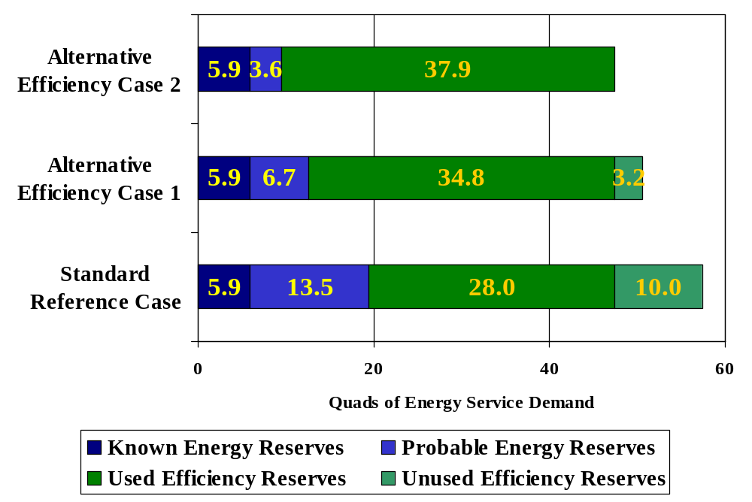
Exploring U.S. Cumulative Energy and Energy Efficiency Reserves 2005-2100

Slide 24
A Note About Renewables
Nothing in this mental mapping of the efficiency potential is intended to exclude the development and use of renewable energy technologies.
Indeed, with the current and anticipated evolution of both energy and enabling technologies, renewable and efficiency resources should be seen as co-evolutionary.

Slide 25
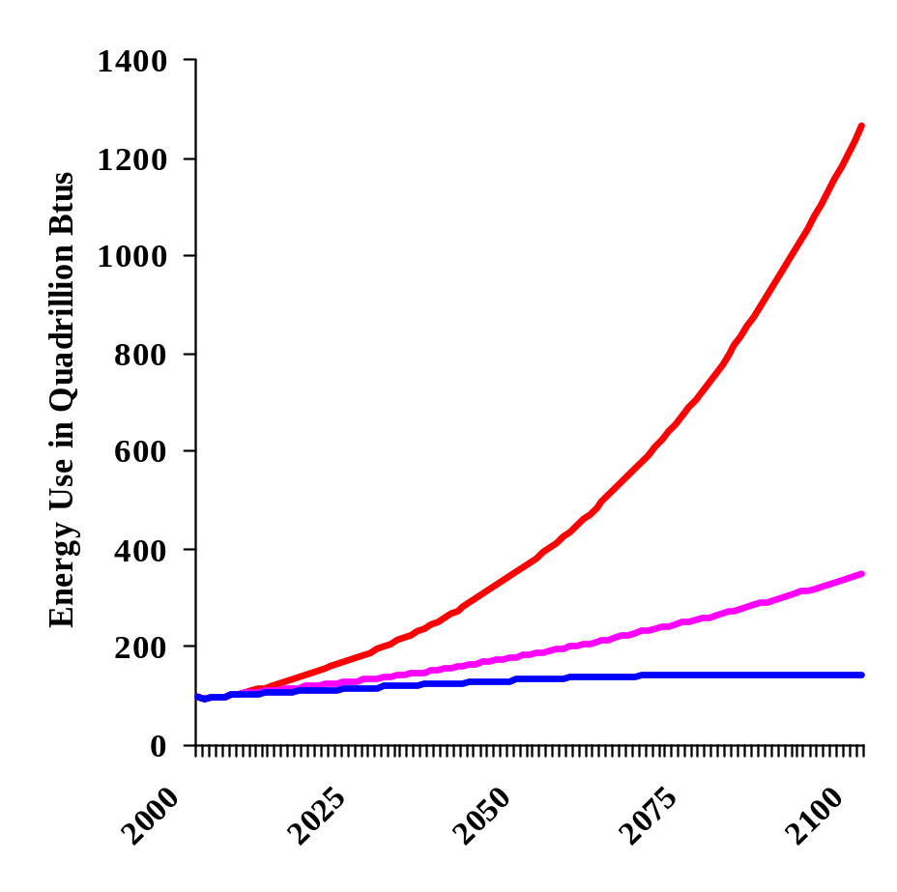
Without New Efficiency Technology, Energy Consumption Will Increase Significantly
Contrast 3 Scenarios
  Using Year 2005 Technology
  Assuming a standard 1.3% Annual Rate of Improvement in Energy Efficiency
  Assuming a 2.3% Annual Rate of Improvement in Energy Efficiency
Where each scenario assumes an average 2.6 percent level of economic growth in US GDP over a 95-year period, but employs a different mix of technologies and efficiency improvements (Laitner 2004†).
An increase of 12.4 times the year 2005 energy consumption
(but it isn’t going to happen)
If I had to guess. . . .
3.4 times year 2005
Policy
Gap
1.4 times year 2005

Slide 26
Some Additional Paper and Pencil Exercises to Explore Possibilities in Changing Energy Intensities

Slide 27
A Typical Approach Using Fuel Economy
In the case of light duty vehicles, for example, some analysts suggest the best we can do by 2100 is go from 27.5 miles per gallon (current CAFÉ) to what they perceive is a practical limit of 110 mpg. Hence, we have an annual rate of improvement:
{(27.5 / 110)^{(1/95)} – 1} * 100% = –1.45%
So, using this perspective one might conclude we can do no better than to reduce our transportation energy intensity by perhaps 1.5% per year over the next 95 years.
But let’s begin to explore the rest of the story . . . .

Slide 28
Checking Out Different Assumptions
Existing average fuel economy worldwide is perhaps more like 18 mpg (MER 2005).
Engineering reviews suggest possible improvements to 200 mpg, or even 300 mpg
  Again, note that the record is 12,665 mpg, although I’m not sure I’d want to ride very long or very far in such a car. . . .
However, if we assume only 200 mpg as the upper bound, then we might get:
{(18 / 200)^{(1/95)} – 1} * 100% = –2.50%
And we’re still not done. . . .

Slide 29
Asking Some Other “What If” Questions
What if U.S. population, now at ~297 million people, stabilizes at no more than 430 million by the year 2100, a 0.4% annual growth?
What if per capita ownership of vehicles increases by 0.5% annually?
What if vehicle miles traveled declined 0.4% annually because of land-use changes, the availability or enabling of other technologies, and changing social preferences?
And, for similar reasons, what if the number of passengers per car increased by 0.25% per year?
And with all this in mind, what if the nation’s GDP grew an average 2.6% annually as we originally hypothesized?

Slide 30
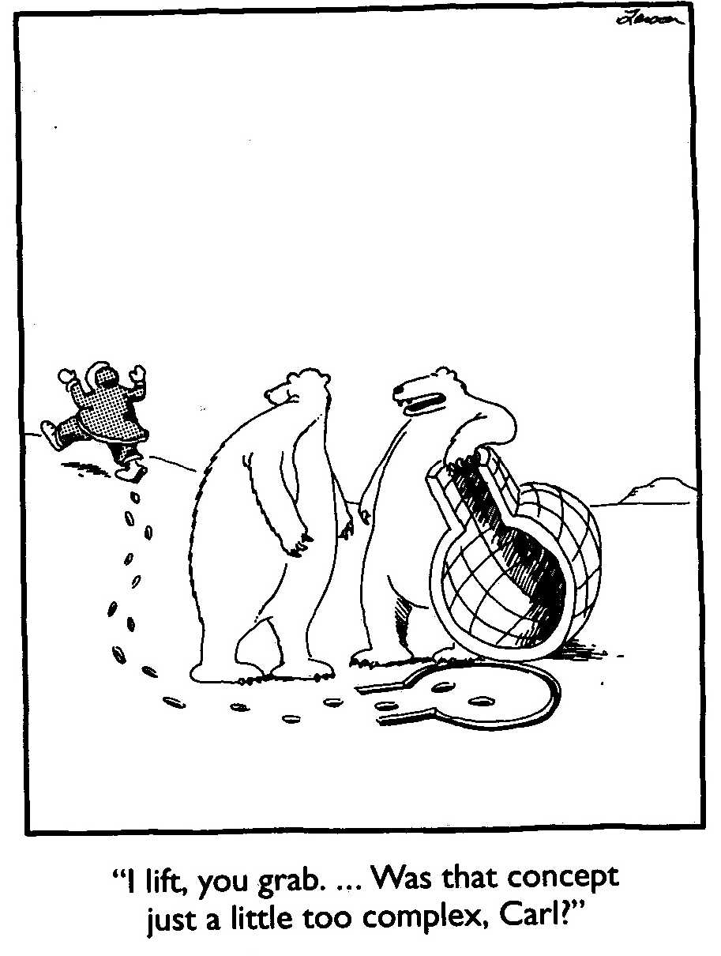
Perhaps efficiency represents too many complexities for standard models and forecasts?

Slide 31
Efficiency Gains as Policy or Social Choices
0.975^{mpg *}
1.004^{pop *}
1.005^{pcapcar *}
0.996^{vmtpcar *}
0.9975^{ppcar}
=
0.9526
1.026^{GDP}
and
(0.9526 – 1) * 100% = –4.74% annual change in E/GDP
Both technology and
social choices
Social choices
So the question, practical limits?
Or limited choices?

Slide 32
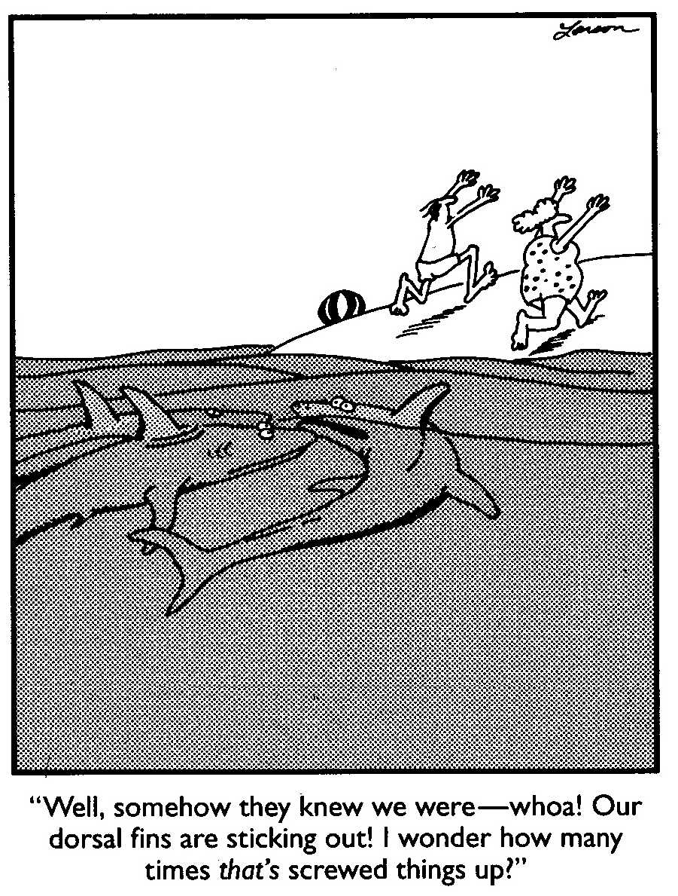

Slide 33
Further Caveats and Thoughts
While the focus of this presentation is to highlight opportunities and images of the future, this again is not to say there are no economic barriers or environmental problems to be resolved as we seek an appropriate level and mix of energy efficiency technologies and policies. And such opportunities will absolutely require a coordinated and persistent policy signal.
Greater levels of population and economic growth (than those implied by the discussion here) will clearly impact requisite efficiencies, as well as generate an even greater level of environmental impact that must be prevented and/or remediated.
“Individuals have a natural tendency to choose from an impoverished option bag (emphasis in the original). Cognitive research in problem solving shows that individuals usually generate only about 30 percent of the total number of potential options on simple problems, and that, on average, individuals miss about 70 percent to 80 percent of the potential high-quality alternatives” (Luke 1998†).

Slide 34
Three Minimum Sets of Policy Conditions to Sustain Improved Efficiency Gains
There is a strong need to market energy efficiency in more concrete terms so that the opportunity seems more real and more compelling;
There is also a need for a clear and persistent policy signal that will direct the creative resources of the market toward greater efficiency innovations; and
Finally, there is a need for tightening but flexible efficiency standards on the one hand, but also greater support for research and development on the other.
Adapted from Laitner and Brown (2005)†.

Slide 35
And Perhaps This Final Perspective . . . .
Nolan Ryan is a hall of fame baseball pitcher who closed his career in 1993 with President Bush’s former team, the Texas Rangers. But he would have won considerably fewer than his 324 games had he taken the field without his catcher, his infield, or even outfield.
In a similar way, the full mix of efficiency and environmental technologies should be among the serious modeling and policy options as we map our future scenarios and evaluate the economic impacts of our alternative technology paths.

Slide 36
For more information on the material or ideas referenced in this presentation, contact:
John A. “Skip” Laitner
EPA Office of Atmospheric Programs
1200 Pennsylvania Avenue NW, MS-6207J
Washington, DC 20460
o: +1 (202) 343-9833
f: +1 (202) 343-2210
email: Laitner.Skip@epa.gov
The ideas contained in this presentation to the NREL Energy Analysis Seminar are believed to rely on credible and accurate sources of information. Any errors in the analysis are solely the responsibility of the author. The results described herein should not be construed as reflecting the official views of either the Environmental Protection Agency or the U.S. Government. A more complete background and analysis that underpins this presentation can be found in Laitner (2004)† and Laitner and Brown (2005)†.

Slide 37
Supplemental Slides
Further Caveats and Thoughts
A Few Economic Fundamentals
Energy Efficiency Abatement Cost Curves
Glossary
Bibliography

Slide 38
Further Caveats and Thoughts

Slide 39
Reviewing the Long-Term Perspective
Energy analysts of all perspectives suggest the likelihood of a significant increase in the cost or shortfall in the availability of conventional fossil fuels by 2030 — and perhaps sooner.
Economist Kenneth Boulding once commented : “Images of the future are critical to choice-oriented behavior.”
For example, whether we include in our analysis the nuclear, hydrogen, renewable, or non-conventional fossil fuel resource options, can we afford to rule out energy efficiency?
And yet, economic models and conventional policy analyses tend to assume that energy efficiency can make only a limited — and “not always cost-effective” — contribution to our nation’s energy future. This is no longer satisfactory.

Slide 40
A Few Economic Fundamentals

Slide 41
Energy Services and Economic Activity
Standard neoclassical economic growth theory suggests that the production of goods and services is a function of some mix of capital and labor with a significant contribution from technological progress (Solow 1957†).
But the evidence also suggests that production in the real world cannot be understood without taking into account the role of (inefficient) materials and energy consumption (Georgescu-Roegen 1976†).
From start to finish — from the mining, processing and fabrication, to consumption and, finally, waste disposal — our use of natural resources, at best, may be only 15 to 20 percent efficient (updated from Claasen and Girifalco 1986†).

Slide 42
Energy Services and Economic Activity
Ayers and Warr (2005†) further demonstrate that improvements in energy services may be the critical factor in the growth of an economy, perhaps one of the primary drivers that underpin “technological progress.”
From a longer term perspective, if sustainable economic activity is to continue — but without proportional increases in emissions and waste, it is essential to reduce energy use per unit of work or dollar of economic activity.
In other words, increased energy efficiency may be the key to long term international development and security; and, one might add, the key to long term sustainability.
The good news is that efficiency improvements do not have to be about ratcheting down the economy. Instead, they can be all about providing new services, making new products, and providing new ways to both work and play (Hanson et al. 2004†).

Slide 43
Some Additional Thoughts
Our forecasts and best thinking about likely outcomes and future options have been eroded by outdated paradigms (e.g., Pareto optimality††) and misunderstood contexts (e.g., reproducible capital†† and thermodynamic limits††).
As an example of the latter, the conceptual convenience of the central station paradigm†† and alleged Carnot efficiencies†† have tended to limit our thinking about technologies and energy efficiency improvements.
Expanding our understanding of technology beyond Carnot limits to the full thermodynamic opportunities of chemistry in action (Feynman 1959† and Gillett 2002†), constraints to efficiency and productivity improvements are largely non-existent in the foreseeable future (Laitner 2004†).
†† See the glossary appendix for a brief description of key terms used throughout this presentation.

Slide 44
Explaining Energy Efficiency and the Marginal Abatement Cost Curve

Slide 45
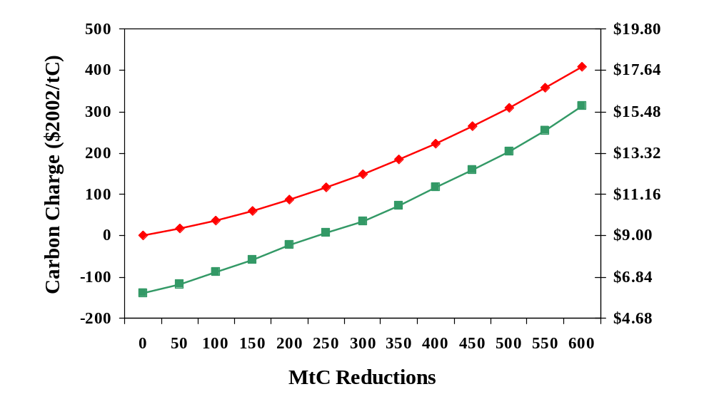
Typical 2015 U.S. Domestic Marginal Abatement Cost Curves (MACC)
Standard MACC based on Y1 axis with only carbon perspective*
Amortized Energy Cost ($/GJ)
MACC based Y2 axis reflecting amortized energy costs**
* Estimated from scenarios plotted with the Second Generation Model.
** Estimated from data contained in the DOE-sponsored study, Scenarios for a Clean Energy Future,
2000. See supplemental slides for further explanation of the MACC based on the Y2 axis.

Slide 46
Cost of Carbon Saved as
Function of Energy Prices
$/tC = (AmortCost – AvgPrice) / CarbCoefficient
Where
$/tC is cost per metric ton of carbon saved
AmortCost is technology cost/GJ amortized over lifetime
AvgPrice is average cost of energy in $/GJ
CarbCoefficient is metric tons carbon per GJ

Slide 47
Example of Cost of Carbon Saved as
a Function of Energy Prices
Assume
Average primary energy price is $9.00/GJ
Efficiency technology has 5-year payback, 10-year life
Current interest rate is 8 percent*
Carbon content is 0.0152 tC/GJ
Then
Capital recovery factor is 0.149
Amortized technology cost is $45 * 0.149, or $6.71/GJ
Cost of carbon saved then becomes:
($6.71 - $9.00) / 0.0152 = -$151/tC
So we then have a negative carbon but a positive energy cost.
* Note: this example draws an important distinction between hurdle rate used to evaluate purchase decision versus interest rate actually paid to amortize investment.

Slide 48
The Economic Costs and Benefits of Shaping Energy Technology Investments
At Least Four Categories of Costs
  Direct Investment Costs
  Operating and Maintenance Costs
  R&D and Program Costs
  Transaction and Search Costs
But Also at Least Four Categories of Benefits
  Direct Savings from Lower Environmental Compliance Costs
  Process Efficiency and other Productivity Gains
  Environmental Benefits not Captured within normal Market Transactions
  Spillovers and/or learning created/induced by either the technology investment, or the R&D efforts
A complete technology benefit-cost assessment suggests that continued and even accelerated energy efficiency investments can show a long-term net positive benefit (Laitner 2005†).

Slide 49
Glossary
Carnot efficiency: Named after a French engineer Sadi Carnot, the maximum efficiency of a heat engine is 1 – Low Temperature / High Temperature (as measured in °Kelvin). Given combustion temperatures in power plants, for example, the maximum practical efficiencies are now are about 45 percent However, heat recovery systems can increase this to as much as 70-90 percent.
Central station paradigm: The idea that economies of scale provide less expensive energy supply resources compared to distributed or on-site resources where the supply is more closely match to actual need (e.g., providing a mix of steam and electricity, for example, with combined heat and power technologies). Improvements in both design, materials, and electronics are dramatically altering technology cost and performance so that economies of scale are moving closer to zero.
Energy efficiency: Broadly speaking, a measure of how much energy is needed to provide one dollar of the nation’s Gross Domestic Product; sometime referred to as reducing the nation’s energy intensity, or E/GDP. This may be the result of improved technology performance or shifts in the economy away from energy intensive production processes to higher value-added manufacturing sectors and services
Pareto optimality: After an Italian economist Vilfredo Pareto, an assumption in many economic models that economic welfare is presumed to be maximized in reference case projections. In other words no one can be made better off without someone else being made worse off following a reorganization of production. Hence, environmental policies, by implication, will cost the economy.
Reproducible capital: The nation’s artifacts, equipment and structures which are assumed to be easily replaced or reproduced using new materials or substitutes with little concern for waste or environmental impact.
Thermodynamic efficiency: Thermodynamic efficiency is the ratio of the amount of work done by a system compared to the amount of heat generated by doing that work. Although the tendency is to think of thermodynamics solely in terms of Carnot efficiency (see above), thermodynamic efficiency is also influential at the atomic level of chemical reactions. Thermodynamic efficiencies (when measured as the change in Gibbs free energy divided by the change in enthalpy at standard temperature and pressure) of greater than 90 percent are possible. As an example, the efficiency of car engines are subject to Carnot limits while the chemical reactions within fuel cells are constrained only by the larger thermodynamic limits.

Slide 50
Bibliography
[Amato 2003] Amato, Ivan. "Instant Manufacturing." Technology Review, November 2003, pp. 56-62.
[Ayres and Warr 2004] Ayres, Robert U. and Warr, Benjamin. "Accounting for Growth: The Role of Physical Work." Structural Change and Economic Dynamics, 2005, 16(2), pp. 181-209.
[Bailey and Worrell 2004] Bailey, Owen and Worrell, Ernst. “Clean Energy Technologies: A Preliminary Inventory of the Potential for Electricity Generation, Lawrence Berkeley National Laboratory, September 2004 (draft).
[Boulding 1995] Boulding, Elyse and Kenneth E. Boulding,. The Future: Images and Processes, Thousand Oaks, CA: Sage Publications, 1995.
[Casten and Downes 2005] Casten, Thomas R. and Downes Brennan. “Critical Thinking About Energy: The Case for Decentralized Generation of Electricity,” Skeptical Inquirer, January/February 2005, pp. 25-33.
[Claassen and Girifalco 1986] Claassen, Richard S. and Girifalco, Louis A. "Materials for Energy Utilization." Scientific American, 1986, 255(4), pp. 103-17.
[Craig et al. 2002] Craig, Paul P.; Gadgil, Ashok and Koomey, Jonathan G. “What Can History Teach Us? A Retrospective Examination of Long-Term Energy Forecasts for the United States.” Annual Review of Energy and the Environment, 2002, 27, pp. 83-118.
[DOE 1980] Office of Policy and Evaluation. Low Energy Futures for the United States, DOE/PE-0020, Washington, DC: U.S. Department of Energy, June 1980.
[EIA 2003] Energy Information Administration. Annual Energy Outlook 2004: With Projections to 2025, Washington, DC: U.S. Department of Energy, 2003.
[Feynman 1959] Feynman, Richard P. “Plenty of Room at the Bottom,” Pasadena, CA: California Institute of Technology, December 1959.
[Georgescu-Roegen] Georgescu-Roegen, Nicholas. Energy and Economic Myths: Institutional and Analytical Economic Essays. New York, NY: Pergamon Press, 1976.

Slide 51
Bibliography
[Gillett 2002] Gillett, Stephen L. “Nanotechnology: Clean Energy and Resources for the Future,” Palo Alto, CA: Foresight Institute, 2002.
[Hanson et al 2004] Hanson, Donald A.; Mintzer, Irving; Laitner, John A. “Skip” and Leonard, J. Amber. “Engines of Growth: Energy Challenges, Opportunities, and Uncertainties in the 21st Century,” Argonne, IL: Argonne National Laboratory, 2004. See also, Laitner, J.A. “Skip”; Hanson, Donald A.; Mintzer, Irving and Leonard, J. Amber. “Adapting in Uncertain Times: A Scenario Analysis of U.S. Energy and Technology Futures,” Proceedings of the 24th USAEE/IAEE North American Conference. Washington, DC: International Association of Energy Economics, 2004.
[Khoshnevisk 2004] Khoshnevisk, Behrokh. 2004. “Houses of the Future: Construction by Contour Crafting Building Houses for Everyone,” University Of Southern California Urban Initiative, Los Angeles, CA.
[Laitner 2004] Laitner, John A. “Skip”. “How Far Energy Efficiency?,” Proceedings of the 2004 ACEEE Summer Study on Energy Efficiency in Buildings. Washington, DC: American Council for an Energy Efficient Economy, 2004.
[Laitner 2005] Laitner, John A. “Skip”. “The Possibility of Net Positive Benefits from Long-Term Energy Efficiency Investments” (forthcoming).
[Laitner and Brown 2005] Laitner, John A. “Skip” Laitner and Brown, Marilyn A. “Industry .” Proceedings of the 2005 ACEEE Summer Study on Energy Efficiency in Industry. Washington, DC: American Council for an Energy Efficient Economy, 2005 (forthcoming).
[Luke 1998] Luke, Jeffrey S. Catalytic Leadership: Strategies for an Interconnected World, San Francisco, CA: Jossey-Bass Publishers, 1998.
[Popper 2002] Popper, Karl. The Logic of Scientific Discovery (Translation of Logik der Forschung), London, England: Routledge Classics, 2002 (1934, 1959).
[Rau 2004] Rau, Greg H. "Possible Use of Fe/CO₂ Fuel Cells for CO₂ Mitigation Plus H₂ and Electricity Production." Energy Conversion and Management, 2004, 45, pp. 2143-52.
[Solow 1957] Solow, Robert M. "Technical Change and the Aggregate Production Function." The Review of Economics and Statistics, 1957, 39 (August 1957), pp. 312-20.

