Slide 1
Genetic Evaluation of Cow Fertility Using DHIA Records

Slide 2
History of DHIA Data
Trait | Collected since | Evaluated since
Milk and fat yield | 1908 | 1935
Protein yield | 1975 | 1977
Calving ease | 1980 (DHIA) | 1978 (NAAB)
Somatic cell score | 1987 | 1994
Calving interval | 1908 | 2003

Slide 3
Factors Affecting Fertility
Environment and management
  Season, region, herd, age
  Milk yield, voluntary waiting period
Fertility of service sire (ERCR)
Genes of cow (DPR)
Interaction of bull and cow
  Inbreeding, recessives (CVM)

Slide 4
Introduction
Cow fertility has declined over time.
Higher yields cause more days open
Genetic evaluations expressed as daughter pregnancy rate (DPR) instead of days open.

Slide 5
Pregnancy Rate
The percentage of non-pregnant cows that become pregnant during each 21-day period
Pregnancy rate < conception rate
  Non-cycling cows
  Estrus not expressed or detected
Typical pregnancy rates
  20% if herd averages 154 days open
  25% if herd averages 133 days open

Slide 6
Pregnancy Rate and Days Open
100
90
80
70
60
Pregnancy Rate
50
40
30
20
10
1
2
3
4
5
6
7
8
9
0
60
81
102
123
144
165
186
207
228
249
Number of Chances
Days Open

Slide 7
Pregnancy Rate Formulas
Can be derived from days open
  Non-linear: 21 / (DO – VWP + 11)
  Linear approx: (233 – DO) / 4
Advantages over days open
  Positive numbers are desirable
  Earlier measure of herd fertility
Notes:
VWP = Voluntary waiting period

Slide 8
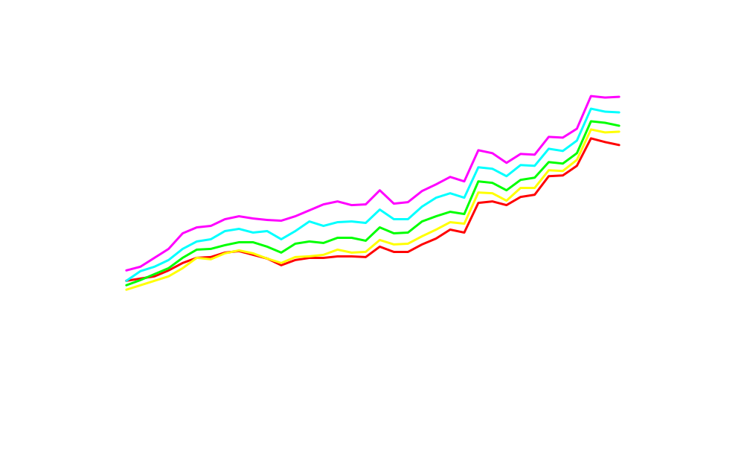
Phenotypic Trend – Holstein DO
Lactation
5th
4th
3rd
2nd
1st

Slide 9
Days Open Trends
Phenotypic trend 1960 - 1998
  Holstein: +37 days
  Jersey: +20 days
Genetic trend 1960 - 1998
  Holstein: +17 days
  Jersey: +9 days
Expected correlated response
  Milk trend x .38 correlation = +17 days

Slide 10
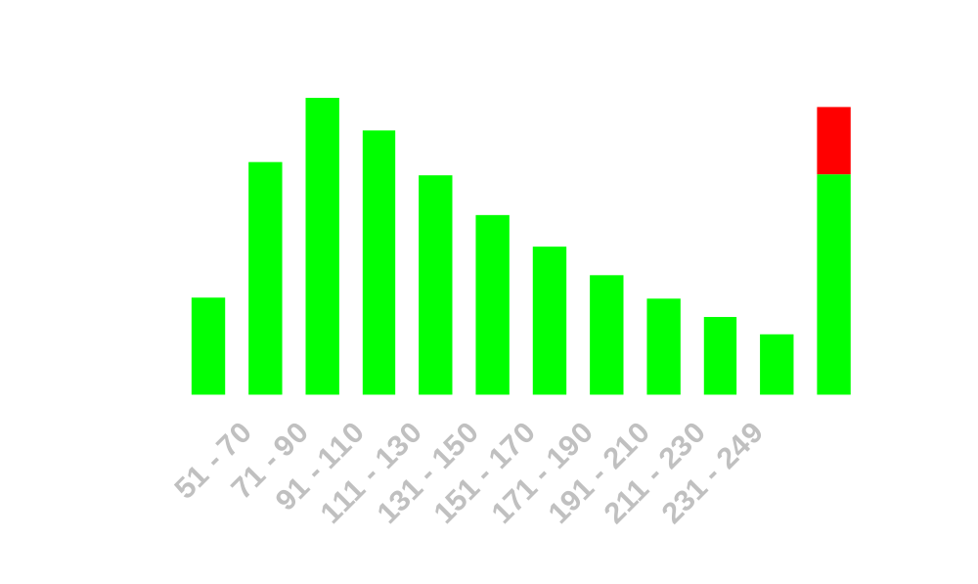
Distribution of Days Open
Holstein Calvings 1990 - 2001
Cows culled for reproductive reasons
≤ 50
≥ 250

Slide 11
Evaluation Methods
Same programs used for yield, PL, SCS
Convert to preg rate = (233 – DO) / 4
Parameter estimates used:
  Heritability = 4%
  Repeatability = 11%
  Sire-by-herd interaction = 1%
Adjust for regional, seasonal, herd, and age differences

Slide 12
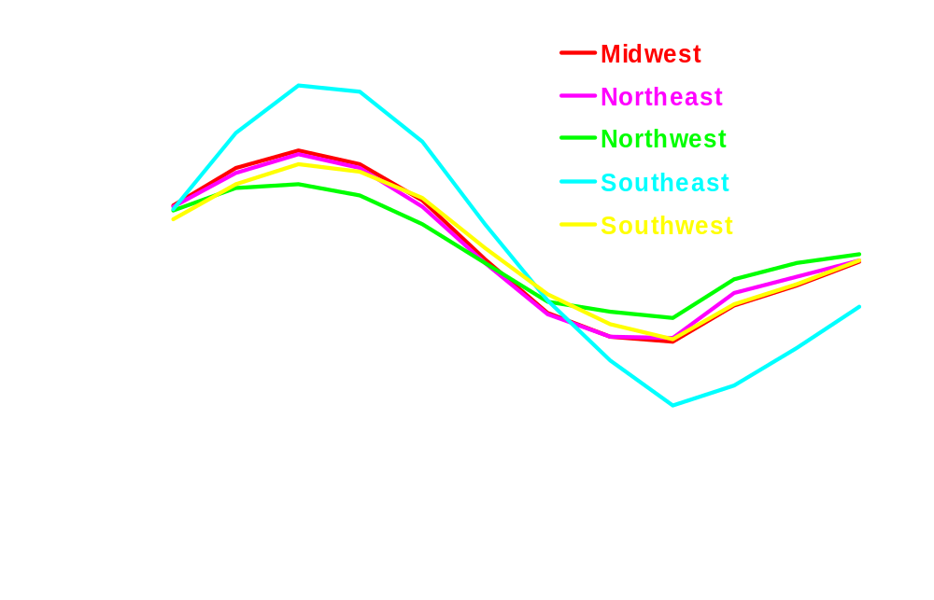
Seasonal Effects on Days Open
Holsteins calving since 1997 in each US region

Slide 13
Pregnancy Rate Evaluation
Lactations 1-5 beginning with 1960
Data sources
  Reported DO confirmed with next calving
  Reported DO if no next calving
  Calving interval – 280 days if no reported DO
  Assigned DO = 250 if sold for infertility

Slide 14
Sources of Fertility Data 1998-1999
 | AY | BS | GU | HO | JE | MS
Breeding date verified by calving date | 55 | 54 | 48 | 57 | 64 | 53
Breeding date disagrees with calving date | 6 | 8 | 8 | 5 | 5 | 8
Breeding date but no next calf | 16 | 15 | 20 | 19 | 17 | 16
No breeding reported, only next calf | 7 | 9 | 8 | 6 | 6 | 11
Cows sold for reproductive problems | 6 | 5 | 5 | 5 | 3 | 4
No information for fertility | 10 | 9 | 11 | 8 | 5 | 8

Slide 15
Genetic Evaluation
Holstein data from February 2003 evaluation
  40 million lactations
  16 million cows
Statistics for recent AI bulls
  Born 1994 – 1998
  Reliability averages
    DPR 59%
    PL 61%
    SCS 69%
    Milk 85%

Slide 16
Older Bull Evaluations
 | REL | DO | DPR | PL | NM$
Duster | 99 | - 10 | +2.4 | +4.3 | +453
Bellwood | 99 | - 1 | +0.2 | -0.5 | +356
Mandel | 99 | + 7 | - 1.8 | -0.7 | +244
Luke | 99 | + 10 | - 2.4 | -1.8 | +132
Mountain | 99 | - 4 | +1.0 | +1.1 | +283
Mascot | 99 | + 3 | - 0.8 | -2.9 | +29
Notes:
DO = Days Open
DPR = Daughter Pregnancy Rate

Slide 17
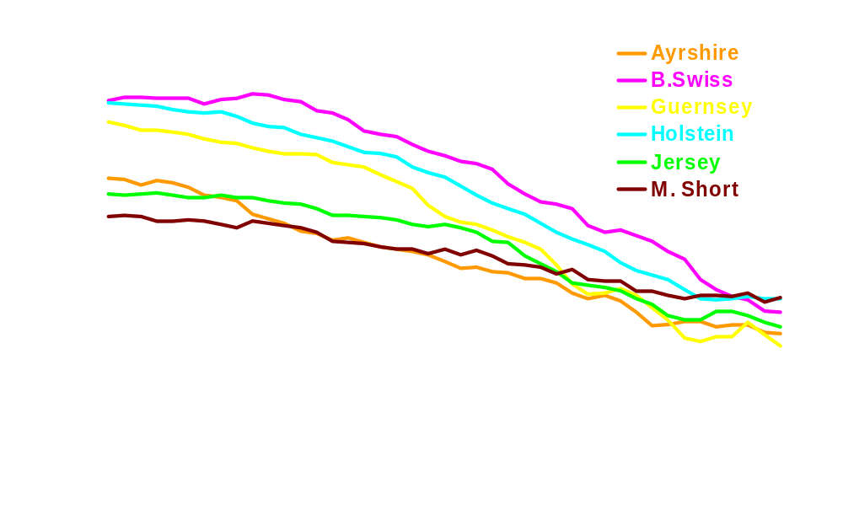
Pregnancy Rate Genetic Trend 1957-1999

Slide 18
Bulls ranked by Net Merit
February 2003
 | DPR | PL | Net Merit $
Vision-Gen Ozzie | 0.1 | 0.9 | 680
Win.-Manor Machoman | 0.9 | 2.8 | 647
Ricecrest Marshall | -1.6 | 0.1 | 644
Carol Prelude Mtoto | -1.6 | 2.6 | 627
Welcome Garter | -1.4 | 0.8 | 620
Shipsholm Glenwood | 0.7 | 2.1 | 600
McCloe-Pond Trent | 0.4 | 0.7 | 597
Pagen-Ernwood Dane | -1.3 | 1.1 | 595

Slide 19
Bulls with High Daughter Fertility
 | DPR | PL | REL DPR | REL PL
Dixellen Design | 2.6 | 0.3 | 93 | 94
KRansom D Event | 2.6 | 4.9 | 65 | 67
HA Sky. George | 2.4 | 2.8 | 56 | 60
Pen Col Duster | 2.4 | 4.4 | 99 | 99
M. Infinity Aruba | 2.3 | 0.1 | 69 | 72
Start. Rudolph | 2.2 | 2.8 | 99 | 99
Boulet Charles | 2.2 | 2.6 | 99 | 99

Slide 20
Bulls with Low Daughter Fertility
 | DPR | PL | REL DPR | REL PL
Kemview Beauty | - 4.1 | 2.4 | 65 | 70
W. Boy Wonder | - 3.2 | - 1.4 | 75 | 79
D. Luke Champ | - 3.2 | - 2.1 | 78 | 68
Ricecrest Lance | - 3.1 | - 2.3 | 91 | 82
S. Star Hi Metro | - 3.1 | 0.8 | 69 | 72
W. Del Convincer | - 3.1 | 1.1 | 93 | 80
Kemview Curtis | - 3.0 | - 0.1 | 48 | 50

Slide 21
Summary
Daughter Pregnancy Rate has low heritability (~4%) but high genetic correlation with Productive Life (>.5)
Official evaluations of DPR began February 2003.
Selection on PL has helped to reduce the decline in cow fertility.

Slide 22
Future Directions
Daughter Pregnancy Rate will be included in Net Merit.
New “Format 5” fertility data
  Store all breedings, not just last
  Store service sire identification
  Pregnancy checks (began 2002)
New “Format 6” health trait data

Slide 23
Thank You!
DHIA was my first employer (Ogle county, IL, 1976-1978).
AIPL staff contributed greatly. We now use more data provided by YOU through DHIA.
Most producers report accurate breeding dates.
More complete information is always welcome.

Slide 24
AIPL Web Site aipl.arsusda.gov
Database queries
Summary lists and reports
Evaluation documentation
Research documentation
Lab facts, general information, kid’s corner
Search engine

