Slide 1
Quark masses and quark mixing parameters – what’s next?
Marina Artuso
Syracuse University

Slide 2
The questions
What are the values of the quark masses and quark mixing parameters?
Are they consistent with the Standard Model?
Within “beyond SM” theory, additional parameters may be pinned down by analyses geared towards CKM determination

Slide 3
Quark Masses
This is a good illustration of the interplay between fundamental parameters and QCD.
QCD effects increase as quark mass becomes closer to QCD scale Λ_{qcd} ≈ 0.5 GeV.
Theoretical tools:
    Lattice
    HQET
    Chiral perturbation theory

Slide 4
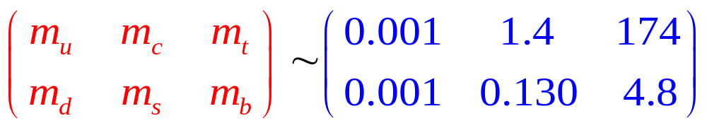
A pocket guide to quark masses
Approximate values (GeV/c²)
Mass hierarchy is a striking feature

Slide 5
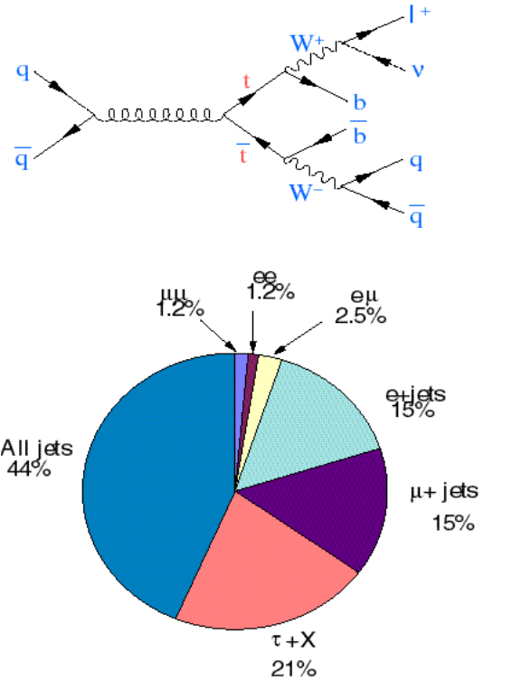
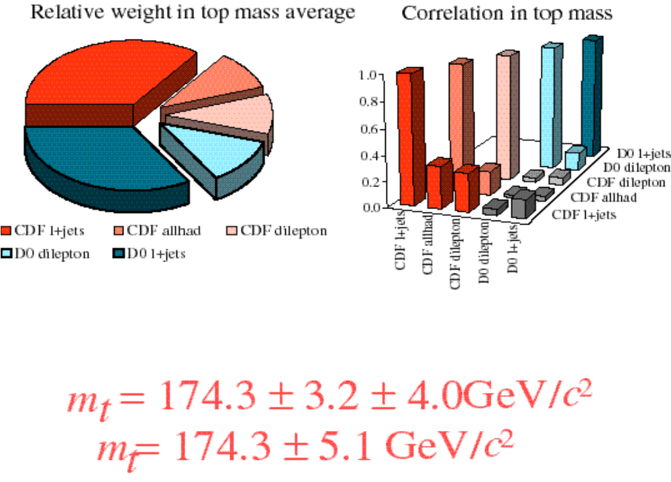

The heaviest of all: m_{t}
CDF & D0 combined results

Slide 6
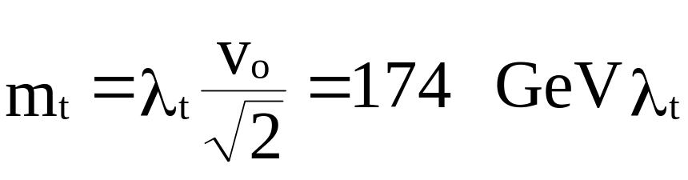
Is the top quark special?
m_{t} ≈ scale of the EW symmetry breaking:
SUSY: large Yukawa coupling at Planck scale  λ_{t} (m_{t} ) ≈1
Higgs a tt bound state? (Bardeen, Hill & Lindner)
TeV II should bring error in mass determination down to 2 GeV!

Slide 7
m_{b} and m_{c}
Non perturbative effects are important.
Quark masses are “running”: important to define the scale at which they are evaluated.
  Pole mass ill defined
  “short distance masses” (potential subtracted,kinetic mass…)
  m_{q}(μ)

Slide 8
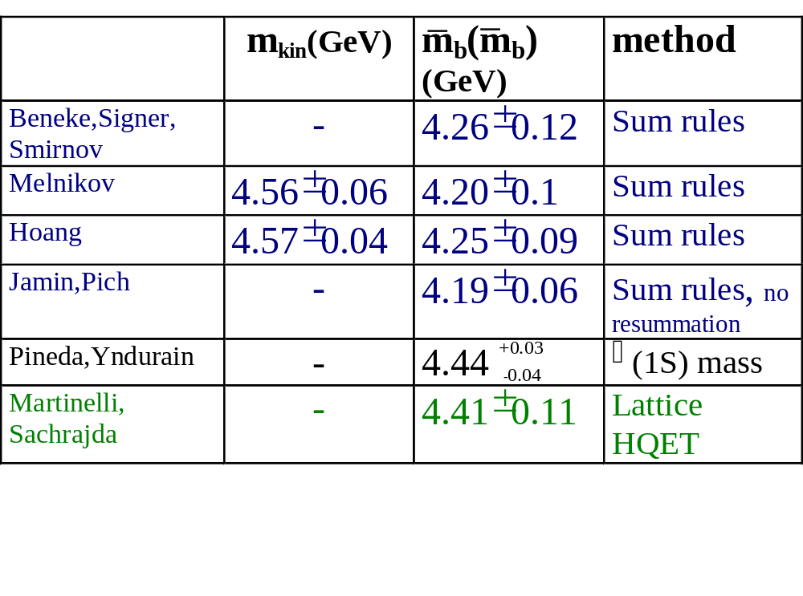
Theory input on m_{b} (sample of a vast literature)
Important for V_{c(u)b}
○ expansion, semileptonic decay moments
Jet observables sensitive to b mass(LEP)

Slide 9
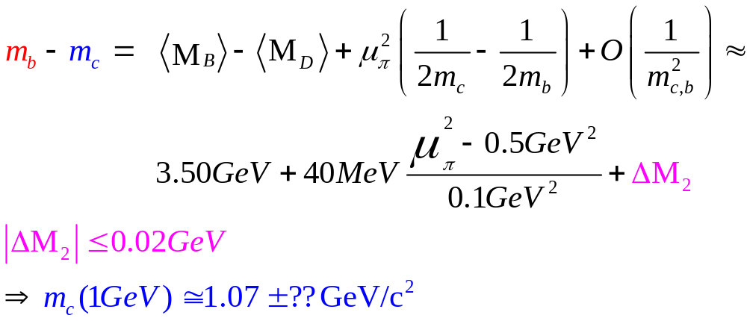
m_{c}
Charmonium data (moments)m_{c}= 1.35±0.05 GeV
HQE (short distance definition):

Slide 10
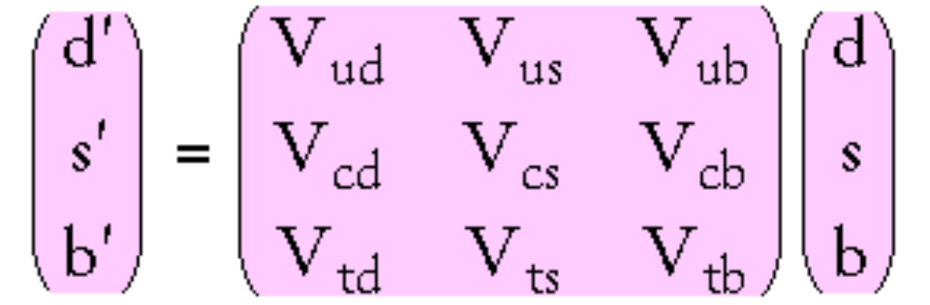
Quark Mixing
Weak interaction couples weak eigenstates, not mass eigenstates: CKM matrix relates these two representations:
↑
↑
↑
weak eigenstates V_{CKM} mass eigenstates
CKM unitary  described by 4 parameters (3 real, 1 imaginary)

Slide 11
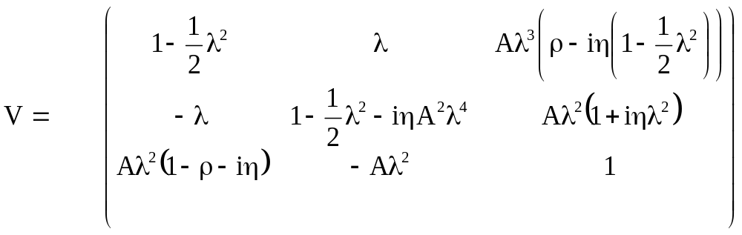
The CKM matrix in the Wolfenstein parameterization
d s b
u
c
t
Good λ³ in real part & λ⁵ in imaginary part
We know λ=0.22, A~0.8; we have constraints on ρ & η strategy to pin them down under way

Slide 12
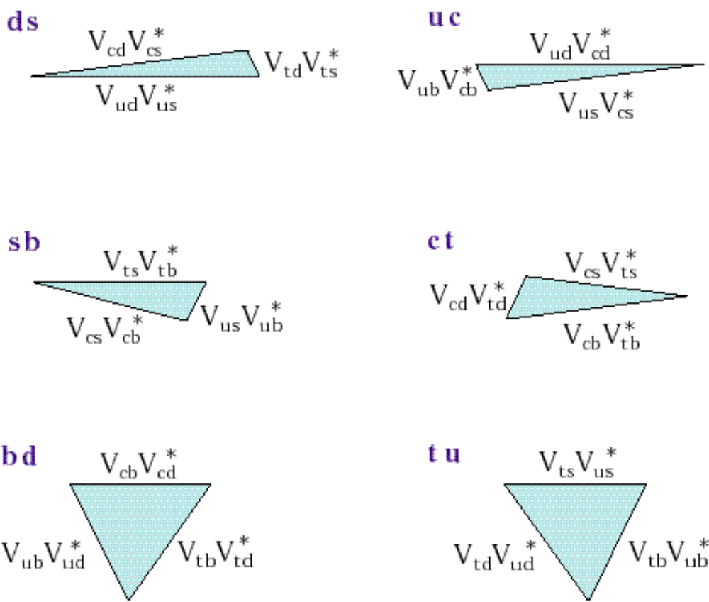
The Unitarity Triangles
“ds” - indicates rows or columns used
There are 4 independent parameters, which can be used to construct the entire CKM

Slide 13
CKM magnitudes: present data
- measured
- assuming unitarity
ud: β-decay 0.9739 ± 0.0009 | us: K→πeν 0.2200±0.0025 | ub: b→ulν &B→π(ρ )lν ≈ 0.0035± 0.001
cd: νd→lc→llX 0.224 ± 0.016 | cs: D→Keν,W →X_{c} X 0.97 ± 0.11 | cb: b→clν, B→Dlν 0.041 ± 0.003
td: B_{d} mixing 0.0083 ± 0.0016 | ts: B_{s} mixing 0.04 ± 0.01 | tb: t→blν 0.99 ± 0.15

Slide 14
In other words:
We now know the Wolfenstein parameters:
  A~0.8
  = 0.22
We are working hard to over-constrain the  plane:
  Precision determination of Standard Model parameters?
  ‘Beyond the Standard Model’ effects
  Check validity of ‘new physics’ effective theories

Slide 15
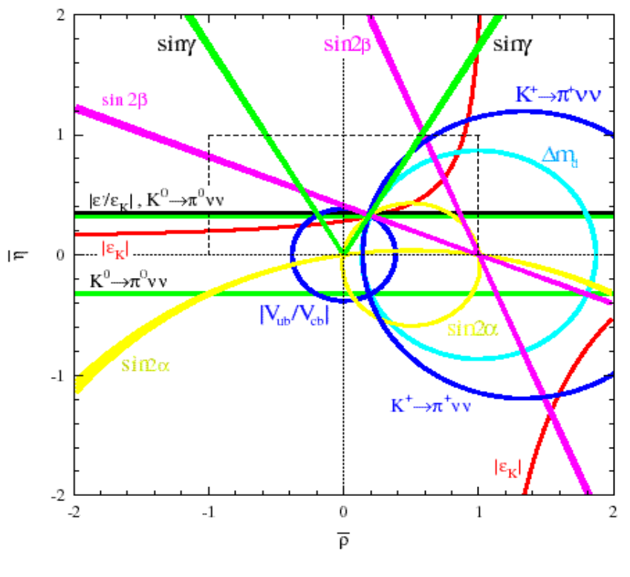
A map of the ‘quark mixing’ hunt
Improvements on the measurements of the sides will be achieved through the interplay between new precision data available and refinements of theoretical tools
The angles α, β, γ will be determined studying 2-body hadronic B-decays (rare):
B→ππ, Κπ, ρπ, DΚ , ψΚ
Help from (rare) K→πνν after 2005

Slide 16
Experimental input
The goal:
  measure all the masses and mixing parameters to challenge the Standard Model and find clues towards a more complete theory
The challenge:
  QCD is the obstacle that nature has put on our “treasure hunt” of these fundamental parameters. We need a better understanding of hadronic matrix elements to complete our program

Slide 17
Experimental constraints
Experimental information:
  semileptonic decays of heavy flavored hadrons
  Δm in flavor oscillation of the B_{(d,s)} mesons
  CP violation observables in B decays (starting now)
  CP violation observables in K decays
  Rare K decays
The challenge: extract the fundamental parameters from data (we observe hadrons, not quarks!)

Slide 18

Theory input
HQET effective theory is valid when m_{q}→
  applications to exclusive decays.
Heavy Quark Expansion
  application to inclusive properties (decay widths, total-semileptonic-moments of inclusive properties)
Lattice Gauge Theory, based on QCD but still on its way to precise calculations (although may be very close, more later..): the first theory to have both statistical and systematic errors!

Slide 19
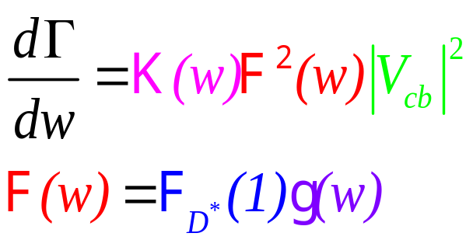

V_{cb} from B→D*ν
HQET:
The shape, not a clearly predictable quantity, but is constrained by theoretical bounds and measured form factors

Slide 20
The parameter F_{D*}(1)
  Lim F_{D*}(1) = 1 as m_{b} → ∞,
  F_{D*}(1)=1+O(α_{s}/π)+δ_{1/m}2+δ_{1/m}3 (no δ_{1/m} , Luke’s theorem)
  F_{D*}(1) = 0.91±0.042, from Caprini, Uraltsev…..
  F_{D*}(1) = 0.89±0.06, from Bigi (June 1999)
  Lattice QCD calculation is an important check.
    Jim Simone’s talk @ Lattice99 F_{D*}(1) = 0.935 ±0.035, some errors not yet evaluated (quenching,cutoff)
  What is the meaning of the theoretical errors?

Slide 21
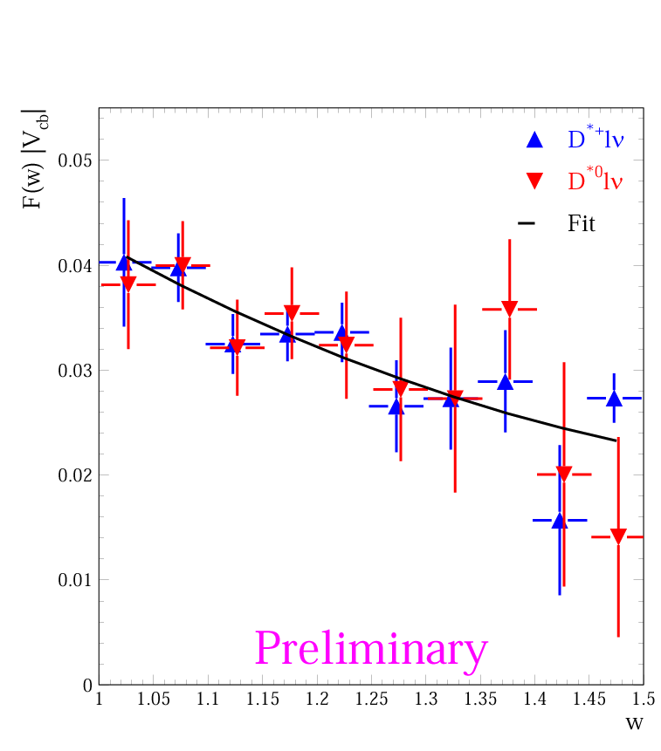

|V_{cb}| from B→D*lν
Study w: σ_{w}(CLEO)= 0.03; σ_{w}(LEP) ≥0.07
Fit each w-bin for (B→D*lν+D*Xlν+bgds)
CLEO limit: ε(slow π)
LEP limit: D*Xlν level
Model of Leibovich, et al.
  PRD 57, 308 (1997)
CLEO measures it, sees less
F(1)|V_{cb}|
Extrapolation
CLEO 2001
F(1)|V_{cb}|=(42.2 ± 1.3 ± 1.8)×10⁻³ ρ²=1.61±0.09
CLEO D^{*+}lν, D^{*0}lν
5% total error on F(1)|V_{cb}|

Slide 22
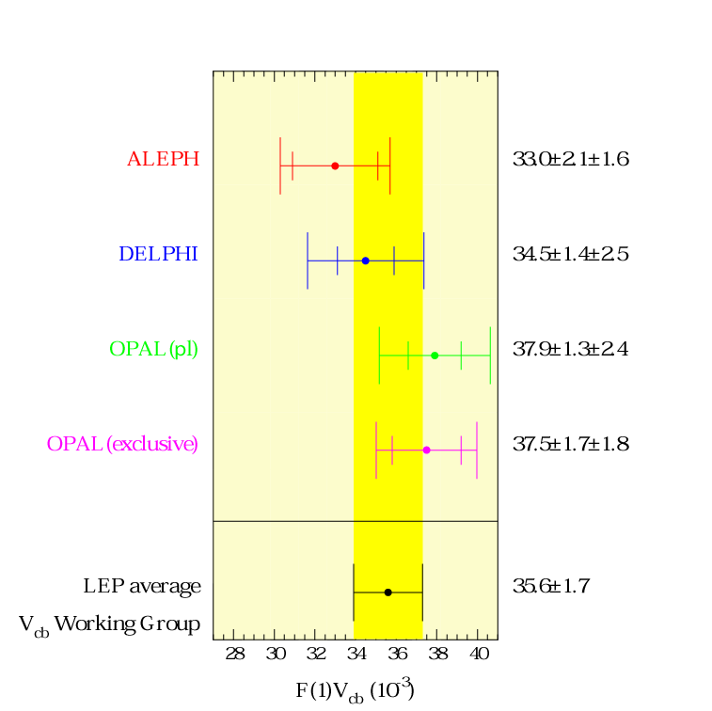
V_{cb} Exclusive Averages
CLEO fits both a smaller
D*Xlν AND a larger ρ² than
LEP, & both are correlated
with F_{D*}(1)|V_{cb}|
πl
When taking out F(1),
LEP WG uses
F(1)=0.88±0.05
CLEO uses
F(1)=0.913±0.042
CLEO 42.2±1.3 ±1.8
7% CL consistency

Slide 23
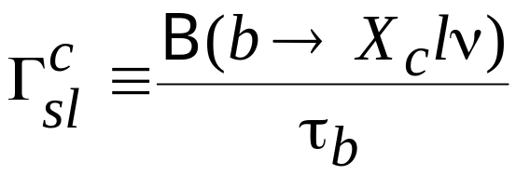
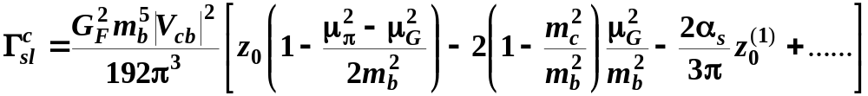
|V_{cb}| from inclusive B →X_{c}ν
From B(B→X_{c}lν) extract the experimental decay width:
Compare with the theoretical prediction from Operator Product Expansion:
Known phase space factors

Slide 24
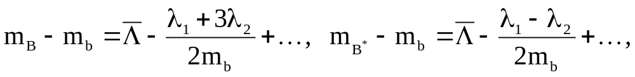
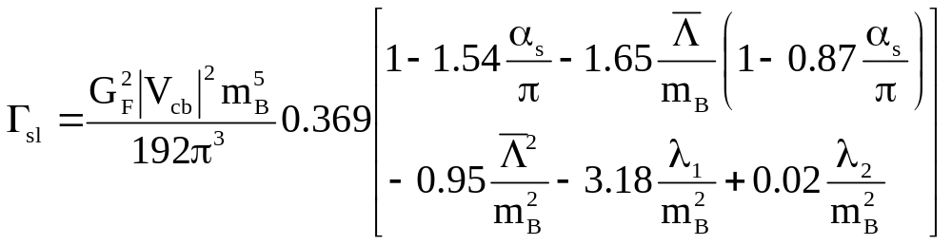
Another parameterization of inclusive semileptonic decays
Using Operator Product Expansion & Heavy Quark Expansion, in terms of α_{s}(m_{b}), Λ, and the matrix elements λ₁ and λ₂
These quantities arises from the differences
From B*-B mass difference, λ₂ = 0.12 GeV²

Slide 25
determined from “Moments”
Λ, λ₁
Prediction on Λ, λ₁ from Lattice QCD (Kronfeld & Simone, hep-ph/0006345.)
Λ, λ₁ determined from
  Measured hadronic spectral moments in b→clν
  Measured photon energy spectrum moments in b→sγ
  Measured lepton energy moments in b→clν
New, preliminary CLEO data on 1,2 (3 close to be ready too).
A.Falk, M. Luke, & M. Savage,
PRD53 (2491) 1996.
M. Gremm & A. Kapustin,
PRD55 (6934) 1997.
M. Voloshin, PRD51 (4934) 1995.

Slide 26
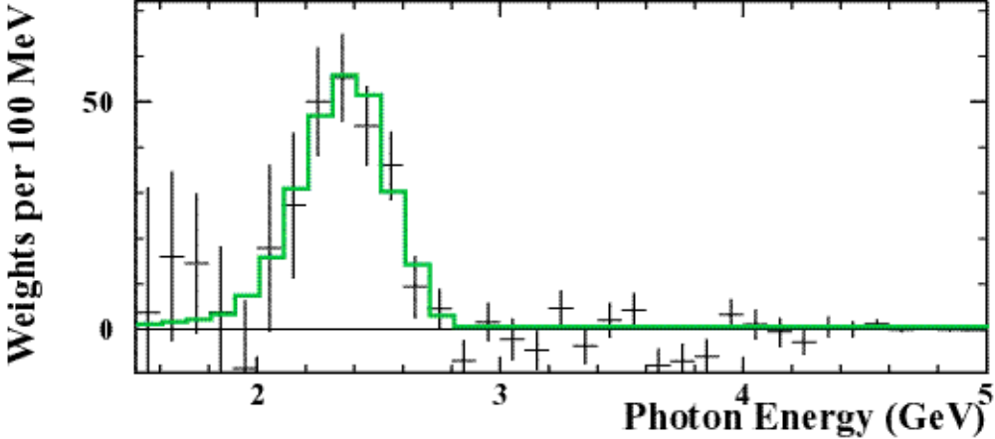
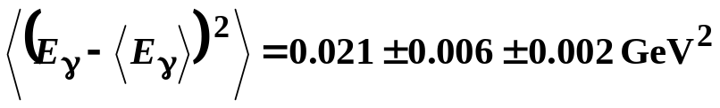
CLEO b→ sγ spectral moments
Measure photon spectrum in lab-frame.
Convert to B rest frame. MC accounts for smearing
  Best match m_{b}= 4719±115 MeV/c²; p_{F} = 378±150 MeV
Extract moments (E_{γ} > 2.0 GeV)
⟨E_{γ}⟩=2.345 ±0.030 ±0.010 GeV (1.3%)
Preliminary

Slide 27
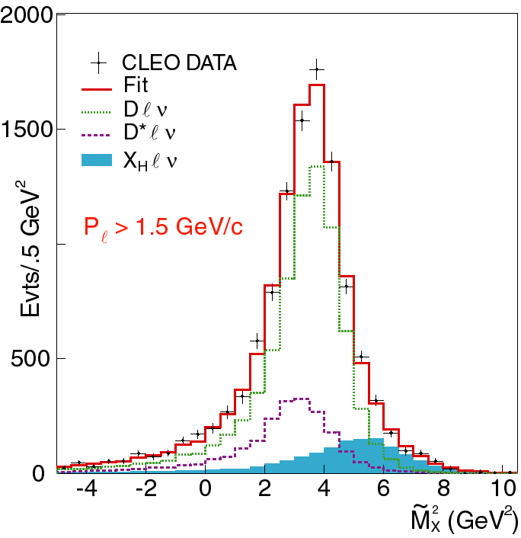
B→ X_{c} lν Hadronic Mass Moments
Lepton (p>1.5 GeV)
ν-reconstruction: p_{ν}
Calculate recoil mass
Fit spectrum w/B→ Dlν, B→ D*lν, B → X_{H}lν (various models for X_{H})
⟨M_{X}² - M_{D}²⟩, M_{D} is spin-averaged D, D* mass
⟨M_{X}²-M_{D}²⟩= 0.287±0.065 GeV²
2nd moment: 0.63 ±0.17 GeV⁴
DATA
Fit
D*lν
Dlν
X_{H}lν
⟨M_{X}² - M_{D}²⟩
Second moments give consistent
results, but still theoretically shaky.
Notes:
Width of the average M_{X} spectrum is from our neglect of the last term and the neutrino energy-momentum resolution (~400 MeV?)
Heavy component includes six D** resonances with decay properties specified by ISGW2 form factors. And also includes non-resonant four body states such as B-> D pi ell nu and are decayed according to model of Goity and Roberts.

Slide 28
CLEO V_{cb} from b→clν, b→sγ
Using
  B(B →X_{c} l ν)=(10.39±0.46)% (CLEO, PRL76 (1570) 1996 )
  τ± = (1.548 ±0.032) psec (PDG)
  τ₀ = (1.653 ±0.028) psec (PDG)
  f₊₋/f₀₀ = 1.04 ± 0.08 (CLEO, hep-ex/0006002)
Γ(b→clν) = ( 0.427 ± 0.020 ) × 10⁻¹⁰ MeV
|V_{cb}|= (40.5 ± 0.9 ± 0.9 ± 0.8) × 10⁻³
(Λ, λ₁ )_{exp}
1/M_{B}³
Γ_{exp}
3.7% total error

Slide 29
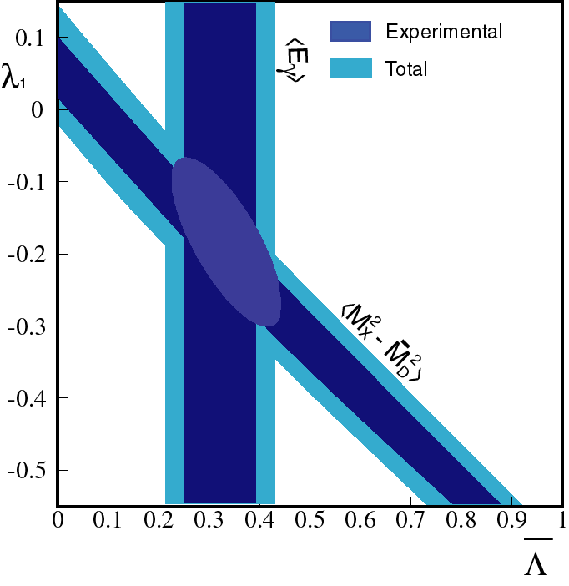
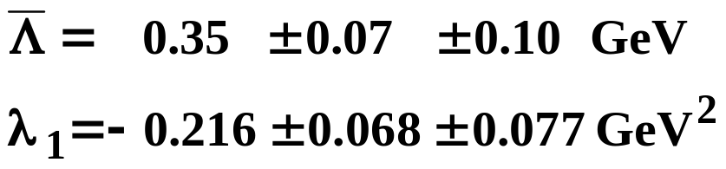
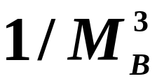
Λ, λ₁ from b→ sγ, B→ X_{c}lν moments
Preliminary
moments

Slide 30
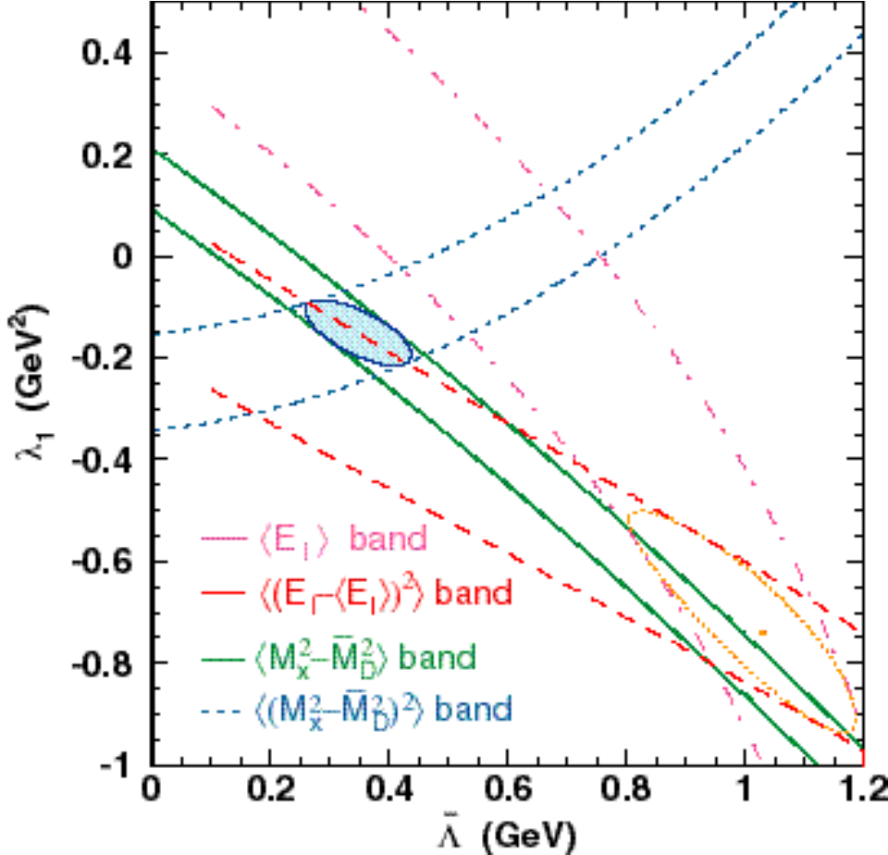
A note of caution
Discrepancy between hadronic mass moments and E_{l} moments
Taking M_{x} estimates only:
  Λ ≡M_{B}-m_{b}(POLE)= 0.33±0.02±0.08 GeV m_{b}=4.97 ±0.10 GeV
  λ₁=-0.13±0.01±0.06 GeV²
CLEO

Slide 31
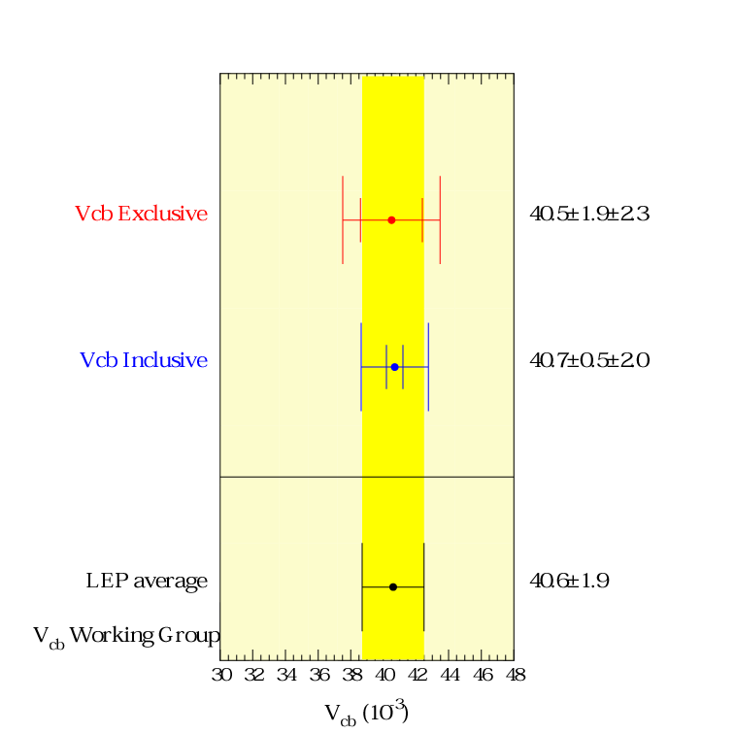
Inclusive b→clν
LEP
CLEO V_{cb} Incl
41±2 ±2
5%? common theoretical error

Slide 32
|V_{cb}| Summary
F(1)=0.88
F(1)=0.913
CLEO Exclusive
46.4±2.4±2.1
CLEO Inclusive
41±2±2
CLEO Moments 2001 Prel.
40.5±1.3 ±0.8
LEP Incl+Excl Avg
Combine at your peril

Slide 33
b→ulν
Similar to b→clν BUT BR(b→ulν ) ~ 2×10⁻³ !
Experimentally: few evts, swamped w/ b→clν
LEP expmts use inclusive analysis
  LEP |V_{ub}| avg has 10% statistical error
  HQE uncertainty (5%) + duality/modeling unc. (12%)
  Systematics from identifying & separating b→u, b→c
  Systematics from non-b→u, non-b→c suppression
CLEO uses “ν-recon.” for B →πlν, ρlν
  Statistical error of 4%
  Form-factor model uncertainty of 17%

Slide 34
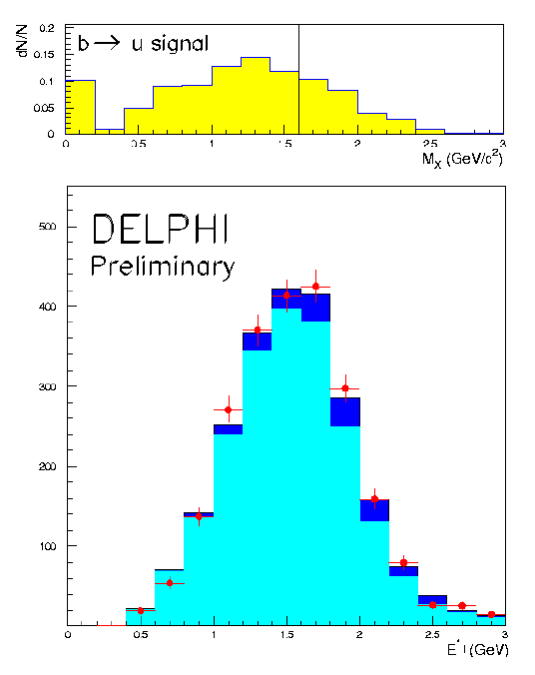
|V_{ub|} from LEP using hadronic mass cut
Analyses of ALEPH, DELPHI & L3
Look for b→u  ν
Use likelihood that hadron tracks come from b decay: vertex info, p_{t}….
Eliminate identified kaons (DELPHI only)
Mass < M_{D} ⇒ b → u →some assumption on M_{u} needed

Slide 35
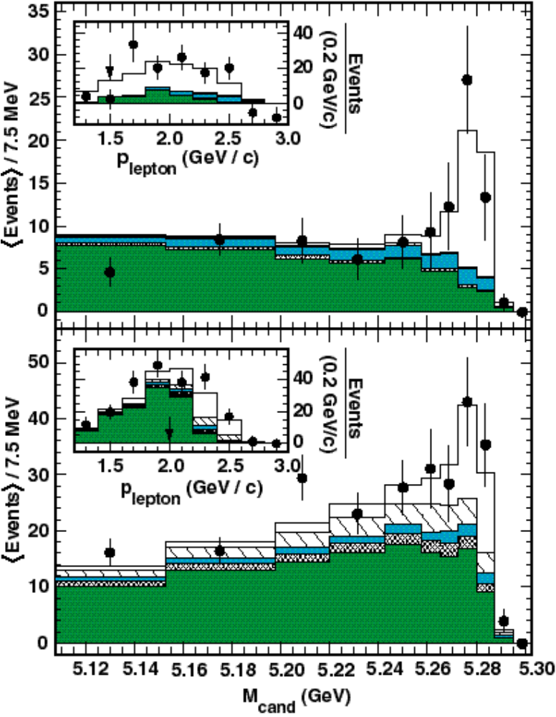
V_{ub} from πν and ρν
π⁺ν + π⁰ν
ρ⁺ν + ρ⁰ν+  ω^{ο}ν
CLEO
b→u backrounds
& cross-feeds
b→c backrounds
b→u backrounds
& cross-feeds

Slide 36
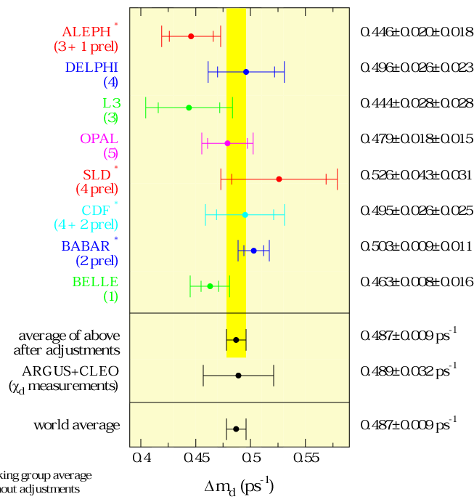
B_{d} Mixing: Δm_{d}
Measured in two ways:
- χ method: t-integrated B⁰B⁰ vs B⁰B⁰; e.g. dileptons
- direct, t-dependent observation of B⁰ ⇔ B⁰ oscillations by flavor tagging as a fcn of decay lengths
2% error
Δm_{d} ≅τ_{B} /3
LEP Working Group
Δm_{d} (ps⁻¹)

Slide 37
B_{s} Mixing
B_{s} too heavy to be produced @ ϒ(4S)
  LEP, SLC, Tevatron
Near maximal mixing observed
  Δm_{s} >>τ unlike B_{d}
  Oscillations not yet definitively seen due to large frequency; hard to measure
  Only get lower limit on Δm_{s}, even when combining all expmts

Slide 38
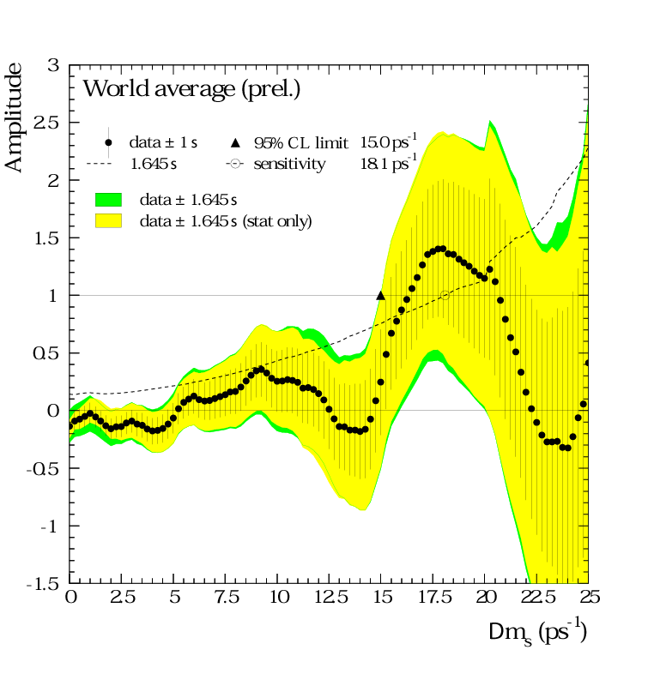
Δm_{s} World Average
LEP B Oscillations
Working Group
Sensitivity to exclude
Amplitude=0 @95%CL
at 18.1 ps⁻¹
1 σ
1.645σ
1.645σ
1.645σ (stat only)
Yes oscillation
No oscillation
Amplitude=1 excluded
@95%CL up to 15 ps⁻¹
Δm_{s} >15 ps⁻¹
Δ
Oscillation frequency

Slide 39
sin 2β
0.34 ± 0.21 BaBar
0.58 ± 0.34 Belle
0.79 ± 0.43 CDF
0.84 ± 0.93 ALEPH
3.2 ± 2.0 OPAL
World Average: 0.48 ± 0.16

Slide 40
sin 2β
0.34 ± 0.21 BaBar
0.58 ± 0.34 Belle
0.79 ± 0.43 CDF
0.84 ± 0.93 ALEPH
3.2 ± 2.0 OPAL
World Average: 0.48 ± 0.16

Slide 41
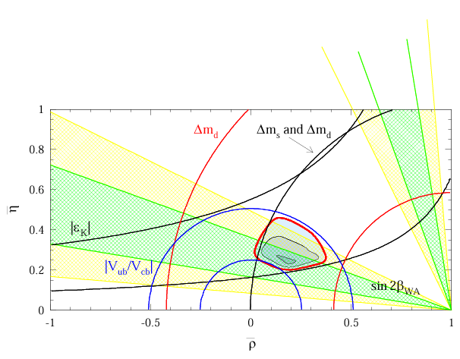
“95% CL” w/sin2β Constraint
From A. Hocker, et al. hep-ph/0104062

Slide 42
A road map to progress
milestones in the experimental program
  large data sets accumulated at e⁺e⁻ b-factories and Tevatron
  large data sets accumulated at dedicated b-experiments at hadron colliders (BTeV-LHCb)
  results from rare K decays
Milestones in theoretical program:
  Precision unquenched lattice gauge calculations available
  Further checks/refinements in HQE/HQET

Slide 43
Milestone I (≈ end of pre-LHC era)
e⁺e⁻ b-factories will have a few hundred fb⁻¹ data sets
  sin2β error down to ±0.05 (500 fb⁻¹)
CDF/D0 will have ~15 fb⁻¹
  Better measurements of sin2β from ψK_{s}
  Plans to measure Δm_{s},
Unquenched lattice calculations of some key parameters with O(few %) accuracy checked by precision charm data (CLEO-c)
Other QCD based effective theories checked to a few % (CLEO, b-factories)

Slide 44
Milestone II (BTeV and LHCb)
Precision studies of B_{d,u}, B_{s}
BTeV projections in 1 year
Precision studied for angles, sides can be studied too
Observable | Precision
sin2β from B→ψK_{s}(ψ →μμ) | ±0.025
α from B→ρπ | < ± 5⁰
γ from B_{s} →D_{s}K | < ± 7⁰
γ from B →DK | < ± 10⁰
γ from B →Kπ | < ± 5⁰(+th error)

Slide 45
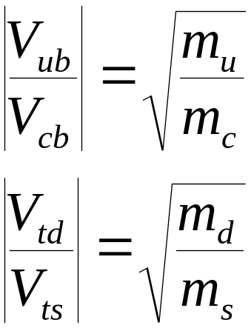
CKM and quark mass hierarchies
Observation: both the quark masses and mixing parameters follow a hierarchical structure → exploring this connection may provide some clues to a dynamical origin of masses (H. Fritzsch)
  investigation of the consequences of specific textures of the mass matrices:

Slide 46
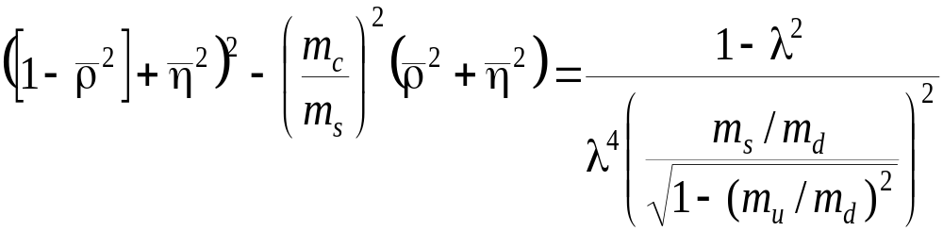
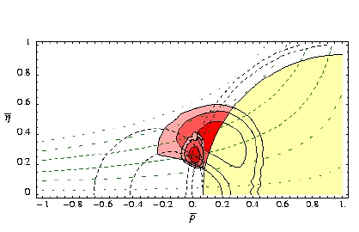
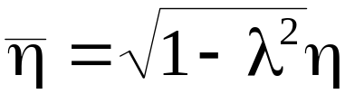
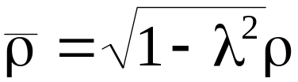
CKM and quark mass textures- an example
origin of flavor via spontaneously broken U(2) symmetry Barbieri,Hall,Romanino

Slide 47

Conclusion: a glimpse at the new millennium
The unitarity triangle will be checked
The mechanism of electroweak symmetry breaking will be unfolded
The mystery of flavour will be unfolded

