Slide 1
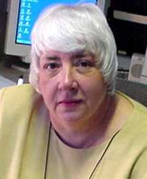
SMALLPOX:
State Planning and Implementation
Nancy Ridley, M.S.
Assistant Commissioner
Massachusetts Department of Public Health

Slide 2
Massachusetts Demographics
Small geography and high density…
6.5 million residents
351 cities and towns (essentially no counties)
76 acute care hospitals (with ERs)
7 Emergency Response Planning Regions

Slide 3
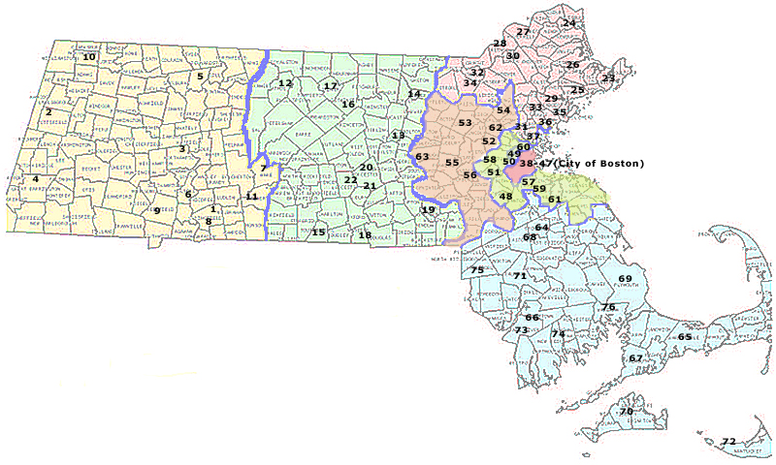
Hospitals by Region
Region 3
Region 4c
Region 1
Region 2
Region 4a
Region 4b
Region 1 West
1 Baystate Health Systems – Springfield
2 Berkshire Medical Center – Pittsfield
3 Cooley Dickinson Hospital – Northampton
4 Fairview Hospital – Great Barrington
5 Franklin Medical Center – Greenfield
6 Holyoke Hospital – Holyoke
7 Mary Lane Hospital – Ware
8 Mercy Medical Center – Springfield
9 Noble Hospital – Westfield
10 North Adams Regional – North Adams
11 Wing Memorial - Palmer
Region 2 Central
12 Athol Memorial Hospital - Athol
13 Clinton Hospital - Clinton
14 Deaconess-Nashoba Hospital - Ayer
15 Harrington Memorial Hospital - Southbridge
16 Health Alliance Hospital - Leominster
17 Heywood Hospital - Gardner
18 Hubbard Regional Hospital -
19 Milford-Whitinsville Hospital - Milford
20 St. Vincent Hospital - Worcester
21 UMass Memorial Medical Center - Worcester
22 UMass University Medical Center - Worcester
Region 5
Region 4c - Boston
38 Beth Israel Deaconess Medical Center
39 Boston Medical Center
40 Brigham and Women’s Hospital
41 Carney Hospital
42 Children’s Hospital
43 Faulkner Hospital
44 Massachusetts General Hospital
45 New England Medical Center
46 St. Elizabeth’s Medical Center
47 West Roxbury VA Hospital
Region 3 Northeast
23 Addison Gilbert Hospital - Gloucester
24 Anna Jaques Hospital - Newburyport
25 Beverly Hospital - Beverly
26 Cable Emergency Center - Ipswich
27 Merrimack Valley Hospital - Haverhill
28 Holy Family Hospital - Methuen
29 Lahey Clinic North - Peabody
30 Lawrence General - Lawrence
31 Lawrence Memorial - Medford
32 Lowell General - Lowell
33 Melrose Wakefield - Melrose
34 Saints Memorial - Lowell
35 Salem/North Shore Children’s Hospital - Salem
36 Union Hospital - Lynn
37 Whidden Memorial Hospital - Everett
Region 4a Metro North
52 Deaconess Waltham Hospital - Waltham
53 Emerson Hospital - Concord
54 Lahey Clinic - Burlington
55 MetroWest Medical Center - Framingham
56 MetroWest Medical Center - Natick
62 Winchester Hospital - Winchester
63 UMass Memorial Marlborough Hospital
Marlborough
Region 4b Metro South
48 Caritas Norwood Hospital - Norwood
49 The Cambridge Hospital - Cambridge
50 Mount Auburn Hospital - Cambridge
51 Deaconess Glover Hospital - Needham
57 Milton Hospital - Milton
58 Newton-Wellesley - Newton
59 Quincy Medical Center - Quincy
60 Somerville Hospital - Somerville
61 South Shore Hospital – Weymouth
Region 5 Southeast
64 Brockton Hospital - Brockton
65 Cape Cod Hospital - Barnstable
66 Charlton Memorial Hospital - Fall River
67 Falmouth Hospital - Falmouth
68 Caritas Good Samaritan - Brockton
69 Jordan Hospital - Plymouth
70 Martha’s Vineyard – Oak Bluffs
71 Morton Hospital - Taunton
72 Nantucket Cottage - Nantucket
73 St. Anne’s Hospital - Fall River
74 St. Luke’s Hospital - New Bedford
75 Sturdy Memorial - Attleborough
76 Tobey Hospital - Wareham
www.state.ma.us/dph/bioterrorism/advisorygrps/pdfs/hospitals_by_region_6_02_2.pdf

Slide 4
Smallpox Planning
Massachusetts
Statewide Smallpox Workgroup
Pre-event plan
  Phase 1A – 7,600 hospital staff
    100 staff X 76 hospitals
  Phase 1B – 2,400 community response team personnel
    16 member teams… Medical, EMS, 1st responders
    150 members X 7 regions to be vaccinated to ensure 24/7 coverage
  Phase 2 (maybe)…

Slide 5
Smallpox: Pre-Event Planning
Massachusetts
Phase 1A and 1B:
Immunization of 10,000 volunteer health care workers, public health workers and first responders
  Previously vaccinated
  Careful screening of volunteers and household contacts for contraindications
  Extensive follow-up for adverse events
  No furloughs…

Slide 6
Smallpox: Pre-Event Planning
Massachusetts (cont.)
Phase 1A and 1B:
State public health response team (DPH staff)
Multidisciplinary teams at 76 hospitals
7 regional response teams
Capacity building
  Public Health nurses
  School nurses
  Visiting Nurse Associations

Slide 7
Smallpox: Pre-Event Planning
Massachusetts (cont.)
Vaccination of DPH staff began February 12th
Phase 1A vaccination (hospitals)
  10-12 weeks
Phase 1B vaccination (response teams)
  12 weeks – completion (<6 months)

Slide 8
Vaccination Process
Hospital Response Teams:
  DPH vaccinates 10 core state public health staff
  50 additional DPH staff, plus Boston and Cambridge health department staff vaccinated
  Once vaccine “takes” confirmed (~ March 1), these 60 vaccinees will begin vaccinating the “vaccinators” in each of the 76 hospitals
Community Response Teams:
  Vendor operated vaccination clinics

Slide 9
Smallpox: Phase 2
Eventual vaccination of all health care workers and first responders
Massachusetts estimate = approximately 120,000 individuals
No official announcement from Federal government
Will be based on lessons learned from Phase 1

Slide 10
Smallpox: Controversial Issues
Liability
Worker compensation (vaccinee, secondary contacts)
Malpractice coverage
Health insurance coverage for side effects
Furloughs
Unions (police, fire, nurses, etc.)

Slide 11
Controversial Issues, cont.
Vaccine safety (Lister v. New York Board of Health strains)
Safety of needles
Municipal v. private first responders
Dissemination of training materials
Sustainability of state bioterrorism initiatives

Slide 12
Pre-Event v. Post-Event Planning
Pre-Event:
  Plan to deal with one suspected case of smallpox in Massachusetts
Post-Event:
  Plan to vaccinate the entire population within 4 days regardless of an actual smallpox case in Massachusetts

