Slide 1

…
Working with Congress Successfully
Debbie Larson
Director
NOAA Office of Legislative Affairs
NOAA Leadership Seminar
Warrenton, Virginia
August 26, 2004

Slide 2
Overview
Why are so many Members and Committees interested in NOAA?
How does NOAA ‘Work the Hill’?
How a NOAA bill becomes law?
Why do we need new NOAA Champions?

Slide 3
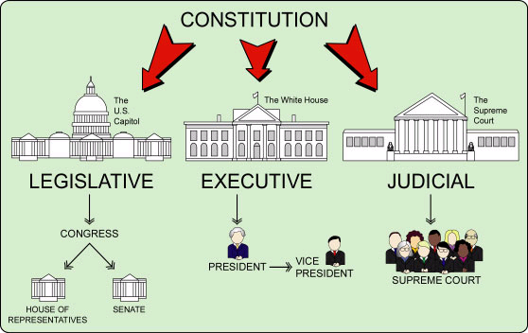
Why do I need to know about the Congress?
The Constitution gives Congress “the power of the purse”
It oversees how the Executive Branch is organized and how it operates
It provides legislative authorities necessary for agencies to carry out their missions
It confirms Executive Branch nominations

Slide 4
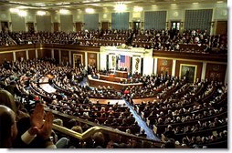
How Congress Works
Majority selects leadership at the beginning of each two-year Congress
Authorization Committees provide legal basis for federal agencies and they monitor program implementation
Appropriations Committees approve funding each fiscal year for federal agencies. Money bills originate in House

Slide 5


NOAA Authorizing Committees
Senate: Commerce, Science, and Transportation
Oceans, Fisheries, and Coast Guard Subcommittee and
Science, Technology, and Space Subcommittee
House: Resources Fisheries Conservation, Wildlife and Oceans Subcommittee
Science Environment, Technology and Standards Subcommittee
Notes:
Under the Senate Commerce Committee there are two subcommittees which authorize NOAA’s programs: The Oceans and Fisheries Subcommittee and the Science, Technology, and Space Subcommittee.

Slide 6
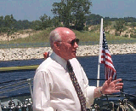
NOAA’s Unique Hill Relationship
Viewed as a
non-political science-
based agency
Intense support from
key leaders
Positive public image—programs touch constituents lives daily
Fisheries regulations causes most controversy and Member concern
Notes:
Rep. Vern Ehlers on a NOAA Corps Ship on Lake Michigan

Slide 7
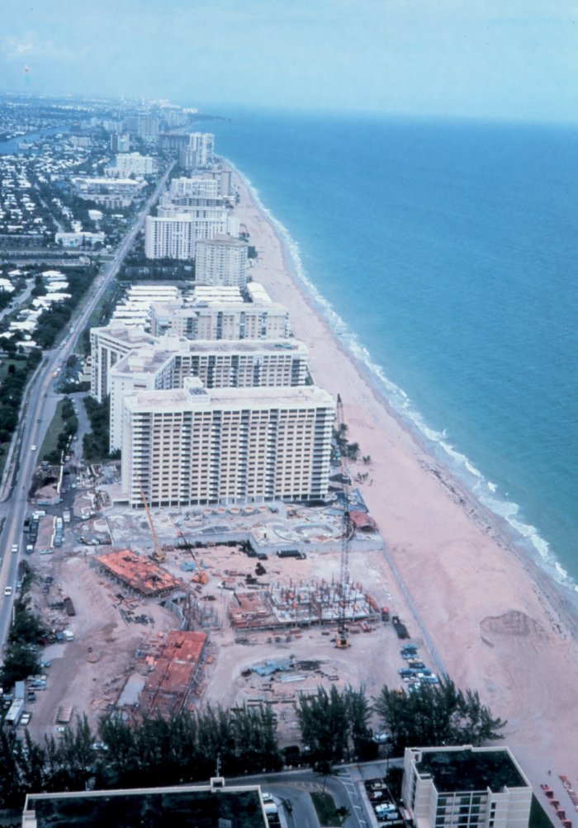

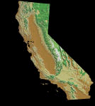
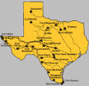
NOAA Benefits from Population Shifts
From 1980 to 2000, 28
new House seats have been
created in Coastal states
because of the in-migration
to the coasts
Most significant gains has been in States with major NOAA programs:
+7 +8 +5

Slide 8
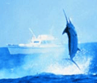
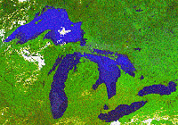
Hill Interest in Oceans Intense
Large number of NOAA-related Caucuses:
--Oceans
--Sportsmen’s
--Long Island
--Coastal
--Northeast-Midwest Coalition

Slide 9
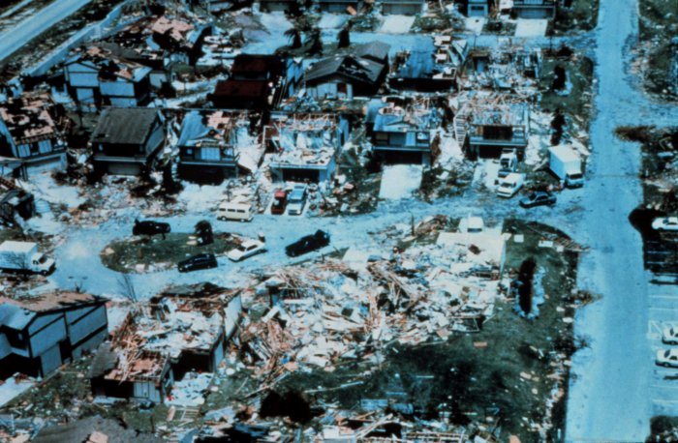
Hill interest in Weather
NOAA Weather has also
benefited from move to
the Coasts
Greater concern for
Atlantic hurricanes
especially with dense South Florida population growth
Persistent wildfires caused by endemic drought in the West threaten new housing

Slide 10
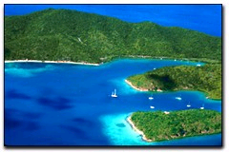
NOAA’s unique relationship with non-voting Delegates
        +NOAA has also benefited
        from the creation of non-voting
        delegates and one Resident
Commissioner
+Under House Rules, the
Delegates can serve on
Committees, including being
Chair or Ranking Minority Members, and speak on the House floor
They are from Guam, American Samoa, Puerto Rico and the U.S. Virgin Islands—all ocean dependent islands

Slide 11
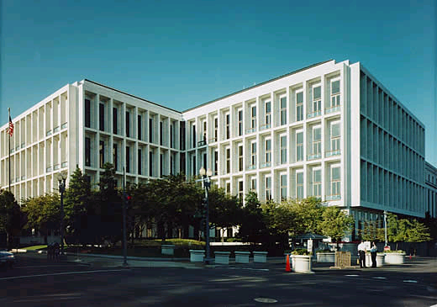

How Does Legislative Affairs Work
Pro-active 24/7/365
Anticipate Member needs
Communicate, communicate, communicate
Respond promptly, if not sooner
Get them into the field
Notes:
Hart Senate Office Building

Slide 12
Organizational Chart
Director
Debbie Larson
Deputy Director
Brook Davis
Special Assistant
Howard Marks
Special Projects
Luke Nachbar
Oeans Team
Jennifer LeBarre
April Roberts
Diana Martinez-Fonts
Fisheries Team
Stewart Harris
Mike Francisco
Noel Turner
Lauren Batte
Kevin Allexon
Atmospheric
Team
Craig Montesano
Scott Carter
Legislative Team
Georgia McCarroll
Neal O’Hara

Slide 13

Office Functions
Hearing coordination:
Selecting witnesses
Managing testimony drafting
Briefing witnesses
Responding to post-hearing questions
Reviewing hearing transcripts

Slide 14
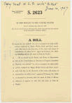
LA Office Functions (cont.)
Legislative coordination:
Drafting Assistance
Monitoring bill and amendment introductions
Maintaining communication with bill sponsors
Coordinating Views Letters, Statement of Administration Policy and unofficial views

Slide 15
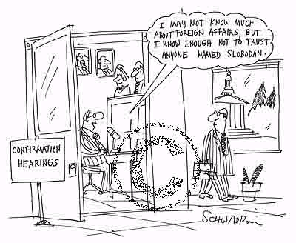
LA Office Functions (cont.)
Senate confirmations:
Arrange nominee appointments with key Members and Staff
Brief nominee on hearing process and possible questions
Coordinate statement preparation
Provide post-hearing information requested by Committee
Notes:
Slobodan Milosevic, former President of Yugoslavia, now being tried as a war criminal

Slide 16

LA Office Functions (cont.)
Communications:
Initiate meetings and briefings with Members and Staff
Respond promptly to Congressional inquiries
Introduce key staff to NOAA through meetings, site visits and written materials
Maintain website
Keep Department and NOAA leadership informed through written and oral reports

Slide 17
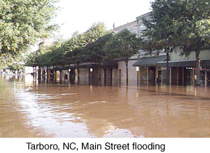
How a NOAA Bill Becomes Law
1. Rep. Bob Etheridge (D-NC)
drops H.R. 2486, authorizing
NOAA to improve inland flooding
forecasts on 7/12/01.
2. The House Science Environment, Technology,
and Standards Subcommittee holds hearing on
10/11/01. National Weather Service S&T Director
Jack Hayes and Research Meteorologist Chris
Landsea testify for NOAA.

Slide 18

How a NOAA Bill Becomes Law (Cont.)
3. Subcommittee marks up bill on 12/12/01. Full
Science Committee marks up bill on 5/22/02
and reports (approves) it with an amendment.
4. The Committee issues a written report on 6/5/02
and the bill is placed on the House calendar.
5. The House Rules Committee on 7/9/01 reports a
resolution authorizing the bill to the go to the floor.
6. The House first adopts the debating resolution
and goes to the bill. Debate begins and Rep. Sheila
Jackson-Lee (D-TX) amendment is adopted by voice
vote. The bill passes 413-3.

Slide 19

How a NOAA Bill Becomes Law (Cont.)
7. The bill goes to the Senate
where it is referred to the
Commerce Committee. There are no
hearings held on the bill.
8. On 9/19/02 the bill is reported favorably to
the floor.
9. The bill clears the Senate by Unanimous
Consent without amendment.
10. President Bush signs the bill into law on 10/29/02.

Slide 20
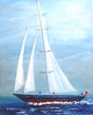
Fair Sailing, Friends
NOAA is losing some of its
most reliable and steadfast
supporters who are retiring
at the end of the 108th
Congress.
Others will be required to move on to new Committee leadership assignments due to rules set by the Republican Caucus.

Slide 21
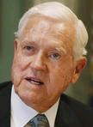
Sen. Ernest Hollings (D-SC)
Sen. Ernest Hollings is the Ranking Democrat on the Senate Commerce Committee and Ranking Democrat on Commerce-Justice-State Appropriations Committee. He supported the recommendations of the Stratton Commission to create NOAA soon after sworn in in 1966. Through the years, he has stood by NOAA’s side. He is the author of the Coastal Zone Management Act, Marine Mammal Protection Act, Coastal and Estuarine Land Protection Act, Authored the Oceans Act of 2000, which created the U.S. Commission on Ocean Policy. He has tirelessly fought to find NOAA programs when faced with reductions and opposed Congressional efforts to dismantle the agency.

Slide 22
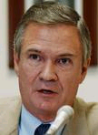
Sen. John Breaux (D-LA)
Sen. Breaux has been a member of the Senate since 1987. He currently serves as Ranking Democrat on the Science, Technology, and Space Subcommittee of the Commerce Committee. He also serves on the Oceans and Fisheries Subcommittee. In 1990, he authored landmark legislation resulting in more than $50 million annually to preserve America's wetlands. This has especially benefited Louisiana. The Act is named in his honor

Slide 23
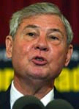
Sen. Bob Graham (D-FL)
Sen. Graham began his Senate service in 1987. Previously, he was governor of Florida. He is Ranking Democrat on the Fisheries, Wildlife, and Water Subcommittee of the Energy and Natural Resources Subcommittee. He authored legislation to create the Florida Key National Marine Sanctuary. He has fought for legislation to preserve the Everglades.

Slide 24
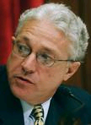
Rep. Jim Greenwood (R-PA)
A Member since 1993, he represents suburban Philadelphia. He is a founder and co-chair of the House Oceans Caucus, even though his district is 70 miles from the Atlantic Coast. While in the Pennsylvania General Assembly he specialized in environmental issues.
Notes:
A

Slide 25
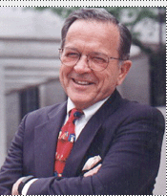
Sen. Ted Stevens (R-AK)
As chair of the Senate Appropriations Committee, Sen. Stevens has worked hard to gain full funding for NOAA. Under the rules of the Senate Republican Conference, he must relinquish his chairmanship of the Appropriations Committee. If the Republicans retain control of the Senate, he will becomes the Chair of the Commerce Committee, where he will still have enormous influence over NOAA policies.

Slide 26



What can we do?

Slide 27

NOAA Champions
Our office has developed a
detailed plan to bring up
new talent from our farm
team in the House and
Senate
We have identified about a dozen Members who are promising prospects
We have already begun to work with their staffs to bring them up to the majors

Slide 28
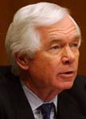
Sen. Thad Cochran (R-MS)
In the 109th Congress, Sen. Cochran will either be the chairman or the Ranking Minority Member on the Senate Appropriations Committee. He will be replacing Sen. Stevens who must leave the Appropriations Committee. Mississippi is a natural because of its Gulf Coast and many NOAA facilities.

Slide 29

Sen. Daniel Inouye (D-HI)
In the 109th Congress, Sen. Inouye will either be the chairman or the Ranking Minority Member on the Senate Commerce Committee. He will remain the second most senior Democrat on Appropriations Committee. He has always been a friend of NOAA and its predecessor agencies during his Senate career, which began in 1963.

Slide 30
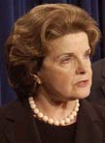
Sen. Dianne Feinstein (D-CA)
Sen. Feinstein is a member of the Appropriations Committee. She joined the Senate in 1993. Previously, she was Mayor of San Francisco. The Bay Area is home to numerous NOAA Sanctuaries.

Slide 31
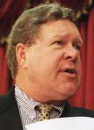
Rep. Norm Dicks (D-WA)
Rep. Norm Dicks (D-WA) is a member of the Appropriations Committee has been active in efforts save endangered or threatened Northwest Pacific Salmon. His district includes parts of Puget Sound and the Strait of Juan de Fuca. He formerly worked for former Sen. Warren Magnuson (D-WA), who authorized Magnuson Fishery Conservation and Management Act, now called the Magnuson-Stevens Act.

Slide 32

Rep. Mark Kirk (R-IL)
Rep. Kirk is a member of the Commerce-Justice-State Appropriations Subcommittee, which funds NOAA. He is a former U.S. Senate staffer. He represents Chicago’s North Shore suburbs, which border Lake Michigan shoreline. Besides Great Lakes pollution, he is interested in the preservation of coral reefs.

Slide 33

The 2004 Elections
Regardless of who wins these
issues will have to be
addressed:
How will the recommendations
of the Oceans
Commission be implemented?
Will other federal ocean programs be transferred to NOAA?
Will NOAA finally have an Organic Act?

Slide 34


The 2004 Elections (Cont.)
Control of the Senate is “in play” with a shift of only two seats changing control
Regardless of the outcome of the election, NOAA is in good shape because of the tradition of bipartisan support
With 23 years under Republican Administrations and 12 years under Democratic Administrations NOAA has been led almost always by a scientist.

