Slide 1
Securing Environmental Outcomes
Adding Environmental Performance
to Performance-Based Service Contracts
Heather Davies
Office of Environmental Policy and Compliance
U.S. Department of the Interior
(202) 208-7884 heather_davies@ios.doi.gov

Slide 2
Presentation Overview
Why include environmental performance outcomes in your contract
Legal mandates
Case Study: DOI Custodial Cleaning Contract
Resources to help you secure environmental outcomes through your service contracts

Slide 3
Greening the Department of the Interior
Vision Statement
The Department will be an innovative leader in “greening” the Federal government by actively and systematically protecting the natural processes that sustain life on earth.
To fulfill this vision, Interior will, in its own operations, minimize solid waste, prevent pollution, save energy and other resources, reduce greenhouse gas emissions, and encourage public support and participation.

Slide 4
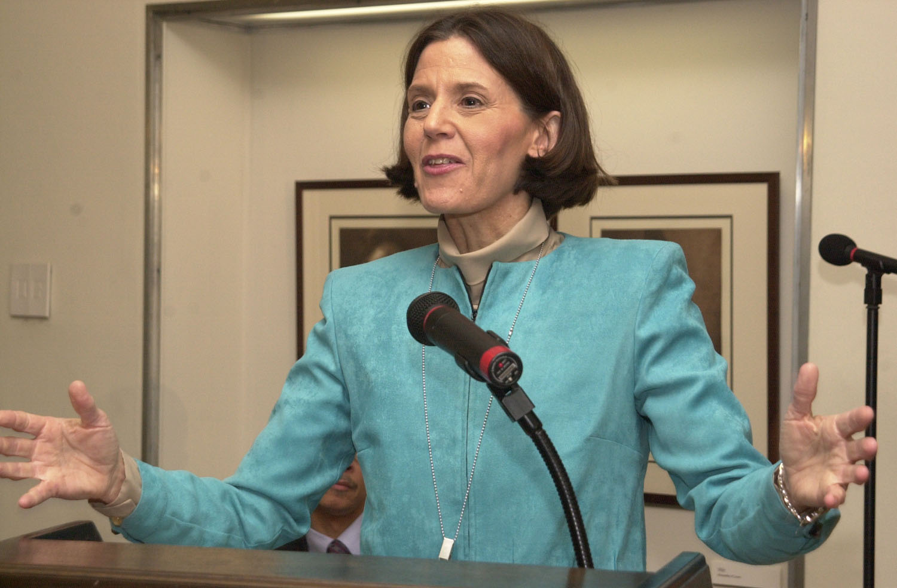
I like to mention what I call the “virdian verge.” “Virdian” for green and “verge” to emphasize a “coming together.” We are increasingly seeing a coming together of environmental and economic goals.”
P. Lynn Scarlett, Ast. Sec. - Policy Management and Budget

Slide 5
Why changes your contact to secure environmental outcomes?
Worker health concerns
Costs of worker injuries
Environmental liabilities
Improved Indoor Air Quality
Leadership opportunity
Federal mandates
Because there are safer, cost-effective alternatives

Slide 6

Greening Statutes and
Executive Orders
EO 12843
Ozone
Depleting
Substances
EO 13101
Waste Prevention,
Recycling
Federal Acquisition
EO 12902
Energy Efficiency
and
Water Conservation
EO 12845
Energy Efficient
Computers
EO 13148 –
Environmental Leadership
EO 12669
Community
Right-to-Know
EO 12856
Pollution Prevention
Comprehensive Procurement Guideline (40 CFR 270)
Resource Conservation and Recovery Act (RCRA) Sec. 6002
2002 Farm Bill
Sec. 9002

Slide 7
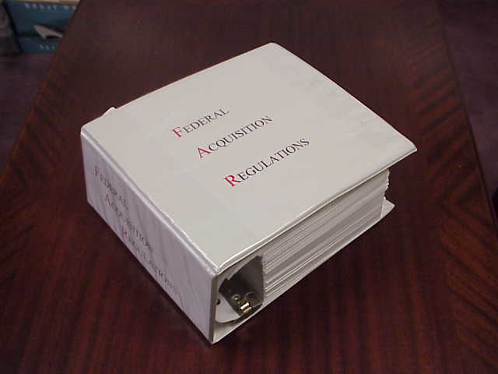
Federal Acquisition Regulations
Green Procurement Revisions Published June 6, 2000
Ongoing revisions to accommodate new Greening the Government EOs.
Part 7 - Acquisition Planning
Part 11 - Defining Agency Needs
Part 13 - Simplified Acquisition Procedures
Part 23 - Environment, Conservation …
Part 52 - Solicitation Provisions and Clauses

Slide 8
FAR Subpart 23.703 -
Contracting for Environmentally Preferable and Energy-efficient Products and Services
“Agencies must:
(a) Implement cost-effective contracting preference programs favoring the acquisition of environmentally preferable and energy efficient products and services; and
(b) Employ acquisition strategies that affirmatively implement the following environmental objectives:
------->

Slide 9
FAR 23.703
Environmental Considerations
Maximize the use of environmentally preferable products and services;
Maximize the use of energy-efficient products;
Eliminate or reduce the generation of hazardous waste…;
Promote the use of non-hazardous and recovered materials;
Realize life-cycle cost savings;
Promote cost effective waste reduction…;
Consider use of biobased products.

Slide 10

Environmentally Preferable Services?
Services that use environmentally preferable products and/or practices
  Custodial Services
  Operation and Maintenance
  Landscaping and Land Management
  Concessioner Operations
  Waste Removal
  Construction and Demolition/Remodeling

Slide 11
Ways to Secure Outcomes
Environmental performance requirements in SOW
Environmental submittals in response to solicitation
Source selection factors include environmental performance criteria
Incentives to provide green products/services (award fee)

Slide 12
Scoping the Desired Environmental Outcomes
What products and waste generating activities are associated with this service?
Do third-party environmental standards exist for these products or activities?
Which federal mandates are relevant?
How does my facility’s Environmental Management System relate to this service contract?

Slide 13
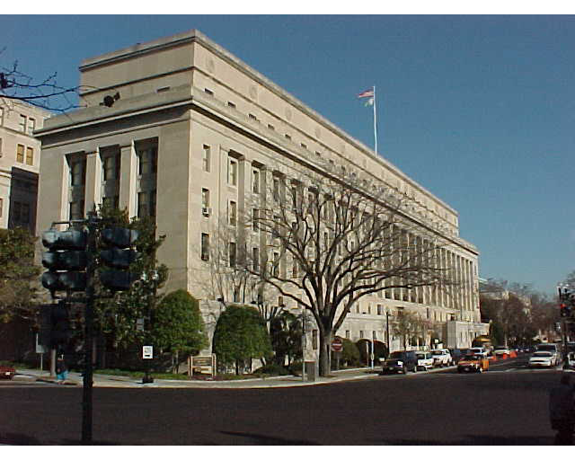
Main Interior Building

Slide 14
Scope of Custodial Services
1 year contract, 4 1-year options
Gross area: 1,423,745 s.f.
Occupant population: 2,936
Products:
  Chemical cleaners, cleaning equipment, bathroom products
Services:
  daily cleaning, floors maintenance, trash removal and recycling, exterior windows (annually), venetian blinds (annually), elevator services, snow removal

Slide 15
Process Followed
Initial Request: 11/98
Team Formed/Objectives Defined: 11/98
Research 12/98
Selection of Attributes: 1/99
Solicitation Issued: 2/99
Proposals Received: 4/99
Award: 7/99

Slide 16

Who Was Involved?
Contract Team Consisted of:
  Facilities Management
  Solicitor’s Office
  Procurement Policy Office
  Environmental Policy Office
  NPS Environmental Management
  U.S. EPA Exposure Assessment Branch

Slide 17
Worker Health Concerns
An average of 58.2 lbs. of chemical cleaning products are used per janitor per year
6% of cleaners should be avoided because of serious health/environmental threats and 35% of cleaners require extreme care

Slide 18
Worker Injuries
Acute:
  Blindness
  Skin damage
  Lung damage
Longer term:
  Damage to fetus
  Hormone modification
  Cancer
  Organ damage
Chronic :
- Chemical dermatitis
- Chemical-induced asthma
- Chemical sensitivities

Slide 19
Cost of Worker Injuries
6 of 100 employees have loss time
Average cost of $725 per claim
From analysis of worker comp claims in Washington State
Tom Barron

Slide 20
Environmental Threats
Aquatic toxicity
Persistent, Bioaccumulative and Toxic Compounds
Eutrophication
Disruption to POTW
Endocrine Disruption
Smog precursors
Ozone depleters
Non-renewable resources

Slide 21
Indoor Air QUALITY
Reduced complaints
Lower health concerns
Improved employee productivity

Slide 22
Leadership Opportunity
Get Certified by the
U.S. Green Building Council
  Leadership in Energy and Environmental Design for Existing Buildings (LEED EB)
  Green housekeeping credits

Slide 23
Cleaning Contract Goals
Use the least aggressive, safest product that is effective for the cleaning task
Use products with biobased content when possible
Maximize use of recycled content products
Maximize occupant recycling and building diversion rates
Support Green Building Certification

Slide 24
What had been done before?
What did we want to do?
Research into Available Standards:
  City of Santa Monica, Yellowstone NP
  EPA/GSA Custodial Pilot
  Green Seal Paper and Household Cleaner Standards
Decisions Regarding Scope of Environmental Requirements, Attribute Selection - Three parts:
  Chemical cleaning products,
  Recycled content products
  Recycling enhancement strategies

Slide 25
Green Seal Standard Criteria
Overall toxicity
Carcinogenic/ reproductive toxicity
Skin/eye irritant
Sensitization
Combustaibility
Photochemical smog/ozone/IAQ
Aquatic toxicity
Aquatic biodegradability
Eutrophication
Packaging
Concentrates
Fragrances
Prohibited Ingredients
Training
Animal testing

Slide 26
PAPER and
Non-Chemical Products
Bathroom tissue*
  20-60% PCW
Paper towels*
  40-60% PCW
Facial tissue
  10-15% PCW
Industrial wipers*
  40% PCW
Toilet seat covers
Plastic trash bags*
  10 – 100%
Recycling containers*
  20- 100% PCW, plastic
Janitorial carts
Plastic mop buckets
* Comprehensive Procurement Guideline item

Slide 27
Enhanced Recycling Strategies
Procedures for monitoring waste/recycling volume
Procedures for monitoring rates of participation in recycling program
Procedures for promoting building occupant participation/avoid contamination
Measures to ensure contractor observance of program

Slide 28
How Contract Was Modified
Incorporation into Solicitation and Specifications
  Section C - Scope of Service
  Section L - Instructions to Offerors
  Section M - Evaluation Factors for Award
  Attachments
Evaluation Plan: Environmental Preferability Given 1/3 of Total Rating
Two Panels: Technical Evaluation Panel and Environmental

Slide 29
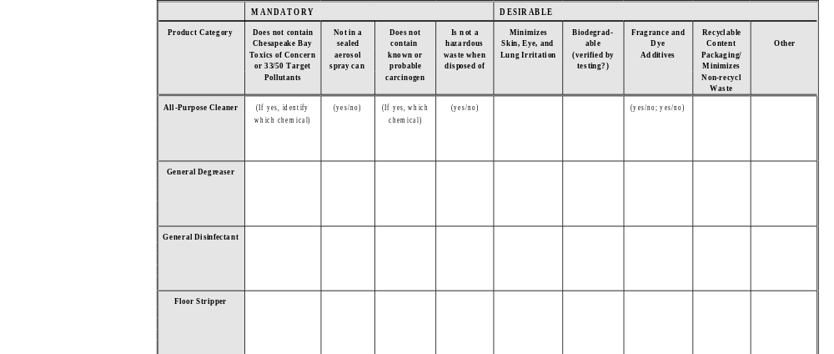
Cleaning Chemical Characteristics

Slide 30
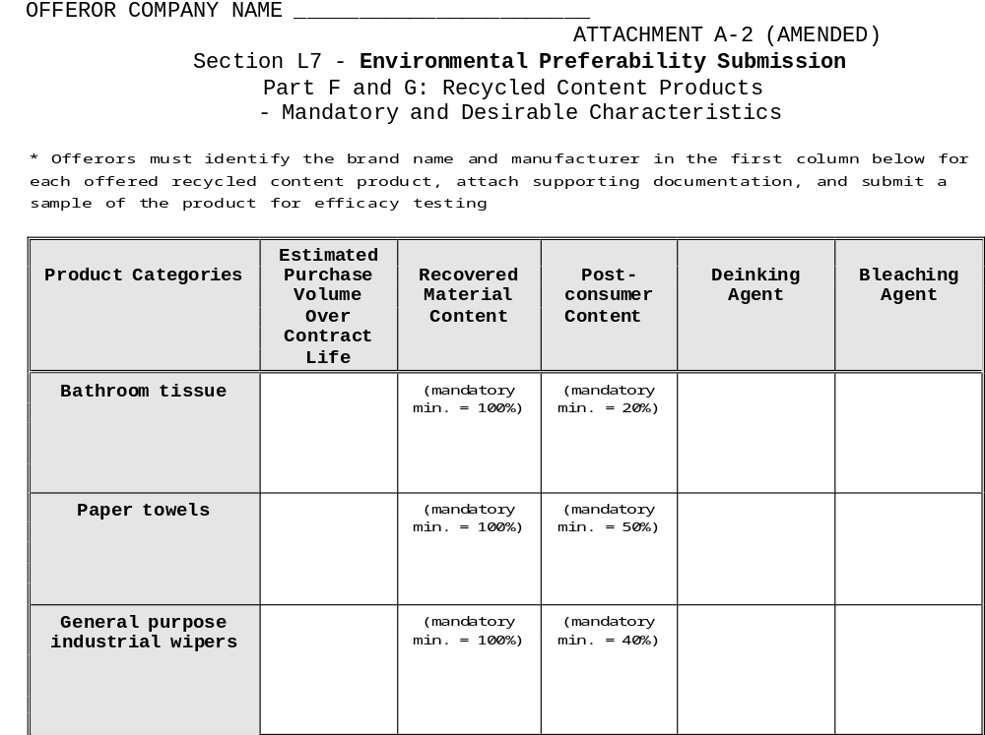
Recycled Content Products

Slide 31
Section M - Source Selection
30% Environmental
“ Completeness and thoroughness of submittal addressing environmental preferability/recycled content products and strategies for execution of a successful waste reduction/recycling program”
Experience - 15%
(partially assigned to environmental)

Slide 32
How Well Did It Work?
A Lot of Questions at PreBid
19 Offers (Roughly Half Understood Environmental Submittal)
Competitive Range: A Handful of Really Good Submitals
Best Value Selected: Best Environmental, Best Technical, Lowest Price of Competitive Range

Slide 33
Update: Summer 2003
Chimes, a NISH affiliated work center, working since starting 9/01
Chimes has now converted almost all of their sites in the DC Metro Area
Over 20 million s.f. of federal office space cleaned with certified cleaners
Improving indoor air quality for 90,000 federal office workers and workplace safety for 1,400 disabled workers!!!!

Slide 34
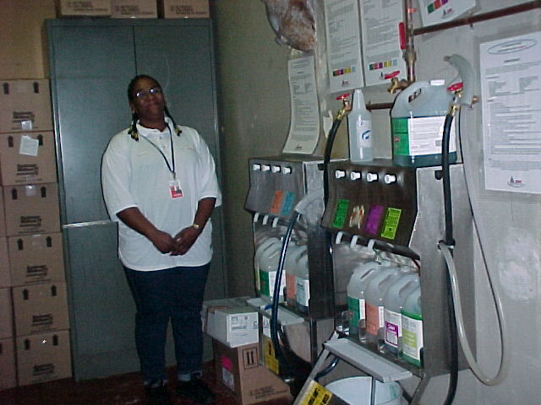
Chemical Portioner

Slide 35
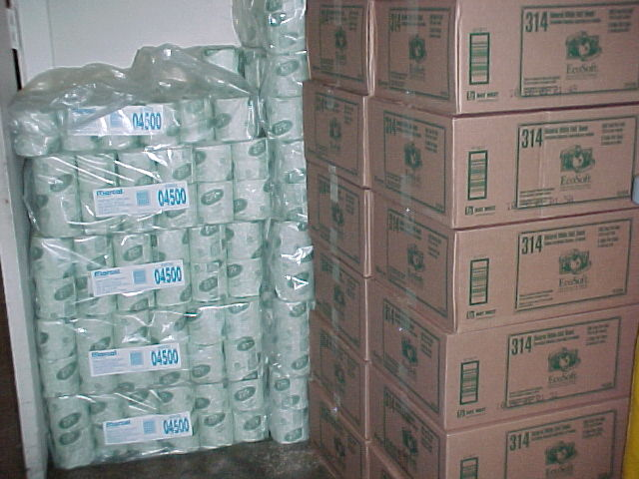
Environmentally preferable tissue

Slide 36
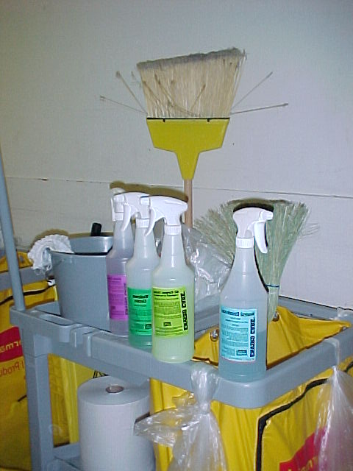
RTU Solution Bottles

Slide 37
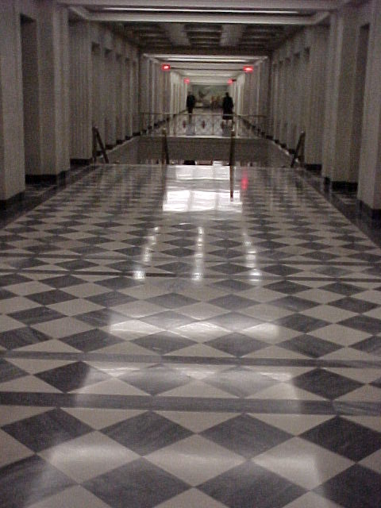
Our “Fish-Friendly Floors”

Slide 38
Cleaning Contract Resources
DOI/NISH Guidance
  http://greeninginterior.doi.gov/sustain/clean.html
Check list for Assessing Baseline Conditions
Transition Planning Suggestions
ASTM Standard E 1971 – Stewardship for the Cleaning of Commercial and Institutional Buildings
Green Seal Standards
DOI Custodial Contract Language

Slide 39
JWOD Certified Green Cleaners
St. Louis Lighthouse for the Blind
- Rochester Midland
http://www.lhbindustries.com/ click on enviro cleaners
Blind Industries and Services of Maryland
– Envirox and 3M Twist & Fill

Slide 40
Other Resources to Get Started
EPA's Comprehensive Procurement Guidelines
for Federal Agency Purchase of Recycled Content Products www.epa.gov/cpg
EPA's Environmentally Preferable Purchasing Program
www.epa.gov/oppt/epp
USDA Biobased Products
http://www.usda-biobasedproducts.net/
Office of the Federal Environmental Executive (OFEE)
  www.ofee.gov

