Slide 1
Putting the “Emergency” Back into “Emergency Public Information”
Phil Taylor (Los Alamos County),
Elmer Torres (LANL) and Vanessa De La Cruz (LANL)

Slide 2
Relationship/Infrastructure/Communication
Government-to-Government relations are maintained between LANL and 22 American Indian Tribal Governments in New Mexico.
  The 22 tribal governments are recognized by the Federal Government as sovereign Indian Tribes.
Daily communication and interaction occurs between the tribal governments, staff and environment departments.
  Interactions involve environmental issues such as:
    health, safety and cultural site preservation,
  Other interactions include issues such as:
    employment, economic development and business initiatives.

Slide 3
Relationship/Communications Link
These are the guiding principles used in the communications link:
  The DOE American Indian Policy and the American Indian Religious Freedom Act
  President Clinton’s White House Memorandum (April 29, 1994), on “ Government-to-Government Relations with Native American Tribal Governments.”
  DOE Secretary of Energy Hazel O’Leary’s Memorandum (May 18, 1994), on implementation of the principles of the White House Memorandum
  Executive Order 13007-Indian Sacred Sites
  Executive Order 13175-Consultation and Coordination with Indian Tribal Governments(2000)
  President George W. Bush Memorandum (September 23, 2004) for the Heads of Executive Department Agencies, Government-to-Government Relationship with Tribal Governments

Slide 4
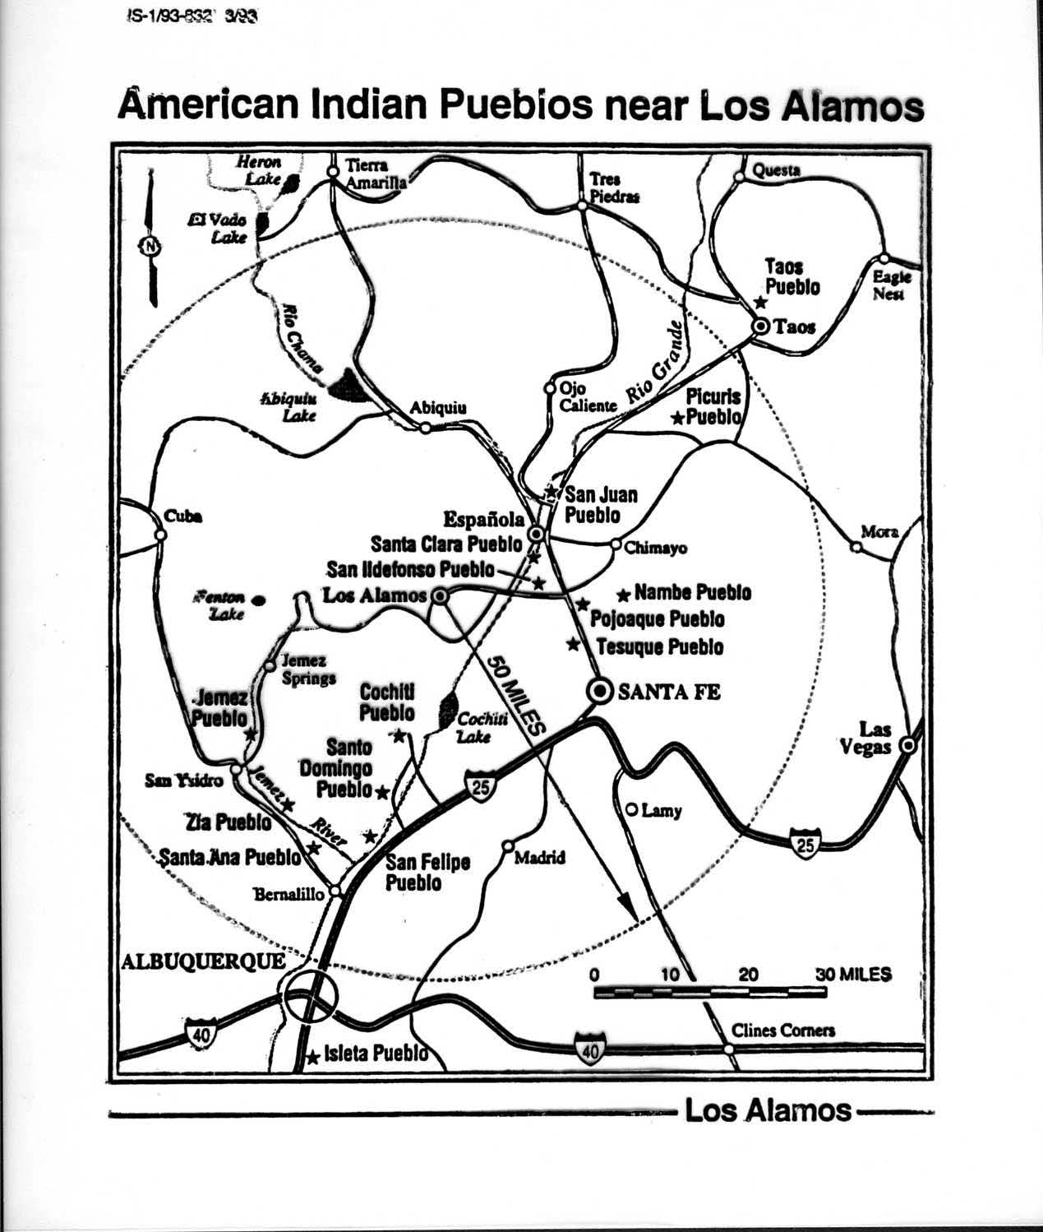
Area Map of Surrounding Pueblos

Slide 5
What are the Accord Agreements?
The Accords, signed in 1992 between DOE Headquarters and the Pueblos of Cochiti, San Ildefonso, Jemez and Santa Clara, do the following:
      affirm sovereignty and the trust relationship
      improve communications
      provide a framework for Government-to-Government relationship
      Provide DOE consultation regarding cultural, religious and environmental resources

Slide 6
What are the Cooperative Agreements?
The Cooperative Agreements, signed in 1994 with the Pueblos of Cochiti, Jemez and San Ildefonso, and in 1996 with Santa Clara, do the following:
-Affirm the trust relationship/duty as contractor
-Improve communications, information and
data sharing
-Further develop the long-term working relationship
-Assist Pueblos through Technical Assistance to
      evaluate environmental and cultural resources
      establish mechanism for meaningful participation in on-going and new Laboratory activities and
      establish mechanism to inform each other in a proactive and timely manner
Notes:
Reaffirmed in 1997 by Director Browne and in 2003 by Director Nanos

Slide 7
Emergency Communication Protocol
Signed between LANL and Pueblos of San Ildefonso, Santa Clara, Jemez and Cochiti
Provides Communication Protocol between Pueblos and LANL for emergency notifications
Identifies contact personnel and telephone numbers 24/7 for Pueblos and LANL, updated annually.
Identifies incident type that activates notification process, whether on Pueblo lands or LANL property
Agreement reviewed annually and remains in effect until terminated in writing by either party.
Coordinated participation in annual LANL Emergency Exercise.

