Slide 1


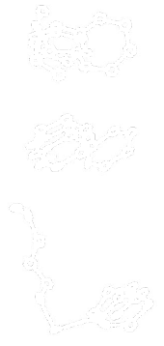

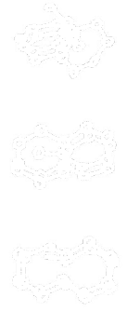
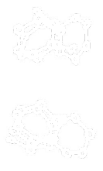
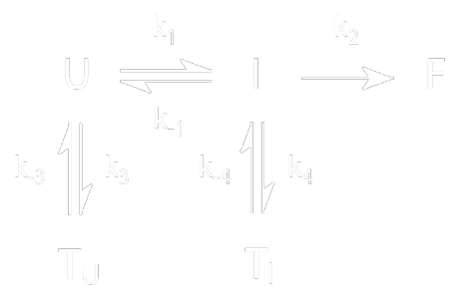
Simulations of polyphenylacetylene (PPA) “foldamers”
Vijay S. Pande
Stanford University MRSEC, DMR-0213618
What are PPA “foldamers”
  nonbiological polymers that fold
  model systems for self-assembling nano structures
  challenge for simulation: long timescale and complex dynamics
New results
  longer chains considerably are more complex: multiple traps and remarkable complexity
  new methods used to predicted long timescale behavior: Markovian model and Folding@Home grid computing
  Folding@Home: a new paradigm of combined research and outreach
F
I
U
T_{I}
T_{U}
Work performed by Sidney Elmer, CPIMA supported graduate student

