Slide 1

Division of Business Office Enhancements
>You Are The Essential Piece<

Slide 2

<<<Partnership Themes>>>
“Preparing for Challenges in Third Party Claims Processing, 1999”
“Building the Foundation, 2000”
“Together Everybody Achieves More,2001”
Strengthening our Partnership for Healthier Indian Communities, 2002
“Partners for Compliance, 2003”
“Bring the Partners Together, 2004”
“Planning Solutions to Improve Business Process, 2005”
“101 Management Meeting/Training “Raising Health Status by Effective and Efficient Third Party Revenue Management, 2003” & CEO/BOM in 200
Notes:
How many in the very first one in OK….
Denver
Nashville….
Reno
Scottsdale
Reno

Slide 3
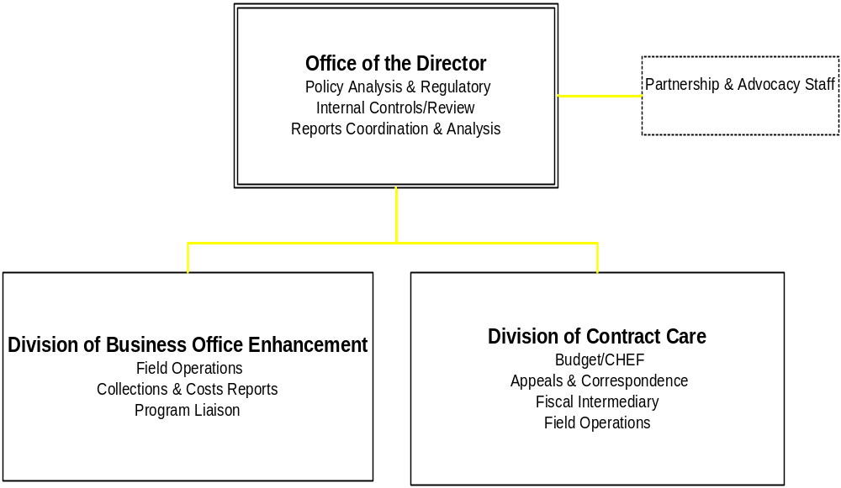
OFFICE OF RESOURCE ACCESS AND PARTNERSHIPS

Slide 4
DBOE STAFF
Elmer Brewster
Sandra Lahi
Balerma Burgess
John Rael
Kris Kirk
Leah Tom and Roland Todacheenie, Chair and Vice Chair of NBOC
Support Staff, Gerald Moses, Tina Connors, Sharon Sorrel, DLR and BOC
Notes:
names so you can ask them questions---they area very smart and have many years of experience…so please use them and while they are here ask them questions and give them your card…and also tap other BOC from some of the Areas….that is what I do frequently because they are much smarter then I about the 15 steps in the revenue cycle

Slide 5
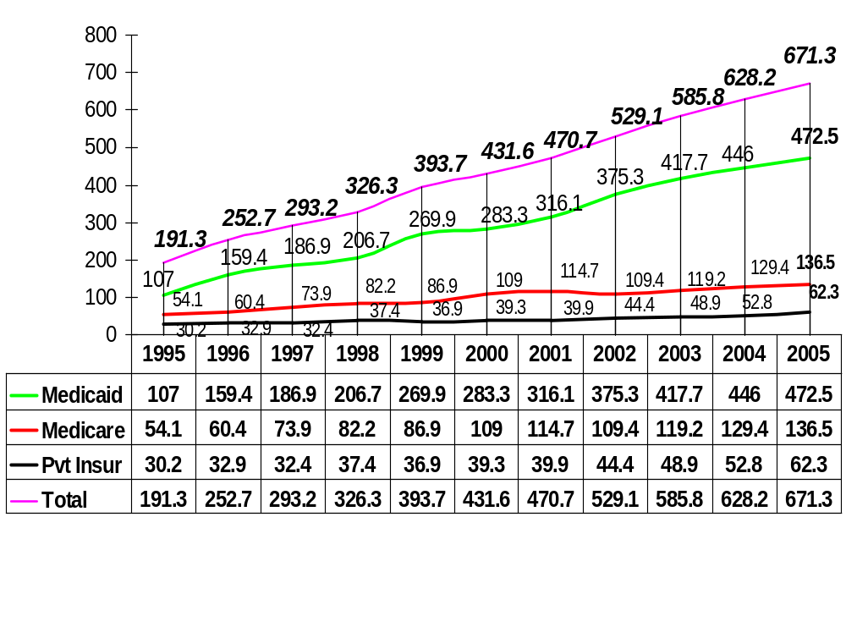
IHS Total Collections by Major Payer 1995-2005
Notes:
Includes Tribal projections, accept PI….Clearly Medicaid largest payer….the total is $671.3 million which represent about 30-60% of hospital and clinic facilities operating budgets.
Overall, the collection percent increase on the average for the first five years of this decade was 18%--this was due to major increases in rates and changes in business practices. The Second 5 years the rate of increase was 9-10%. Given minor rate increases, collections have been consistently greater then the rate increases due to business process changes ie. Enrollment in M & M, better documentation coding and timely data entry, updated fee schedules, accurate billing and improved accounts receivable management.
The past 2 years about 7 and 8%. What will be the average the next 5 years…..can we expect big increase as in the past?
The next slide identifies the major impacts on our collections---.

Slide 6
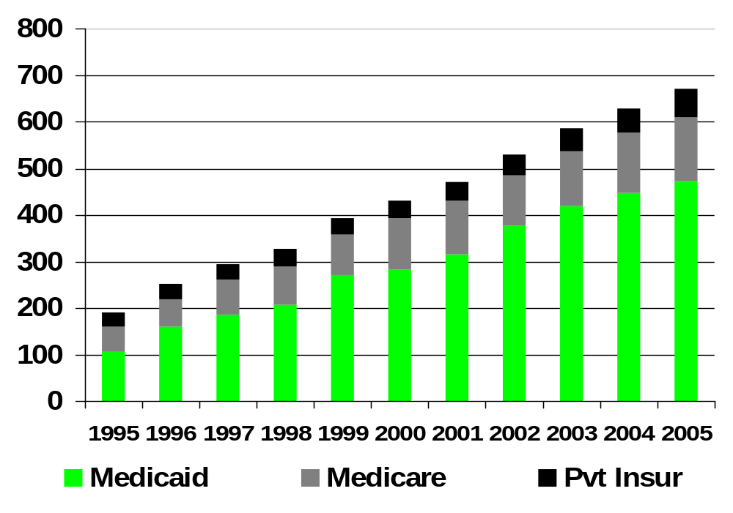
IHS 3rd-Party Collection:1995-2005
672.3
Since 2001, Average % Chge = 9%
431.6
191.3

Slide 7
Why Revenue Levels Go up & Down
  Big Picture Impacts
  National, State (Laws, Regulations, Policy)
    Coverage/Eligibility
    Payer Fee schedules
    New programs (MMA Diabetes, Part B, Part D Drugs, SCHIP)
    Medicaid Reform
  Medicare and Medicaid negotiated rates
  MC Plans/Networks
  Tribal Self Insurance
  >>>LESS CONTROL>>>
Business Process Investments
that optimize 12-15 steps in 3rd Party revenue Business Process (Rev Cycle)---ROI
Enrollment in Alt Resources
Provider Documentation, Coding, Data entry
Accts. Receivable Follow-up
Facility Capacity, space, equipment
IT Support & improvements ie., user support, capturing all CPT Procedures
Training to Incr Knowledge, Skills and Abilities ie. “Partnership”
Access/Alternate Resource Enrollment
Return on Investment Mgt Mindset
>>>>>>MORE CONTROL>>>>>___

Slide 8
Revenue Cycle/Business Process/Key Functions?
Triage (check-in)
Patient Registration, admissions Appointments
Third Party Benefits Coordination
Documentation of Provider Services (including Ancillary)
HCPC Coding
Data Entry
Accurate Billing
Timely Collections
Accounts Receivable—Denial Management
Medical records
Financial Management
SU Leadership/Management
Systems Development
CULTURE
TEAM
SYSTEMS
MANAGMENT

Slide 9
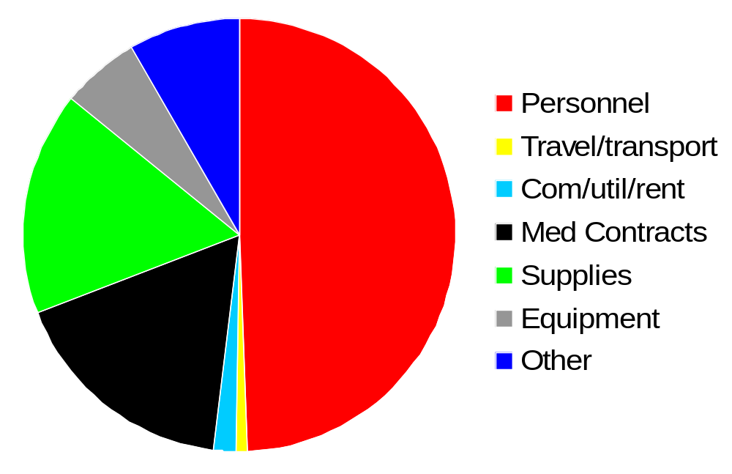
2004 OBLIGATIONS, Third Party Revenue

Slide 10
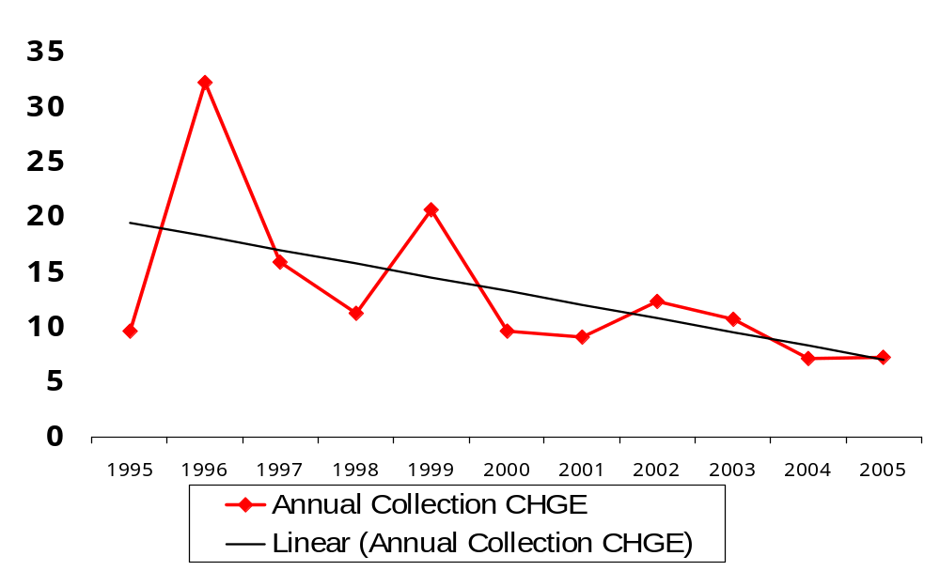
Annual Percent Chge in IHS Collections, 1995-2004

Slide 11
SUMMARY OF COLLECTIONS
Big Picture Impacts and local Business Process impacts collection levels-- + or --
By analyzing 3P BP we know what effects our revenue levels---given trends on flat appropriations, minor rate increases, focus must be on BP improvements
Collections % Increase is greater then rate % Increases
OVERALL, not substantial changes in rates in past 3 years; as IHS completes cost reports in 2006 at all facilities the rates will continue to stabilize.

Slide 12
Program Break-Out
Key Information specific to your program.
Opportunity to Ask Questions
Pick your brains via the planning
  Best Practices
  Problem Areas
  Recommendations
  Top Training Recommendations

Slide 13



Slide 14
Cascade of IHS 2006 Performance Objectives
DBOE will be reporting on…
  Requirements for 100% Accreditation of Federal Facilities
  A 3% increase in third party collections or…….
  Implementation of Third Party Accounts Mgt. and Internal Control Policy
  ROM, Revenue Operations Manual
  Medicare Part D enrollment

Slide 15
2006 Priorities/Action Items
Management of Third Partly Revenue for IHS
  2005 Cost reports to be completed at all 46 hospitals & 10 Areas to set 2007 M & M rates
  Assess CAH pros and cons—at least 1/3 applicable to IHS hospitals
  National Partnership Training---Medical Records, CHS and Business Office Partnership Training April 17, 2006 in Reno, NV…….8 years running—User Focus!
  Leadership/Management Training---101 in past, in 2005 CEO/BOM, in 2006 Third Party & Internal Controls
  Revenue Operations Manual, ROM, 2006
  Development/Implementation of PAMs software

Slide 16
2006 Priorities/Actions
Workgroups on patient registration, 3rd Party Billing & AR, Reg,Revenue Operations Manual,
Training on Third Party Internal Control policy
PAMs Training/implementation
MMA Medicare Part D Prescription Drug Benefit, 1/2006---May 15, 2006
HQs Mgt Control focus…Accreditation Status, Accounts. Rec Mgt, Internal Control Policy, BMP/Commissioned Officers Payment Chge
Part B FI Training, ie., “Putting it all Together”

Slide 17
2006 Priorities/Action Items
  Laws, Regs and Policy reviews ie., Medicaid Reform in 2006, Medicare Chges
  Tribal Technical Advisory Group & NIHB Medicare and Medicaid Policy Committee
  Support to InterAgency Agreements ie., CMS
  Controlled Correspondence

Slide 18
BO and IT Projects
PAMs…integrates 3rd billing and AR
Pt Reg 7.1
3M bi-directional interface
BO TAG workgroups
POS
MNT, DMTS, PT/OT, DME, MTM
POD
UFMS
Part D
MORE later…….

Slide 19

IHS AND TRIBAL SPECIFIC MMA PROVISIONS
  Sec 506--- Requires Mcare participating Hosp to accept Medicare Like Rates for CHS payment for Hospital services.
  Sec 1011 Authorizes IHS to share in Federal reimbursement for emergency services provided to undocumented persons.
  Sec 630 Provides Authority for IHS to be paid for all Part B Services, 5 yr. limitation, effective, 1/1/2005--excludes home health care

Slide 20
IHS MEDICARE BENEFICIARIES, 2005
Total 115,558 3-YEAR ACTIVE USERS
65+ 95,293 (82.5%)
Mcare/AB 36,074
AB/Mcaid 30,184
AB/PI 30,709
Mcare AB,PI,& Mcaid 7,126
Mcare A 4,089
Other 7,376

Slide 21
IHS ACTIVE USERS, 2005
ACTIVE USERS* Percentage
Mcaid 402,093 28%
Mcaid &PI 139,776 9.7%
Pvt Ins 348,656 24.3%*
NO Ins 417,478 29.1%
Mcare 115,558 8.1%
Vet Only 12,452 .87%
TOTAL USERS 1,435,993 100.00%
*3-YEAR DATABASE (Adj Annual 3-yr active users @ 85%, *PI 50% not billable, Data non-official, need SU level comparison)

Slide 22
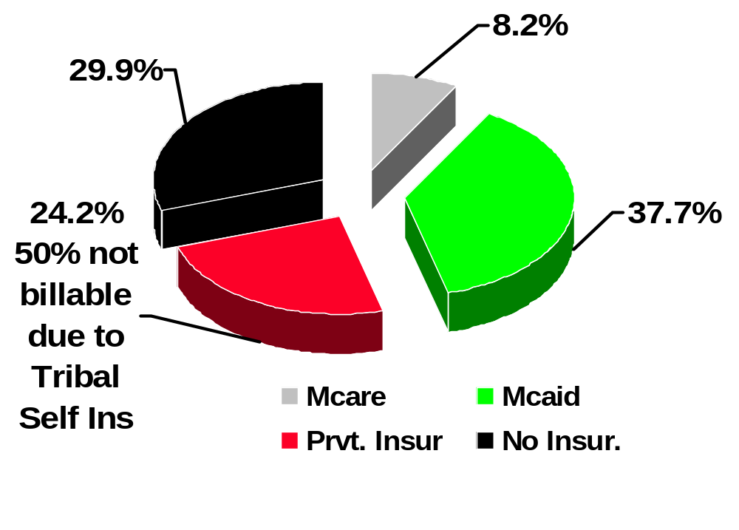
IHS Eligibility, 1.435 Million Users 2005

Slide 23
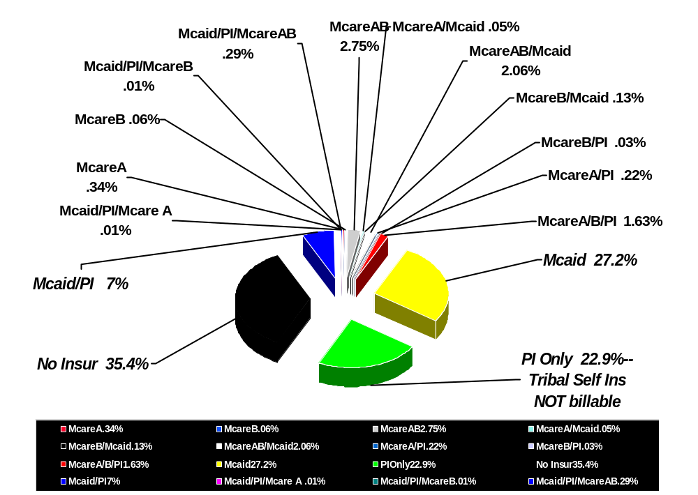
2003 IHS Total Eligibility Categories By %

Slide 24

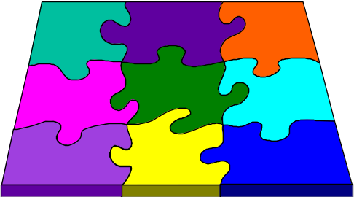
Management Actions
”Back to the Basics”
Need SU plan 3rd party revenue generation
  Develop SU committees to evaluate and manage 3rd party business process/issues
  Set revenue targets, establish Mgt reporting requirements, identify clinical and other improvements as a result
The right investment in the business process will pay for itself—”Return on Investment Mindset”
  staffing, equipment, training, contracting, IT improvements, facility mods
Recognize that training is key to building skills to optimize third party revenue collections and compliance

Slide 25
More Nuts and Bolts Management
Connect with other IHS facilities to share Business Process innovations---avoid reinventing the wheel……. “Duplicate Best Practices”
Appoint staff to stay abreast of Federal/State/ Private Managed Care Initiatives
Support Information System development
  Pt Regis……..Billing……Accts Receivable
Third Party Accounts Management and Internal Controls implementation plan

