Slide 1

2004 National African American History Month
Celebrating The 50th Anniversary of the Supreme Court's 1954 Decision in Brown V. Board of Education

Slide 2
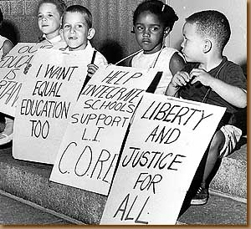
Newsday Photo/Marvin Sussman

Slide 3
Brown V. Board of Education
Oliver L. Brown et. al. vs. The Board of Education of Topeka (KS) 1954…State-sanctioned segregation of public schools was a violation of the 14th amendment and was therefore unconstitutional.

Slide 4
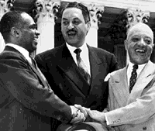
Courtesy of AP/Wide World Photos

Slide 5

Source: Associated Press

Slide 6

Source: Associated Press

Slide 7

Courtesy of the NAACP

Slide 8
A Nation of Laws
The 14th Amendment of the U.S. Constitution states: All persons born or naturalized in the United States, and subject to the jurisdiction thereof, are citizens of the United States and of the State wherein they reside. No State shall make or enforce any law which shall abridge the privileges or immunities of citizens of the United States; nor shall any State deprive any person of life, liberty, or property, without due process of law; nor deny to any person within its jurisdiction the equal protection of the laws.

Slide 9
Civil Rights Act of 1957
…provided for the establishment of the Civil Rights Section of the Justice Department and empowered federal prosecutors to obtain court injunctions against interference with the right to vote. It also established a federal Civil Rights Commission with authority to investigate discriminatory conditions and recommend corrective measures…

Slide 10
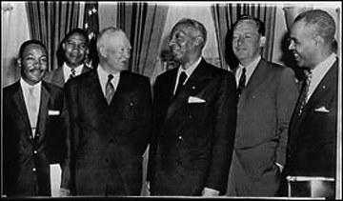
Source: The Associated Press

Slide 11
Civil Rights Act of 1960
...enabled federal judges to appoint referees to hear persons claiming that state election officials had denied them the right to register and vote…

Slide 12

Source: Associated Press

Slide 13
Civil Rights Act of 1964
…made racial discrimination in public places, such as theaters, restaurants and hotels, illegal. It also required employers to provide equal employment opportunities. Projects involving federal funds could now be cut off if there was evidence of discriminated based on color, race or national origin…

Slide 14
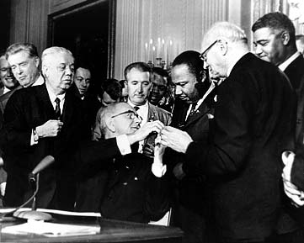
Source: Associated Press

Slide 15
Voting Rights Act of 1965
  …removed the right of states to impose restrictions on who could vote in elections…

Slide 16
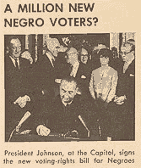
Source: U.S. News and World Report

Slide 17
Department of Housing and Urban Development Act of 1965
It founded the Department of Housing and Urban Development in 1965 to develop and execute policy on housing and cities.

Slide 18
Civil Rights Act of 1968 (Fair Housing Act
…prohibits discrimination in the sale, rental, and financing of housing. HUD is given the responsibility of fair housing programs…

Slide 19
“That One Third of a Nation"
February 1, 1940
Survey Graphic
“Houses are also like factories. Their output is children-the citizens of tomorrow…”(EDITH ELMER WOOD)

Slide 20
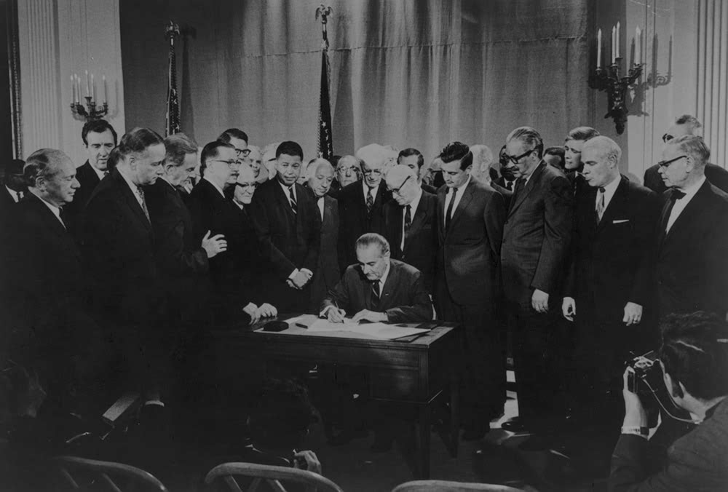
Source: U.S. News and World Report

Slide 21
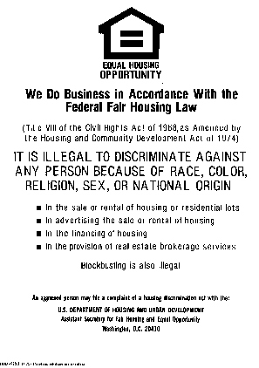

Slide 22
Some Homeownership Realities
The annual average homeownership rate for African Americans (based upon monthly data) was 42.5% in 1994 and 47.9% in 2002. (HUD/PD & R, “U.S. Housing Market Conditions, August 2003)
According to the U.S. Census Bureau, the annual median income of African Americans in 2001 was approximately $29,470. According to HUD/PD & R, the income level required to qualify for a mortgage in 2001 was $37,872. In 2001 the median existing price of a home was $147,800.

Slide 23
President Bush’s FFY 2005 Budget: Homeownership Goals
Increases minority homeownership adding 5.5 million new minority homeowners through the American Dream Down Payment Fund ($200 million to help approximately 40,000 low-income families with the down payment on their first home).
Self-Help Homeownership Program ($65 million to non-profit organizations, such as Habitat for Humanity, that reduce the costs of homeownership for low-income families).
Single-Family Homeownership Tax Credit (a tax credit of up to 50% of the cost of constructing or rehabilitating a home for eligible homebuyers).
Housing Counseling ($45 million to help families manage their finances and improve credit ratings in order to achieve homeownership).
The Zero Down Payment Initiative (allows first-time buyers with a strong credit record to finance 100% of the purchase price and closing costs).
Source: Office of Management & Budget

Slide 24
President Bush’s FFY 2005 Budget: Section 8 Rental Assistance Goals
Since two-thirds of HUD’s current budget goes toward rental assistance, the President has proposed the following to Congress:
HUD's new Flexible Voucher Program (FVP) will continue to serve at least 1.9 million families, the same number of families that are currently being served.
FVP is designed to serve more people by encouraging self-sufficiency and HUD will monitor PHA results.
HUD will give incentives to PHAs that help transition families out of the program on to self-sufficiency.
Source: (HUD/Office of Public Affairs News Release, February 12, 2004)

Slide 25
“That One Third of a Nation"
February 1, 1940
Survey Graphic
“…There is no one answer to the housing problem. We must not put our public servants in legal straitjackets by imposing statutory obligations to solve their local housing problems precisely in this way or that. The general in the field should be left free to be an opportunist within the limits of his main objective—to push ahead where he sees an opening, to occupy a height by surprise in a quiet sector, to use now one sort of attack, now another…” (Edith Elmer Wood)

