Slide 1

History of NRCS
Minnesota
Notes:
The New soil conservation program introduced in 1933 was indeed successful as viewed today: in fact very successful. This power point presentation will attempt to highlight some portions of MN Soil and Water Conservation History..

Slide 2
Thank you to Vic Ruhland
Vic Ruhland was a Resource Conservationist with the Soil Conservation Service/Natural Resources Conservation Service for 46 years. Vic retired in 2003.
Through the Eyes- Seventy years of Soil and Water Conservation in MN .. A history piece developed by Vic Ruhland..
This historical document will be unveiled in 2004

Slide 3
William Hunt
Why compile 70 years of Soil and Water Conservation history in Minnesota?
“The purpose of the effort is to better document the history of the soil conservation movement in Minnesota for the benefit of present and future generations.”

Slide 4
Documentation on soil and water conservation history has been done at the National Level
Douglas Helms, National NRCS Historian developed a series of Historical Notes including:
The history section on the NRCS Website is available at: http://www.nhq.nrcs.usda.gov/RESS/econ/History/Contents.html

Slide 5
“Soil Erosion, A National Menace”
The spark that started the flame for soil conservation was Dr. Hugh H. Bennett. He developed the “menace” bulletin in 1928.

Slide 6
What do you do to sell conservation after so many years of rebuffs?
Bennett responded, “We decided on four steps; science, farmer participation, publicity, and congressional relations”.

Slide 7
Coon Creek Project
The Coon Creek Soil Erosion Control Demonstration Project in Wisconsin set the stage for soil conservation –nationwide
The Coon Creek Project was selected by Bennett as the very first conservation project in the nation. It was officially started on October 10, 1933

Slide 8
CCC Camps in 1933/1934
After the passage of the Emergency Conservation Work law in March of 1933… locations for CCC camps were sought.
9 sites were selected in six counties in SE Minnesota. Red Wing, Wabasha, Whitewater State Park, Winona, Hokah, Caledonia, Preston, Chatfield and Rochester, Minnesota

Slide 9
CCC work projects
Conservation work projects at CCC camps included: quarrying of rock, construction of reservoirs, trout ponds, and check and wing dams; and erosion control work along highways.
Additionally, some on-farm conservation was done which included the construction of terraces

Slide 10
Soil erosion from the 1930’s described
March, 1935 –Pat Keliher, acting project Manager described soil erosion as follows:
“The red colored soil we saw about us was sub-soil and the thin mantle of gray we saw here and there was the remnant of the original top soil which was, when the land was cleared, about one foot deep. There were gullies every 100 feet more or less

Slide 11
Soil Described from the 1930’s
They were from 2-3 feet deep and about a foot wider than the depth!
Keliher noted “I had never seen such devastation in my life. It was like a bad dream. They can’t possibly make a land on this land was my opinion.”
“If someone were to tell me that in about 7 years the Michael farm would be a show place for soil conservation .. I would have said he was crazier than a loon”.

Slide 12
The first great dust storm
Occurred on May 11, 1934.
This was followed by the second great dust storm on March 6, 1935.
Clouds of topsoil from the Great Plains swept over Washington DC, and other eastern cities and extended 300 miles out into the Atlantic Ocean.
These storms raised major concerns among the people, including the Congress

Slide 13
April 27, 1935
Congress passed the Soil Conservation Act (Public Law 46) creating the Soil Conservation Service (SCS) within the United States Department of Agriculture (USDA). Hugh Bennett was designated as the Chief of SCS

Slide 14
The Bismarck, North Dakota Plant Materials Center
This was established in 1954. The Plant Materials Center (PMC) is celebrating its 50th Anniversary in June, 2004

Slide 15
Soil Erosion Surveys
Soil Reconnaissance (Erosion) Maps were developed by SES for the nation in the fall of 1934.
The Soil Survey Program expanded rapidly with the creation of the SCS in 1935. The program had been started in 1989 by the USDA’s Division of Soils.

Slide 16
Extension Service Role in Soil Conservation
County agents (Extension Service) were involved from the outset in promoting soil conservation in Minnesota.
The Extension Service and the SCS agreed at the Federal level in 1935 that the Extension Service would assume responsibility and leadership for soil conservation educational work.

Slide 17
Soil Conservation Districts
The formation of soil conservation districts (SCD’s) by local people occurred in 1937.
The law called for soil conservation districts to be governmental subdivisions of the state, organized and operated by farmers for the purpose of conserving their soil resources.

Slide 18
CCC camps officially closed
June 30, 1942 in Minnesota.
The CCC story in Minnesota can be found at the Minnesota CCC History Building in Chisholm, Minnesota.
The closing of the CCC camps left the continuation of any soil conservation work up to the farmers who needed to organize soil conservation districts!

Slide 19
Flood Control Efforts
The first stage of Federal legislation to help local governments and organizations and bridge the gap between soil and water conservation work on individual farmers and downstream dams came with the Flood Control Act of 1936, as amended in 1937.
In Minnesota, these included Gilmore Creek, Root River, Zumbro River, and the Whitewater River. WW II delayed activities under this law

Slide 20
SCS State Office
On July 1, 1942, SCS went through another reorganization.
State offices were established with full responsibilities of all SCS work in a state.
The Service adopted a line and staff organization, as is still the case.
Herb Flueck became State Conservationist in 1942-1968

Slide 21
Why the 1942 reorganization?
This was done in “the interest of economy of operation and to release a major portion of funds for field work.”
“to give farmers and ranchers more help with wartime production and conservation problems.”

Slide 22
Difficult times during WW II
Maintaining a good staff during the Second World War was difficult. Many employees were drawn into military service, thus forcing a reduced overall operation for SCS.
During WW II over 3,000 employees in the nation were on military duty.

Slide 23
Interest in drainage work!
This was first mentioned in the 1942-43 SCS Annual Report for Minnesota.
This was considered a significant development in the State of Minnesota
The formation of SCD’s during this period frequently occurred because of wet soil problems.
Needed assistance with drainage practices was considered important to landowners and to the SCD’s

Slide 24
Dr. Hugh H Bennett
“Father of Soil Conservation,” retired from Government Service in 1952. He passed away on July 7, 1960

Slide 25
Changes in the 1950’s
The title of district conservationist was changed to area conservationist in 1953.
Annual Soil Conservation Field Days and plowing matches were held between the years of 1947 and 1965. These special field activities were held jointly between SCS and SCD’s.
Main value in these events was the publicity before the event and in the effect of crowd psychology on those farmers who were slow at adopting new conservation practices.

Slide 26
Locating Elmer in Minnesota!
“Locating Elmer” was the slogan used during this period. Elmer was a coined symbolic term to identify a respected and progressive farmer-leader who could be effective in working with neighborhood groups of farmers to cooperate in the application of soil and water conservation practices

Slide 27
SCS’s CO-1 program
SCS’s Conservation Operations (CO-1) continued to be the agency’s main program.. Devoting the application of conservation on the land!

Slide 28
The Big rain of 1957
The big rain of 1957 had a major impact on soil erosion in Minnesota.
The “heavy rain area was from 4 to 10 inches and in one area immediately out of Lake Benton there was 15 inches of unofficial recording, most of the rain came between 5:30 p.m. June 16th to 2:00 p.m. on June 17th.

Slide 29
RC&D Authorized
Wes Min RC&D was the first approved MN RC&D. Officially authorized in 1964, the third in the nation to be approved.
RC&D works with a great caliber of local leadership, many project measures which make an impact on conservation, economic and social concerns in local communities

Slide 30
Growth of Environmental Concerns
Concerns about damage to the environment grew during the 1960’s
Attention was given to pesticide poisoning of people and nature
The role of SCS and SCD’s involved in the drainage of wetlands was challenged.

Slide 31
Environmental concerns.. Continued
US EPA was established in 1970
Minneosota Pollution Control Agency was created in 1967 to protect Minnesota’s air, waters, and land in the state.

Slide 32
Irrigation developments
Irrigation developments increased significantly during the 1960’s, especially following the DROUGHT of 1976.

Slide 33
Norm Berg
Norm Berg, SCS employee who was raised on a farm in Pine county, Minnesota.. Served as SCS Chief between the years of 1979-1982.

Slide 34
Minnesota Firsts
The first Black SCS employee in Minnesota was Ray Brown, who started as a Civil Engineering Aid in the state office in the mid 1960’s.
Charles Loggins became the first Black Soil Conservationist in Minnesota in 1974
Mary Jane Reetz in 1981 became the first woman District Conservationist in Minnesota

Slide 35
SCS Symbol… in 1970
In 1970, SCS adopted a blue drop of water in a green basin below the SCS letters.
In 2002, NRCS adopted the logo again, changing the letters on the logo from SCS to NRCS

Slide 36
Use of Computers!
The earliest reference to the use of computers for SCS in Minnesota was found in correspondence dated June 26, 1962, which discussed the use of an IBM 650 computer which was located at the Corn Belt Work Shop in Saint Paul, Minnesota
During the 1980’s forms were filled out and data was transferred to a 3 ¼ x 7 inch punch card and read into the computer for analysis!

Slide 37
Water Bank
Water Bank Act of 19960 authorized the Secretary of Agriculture to enter into agreements with operators and owners of land located in important migratory waterfowl nesting, breeding, or feeding areas to preserve and improve the Nation’s wetlands

Slide 38
Minnesota Politicians
Throughout the years Minnesota politicians have supported conservation efforts. Hubert H. Humphrey, Orville Freeman, Robert Berglund, David Durenburger, an, later Gil Gutknecht and david Minge are examples.

Slide 39
Energy crunch
SCS was expected to reduce energy consumption by 7% in 1974 from the 1973 levels. Reducing vehicle usage by 22% was seen as the best opportunity to meet the energy conservation goal.
In 1976, the goal was 15% below the 1973 levels. Conservation tillage was promoted not only as protecting the soil and water but also as an energy conservation measure.

Slide 40
Metropolitan Agriculture Preserves Act
Established in 1981.. This act provided farmers with economic and agricultural benefits, including lower property tax rates and special assessments for sewer and water lines.

Slide 41
Changing Times!
The use of movie films for educational programs took a setback in the early 1970’s. SCS closed its film library in Lincoln, Nebraska.
The reason cited for closure was due to fiscal limitations.

Slide 42
Completed Watershed Projects
The largest dam built by SCS in Minnesota was constructed during the 1980’s. It provided flood control and a recreation lake to the city of Canby, Minnesota
In 1986, the structure was selected as the “Seven Wonders of Engineering Award.”

Slide 43
50th Anniversary of SCS
The 50th anniversary of SCS was celebrated on April 27, 1985.
Numerous celebrations and activities were held throughout the United States of America.

Slide 44
Food Security Act (FSA) of 1985
4 major provisions were included: conservation reserve program (CRP), conservation (cross) compliance, swamp buster, and sodbuster
This moved SCS toward more of a regulatory agency because of these farm bill provisions

Slide 45
Implementing the Farm Bill
Implementing the provisions of the farm bill created a heavy workload in Minnesota.
Thousands upon thousands of additional staff hours were needed to successfully pull off the farm bill.
Long days and extra days were involved in educating land users, writing contracts, and developing conservation plans.

Slide 46
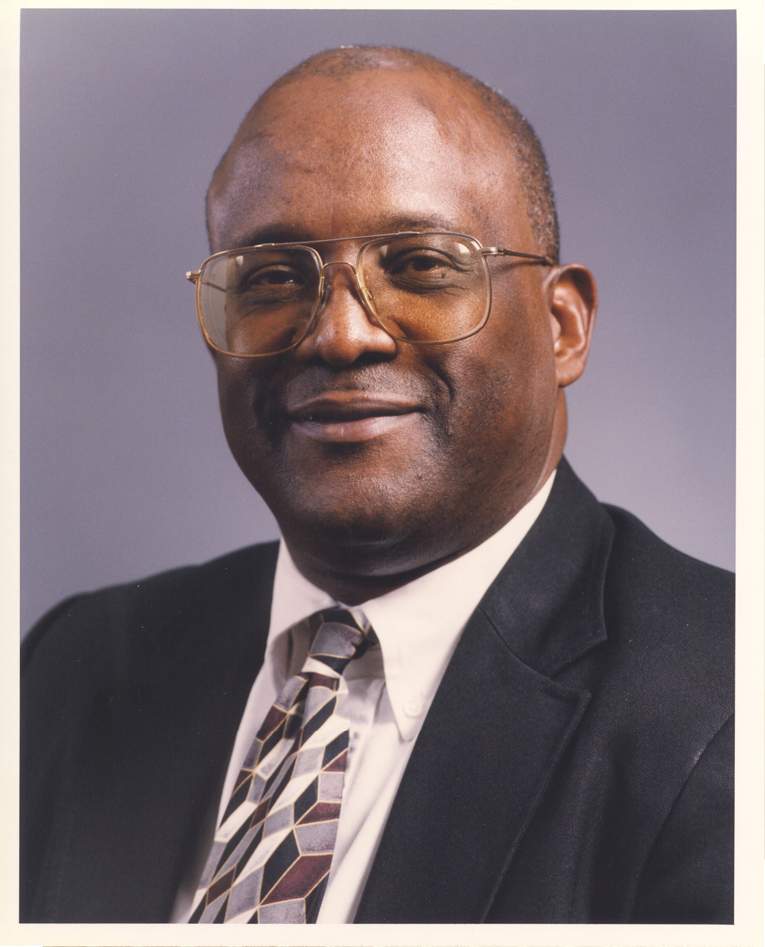
SCS/NRCS personnel
Don Ferren retired as State Conservationist in 1986. He was replaced by Gary Nordstrom who served as State Conservationist – 1995.
William Hunt became State Conservationist in
Minnesota in 1995.

Slide 47
1990’s
The 1990’s brought forth “buyouts” of employees who wanted to retire.
The first occurred in 1994, when 25 employees took advantage of the opportunity and retired.

Slide 48
Anoka Sand Plain Demo Project
The Anoka Sand Plain Demonstration Project was established in east-central Minnesota in 1990. Local concerns existed about groundwater quality in the sand plain.

Slide 49
1993 Flood
A wet cool spring and early summer saturated soils.. Combined to create devastating floods throughout Minnesota.
Over 500,000 acres were unplanted in NRCS Area 5 .. Because of the flood.
Yields were down 20-40% in Area 5

Slide 50
SCS becomes NRCS
In October, 1994 SCS received a new name – Natural Resources Conservation Service (NRCS)
With the name change came more program responsibilities and services

Slide 51
MLRA Soil Survey
MLRA – Major Land Resource Areas… went nation wide in 1995. A new concept for mapping soils!
Currently, 22 Minnesota counties have Soil Survey Geographic Certified digital soils available on line or via CD

Slide 52
Center of Excellence
Center of Excellence for map compilation was established by the Fond du Lac Tribal and Community College and NRCS in 1998.
The Center is located in Cloquet, Minnesota and enhances the local Tribal College in providing additional educational opportunities and employment opportunities

Slide 53
Conclusion
This concludes the History for some highpoints of soil and water conservation in Minnesota.
The Farm Bill, new technologies and greater public awareness of what NRCS does will continue to place soil and water conservation on a radar screen for future historians to assess!

