Slide 1

Pre-Validation of the Aromatase Assay using Human and Bovine Placental, and Human Recombinant Microsomes
Endocrine Disruptor Methods Validation Subcommittee (EDMVS) Plenary Session
June 5, 2003
Research Triangle Park, North Carolina
RTI International is a tradename of Research Triangle Institute.

Slide 2

Overview
Background: Aromatase (CYP19)
Study Goals
Substrate characterization
Placenta tissues – human, bovine, porcine
Methods
Results
Protein yield
P450 Spectra
Aromatase activities
Conclusions
Future studies

Slide 3
Aromatase
Cytochrome P450 enzyme – CYP19
Present in the gonads and placenta
Responsible for the biosynthesis of estrogen steroid hormones
Can be inhibited at the level of gene expression (e.g., ethylhexylphthalate), or directly at enzyme (e.g. azoles)

Slide 4
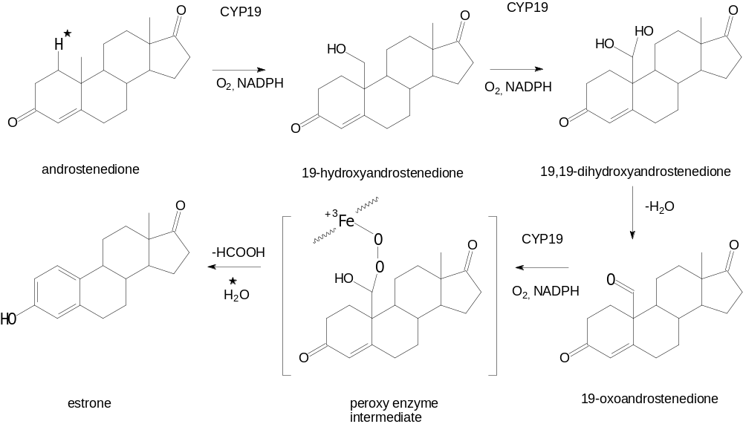
Steroid Hormone Biosynthesis by Aromatase

Slide 5
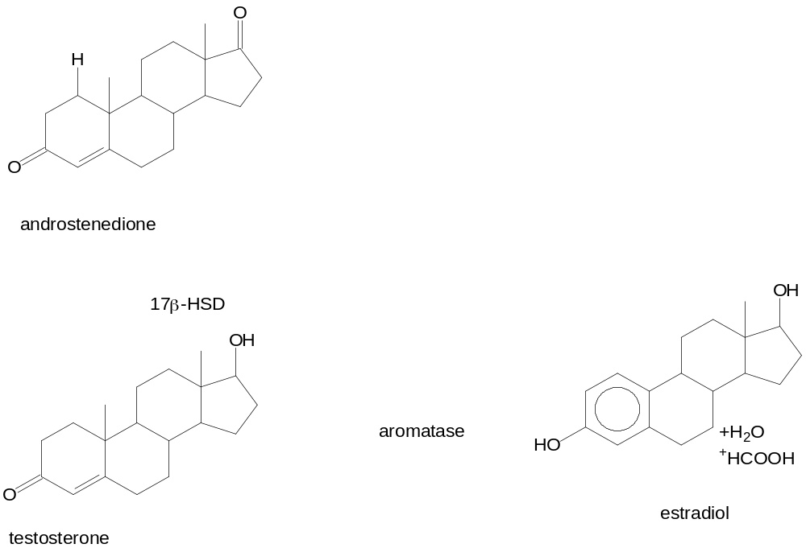
Steroid Hormone Biosynthesis by Aromatase (cont’d)

Slide 6
Study Goals
The goal of this work is to identify the optimal factors and conditions for the assay of aromatase, including:
Characterization of radiolabeled substrate (androstenedione)
Selection of mammalian placenta allowing sufficient yield of catalytically-active microsomal protein, and assessment of human recombinant CYP19
Optimization of assay with respect to concentration of protein, cofactors, substrate, and incubation time using a factorial design
Using this optimized assay, determine the effect of selected substances on aromatase activity

Slide 7
Substrate Characterization
Sources
Nonradiolabeled 4-androstene-3,17-dione (99%): Sigma Chemical Co.
Radiolabeled [1β-³H(N)]androst-4-ene-3,17-dione: Perkin-Elmer Life Science
Specific activity: 25.3 Ci/mmol
Radiochemical purity: 98%

Slide 8
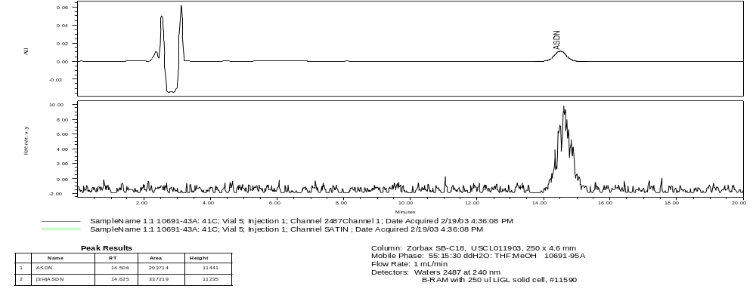
HPLC Radiochromatogram for
[³H]Androstenedione

Slide 9
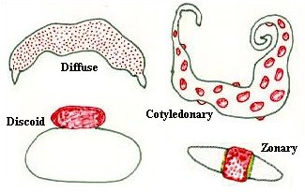
Placental Tissues
http://www.vivo.colostate.edu/hbooks/pathphys/reprod/placenta/structure.html

Slide 10
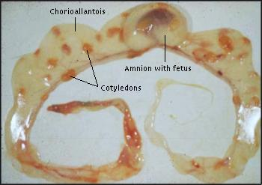
Placental Tissues (con’t)
http://www.vivo.colostate.edu/hbooks/pathphys/reprod/placenta/ruminants.html

Slide 11
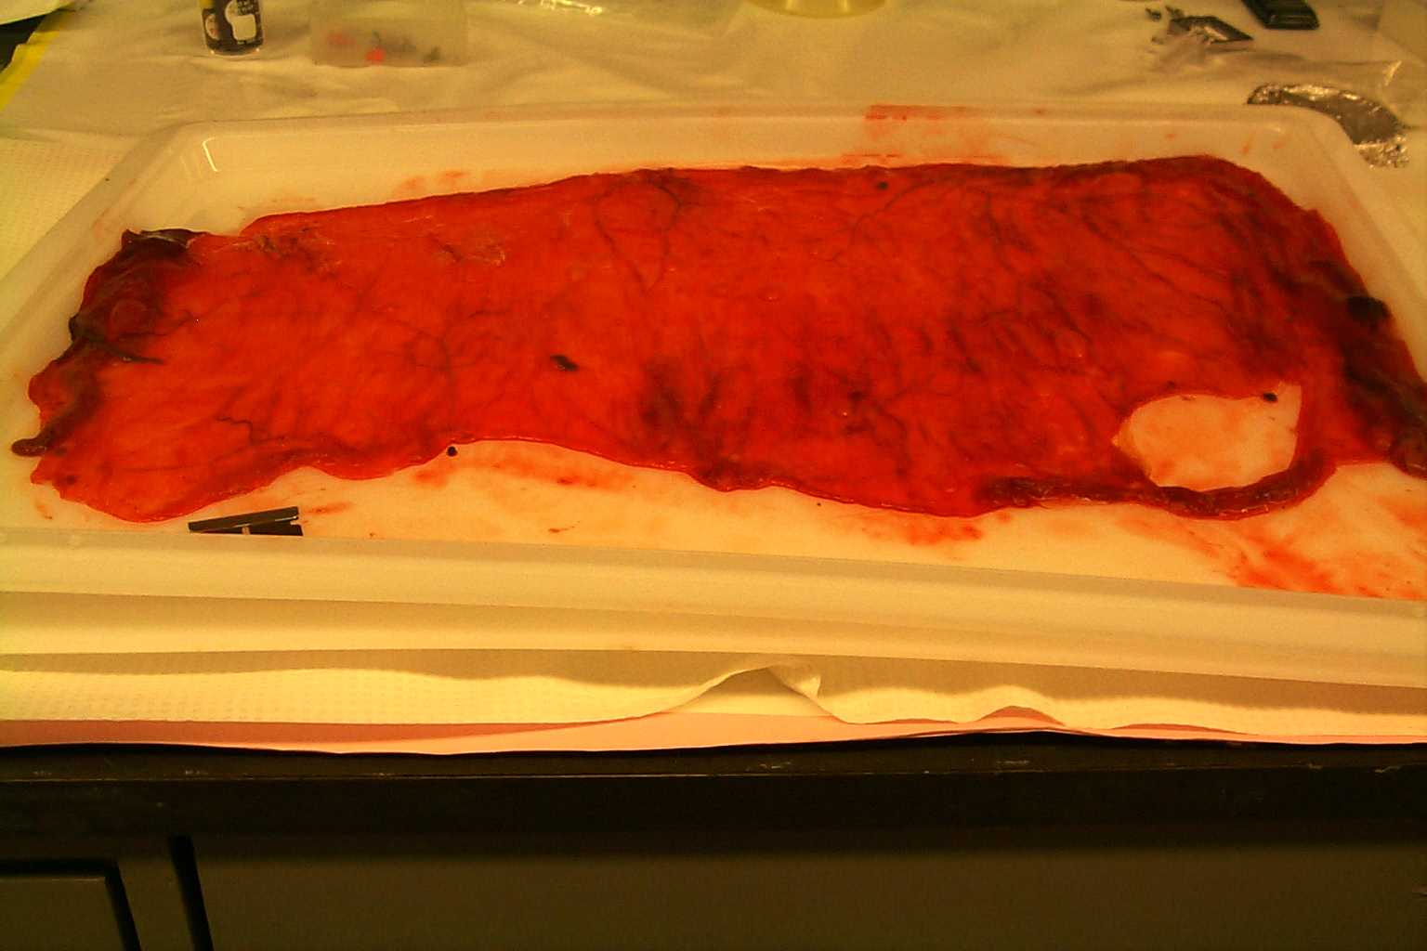
Placenta Tissues (con’t)

Slide 12
Methods
Preparation of microsomes from tissues
Iced-down (not frozen!) within 10 min of delivery
Soft tissue harvested, homogenized in cold buffer
Homogenate centrifuged @ 10,000g for 30 min, 4°C
Supernatant centrifuged @ 100,000g for 60 min, 4°C
Pellet resuspended in buffer, centrifuged @ 100,000g for 60 min, 4°C
Pellet “washed” by repeating above
Resuspended in buffer, protein concentration determined
Spectral P450 content determination: difference spectrum, 400 – 500 nm, of CO vs. CO/dithionite reduced microsomes, quantitation using extinction coefficient for the
450 nm absorbance of 100 mM⁻¹ cm⁻¹

Slide 13
Methods (cont’d)
Addition of the following into 16 x 100 mm test tubes:
0.1 mL propylene glycol
50.0 nM ³H-androstenedione (0.1 μCi)
1.7 mM NADP⁺
2.8 mM glucose-6-phosphate
1.0 u glucose-6-phosphate dehydrogenase
Dilute to 1.0 mL volume with phosphate buffer, pH 7.4, and warm to 37 °C
Preparation of placental or recombinant microsomal pellet
Suspension of placental or recombinant microsomes and dilution to
~0.1 mg/mL in phosphate buffer
Warm microsomes to 37 °C
Add 1.0 mL placental microsomal suspension to each test tube
Incubate at 37 °C for 30 minutes in shaking water bath

Slide 14
Methods (cont’d)
Add 2.0 mL of CH₂Cl₂ to quench enzyme reaction; vortex for 30 seconds; centrifuge for 10 minutes at 500 rpm
Transfer organic layer to a capped vial.
Add 2.0 mL of CH₂Cl₂ to test tube containing aqueous layer; vortex for 30 seconds; centrifuge for 10 minutes at 500 rpm
Transfer organic layer to a capped vial.
Add 2.0 mL of CH₂Cl₂ to test tube containing aqueous layer; vortex for 30 seconds; centrifuge for 10 minutes at 500 rpm
Transfer organic layer to a capped vial. Prepare aliquots of each organic extract for analysis by LSC.
Transfer aqueous layer to a capped vial; transfer 0.5 mL to
a LSC vial; add 10.0 mL scintillation cocktail; count in LSC.

Slide 15
Tissue Procurement Issues
Human placenta
Caesarian section allows for 1) timed delivery and optimal collection conditions, and 2) less chance of disease transmission
Bovine and porcine
Requires farms close to laboratories, assistance of farm staff
Deliveries seasonal, and any time of day

Slide 16
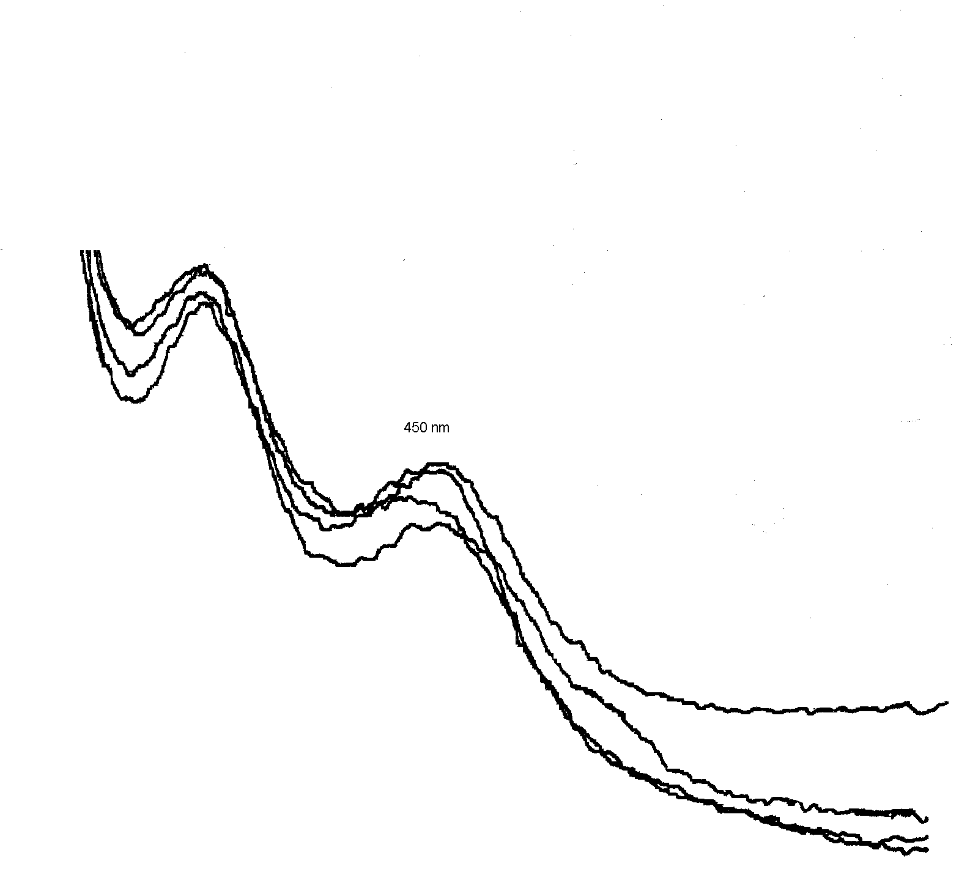
P450 Difference Spectrum
Human Recombinant CYP19

Slide 17
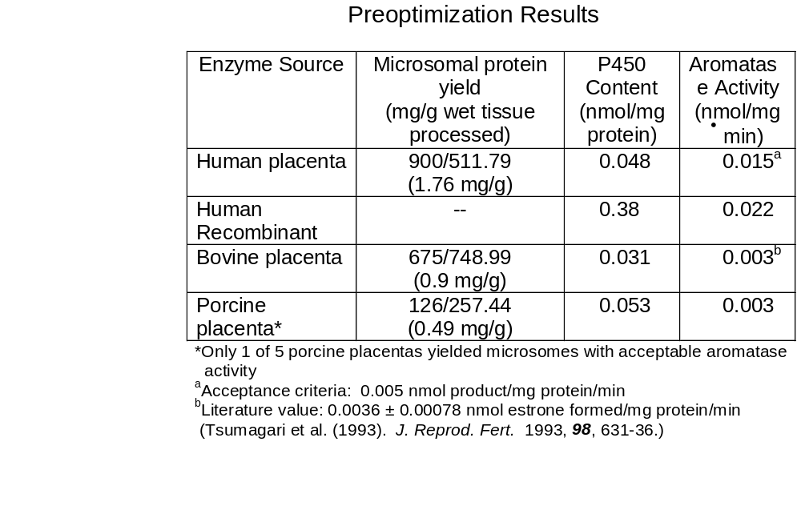
Results (cont’d)

Slide 18
Conclusions
Collection conditions used for placentas are crucial to activity
Human Placentas
easiest to collect under optimal conditions
well-defined morphology and good yield of microsomal protein
high activity
Human recombinant, comparable activity with best placental preparations
However,
SOPs must be in place for handing potentially infectious materials
Although Caesarian vs. birth canal delivery minimizes infection of the placental tissue, information regarding screening for HIV, hepatitis, etc. should be obtained if available.

Slide 19
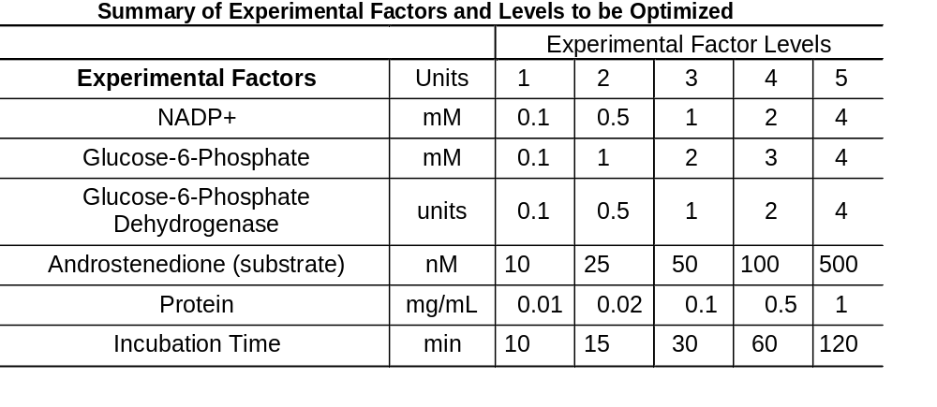
Future Studies
Optimization of conditions using a factorial design

Slide 20
Future Studies
Determination of variance of the optimized assay
Using the optimized conditions determined for each preparation, three technicians independently conduct the assay on three separate days
The results are assessed for technician-to-technician and day-to-day variance.

Slide 21
Future Studies
Determination of IC₅₀ for:
  aminoglutethimide (non-steroidal aromatase Inhibitor)
  4-hydroxyandrostenedione (potent steroidal aromatase inhibitor
  chrysin (potent flavonoid)
  genistein (weak isoflavonoid)
  ketoconazole (weak imidazole anti-fungal)
  econazole (potent imidazole anti-fungal)
  atrazine (affects aromatase gene expression; no aromatase inhibition)
  bis-(2-ethylhexyl)phthlate (affects aromatase gene expression; no aromatase inhibition)
  nonylphenol (affects AR/ER; no aromatase inhibition)
  lindane (affects StAR and cholesterol metabolism; no aromatase inhibition)
  dibenz(a,h)anthracene

Slide 22
Acknowledgements
RTI International
Ms. Sherry Black
Ms. Purvi Patel
Study Plans
Dr. Robert Brueggemeier
(Ohio State University)
Dr. Jerry Johnson (Battelle)
Placental Tissues
Dr. Amy Murtha (Duke University)
Mr. Rick Kern (North Carolina State University)
Mr. Curtis Powell (North Carolina State University)

