Slide 1
What should all psychiatry
residents know about treating
ADDICTION?
May 21, 2007
Charles P. O’Brien, MD, PhD
University of Pennsylvania
Philadelphia VA Medical Center

Slide 2
Disclosures
Consultant to
Forest (Campral)
  Alkermes/Cephalon (Naltrexone)

Slide 3
What is Addiction/Dependence?
Drug use “out of control”
NOT necessarily
Daily use
Tolerance
Physiological Dependence
Withdrawal

Slide 4
Why do people take drugs to excess?
Why do they repeatedly relapse?

Slide 5
Drug Categories
Nicotine
Alcohol
Marijuana
Anabolic Steroids
Inhalants
Club Drugs
Stimulants
Sedatives
Heroin

Slide 6
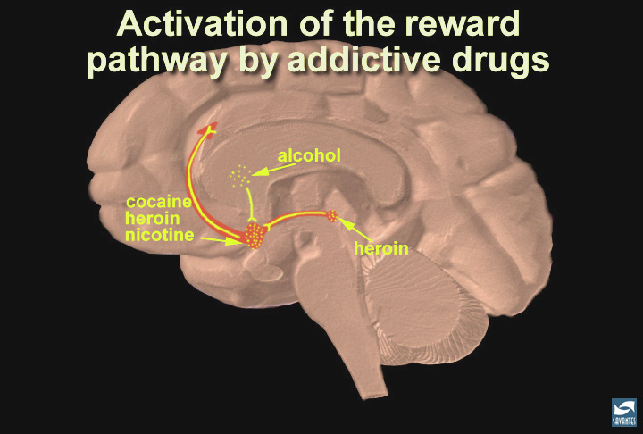
Notes:
Slide 30: Summary; addictive drugs activate the reward system via increasing dopamine neurotransmission
In this last slide, the reward pathway is shown along with several drugs that have addictive potential. Just as heroin (morphine) and cocaine activate the reward pathway in the VTA and nucleus accumbens, other drugs such as nicotine and alcohol activate this pathway as well, although sometimes indirectly (point to the globus pallidus, an area activated by alcohol that connects to the reward pathway). While each drug has a different mechanism of action, each drug increases the activity of the reward pathway by increasing dopamine transmission. Because of the way our brains are designed, and because these drugs activate this particular brain pathway for reward, they have the ability to be abused. Thus, addiction is truely a disease of the brain. As scientists learn more about this disease, they may help to find an effective treatment strategy for the recovering addict.

Slide 7
Addiction = Memory
Drugs are reinforcers
Pavlov’s lab- 1920s
Wikler- 1940s, Lexington
Proneness to relapse after
  months to years abstinent

Slide 8
New Medications
Buprenorphine
Bup/Naloxone (Suboxone)
Varenicline
Naltrexone for alcoholism
Depot Naltrexone
Acamprosate
Modafinil
Topiramate, Baclofen, GVG
Ondansatron
Bupropion
Rimonabant
Dronabinol

Slide 9
Manual Guided Therapies
Cognitive Behavioral (CBT)
Drug Counseling (DC)
Twelve Step Facilitation (TSF)
Motivation Enhancement Therapy (MET)
BRENDA (Biopsychosocial, Nurse)
Interpersonal Therapy (IPT)
Family Therapy
Group Therapy

Slide 10
Best Treatment
Medications
    Plus
Psychosocial Intervention

Slide 11
Penn/VA Center Team
Arthur Alterman James McKay
Wade Berrettini A. Thomas McLellan
John Cacciola David Metzger
Anna Rose Childress David Oslin
James Cornish Helen Pettinati
Charles Dackis Michael Stromberg
Ronald Ehrman Elmer Yu
Teresa Franklin George Woody
Kyle Kampman Joe Volpicelli
obrien@mail.trc.upenn.edu
http://www.uphs.upenn.edu/trc

