Slide 1
Mirror Support: Edge, 70%, or both?
M.Lampton
Space Sciences Lab
University of California Berkeley
Oct 2003

Slide 2
Overall optical test plan
Each component is tested alone, 1-G environment, by manufacturer
  Mirrors, structure will have vendor test protocols
Entire telescope interferometric tests can be run vertical or horizontal
  Interferometric tests yield pupil WFE distribution
  If interferometer resolution is good enough, +1G and –1G interferograms can be combined to give a 0-G interferogram <<ACCURACY IS THE ISSUE
  no flotation system is then needed, horiz beam OK
Entire telescope autocollimation imaging tests yield PSF information
  Secondary, flat, tertiary mirrors have small 1-G deformation when mounted on flight support systems; flotation support is unnecessary
  Primary mirror deforms 2 to 20 microns (huge!) on flight support bipods
  Therefore primary mirror needs a GSE flotation system to verify the 0-G performance for autocollimation test
  Would also improve sensitivity of interferometric tests.
We want both interferometry and imaging.

Slide 3
What does industry recommend?
Contraves-Brashear: vert, 70% w/float
  Yields both interferometry and PSF
Eastman Kodak: vert, 70% w/float
  Yields both interferometry and PSF
Goodrich: horizontal, 70% no float
  Interferometry only
Tinsley: horizontal, 100% no float
  Interferometry only
  But they have not done a two-meter mirror
SAGEM: horizontal, 100% no float
  Interferometry only
  But on all their big mirrors, they use vertical beam testing with multipoint support

Slide 4
What does common sense say?
70% support better for minimizing launch stress
  Puts top plate into tension: top is stronger
70% support better for fringe visibility
Horizontal beam testing better for test flat
  Flat stands on edge; figure is constant
Horizontal beam testing better operationally
  no hoisting; less danger of dropped wrenches
Vertical beam test mandatory for PSF image test

Slide 5
Conclusions
Edge support at R=100% is a nonstarter
  Poorer launch stress margins
  Poorer interferograms, either H or V
Recommend we adopt R=70% support now
Recommend we simplify our blank drawings: “universal” as regards H and V but adopt six attach zones at 70% radius, delete edge support zones
Most tests can be run H or V interferometrically
All tests will be witnessed by Sholl BITE
One test will have to be flotation: perhaps at level 5?
  This one test shows that our zero-gravity system meets reqts
  Sholl BITE shows that system has not changed from one-gravity figure

Slide 6
Mirror flotation systems
Employed at Perkin-Elmer for HST
  M.H.Krim “Metrology mount development and verification for a large spaceborne mirror” Proc.SPIE 332#57, 1982
  Approx 100 jeweled counterweights, individually calibrated
Employed on all large ground-based monolithic mirror telescopes
  Subaru (8.2m, Mauna Kea) uses 120 pneumatic actuators
  Gemini (two 8.1m; Mauna Kea & Cerro Pachon) use 148 pneumatic actuators
  LBT (two 8.4m, Mt Graham) use ~100 pneumatic actuators
Function is to distribute the load according to the local weight
  Maintains a condition of near-zero local strain, hence stress
  Allows mirror surface figure to remain independent of orientation

Slide 7
SNAP primary mirror flotation concept
H.Heetderks
Primary Mirror
Load cell
}
10 psig air
Repeated 100 places
Pressure controller
Cylinder
Strongback
Control box

Slide 8
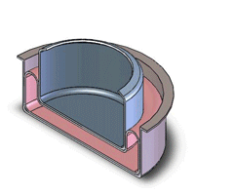
Frictionless piston + cylinder
* Outer cup
* Inner cup
* Rubber flex joint
---------------
No sliding friction
No leaks or maintenance
Low cost
Easy tolerances

Slide 9
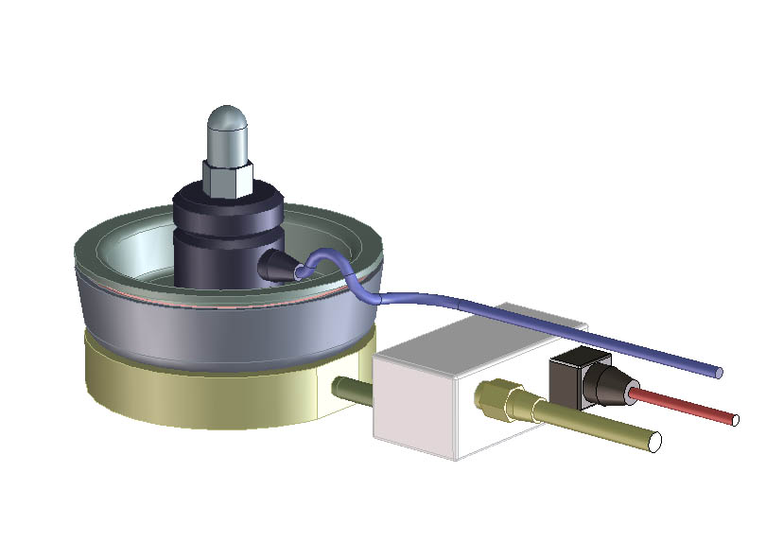

Slide 10
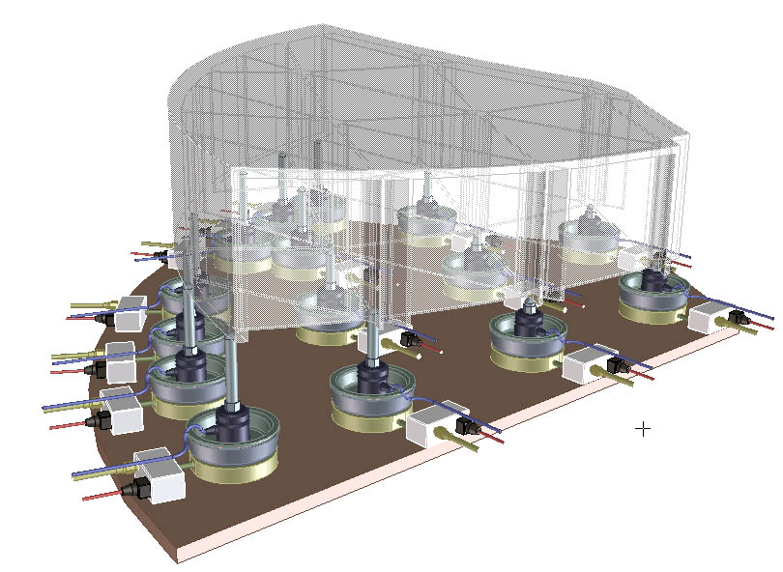

Slide 11
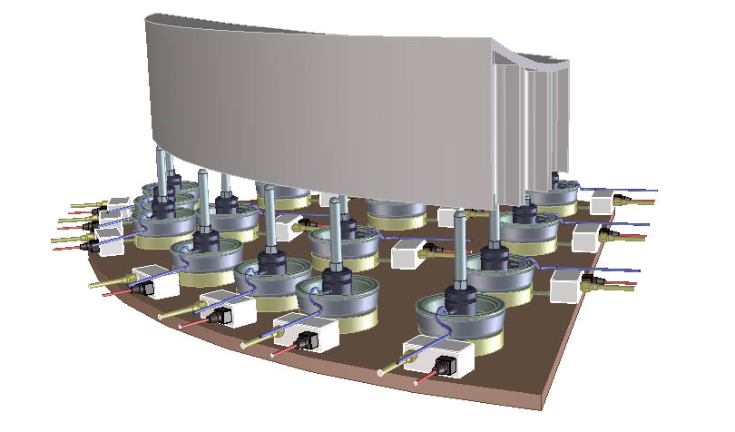

Slide 12
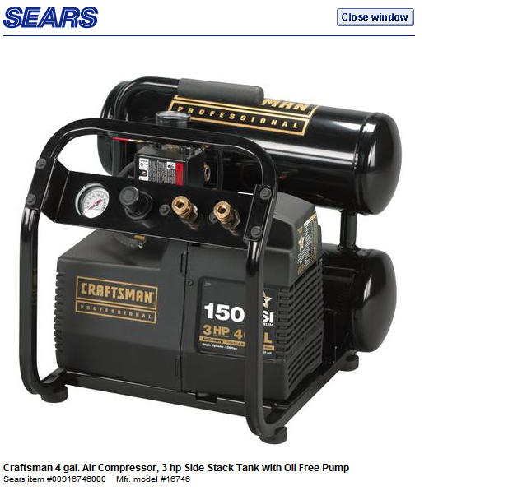
Compressed air is not a problem

Slide 13
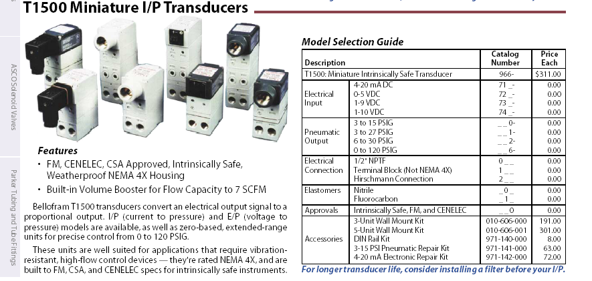
Air Pressure control is not a problem
Bellofram T1500 Controller http://www.lesman.com/downloads/s13sp_accessories.pdf

Slide 14
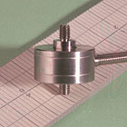
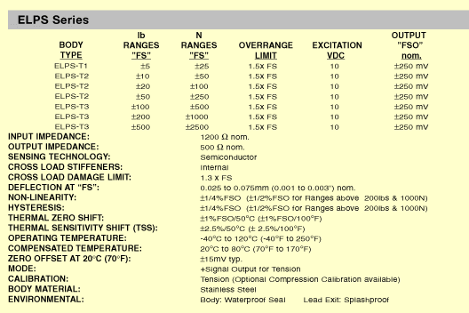
Sensing force is not a problem
Entran load cells http://www.entran.com/elps.htm

Slide 15
Conclusion: flotation test is valid
Zero-gravity is approximately simulated when the local weights and local supports are equal
  Neglects gravity quilting
FEM weight model& fab metrology errors are < 1%
  Cross checks: total mass; center of gravity; local force/deflection compared to FEM predictions
Force errors are <1% thanks to good accuracy of load cells
Anticipate imbalance of weight+force < 2% of each load
  Typical 40 newton load, so load imbalance < 0.8 newton
Net large scale mirror compliance is 4nm/newton
Typical surface errors ~4nm due to imperfections in the flotation test
Acceptably within 1-gravity release surface error budget

