Slide 1
Welcome to the
Johnson Space Center
Pre-Proposal Conference
for the Center Institutional Safety Services (CISS) Contract
RFP No. NNJ08239192R

Slide 2
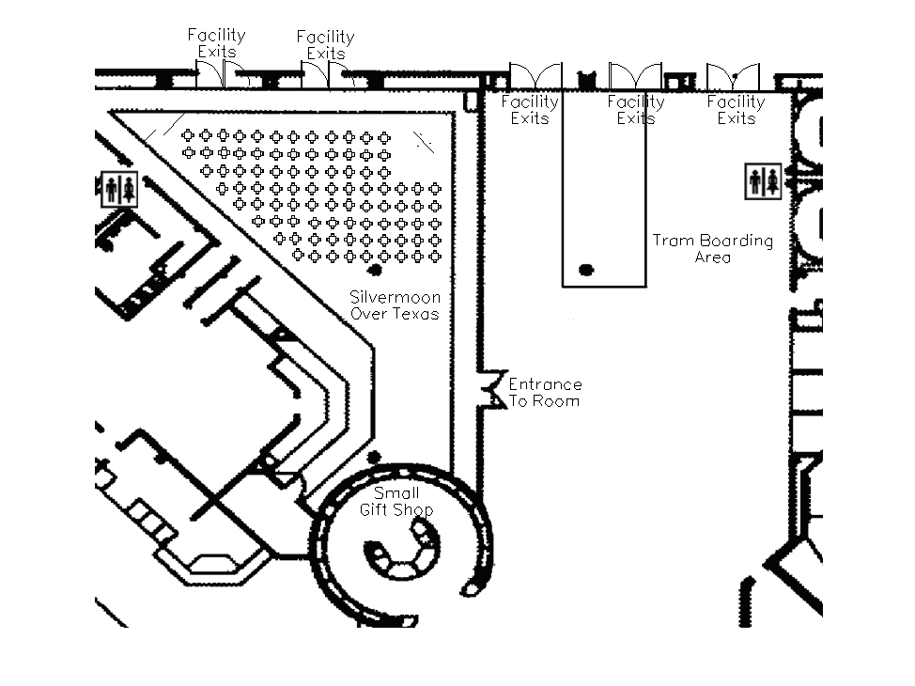
Safety and Administrative Information
Fire Exits
Restrooms are directly behind you and outside directly across the hallway from this room
Fire exits are located in the front of the room and side exit door. In the event of a fire, you must exit the building and move at least 150 ft. away from the building
Fire Exit
Restrooms

Slide 3
Agenda
  08:30 Registration L. Carr SEB Administrative Support
  09:00 Welcome Remarks V. Jankowski Contracting Officer
  09:10 Opening Remarks D. Johnson JSC Procurement Director
  09:15 S&MA Remarks D. Loyd JSC Safety and Test Operations Chief
  09:30 RFP Overview V. Jankowski Contracting Officer
  10:00 SOW Overview D. Clem SEB Lead for Safety and Test Operations
  11:00 Proposal Instructions A. Huynh SEB Chairperson
  Overview
  11:20 Pricing Overview H. Rocha JSC Procurement Pricing
  11:35 Proposal Evaluation A. Huynh SEB Chairperson
  Overview
  11:45 Site Tour Overview J. Taylor Safety and Test Operations
  12:00 Lunch (on your own)
  12:50 Bus Loading for Tour K. Chevalier SEB Lead for Center Operations
  01:00 Bus Departing SCH
  04:00 Bus Returning to SCH

Slide 4

Welcome Remarks
Venessa L. Jankowski
Contracting Officer

Slide 5
Welcome Remarks
These slides are not to be interpreted as a comprehensive description of all requirements of the solicitation
To the extent there are any inconsistencies between this briefing and the solicitation, the solicitation governs

Slide 6
Welcome Remarks (cont’d)
Today’s presentation will follow a written script in order to avoid preferential treatment toward those attending
Attendees may submit any questions in writing on forms provided at the registration desk
Official responses to questions will be posted on both the NAIS (EPS) CISS and JSC CISS procurement webpages
http://prod.nais.nasa.gov/cgi-in/eps/bizops.cgi?gr=D&pin=73
http://procurement.jsc.nasa.gov/ciss/default.asp

Slide 7
Opening Remarks
Procurement at JSC
Debra L. Johnson
JSC Procurement Director

Slide 8
JLT Responsibility, Accountability, Authority Team
Contract Relationships:
A Working Guide
Civil Servants and Contractor Employees

Slide 9
S&MA Remarks
David T. Loyd
JSC Safety and Test Operations Chief

Slide 10






Safety & Mission Assurance Office
Yolanda Y. Marshall, Director
Terrence W. Wilcutt, Deputy Director
Management Integration Office
E. Joe Ripma, Manager
Perry J. Bennett, Deputy Manager
Flight Safety Office
David F. Thelen, Manager
Nigel J. Packham, Deputy Manager
NC/Shuttle & Exploration Division
Chief: James D. Rush
Deputy: Keith W. Dyer
NE/ISS Division
Chief: Michael P. Fodroci
Deputy: Mary Beth Schwartz
NS/Safety & Test Operations Division
Chief: David T. Loyd
Deputy: Stacey A. Menard
NT/Quality and Flight Equipment Division
Chief: Vincent D. Watkins
Deputy: David I. Kaplan

Slide 11
Safety & Test Operations Division
NS/Safety & Test Operations
Division
Chief – David T. Loyd
Deputy Chief – Stacey A. Menard
Division Secretary –
Gwendolyn Urps
NS3/Safety & Mission
Assurance Office – WSTF
Chief – Diane McLaughlin
Office Secretary –
Juliana Barajas/RCJV
Occ & System Safety
Quality Engineering
Emergency Services
Management Systems
Audit & Corrective Action
NS21/Program
Assessment Team
Team Lead –
Elmer Johnson
NS22/Systems
Safety Team
Team Lead –
Wayne Gremillion
NS23/Analysis &
Investigation Team
Team Lead –
Michael Hulet
Procedure & Policy
Occupational Safety
Voluntary Protection Program (VPP) Coordination
Training & Awareness
Test Safety
Pressure Systems
Fire Protection
Construction Safety
Facility Risk Management
Mishap/Close Call Investigation
Hazard Abatement Planning
Information Systems
NASA Safety Reporting System
Procurement

Slide 12
Future Vision of Institutional Safety
The CISS Contract is a principle partner in meeting our Strategic Goal for the future of JSC Institutional Safety:
“Ensure a safe work environment for JSC’s people and property”
  Improve safety behavior through increased awareness of safety requirements and improved accountability measures
  Improve the timeliness and quality of mishap investigations
  Integrate risk-based analysis into facility management decision-making to optimize risk trades based on available funding

Slide 13
Challenging Work Environment
The JSC work environment is multifaceted, involving diverse hazards from the office, to industrial work areas, to the most advanced laboratories and test systems
The demands of the NASA mission provides unique opportunities in new and emerging technology (e.g., nanotechnology, gamma irradiation, etc.)
With an aging infrastructure, many of its facilities have presented unique challenges to maintaining a safe workplace

Slide 14
Management Challenges
The JSC work environment demands CISS contract leadership agility to identify and manage the risk in a creative, proactive, and cost effective manner by:
  Establishing relationships that encourage a safe work environment with personnel at the Center
  Performing data analysis that quickly recognizes trends in safety performance
  Recommending better performance indicators of changes in risk at the center
  Understanding the latest tools and techniques available to improve safe work conditions and behaviors
  Assisting NASA to prioritize resources in a manner most effective at reducing the Center’s mishap risk

Slide 15
Skills Necessary for Institutional Safety
With these challenges in mind, JSC must have institutional safety resources which can assist NASA management in:
  Assessing adherence to regulatory requirements and JSC policy, and communicating options for compliance
  Reviewing complex systems and operations for potential hazards and providing effective options for hazard elimination or control
  Providing timely and relevant promotion of safety awareness
  Developing and implementing thoughtful strategies on safety and fire system investments
  Suggest Center safety performance measurements
  Responding to mishaps, monitoring associated corrective actions, and targeting lessons to those most affected

Slide 16
RFP Overview
Venessa L. Jankowski
Contracting Officer

Slide 17
Request for Proposal (RFP) Overview
Points of Contact:
  Contracting Officer:
    Venessa L. Jankowski
    venessa.jankowski-1@nasa.gov,
    281-483-1415
  Center Institutional Safety Services web address:
    http://procurement.jsc.nasa.gov/ciss/default.asp
    Click on the “Anonymous Questions to Contracting Officer” link to submit a question

Slide 18
Request for Proposal (RFP) Overview
  Ombudsman (NFS 1852.215-84): “…before consulting with an ombudsman, interested parties must first address their concerns, issues, disagreements, and/or recommendations to the contracting officer for resolution … If resolution cannot be made by the contracting officer, interested parties may contact the installation ombudsman …”
  Installation Ombudsman: Lucy Kranz, Associate Director (Management), Building 1, Room 957B, telephone 281-483-0490

Slide 19
RFP Overview (cont’d)
  Procurement Schedule (subject to change)
    3/12/08 Industry Day
    5/14/08 Release Draft RFP
    5/21/08 Pre-proposal Conference
    5/23/08 Questions/Comments from DRFP Due
    7/03/08 Release Final RFP
    7/14/08 Last Date Questions will be Accepted
    7/31/08 Past Performance Volume II Due
    8/07/08 Proposals (Volumes I, III, IV) Due
    2/13/09 Contract Award
    4/01/09 Contract Start

Slide 20
RFP Overview (cont’d)
Official RFP and subsequent amendments take precedence over this conference
Anticipated release date: 7/03/08
Procuring: Center Institutional Safety Services
Competition: 8(a) set-aside
Period of Performance:
  Estimated Phase-In Period: 2/15/09 to 3/31/09
  Basic Contract: 4/1/09 to 3/31/12
  Single two-year option: 4/1/12 to 3/31/14

Slide 21
RFP Overview (cont’d)
Type of Contract: Time and Materials Contract
with Award Fee Feature
  A time-and-materials contract provides for acquiring supplies or services on the basis of—
  (1) Direct labor hours at specified fixed hourly rates that include wages, overhead, general and administrative expenses, and profit; and
  (2) Actual cost for materials
Award Fee Feature
  Award Fee based on Government-provided fixed rate multiplied by labor hours authorized per Task Orders

Slide 22
RFP Highlights (cont’d)
When reading the RFP, note that:
  Important information is contained in SF33 and numerous clauses and provisions that have been incorporated, via full text and/or referenced text, throughout the document
  Clauses incorporated by reference have the same force and effect as if they were included in their full text
  Section J includes important documents, exhibits, and other attachments
    Award Fee Plan, Wage Determination Data, Property Lists, Government Furnished Information, and Data Requirements

Slide 23
RFP Highlights (cont’d)
Central Contractor Registration
  Offeror responsible for updating and/or completing company information prior to proposal submission
  Processing time, which normally takes 48 hours, should be taken into consideration when registering. Offerors who are not registered should consider applying for registration immediately upon receipt of this solicitation
  Contractor is responsible for the accuracy and completeness of the data within the CCR database, and for any liability resulting from the Government’s reliance on inaccurate or incomplete data

Slide 24
RFP Highlights (cont’d)
Associate Contractor Agreements
  Interface arrangement to establish and maintain effective working relationships with the other JSC Contractors
    Facilities Operations Support Services Contract
    Facility Project Management & Engineering Services Contract
    Protective Services Contract
    Environmental Support Services Contract
    Occupational Medicine Occupational Health Contract
    Others as required
  Establish the means for coordination and exchange of information with associate Contractors
  Engage in cooperative relationships that facilitate effective management of overall center operations
  Establish formal guidelines to address coordination, cooperation, and communication

Slide 25
RFP Highlights (cont’d)
Government Furnished Equipment/Facilities/Services
  Bench Stock—Listed in Section J, Contractor will replace
  Installation Accountable Government Property – Listed in Section J, Government will provide
  Critical Spares—Listed in Section J, Government will restock
  Work Space—Bldg 226, Bldg 226N, and Bldg 25
  IT Support— workstations and telephones for personnel including technical support
  Miscellaneous Services—on-site services (print shop, cafeteria, recreation center, etc.)
Contractor shall furnish EVERYTHING ELSE required to do the job

Slide 26
RFP Highlights (cont’d)
Wage Determination Information
Service Contract Act (FAR 52.222-41):
  Requires a Department of Labor Wage Determination for nonexempt employees performing services (FAR 22.1001)
  Establishes the minimum Wages & Fringe Benefits
Solicitation contains Wage Determination (WD):
  WD 2005-2516 Rev 5 – Harris County, TX
    Nonunion nonexempt service employees
    A new Wage Determination will be incorporated annually per DRD on the anniversary date of the contract
  Wage & Fringe Benefit information submitted in the proposal for nonexempt employees must include a direct match to the appropriate wage determination

Slide 27
RFP Highlights (cont’d)
It is the intent of the Government to award without discussions
Offeror’s initial proposal should contain the offeror’s best terms from a price and technical standpoint
The Government reserves the right to conduct discussions
  If discussions are to be held, those offerors who have made it to competitive range will:
    Enter Discussions and have opportunity to correct weaknesses
    Be requested to resubmit the SF33 with Final Proposal Revisions (FPR) which will include clearly marked changes

Slide 28
Proposal Overview
Proposal Structure
  Acknowledgment of receipt of all amendments
  Volume I –Mission Suitability
    This volume will include technical and management approach, solutions to scenarios, as well as:
      Management Plan—including Section L, Att. L-2, Key Personnel
      Safety & Health Plan
      Phase-In Plan
      Quality Plan
      Total Compensation Plan
      Conflict of Interest Plan
    Plans are excluded from page count

Slide 29
Proposal Overview (cont’d)
  Volume II—Past Performance
    In addition to self assessment narrative, include:
      RFP Attachment L-1 : Past Performance References
  Volume III—Cost
    Other than Certified Cost and Pricing Data
      Templates for submitting cost data provided in Sec. L
  Volume IV— Model Contract
    SF33
    Contract Clauses (Sections A - K)

Slide 30
Proposal Overview (cont’d)
Proposal Delivery Procedures:
  Volume II - Past Performance and Reference Information
    Past performance references (Sec L, Attachment L-1) are due at JSC by 1:30 p.m. July 31, 2008
    Volume II MUST be received at JSC by 1:30 p.m. July 31, 2008
  Volume I - Mission Suitability, Volume III - Cost/Price, Volume IV - Model Contract and acknowledgement that all amendments have been received
    MUST be received at JSC by 1:30 p.m. August 7, 2008

Slide 31
Proposal Overview (cont’d)
Proposal Delivery Procedures:
  Mail or commercial carrier. Must reach JSC, Bldg 421-Central Receiving by 1:30 p.m.
  For hand deliveries:
    Deliveries should be coordinated with Venessa Jankowski beforehand
    Deliveries shall be made ONLY through Gate 4
    to Post 12
      Company Rep is encouraged to verify with the Contacting Officer that an authorized civil service point of contact has been requested to accompany the Rep for the remainder of the delivery process
    Proposals MUST be delivered to JSC, Bldg 421-Central Receiving no later than 1:30 p.m.

Slide 32
Communications
Have a question on Draft or Official RFP?
  Offerors may submit written questions to the Contracting Officer, Venessa Jankowski, or Anonymous Q link via the JSC CISS website
  Responses to written questions will be posted on the NAIS (EPS) CISS and JSC CISS webpages
    Offerors are solely responsible for ensuring the Contracting Officer acknowledges receipt of all written questions (e.g., reply via e-mail)
    No verbal questions will receive an official response from the Government

Slide 33
SOW Overview
Dan L. Clem
SEB Lead for Safety and Test Operations

Slide 34
Statement of Work, 12 Sections
Mission of Safety & Test Operations Division
  Help line management and employees in reducing and preventing injuries and damage to NASA equipment
CISS contractor supports Safety and Test Operations Division in accomplishing its mission:
  Provide reviews, audits, inspections, and consultation
  Assure NASA, Local, State, and Federal safety requirements are met
  Provide training & manage safety data
  Maintain fire protection systems

Slide 35
Statement of Work, 12 Sections
The CISS Contract will differ from the existing Safety and Fire Services (SFS) Contract. Significant changes include, but are not limited to, the following:
  The SFS Contract provides emergency response by Fire Protection Specialists. This service will move to another contract and will not be included in the CISS Contract
  The SFS Contract includes the operation of the JSC Safety Learning Center (SLC). While the CISS Contract will continue to teach safety courses in the SLC, JSC Human Resources will administer the SLC rather than the CISS Contract
  The SFS Contract has six government vehicles provided for the contractor use. The CISS Contract will provide no government vehicles or fuel for contract use
  On the SFS Contract, the Government furnishes man-lift support. In the CISS Contract the Contractor will be required to provide all needed man-lift support
  The SFS Contract includes extra preventive maintenance for important or critical buildings. The CISS contractor will perform maintenance according to code only

Slide 36
Statement of Work, 12 Sections
JSC is an OSHA VPP “Star” Site
  VPP (Voluntary Protection Program) is an OSHA program designed to be partners with management and labor for a safer, healthier work environment
  Promotes effective safety and health programs comprised of 4 major elements
  Results in injury or illness rates lower than industry average
  Demonstrates a commitment of management and employees
  Currently has over 1500 sites approved by OSHA in United States

Slide 37
Statement of Work, 12 Sections
For More information on VPP see:
  Department of Labor-OSHA (www.osha.gov/oshprogs/vpp/)
  VPP Participants Association (www.vpppa.org/)

Slide 38
SOW Section 1: Management
Manage the effort to efficiently accomplish the work and achieve the required level of performance
Establish an ISO-compliant Quality Management System for the contract
Establish a training and certification program for your employees
Have at least one each on your staff:
  Registered as Professional Engineer in the state of Texas
  Registered as a Professional Engineer, specialty in Fire Protection Engineering in the state of Texas
  Registered as Certified Safety Professional

Slide 39
SOW Section 1: Management (Cont’d)
Have company certified by the Texas Commission on Fire Protection for fire protection system maintenance – by Contract Start Date
Ensure the protection of the environment
Ensure the safety and health of your employees
  Establishing an exemplary “Star” quality safety and health program
  Develop and follow your Safety and Health Plan
  Follow NASA safety and health policies and requirements, including JPR 1700.1 JSC Safety and Health Handbook

Slide 40
SOW Section 1: Management (Cont’d)
Safety and Health (Cont’d)
  Follow and monitor compliance to all Federal, State, and local regulations and other applicable consensus standards for safety and health
  Contract Phase-In:
    You must implement your approved Safety and Health Plan from contract start date
  Stop Work Orders:
    If any work is done unsafely or unsafe conditions are discovered and not corrected; the “Stop-Work Order” (FAR 52.242-15) is invoked

Slide 41
SOW Section 2: Engineering Analysis and Support
Review design documents (new and modified facilities & equipment) to ensure safety and fire protection issues are addressed
Ensure all safety and fire protection requirements are met
Participate in design and readiness review teams
Coordinate with Occupational Health as necessary
Assess construction safety

Slide 42
SOW Section 2: Engineering Analysis and Support (Cont’d)
Ensure cranes and lifting operations meet unique NASA requirements
Ensure fire protection equipment meets established codes and unique NASA requirements
Conduct annual safety and fire protection surveys and studies and prepare the S&MA Project Submittal Request Report
Ensure explosives and pyrotechnics meet unique NASA requirements
Provide Safety Consultation
Teach JSC-Specific Safety Classes

Slide 43
SOW Section 3: Verification
Audits and Inspections
Audit JSC line organizations and contractors annually to assess compliance with JSC’s Safety & Health Program
Inspect all JSC facilities annually
  Stagger schedule so the buildings are inspected in a different season each year to find seasonal hazards
Provide inspection and audit reports, which factor into JSC’s annual VPP Self Evaluation
Audit Facility Baseline Documentation
Track findings to closure

Slide 44
SOW Section 4: Mishap Investigation
NASA uses the term “mishap” rather than “accident.” JSC includes property damage as well
Ensure that mishap scene and evidence are preserved for the investigation
Facilitate and support investigations
Operate an area for mishap investigation boards
Provide guidance on mishap and close call investigations and ensure investigations meet NASA requirements
Track mishap reports to closure

Slide 45
SOW Section 4: Mishap Investigation (Cont’d)
Investigate Safety Action Hotline reports
  JSC maintains a hotline for employees to report hazards in a confidential manner
Replenish NASA Safety Reporting System (NSRS) and Close Call forms
  NSRS is an agency-wide anonymous hazard reporting system
  Close Call System is a JSC system for reporting near-misses or hazards in a confidential manner

Slide 46
SOW Section 5: Safety
Awareness & Motivation
Provide safety awareness products, such as newsletters, posters, give-aways, etc.
Develop, coordinate, and implement safety awareness activities and campaigns aimed at motivating employees to be safe on the job and at home
Maintain existing safety library with current educational materials

Slide 47
SOW Section 6: Fire Protection Systems Maintenance Services
The contractor is responsible for maintenance and incidental repair of fire detection and suppression systems at JSC, SCTF, and Ellington Field
Maintain Fire Detection and Suppression Systems
  Inspect, test, and maintain all fire detection and suppression systems as described in the appropriate NFPA code and any other applicable standard

Slide 48
SOW Section 6: Fire Protection Systems Maintenance Services
Maintain engineering drawings and records of fire detection and suppression systems
Oversee acceptance testing and connection of new or modified fire detection and suppression systems
Provide necessary bench stock, vehicles, and equipment
Provide necessary lift support

Slide 49
SOW Section 7: Safety Information Management
Collect, maintain, and analyze JSC safety data and records of CISS contract activity – electronic and paper
Follow the Privacy Act of 1974 and NPR 1441.1, NASA Records Retention Schedule
Maintain data security
Provide reports
Maintain safety web-page

Slide 50
SOW Section 7: Safety
Information Management (Cont’d)
Maintain databases
  Enter initial reports and investigation results
  Ensure data quality
  Follow up on inadequate or delinquent reports
  Provide status reports and meet performance standards
NASA Incident Reporting & Information System (IRIS):
  Agency-wide tracking system, off-the-shelf system by Ex3 Inc., customized to NASA requirements
  JSC data systems augment IRIS
  For more information, see http://www.ex3.com
Local JSC databases:
  Mishap
  Close Call
  Hazard Abatement Tracking System
  Projected consolidated database

Slide 51
SOW Section 7: Safety
Information Management (Cont’d)
CISS action tracking
Safety Action Hotline records
Building files:
  Official records of all scheduled work that has been done by the CISS contractor for the facility as described in the SOW. For example, surveys, audit reports, design review results, and operational procedures reviewed
  Includes information developed by other JSC organizations that will have a bearing on safety of those facilities
Fire protection system maintenance and repair records

Slide 52
SOW Section 8: NASA Safety Training Center (NSTC)
Provide safety training to all NASA Centers to support both institutional and space flight program objectives
Operate the NSTC
  Interface with NASA Safety Center and other Centers. Keep the COTR apprised of these discussions
Develop, Present, and Maintain safety training courses
  Provide instructors for all classes by securing access to qualified adjunct instructors, or from qualified engineers assigned to contract
  New course development requires approval by NASA Safety Center, during budget process

Slide 53
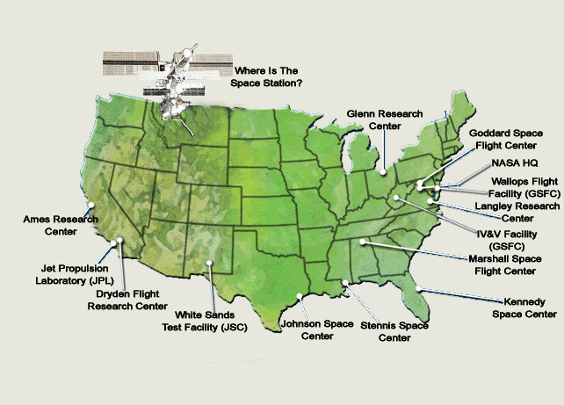
NASA Centers

Slide 54
SOW Section 8: NASA Safety Training Center (NSTC) (cont’d)
Conduct an Annual Training Needs Survey
Develop proposed training schedule based on the survey
Maintain training records in NASA’s training system, currently SATERN (System for Administration, Training, and Educational Resources for NASA)
Note: Budget for the NSTC is from NASA Safety Center and out of JSC’s direct control

Slide 55
SOW Section 9: Safety Program Development and Evaluation
Encouraged to recommend improvements to JSC's Safety Program
Implement program improvements as directed
Recommend changes to JPR 1700.1 to keep current with higher level requirements and good safety practice

Slide 56
SOW Section 9: Safety Program Development and Evaluation (Cont’d)
Review Agency-level safety requirements and standards
Review proposed Federal Register safety-related changes to assess impact on JSC
Analyze data and measure the performance of JSC's Safety and Health Program

Slide 57
SOW Section 10: Test Safety
Includes hazardous hardware tests and tests involving human subjects
Review test documents such as plans, procedures, and hazard analyses
Participate in test readiness reviews for test approval
Monitor human tests and selected hardware tests
Support the JSC Committee for the Protection of Human Subjects
Ensure JSC and NASA requirements are met
May require international travel

Slide 58
SOW Section 11: Administer Lockout/Tagout Equipment
JSC has standardized lockout/tagout program, which includes centralized issuing of locks and other lockout/tagout devices
Maintain and account for an inventory of lockout and tagout devices that meet JSC and OSHA requirements
Issue lockout and tagout devices to organizational and contractor representatives
  Representatives are responsible for issuing devices to users
NOT required to keep track of where and how the locks are used

Slide 59
SOW Section 12: Special Projects
No Section 12 work is authorized without approval from CO
Routine, unexpected repairs and modifications exceeding $5K
Year end upgrades to modernize JSC’s fire protection systems
Other Special Projects (authorized by separate task order). Examples include:
  New Safety Databases
  Safety surveys or tools
  Special safety studies
  Other safety-related initiatives

Slide 60
Proposal Instructions Overview
Anh H. Huynh
SEB Chairperson

Slide 61
Section L - Proposal Instructions
Section L provides essential information about what to include in your proposal and how to organize the information
  Proposals should demonstrate overall understanding of requirements & convey your companies capabilities
  Do not simply repeat our statement of work
  Proposals should include 4 volumes
    Volume I – Mission Suitability
      Restricted to 100 pages
      Management Plan, Total Compensation Plan, Quality Plan, Phase-in Plan, Conflict of Interest Plan, and Safety and Health Plan will be attachments to this volume, but are not included in page count
    Volume II – Past Performance (No page restriction)
    Volume III – Cost (No page restriction)
    Volume IV – Model Contract (No page restriction)

Slide 62
Section L - Proposal Instructions (cont’d)
Volume I – Mission Suitability
  Technical Approach
    Detailed approach to accomplishing each SOW item
      Innovation, when substantiated, is good
      Include skill mix and staffing. Substantiate any differences with Government estimate
    Proposed solutions to two hypothetical safety scenarios
  Overall Management Approach
    Approach to establishing Associate Contractor Agreements
    Key Personnel Resumes, Sec L, Attachment L-2
    Attachments:
      Management Plan
      Total Compensation Plan
      Quality Plan
      Phase-In Plan
      Conflict Of Interest Plan

Slide 63
Section L - Proposal Instructions (cont’d)
Volume I – Mission Suitability (Cont’d)
  Safety and Health
    Safety and Health Plan
    Statement of past safety performance for similar contracts
      OSHA citations during past 5 years and corrective actions taken
      Records of recordable injuries and illnesses
      If you propose a joint venture, provide the same information for each subcontractor company
    Statement of past environmental performance
      Environmental citations during the past 5 years and corrective actions taken
      If you propose a joint venture, provide the same information for each subcontractor company
    List of safety and health insurance carriers during past 5 years
      Point of contact information for carriers (please notify carriers that NASA will be contacting them, to prevent delay of data release)
      Certification Letter from Workers Compensation Insurance Carrier

Slide 64
Section L - Proposal Instructions (cont’d)
Volume II – Past Performance
  Send Reference forms (Sec L, Attachment L-1) to three recent and relevant references
    Government contracts are preferred but not mandatory
    Your references must complete the forms and send them to NASA directly by the cutoff date (this is your responsibility)
    If you propose a joint venture, provide the same information for each team member or subcontractor company
  Provide on the first page of Sec L, Attachment L-1:
    Company names, addresses, and point of contact information for the three references mentioned above
    Company names, addresses, and point of contact information for two additional references
      Reference forms not required

Slide 65
Section L - Proposal Instructions (cont’d)
Volume III – Cost
  Carefully follow all cost/pricing instructions included in
  Section L
  Use Excel spreadsheets provided for reporting of cost data
  See Government Standard Labor Categories and map your labor categories to this list
  Government estimate of the skill mix is provided as a reference
Volume IV – Model Contract
  Three (3) original signed Standard Form 33’s
  Sections A-J, with all fill-ins completed
  Section K, Representations and Certifications with all fill-ins completed

Slide 66
Pricing Overview
Herbert Rocha
JSC Procurement Pricing

Slide 67
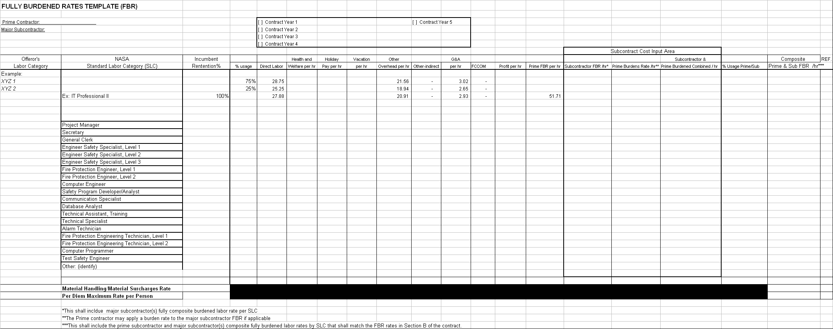
Pricing Overview

Slide 68
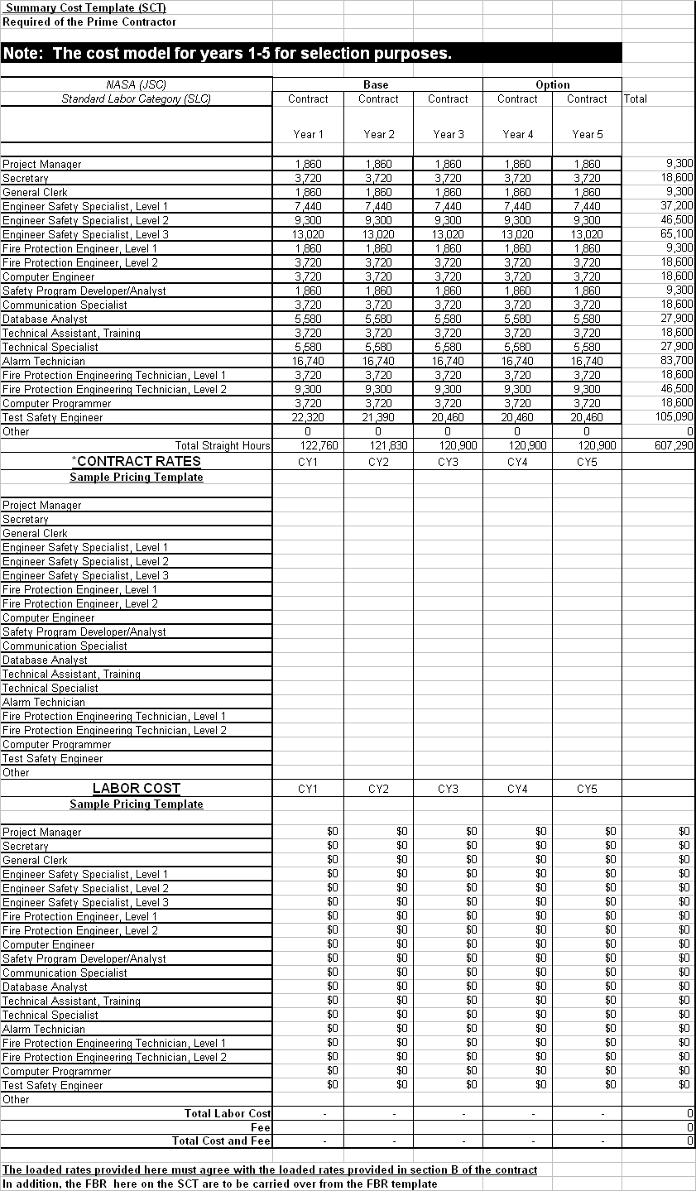
Pricing Overview (cont’d)

Slide 69
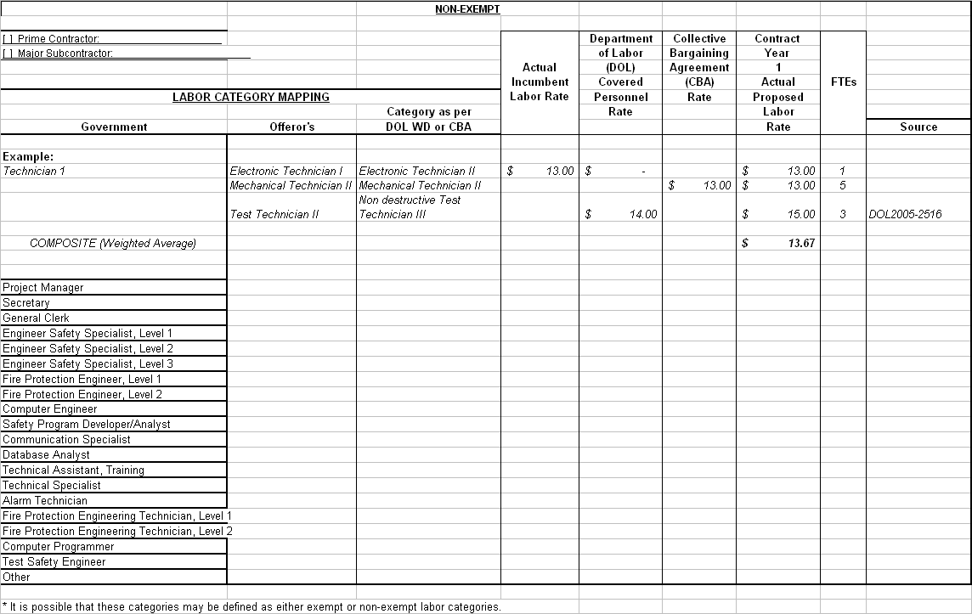
Pricing Overview (cont’d)

Slide 70
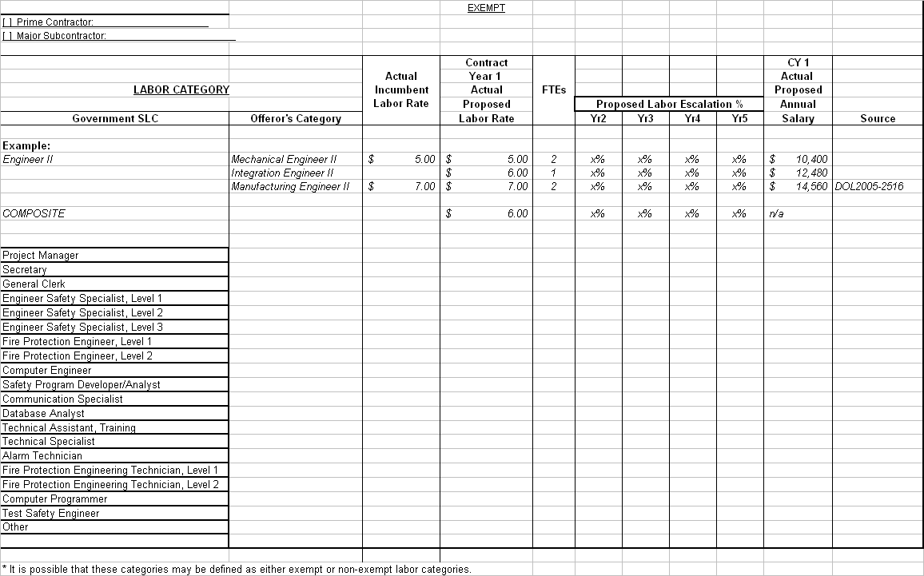
Pricing Overview (cont’d)

Slide 71
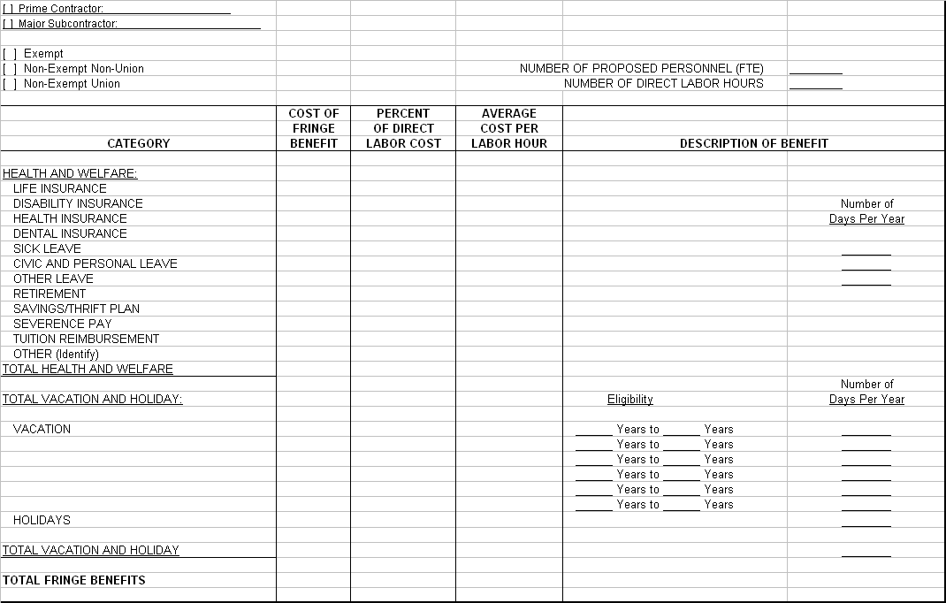
Pricing Overview (cont’d)

Slide 72
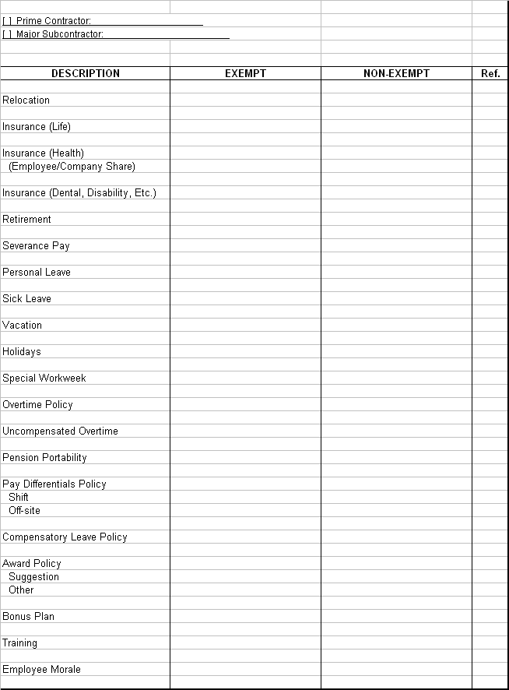
Pricing Overview (cont’d)

Slide 73
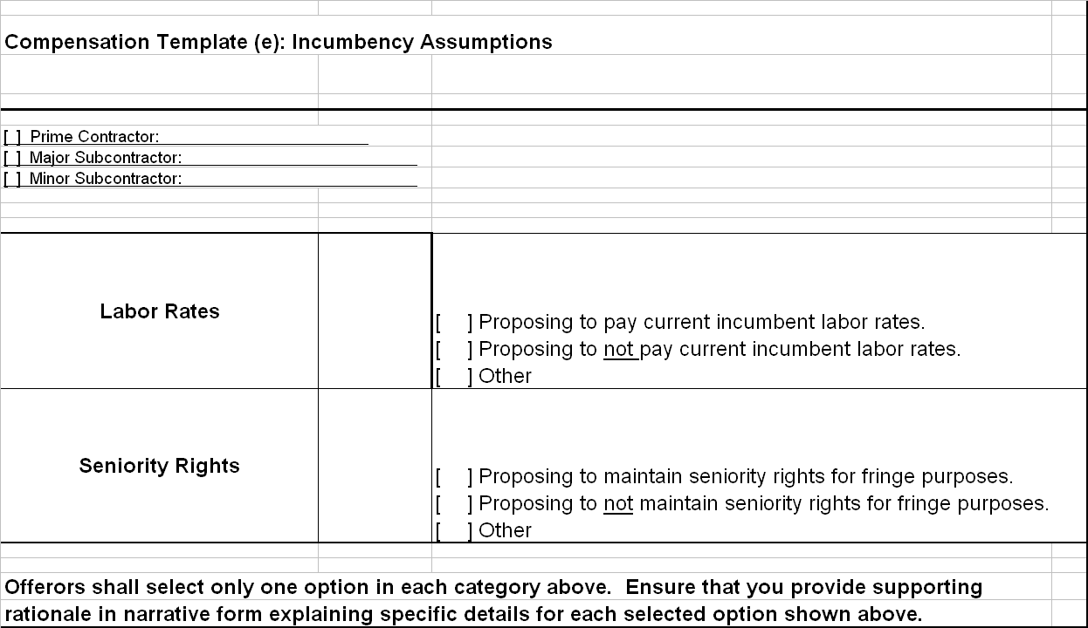
Pricing Overview (cont’d)

Slide 74
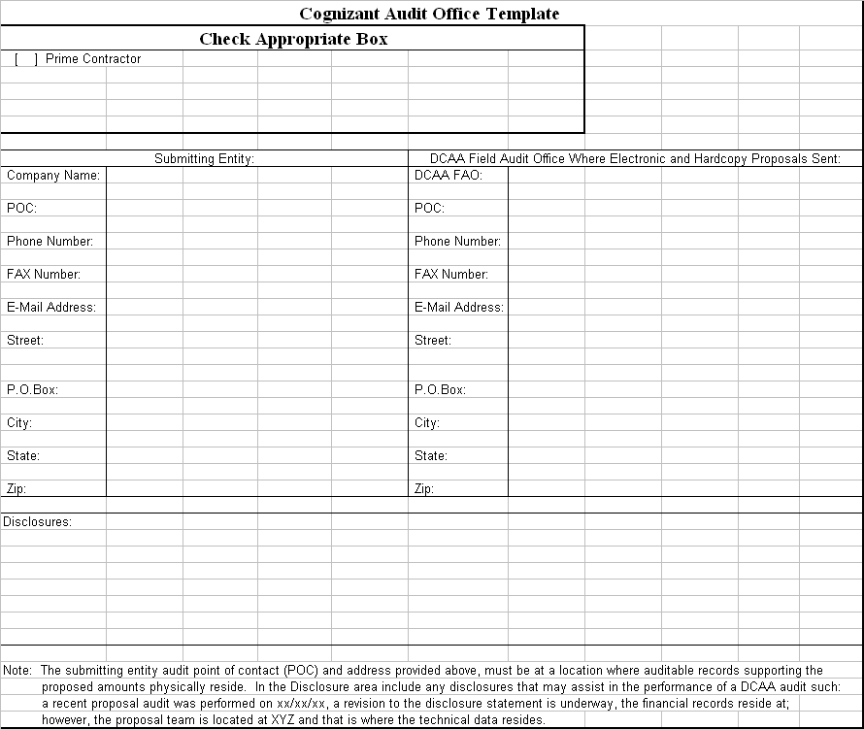
Pricing Overview (cont’d)

Slide 75
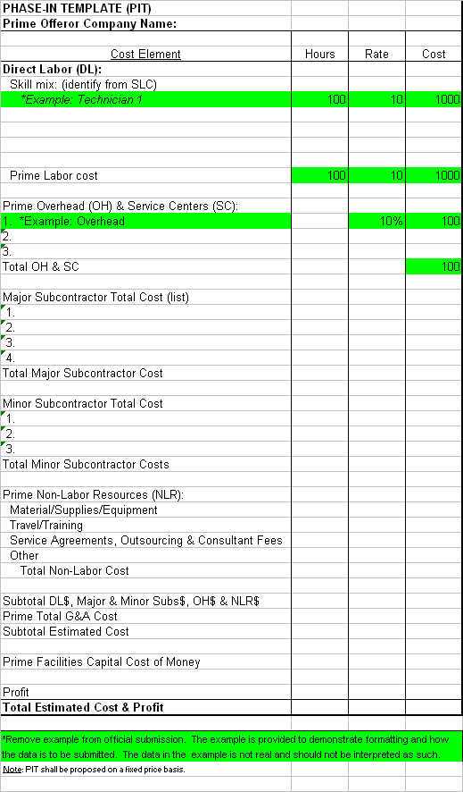
Pricing Overview (cont’d)

Slide 76
Proposal Evaluation Overview
Anh H. Huynh
SEB Chairperson

Slide 77
Section M - Evaluation Factors
  Evaluation Factors for Award
    Mission Suitability Factor
      Technical Approach 500 Points
      Management Organization and Approach 400 Points
      Safety and Health 100 Points
    Past Performance Factor
    Cost Factor
  “Mission suitability and past performance when combined are significantly more important than cost. Mission Suitability and Past Performance are approximately equal in importance.”

Slide 78
Section M - Evaluation Factors (cont’d)
  Technical Approach
    Proposed approach for accomplishing the SOW
      Achieving the goal and objectives as stated in the JSC safety vision
      Integrating critical elements in a logical and systematic manner
      Including sufficient details to verify that the SOW items are understood
      Substantiating steps to implement in the JSC environment
      Taking into account relevant policies, procedures, staffing and skill mix
      Innovative solutions need to be substantiated
    Solutions proposed for the two hypothetical safety scenarios
      Scenario solutions should be a good indicator that you understand the fundamental requirements of the SOW
      Solutions must be relevant to the unique environment at JSC

Slide 79
Section M - Evaluation Factors (cont’d)
  Management Organization and Approach
    Overall management approach and organization
    Approach for the Total Compensation Plan
    Approach to establishing the ACA’s
    Qualifications of Key Personnel to manage their areas of responsibility
    Approach for the Management Plan, Quality Plan, Phase-In Plan, and Conflict Of Interest Plan
    Proof that your company will be certified by Texas Commission of Fire Protection by the contract start date

Slide 80
Section M - Evaluation Factors (cont’d)
  Safety and Health
    Addressing applicable areas specified in the Safety and Health Plan
    Demonstrating policies, procedures, and techniques used to ensure the safety and health of your employees and any sub-contractor employees
    Discussing Safety and health data:
      OSHA Citations and Corrective Actions Taken
      OSHA recordable injuries and illnesses
      Environmental Citations and Corrective Actions Taken
      Insurance carrier certification letters
      Experience Modifier Ratio
    Correlating with JSC’s Safety and Health Program

Slide 81
Section M - Evaluation Factors (cont’d)
  Past Performance Factor will be evaluated based on the following:
    Offeror’s personal assessment
    Reference information submitted to NASA on Sec L, in Attachment L-1
    References contacted directly by NASA
    Other information NASA obtains, such as information from the Government-wide past performance database
  Adjective score will be assigned to Past Performance

Slide 82
Section M - Evaluation Factors (cont’d)
  Cost Factor will be evaluated based on the following:
    DCAA will review your company’s rates and business methods to verify they are adequate for performing the contract
    Labor cost will be calculated based on proposed fully-loaded rates and Government-estimated hours

Slide 83
Site Tour
James D. Taylor
Safety and Test Operations Division

Slide 84
Site Tour
Please be at the front of Space Center Houston at 12:50 p.m.
Site Tour leaves promptly at 1:00 p.m.
Approximate time for the tour is 3 hours.
Badge required for site tour.
Maximum of three representatives (U. S. citizens) from each company.

Slide 85
Site Tour (cont’d)
ELLINGTON FIELD - NASA AIRCRAFT SUPPORT – Pump House and
Hanger 990
SCTF- NEUTRAL BUOYANCY LABORATORY – TSO Offices and general
overview
Post 12 & Building 421 (Drive by only)
B-420 – LOGISTICAL SERVICES OFFICE – Critical Spares
“300 Area” – MAINTENANCE SHOPS (Drive by only)
B-350 – ENERGY SYSTEMS TEST AREA (Drive by only)
B-24 – CENTRAL HEATING AND COOLING PLANT (Drive by only)
B-25 – FIRE OPERATION FACILITY (25 minutes)
B-20 – CONSTRUCTION SITE (Drive by only)
B-30 – MISSION CONTROL – HOUSTON (Drive by only)
B-45 – PROJECT ENGINEERING OFFICES / NASA SAFETY DIVISION (Drive
by only)
B-32 – SPACE ENVIRONMENT SIMULATION LABORATORY (Drive by only)

Slide 86
Site Tour (cont’d)
B-33 – SPACE ENVIRONMENT EFFECTS LABORATORY (Drive by only)
B-9 – SPACE VEHICLE MOCKUP FACILITY (Drive by only)
B-10 – TECHNICAL SERVICES SHOP (Drive by only)
B-226 & 226N – ADMINISTRATION SUPPORT FACILITY
B-8 – PHOTOGRAPHIC TECHNOLOGY LABORATORY / NASA CLINIC (Drive
by only)
B-7 – CREW SYSTEMS LABORATORY
B-35 – MISSION SIMULATION DEVELOPMENT FACILITY (Drive by only)
B-5 – JAKE GARN SIMULATOR AND TRAINING FACILITY (Drive by only)
B-4 – Mechanical Room - OFFICE BUILDING – Fire protection systems
B-1 – PROJECT MANAGEMENT (Drive by only)
B-110 – SECURITY CENTER / BADGE OFFICE (Drive by only)

Slide 87
Thank you for attending the
Johnson Space Center
Pre-Proposal Conference
for the Center Institutional Safety Services Contract

