Slide 1
The Community Networks Program (CNP)
Bridging the gap between scientific discovery and delivery of care to the community
What is the Community Networks Program?
Launched in spring 2005, the National Cancer Institute’s (NCI) Community Networks Program (CNP) aims to reduce and eliminate cancer disparities through community-based research, education and training. Its goal is to significantly improve access to and use of beneficial cancer interventions in communities experiencing disparities.
To achieve this goal, CNP is working closely with multiple community agencies and organizations to develop and implement effective ways to reduce cancer health disparities.
CNP - Implementing Community-based Research, Education and Training
To address cancer disparities, NCI awarded $95 million in 5-year grants to fund 25 CNP cooperative agreement projects across the United States and in American Samoa.
Who Does CNP Reach?
CNP addresses cancer disparities among African Americans, American Indians/Alaska Natives, Hawaiian Natives and other Pacific Islanders, Asians, Hispanics/Latinos, and rural underserved populations. Ten grantees work in local areas, ten in regional areas, and five in national programs.
Phases of the CNP Program
Building capacity through partnerships and collaborations
Strategic partnerships and collaborations are being developed within the CNP to further enhance vital training, research and educational functions of the program. One type of partnership involves working directly with community-based groups representing populations that experience disparities, or working through Community Advisory Groups, composed of community leaders who serve as a voice of the community. Other partnerships involve clinical resources, such as cancer prevention clinics and early detection initiatives, which provide cancer screening. Clinical resources may also include hospitals that serve the cancer care needs of the community. A third type of partnership involves working with other community groups, such as local chapters of the American Cancer Society, to enhance efforts to reduce disparities in CNP communities.
Creating community-based cancer disparities research and training
CNP research spans the spectrum of community-based participatory research, from needs assessments to development of culturally appropriate interventions to policy evaluations. The CNP projects also include training in community-based participatory research to reduce cancer health disparities. A third aspect of this phase includes development and implementation of research pilot studies by new investigators.
For More Information
For more information about the Community Networks Program, visit our Web site at http://crchd.nci.nih.gov/initiatives/cnp/.
Center to Reduce Cancer Health Disparities
6116 Executive Boulevard, Suite 602
Rockville, MD 20852
Phone: 301-496-8589
Fax: 301-435-9225

Slide 2
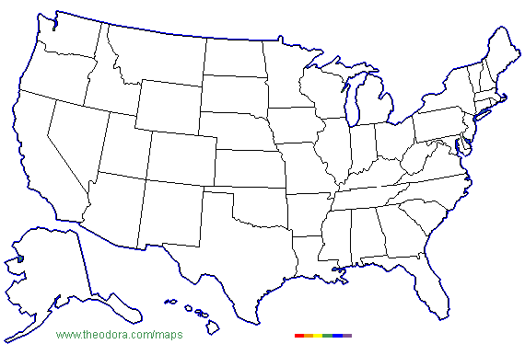
Establishing credibility and sustainability of programs
CNP grantees will disseminate findings on promising interventions that can be adopted by other communities; obtain funding for further research in disparities reduction; increase participation in primary and secondary prevention activities; improve access to standard cancer screening, diagnosis, and treatment; provide best practice guidelines; and inform decision makers of promising practice and policy approaches to reducing cancer health disparities.
Encouraging Community Participation
Through the CNP, the fight against cancer health disparities is being elevated to a new level, and tangible steps are being taken to eliminate disparities by working in partnership with and through communities to address their cancer prevention and control needs. Practices and lessons learned from the CNP will form the basis for the development of future programs and projects focused on eliminating the disparities that affect too many Americans.
What are Cancer Health Disparities?
There have been great advances in the development of beneficial medical interventions in cancer prevention, early detection, diagnosis and treatment. However, many Americans have not fully benefited from these advances.
There is a “disconnect” between our research system, which develops interventions, and our delivery system, which provides these to everyone. This “disconnect” leads to cancer health disparities.
Eliminating these disparities is a challenge to science and a moral and ethical dilemma to the Nation.
Community Networks Program Projects
Fred Hutchinson Cancer Research Center Beti Thompson
University of Washington Dedra Buchwald
Mayo Clinic Judith S. Kaur
University of California Moon S. Chen, Jr.
University of Colorado Estevan T. Flores
Washington University Dione Farria
California State University Sora P. Tanjasiri
University of Oklahoma Laura Beebe
Inter Tribal Council of Arizona Kathryn Coe
Baylor College of Medicine Amelie G. Ramirez
Papa Ola Lokahi Clayton Chong
Lyndon Baines Johnson Tropical Medical Center Victor W. Tofaeono
Wayne State University Terrance L. Albrecht
Harvard School of Public Health Howard K. Koh
Temple University Grace X. Ma
University of Maryland Claudia Baquet
MedStar Research Institute Elmer E. Huerta
University of Kentucky Mark B. Dignan
University of North Carolina Paul A. Godley
Meharry Medical College John E. Maupin, Jr.,
University of South Carolina James R. Hebert
Morehouse School of Medicine David Satcher
University of Alabama Edward E. Partridge
University of Arkansas Ronda S. Henry-Tillman
H. Lee Moffitt Cancer Center & Research Institute Cathy D. Meade
▲
▲
▲
▲
▲
▲
▲
▲
▲
▲
▲
▲
▲
▲
▲
▲
▲
▲
▲
▲
▲
▲
▲
▲
▲

