Slide 1



U.S. Military – Activities and Responses to Climate Change
William D. Goran
Southeast Natural Resources Leaders Group (SENRLG)
Charleston SC, May 2008

Slide 2



Climate Change Impacts
Inter-Agency Working Group
Voluntary and informal group. No official status within or across agencies.
Co-leads:
  Sam Higuchi, NASA HQ
  William Goran, Army Corps of Engineers, R&D
Formed in 2007, responsive to GAO Report: 07-863
Purpose is to share approaches, data and experiences in characterizing and responding to anticipated impacts related to climate change to facilities and missions
Linkages to Climate Change Science Program Office
Will meet as long as serving useful purpose

Slide 3
Upcoming Climate Change Inter-Agency Forum
26 June 2008 NASA HQ
Welcome and Introductions | Mr. Sam Higuchi, NASA Sustainability Coordinator | 1:00 PM
NASA Administrator | ROSES Program | 1:30 PM
Damien Parmenter, Office of the Secretary of Defense | Policy Analysis on Shock and Trends - Climate Change Focus | 1:45 PM
Break | Discussion on economic impacts | 2:30 PM
Susan Asam, ICF International | A Framework for Analysis of Climate Change Impacts | 2:50 PM
Rachel Jonassen, LMI | Federal Leaders Guide to Climate Change | 3:30 PM
Discussion on schedule and topics for upcoming meetings | W. Goran and all | 4:20 PM
Adjourn |  | 4:30 PM

Slide 4
Defense Climate Change Impact Legislation
Defense 2008 Authorization Bill (Subtitle F, Other Matters, Section 951. Department of Defense Considerations of Effects of Climate Change on Department Facilities, Capabilities and Missions.
  Assess risks
  Update Defense plans
  Develop capabilities needed to reduce future impacts
Include assessment and plans update in next quadrennial defense review
Use mid-range projections from fourth assessment report of the Intergovernmental Panel on Climate Change
Ensure that climate change impacts do not have a negative impact on national security of the United States

Slide 5
Office of Secretary of Defense
Climate Change Study
Part of an overall effort related to “emerging” issues (Trends & Shocks), in their “sub-area” entitled Environment & Climate Change, Damian Parmenter, ODASD Policy Planning. Analysis focused on missions, not facilities.
Why Environment & Climate?
Today pressures on the environment present a range of emerging challenges and will increasingly be a driver of internal conflict within vulnerable states
Trends to 2030 suggest these pressures will increase slowly and linearly, beyond 2030 they may accelerate and become a principal driver of external conflict
Rapid population growth, increasing littoral urbanization, and globalization will increase sensitivity to these changes
Climate extremes may effect operational performance

Slide 6
National Security and the Threat of Climate Change*
Projected climate change poses a serious threat to America’s national security
Climate change acts as a threat multiplier for instability in some of the most volatile regions of the world
Projected climate change will add to tensions even in stable regions of the world
Climate change, national security and energy dependence are a related set of global challenges for the US
*Study conducted by the Military Advisory Board of the CNA Corporation,
released in April 2007

Slide 7

A
2036: Multiple & growing stresses
AREAS AT MOST RISK:
Africa: multiple severe stress
ME, Asia: Increased physical stress
America, Europe: Coastal risks
Water stress
Demographic stress
Crop decline
Hunger
Coastal risk
Recent history of conflict
Source: DCDC

Slide 8
New Research Initiatives
Strategic Environmental Research and Development Program (SERDP) FY09 statements of need:
  SISON-09-02: Managing and Restoring Southeast Coastal Ecosystems Under the Threat of Climate Change
  SISON-09-05: Assessment of the Impact of Sea Level Rise on Military Infrastructure
  Ecosystem service workshop (Eglin AFB, April 08)

Slide 9
DoD Clean Air Act Services Steering Committee (CAA SSC)
Mr. Elmer Ransom– the DoD Clean Air Act Subcommittee Chair for Global Climate Change
Subcommittee’s interest triggered by Supreme Court ruling Supreme Court Ruled on 2 April 2007 that the EPA has the authority to regulate GHG within the CAA definition of “air pollutant”
Also tracking extensive activities of states
  GHG laws
  State executive orders
  State goals
  State engaged in regional initiatives

Slide 10
U. S. Army Corps of Engineers Actions for Change (AFC)
AFC is a Corps of Engineering initiative intended to result in fundamental change in the Corps processes and culture by developing and implementing an integrated, comprehensive and risk-based systems based approach in the execution of all its mission areas.
Developed from an analysis of the performance of the Southeast Louisiana Hurricane Protection System during Hurricanes Katrina and Rita and other analyses internal and external to the USACE.
Theme 1 (Comprehensive Systems Approach) objective is to develop and incorporate anticipatory management to remain adaptable and sustainable over time.
Temporal and Spatial Systems team addresses climate change and other dynamic temporal and spatial system changes that introduce uncertainty and reduce resilience into natural (and human altered) systems.

Slide 11
Additional Climate Change Impacts and Mitigation Knowledge Gaps
Ft. Carson greenhouse gas study
Air Force “inventory” initiative
Ecosystem services workshop – Eglin Air Force Base
Army and Corps of Engineers water supply study
Alaska Workshop on climate change impacts

Slide 12
Issues
Who’s in charge? Climate Change concerns (reduction of footprint, impacts, adaptations) cross many stovepipes in military
Federal agencies hesitant to move forward with new administration soon to be elected. Focus on climate change issues will increase in near future. Meanwhile, needed guidance on the back burner.
Inventory: What to count, how to report, how does counting impact our actions ?
Markets: how will agencies relate to GHG and carbon markets?
Cost Models: How do we credibly account for costs of actions and inactions?
Jurisdictional complexity: if feds participate in plans with states, in the absence of agency guidance, what are the risks and how are they mitigated?

Slide 13
Backup

Slide 14
Upcoming Forums
Informal Interagency Working Group: Climate Change Impacts (meets in DC at NASA HQ monthly)
DoD Clean Air Act Services Steering Committee (CAA SSC)
Unfrozen Treasures – National Security, Climate Change and the Arctic Frontier (May 12-13, 2008, National War College)
Paris Workshop: Bill Van Houten, OSD (Nov 2008)
Anchorage Workshop: Climate Change Impacts in Alaska (Spring 2009)

Slide 15
Building Awareness within the Military
Analysis and Reports
CNA report on threats of Climate Change
OSD Trends and Shock Analysis
U.S. allies military analysis of “impacts” of climate change
  UK Defense CDC Strategic Report (December 2006)
  Swedish Defence Research Agency Report (2007) – Geopolitics of Climate Change
AEPI Foresight Bulletin, July 07: Climate Change and Army Sustainability
SERDP Symposium, December 2007 (Keynote and Work Session)
Corps of Engineers “Actions for Change”

Slide 16

Army Foresight:
Climate Change and Army Sustainability
Edition 4.1 July 2007
Highlights the CNA report
Interprets the IPCC findings
Examines the Army impacts:
  Army coastal installations
  Infrastructure vulnerability
  Population displacement potential
  Human health risks
  Army resource issues (costs of challenges related to missions)
  Sudden change potential

Slide 17
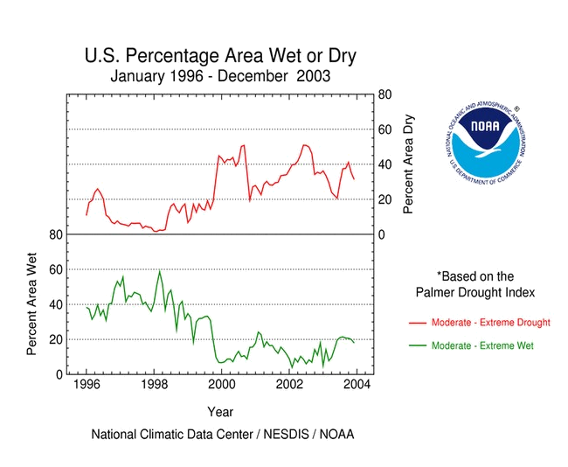
Water Supply Study Proposed by AEPI
Examine water supply concerns to:
Relate to military bases and missions
Anticipate local and regional water supply problems
Forecast issues for next several decades, and include understanding of climate impacts on water supply
Examine policy options to respond to anticipated problems
Help focus military response and engagement with stakeholders
Integrated Civil Works and Military Installation Perspectives on Water Supply

Slide 18



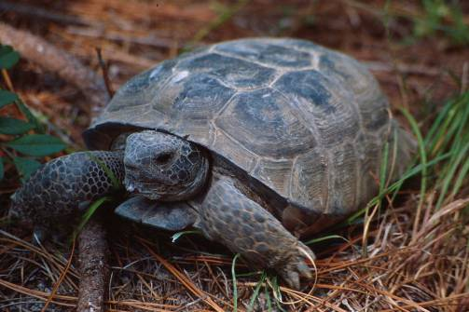
Ecosystem Service Valuation
Foresight bulletin March 2007
JSEM presentations May 2007
ERDC Special Report on current & potential military land actions related to ecosystem services (Feb 2008)
The Nature Conservancy and SERDP Workshop hosted at Eglin Air Force Base (April 2008)
Concept for new Army conservation research initiative (2011)
“The disparity between actual and perceived value is probably nowhere greater than in the area of ecosystem services.” (Gretchen Daily, 1997)

Slide 19




Climate Change Impacts on Defense Missions and Assets in Alaska
A Workshop to Examine Issues
Related to Climate Change Impacts on Defense
Missions, Infrastructure, Facilities
and Managed Ecosystems in Alaska

Slide 20
Strategic Trends 2007- 2036
UK Ministry of Defence
Strategic Trends is an independent view of the future produced by the Development, Concepts and Doctrine Centre (DCDC), a Directorate General within the United Kingdom’s Ministry of Defence. It is a source document for the development of UK Defence Policy.
Identifies 3 “Ring Road” Drivers: Climate Change, Globalization, Global Inequity
Provides detailed global examination of these drivers
Website:
http://www.mod.uk/DefenceInternet/AboutDefence/WhatWeDo/DoctrineOperationsandDiplomacy/DCDC/

Slide 21
The Geopolitics of Climate Change
Peter Halden, 2007
Swedish Defence Research Agency
Region by region global analysis of the anticipated stresses of climate change, and how the natural system dynamics might influence human system responses (with strong emphasis on the decoupling of these systems, and “choices” of response within human systems)

Slide 22
Legislative and other Drivers
Reducing Impact
Executive Order 13423
Energy Independence and Security Act of 2007
Defense and Service Strategies and Goals
ISO standards for GHG
EPA’s Climate Leaders
DOE/EIA 1605b Voluntary GHG Reporting Program
California Climate Action Registry
Understanding Impact and Adapting
Defense 2008 authorization bill - instructions to assess climate change impacts
GAO Report: 07-863

Slide 23
GAO Report 07-863
Title: Climate Change: Agencies Should Develop Guidance for Addressing the Effects on Federal Land and Water Resources
Report Released: August 07
Finding: Federal lands and waters are subject to a wide range of impacts from climate change, from physical effects, biological effects and social and economic effects
Finding: Research managers lack guidance about whether or how to address climate change impacts
Recommendation: Agencies need to develop guidance
Report Access: www.gao.gov/cgi-bin/getrpt?GAO-07-863

Slide 24
EPA’s Climate Leaders
Climate Leaders is an EPA industry-government partnership that works with companies to develop comprehensive climate change strategies. Partner companies commit to reducing their impact on the global environment by completing a corporate-wide inventory of their greenhouse gas emissions based on a quality management system, setting aggressive reduction goals, and annually reporting their progress to EPA. Through program participation, companies create a credible record of their accomplishments and receive EPA recognition as corporate environmental leaders.
Website: http://www.epa.gov/stateply/
Launched in 2002.
Partner Company list at: http://www.epa.gov/stateply/partners/index.html
What leverage is Defense using to encourage companies serving Defense to participate?

Slide 25
Executive Order 13432
Subject: Cooperation Among Agencies in Protecting the Environment with Respect to Greenhouse Gas Emissions from Motor Vehicles, Non-road Vehicles, & Non-road Engines
Effective May 16, 2007
Cooperative response across agencies
Generating significant agency responses (certainly in reporting)

Slide 26
Energy Independence and Security Act of 2007
Key Elements
Increasing the supply of alternative fuel sources by setting a mandatory Renewable Fuel Standard (RFS) requiring fuel producers to use at least 36 billion gallons of biofuel in 2022
Reducing U.S. demand for oil by setting a national fuel economy standard of 35 miles per gallon by 2020 – which will increase fuel economy standards by 40 percent and save billions of gallons of fuel.
Require all general purpose lighting in Federal buildings to use Energy Star® products or products designated under the Energy Department's Federal Energy Management Program (FEMP) by the end of Fiscal Year 2013.
Update the Energy Policy and Conservation Act to set new appliance efficiency standards that will save Americans money and energy
Establish an Office of High-Performance Green Buildings (OHPGB) in the U.S. General Services Administration
Federal facilities with a footprint that exceeds 5,000 square feet shall use site planning, design, construction, and maintenance strategies for the property to maintain or restore, to the maximum extent technically feasible, the predevelopment hydrology of the property with regard to the temperature, rate, volume, and duration of flow.
Signed 19 Dec 2007. Fact sheet Website: http://www.whitehouse.gov/news/releases/2007/12/20071219-1.html

Slide 27
DOE Voluntary Reporting
For More Information About Voluntary Reporting...
Voice: 1-800-803-5182 or 202-586-0688 Fax: (202) 586-3045
E-mail: infoghg@eia.doe.gov
Internet: http://www.eia.doe.gov/oiaf/1605/frntvrgg.html
FTP: fttp://ftp.eia.doe.gov/pub/oiaf/1605/cdrom
Mailing Address: Voluntary Reporting of Greenhouse Gases Program, U.S. Department of Energy, Energy Information Administration
Greenhouse Gas Reductions or Greenwash?: The DOE’s 1605b Program* Thomas P. Lyon and Eun-Hee Kim, University of Michigan DRAFT FEBRUARY 2007

Slide 28
California Climate Action Registry
A non-profit public/private partnership that serves as a voluntary greenhouse gas (GHG) registry to protect, encourage and promote early actions to reduce GHG emissions.
Federal facilities across multiple agencies (Defense, NASA, USDA, etc) are electing to participate in the registry
Website: http://www.climateregistry.org/Default.aspx?refreshed=true

Slide 29
Ft. Carson GHG Footprint
The National Defense Center for Environmental Excellence (NDCEE) is tasked with providing the "U.S. Army with a methodology to create a credible and auditable greenhouse gas (GHG) footprint at an installation scale that could be consistently applied throughout the Army."
Tasks are to identify and validate sources of information on direct and indirect emissions, verify emissions data, and provide means for generating reports to satisfy the requirements of EO 13423 (DOE/EIA 1605b Voluntary GHG Reporting Program; an intensity-based metrics report), a GHG Emissions Annual Inventory Report; a report tailored to Ft. Carson's Sustainability metrics; and a report for submission to the Climate Registry (Colorado is a participant).
Timeframe: October 2007 through October, 2008
Ft. Carson is the first test site, and their environmental staff is actively engaged in identifying information sources on direct and indirect GHG emissions from Ft. Carson.

Slide 30
Center for the Advancement
of Sustainability Innovations
US Army Corps
of Engineers
William D. Goran, Center Director
Website: https://casi.erdc.usace.army.mil/
2902 Farber Drive . P.O. Box 9005 . Champaign, Illinois 61826-9005
217-373-6735 . Facsimile: 217-373-7222 . Email: william.d.goran@us.army.mil

