Slide 1
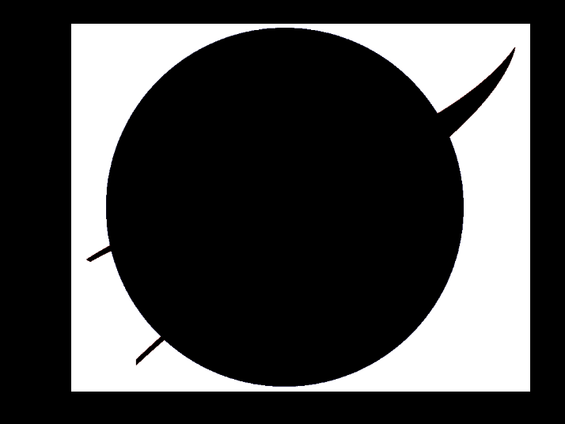
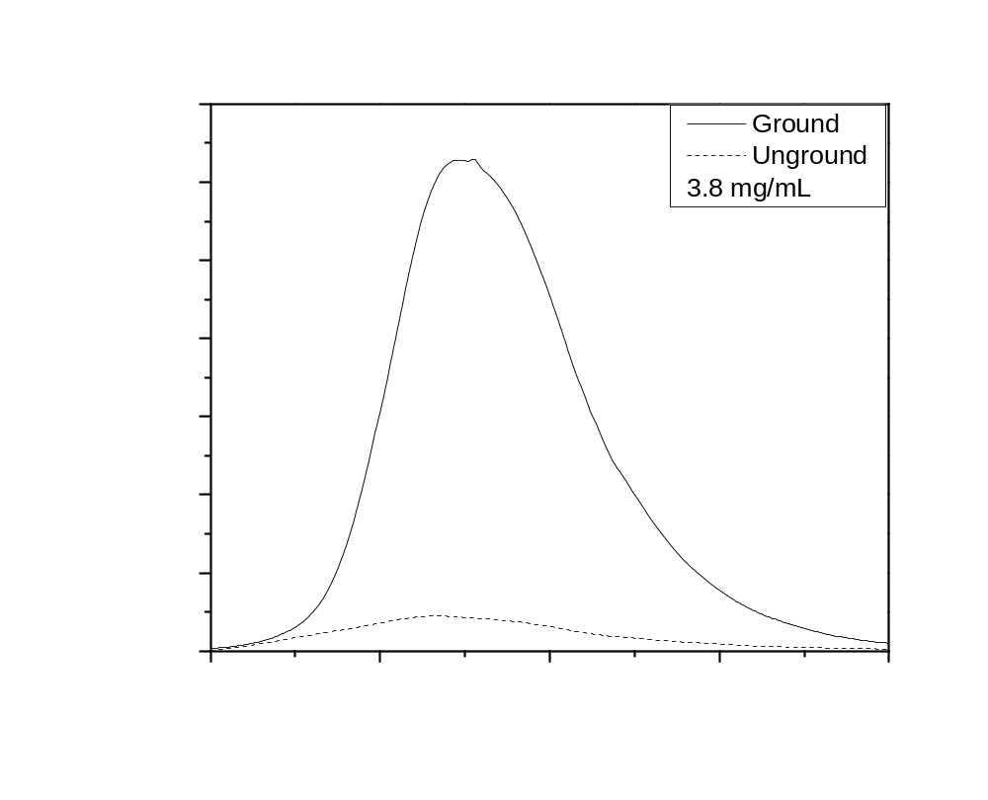
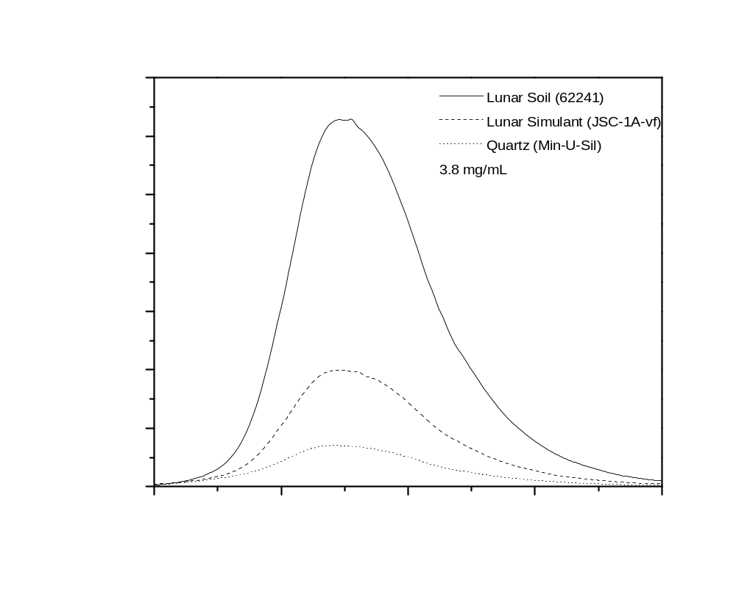
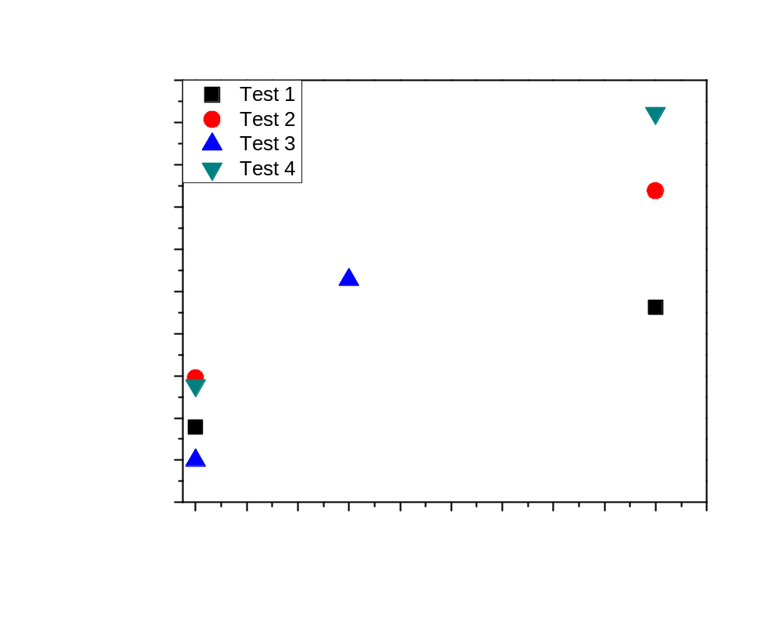
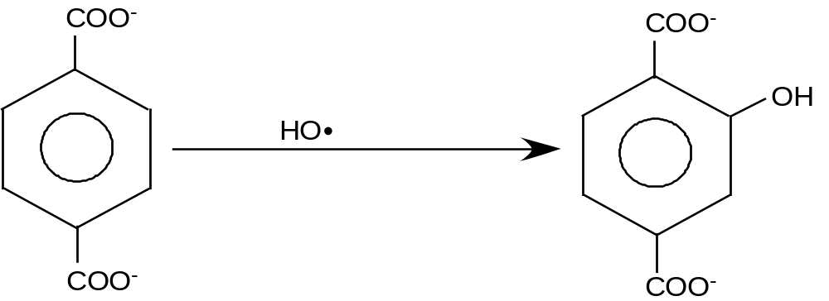
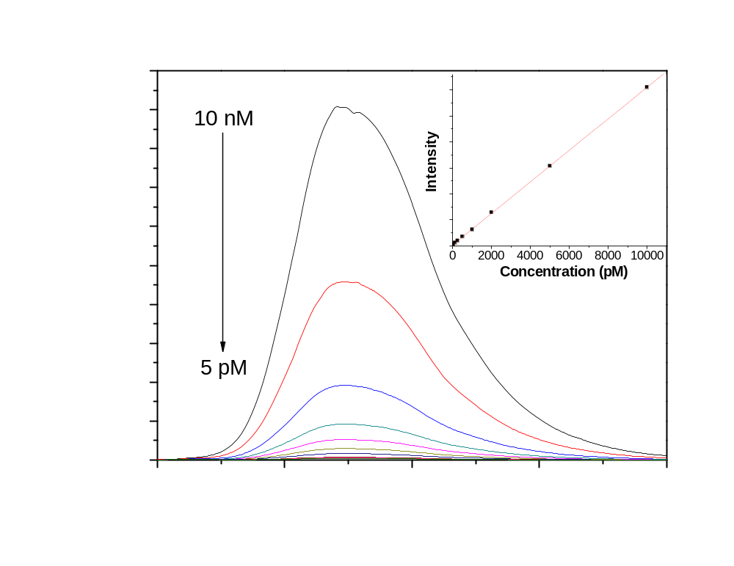
National Aeronautics and Space Administration
Lunar Dust and Lunar Simulant Activation and Monitoring
W.T. Wallace¹, D.K. Hammond², and A.S. Jeevarajan³
¹USRA/NASA Johnson Space Center, ²EASI/NASA Johnson Space Center, and ³NASA Johnson Space Center
Introduction
Prior to returning to the moon, understanding the effects of lunar dust on both human physiology and mechanical equipment is a pressing concern, as problems related to lunar dust during the Apollo missions have been well documented (J.R. Gaier, The Effects of Lunar Dust on EVA Systems During the Apollo Missions. 2005, NASA-Glenn Research Center. p. 65). While efforts were made to remove the dust before by brushing the suits prior to reentering the lunar module or vacuuming once inside, a significant amount of dust was returned to the spacecraft, causing various problems. For instance, astronaut Harrison Schmitt complained of “hay fever” effects caused by the dust, and the abrasive nature of the material was found to cause problems with various joints and seals of the spacecraft and suits. It is clear that, in order to avoid potential health and performance problems while on the lunar surface, the reactive properties of lunar dust must be quenched.
It is likely that soil on the lunar surface is in an “activated” form, i.e. capable of producing oxygen-based radicals in a humidified air environment, due to constant exposure to meteorite impacts, UV radiation, and elements of the solar wind. An activated silica surface serves as a good example. An oxygen-based radical species arises from the breaking of Si-O-Si bonds. This system is comparable to that expected for the lunar dust system due to the large amounts of agglutinic glass and silicate vapor deposits present in lunar soil. Unfortunately, exposure to the Earth’s atmosphere has passivated the active species on lunar dust, leading to efforts to reactivate the dust in order to understand the true effects that will be experienced by astronauts and equipment on the moon.
Electron spin resonance (ESR) spectroscopy is commonly used for the study of radical species, and has been used previously to study silicon- and oxygen-based radicals, as well as the hydroxyl radicals produced by these species in solution (V. Vallyathan, et al., Am. Rev. Respir. Dis. 138 (1988) 1213-1219). The size and cost of these instruments makes them unattractive for the monitoring of lunar dust activity. A more suitable technique is based on the change in fluorescence of a molecule upon reaction with a hydroxyl radical (or other radical species). Fluorescence instruments are much less costly and bulky than ESR spectrometers, and small fluorescence sensors for space missions have already been developed (F. Gao, et al., J. Biomed. Opt. 10 (2005) 054005).
For the current fluorescence studies, the terephthalate molecule has been chosen for monitoring the production of hydroxyl radicals in solution. As shown in Scheme 1, the reaction between the non-fluorescent terephthalate molecule and a hydroxyl radical produces the highly-fluorescent 2-hydroxyterephthalate molecule. This reaction has been shown to
be an excellent choice for monitoring hydroxyl radical prodcution (N. Soh, Anal. Bioanal. Chem. 386 (2006) 532-543). The major advantage of this reaction is the fact that attack of the hydroxyl radical at any of the open ring positions results in the same product, which provides ease in interpreting the fluorescence spectra.
The results presented here focus on our studies of the abilities of different methods to activate lunar simulant, lunar dust, and quartz, and the ability of fluorescence to monitor this activity using the terephthalate molecule. Additionally, we show initial results on the in situ toxicity of lunar simulant on human lung and skin cells.
Materials and Methods
Test materials: Crystalline silica (Min-U-Sil 15) was provided by U.S. Silica, Mill Creek, OK. This material has a mean diameter of 15 µm. Lunar simulant (JSC-1A-vf) was obtained from Dr. James Carter at the University of Texas at Dallas. This simulant was designed to be similar to low-titanium, mature lunar mare regolith with 90% of the particles less than 13 µm . The lunar dust used for this study was an Apollo 16 soil (62241) provided by Dr. Larry Taylor at the University of Tennessee-Knoxville. This particular sample is a mature highland soil with a size distribution between 3 µm – 450 µm.
Preparation of terephthalate solutions: Terephthalate solutions were prepared by dissolving disodium terephthalate (99%, Alfa Aesar) in phosphate-buffered saline (PBS, Sigma Aldrich) in order to produce a final terephthalate concentration of 10 mM.
Grinding procedure: 70 mg of quartz, lunar simulant, or lunar dust were placed in a mortar and ground with a pestle for 10 minutes, stopping every 2 minutes to scrape the sides in order to ensure even grinding. It is important to start with the same amount of material for every test, as grinding different amounts will lead to different activities.
Fluorescence testing procedure: Ground and unground material were added to 15 mL centrifuge tubes containing 2.5 mL of 10 mM terephthalate dissolved in PBS. The mixtures were allowed to interact for 30 minutes before being filtered using 0.22 µm syringe filters. Two mL of the filtered solution was added to a quartz fluorescence cuvette, and the fluorescene spectrum was obtained using a Perkin-Elmer LS-50B spectrometer.
Calibration procedure: The spectra and calibration curve shown in Figure 1 were produced using 2-hydroxyterephthalate synthesized using a method from the literature (L. Field and P.R. Engelhardt, J. Org. Chem. 35 (1970) 3647-3655). The material was then purified using recrystallization until the fluorescence spectra were maximized. Mass spectrometry also confirmed that the only species present following recrystallization was 2-hydroxyterephthalate. A 1 mM solution was prepared by dissolving the product in PBS. Further dilutions were made from this stock solution. For concentrations above 10 nM, the fluorescence saturated the detector. Dilutions below this threshold varied linearly with concentration, as shown in the figure. The excitation wavelength was 324 nm.
Figure 2: Activity Comparison of Freshly Ground and Unground Apollo 16 Soil (62241).
Figure 3: Activity Comparison of Freshly Ground Apollo 16 Soil, Lunar Simulant, and Quartz.
Results
The addition of a small amount of unactivated materials to a 10 mM terephthalate solution produces very little fluorescence (not shown). However, it can be seen that the general order or hydroxyl radical production decreases in the order lunar dust > lunar simulant > quartz. Grinding of the materials was shown to have a large effect. For instance, grinding of Apollo 16 soil (62241) produces the spectrum in Figure 2. With the spectrum produced by the unground material also shown, and a comparison to the calibration curve, it is easy to see that simply grinding the lunar dust produces a large amount of hydroxyl radicals. The amount of radicals is even more striking when the lunar dust, lunar simulant, and quartz are compared. In Figure 3, it can be seen that, under the same grinding conditions, lunar soil produces 2-3 times more hydroxyl radicals than lunar simulant and 10 times more than quartz.
Ideally, due to the fact that grinding changes the particle size distribution of the sample, other methods would be used to reactivate the samples. One possibility is to mimic the ultraviolet radiation experienced by the lunar soil. Initial experiments have been carried out by exposing unground lunar simulant under moderate vacuum to an 800 W UV lamp. As can be seen in Figure 4, after performing the terephthalate fluorescence test, it can be seen that exposure to UV radiation does indeed lead to an increase in reactivity.
As the effect of lunar dust on the human body is of major interest, initial cellular viability studies have been performed. Figures 5 and 6 show the changes in viability of human lung (NHBE) and skin (HEK) cells when exposed to varying concentrations of unground lunar simulant. For each of cell strains, very large concentrations of dust were required to see a change in viability. However, cell death is not the only possible effect of exposure to lunar dust. It is possible that exposure to these materials could cause the cells to produce other harmful species, such as hydrogen peroxide, or to damage the cell walls. Activated simulant and lunar dust may also cause damage or death at lower concentrations. Further studies are needed in order to determine the full effects of lunar dust on cells.
Conclusions
This work has demonstrated methods of activating quartz, lunar simulant, and lunar soil, and monitoring the levels of activation using a fluorescence assay based on the production of hydroxyl radicals in solution. Ground quartz was shown to be much less active for the production of hydroxyl radicals than ground lunar simulant and ground lunar soil. Additionally, the same assay has shown that exposing unground lunar simulant to a high-powered ultraviolet source (to mimic the UV radiation obtained by soil on the lunar surface) can also lead to activation. Concurrent studies on the toxicity of lunar simulant in cellular systems has shown that extremely high doses of unground simulant are required in order to cause cell death. Each of these results provide evidence of the need for further studies on these materials prior to returning to the lunar surface.
Figure 4: UV Activation of Unground Lunar Simulant.
Terephthalate
(non-flurorescent)
2-Hydroxyterephthalate
(fluorescent)
NHBE with Lunar Simulant
Scheme 1: Reaction of hydroxyl radicals with non-fluorescent terephthalate to produce fluorescent 2-hydroxyterephthalate.
3.0
Figure 1: Fluorescence of Synthetic 2-Hydroxyterephthalate. Excitation wavelength – 324 nm.
2.5
2.0
1.5
Absorbance
1.0
0.5
0.0
0
8E-04
0.004
0.008
0.038
0.075
0.375
0.75
3.75
7.5
37.5
75
Concentration [mg/mL]
Figure 5: Effect of Unactivated Lunar Simulant on Lung Cells. (courtesy M.J. Cunningham)
HEK with Lunar Simulant
3.0
2.5
2.0
1.5
Absorbance
1.0
0.5
0.0
0
1E-4
0.001
0.01
0.03
0.07
0.33
0.66
3.3
6.6
33
66
Concentration [mg/mL]
Figure 6: Effect of Unactivated Lunar Simulant on Skin Cells. (courtesy M.J. Cunningham)
Future work
Future work will focus on a variety of tests involving lunar dust activation, deactivation, dissolution properties, and cellular toxicity.
Proton beam and further UV exposure experiments will be conducted to mimic the UV radiation and solar wind exposures experienced by dust on the lunar surface.
The deactivation kinetics of activated lunar dust will be monitored under controlled conditions in order to aid in the development of dust mitigation programs.
Dissolution studies will be carried out to determine if any potentially harmful species are leached into solution and to determine their concentrations.
Further cellular toxicity experiments will be conducted using different cell lines in order to determine the effects of lunar dust activation in vitro and to determine if different cells are more susceptible to damage from lunar dust.
Acknowledgements
Lunar Airborne Dust Toxicity Advisory Group (LADTAG), D.H. Garrison, R.K. Bradley, Ph.D., M.J. Cunningham, Ph.D., Prof. J. Wise

