Slide 1



A Cooperative Transboundary Water Monitoring Project in Central Asia
The “NAVRUZ” Experiment
Amir H. Mohagheghi
Sandia National Laboratories
http://www.sandia.gov
Sandia is a multi-program laboratory operated by Sandia Corporation, a Lockheed martin Company,for the United States Department of Energy under contract
DE-AC04-94AL86000

Slide 2
Co-Authors
David Barber, SNL, CMC Central Asia Program Manager
Melecita Archuleta, SNL, Analytical Chemistry Project Leader
David Betsill, SNL, Technical Manager
Howard Passell, SNL, Ecologist
Sonoya Shanks, SNL, Nuclear Engineer
Bekhzad S. Yuldashev, Institute of Nuclear Physics, Tashkent, Uzbekistan (see report at www.cmc.sandia.gov)

Slide 3
Presentation Outline
The Cooperative Monitoring Center
The NAVRUZ Experiment
Analytical Methods
Preliminary Results
Conclusions

Slide 4
The Cooperative Monitoring Center at Sandia National Labs
Mission: The CMC promotes international cooperation through technology for a more peaceful world.

Slide 5
The Cooperative Monitoring Center at Sandia National Labs
The CMC promotes communication by hosting visiting scholars, workshops, and training programs.
Current focus areas include designing monitoring systems in the Middle East, South Asia, Northeast Asia, Central Asia, and Russia.

Slide 6
Central Asia Program
The Central Asia program promotes regional cooperation to strengthen non-proliferation efforts in the Republics of Kazakhstan, Kyrgyzstan, Tajikistan, Turkmenistan, and Uzbekistan.
The program brings scientists from leading institutes within Central Asia together to demonstrate how collaboration and transparency can help resolve environmental and other regional concerns.

Slide 7
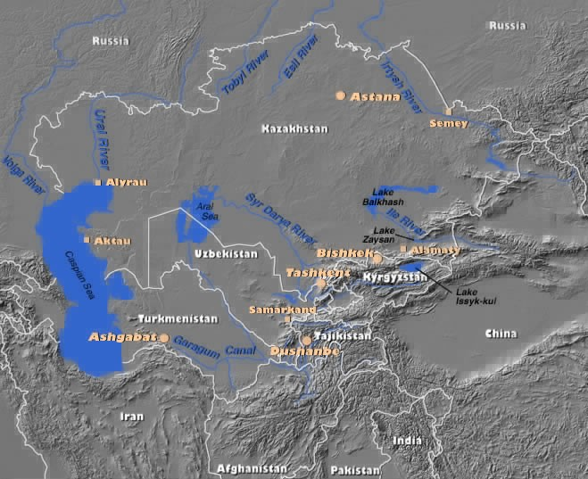

Slide 8
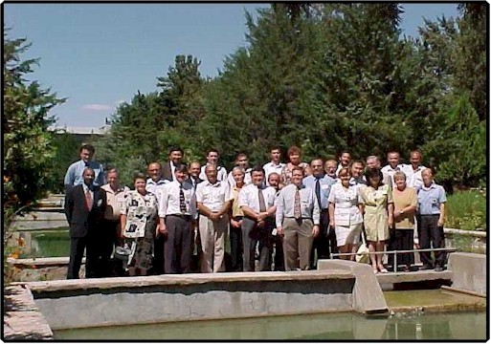
The NAVRUZ Experiment
In March, 2000 the scientists from four institutes in the Central Asia Republics of Kazakhstan, Kyrgyzstan, Tajikistan and Uzbekistan, and the Cooperative Monitoring Center of Sandia National Laboratories embarked on a three-year cooperative transboundary river monitoring experiment.
Participants at the August 2000 Meeting at the Institute of Nuclear Physics, Ulugbek, Uzbekistan

Slide 9
The NAVRUZ Partners
The Institute of Nuclear Physics of the Uzbekistan Academy of Sciences
The Institute of Nuclear Physics, National Nuclear Center, Republic of Kazakhstan
Kazakhstan Association Institute on Non-Proliferation
Atomic Energy Agency, the Tajik Academy of Sciences
Institute of Physics of the National Academy of Sciences, Kyrgyz Republic
Monterey Institute, Newly Independent States Non Proliferation Project, United States
Cooperative Monitoring Center, United States

Slide 10
The NAVRUZ Experiment
The experiment monitors basic water quality parameters for radionuclides and metals in the Syr Darya and Amu Darya rivers, and their major tributaries.
These rivers are crucial for domestic, agricultural and industrial use throughout Central Asia.
Contamination of these rivers is a result of uranium mining, industry, and other activities.

Slide 11
Monitored Parameters
Ecological Parameters (Water Flow Rate, Water Temperature, Dissolved Oxygen, Specific Conductivity, Salinity, TDS, Depth pH, and Redox Potential.
Radionuclides (U-238 chain, Th-232 Chain, K-40, Sr-90, and fission & activation products).
Core Metals (Be, Sb, As, Hg, Cd, and Pb).
Gross Alpha/Beta (dropped after first year).

Slide 12
Sampling Plan
Participating countries are collecting water, bottom sediment, vegetation and soil samples from a total of 60 stations along the rivers.
The samples are sent to laboratories in Kazakhstan, Uzbekistan.
Each country sends a set of samples from two locations to SNL for independent verification.
Rio Grande samples are also taken and sent to SNL for analysis.

Slide 13
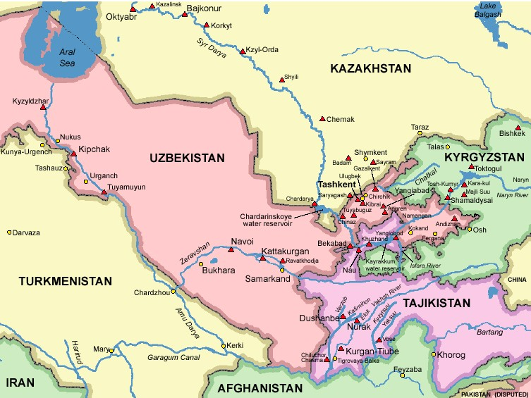
Sampling Locations

Slide 14
Field Sample Preparation
Take 1 kg of soil near the river, dry, and homogenize.
Take 1 kg of bottom sediment from the river, dry, and homogenize.
Take 0.5 kg of vegetation near the river, mulch, dry, and homogenize.
Take 5 Liters of water, filter to separate the suspended materials from dissolved, acidify the filtered water, and concentrate to 50 mL. Analyze both the concentrated water and the filter for suspended solids.

Slide 15
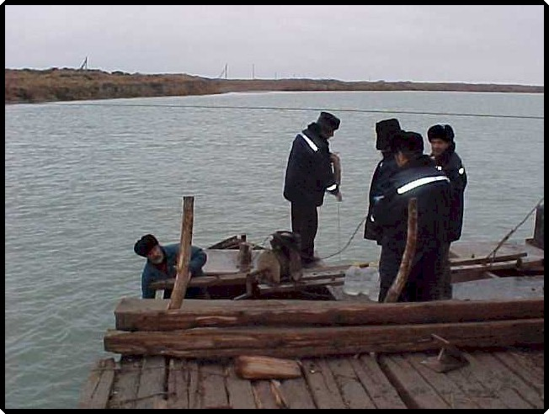
Collecting water samples from the Syr Darya upstream of Shyili, Kazakhstan

Slide 16
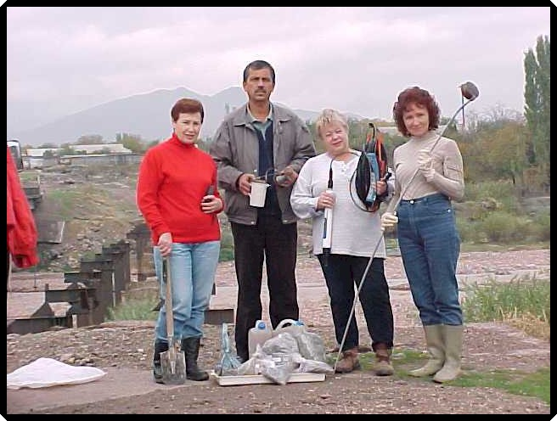
Uzbek Sampling Team

Slide 17
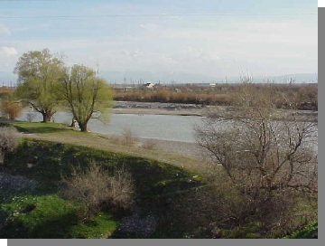
Zeravshan River sampling location near Samarkand, Uzbekistan

Slide 18
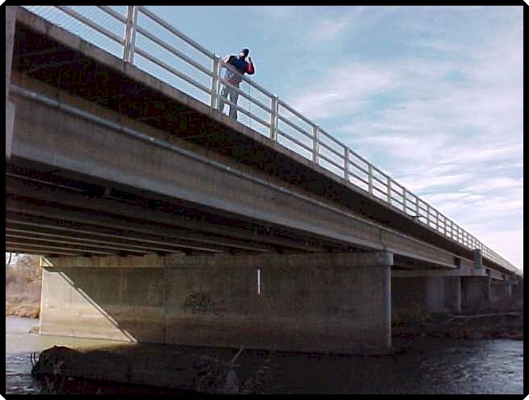
Howard Passell Lowering Hydrolab from bridge at Bernalillo

Slide 19
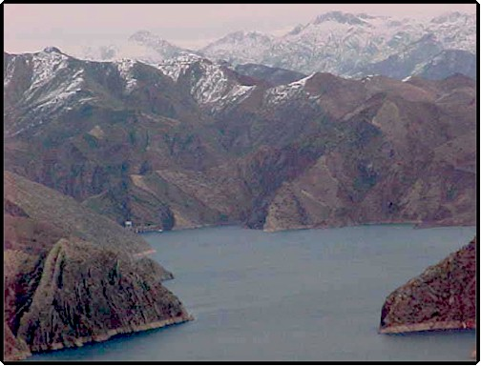
The Nurek Reservoir, Tajikistan

Slide 20
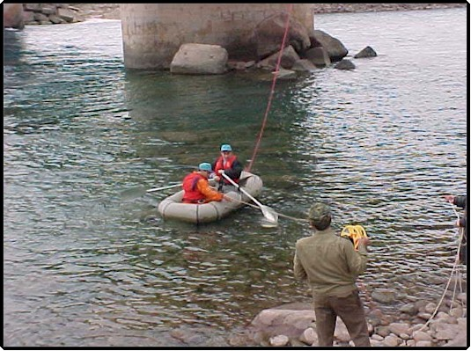
Vahsh River, Lower Nurek, Tajiskistan

Slide 21
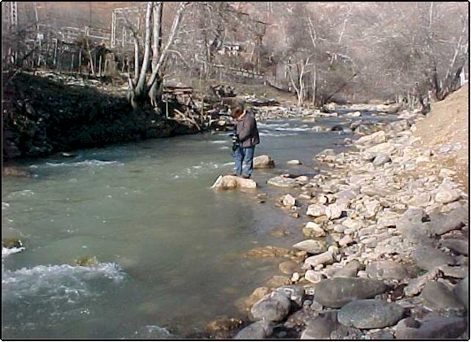
Naryn River near the town of Tash-Kumyr, Kyrgyzstan

Slide 22
Sample Receipt and Login at Sandia National Laboratories
The samples are checked against the Chain Of Custody (COC) form to ensure the correct number of samples and volumes are received
Check for any problems (e.g. leakage, damage, etc.)
Screen using a portable detector
Log samples into the laboratory’s LIMS

Slide 23
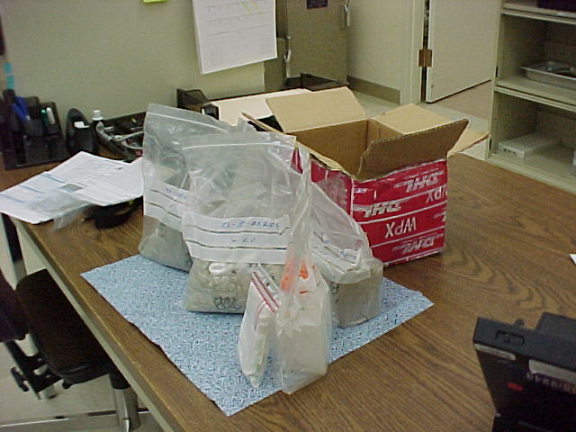
Kazakhstan Samples Received

Slide 24
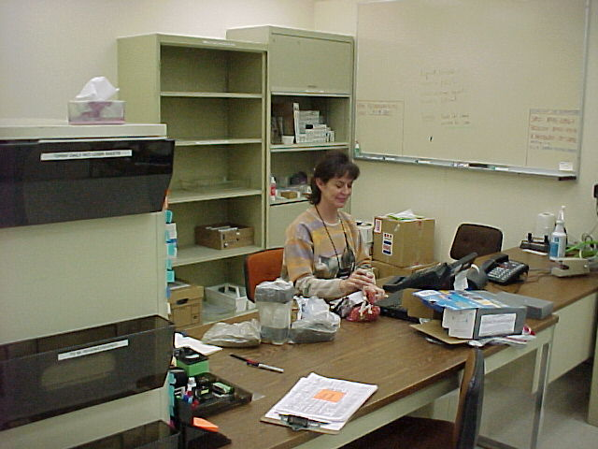
Tajikistan Samples Received

Slide 25
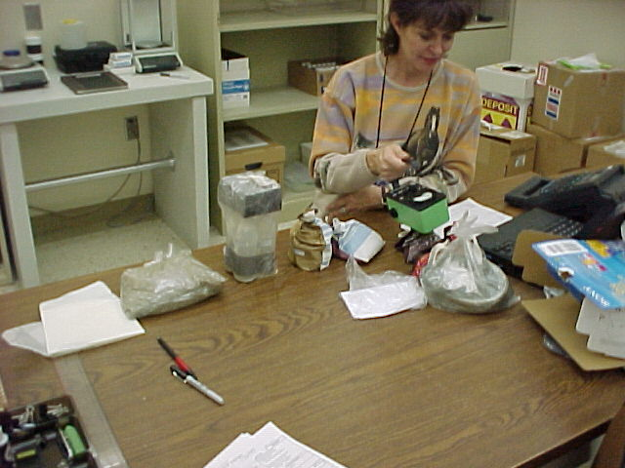
Sample Screening

Slide 26
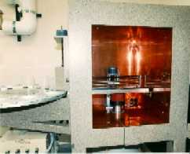
Gamma Spectroscopy with a Sample Changer

Slide 27
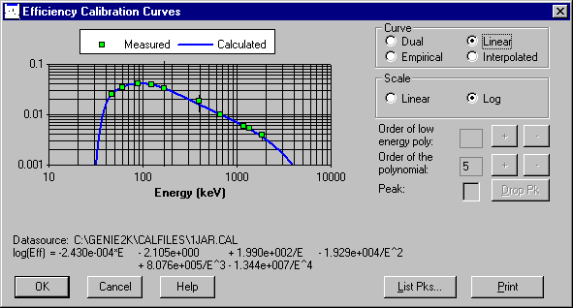
Efficiency Calibration Graph for 200 mL Solid Jar (1.75 g/cc)

Slide 28
Instrument Quality Control
After calibration, each instrument is checked each work day by counting a source that contains Am-241, Cs-137, and Co-60 to confirm the validity of the initial energy, shape, and efficiency calibration
The peak centroids, FWHM, and counts per second for the 60, 662, and 1333 keV peaks are recorded and monitored

Slide 29
Sample Preparation for Gamma Spectroscopy
The dried homogenized soil, bottom sediment, and vegetation samples are placed and packed in a standard 500 mL Marinelli beaker or a 200 mL jar, depending on the available volume
For water samples, 450 mL is placed in a Marinelli beaker
For concentrated waters, a 5 mL aliquot is dried on a two inch planchet (representing 500 mL of the original sample)
Filters are placed directly on the gamma spec unit

Slide 30
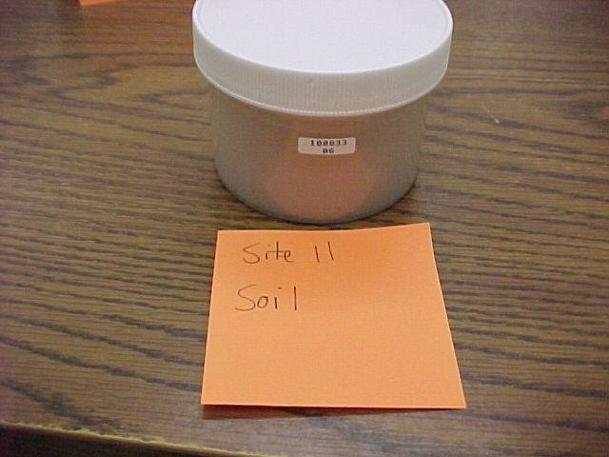
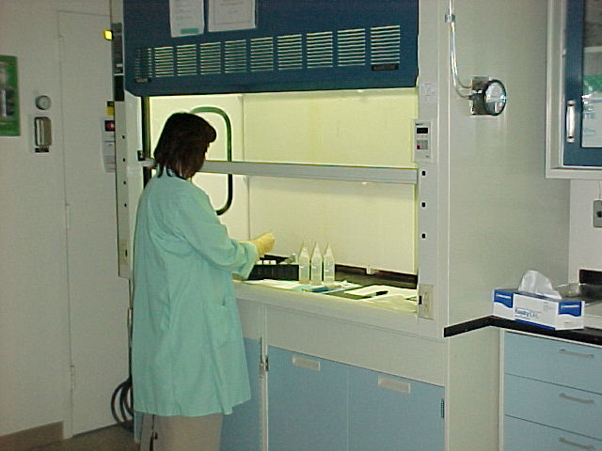
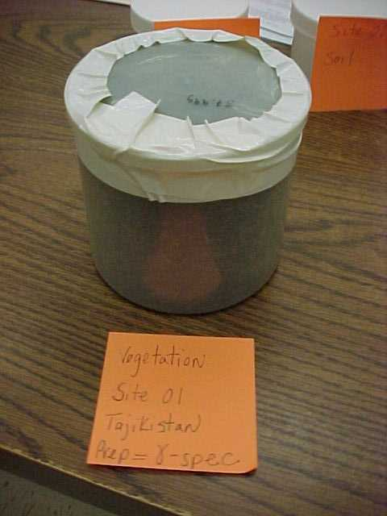
Sample Preparation

Slide 31
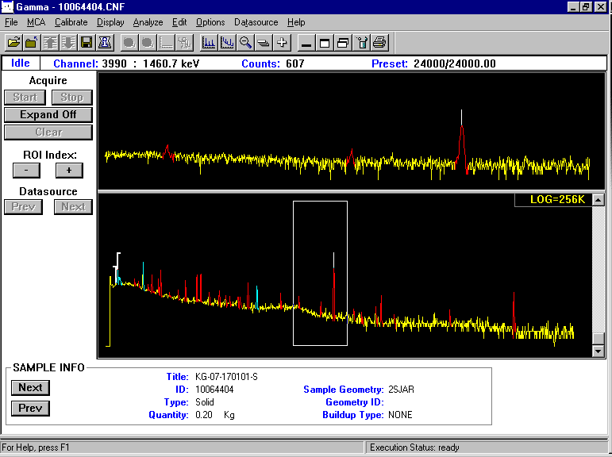
Example Spectrum
K-40

Slide 32
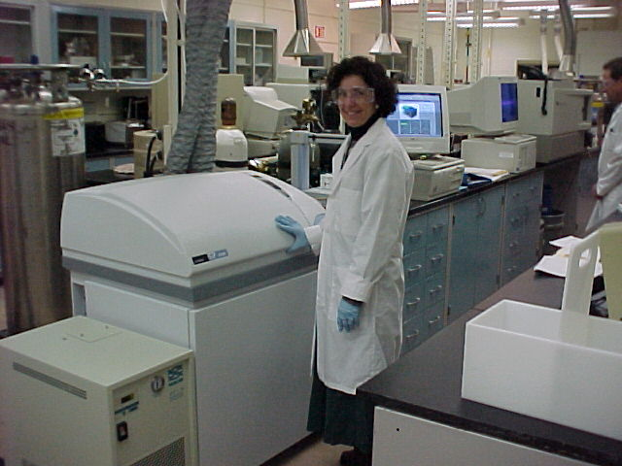
ICP-MS (Perkins Elmer Elan 6100)

Slide 33
ICP-MS Sample Preparation
One tenth of a gram of dried homogenized soil, vegetation, sediment (or a filter) is placed in a Teflon microwave vessel
Add 5 mL of DI water, 1 mL of HCl acid, 3 mL of HF acid, and 5 mL of concentrated Nitric acid
The sample is completely digested using high temperature (180 ºC) and high pressure (120 PSI) in 10 minutes

Slide 34
Sample Preparation …
The sample is volumed up to 50 mL using DI water
5 mL is placed in a test tube and diluted to 25 mL and is analyzed by ICP-MS
Water samples are analyzed directly
Concentrated waters are diluted from 5 mL to 25 mL and analyzed

Slide 35
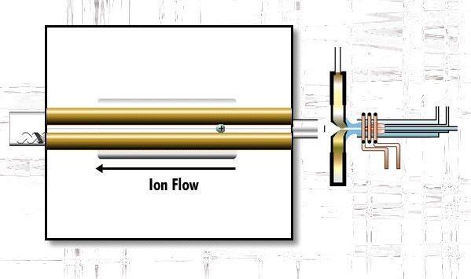
ICP-MS Components
Focusing
Plates
Plasma
Detector
Sample
Chamber
Heating Coil
(RF Coupled)
Skimmer
Cones
Mass
Spectrometer

Slide 36
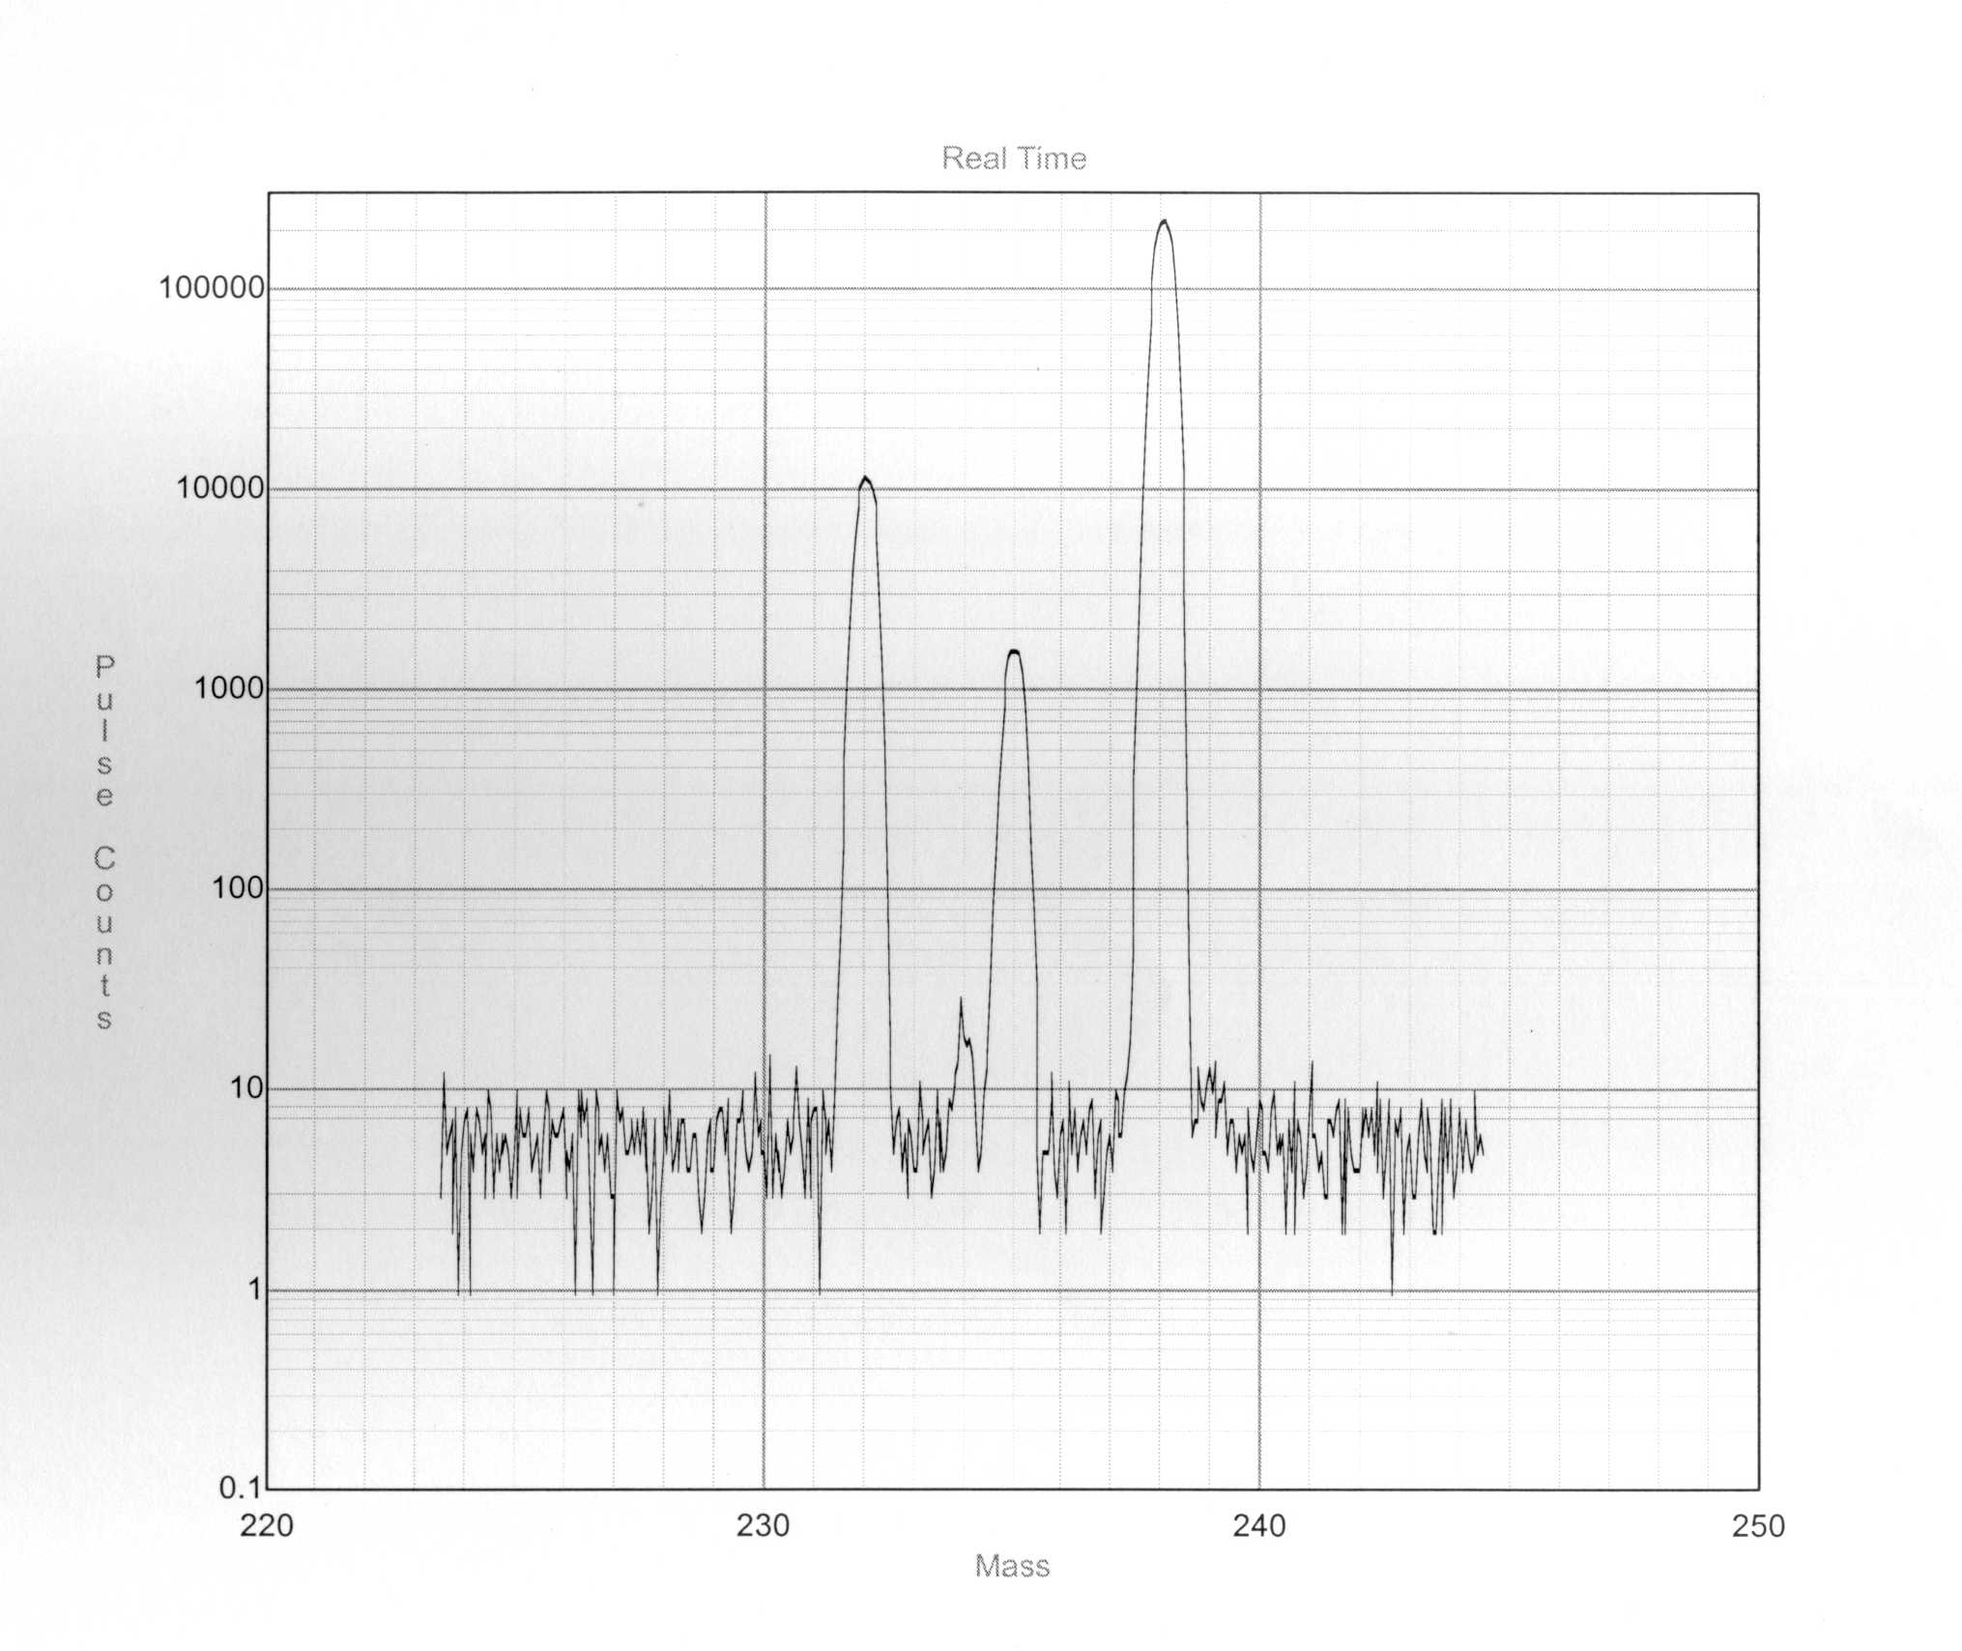
Example Spectrum
(DOE-EML Test Filter)
U-235
Th-232
U-238
Pu-239
U-234

Slide 37
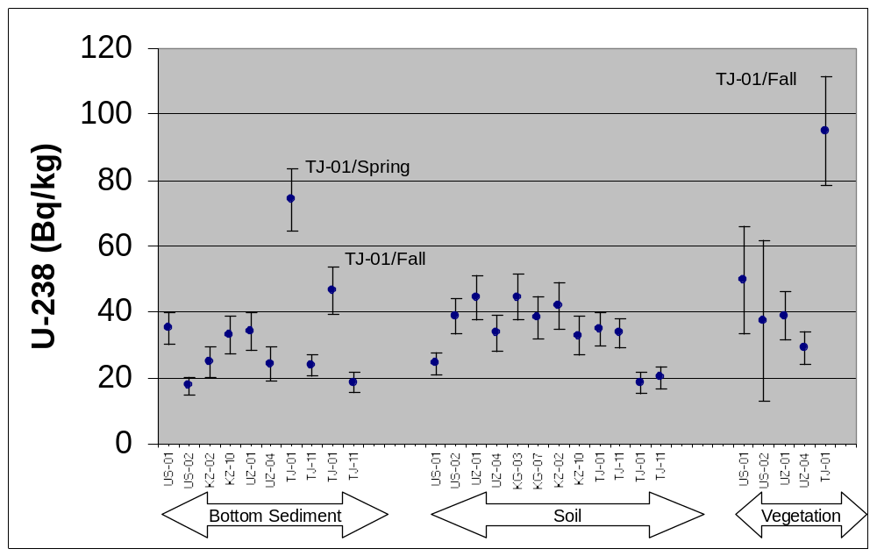
Preliminary Results, U-238 by Gamma Spec (based on Th-234)

Slide 38
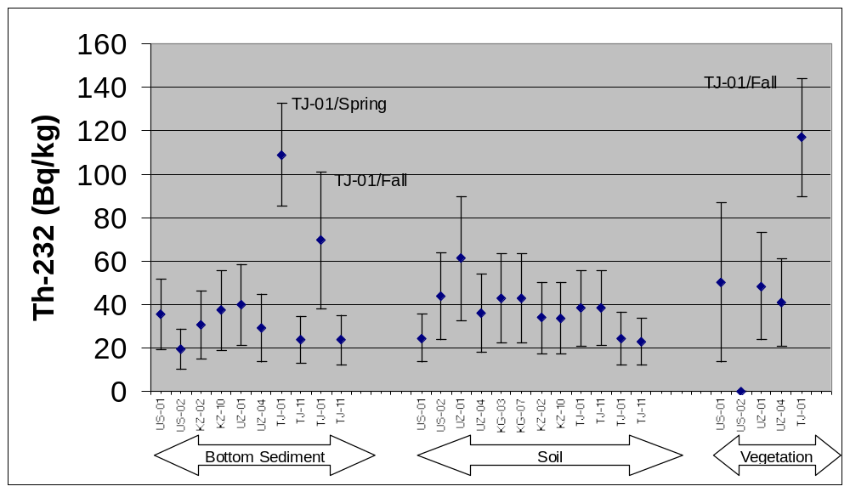
Preliminary Results, Th-232

Slide 39
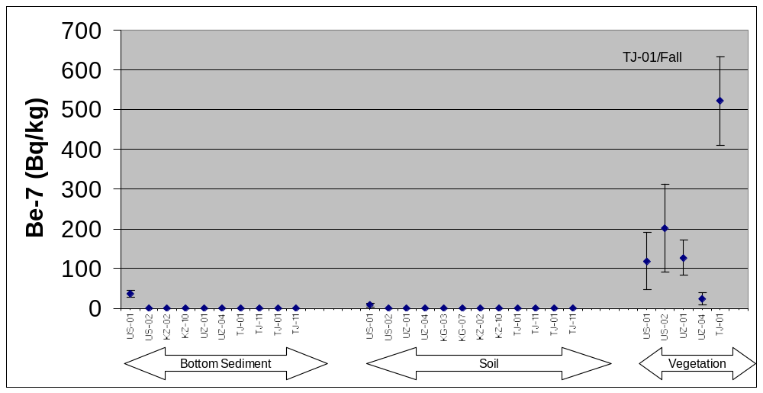
Preliminary Results, Be-7

Slide 40
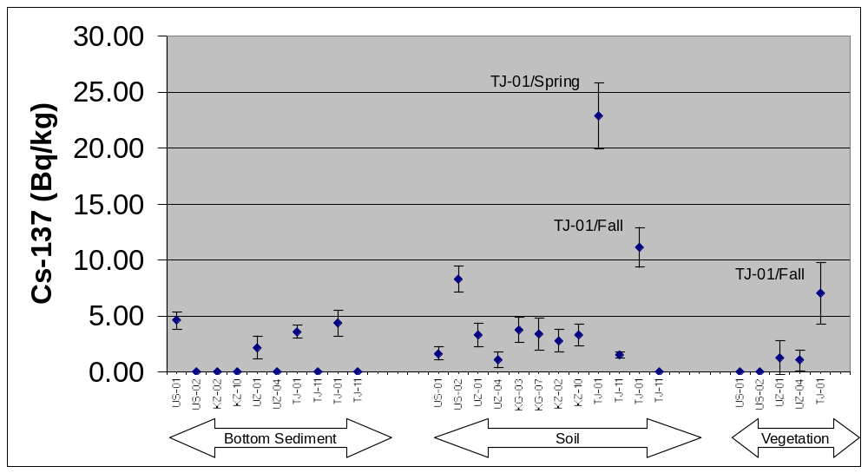
Preliminary Results, Cs-137

Slide 41
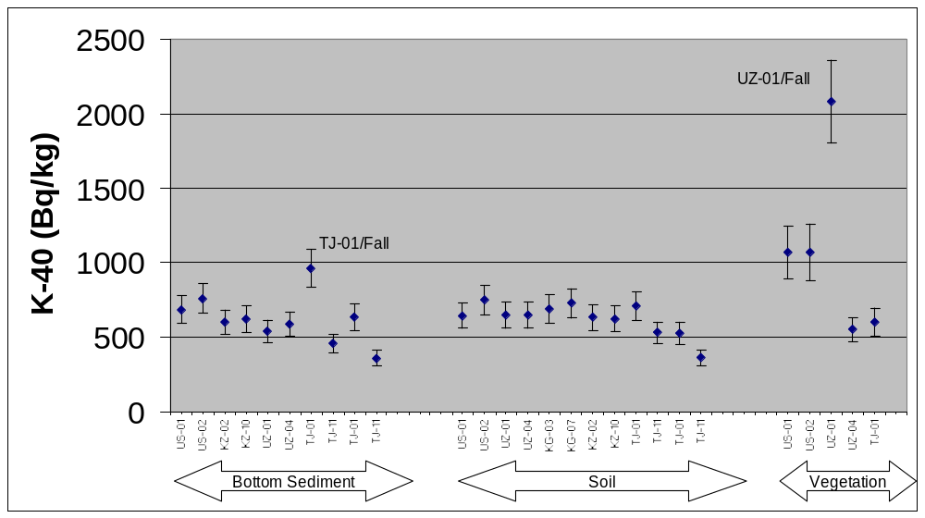
Preliminary Results, K-40

Slide 42
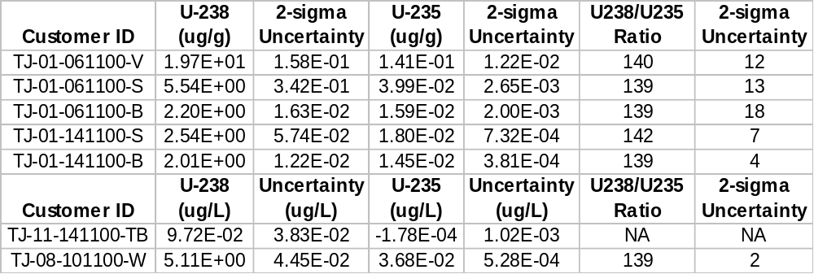
Uranium Analysis by ICP-MS
(Expected ratio for Natural U = 138)

Slide 43
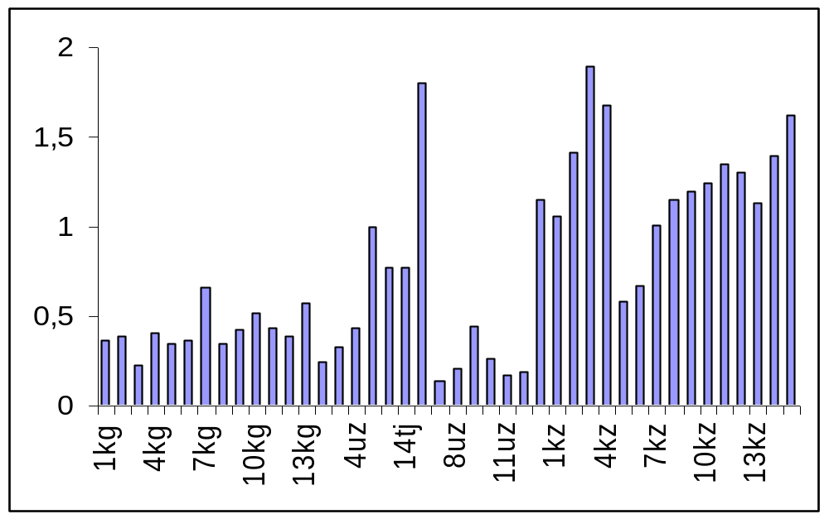
Salt concentration (g/L) along the Syr Darya river (Uzbek Report)

Slide 44
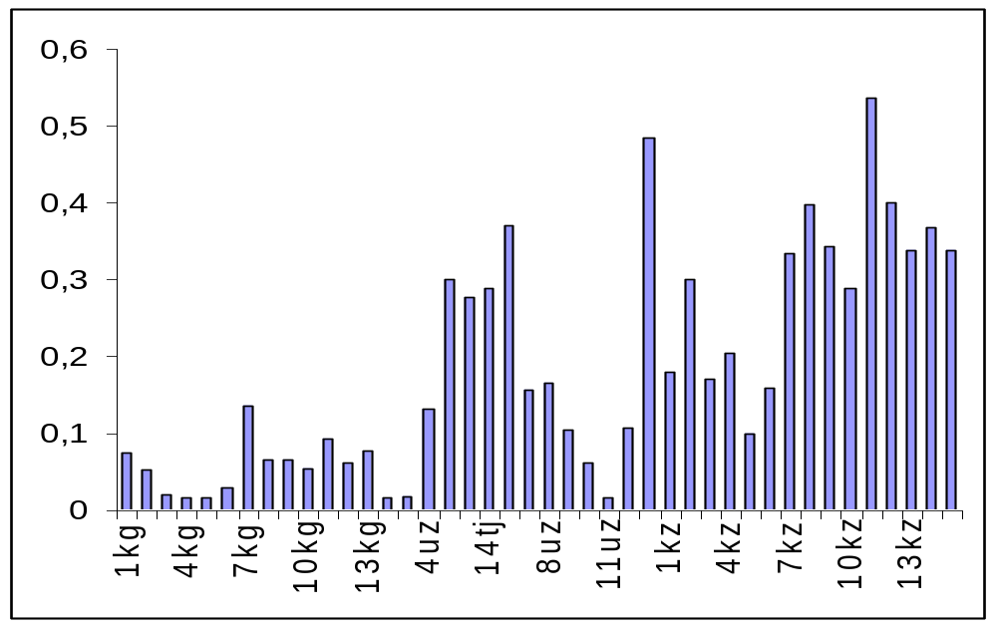
Gross Beta Activity (Bq/L) along the Syr Darya river (Uzbek Report)

Slide 45
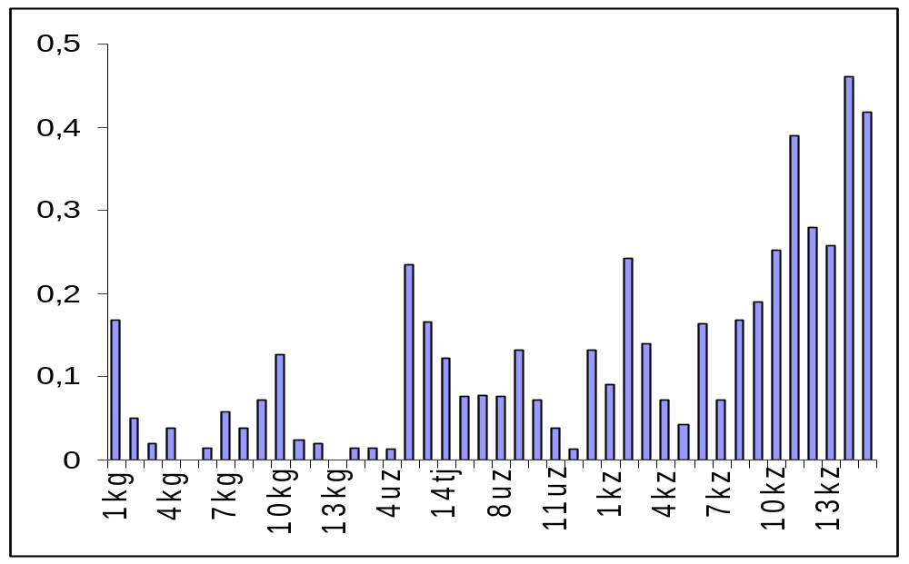
Gross Alpha Activity (Bq/L) along the Syr Darya river (Uzbek Report)

Slide 46
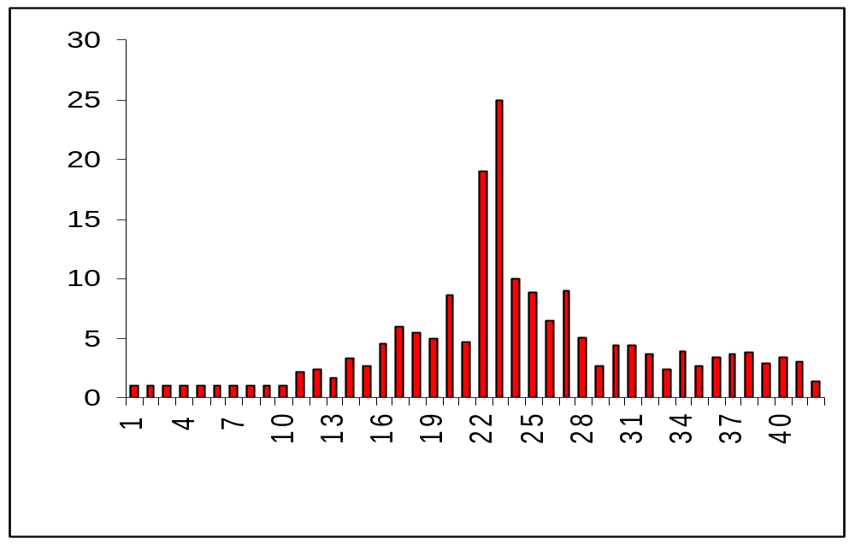
Th (mg/kg) in bottom sediment along the Syr Darya river (Uzbek Report - measured by neutron activation)
NO SAMPLES
Mountains Aral-Sea

Slide 47
Conclusions
The initiative is highly successful in being able to get the CA countries interested in the concept and to conduct the monitoring experiment.
Preliminary results indicate contamination in Tajikistan site 1 (Varzob River, 18 kilometers above Dushanbe), a Uranium mining and enrichment site.
Isotopic analysis shows the U in sample from Tajik site 1 is natural (suggests contamination is due to mining, not enrichment activities).

Slide 48
Conclusions
Uzbek data suggest contamination in three additional locations - a follow up study is needed to characterize the sites.
There are too many uncontrolled parameters: As the project matures the focus needs to shift from logistics and team building to scientific analysis by standardizing the methods.

