Slide 1
LCG Database Workshop Summary and Proposal for the
First Distributed Production Phase
Dirk Duellmann, CERN IT
(For the LCG 3D Project : http://lcg3d.cern.ch)

Slide 2
Why a LCG Database Deployment Project?
LCG today provides an infrastructure for distributed access to file based data and file replication
Physics applications (and grid services) require a similar services for data stored in relational databases
  Several applications and services already use RDBMS
  Several sites have already experience in providing RDBMS services
Goals for common project as part of LCG
  increase the availability and scalability of LCG and experiment components
  allow applications to access data in a consistent, location independent way
  allow to connect existing db services via data replication mechanisms
  simplify a shared deployment and administration of this infrastructure during 24 x 7 operation

Slide 3

LCG 3D Service Architecture
O
M
T0
- autonomous
reliable service
M
T1- db back bone
- all data replicated
- reliable service
T3/4
T2 - local db cache
-subset data
-only local service
O
M
O
M
Oracle Streams
Cross vendor copy
MySQL/SQLight Files
Proxy Cache

Slide 4
3rd LCG Database Workshop
Three days workshop Oct 17-19 with LHC experiments and
  Sites: ASCC, CERN, CNAF, BNL, FNAL, GridKA, IN2P3, RAL
    Contact with PIC and NIKHEF/SARA
  Details: http://agenda.cern.ch/fullAgenda.php?ida=a055549
Focus on preparation for large scale deployment
  Capture current deployment plans
  Discuss proposed services and impact on applications
  Continue service validation with real apps/workload
  Define and schedule production setup at LCG Tier sites

Slide 5
ATLAS Database /
Data Management Project
Responsible for DB/DM activities across ATLAS:
  DBs for detector production & installation, survey, detector geometry
  Online configuration, bookkeeping, run conditions
  Online and offline calibrations & alignments
  Event data and metadata
  Offline processing configuration and bookkeeping
  Distributed data management (file-based data)
  Distributed database infrastructure and services
All of these rely on DB services at CERN and at external institutes, and a distributed DB infrastructure knitting these together
Consequently we strongly support and rely on the 3D project!
Subprojects
Production DBs
Installation DBs
Geometry DB
Online DBs
Calib/Align
Conditions DB
Event Data
Distributed DM
Offl Processing
DB Services
SW Support

Slide 6
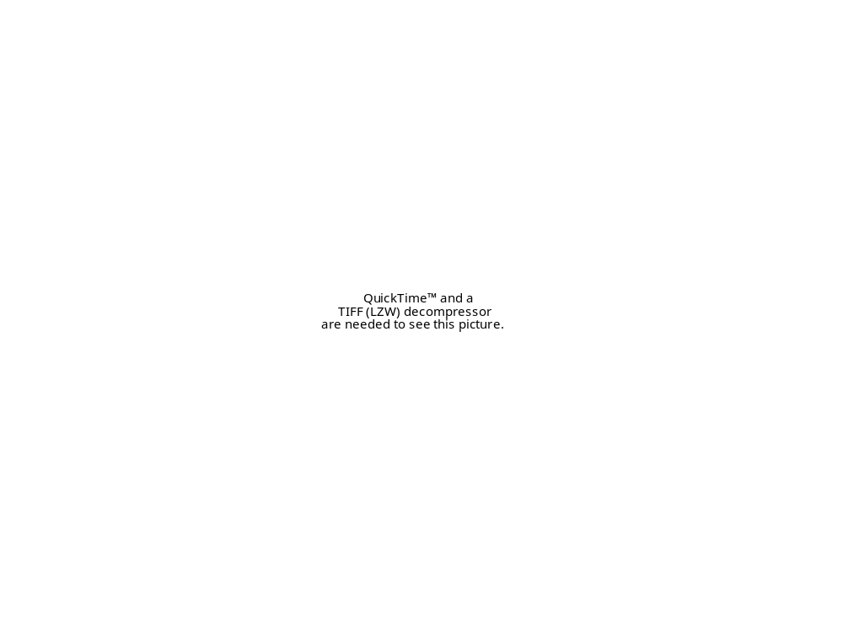

Slide 8
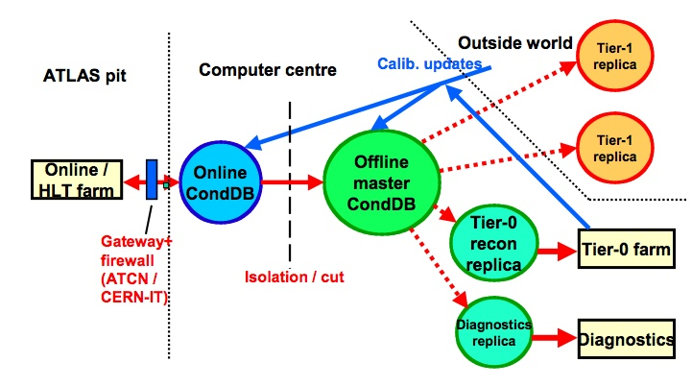
Online/T0 DB System Architecture

Slide 9
Experiment Deployment Plans
LHCb
  Databases online / Tier 0 / Tier 1
  Oracle streams for conditions replication (COOL)
ATLAS
  Databases online / Tier 0 / Tier 1 / T2 (mysql)
  Oracle streams for conditions replication (COOL)
Both interested in FroNtier cache for conditions data in COOL

Slide 10

Offline conditions DB relations
Physics
data
files
calibration procedures
ECS
API
DAQ
API
calibration files
Trigger
API
Calibration classes
DCS
AliEn/GLite:
metadata
file store
API
DCDB
AliRoot
API
HLT
API
API

Slide 11

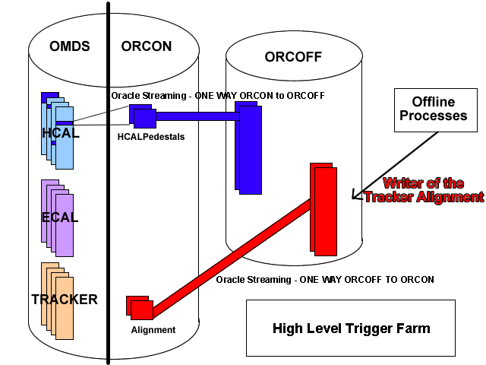
CMS Online⬅➔Offline DB
Sub-Detector designed format
POOL-ORA
format

Slide 12
Rough Estimates of CMS DB Resources
March through September 2006
Area (CMS contact) | Disk Maximum (GB) | Concurrent Users Peak usage | Transactions Peak usage (Hz)
Online P5 (F. Glege) | 500 | 20 | 10
Offline Conditions Tier-0 (L. Lueking/O.Buchmuller) | 500 (DB) 100 (per Squid) 2-3 Squids | 10 (DB)* 10 (Squid) * Incl. On2off Xfer | 10 (DB)* 10 (Squid) * Incl. On2off Xfer
Offline Conditions Tier-1 (each site) (L.Lueking/O. Buchmuller) | 100 (per Squid) 2-3 Squids/site | 10(per Squid) >100 Σ all sites | 10 per (Squid) >100 Σ all sites
Offline DMS Tier-0 (P. Elmer/L. Turra) | 20 | 10 | 10

Slide 13
Offline FroNTier Resources/Deployment
Tier-0: 2-3 Redundant FroNTier servers.
Tier-1: 2-3 Redundant Squid servers.
Tier-N: 1-2 Squid Servers.
Typical Squid server requirements:
  CPU/MEM/DISK/NIC=1GHz/1 GB/100GB/Gbit
  Network: visible to Worker LAN (private network) and WAN (internet)
  Firewall: Two Ports open for URI (FroNTier Launchpad) access and SNMP monitoring (typically 8000 and 3401 respectively)
Squid non-requirements
  Special hardware (although high-throughput Disk I/O is good)
  Cache backup (if disk dies or is corrupted, start from scratch and reload automatically)
Squid is easy to install and requires little on-going administration.
Tier N
Squid
Squid
Squid
Tier 1
Squid
Squid
Squid
http
Tier 0
Squid(s)
Tomcat(s)
JDBC
FroNTier
Launchpad
DB

Slide 14
Experiment Deployment Plans
ALICE
  Databases online / Tier 0 - files Tier 1 and higher
  Alice s/w for online to offline copy/transformation
  Files for conditions data distribution
  No 3D service request outside T0
CMS
  Databases online / Tier 0 - DB cache Tier 1 and higher
  Oracle streams for online to offline replication
  FroNtier/POOL for conditions data distribution (cache at T1/T2)
    Oracle streams as fallback

Slide 15
Databases in SC3 Middleware Deployment
Takes place already for services used in SC3
  Existing setups at the sites
  Existing experience with SC workloads -> extrapolate to real production
LFC, FTS - Tier 0 and above
  Low volume but high availability requirements
  CERN: Run on 2-node Oracle cluster; outside Oracle or MySQL
CASTOR 2 - CERN and some T1 sites
  Scalability requirements may need effort on DB side
  CERN: Currently run on 3 Oracle servers
Currently not driving the requirements for the database service
Consolidation of databases h/w and procedures may reduce effort/diversity at Tier 1 sites

Slide 16
DB Requirements Status
Experiment data at Tier 1 and higher read-only
  Few well defined accounts write online/Tier 0
Volume, CPU and transaction estimates still evolving
  Need detector s/w integration for conditions data
  Need production service in place for SC4
    based on today’s estimates
  Review access pattern after eg first 3 month of production
Iterate via application validation tests
  Significant testing effort and flexibility from all participants
    Experiments, db service and s/w development teams

Slide 17
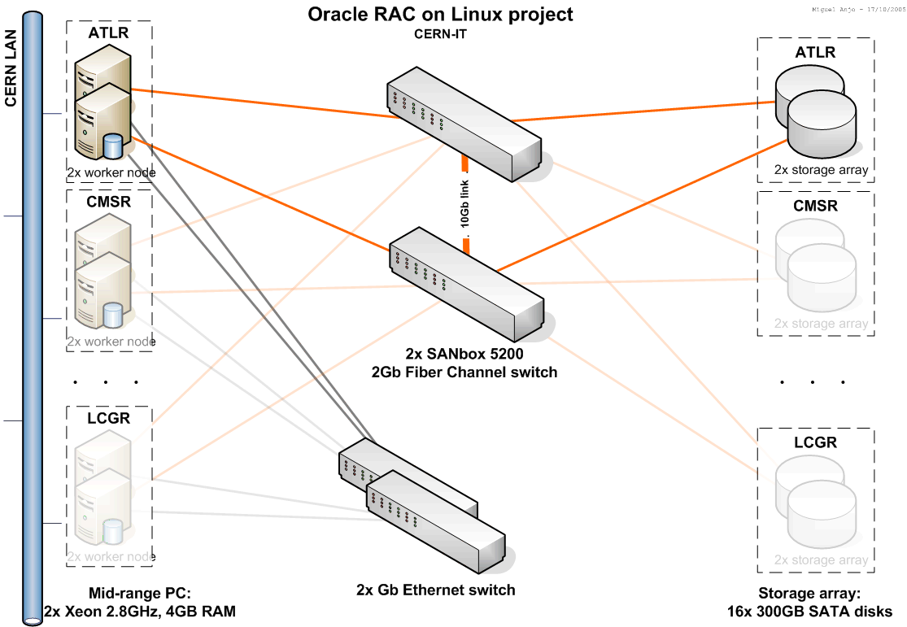
Service Architecture @ CERN
The Physics Database services at CERN moved to database clusters

Slide 18
CERN Database h/w Evolution
Ramp up of hardware resources during 2006-2008
Current State
ALICE | ATLAS | CMS | LHCb | Grid | 3D | Non-LHC | Validation
- | 2-node offline | 2-node | 2-node | 2-node | - | - | 2x2-node
 | 2-node online test
Proposed structure in 2006
2-node | 4-nodes | 4-nodes | 4-nodes | 4-nodes | 2-node | 2-node (PDB replacement)
 | 2-node valid/test | 2-node valid/test | 2-node valid/test | 2-node pilot |  | Non-LHC

Slide 19
Database Clusters
Several sites are testing/deploying Oracle clusters
  CERN, CNAF, BNL, FNAL, GridKA, IN2P3, RAL
Several experiments foresee Oracle clusters for online systems
Focus on db clusters as main building block also for Tier 1
3D will organize detailed DBA level discussions on database cluster setup
  Tier 1 DB teams and Online DB teams
  Share test plans and expertise among LCG sites and experiments
  Cluster setup and existing test results
  Storage configuration and performance tests

Slide 20
Proposed Tier 1 Service Setup
Propose to setup for first 6 month
  2/3 dual-cpu database nodes with 2GB or more
    Setup as RAC cluster (preferably) per experiment
    ATLAS: 3 nodes with 300GB storage (after mirroring)
    LHCb: 2 nodes with 100GB storage (after mirroring)
    Shared storage (eg FibreChannel) proposed to allow for clustering
  2-3 dual-cpu Squid nodes with 1GB or more
    Squid s/w packaged by CMS will be provided by 3D
    100GB storage per node
    Need to clarify service responsibility (DB or admin team?)
Target s/w release: Oracle 10gR2
  RedHat Enterprise Server to insure Oracle support

Slide 21
Proposed 2006 Setup Schedule
November: h/w setup defined and plan to PEB/GDB
January: h/w acceptance tests, RAC setup
Begin February: Tier 1 DB readiness workshop
February: Apps and streams setup at Tier 0
March: Tier 1 service starts
End May: Service review -> h/w defined for full production
September: Full LCG database service in place

Slide 22
Summary
Database applications s/w and distribution models firming up - driving application “Conditions database”
  ATLAS, CMS and LHCb require access to database data also outside CERN, ALICE only at CERN
Two target distribution technologies (Streams and FroNtier) and complementary deployment plans for initial production phase
  Online -> offline replication based on streams for all three experiments
Propose to setup pre-production services for March 06 and full LHC setup after 6 month deployment experience
  Definition of concrete conditions data models in experiment s/w should be aligned

Slide 23
Questions?

Slide 24
Additional Slides

Slide 25
Tier 2 Setup
Only little effort from 3D so far
  Will change with full slice test for COOL now
BNL / ATLAS have most deployment experience
Propose to define and document standard s/w installation
  Need more participation of prototype Tier 2 sites

Slide 26
Project Non-Goals
  Store all database data
    Experiments are free to deploy databases and distribute data under their responsibility
  Setup a single monolithic distributed database system
    Given constraints like WAN connections one can not assume that a single synchronously updated database work and provide sufficient availability.
  Setup a single vendor system
    Technology independence and a multi-vendor implementation will be required to minimize the long term risks and to adapt to the different requirements/constraints on different tiers.
  Impose a CERN centric infrastructure to participating sites
    CERN is one equal partner of other LCG sites on each tier
  Decide on an architecture, implementation, new services, policies
    Produce a technical proposal for all of those to LCG PEB/GDB

Slide 27
LCG Certificate Support
Easier for 3-tier apps
Still an issue for client-server db applications
  X509 authentication in Oracle and MySQL
  Proxy certs can be made work with MySQL but fail so far with Oracle
  Authorization (mapping of VOMS to DB roles) still missing
Stop-gap solution (read-only access outside T0) acceptable for security and experiments for ~6month
  Monitoring will important and needs real user id (DN)
Little manpower left in the project
  ASCC contributing in the area of Oracle security infrastructure setup
  Need a test system and review manpower @ CERN

Slide 28
Physics DB Services @ CERN
Database clusters (RAC) are in production now !!
  Big effort of Maria’s team in parallel to ongoing services and significant support load
Hope to re-focus resources to consultancy and service improvement
  Standardized account setup for smother transition between service levels and more stable client side connection information
  Proposed new storage organization provides improved performance and uses available disk volume to decrease recovery latency
  Backup policy review and read-only data are important to insure that tape backup volume stays scalable as volume grows
  DB Server monitoring for developers/deployment integrated into LEMON
  Unavailability caused by security patches and overload are most significant - applications and services need to retry/failover

Slide 29
Database Service Levels
Development Service (run by IT-DES)
  Code development, no large data volumes, limited number of concurrent connections
  Once stable, the application code and schema move to validation
Validation Service (for key apps)
  Sufficient resources for larger tests and optimisation
  Allocated together with DBA resources consultancy
    Needs to be planned in advance
  Limited time slots of about 3 weeks
Production Service
  Full production quality service, including backup, monitoring services, on call intervention procedures
  Monitoring to detect new resource consuming applications or changes in access patterns
OS level support provided by IT-FIO

Slide 30
Streams
Tested successfully for simple workloads (file catalogs)
  LFC replication test requested by LHCb scheduled
Several validation test ongoing for conditions data
  Online->offline for ATLAS and CMS (CC->CC, CMS P5->CC)
  Offline->T1 for ATLAS and LHCb (CERN->RAL->Oxford)
Several tests scheduled requiring service and consultancy
  0.5 FTE DBA support the CERN side likely to become a bottleneck

Slide 31
FroNtier
CMS Baseline for conditions data
  No database service outside T0 required
  Simpler squid service on T1 and T2
Integrated with LCG persistency framework via transparent plug-in
  Early testing phase in CMS
  Interest from other experiments (ATLAS/LHCb)
  FroNtier test setup available in 3D test bed

Slide 32
CMS Non-event Data Model
Conditions data: (Calibration, Alignment, Geometry, Configuration, Monitoring)
  Online DB: Schemas designed specific to sub-system; Oracle DB server at P5
  Offline DB: POOL-ORA repositories
    HLT Farm: Oracle DB server at P5
    Tier-0:Oracle DB server at IT
  Online to offline: Transform online format to POOL-ORA payloads. Transfer POOL-ORA payloads to offline via Oracle Streams.
  Offline (Tier-0) to Tier-N:
    Plan A: CMS Client POOL-RAL ⬅ SQUID proxy/caching servers ⬅ FroNTier “pass through” server ⬅ POOL-ORA repository.
    Plan B: Oracle replication to Tier-1 sites, if Plan A is insufficient or fails.
Event Data Management System (DMS)
  Tier-0: Dataset Bookkeeping Service (DBS), Dataset Location Service (DLS)
  Tier-1: Local DBS and DLS for internal bookkeeping. Possible use of Oracle replication w/ Tier-0 if needed for performance/availability.
  Tier-2: Local DBS and DLS for internal bookkeeping (not Oracle).

Slide 33




ATLAS applications and plans
LCG Database Deployment and Persistency Workshop
17-Oct-2005,CERN
Stefan Stonjek (Oxford), Torre Wenaus (BNL)

Slide 34
Online Databases
ATLAS Online uses standardized DB tools from the DB/DM project (and mostly from LCG AA)
RAL used as standard DB interface, either directly or indirectly (COOL)
  Direct usages: L1 trigger configuration, TDAQ OKS configuration system
COOL conditions DB is successor to Lisbon DB for time dependent conditions, configuration data
  Links between COOL and online (PVSS, information system) in place
  PVSS data sent to PVSS-Oracle and then to COOL (CERN Oracle)
Strategy of DB access via ‘offline’ tools (COOL/POOL) and via direct access to the back end DB popular in online
Joint IT/ATLAS project to test online Oracle DB strategy being established
  Online Oracle DB physically resident at IT, on ATLAS-online secure subnet
  Data exported from there to offline central Oracle DB, also IT resident

Slide 35
Conditions DB – COOL (1)
COOL used for conditions data across ATLAS subdetectors and online
  ATLAS is the main experiment contributor to its development
  Initiative started to use COOL to manage time-dependent aspects of subsystem configurations
COOL now fully integrated with ATLAS offline framework Athena
Deployment plan written and well received within ATLAS and by IT
Usage model: write centrally (CERN Oracle), read mainly via caches/replicas
Scalability and performance testing/debugging of COOL and underlying DB services being tested with realistic ATLAS online workloads

Slide 36
Some ATLAS DB Concerns (1)
Scalable distributed access to conditions data
  COOL copy/extraction tools in development, and in good hands; will come but aren’t there yet
  FroNTier approach of great interest but untouched in ATLAS for lack of manpower
    FroNTier/RAL integration is welcome, we need to look at it!
  DDM already deployed in a limited way for calibration data file management, but needs to be scaled up and the divide between file- and DB-based conditions data better understood
  Role of object relational POOL and implications for distributed access still to be understood

Slide 37
Conclusion (1)
ATLAS DB/DM is well aligned with, draws heavily from, and contributes to LCG 3D and LCG AA/persistency; we depend on them being strongly supported and will continue to support them as best we can
The ‘easier’ applications from the DB services point of view are well established in production, reasonably well understood, and relatively light in their service/distribution requirements
  TC databases (except survey), geometry database

Slide 38
Conclusion (2)
For the most critical of the rest, the ‘final’ applications now exist in various states of maturity, but more scale/usage information and operational experience is needed before we can be reliably concrete
  Conditions DB, event tags?, production DB, DDM
For the remainder, applications and even strategies are still immature to non-existent (largely because they relate to the still-evolving analysis model)
  Event processing metadata, event tags?, physics dataset selection, provenance metadata

Slide 44
Databases in ALICE
L.Betev
LCG Database Deployment and Persistency Workshop
Geneva, October 17, 2005

Slide 45
Databases relations and connectivity
Examples from previous slides:
  DCDB – “quasi” distributed system, central repository is read-only, updates are infrequent
  DAQ – completely closed central system
The biggest challenges remain the Grid file catalogue and offline conditions databases:
  Used in a heterogeneous and often ‘hostile’ computing environment (the Grid).
  Contains data from wide variety of sources

Slide 46
Considerations for Conditions DB
Sources for conditions DB and relations to other DBs are already quite complicated:
  All databases potentially containing conditions information are “closed”, i.e. only accessible at CERN
  It would be difficult to provide access methods to all DBs from the production and analysis code
ALICE uses ROOT as offline framework base:
  Naturally defines the technology choice for object store – all conditions data are stored as root files
  Additional condition - these files are read-only

Slide 47
Considerations for Conditions DB (2)
Conditions data should be accessible in a Grid distributed production and analysis environment
  The root files are registered in the Grid Distributed File Catalogue:
  No need for distributed DBMS in a traditional sense and with all accompanying problems (access, replication, authentication) – a very big plus
  Assures worldwide access to all files and associated tags
Drawbacks:
  Replication of information
  Depends almost entirely on the Grid file catalogue functionality

Slide 48
Medium term plans
Grid file catalogue is used routinely in ALICE since several years in the scope of the physics data challenges (PDC04, PDC05, SC3)
ROOT Grid access classes are now mature
AliRoot Conditions DB access framework is complete
Beginning of 2006 – Test of ALICE TPC with operational DCS and DAQ:
  Test of both DBs and in addition the offline Conditions DB
Beginning of 2006 – Physics Data Challenge ’06:
  Final test of the entire ALICE offline framework on the Grid, including test of Conditions framework

Slide 49
Conclusions
ALICE has a rich field of databases used in the various groups for wide variety of tasks
The development of the majority of DBs is well advanced:
  Some of them are already in production since several years
The biggest challenge remaining is to gather the information from all sources and make it available for Grid data reconstruction and analysis:
  In this context, ALICE has decided to re-use the already existing Grid file catalogue technology
  And enrich the AliRoot framework with tools allowing connectivity to all other DBs currently in existence

