Slide 1

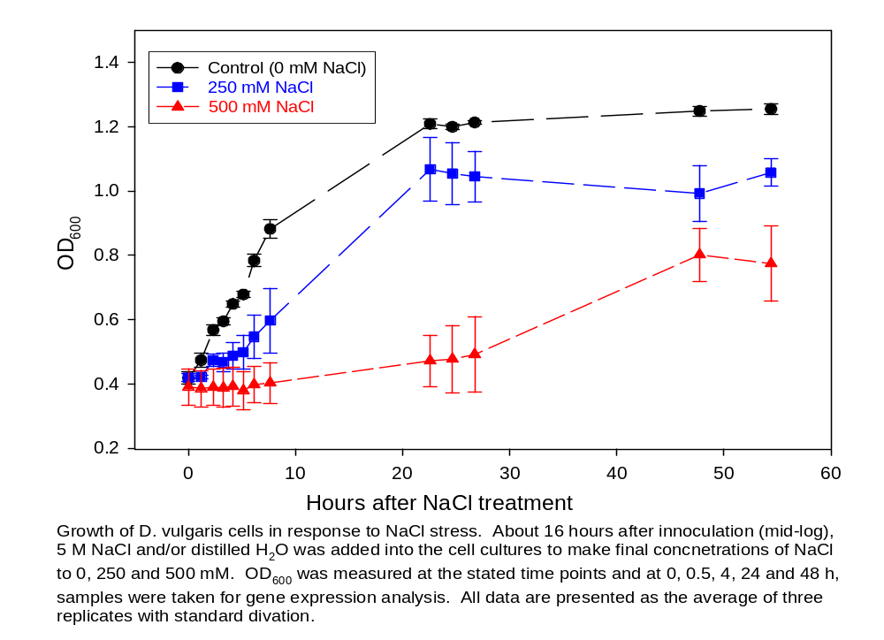
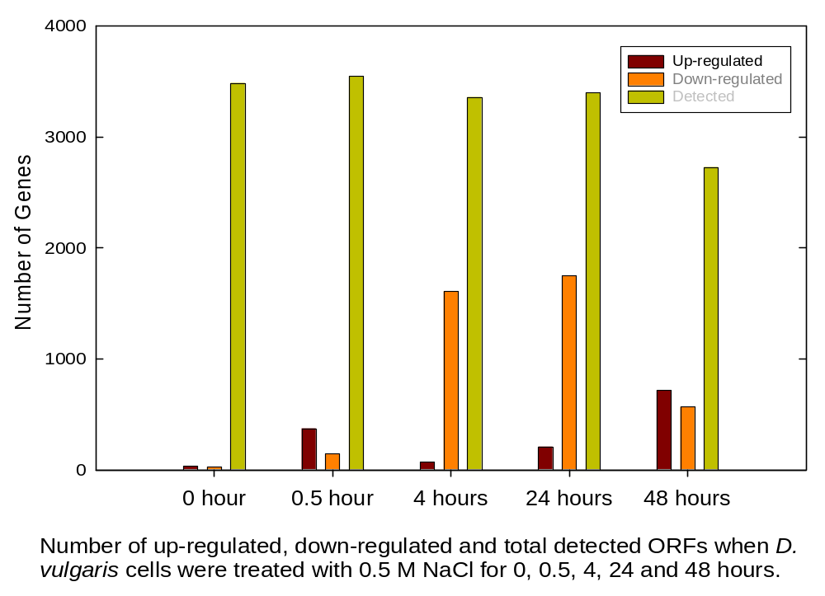
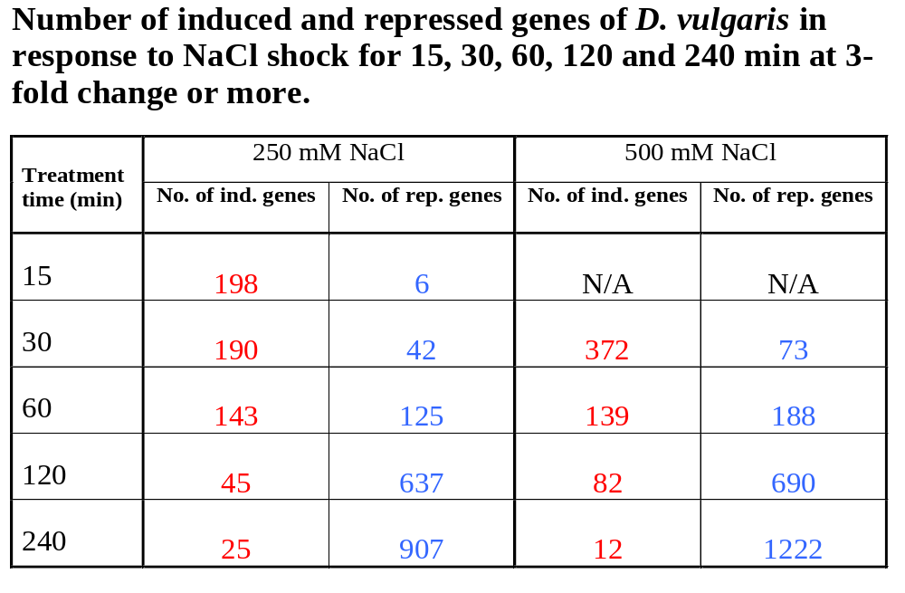
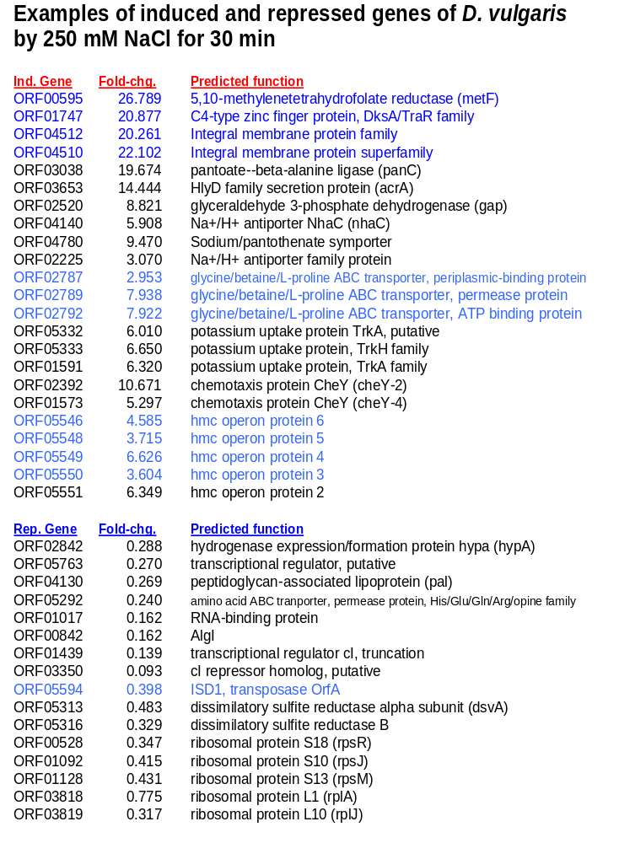
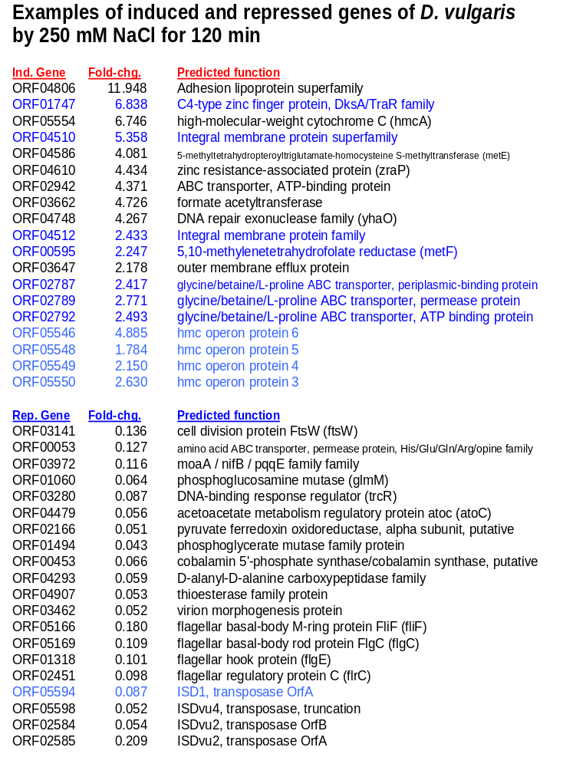
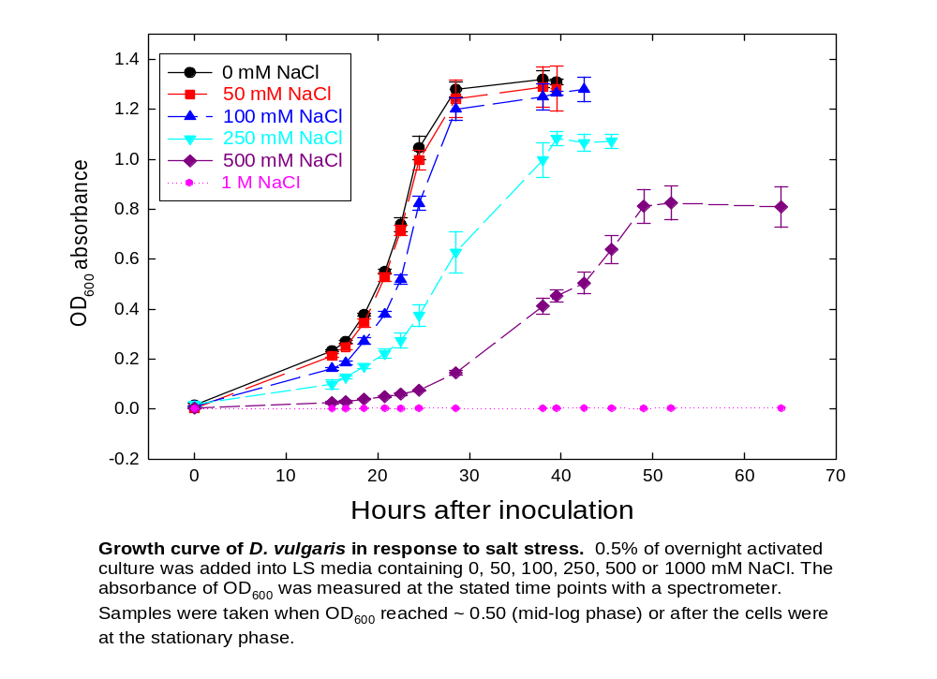
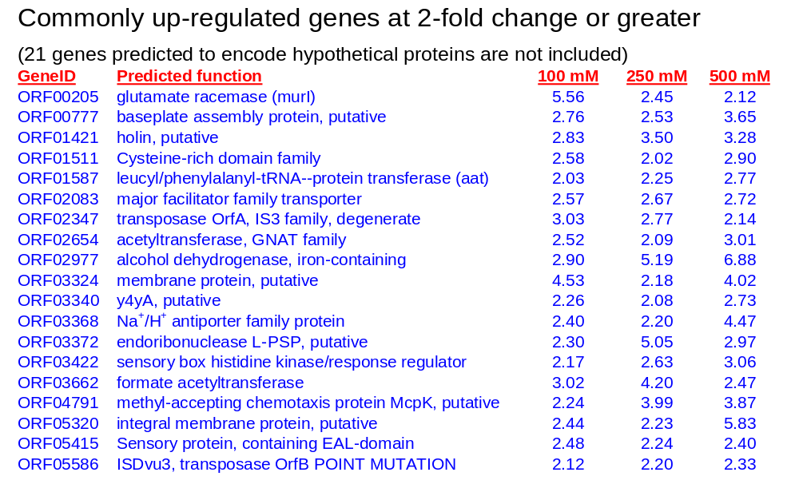
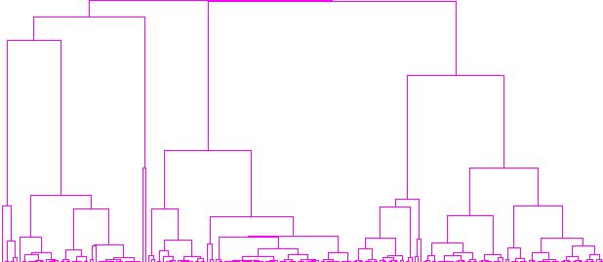
K-072 Transcriptional Analysis of Desulfovibrio vulgaris Responses to NaCl Stress Using Whole-Genome Oligonucleotide Microarrays
Zhili He¹, Qiang He¹, Liyou Wu¹, Judy D. Wall², Terry Hazen³, Matthew W. Fields⁴ and Jizhong Zhou¹
¹Oak Ridge National Laboratory, Oak Ridge, TN, ²University of Missouri, Columbia, MO, ³Lawrence Berkeley National Laboratory, Berkeley, CA, ⁴Miami University, Oxford, OH
Abstract
Survey and Comparisons of Genes in D. vulgaris in Response to Salt Stress Compared With E. coli
Growth and Gene Expression Changes in D. vulgaris Under NaCl Stress
The whole-genome oligonucleotide microarrays were used to identify possible response mechanisms of D. vulgaris to elevated salt concentrations. We first examined the growth of D. vulgaris under different concentrations of NaCl and then investigated responses of D. vulgaris to salt shock and salt adaptation with different concentrations of NaCl. Growth of D. vulgaris cells was not affected significantly with 50 or 100 mM NaCl. When cells were grown in the presence of 250 or 500 mM NaCl, the lag phases increased, and the growth rates were decreased approximately 1.25-fold and 2-fold, respectively. D. vulgaris cells were not able to grow in the presence of 1 M NaCl. Salt shock with 250 or 500 mM NaCl indicated that D. vulgaris cells immediately responded to increases in salinity. Approximately 370 or 190 ORFs were up-regulated (3-fold or greater) and 70 or 40 ORFs were down-regulated when D. vulgaris cells were treated with 250 or 500 mM NaCl for 0.5 hour, respectively. More genes were down-regulated and fewer genes up-regulated over time. After 4-hour treatment with 250 or 500 mM NaCl, approximately 25 or 12 ORFs were seen to be up-regulated and more than 900 or 1200 ORFs to be down-regulated, respectively. Those consistently up-regulated genes include glycine/betaine/L-proline transporters, hmc operon proteins and metF. Salt adaptation study shows that some genes were up-regulated in the presence of 100, 250 and 500 mM NaCl, including sensory proteins, response regulators, Na⁺/H⁺ antiporters, alcohol dehydrogenase and formate acetyltransferase. However, for most significantly changed genes, patterns of gene expression were distinctly different between time points and between NaCl concentrations. Almost half of those genes significantly changed were predicted to be conserved hypothetical or hypothetical proteins, and we are trying to use microarray data to help the identification of their functions. Further study is in progress on the details of those genes significantly changed in expression, on elucidation of their regulatory networks.
Na⁺/H⁺ antiporters E. coli has main systems, nhaA/nhaB and nhaR in response to salt stress. D. vulgaris does not have similar systems but does have nha-C1(ORF05281) and nha-C2 (ORF04140) and six other types of Na⁺/H⁺ antiporters, including ORF02225 (metT), ORF03368, ORF04673 (NhaD), ORF02889 (NhaD), ORF05368 (mnhA), and ORF02767 (mnhD).
Trk-type K⁺ transport systems E. coli has TrkG and TrkH for K⁺ uptake and transport systems, and a similar gene is Trk1 (ORF05333) in D. vulgaris. The main gene responsible for K⁺ transport, TrkA in E.coli does not have a homolog in D. vulgaris. ORF05332 and ORF01591 predicted to be K⁺ uptake proteins in D. vulgaris do not have homologs in E. coli. In D. vulgaris, ORF02798 is predicted to be a glutathione-regulated K⁺-efflux system protein KefB, and it has two homologs in E. coli.
Kdp K⁺ transport systems D. vulgaris has kdpA, B, C and D homologs to the well-known Kdp K⁺ transport system in E. coli. But it does not have kdpE, and kdpF in D. vulgaris is different from kdpF in E.coli.
Glycine/betaine/L-proline ABC transporters E. coli has a three-gene (proV, proW and proX) operon for glycine/betaine/praline ABC transport systems. D. vulgaris has a similar operon predicted with three genes, ORF02792 (proV), ORF02789 (opuBB) and ORF02787 although proX is not a homolog with ORF02787. E. coli has other systems such as proP and betT for proline and betaine transport, and no similar systems have been found in D. vulgaris.
Two-component regulatory systems E. coli has envZ and ompR to detect changes in environmental osmolality and to set the level of ompF and ompC synthesis. D. vulgaris does not have homologs with any of those genes although it has a few genes, ORF04712, ORF02917, ORF02446 and ORF02913 which encode outer membrane proteins.
Universal stress proteins (USPs) E. coli has at least three genes, uspA, rplY and osmC predicted to respond to stresses. D. vulgaris only has rplY (ORF01537) annotated to be the same (ribosomal protein L25) as in E. coli. However, D. vulgaris also has other seven genes, ORF04641, ORF05076, ORF05350, ORF05561, ORF00416, ORF00653 and ORF02440 predicted to encode USPs, which belong to COG589.
The growth stopped for at least 8 hours when 0.5 M NaCl was applied to the growing cells. The Cell growth decreased with addition of 0.25 M NaCl.
After cells were treated for 0.5 h with 0.5 M NaCl, about 10% genes were up-regulated and less than 5% were down-regulated. Those up-regulated genes might respond to immediate salt stress.
From 4- to 24-h treatment, more genes were repressed and fewer up-regulated. Those up-regulated genes may be related to cell survival mechanisms.
After 48-h treatment, more genes were up-regulated and fewer down-regulated. At this time, cells had started to grow, maybe by overcoming the stress. The gene expression data agreed with the growth data.
Based on the information, salt adaptation and salt shock studies were further conducted.
Salt shock was focused on dynamic responses of growing cells to NaCl in a short period of time (15 to 240 min) when cells stopped growing or decreased in the growth rate.
Salt adaptation was focused on mechanisms by which cells could adapt to high salinity environments.
Materials and Methods
Oligo Probe Design and Microarray Construction 70mer oligo probes were designed using a computer software ArrayOligoSelector (Zhu 2002) combined with other programs such as Oligopicker (Wang and Seed 2003) and OligoArray (Rouillard et al., 2002). The whole genome microarray covers 3574 ORFs, including 3471 (97.1%) unique probes and 103 (2.9%) probes which may cross-hybridize with other sequences. Oligo probes were spotted onto UltraGAPSTM coated glass slides (Corning Life Science, NY) using a Microgrid II robotic arrayer (Genomic Solutions Inc., MI).
Cell Preparations D. vulgaris cells were cultured in LS media at 37ºC overnight and then was inoculated to new LS media with 0.5% of the culture. For salt shock study, NaCl was added when cells grew at the mid-log phase and samples were taken at 0, 15, 30, 60, 120 and 240 min. For salt adaptation study, NaCl was added to the LS media before inoculation, and samples were taken at OD₆₀₀ of ~ 0.50 for the mid-log phase and ~ 0.90 for the stationary phase.
Genomic DNA Extraction and Labeling Genomic DNA was isolated and purified as described (Zhou et al., 1996). The purified genomic DNA was fluorescently labeled with cy3 dye by random priming using Klenow fragment of DNA polymerase.
RNA Extraction and Labeling Total cellular RNA was isolated using TRIzolTM (Invitrogen Life Technologies, CA). RNA samples will be treated with RNase-free DNase I (Ambion, Austin, TX) and purified using the Mini RNeasy Kit (Qiagen, Chatsworth, CA). Total RNA labeling and purification of the products was described by Thompson et al. (2002) using cy5 dye.
Hybridization, Image and Data Analysis Genomic DNA was used as common references to co-hybridize with RNA samples for each slide. Hybridized microarray slides were scanned to using ScanArrayTM Express microarray analysis system (Perkin Elmer®, MA). Spot signal, spot quality, and background fluorescent intensities were quantified with ImaGene version 5.5 (Biodiscovery Inc., Los Angeles, CA). The adjusted data were analyzed using GeneSpring version 6.0 (Silicon Genetics, Redwood City, CA). Hierarchical clusters were constructed with Cluster and visualized with TreeView (Eisen et al.). Those two programs were obtained from http://rana.lbl.gov/EisenSoftware.htm.
Responses of D. vulgaris to Salt Shock
Responses of D. vulgaris to Salt Adaptation
In the presence of 50 and 100 mM of NaCl, the growth of D. vulgaris was not affected. 250 and 500 mM NaCl caused cells to grow slower with a prolonged lag period and reduced biomass. D. vulgaris cells were unable to grow in presence of 1 M NaCl.
Gene expression profiling shows that 41 and 6, 63 and 12, or 74 and 45 genes were up-regulated and down-regulated under 100, 250 and 500 mM NaCl conditions, respectively.
There are 19 genes commonly up-regulated at 2-fold or greater under different NaCl conditions. Those genes are involved in sensory protein (ORF05415), response regulator (ORF3422), Na⁺/H⁺ antiporter (ORF03368), alcohol dehydrogenase (ORF02977) and formate acetyltransferase (ORF03662).
Hierarchical clustering analysis shows that gene expression profiling was different under 100, 250 and 500 mM NaCl conditions, suggesting different genes are responsible for salt tolerance at low or high NaCl concentrations.
Responses of growing cells of D. vulgaris (OD₆₀₀ ~= 0.50) to salt shock (15 to 240 min) were investigated.
Gene expression patterns/profiling shows that fewer genes were up-regulated and more genes down-regulated over time.
Some similarly induced genes were observed but repressed genes show more diversity.
Function-Unknown Genes of D. vulgaris
Possibly Involved in Salt Stress Responses
ORF03372
ORF03373
ORF03374
ORF03375
ORF04466
ORF04468
ORF04470
ORF04472
Hierarchical clustering analysis of D. vulgaris genes grown under different concentrations of NaCl
Conclusions and Future Work
No change
70
-3
545
No change
-13
14
62
Responses of D. vulgaris to salt shock and salt adaptation were investigated using the whole genome microarrays.
Some commonly salt-induced genes were identified. However, patterns of gene expression were distinctly different between time points and between NaCl concentrations.
Comprehensive microarray data will help the identification of functions for hypothetical, or conserved hypothetical proteins.
Further study will be focused on the details of those genes significantly changed in expression, on elucidation of their regulatory networks.
Under 500 mM NaCl
up 6 fold at 30 min
up 8 fold at 60 min
Under 250 mM NaCl
up 3.2 fold at 30 min
up 3.7 fold at 60 min
up 2.8 fold at 120 min
ORF04468 and ORF04470 are predicted to be hypothetical proteins in a two-gene operon.
Microarray data show that gene expression of the two genes was down-regulated by salt shock (250 mM NaCl for 120 or 240 min). They were also repressed when D. vulgaris cells were grown in LS media in the presence of 100, 250 and 500 mM NaCl (salt adaptation).
Microarray data also show that those two genes were down-regulated by oxygen stress (e.g. 20 min).
Interestingly, the two genes were up-regulated under nitrite stress (e.g. 2.5 mM for 30 min).
The results suggest that ORF04468 and ORF04470 may be universal stress response genes in D. vulgaris.
Under 500 mM NaCl
up 2.5 - 2.8 fold at 60 min treatment
Under 250 mM NaCl
up 1.5 – 1.8 fold at 60 min treatment
Acknowledgements
This research was funded by the U.S. Department of Energy (Office of Biological and Environmental Research, Office of Science) grants from the Genomes To Life and Microbial Genome Programs. Oak Ridge National Laboratory is managed by University of Tennessee-Battelle LLC for the Department of Energy under contract DOE-AC05-00OR22725.
ORF03373 and ORF03374 are annotated as hypothetical proteins. Microarray data showed that gene expression of this predicted two-gene operon was up-regulated, suggesting they may play a role in D. vulgaris in response to salt shock.

