Slide 1


FY02 ASA Presentation
Provide Radiation Safety
Presented by:
Bob Zoon, Team Leader
Nancy Newman
Cathy Ribaudo
Israel Putnam
Office of Research Services
National Institutes of Health
18 November 2002
Notes:
Here is an ASA Presentation file to help you prepare your presentation for the Performance Management Conference to be held at the Natcher Conference Center on 18 November.
OQM must receive your final PowerPoint presentation file by Monday, 11 November. Please email this file to kaplanc@ors.od.nih.gov.
Note that this template provides guidance and that you should not limit your report/presentation to the examples provided in it.
Copy this file to your computer and name it for your ASA.
Realize you are currently in the Notes Page View, where you will find advice on how to put together your ASA Presentation.
To view your slides as they will appear in Power Point, click on View and select Normal. To return to the this view, click on View and select Notes Page.

Slide 2
Table of Contents
Main Presentation
  ASA Template ……………………………….……………………………….4
  Customer Perspective……………………….……………………………….5
    Customer Segmentation …………………….……………………………………6
    Customer Satisfaction……………………….…………………………………….8
  Internal Business Process Perspective…………………………………….9
    Service Group Block Diagram…………………………………………………..11
    Conclusions from Discrete Services Deployment Flowcharts……………….12
    Process Measures………………………………………………………………..13
  Learning and Growth Perspective………………………………………….17
    Conclusions from Turnover, Sick Leave, Awards, EEO/ER/ADR Data……..18
    Analysis of Readiness Conclusions…………………………………………….19
  Financial Perspective………………………………………………………..20
    Unit Cost……………………………………………………………………………21
    Asset Utilization…………………………………………………………………23, 25
  Conclusions and Recommendations……………………………………….26
    Conclusions from FY02 ASA..……………………………………………………27
    Recommendations…………………………………………………………………28
Notes:
This Table of Contents lays out a recommended structure for your ASA presentation.
Notice this page describes the Main Presentation.
Keep in mind that you have 30 minutes for the presentation, including questions from the audience.

Slide 3
Table of Contents
Appendices
  Page 2 of ASA Template 
  Customer segments graphs  (main presentation)
  Customer satisfaction graphs 
  Block diagram  (main presentation)
  Process maps 
  Process measures graphs  (main presentation)
  Learning and Growth graphs 
  Analysis of Readiness Information 
  Unit cost graphs  (main presentation)
  Asset utilization graphs  (main presentation)
  Any unique measures graphs  (cost of ASA for DS 2)
Notes:
Notice this page describes the slides that should be included in your Appendices.

Slide 4
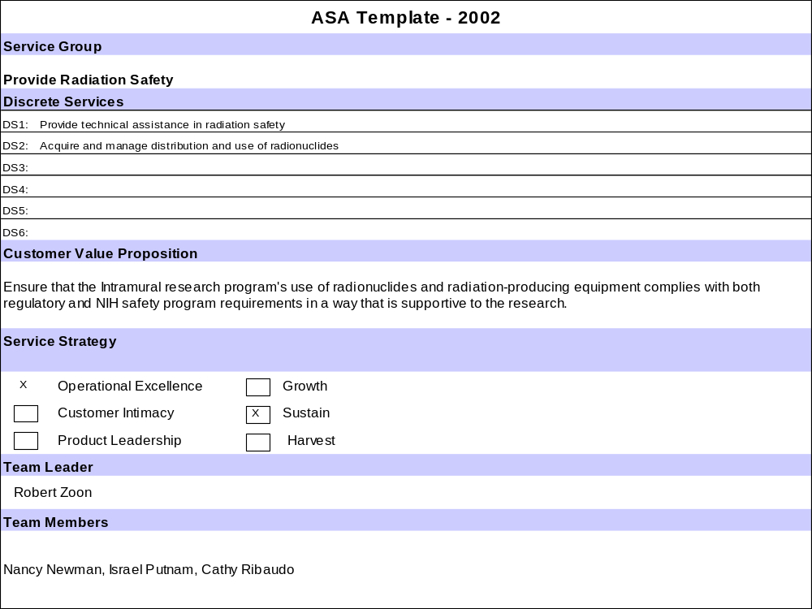
Notes:
Replace the template shown here with page 1 of your ASA template.
To copy an Excel chart, diagram, graph, Visio chart, or MS Word narrative into PowerPoint:
1. Copy selected chart/diagram/graph/ text in Excel/Visio/Word
2. In PowerPoint, insert a new slide on which to paste your chart/diagram/graph. Note when selecting a new slide on which to paste a graphic, you will want to select the slide type that only has a text box for a title, and the rest of the slide is blank. To insert a slide, choose “Insert”, then “New Slide” from the menu, select the type of slide to insert, and then click “OK”.
3. Once you have positioned your cursor onto the new blank slide on which you want to import your graphic, choose “Edit” and then “Paste Special” from the menu. By using “Paste Special” instead of just paste, you will help to keep the size of your file manageable.
Resize the copied object if necessary. Resizing the chart or graph in Excel first may give you better results. You may want to try it both ways.
In your presentation, please emphasize the value proposition and the service group strategy. Have your customers had a chance to discuss with you the the VP? What elements of the value proposition were assessed in the ASA?

Slide 5
Customer Perspective
Notes:
Transition Slide for your Customer Perspective data and findings.

Slide 6
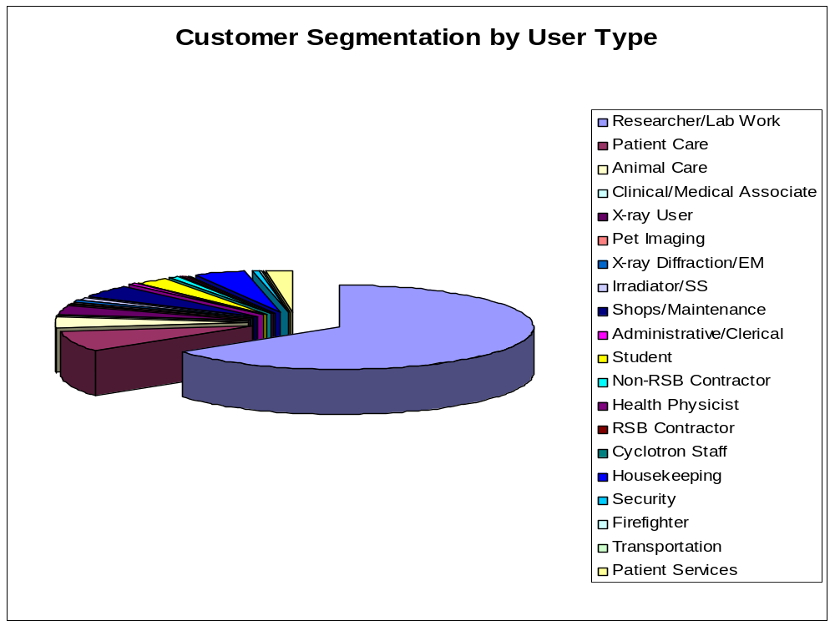
Customer Segmentation
Notes:
Insert bullet statements summarizing your findings from your customer segmentation graphs, or insert the actual graphs if you desire.
If you have more than one graph, you will need to add additional blank slides to your presentation, and import your graphics to those slides. To insert a slide, choose “Insert”, then “New Slide” from the menu, select the type of slide to insert, and then click “OK”.
Refer to page 4 of this presentation for directions on how to insert charts/diagrams/graphs from other programs into PowerPoint.
Ideas for summarizing your Customer Segmentation Data:
Which segments are your primary customers?
Which NIH customers are not currently your customers? Why?
If you have multiple year data, how has your customer base changed over time?
What does the information show about who you are and are not serving? What does this mean for your service area?
Have you chosen growth as your service strategy? If so, how is this reflected in your chart (i.e., which segments will you target for growth)?

Slide 7
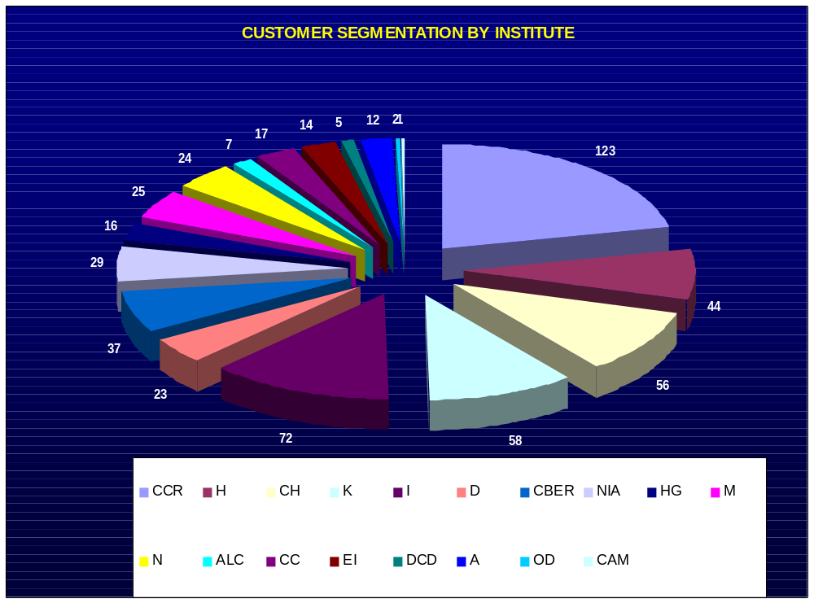

Slide 8
Customer Satisfaction
ORS Customer Scorecard used
Response rate 15%
Product/service satisfaction index 8.75/10.0
Customer service satisfaction index 8.90/10.0
Overwhelmingly positive feedback
Notes:
Insert bullet statements summarizing your findings from your customer satisfaction graphs, or insert the actual graphs if you desire.
If inserting your radar charts or scatter diagram, refer to page 4 of this presentation for directions on how to insert charts/diagrams/graphs from other programs into PowerPoint.
Ideas for summarizing your Customer Satisfaction Data:
Which ratings are highest? Which are lowest? Why?
How do the ratings compare to the data collected in the internal business perspective? For example, if the average satisfaction with timeliness is low and your response time measure in the process perspective indicates that 97% of the time you delivered within agreed upon schedules, then the discrepancy needs to be investigated.
How do you compare to ORS overall?
What did you learn from reviewing all your comments?
Which areas will you concentrate your improvement efforts on and why?

Slide 9
Internal Business Process Perspective
Notes:
Transition Slide for your Internal Business Process Perspective data and findings.

Slide 10
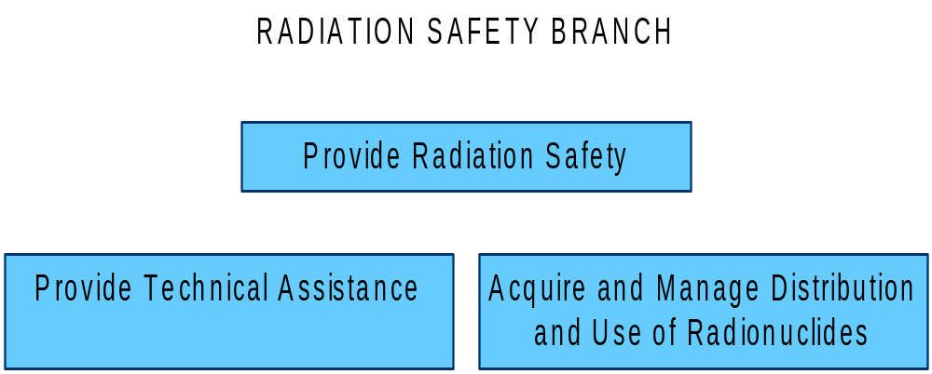
Service Group Block Diagram
Notes:
Discuss the relationship between your Service Group and the discrete services included in the group.
This would be the place to point out any difficulties you had with establishing performance measures for your existing discrete services (e.g., because they do not accurately reflect the work you do or the services you provide to customers).
You may also highlight suggested changes to the service group focus, or to the discrete service composition.
If you want to insert your block diagram, refer to page 4 of this presentation for directions on how to insert charts/diagrams/graphs from other programs into PowerPoint.

Slide 11
Conclusions from Discrete Services Deployment Flowcharts
Our Service Group completed 2 deployment flowcharts for 2 discrete services
For technical assistance, flowchart showed that collaboration among Branch components, customer and the Radiation Safety Committee is essential.
For radionuclides, flowchart showed smoothly functioning process for receipt and delivery of products to customers via contractor, with minimal problems.
Notes:
Each Service Group was required to complete a deployment flowchart on every discrete service in their Service Group. After reviewing these flowcharts, summarize what you learned from this analysis.
Ideas for summarizing conclusions from your Deployment Flowcharts:
Did it lead to suggestions for changing the process?
Did it lead to identifying process measures?
Have you made any changes in your processes already based on what you learned?
What impact should these changes have in process performance, customer satisfaction?
How would you know if the changes achieved expected results?
If particularly useful, you may want to include a copy of a deployment flowchart. Realize that in most cases, it will be difficult for your audience to readily see your chart in this format. However, you could focus on a section that you changed.
If you choose to insert any deployment flowcharts, refer to page 4 of this presentation for directions on how to insert charts/diagrams/graphs from other programs into PowerPoint.

Slide 12
Process Measures
Process measures for each discrete service
  DS 1: Enforcement actions per year
  DS 2: Vendor errors by month
Enforcement actions decline over a five year period, indicating program success
Vendor errors below 1.2 %
Notes:
Each Service Group was required to come up with a unique process measure for every discrete service. List those measures here. A simple way to do that is indicated above.
Also summarize any data that was collected on these process measures, and the findings from that data. If relevant, include graphs showing your process measures data.
You should indicate how these unique measures helped you assess the performance elements of your team’s value proposition.
For example, if you indicated that you provide timely and cost efficient services, then show the percentage of times that your services were delivered within agreed upon schedules. Then, in the financial perspective you can show how your unit cost has changed over time, or how your rates compared to other service providers. You may also show how your response time to service requests has changed over time.

Slide 13
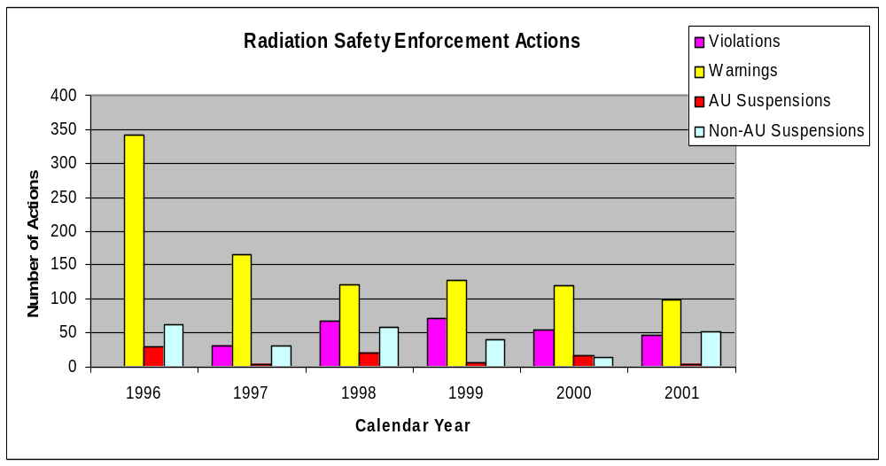
DS 1: Enforcement Actions by Year

Slide 14
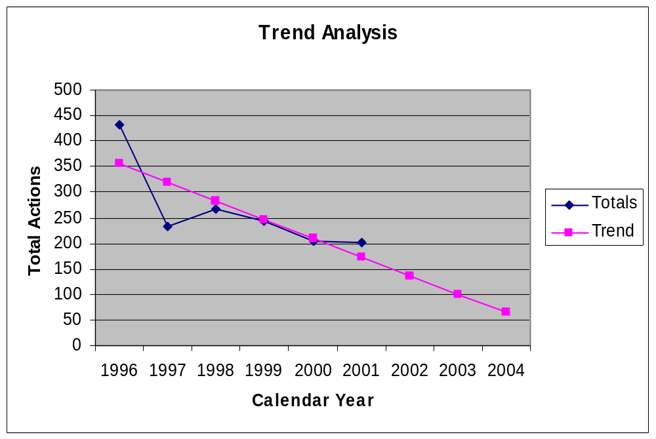
DS 1: Enforcement Actions

Slide 15
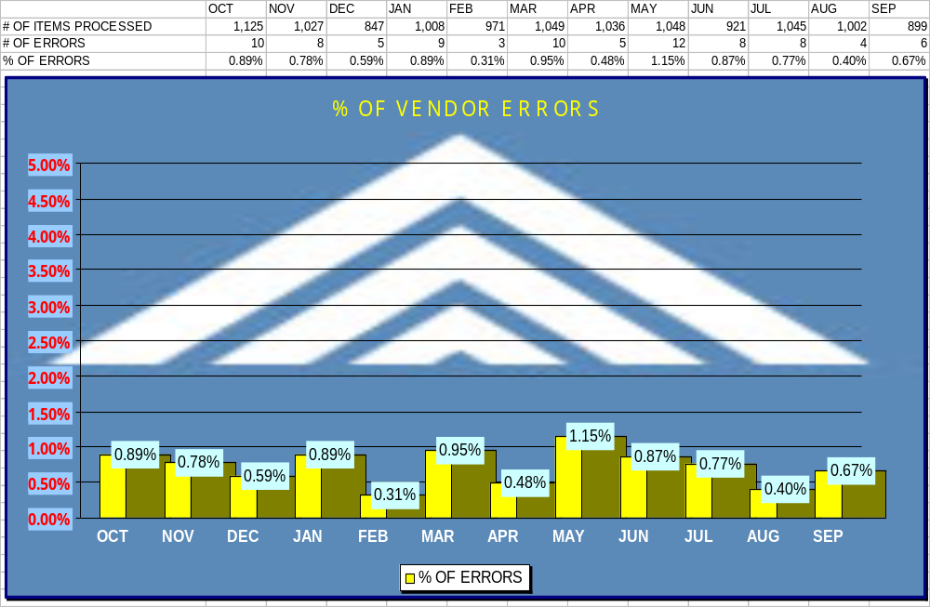
DS 2 : Vendor Errors per month

Slide 16
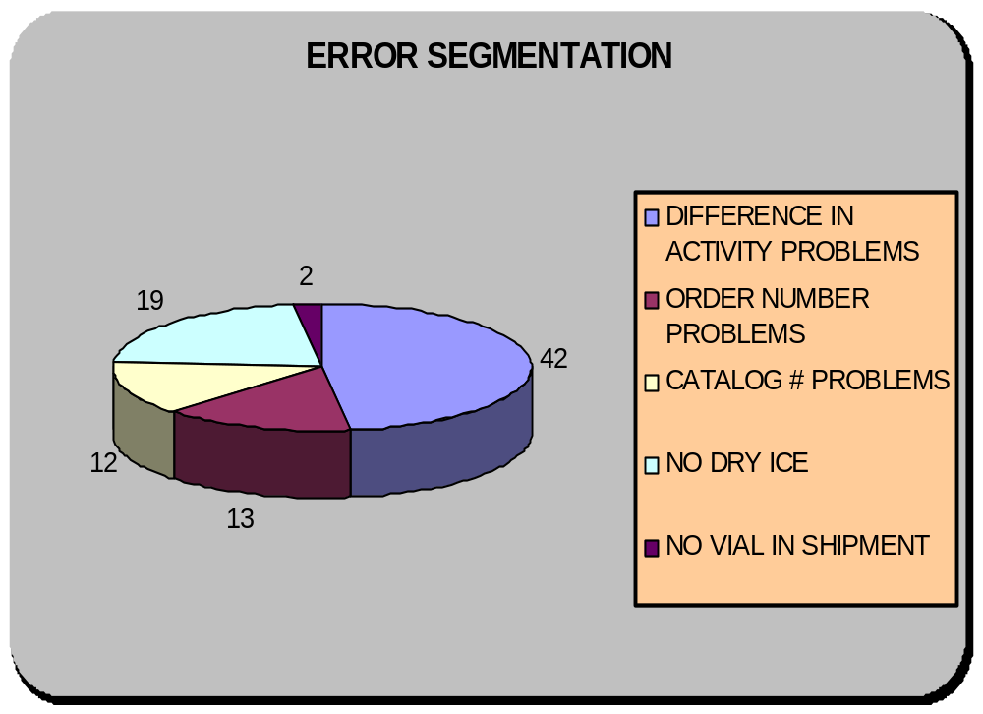
ERROR SEGMENTATION BY PROBLEM

Slide 17
Learning and Growth Perspective
Notes:
Transition Slide for your Learning and Growth Perspective data and findings.

Slide 18
Conclusions from Turnover, Sick Leave, Awards, EEO/ER/ADR Data
Our higher-than-average turnover rate puts us at a disadvantage
  Filling vacancies takes an inordinately long time
  Bringing new people up to speed takes time and effort
Use of sick leave is below ORS average
To be consistent with the rest of ORS, we need to consider more awards for employees.
The EEO data is misleading, i.e., both cases were resolved by withdrawal of the pre-complaints.
The number of ER “cases” is misleading, as all 3 were, in fact, sequential actions for the same individual.
Notes:
Summarize your findings and conclusions from the Learning and Growth data provided to your Team. If useful, insert any Learning and Growth graphs from the feedback packages provided by OQM.
Refer to page 4 of this presentation for directions on how to insert charts/diagrams/graphs from other programs into PowerPoint.
Ideas for conclusions on Turnover, Sick Leave, Awards, EEO/ER/ADR:
How has the employee turnover in your area impacted your ability to deliver excellent service to your customers?
Have you not had turnover in your area? How does that impact your ability to stay current with customers’ ever changing demands for services?
Does your EEO/ER/ADR data indicate issues that need to be addressed in your work place?
What has been the cumulative impact of sick leave usage, and the need to address workplace issues through the ADR, EEO and ER processes in servicing NIH or ORS customers?
Do the awards provided to your employees seem to match with the service they are delivering to their customers? In answering this question, please relate to the customer satisfaction data and indicators of service performance (e.g., cycle time, unit cost, quality).

Slide 19
Analysis of Readiness Conclusions
We believe we will have the necessary resources to face the challenges of the future
  Plans for additional staffing via contract in response to major expansion of NIH facilities
  Diversion of existing staff to supporting research involving Positron-Emission Tomography (PET)
  Training of staff in cyclotron and PET technology
  Training of staff in high dose rate brachytherapy
Notes:
Summarize the major findings from the Analysis of Readiness questions reviewed by your team.
Ideas for Analysis of Readiness Summary:
Do you expect major changes in the service group value proposition, or in the composition of discrete services ( 3 - 5 years from now)?
What new skills and abilities are needed by your workforce?
How do you plan to address fluctuations in discrete service demand?
What changes in technology or tools, if any, are needed or desired? How do you know? Is it based on best practices or benchmarking studies? If so, please explain.
What is the team doing to address the changes needed? What is the plan? What are the possible consequences of not implementing the changes in the time needed?

Slide 20
Financial Perspective
Notes:
Transition Slide for your Financial Perspective data and findings.

Slide 21
Unit Cost Measures
DS 1: Membership fee of $5,521.74 per Authorized User per year (FY03)
DS 2: Per item fee of $76.34 (Non-RAMOS) or $89.06 (RAMOS) in FY03
Both costs have increased due to increased cost of labor, contracts and higher costs for rent; expect continued increases in future
Notes:
If you choose to insert your unit cost graphs, refer to page 4 of this presentation for directions on how to insert charts/diagrams/graphs from other programs into PowerPoint.
Ideas for Summarizing your Unit Cost Measures:
How did you define unit cost for each discrete service?
If you didn’t define unit cost for each discrete service, why not?
Is your unit cost going up or down or remaining stable? Why?
What do you anticipate next year and in the future?

Slide 22
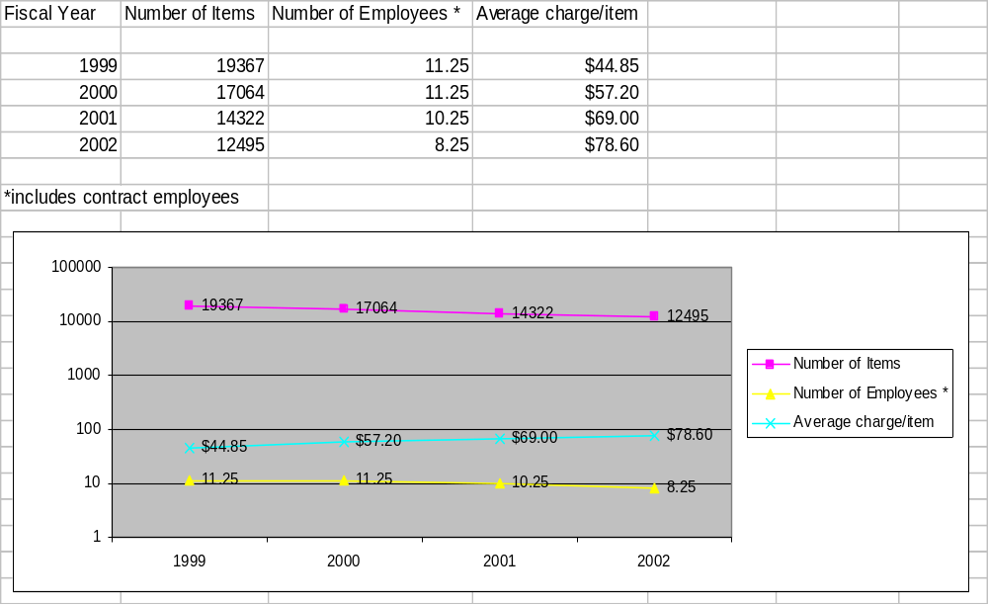
COST ANALYSIS TREND FOR DS 2

Slide 23
ASSET UTILIZATION
(DS 1: provide technical assistance)
Maximum Input Capacity = FTE hours + overtime = 73,600 + 390 = 73,990 hours
Nonproductive Input = Standby + Duplication of Effort = 4,726 + 460 = 5,186 hours
Asset Utilization = (Maximum Input Capacity - Nonproductive Input)/Maximum Input Capacity = (73,990 - 5,186)/73,990 = 92.9%
Notes:
40 FTEs (including contract support other than package receipt and waste disposal)
40 FTE x 1840 hours/FTE = 73,600 hours
Total Overtime = 390 hours/year
After-hours security checks = 360 hours/year
Emergency response = 30 hours/year
Maximum input capacity = 73,600 + 390 = 73,990 hours
Standby = 4,726 hours (1 FTE admin support plus 4% of other FTEs)
Duplication of effort = 460 hours (25% of FTE)
Nonproductive input = 4,726 + 460 = 5,186 hours

Slide 24
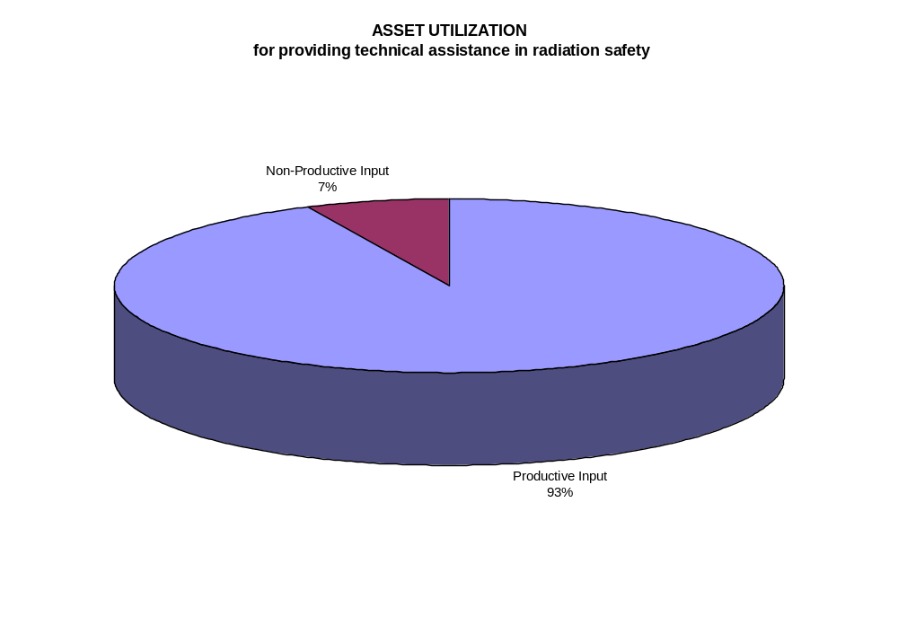
Asset Utilization Measures
Notes:
Ideas for Summarizing Asset Utilization Measures:
How did you define asset utilization?
How close are you in meeting your planned utilization? Why?
How can you better plan asset utilization in the future?

Slide 25
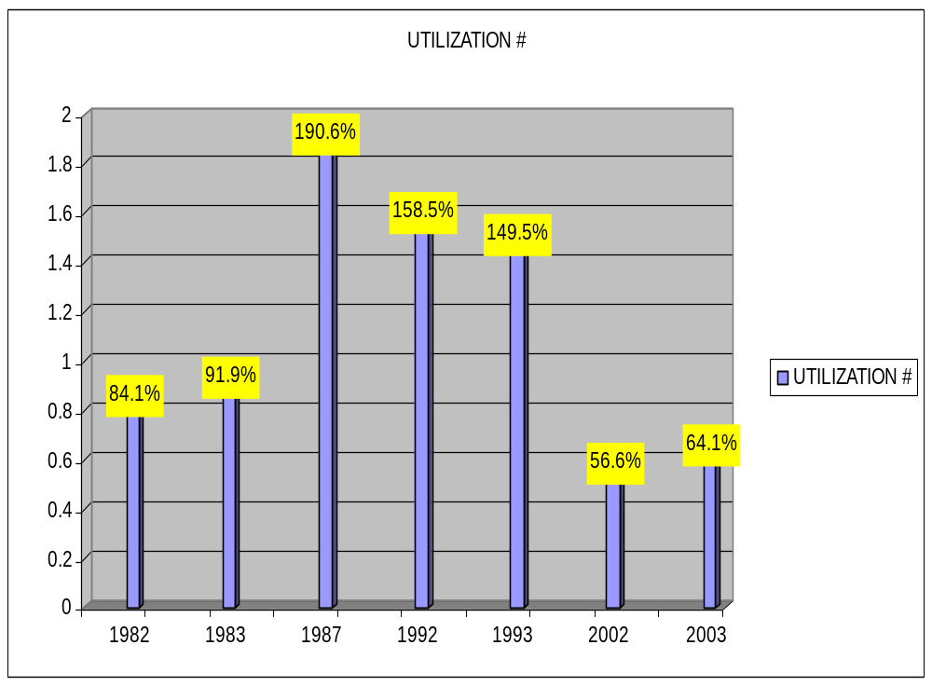
ASSET UTILIZATION FOR DS 2

Slide 26
Conclusions and Recommendations
Notes:
Transition Slide for your Conclusions and Recommendations.

Slide 27
Conclusions from FY02 ASA
Program, as operated, is highly successful at qualifying users to work with radioactivity and radiation safely.
Customer satisfaction with program services and products, such as radioactive materials receipt and delivery, is very high.
Given the necessity to maintain the capability to respond to emergencies (readiness) and the regulatory requirement for the program, there is little leeway for cost reduction.
Notes:
Use this slide to summarize your conclusions from the FY02 ASA.
Ideas for Conclusions:
What are your major findings based on all of the analyses you’ve conducted?
What services, products, or processes have you identified for improvement?
What have you already implemented based on your findings?

Slide 28
Recommendations
Steps should be taken to reduce staff turnover
  Boost staff morale by increasing awards
  Encourage mentoring
Continue expanding on-line services
Incorporate decay into inventory records
Eliminate the current radioactive material ordering system, “RAMOS”
Decreasing package receiving contract by 1 FTE in response to decrease in packages received
Consider reducing 1 administrative FTE (via attrition)
Notes:
Use this slide to summarize your recommendations.
Ideas for Recommendations:
How do you recommend making improvements for the future?
What recommendations can you implement without higher-level approval?
If you need approval from higher authority to implement a recommendation, clearly state who that would be, and the date by which you need the decision.

Slide 29
Appendices
Notes:
Transition Slide for your Appendices.

Slide 30
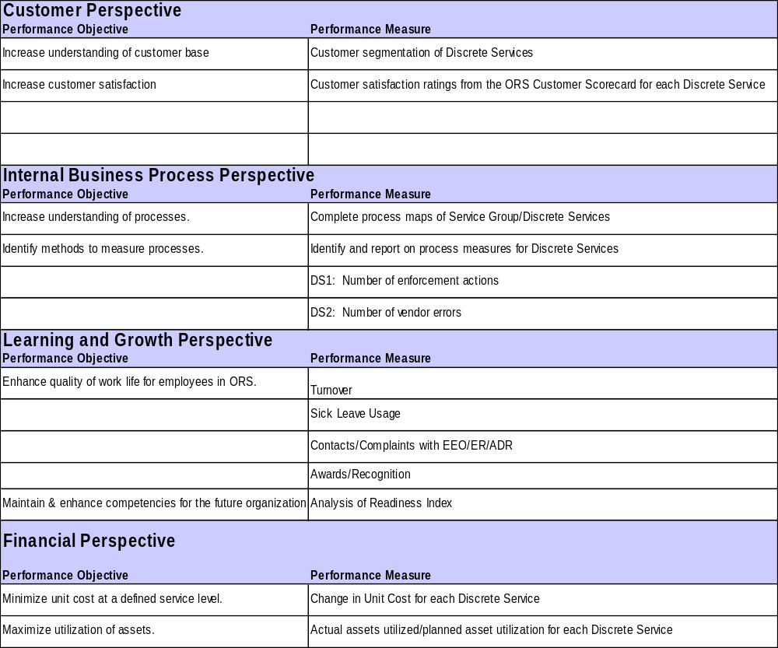

Slide 31
Survey Distribution
Number of Surveys Distributed
Radiation Technical Services 594
Number of Surveys Returned
Radiation Technical Services 89
Response Rate 15%

Slide 32
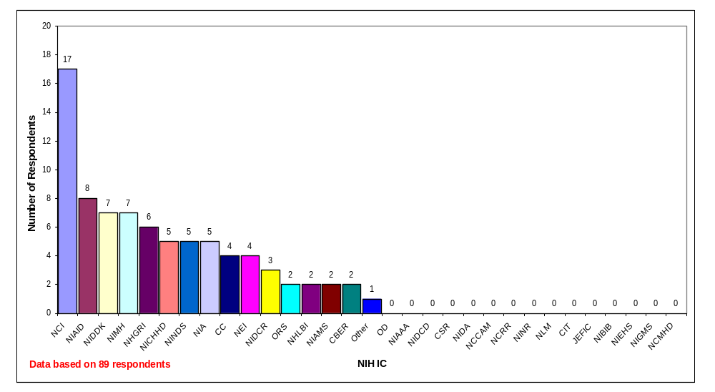
Survey Respondents
FY02 Respondents by IC
Note: Not all respondents answered this question.

Slide 33
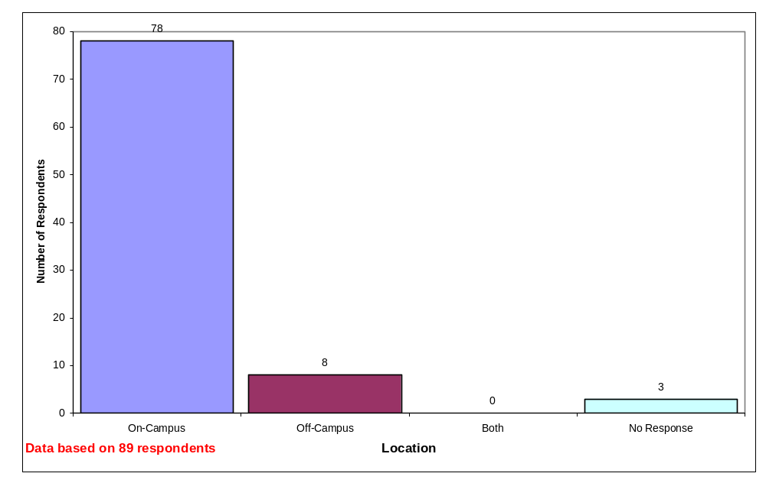
Survey Respondents (cont.)
FY02 Respondents by Location

Slide 34
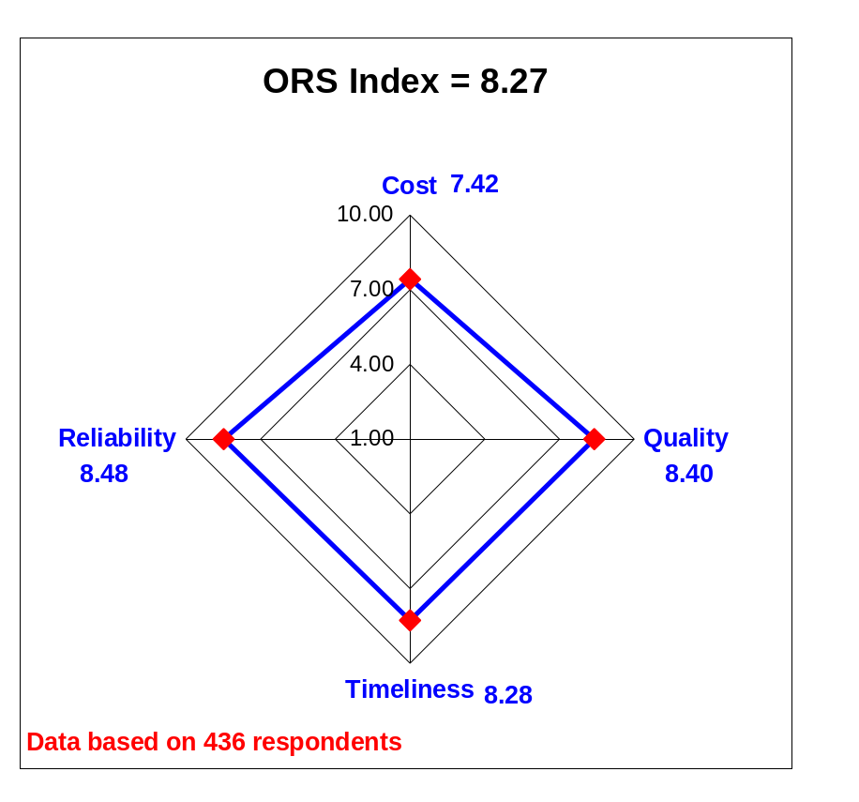
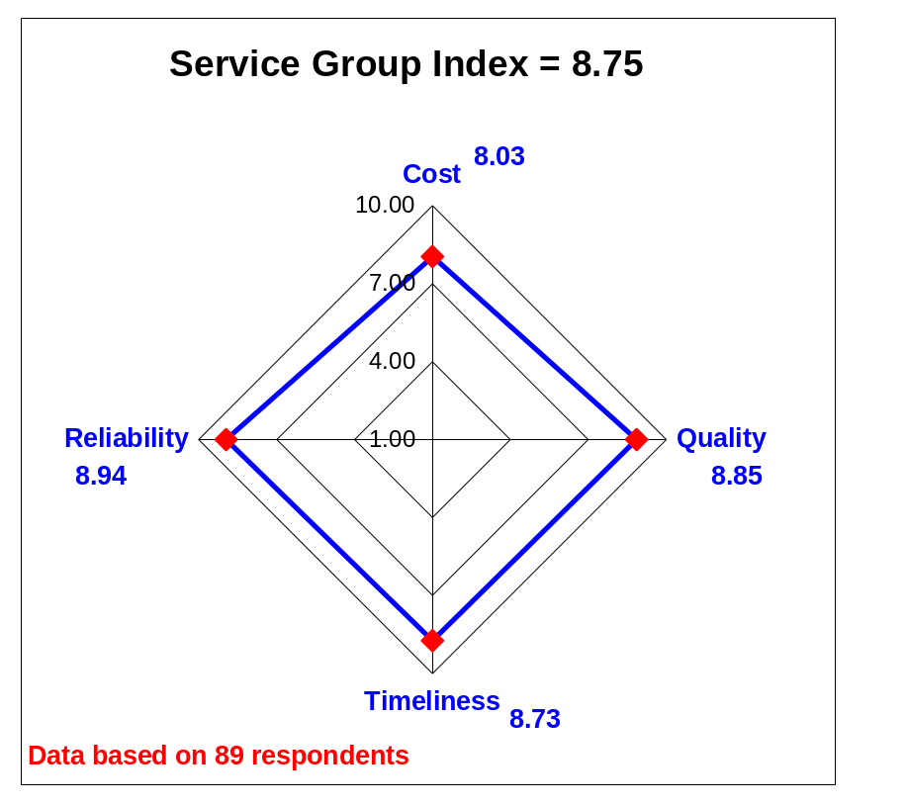
Radar Chart
FY02 Product/Service Satisfaction Ratings
Note: The rating scale ranges from 1 - 10 where “1” represents Unsatisfactory and “10” represents Outstanding. Refer to the Data Analysis and Graphing training for advice on interpreting these results.

Slide 35
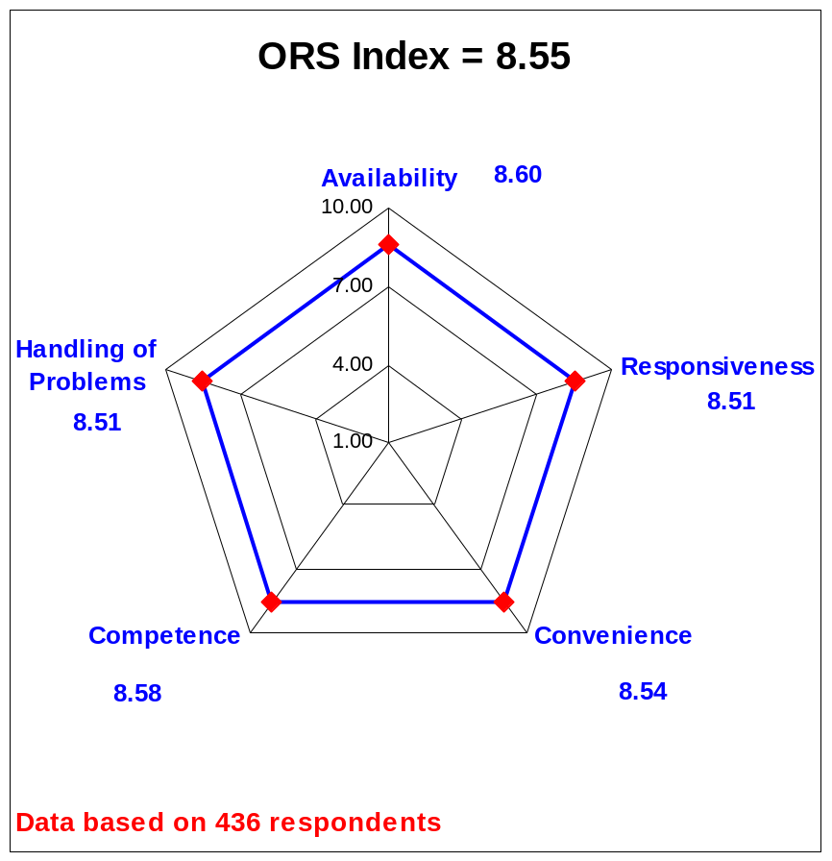
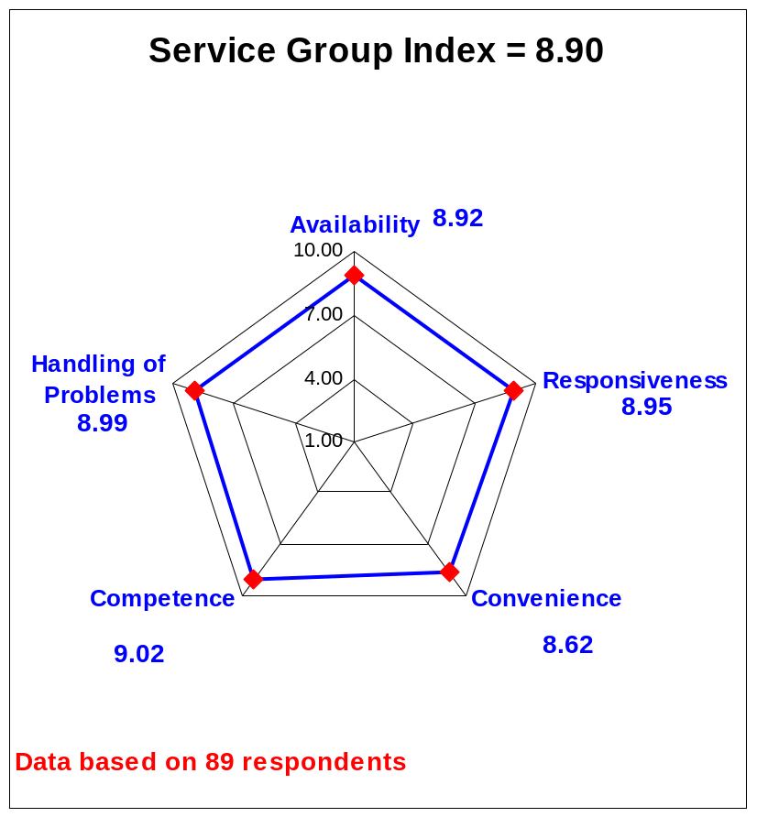
Radar Chart
FY02 Customer Service Satisfaction Ratings
Note: The rating scale ranges from 1 - 10 where “1” represents Unsatisfactory and “10” represents Outstanding. Refer to the Data Analysis and Graphing training for advice on interpreting these results.

Slide 36
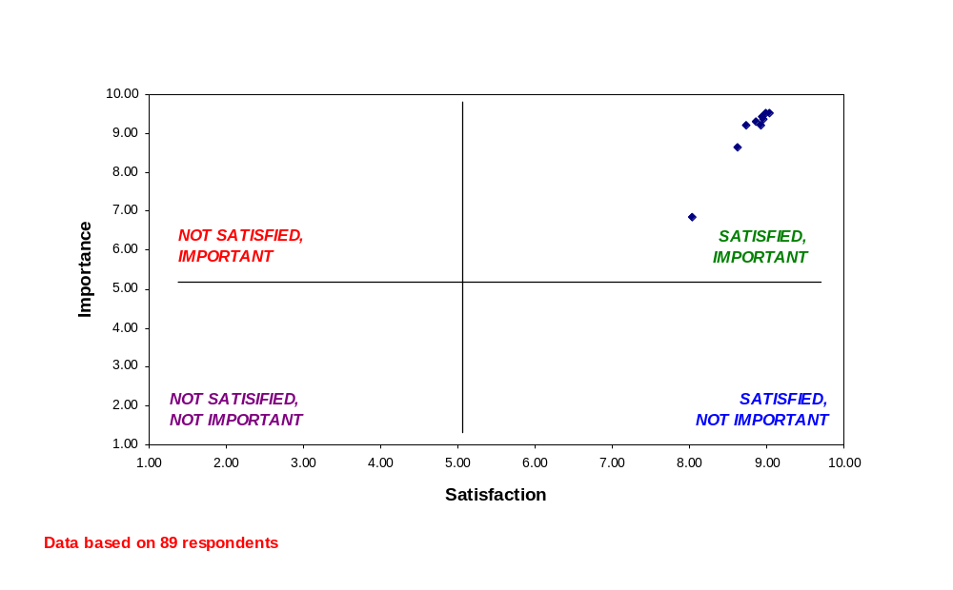
Scatter Diagram
FY02 Customer Importance and Satisfaction Ratings
Note: The Importance rating scale ranges from 1 - 10 where “1” represents Unimportant and “10” represents Important. The Satisfaction rating scale ranges from 1 - 10 where “1” represents Unsatisfactory and “10” represents Outstanding.

Slide 37
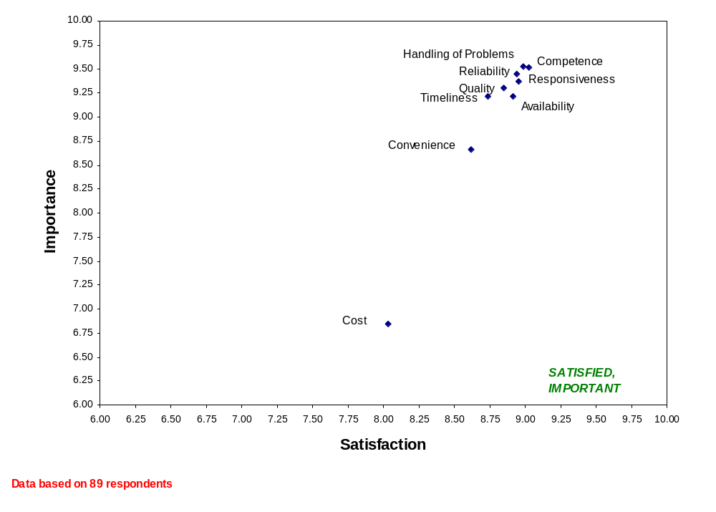
Scatter Diagram
FY02 Customer Importance and Satisfaction Ratings:
A Closer Look
Note: A smaller portion of the chart is shown so that the individual data points can be labeled.

Slide 38
What was done particularly well?
Problem handling is excellent. Health physicists have generally been creative and pro-active in solving problems ranging from personnel issues to experimental design considerations. New on-line services add greatly to the convenience.
Radiation safety training is very well-organized, easy to register, etc. Delivery of isotopes is very timely. Pickup of radioactive waste is also extremely prompt.
Suggestions for improvements in radiation issues brought to our attention during monthly surveys. Handling of specific acute radiation safety problems that may arise. Responsiveness to requests for meetings to discuss radiation safety issues.
Questions answered and new situations addressed promptly and completely.
Response to questions concerning record keeping and safety.
The RSB shows excellence in just about every aspect they are involved in.
1. Waste was picked up in a timely fashion. 2. Isotope was delivered in a timely fashion.
I ship radioactive materials frequently. This has always been done very smoothly and with no problems. Also I receive FedEx receipts etc. from Jamie West promptly after the shipment has been shipped. Also I have never met a person from the radiation safety branch or a contractor that wasn't very nice and helpful.
Quality of isotopes and relatively low cost.
I think the radiation branch has a difficult job that it does extremely well. The most outstanding feature of the radiation branch is its wonderful attitude where I have always felt they really try to help the scientists do their job. All the contract workers are just fantastic ranging from radiation pickup to routine surveys. The development of contract surveys (very reasonable price!) was brilliant and just what we needed to assist in the compliance of rules of operations. When there is a problem I can always count on the radiation office to help rather that be heavy handed in "blaming" (i.e, radioactive spill or other queries).

Slide 39
What was done particularly well? (cont.)
Last year we had a summer guest researcher who wanted to use Cu-65 in the lab. We received excellent response and information from your staff when we were concerned about shielding, use, disposal, etc, as many lab personnel were concerned about exposure. And this year, in discussing this with our HP, we were happy to learn that allowing the use of such "unusual" isotopes is at our discretion. This year I told the guest researcher that he couldn't use Cu-65 under my authorization.
Registration for the training classes.
Always someone there to answer questions. Staff is very helpful.
Prompt responses to inquiry.
Response to query about safety of maintaining radioactive waste in the lab.
Starting up a new lab, approving of new users, survey reviews.
Waste pick up is very reliable. Training is conveniently scheduled and staff was very receptive and flexible about retaking of a test that someone in my group (a non-native speaker) didn't pass the first time. Thank you.
Shipping discrepancies and information are dealt with efficiently. Requests for information are processed promptly and response is rapid.
Willingness to meet and discuss questions with regard to Rad. Safety.
Handling the logistics of closing laboratory down for renovations.
I have seen significant overall improvement from placement of orders to receipt and delivery of isotopes. Both the NIH and the contractor personnel are very responsive to our needs.

Slide 40
What was done particularly well? (cont.)
Our health physicist, Beth Reed, is always willing to stop by my lab or answer my questions over the phone. She has been quite helpful over the year I have been employed here at NIH.
Our health physicist is outstanding. That was not always the case with former ones. I really like the online resources for changing people and locations under my supervision. The overall improvement over the years is much noticed.
Helping us move our radioactivity during our move from 4th to 5th floors.
Availability of the product.
Efficient pre-review of new clinical research protocol.
Samples are always rapidly cleared through RSO and delivered to us in a timely manner.
RSO is very responsive to any questions etc. He is usually available.
Communication from Radn Safety branch is clear and well distributed. I know that I can good information quickly in an emergency.
All things considered, I think the Rad Branch does a pretty good job. My orders are always placed and arrive in a timely fashion. My health physicist is available when I have questions. My orders are delivered in a timely fashion. Additionally, any communication that I receive from the branch is usually to the point and worthwhile.
We recently moved into a new lab and had a dedicated hot lab built. George Redmond was instrumental in many of the features of this space and how I equipped it. The end result is a lab available to 2 branches of an institute and no complaints from users (yet). The new web site is a great addition to the services.

Slide 41
What was done particularly well? (cont.)
Every problem we have had has been dealt with appropriately and efficiently. The services work. They stand out from many other services in this way.
Pick up waste, web site
Contractor surveys. Setting up new personnel with training and registration.
Teaching, record keeping, contractor management, on-site problem solving.
The emergency response and availability of the health physicist was very good.
Waste management.
Protocol processing.
John Jacobus provides the training for DLM on a regular basis and manages to keep it interesting and to the point (especially since we do not handle primary sources vials, but radiation as it occurs in patient samples). I addition, he has been helpful in evaluating waste disposal for the service.

Slide 42
What needs to be improved?
I think that e-mail notices that high-light changes in rules would be useful.
There sometimes seems to be some confusion with our procurement agent with ordering isotopes. Many times, during the past several yrs, I have received a phone call from Rad Safety Branch asking for an 88-1 form after we already submitted one with the order. I don't know whether the confusion is with our procurement agent or the DELPRO system or ?
Further increase in the use of internet or other computer-based ordering, tracking, user information based interface between radiation safety and is user group.
RAD Safety User Training: Could be shortened.
It is at times hard to get in touch with our health physicist. I think this is due to the recent turnover. At this point, I am not sure who was assigned as ours as they have not tried to contact me.
Delivery time.
Keep up the good work.
Because of half life considerations, it would be great if partial 32P orders are delivered instead of waiting for the arrival of the complete set.
After an isotope has been ordered, if we have an expectation of delivery to the lab the following day, we are always anxious about: did the vendor ship the isotope, did the RSB receive the isotope, and are we going to obtain delivery to the lab that day? In other words, once an order is placed, the complex processing of isotope orders (purchasing agent, vendor, RSB processing, delivery to lab) puts us out of the loop. No good way for the investigator/user to track all of these steps, creating anxiety and "should I begin the experiment not knowing when the isotope will arrive on campus and into my lab?"
Nothing.

Slide 43
What needs to be improved? (cont.)
Feedback from Health Physicist if a problem occurs.
Training refreshers-have we had them in a while?
The delivery time of short T 1/2 radioisotopes for in-human use.
Perhaps staffing more than one day a week at this facility.
Coordination of RSC with other committees and PI to minimize delays.
Ordering needs to be straightened out between radiation and purchasing. Only certain quantities of isotopes can be ordered through Ambis and not be rejected or needing an 88 form. But no one seems to know what they are.
Given the important restrictions that need to be followed for handling isotope, I think Radn safety branch is doing a good job.
I think that the record keeping/inventory controls on the Rad Safety end of things could be improved a bit. Every once in a while, my monthly reports are not accurate despite having sent paperwork into the Rad Saf Branch. Also, the manner/courteousy of the person handling the main phone line could be improved.
When planning a survey/AU check, appointments made should be kept. If a time is set or mentioned by the AU, then it should be respected.
I do not know which services we are billed for and how much, and which come from institutional funds. Having some more information and control over costs would be nice.
Adding users to use/disposal sheets.
Very little

Slide 44
What needs to be improved? (cont.)
Although deliveries were generally handled well, at least three times in the last two years we lost a set of experiments because samples were misplaced or not delivered.
They do a great job and work very hard. My perception is that they need more FTE's to do their job. If so, they should get more resources.
The quantity of short-lived isotopes held for a long time should not be calculated from the starting date - i.e., decay should be calculated for the day of report.
I would like to see one surveyor return each time - it is easier to work with the same person each time.

Slide 45
Other Comments
Other than my brief comments above, I think the Rad Safety Branch does a very admirable and important job.
Was satisfied with all aspects of the service received.
Radiation Safety is a well organized, helpful branch of NIH.
Generally the system works very well.
Thanks for a job well done. You are one of the best divisions of the NIH.
Overall, Radiation Safety does a great Job!!!
Try to devise a system for the investigator/user to track the above steps.
I think you are doing a great job. You have streamlined the record keeping. Allowing the securing of isotopes and waste in locked refrigerators/containers has pretty much eliminated the problem of keeping rooms locked during working hours. Your procedures have reduced the time I have to spend on compliance. Our use of isotope has been dramatically reduced by use of automated sequencing and other non-radioactive techniques, but we still have the need to use radioactivity, and we find all the new procedures to be very user-friendly.
I'm quite satisfied with you.
Lisa Coronado is a gem!
Keep up the good work.
I have had very light use of RSB services, and my comments should be weighed accordingly.
By and large, Radiation Safety appears well organized, competent and helpful.
Provide an online radiation safety course and certification.

Slide 46
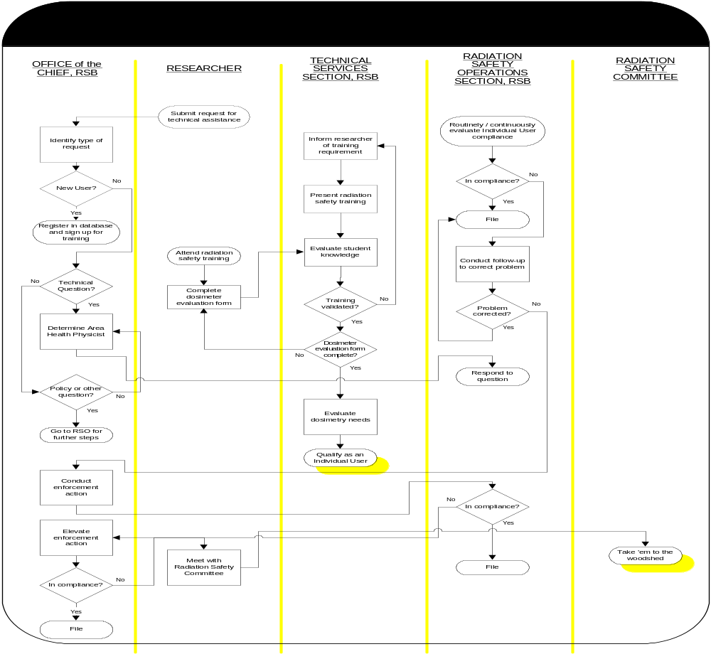

Slide 47
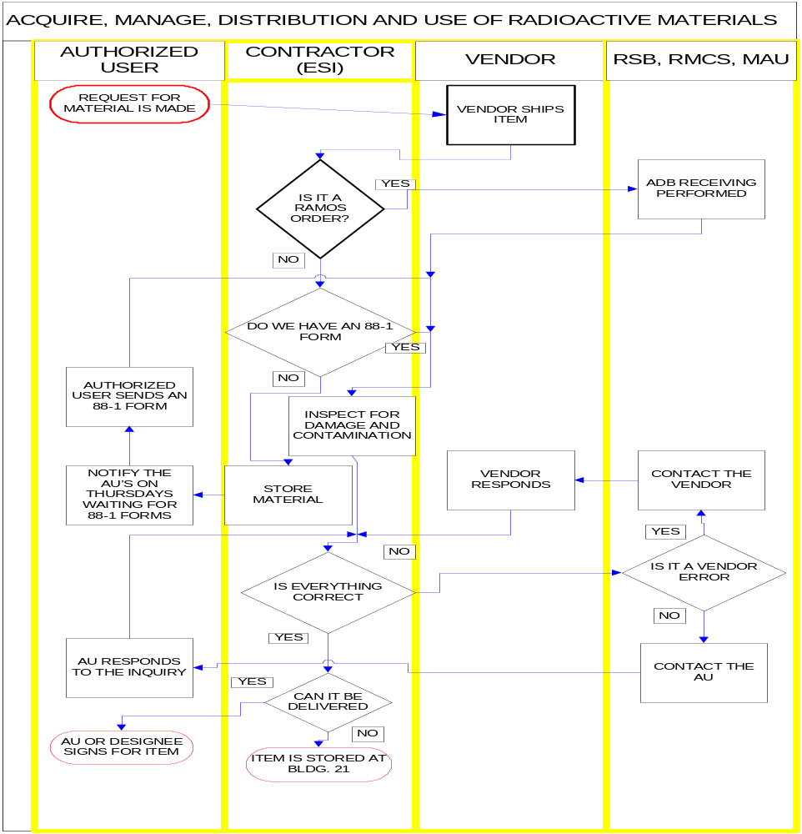

Slide 48
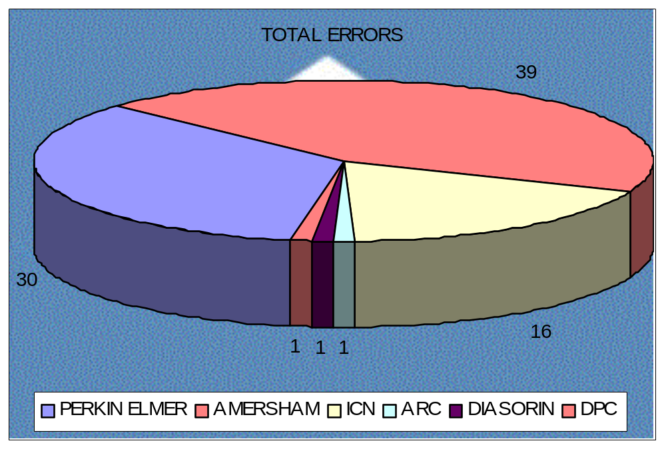
DS 2: VENDOR ERRORS SEGMENTATION

Slide 49
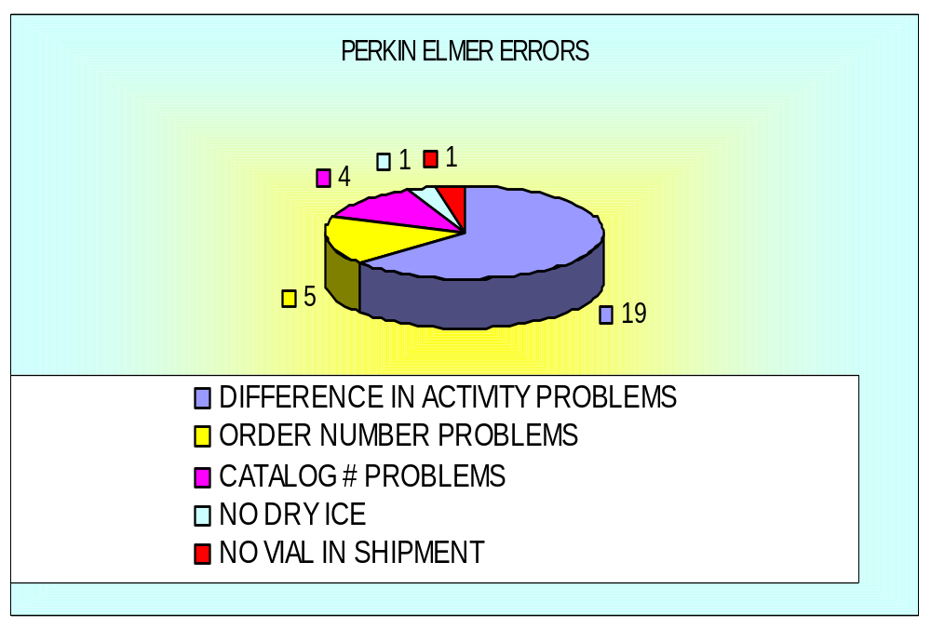
PERKIN ELMER ERRORS

Slide 50
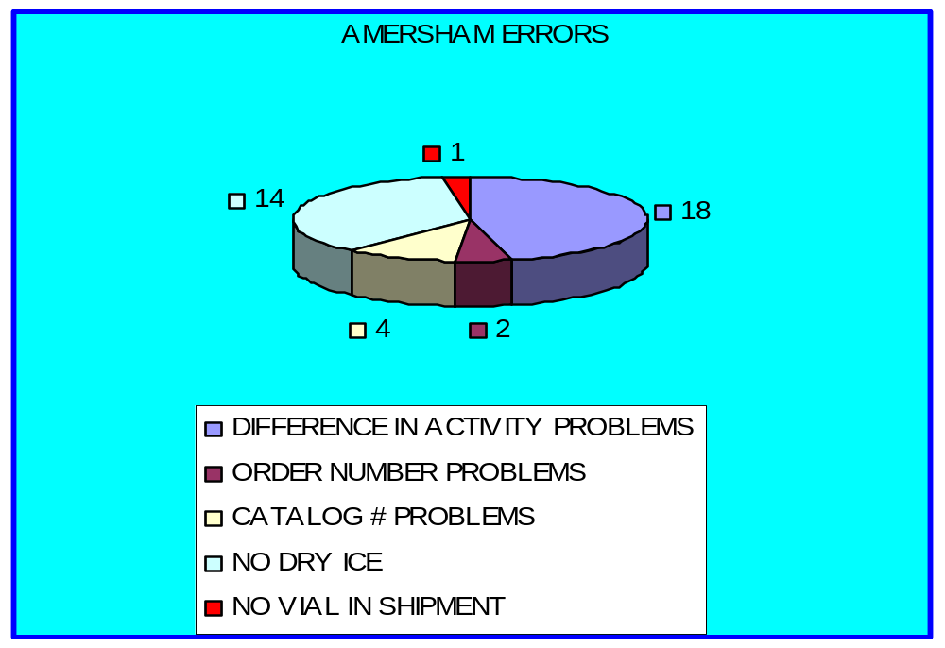
AMERSHAM ERRORS

Slide 51
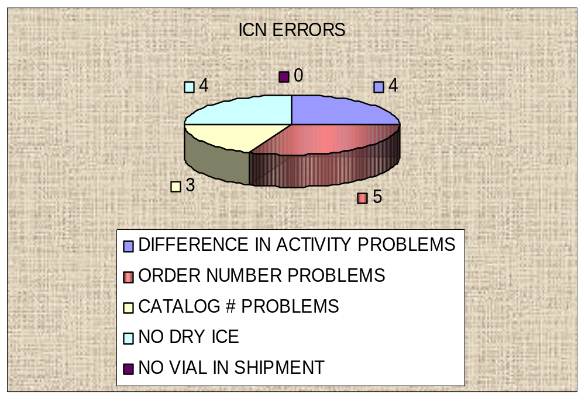
ICN ERRORS

Slide 52
Learning and Growth Data
All of the “Learning and Growth” data provided to us are incorrect:
The percentages are based on 31 FTE’s and the Branch actually has 33 FTE’s.
The “3” ER cases were, in fact, sequential actions for the same individual.
The 2 EEO cases were both resolved and the precomplaints were withdrawn.

Slide 53
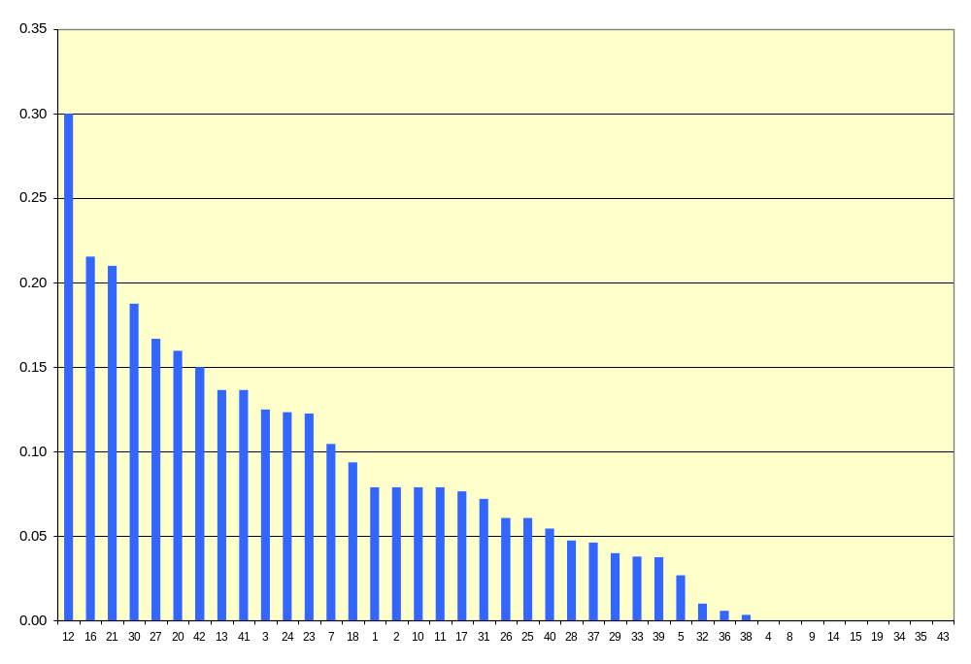
Service Group Turnover Rate
(Oct 2001 - June 2002)
Turnover Rate
Service Group Number

Slide 54
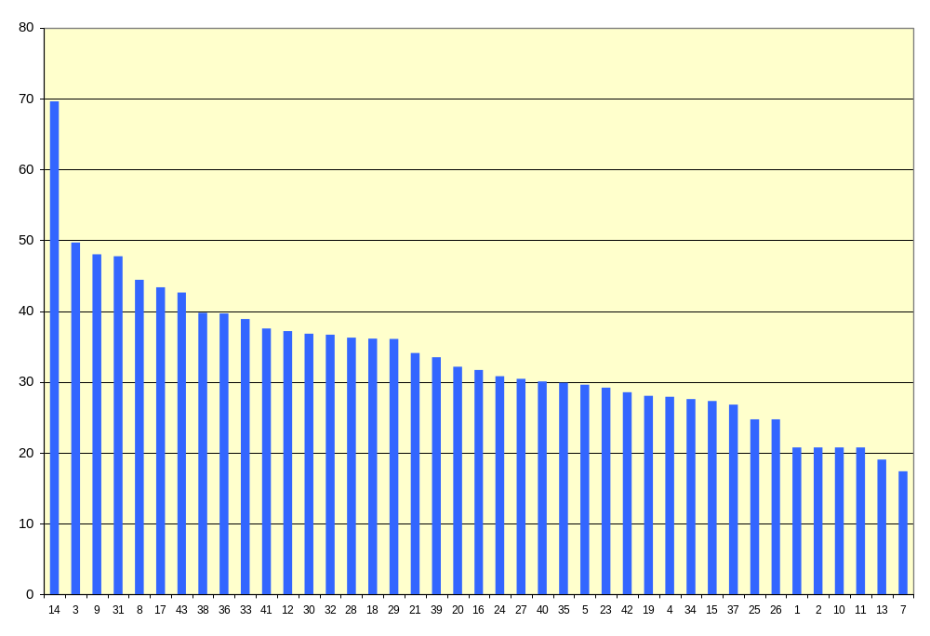
Average Hours of Sick Leave Used
(Oct 2001 - June 2002)
Average Hours
Service Group Number

Slide 55
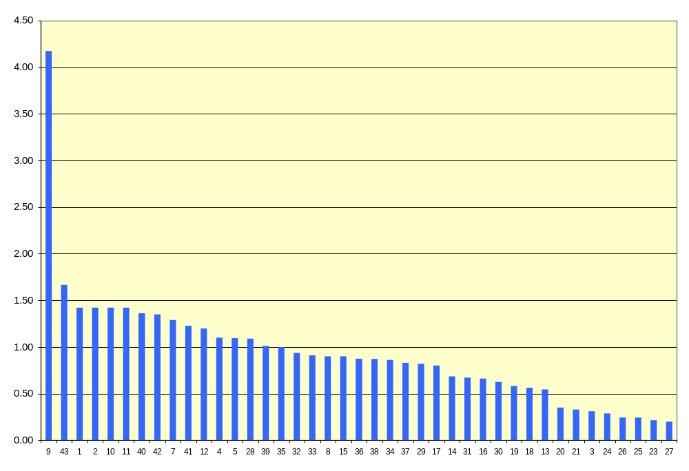
Average Number of Awards Received
(Oct 2001 - June 2002)
Average number
Service Group Number

Slide 56
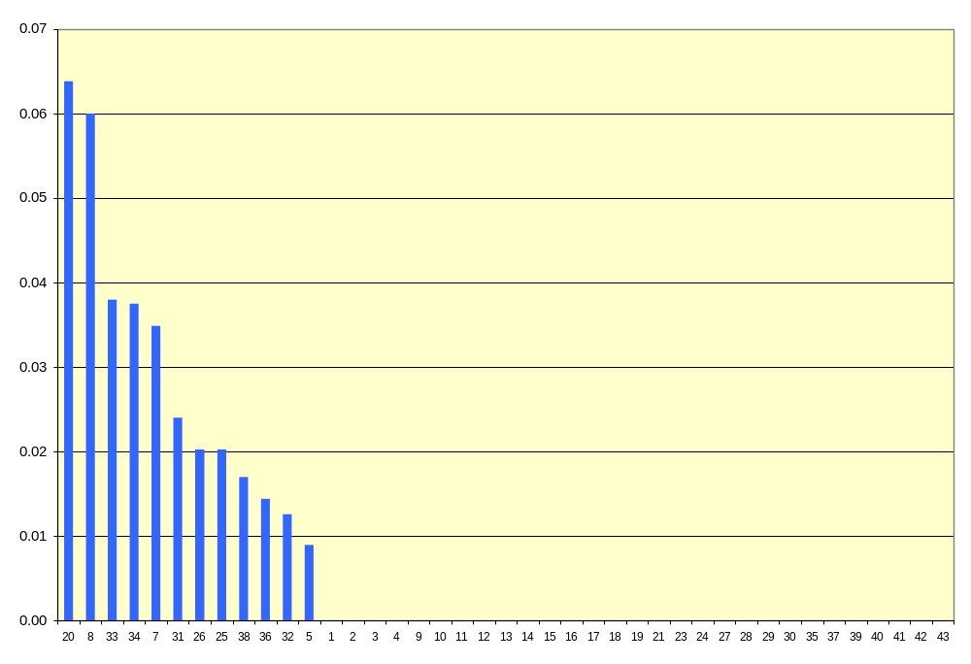
Average Number of EEO Complaints
(Oct 2001 - June 2002)
Average Number
Service Group Number

Slide 57
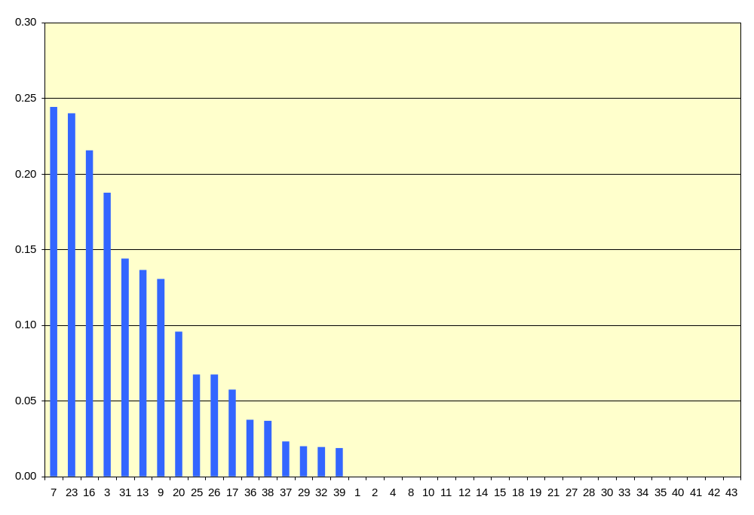
Average Number of ER Cases
(Oct 2001 - June 2002)
Average Number
Service Group Number

Slide 58
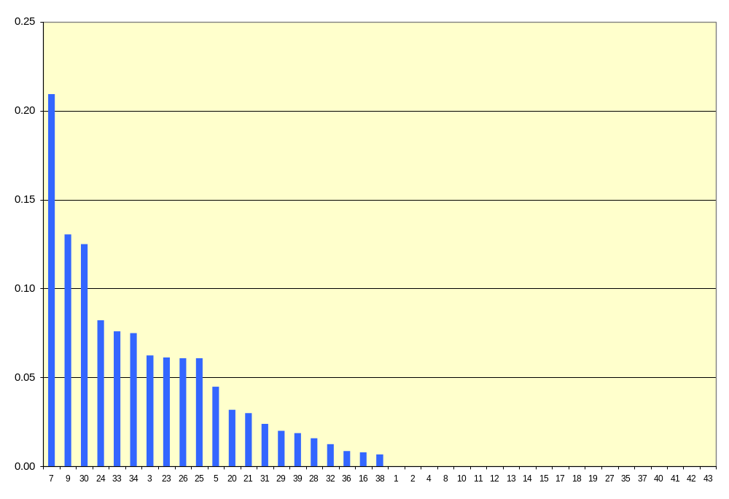
Average Number of ADR Cases
(Oct 2001 - June 2002)
Average Number
Service Group Number

Slide 59
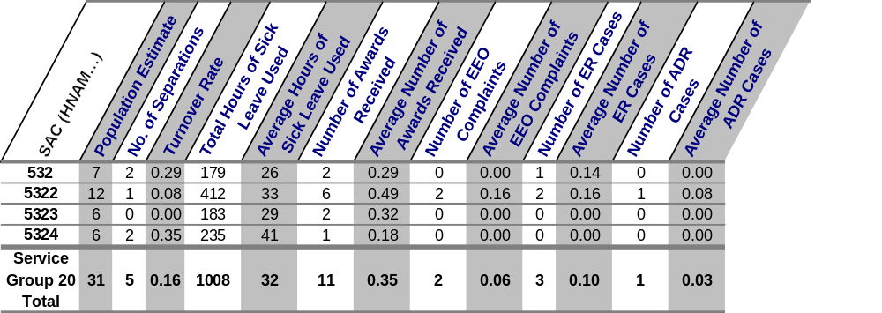
Learning and Growth Data Table
1 ADR case out of 31 employees
About 16% employee turnover
3 ER cases out of 31 employees
2 EEO cases out of 31 employees
About 1 award for every 3 employees
About 4 days sick leave per employee

Slide 60
Readiness Questions
What are the right mix of skills and abilities needed to carry out the mission of this service group?
- Knowledge of the body of standardized, technical radiological survey and control practices and requirements such as those used in exposure minimization, contamination control, and decontamination. This knowledge should be applied on a regular basis to identify radiation deficiencies and enforce controls when applicable.
- Employees must be able demonstrate skill in monitoring activities of limited radiological complexity such as: preparation and decontamination of a therapy room, radioactive materials package and receipt, analysis of samples containing radioactive materials, radioactive waste handling, and inventory and leak test of sealed sources. The staff must be able to conduct technically sound radiological surveys in a variety of areas such as a research laboratory, contaminated patient room, animal care facility, unrestricted areas, radioactive materials packages, and radioactive waste areas.
- Knowledge of proper shielding necessary to protect against alpha, beta, and gamma radiation. Knowledge of equipment for detecting the presence of radioactivity; ability to read various standard radioactivity counters and accurately record the readings from detector equipment. The individual must be able to respond to emergencies and apply their skills in controlling potentially exposed personnel and activities in the event of a radioactive material spill and skin contamination.
- Staff must be able to access data from a computer database system, demonstrate knowledge of basic word processing, and use this information to create sound technical reports. The staff must be particularly adept at organizing, scheduling, and record keeping, and attentive to the absolute critical importance of executing his/her responsibilities accurately on schedule. All staff must have the ability to work in harmony with Vendors and Researchers using tact and diplomacy when dealing with problems. Staff must be able to use the NIH Administrative Database for the placing of consolidated orders to the Vendors on the RAMOS system.
- Staff must be able to properly package all forms of Hazardous Materials to comply with Department of Transportation (DOT) regulations and International Civil Aviation Organization Regulations.

Slide 61
Will the service group have sufficient numbers of people, with the right skills and abilities to carry out its mission in the next three years? If not, what are the skills and abilities that will be needed, and how are you planning to obtain them (e.g., contracting out, hiring)?
- Based on present trends, yes. However, it should be noted that determining the direction of radioactive materials use in medical research is not known and could increase or decrease at anytime. If more staff is required, both contracting and hiring would be pursued.

Slide 62
What are going to be the training needs of the employees and contractors employed in this service group in the next two to three years?
-Contractor training is the responsibility of the contractor. Some government employees of this Service Group require training in the shipment of hazardous materials every two years, and DOT regulations every three years. Most staff are offered the opportunity to participate in the RSB Training & Travel plan to attend courses, both local and requiring travel, or to attend professional meetings, such as the Annual and Mid-Year meetings of the Health Physics Society. Training is a continual process and various training courses will be attended as needed.

Slide 63
What will be the right tools or materials (e.g., information, software applications, hardware, specialized equipment) needed to carry out the mission of this service group in the next three years?
-This list would be too great to list here, everything required presently to perform these services will still be required in three years. As is evident in the recent ASA, anything that is planned for can change without warning and therefore would require Radiation Safety to cover those changes. This could include changes to vendors, nuclides, volume, inventories, software (especially for the ASA!), regulations, medical research, and staffing.
Does the service group have the right quantity of tools or materials needed to carry out its mission in the next three years? If not, what are the ones needed and how are you planning to obtain them?
- See the answer to the previous question.

Slide 64
What are the anticipated implications of not obtaining the right mix of skills and abilities, or tools and materials (e.g., service disruption, inefficiencies, increased turnover of key personnel) in meeting service or mission expectations? Please explain.
- Unknown at this time, most of the information for this question has been answered in the previous questions. If the proper mix of skills, abilities, tools, and materials are not provided this service group would not be able to provide the excellent customer service that has been provided for years. If this service group does not meet its service requirements the NIH would be in jeopardy of losing its ability to use radioactive materials in the Intramural Research Program.

Slide 65
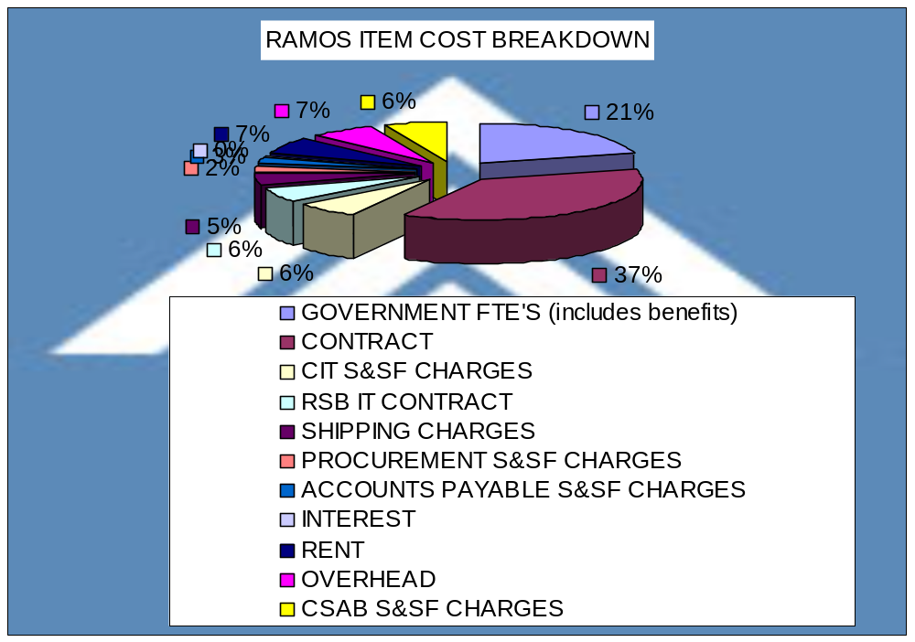
DS 2: RAMOS COST SEGMENTATION

Slide 66
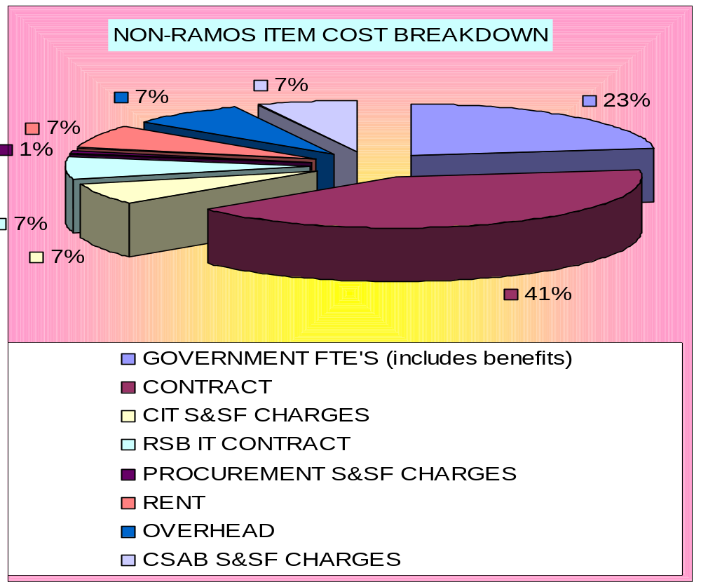
DS 2: NON-RAMOS COST SEGMENTATION

Slide 67
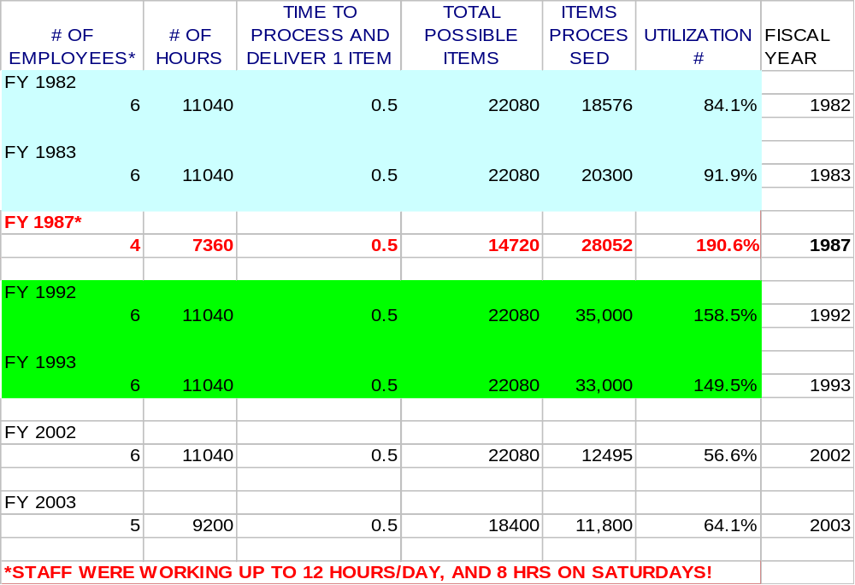
ASSET UTILIZATION FOR DS 2

Slide 68
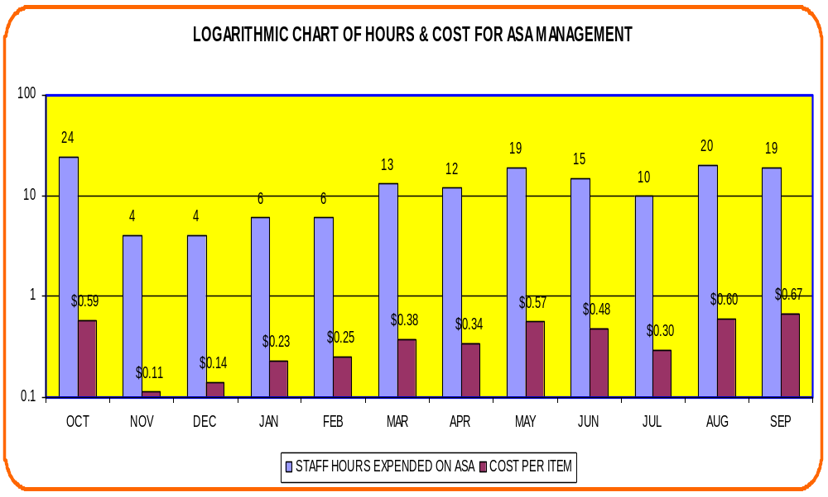
COST OF MAINTAINING THIS INFORMATION FOR DS 2

